Slide 2
Lesson Objectives
At the end of this lesson, you will be able to identify:
Automation procedures
En Route Decision Support Tool (EDST) national procedures
CPDLC national procedures

Slide 3
En Route Automation System (EAS)
The complex integrated environment consisting of Situation Display systems, surveillance systems and flight data processing, remote devices, decision support tools and related communications equipment.

Slide 4
Automation Procedures
Procedural preference
Use automation procedures in preference to nonautomation procedures
Use radar separation in preference to nonradar separation when it will be to an operational advantage
Use nonradar separation in preference to radar separation when an operational advantage will be gained

Slide 5
Conflict Alert and Mode C Intruder Alert
Conflict Alert - A function of air traffic control automated systems designed to alert radar controllers to existing or pending situations between tracked targets that require immediate attention
Mode C Intruder Alert - A function of air traffic control automated systems designed to alert radar controllers to existing or pending situations between a tracked target and an untracked target that requires immediate attention or action

Slide 6
En Route Minimium Safe Altitude Warning (E-MSAW)
A function of the En Route Automation System that aids the controller by providing an alert when a tracked aircraft is below or predicted by the computer to go below a predetermined minimum IFR altitude (MIA)

Slide 7
Computer Entry of Flight Plan Information
Altitude
The altitude field(s) of the data block must always reflect the current status of the aircraft unless otherwise specified in an appropriate facility directive

Slide 8

When can you change the altitude in a data block not inside your area of jurisdiction?
Never, unless the aircraft is experiencing weather deviations
When the aircraft is within 5 miles of your boundary
After verbal coordination is completed with the sector the aircraft is in

Slide 9
Reported Altitude
When Mode C altitude information is either not available or is unreliable, enter reported altitudes into the computer as follows:
When an aircraft reaches the assigned altitude
When aircraft at assigned altitude is issued a clearance to climb or descend
A minimum of each 10,000’ during climb to or descent from FL180 and above

Slide 10
Route Information
Route information must not be modified outside of the controller’s area of jurisdiction unless verbally coordinated or specified in a letter of agreement or facility directive

Slide 11
Selected Altitude Limits
Sectors must ensure the display of Mode C targets and data blocks by entering appropriate altitude limits and display filters to include, at a minimum, the altitude stratum of the sector, plus:
1,200’ above the highest and below the lowest altitude or flight level where 1,000’ vertical separation is applicable; and
2,200’ above the highest and below the lowest flight level of the sector where 2,000’ vertical separation is applicable

Slide 12
Sector Eligibility
The use of the /OK function is allowed to override sector eligibility only when one of the following conditions is met:
Prior coordination is effected
The flight is within the control jurisdiction of the sector

Slide 13
What are the minimum altitude limit settings above and below a sector using 1,000’ separation?
1,000’
1,200’
1,500’

Slide 14
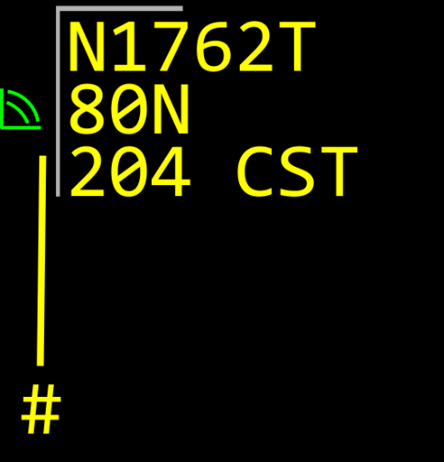
Coast Tracks

Slide 15
ERAM Computer Entry of Hold Information
When an aircraft is issued holding instructions, the delay is ATC initiated, and the EFC is other than no delay expected:
Enter a hold command
Maintain a paired track
Enter an EFC time via a hold command, the Hold Data Menu, or the Hold View

Slide 16
ERAM Visual Indicator of Special Activity Airspace (SAA) Status
Sector controllers shall ensure the Situation Display accurately reflects the status of all SAAs that impact their area of control responsibility

Slide 17
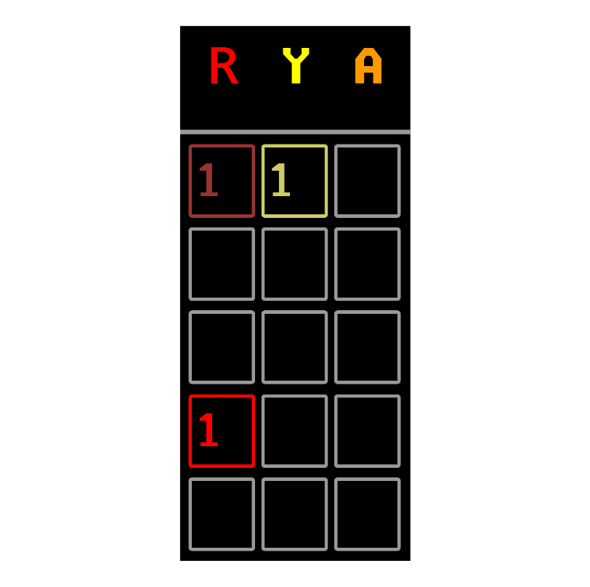
Conflict Detection and Resolution
Actively scan EDST information for predicted aircraft-to-aircraft and aircraft-to-airspace alerts

Slide 18
Trial Planning
When EDST is operational at the sector and when sector priorities permit, use the trial plan capability to evaluate:
Solutions to predicted conflicts
The feasibility of granting user requests
The feasibility of removing a flight direction constraint (i.e., inappropriate altitude for direction of flight) for an aircraft
The feasibility of removing a static restriction for an aircraft

Slide 19
Conflict Probe Based Clearances
When the results of a trial plan based upon a user request indicate the absence of alerts, every effort should be made to grant the user request, unless the change is likely to adversely affect operations at another sector

Slide 20
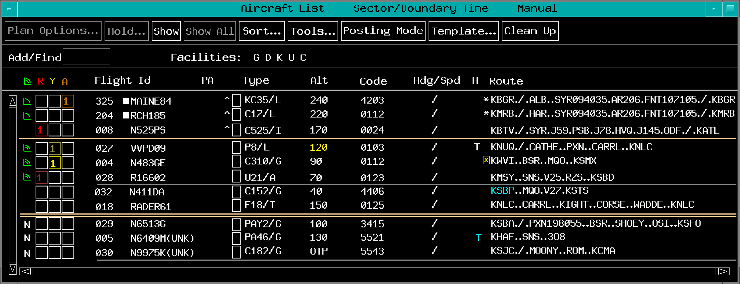
Aircraft List, Departure List, and Flight Data Management

Slide 21
What must be done to indicate a flight requires action or special attention?
Angulate the EDST
Place a check in the housekeeping box on the EDST
Highlight the entry in the EDST

Slide 22
Manual Coordination and the Coordination Menu

Slide 23
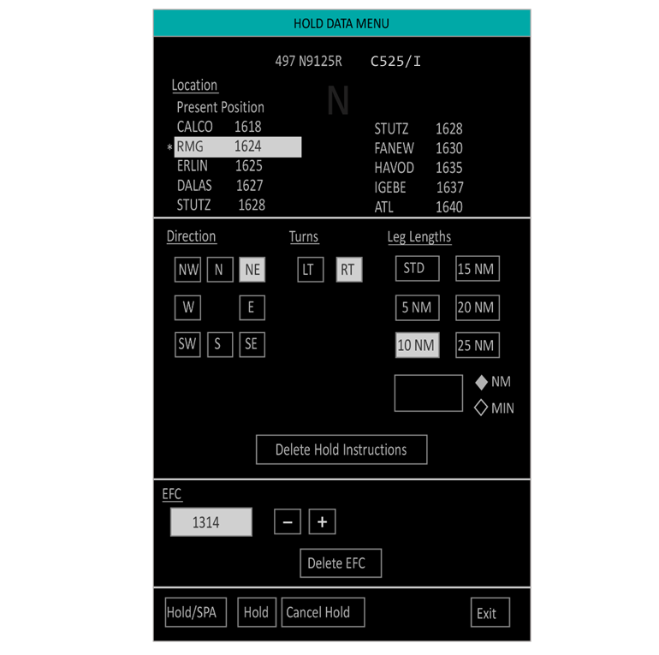
Holding

Slide 24
Recording of Control Data
All control information not otherwise recorded via automation recordings or voice recordings must be manually recorded using approved methods

Slide 25
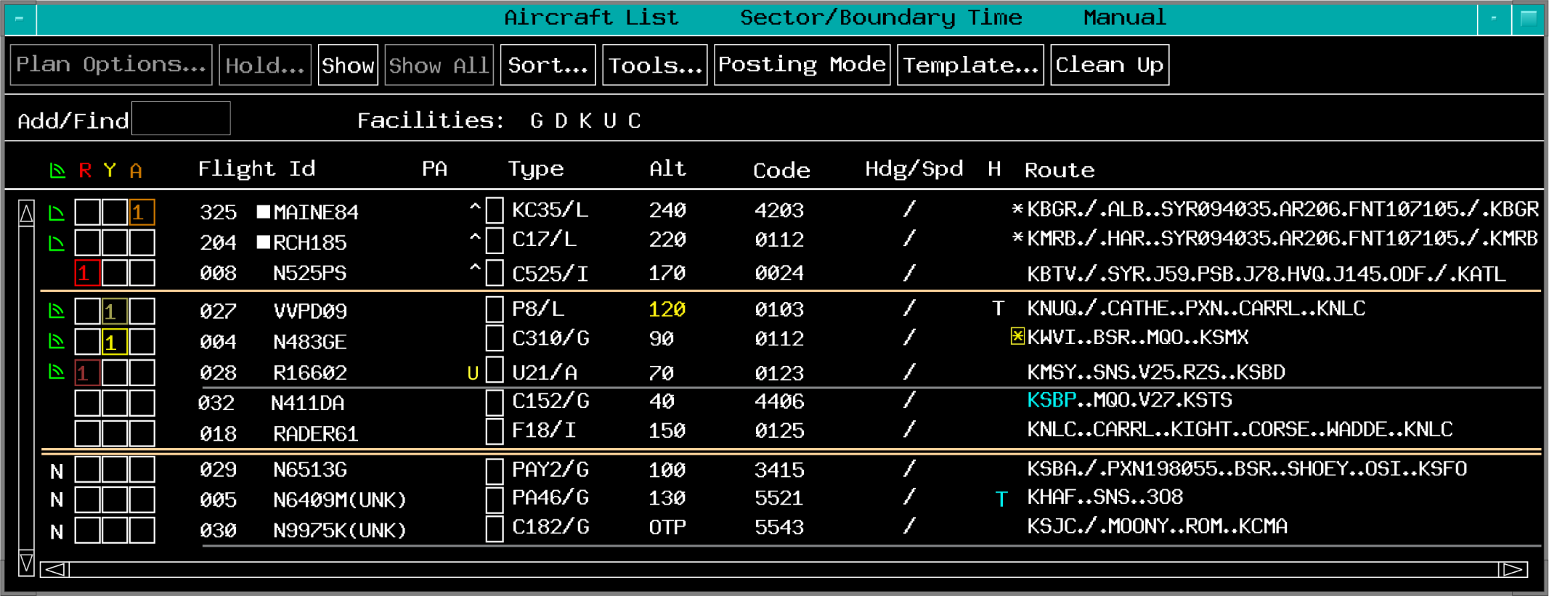
Acknowledgement of Automated Notification
Unacknowledged UTM
Unacknowledged IAFDOF

Slide 26
When the Free Text area of the EDST is used to record control information, what must be done when that information is no longer relevant?
Update or delete the information in the Free Text area
No changes are needed; just close the Free Text area
Highlight the entry in the Free Text area

Slide 27
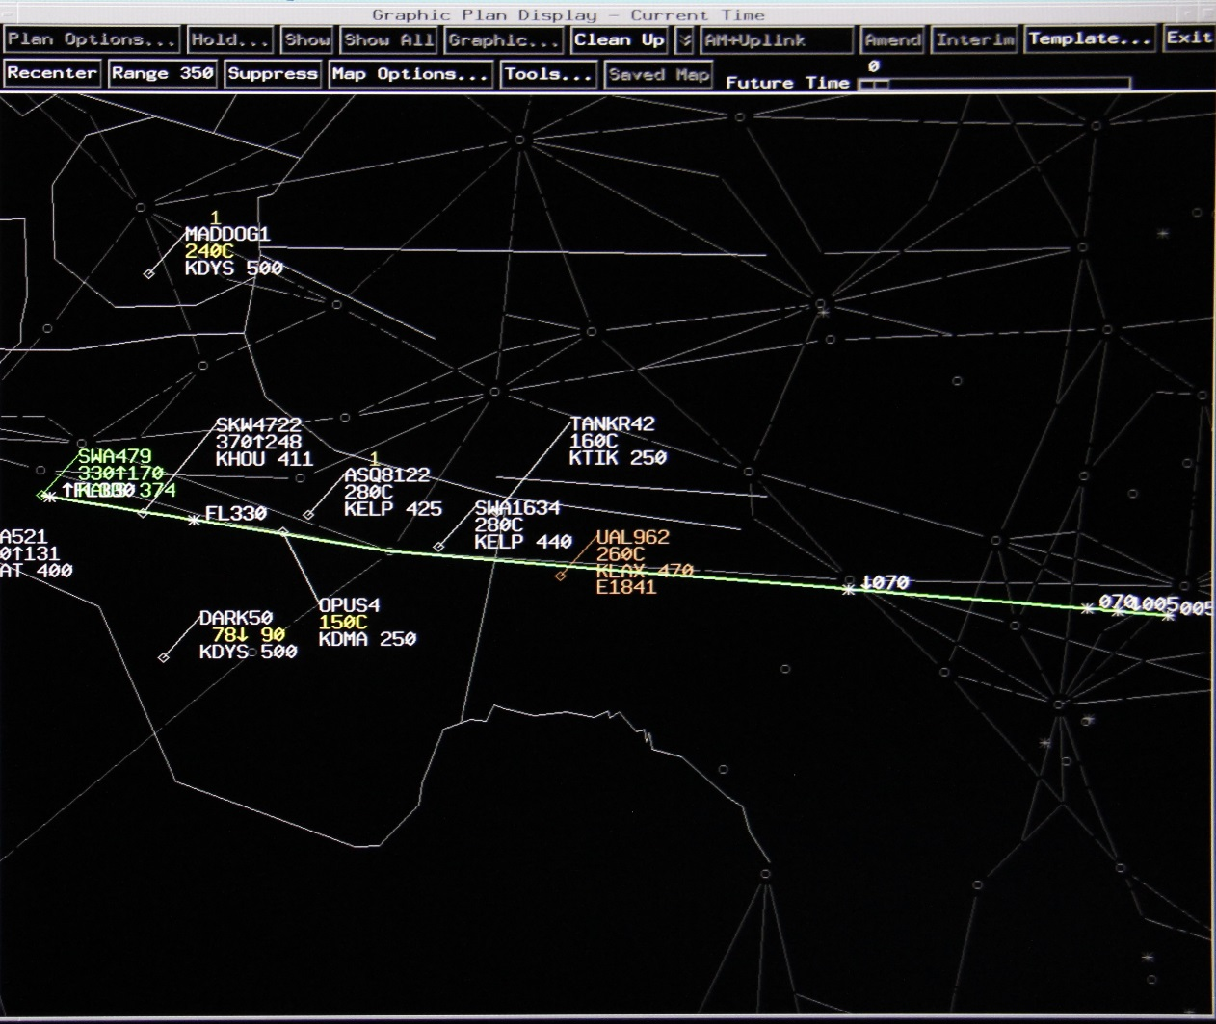
Currency of Trajectory Information

Slide 28
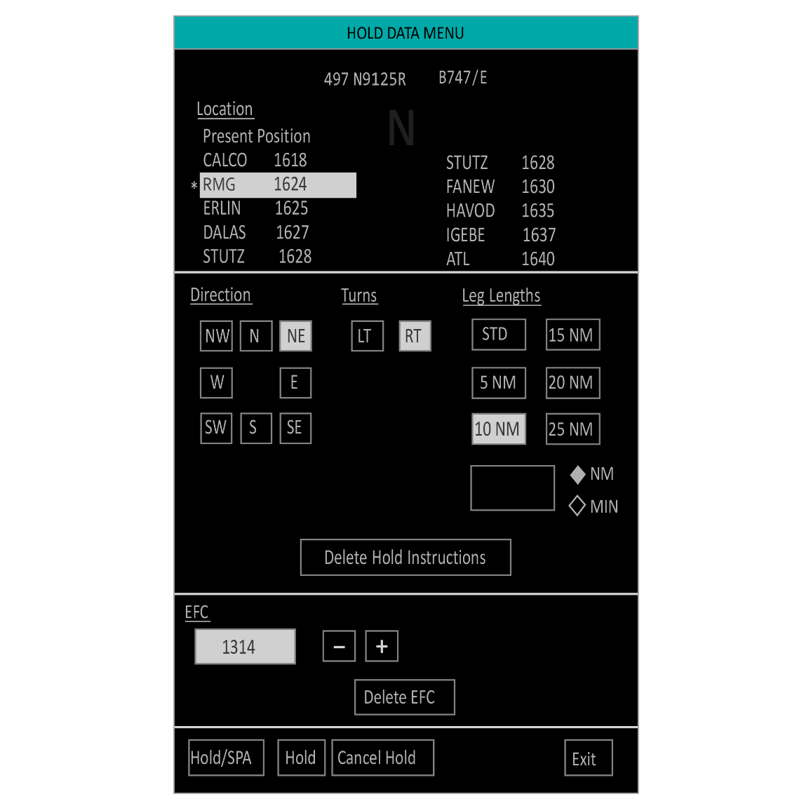
Delay Reporting

Slide 29
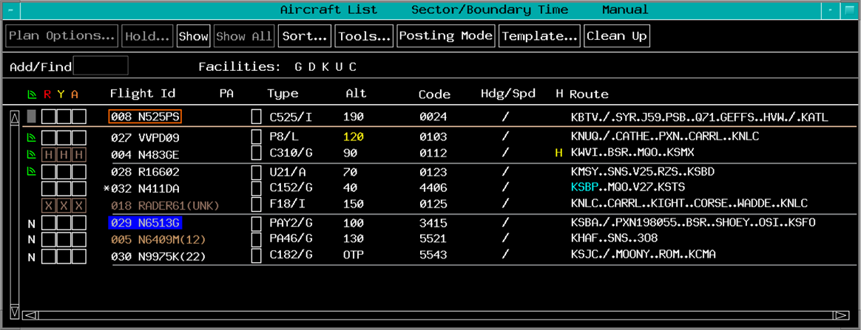

Overdue Aircraft

Slide 30
Use of Graphics Plan Display (GPD)

Slide 31
Forecast Winds

Slide 32

Interfacility Connectivity

Slide 33
Surveillance and Flight Data Outages

Slide 34
Airspace Configuration Elements

Slide 35
Conflict probe accuracy requires _____ updates of data used to model each flight's trajectory.
automated
pilot initiated
timely

Slide 36
Messages
Use of CPDLC is approved to augment all applicable voice communication requirements in the issuance of altitude, route, altimeter, or frequency clearances and instructions
Controllers should minimize the use of CPDLC during critical phases of flight
The sector team is responsible for sending and responding to CPDLC messages

Slide 37
Clearances
CPDLC should not be used to issue immediate or expeditious clearances, unless voice communication is not operationally feasible
Ensure there are no trajectory altering uplinks open prior to transfer of communication, unless otherwise coordinated
Abnormal CPDLC indications should be acknowledged by the controller only after required coordination has been performed

Slide 38
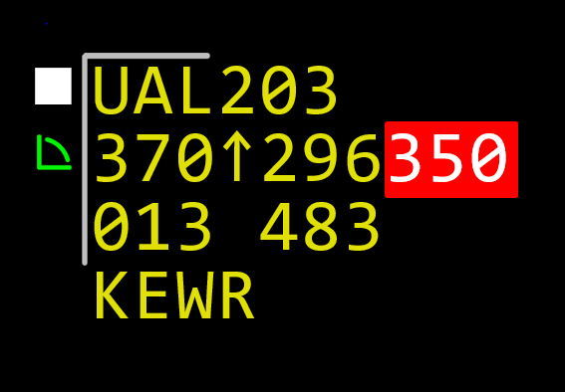


Initial Contact Mismatch

Slide 39
Overriding a CPDLC Clearance
Use voice communications when overriding a CPDLC clearance and issuing alternate control instructions

Slide 40
Voice Communication Indicator (VCI)
Aircraft may be automatically marked on frequency via monitor transfer of communication
When a CPDLC session is unexpectedly lost with an aircraft, and voice communication had not previously been established:
The controller must ensure voice communication is established and maintained with that aircraft

Slide 41
What action must be taken when an Initial Contact Mismatch indicator is observed?
The altitude must be verbally verified and the Mismatch indicator cleared
A Verify Altitude Uplink message must be sent, which will clear the Mismatch indicator
No action is needed if the aircraft is in level flight, as it will update within 30 seconds

Slide 42
Session Termination
Unless otherwise coordinated, the last controller working the aircraft before it exits the continental United States must ensure the CPDLC session is terminated upon transfer of communication to any non-U.S. or Advanced Technologies and Oceanic Procedures (ATOP) facility
Coordination must be accomplished with the sector with eligibility prior to terminating a CPDLC session from any other position or adapted Air Traffic Specialist Workstation

Slide 43
Altimeter Issuance
If the CPDLC system fails to provide a necessary automated altimeter setting to an aircraft:
The controller with eligibility will be notified with an abnormal indication in the FDB
An altimeter must be issued

Slide 44
NORDO With Active CPDLC Session
For No Radio (NORDO) aircraft with an active CPDLC session:
The controller with eligibility may mark the aircraft on frequency to allow CPDLC communications with that aircraft
Use existing communications failure procedures for all CPDLC aircraft that experience a two-way voice radio communications failure

Slide 45
Emergencies

Slide 46
CPDLC Shutdown or Failure
Whenever there is a shutdown or failure of CPDLC service:
The Operations Manager in Charge (OMIC) must coordinate with each area to ensure controllers refrain from initiating new CPDLC uplinks and start cleaning up existing CPDLC messages
Controllers must use voice to broadcast a message alerting pilots to the shutdown and request no pilot downlinks until further advised

Slide 47
When may a NORDO aircraft be manually marked on frequency using the VCI?
Never, the aircraft is not on the radio frequency
When required to allow CPDLC communications
Anytime the aircraft crosses a sector boundary

Slide 48
Lesson Summary
This lesson covered:
Automation procedures
EDST national procedures
CPDLC national procedures

Slide 49

The End

