Slide 2
Duty priorities
Procedures and phraseology for implementing air traffic services

Slide 3
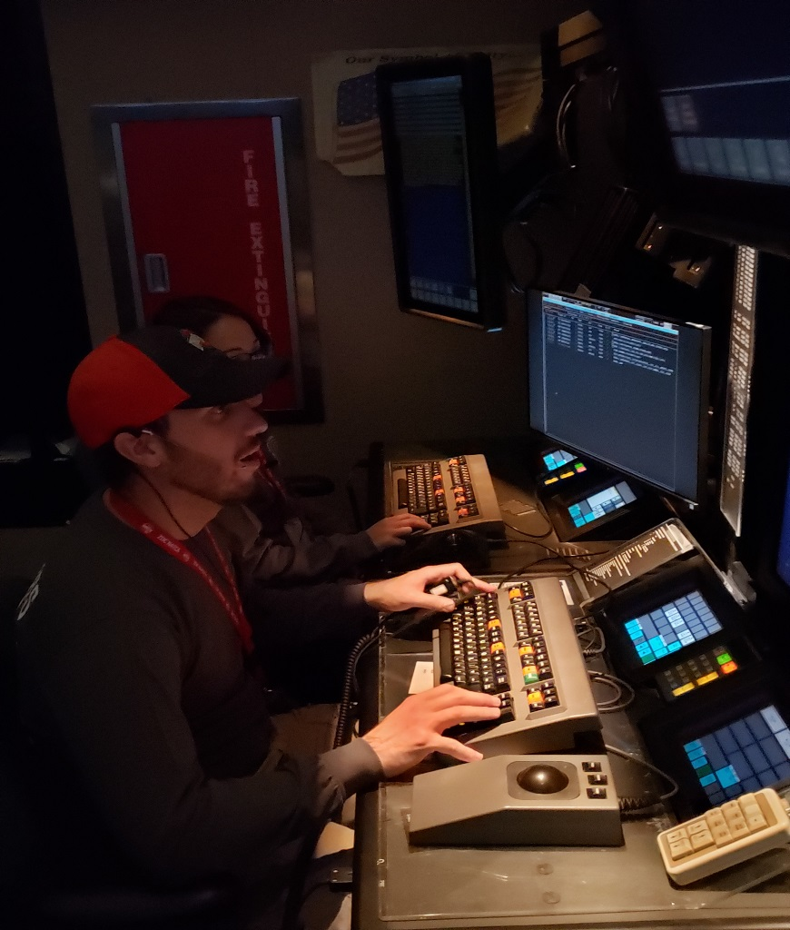
Duty Priorities
Give first priority to:
Separating aircraft
Issuing safety alerts
Use good judgement to prioritize other duties and additional services

Slide 4
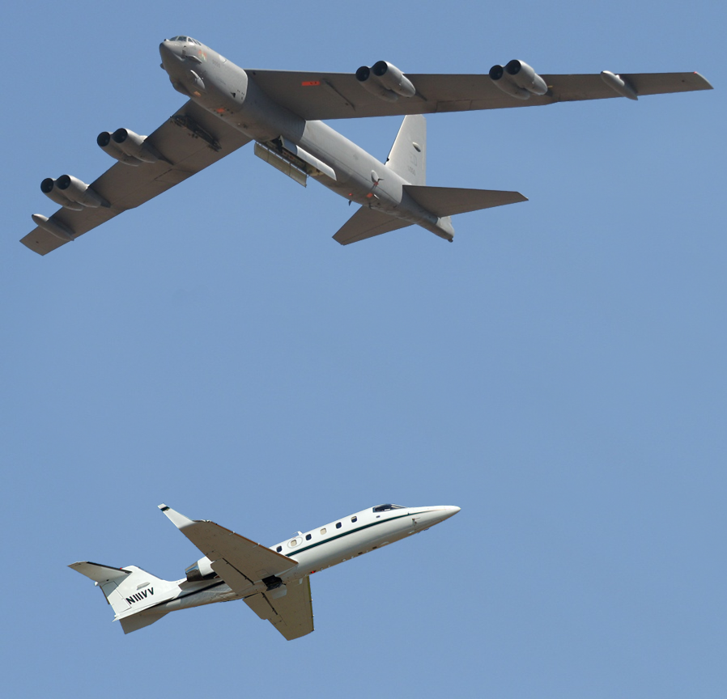
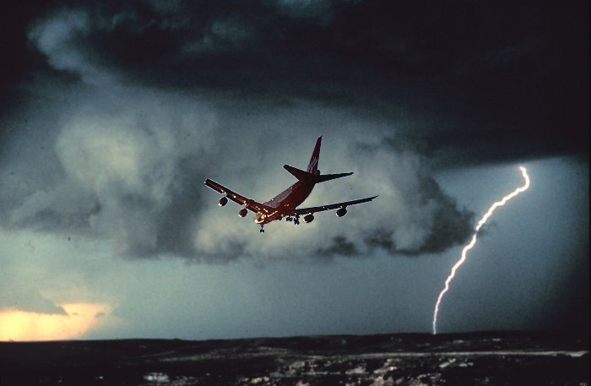
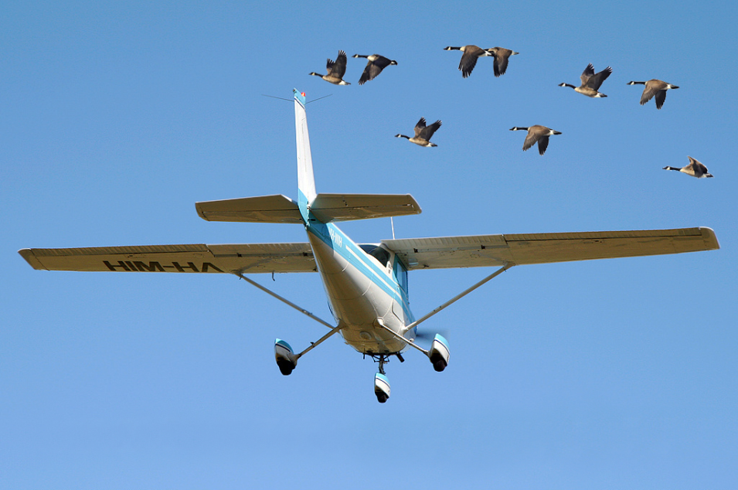
Additional Services

Slide 5
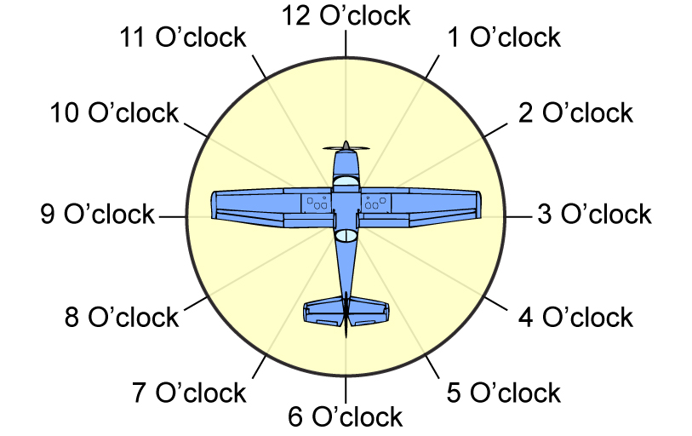
Azimuth in Terms of 12-Hour Clock

Slide 6






Not Radar Identified, No Mode C
SWA428
90 108
348 221
SWA428
70 102
348 221
“SOUTHWEST FOUR TWENTY-EIGHT, TRAFFIC EIGHT MILES SOUTHWEST OF LEESBURG, WESTBOUND, ALTITUDE UNKNOWN”
“SOUTHWEST FOUR TWENTY-EIGHT, TRAFFIC, NUMEROUS AIRCRAFT VICINITY LEESBURG”
5

Slide 7
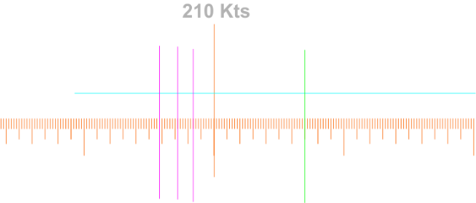

Issuing Vectors
“SOUTHWEST FOUR TWENTY-EIGHT, REQUEST A VECTOR TO CLEAR THE TRAFFIC”
SWA428
90 102
348 221
“SOUTHWEST FOUR TWENTY-EIGHT,
TURN LEFT HEADING ONE TWO ZERO,
VECTOR FOR TRAFFIC”

Slide 8
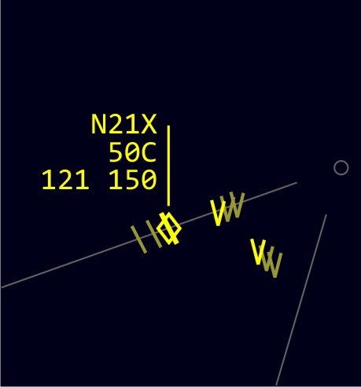
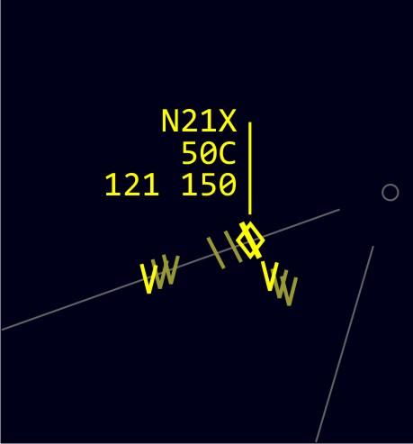
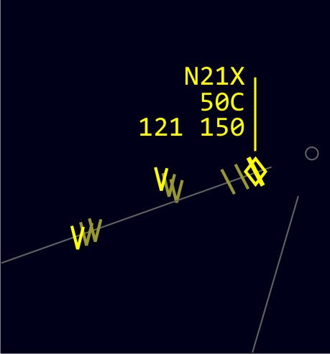


Traffic No Longer in Sight
1
2
3
N21X
50C 221 150
N21X
50C 221 150
N21X
50C 221 150
N21X has been issued traffic information on both targets.
“CESSNA TWO ONE X-RAY, TRAFFIC NO FACTOR”
“CESSNA TWO ONE X-RAY, TWELVE O’CLOCK TRAFFIC NO LONGER OBSERVED”
7

Slide 9
Knowledge Check
Which air traffic duties are given first priority?
Issuing vectors requested by pilot
Traffic advisories
Separating aircraft and issuing safety alerts
8

Slide 10
Knowledge Check
When issuing traffic to radar identified aircraft, give the position of the traffic in terms of the 12-hour clock or the________.
major magnetic heading points
eight cardinal compass points
relative bearings from the aircraft
9

Slide 11
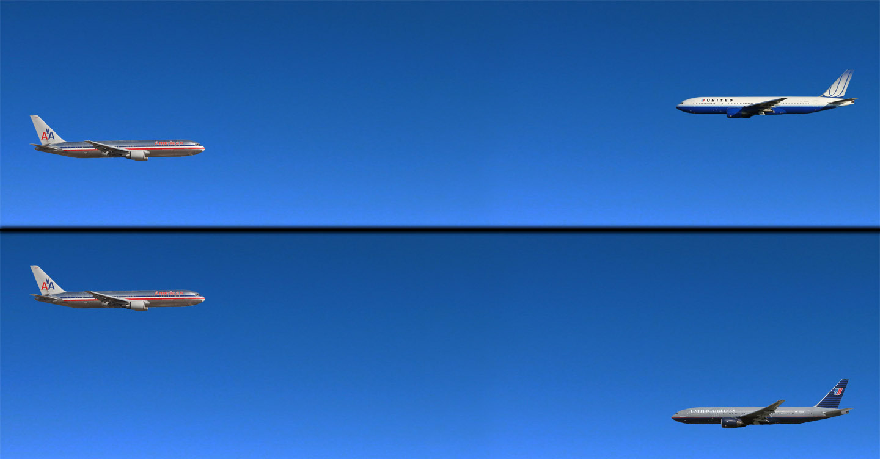
Merging Target Procedures
UAL65 @ 10,000’
AAL52 @ 9,000’
Apply Procedures?
Yes
AAL72 @ 11,000’
UAL71 @ 8,000’
Apply Procedures?
No
10

Slide 12
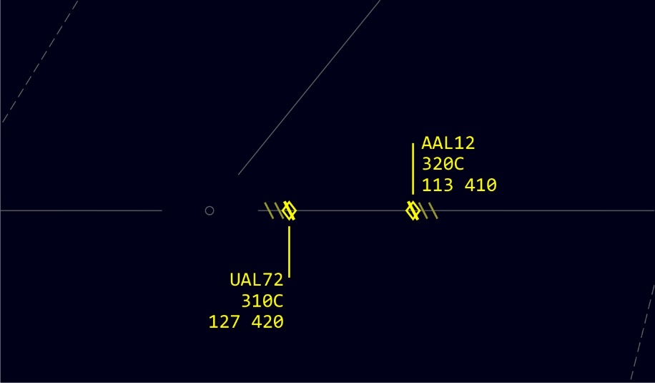


Merging Target Application
In RVSM airspace with two aircraft vertically separated by 1,000’:
If either unable to maintain RVSM, vector either aircraft to avoid merging with the target of the other aircraft
If pilot requests, vector aircraft to avoid merging with a target of previously issued traffic
UAL65 @ 10,000
AAL52 @ 9,000
AAL12 320C 113 410
UAL72 310C 127 420
11

Slide 13
Radar Monitor Holding Aircraft
Provide radar surveillance of holding airspace areas whenever aircraft are holding there
If deviation from protected airspace of the holding pattern is detected, assist pilot in returning to the assigned airspace
An adapted holding pattern airspace may be displayed on the Situation Display
UAL65 @ 10,000
AAL52 @ 9,000
12

Slide 14
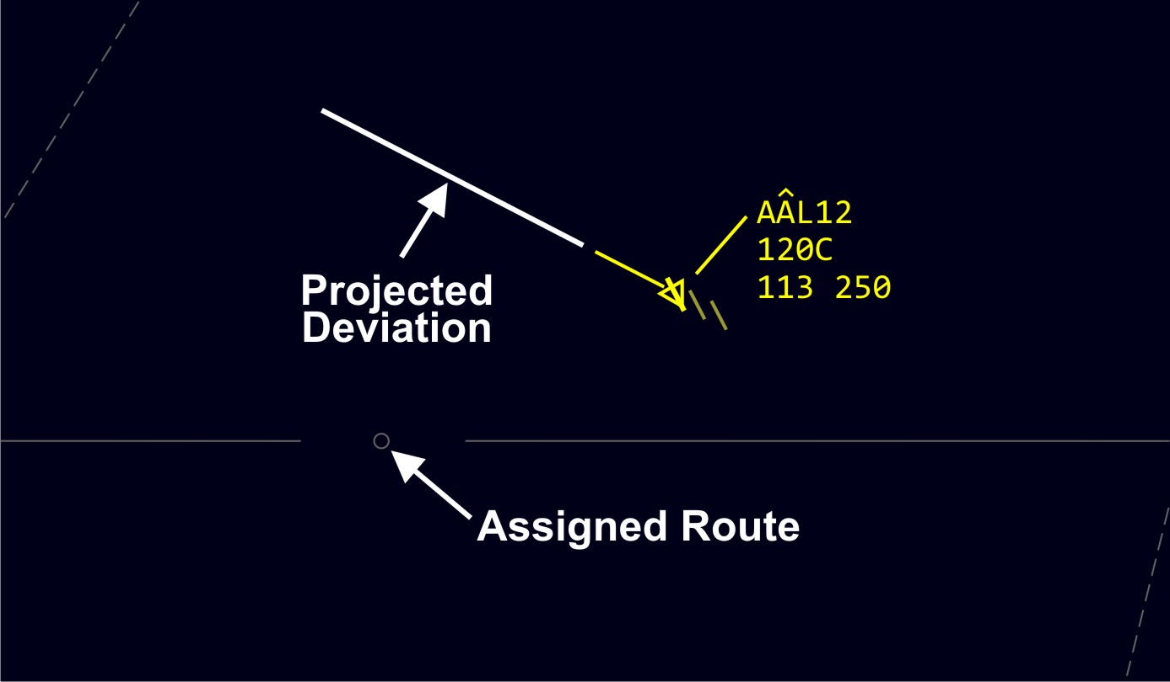


Deviation Advisories
UAL65 @ 10,000
AAL52 @ 9,000
AAL12 120C 113 250
AAL12
AAL72 @ 11,000
UAL71 @ 6,000
13

Slide 15
Knowledge Check
At what altitudes should you apply merging target procedures to all radar identified aircraft?
At and above 10,000’
At and below 9,000’
At and above 19,000’
14

Slide 16
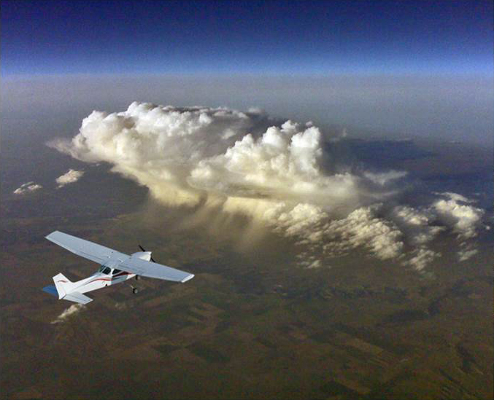
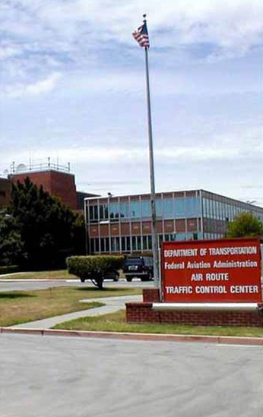
Hazardous Inflight Weather Advisory
UAL65 @ 10,000
“ATTENTION ALL AIRCRAFT. HAZARDOUS WEATHER INFORMATION CONVECTIVE SIGMET 7 CENTRAL FOR THUNDERSTORMS WITHIN SOUTHEAST KANSAS, THE EASTERN HALF OF OKLAHOMA, SOUTHWEST MISSOURI, AND NORTHWEST ARKANSAS AVAILABLE ON FLIGHT SERVICE FREQUENCIES.”
AAL52 @ 9,000
AAL72 @ 11,000
UAL71 @ 6,000
15

Slide 17
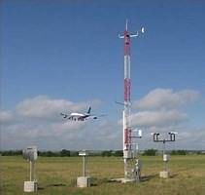
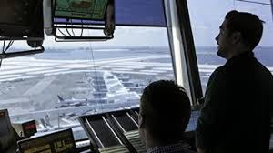
Weather Observations
METAR KOKC 011955Z AUTO 22015G25KT 180V250 3/4SM R17L/2600FT +TSRA BR OVC010CB 18/16 A2992 RMK AO2 TSB25 TS OHD MOV E SLP132
16

Slide 18
METAR Report Fields
METAR KOKC 011955Z AUTO 22015G25KT 180V250
3/4SM R17L/2600FT +TSRA BR OVC010 18/16
A2992 RMK AO2 TSB25 TS OHD MOV E SLP132
Type of Report
Station
Identifier
Date and Time of Report
Report
Modifier
Wind
Visibility
Runway Visual Range
Present
Weather
Sky
Condition
Temperature
and Dew
Point
Altimeter
Remarks
17

Slide 19
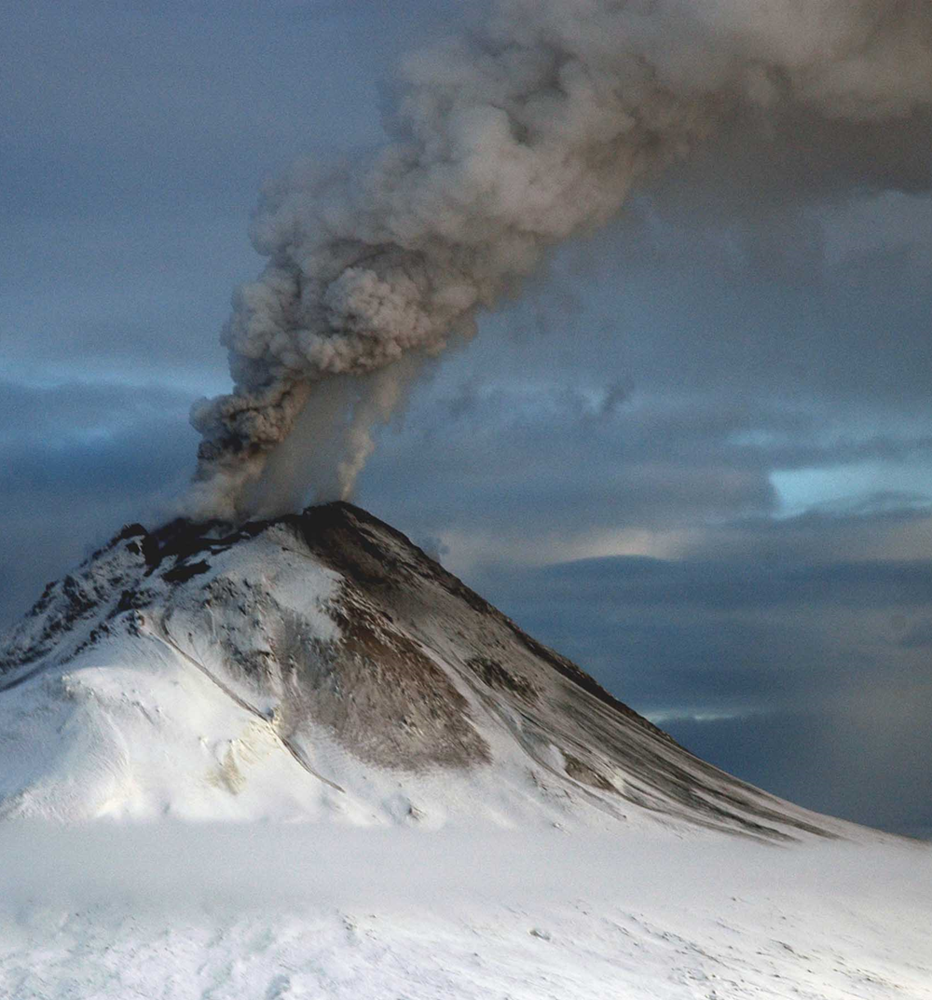
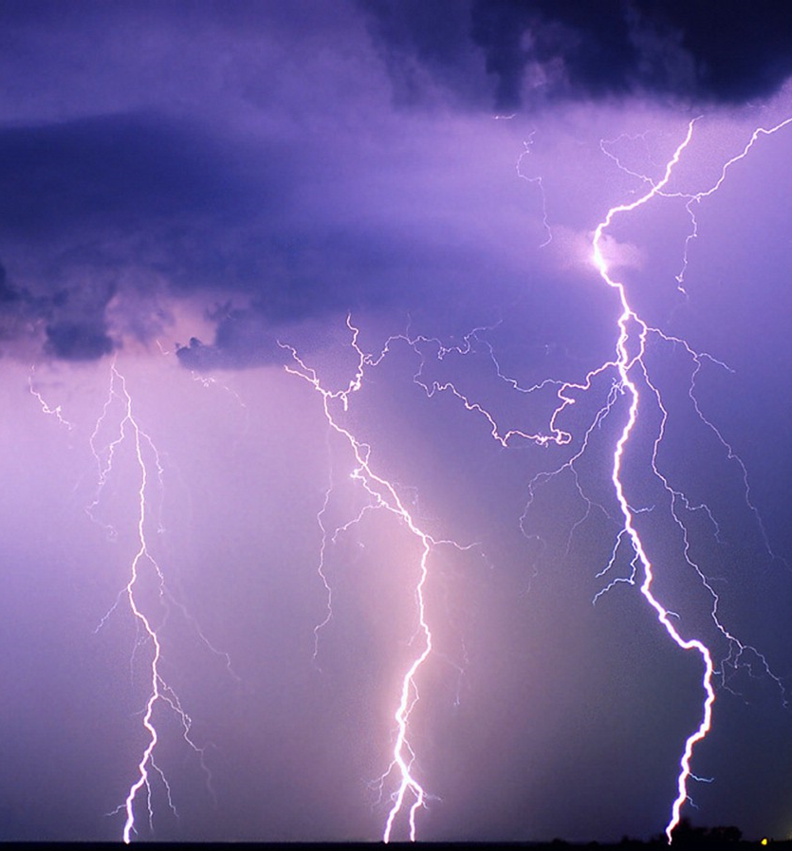
Soliciting Pilot Reports (PIREPs)
UAL65 @ 10,000
AAL52 @ 9,000
AAL72 @ 11,000
UAL71 @ 6,000
18

Slide 20

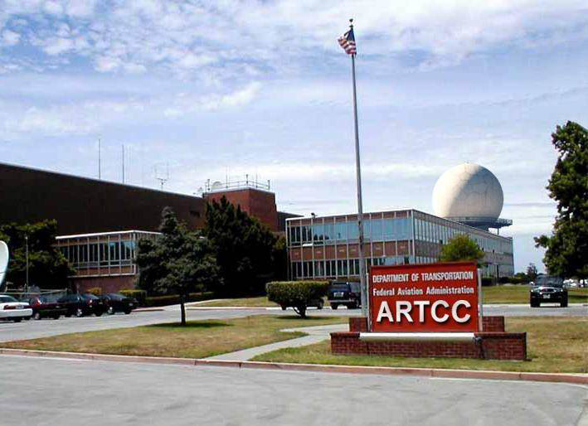
Soliciting PIREPs - Phraseology
“AMERICAN TWENTY-TWO, REQUEST FLIGHT CONDITIONS”
UAL65 @ 10,000
AAL52 @ 9,000
“DENVER CENTER, AMERICAN TWENTY-TWO REPORTING ON TOP AT FL280 CLEAR ABOVE”
AAL72 @ 11,000
UAL71 @ 6,000
19

Slide 21
PIREP Fields
UA /OV APE230010/TM 1516/FL085/TP BE20
/SK BKN040-TOP065/WX FV03SM BR/TA M02
/WV 23008KT/TB LGT/IC TRACE RIME/RM TCU W
Message Type
Location
Time
Flight Level
(Altitude)
Aircraft
Type
Sky Condition
Flight Visibility and Weather
Air Temperature
Wind
Turbulence
Icing
Remarks
20

Slide 22
Knowledge Check
Which METAR entry indicates 15 knot winds from the direction of 220 degrees gusting to 35 knots?
22015G35KT
04015G35KT
15G35KT220
21

Slide 23
Knowledge Check
What items would require PIREP solicitation?
Ceilings at or below 5,000’ (include cloud base/tops reports)
Visibility (surface and aloft) at or less than 5 miles
Thunderstorms and related phenomena
Turbulence (moderate or greater)
Icing (light or greater)
Wind shear
Braking action reports
Volcanic ash clouds
Detection of sulfur gases in the cabin, associated with volcanic activity
22

Slide 24
Knowledge Check
Which PIREPs are forwarded for dissemination?
Mountain wave
Negative icing
All
23

Slide 25
Knowledge Check
What is the phraseology to obtain a PIREP?
“SAY FLIGHT CONDITIONS”
“REQUEST PIREPS”
“PROVIDE FLIGHT CONDITIONS”
24

Slide 26


Weather and Chaff Services
MODERATE
HEAVY
EXTREME
DAL552
370C
221K448
AAL543
370C
334K442
Air Route Surveillance Radar (ARSR)
NEXRAD
25

Slide 27
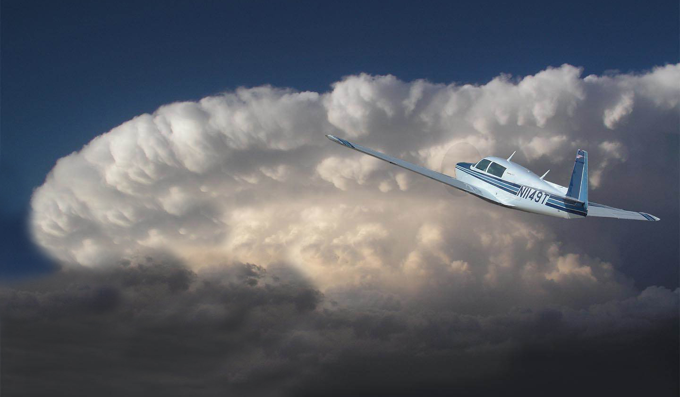
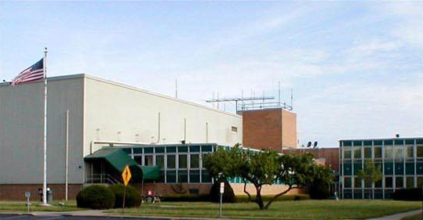
Precipitation
“MOONEY FOUR NINER TANGO, THREE ZERO MILE AREA OF MODERATE PRECIPITATION FROM ONE ZERO MILES SOUTHWEST OF TULSA TO TWO ZERO MILES NORTHEAST OF TULSA”
“MOONEY FOUR NINER TANGO, ROGER, REQUEST TO DEVIATE SOUTH AROUND THE WEATHER”
UAL65 @ 10,000
AAL52 @ 9,000
AAL72 @ 11,000
UAL71 @ 6,000
26

Slide 28
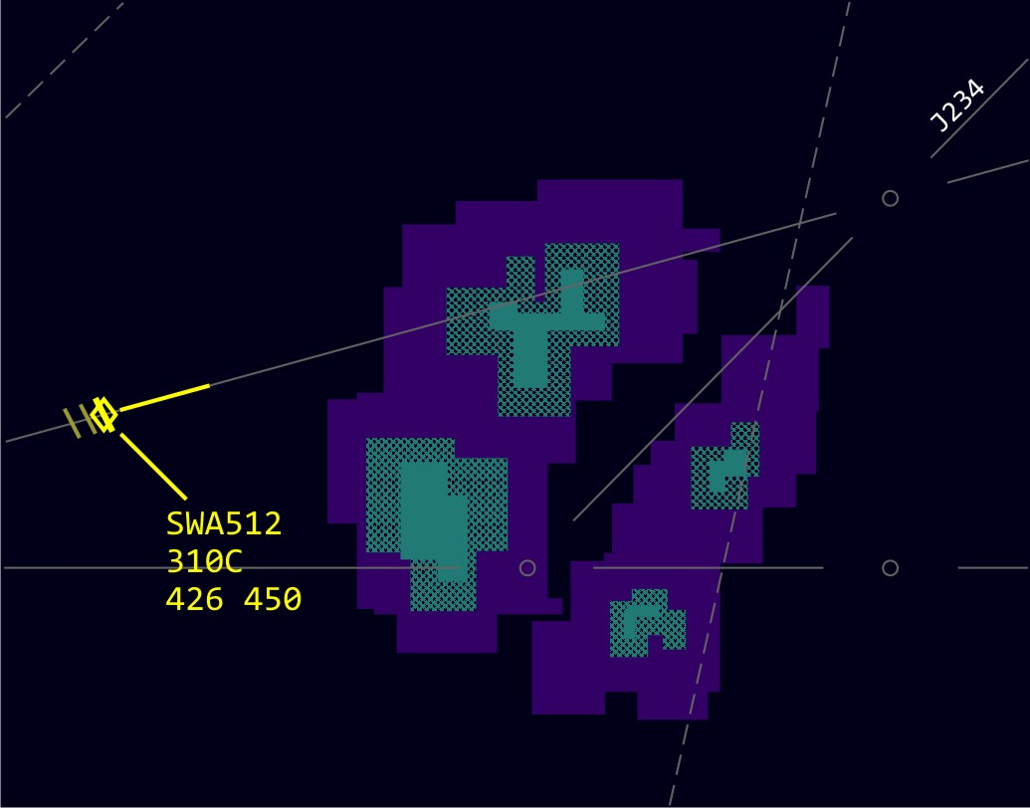
Weather Deviations
“SOUTHWEST FIVE TWELVE, DEVIATION THIRTY DEGREES LEFT APPROVED, WHEN ABLE FLY HEADING ZERO NINER ZERO, VECTOR TO JOIN JAY TWO THIRTY-FOUR AND ADVISE”
UAL65 @ 10,000
SWA512
310C 426 450
UAL71 @ 6,000
27

Slide 29
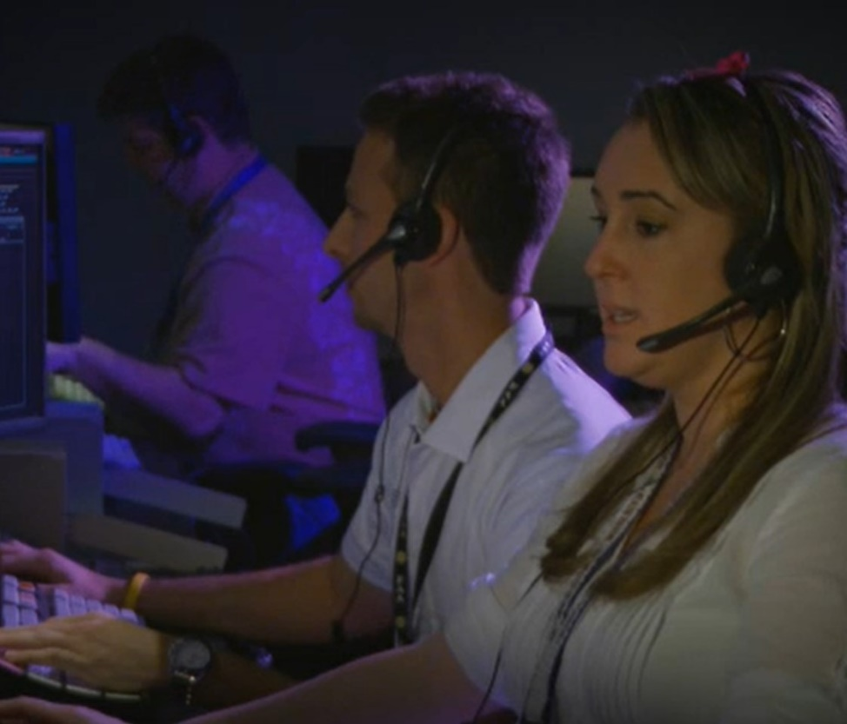
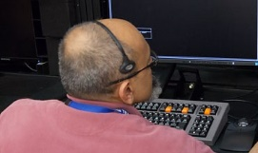
Forwarding Weather Information
“DENVER CENTER, SOUTHWEST FIVE TWELVE, DEVIATING NORTH, PILOT REQUESTED”
28

Slide 30


Fourth Line Data Transfer
UAL45
310C
024 470
D20R/F
SWA427
330C
425 400
D20R
29

Slide 31
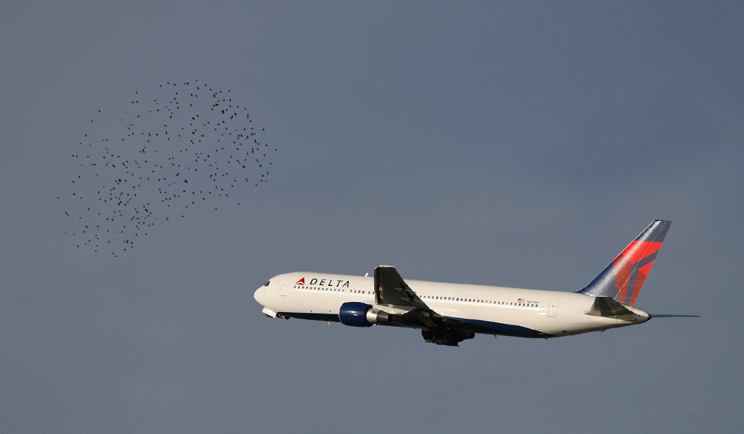
Bird Activity Information
UAL65 @ 10,000
AAL52 @ 9,000
“DELTA TWENTY-THREE, FLOCK OF GEESE, ONE O’CLOCK, SEVEN MILES, NORTHBOUND, LAST REPORTED AT FOUR THOUSAND”
AAL72 @ 11,000
UAL71 @ 6,000
30

Slide 32
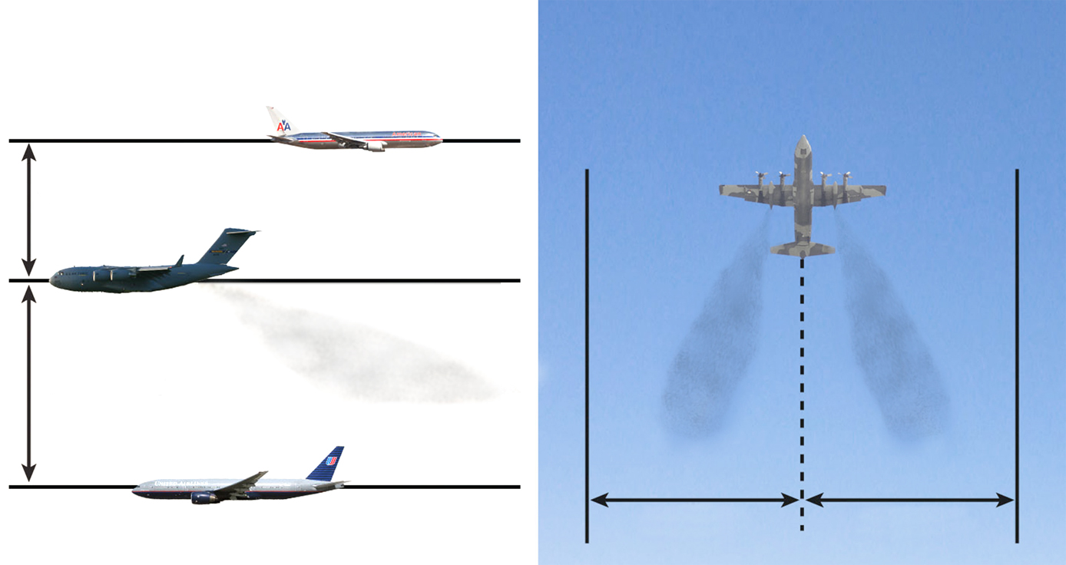
Fuel Dumping Separation
Vertical
Lateral
UAL65 @ 10,000
AAL52 @ 9,000
1000’
2000’
AAL72 @ 11,000
UAL71 @ 6,000
5 Miles
5 Miles
31

Slide 33
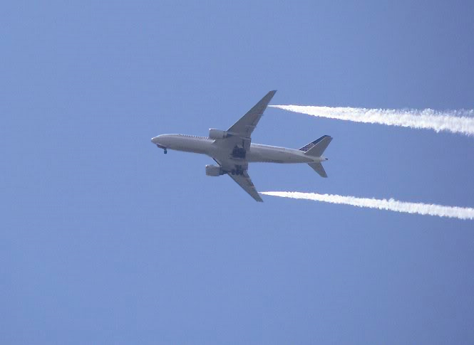
Fuel Dumping Advisories
UAL65 @ 10,000
AAL52 @ 9,000
32

Slide 34
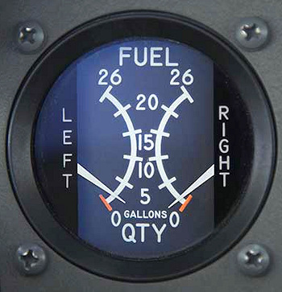
Minimum Fuel
Fuel supply has reached a state where undue delays cannot be accepted
This is not an emergency situation, but an advisory that an emergency is possible
Inform any facility to whom control of the aircraft is transferred
Be alert for en route delays
UAL65 @ 10,000
AAL52 @ 9,000
UAL71 @ 6,000
33

Slide 35
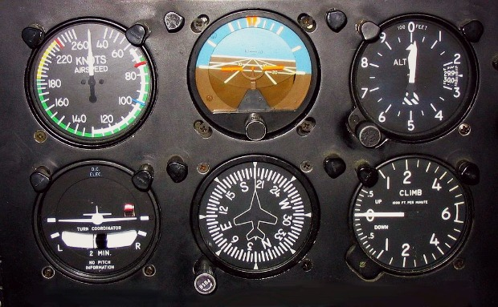
Inflight Equipment Malfunction
Determine the nature and extent of any special handling desired by the pilot
Provide the maximum assistance possible
Relay details to subsequent controllers or facilities as necessary
UAL65 @ 10,000
AAL52 @ 9,000
UAL71 @ 6,000
34

Slide 36
Knowledge Check
When should you approve weather deviations?
When requested by the pilot
When there is thunderstorm activity forecast along an aircraft’s route
When your facility authorizes it
35

Slide 37
Knowledge Check
Issue information on bird activity that has been observed on radar, provided that the_______.
direction and altitude are known
activity has been pilot verified
bird movement has been followed on radar for at least 15 minutes
36

Slide 38
Lesson Summary
This lesson covered:
Duty priorities
Procedures and phraseology for implementing air traffic services
37

Slide 39

The End

