Slide 2
Vectoring
Speed adjustment
Scanning

Slide 3

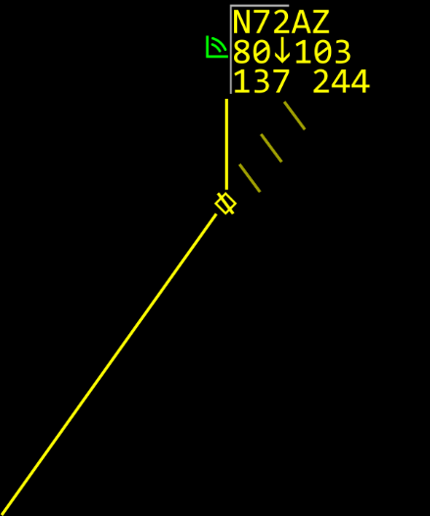

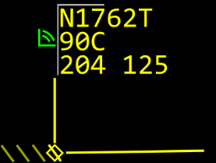





Vectoring

Slide 4
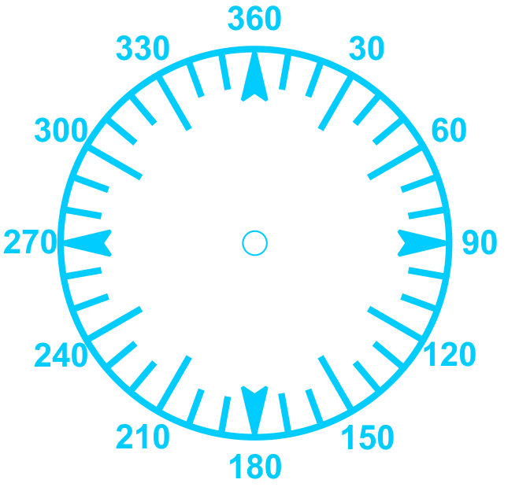
Methods of Vectoring
20º
…TURN RIGHT, HEADING ONE ONE ZERO…
…TURN TWENTY DEGREES RIGHT…
110

Slide 5
Knowledge Check
What is a standard rate turn?
  2 degrees per second
  3 degrees per second
  5 degrees per second

Slide 6
Knowledge Check
What information should be included when issuing a vector?
  Purpose
  Duration of the vector
  Altimeter

Slide 7
Knowledge Check
Can you vector for noise abatement?
  Yes
  No

Slide 8
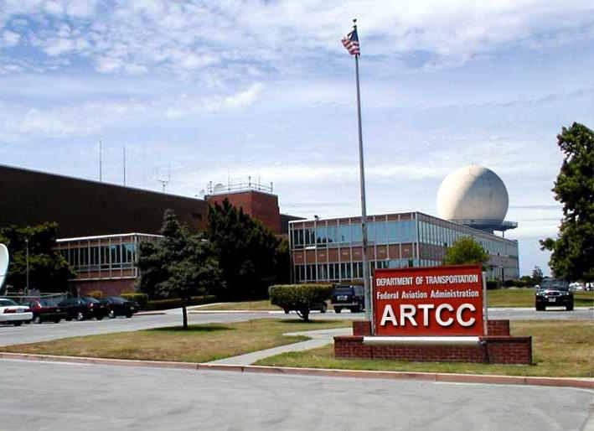
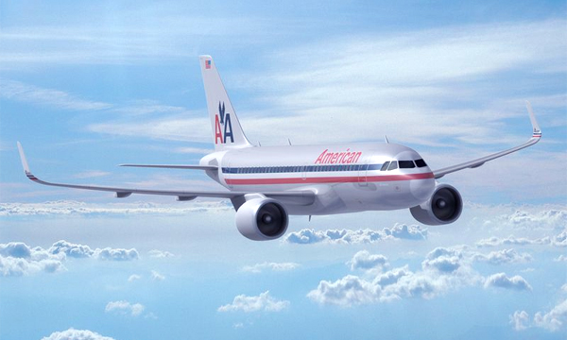
Excessive Speed Adjustments
“AMERICAN SIXTY-ONE, REDUCE SPEED TO THREE ZERO ZERO”
“AMERICAN SIXTY-ONE, INCREASE SPEED TO THREE TWO ZERO”
“AMERICAN SIXTY-ONE, REDUCE SPEED TO TWO EIGHT ZERO”
“I wish Center would make up its mind”

Slide 9
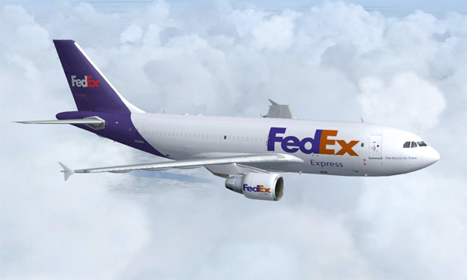
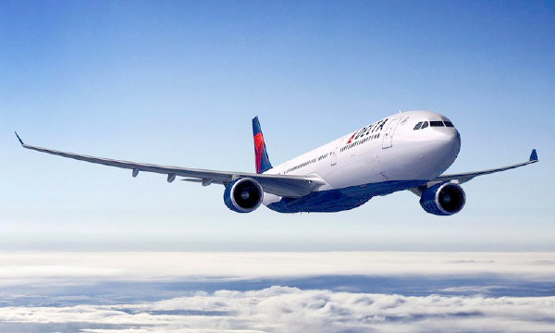
Techniques
“FEDEX FIFTY, INCREASE SPEED TO THREE ZERO ZERO”
“AMERICAN TWELVE, MAINTAIN THREE ZERO ZERO KNOTS”
“DELTA TEN, DO NOT EXCEED THREE ZERO ZERO KNOTS”

Slide 10
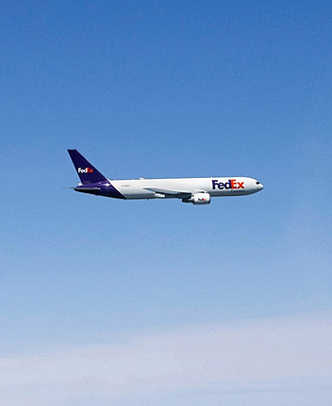
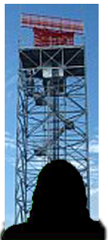
Assignment Restrictions
“FEDEX SEVEN-TWELVE, REDUCE SPEED TO MACH POINT SEVEN NINER, IF UNABLE ADVISE”
FL390
ARTCC

Slide 11
Issuing Speed Adjustments - Terms
Knots
  Based on indicated airspeed (IAS)
  Expressed in increments of 5
Mach numbers
  May be be used at or above FL240
  For turbojet aircraft with Mach meters
  Expressed in increments of .01

Slide 12
Knowledge Check
Speed adjustments are based on what value?
  True airspeed
  Ground speed
  Indicated airspeed

Slide 13
Knowledge Check
What increments, in knots, are speed adjustments expressed?
  5
  10
  15

Slide 14
Knowledge Check
What is the range in knots (+/-) that pilots must maintain when complying with speed adjustments?
  5
  10
  25

Slide 15
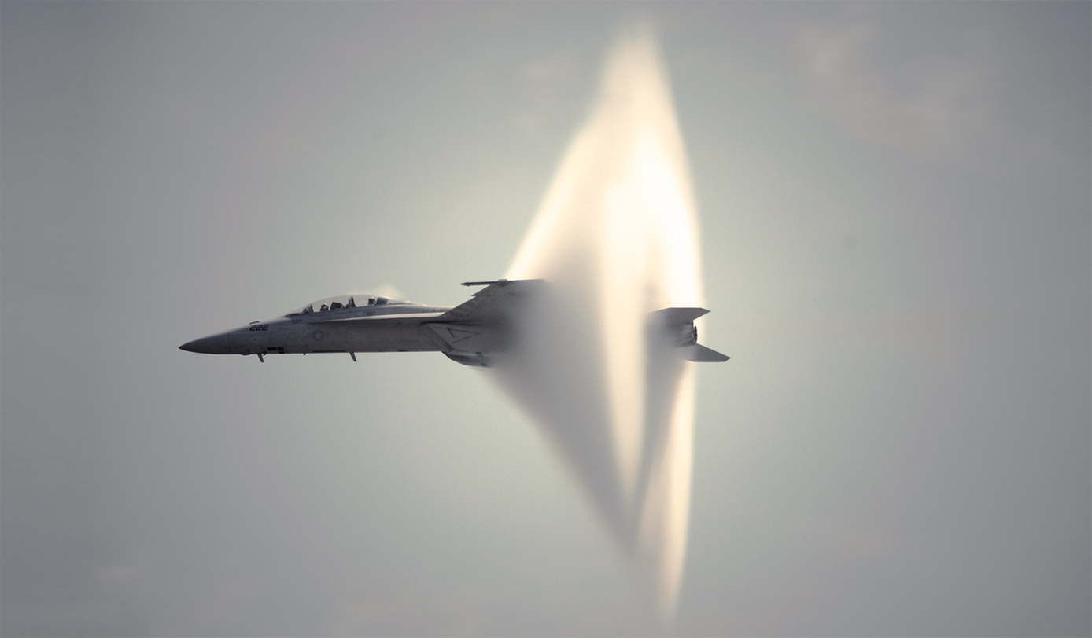
Airspeed and Mach

Slide 16
Definitions
Airspeed
Indicated Airspeed (IAS)
True Airspeed (TAS)
Mach Number
Ground Speed (GS)

Slide 17
Mach 1.0 = Speed of Sound
Mach is the speed an aircraft moves in relation to the speed of sound
  The speed of sound is M1.0
    Aircraft traveling at 80% of the speed of sound are maintaining M.80
    Aircraft traveling at 75% of the speed of sound are maintaining M.75

Slide 18

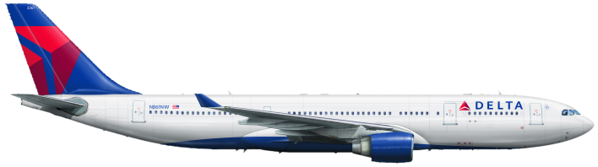
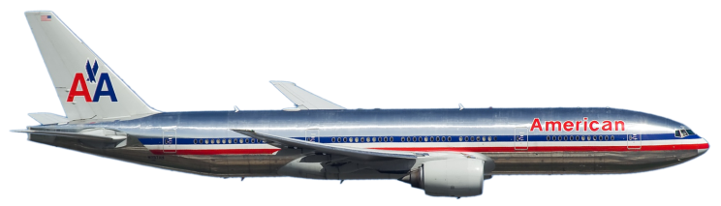
Using Mach “Higher” is “Slower”
M.84 @ FL390 = 483 TAS
M.84 @ FL370 = 483 TAS
M.84 @ FL290 = 500 TAS

Slide 19

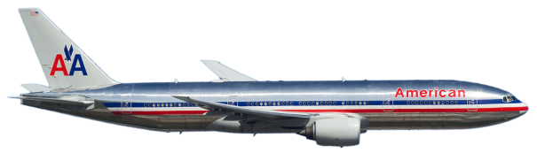
Mach Speeds at Same Altitude
6 TAS is equivalent to .01 of Mach
FL340
M.78
FL340
M.76
12 TAS
2 (.01 Mach) x 6 TAS = 12 TAS

Slide 20
Mach Speeds at Different Altitudes
6 TAS Difference per 2,000'
FL330
M.82
12 TAS
4,000’
4,000’ = 2 (2,000’ units)
FL290
M.82
2 x 6 TAS = 12 TAS
ACFT at FL290 is 12 TAS Faster

Slide 21
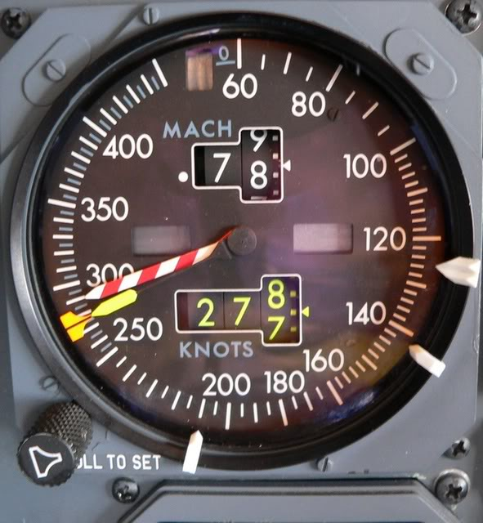

At or Above FL240
Mach Limit
“Barber Pole”
Mach Number
Indicated Airspeed

Slide 22
Knowledge Check
What does M.80 mean?
  Minimum speed of 80 knots
  Aircraft speed is 8 times the speed of sound
  Aircraft speed is 80% the speed of sound

Slide 23
Knowledge Check
At or above FL360 at a given Mach number, what happens to TAS?
  Remains the same
  Increases
  Decreases

Slide 24
Knowledge Check
Mach numbers are adjusted in increments of ___.
  M.01
  M.10
  M1.0

Slide 25
Knowledge Check
Given a no wind situation, if an aircraft at FL350 is maintaining M.79, what Mach number would be assigned to an aircraft at FL330 to maintain the same TAS?
  M.78
  M.79
  M.81

Slide 26
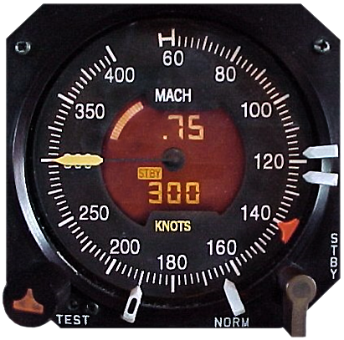
What is Indicated Airspeed?
Indicated Airspeed

Slide 27
Relationship of IAS to TAS
With constant indicated airspeed, true airspeed increases about 2% per 1,000' of increase in altitude
Altitude | Knots IAS | Approximate Knots TAS
FL300 | 10 | 16
FL250 | 10 | 15
FL200 | 10 | 14
15,000’ | 10 | 13
10,000’ | 10 | 12
5,000’ | 10 | 11
1,000’ | 10 | 10
0’ | 10 | 10

Slide 28
5 - 7 Knots TAS for Every 1,000'
FL240
If both aircraft are assigned 250 IAS, the aircraft at FL240 will be 24 TAS faster.
24,000’ - 20,000’ = 4,000'
6 TAS for Every 1,000'
6 KTS x 4 = 24 TAS
FL200

Slide 29
Knowledge Check
If aircraft at FL190 and 15,000’ are assigned 250 IAS, which will have a faster TAS?
  Both aircraft will have similar TAS
  Aircraft at 15,000’
  Aircraft at FL190

Slide 30
Knowledge Check
What happens to the TAS of an aircraft that descends at a constant IAS?
  Increases
  Decreases
  Remains the same

Slide 31
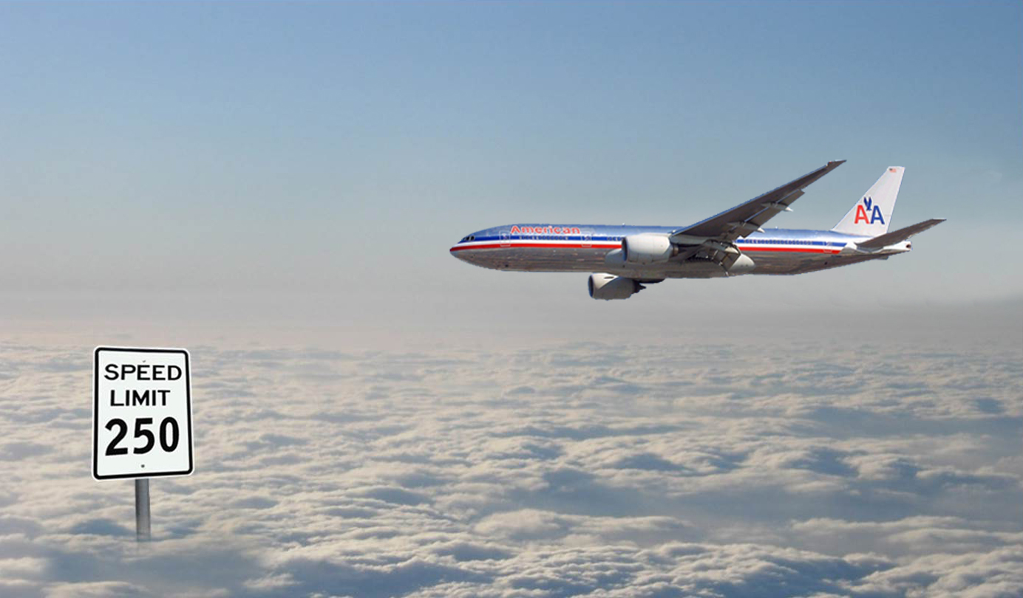
Minima Below 10,000'

Slide 32




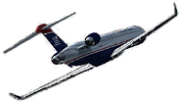
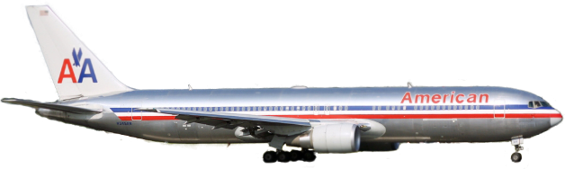


Speed Adjustment Minima
FL280
FL280
Not Less Than
250 Knots
10,000’
10,000’
20 Flying Miles
Not Less Than 210 Knots
Turbojets
Not Less Than 170 Knots
20 Flying Miles
Reciprocating
Turboprops
Not Less Than 200 Knots
Not Less Than 150 Knots

Slide 33
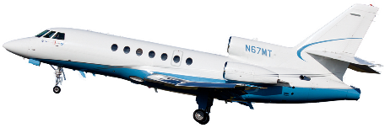
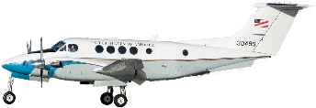
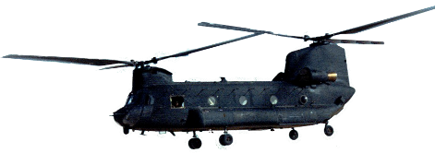
Speed Minima, Departures
Departing: | Not Less Than:
Turbojet aircraft | 230 Knots
Reciprocating and turboprop aircraft | 150 Knots
Helicopter | 60 Knots
Not Less Than
230 Knots
Not Less Than
150 Knots
Not Less Than
60 Knots

Slide 34
Knowledge Check
What is the minimum speed, in knots, that may be assigned to a departing turbojet aircraft?
  210
  230
  250

Slide 35
Knowledge Check
What is the minimum speed, in knots, that may be assigned to an aircraft between 10,000' and FL280?
  200
  230
  250

Slide 36
Knowledge Check
Can you assign an aircraft 270 knots below 10,000’?
  Yes
  No

Slide 37
Speed Phraseology
Speed | Phraseology Example
250 Knots | “TWO FIVE ZERO KNOTS”
180 Knots | “ONE EIGHT ZERO KNOTS”
150 Knots | “ONE FIVE ZERO KNOTS”
Mach | Phraseology Example
1.5 | “MACH ONE POINT FIVE”
0.64 | “MACH POINT SIX FOUR”
0.82 | “MACH POINT EIGHT TWO”

Slide 38






Maintain a Specified Speed
“NOVEMBER SIX GOLF ALPHA, MAINTAIN TWO FIVE ZERO KNOTS”
AAL326
110C
321HTUL
KTUL
UAL45
110C
313OTUL
KTUL
R
N626GA
110 130
421 390
KTUL
N626GA
110 130
421 390
S250
AAL12
110 130
324 390
KTUL

Slide 39


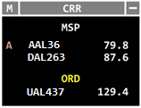
Increase/Reduce Speed
“AMERICAN THIRTY-SIX, INCREASE SPEED TO THREE ONE ZERO”
“DELTA TWO SIXTY-THREE, REDUCE SPEED TO TWO SIX ZERO”
A 79.8
AAL36
210 102
009 390
KMSP
87.6
DAL263
230C
007 426
KMSP
129.4
UAL437
230T230
003 426
KORD

Slide 40
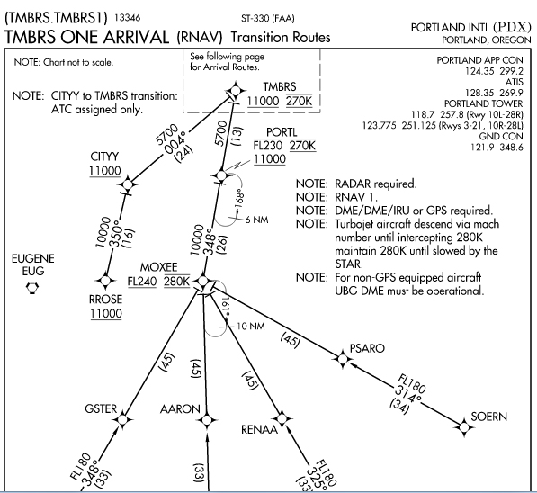
Published Speed Restrictions
Example 1: Aircraft is inbound to MOXEE and has been cleared to descend pilot’s discretion to FL240. Because there are underlying speed restrictions on the route, the aircraft must comply with the published speed restrictions.
Example 2: Aircraft is inbound to MOXEE and has been cleared to descend via the TMBRS STAR. Aircraft must comply with published speed and altitude restrictions.

Slide 41
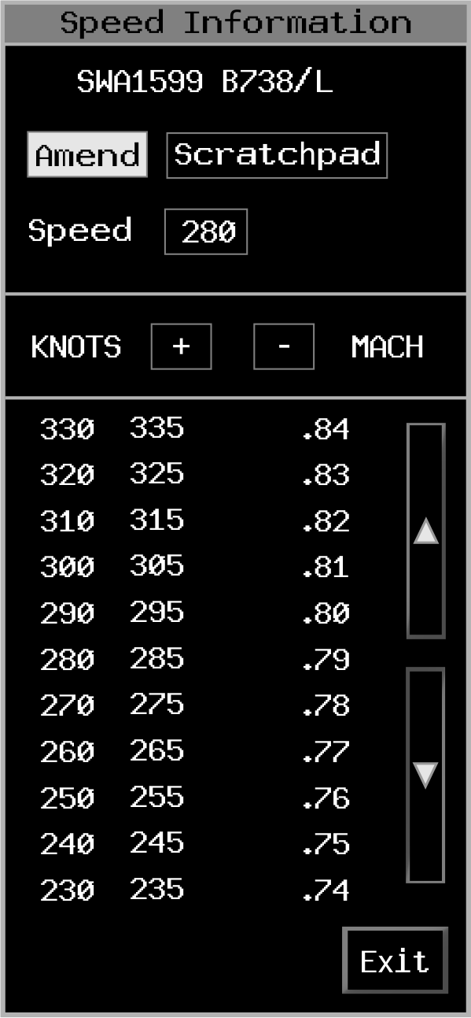
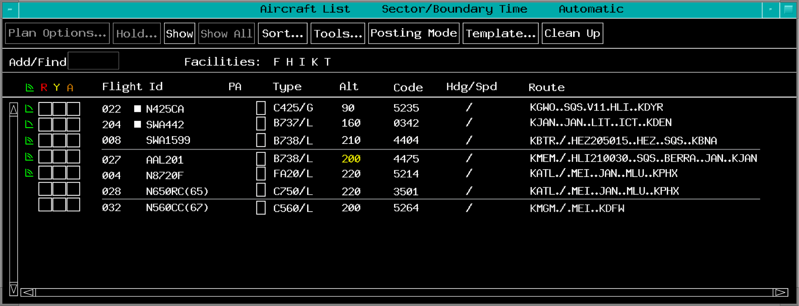
4th Line Data

Slide 42
4th Line Speed Value Formats
Formats
ddd | Mdd
ddd+ | Mdd+
ddd- | Mdd-
+d(d) | M.dd
-d(d) | .dd
dd | .dd+
dd+ | .dd-
dd- | Sddd
+ | -
PS
GIM-S accepted speed formats:
⎳(d)dd | ⎳Mdd

Slide 43
Knowledge Check
What is the phraseology to reduce the speed of an aircraft to 250 knots?
  REDUCE SPEED TO TWO FIVE ZERO
  REDUCE TO TWO FIVE ZERO KNOTS
  SLOW TO TWO FIVE ZERO KNOTS

Slide 44
Knowledge Check
What is the phraseology to instruct an aircraft to increase speed from 200 knots to 230 knots?
  ADJUST INDICATED AIRSPEED TO TWO THREE ZERO KNOTS
  INCREASE TO TWO THREE ZERO KNOTS
  INCREASE SPEED TO TWO THREE ZERO

Slide 45
Activity: Airspeed Flowchart Review
Purpose
  Review Airspeed Flowchart
Materials
  Airspeed Flowchart
Directions
  Steps to use the flowchart on the next page:
    Begin at the top START oval, follow the paths
    Answer questions in decision boxes (diamonds)
    Note the answer in the last step of the chart (oval)

Slide 46
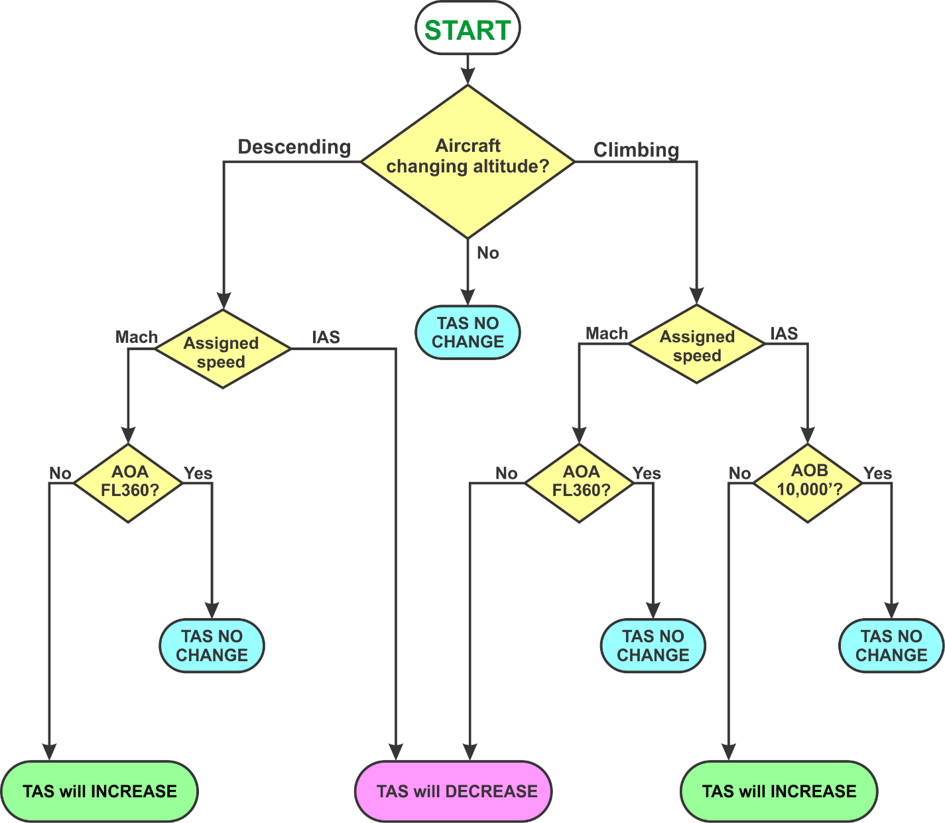
Activity: Airspeed Flowchart Review (Cont’d)
Situation #4
  A flight at FL220 is descending with an assigned IAS restriction
Situation #3
  A flight at 15,000’ is climbing with an assigned IAS restriction
Situation #2
  A flight at FL370 is climbing with an assigned Mach number speed restriction
Situation #1
  A flight at FL290 is descending with an assigned Mach number speed restriction
  Helps you understand the relationship between true airspeed, IAS and Mach speed, as aircraft change altitude
Answer:
  True airspeed and ground speed will increase
Answer:
  True airspeed and ground speed will decrease
Answer:
  True airspeed and ground speed will increase
Answer:
  No change in true airspeed and ground speed

Slide 47
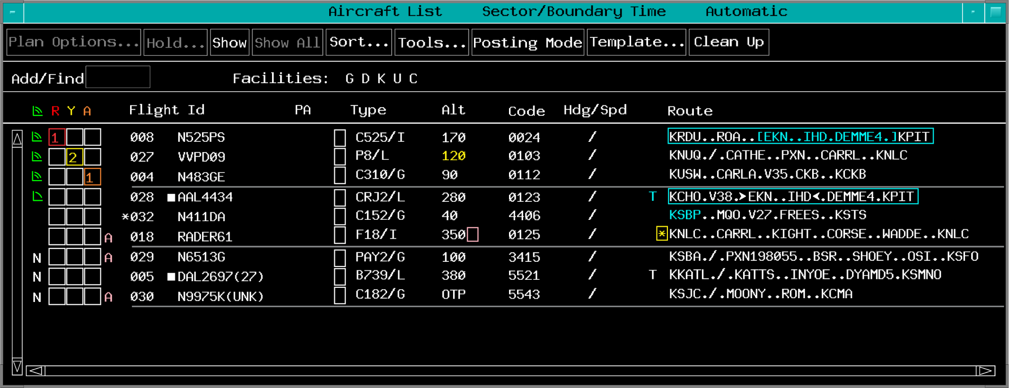



Scanning

Slide 48

Sector Team Responsibilities

Slide 49
RA Position Responsibilities
R Position
RA Position
Initiate Control Instructions and Clearances
Ensure
Separation
Initiate Direct Control Actions
Accept and Initiate
Automated H/Os
Use EDST
Scan flight progress strips
Ensure Computer Entries and Strip Marking are Complete
Monitor Radios
Coordinate Other Sectors
Operate Interphones
Monitor and operate radios
Manage Flows
Ensure Situation Display accurately reflects the SAAs
Process Flight
Strips
Nonautomated H/Os

Slide 50
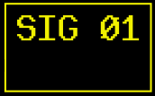
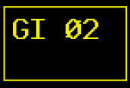

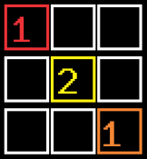

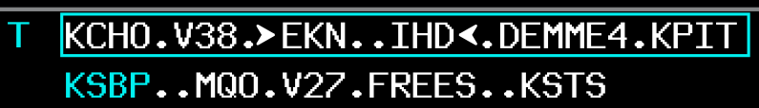
Scanning
Color coding gets your attention

Slide 51
Scanning Data Blocks
Actively scan the Situation Display
  Ensure all FDBs can be seen
    Avoid data block overlap
  Potential conflicts
    Aircraft-to-aircraft
    Aircraft-to-airspace
  Unusual situations
  Weather
  Sector boundaries

Slide 52
Vectoring
Speed adjustment
Scanning

Slide 53
The Decision Process
Start Here
Observe
Act
Project
Decide

Slide 54
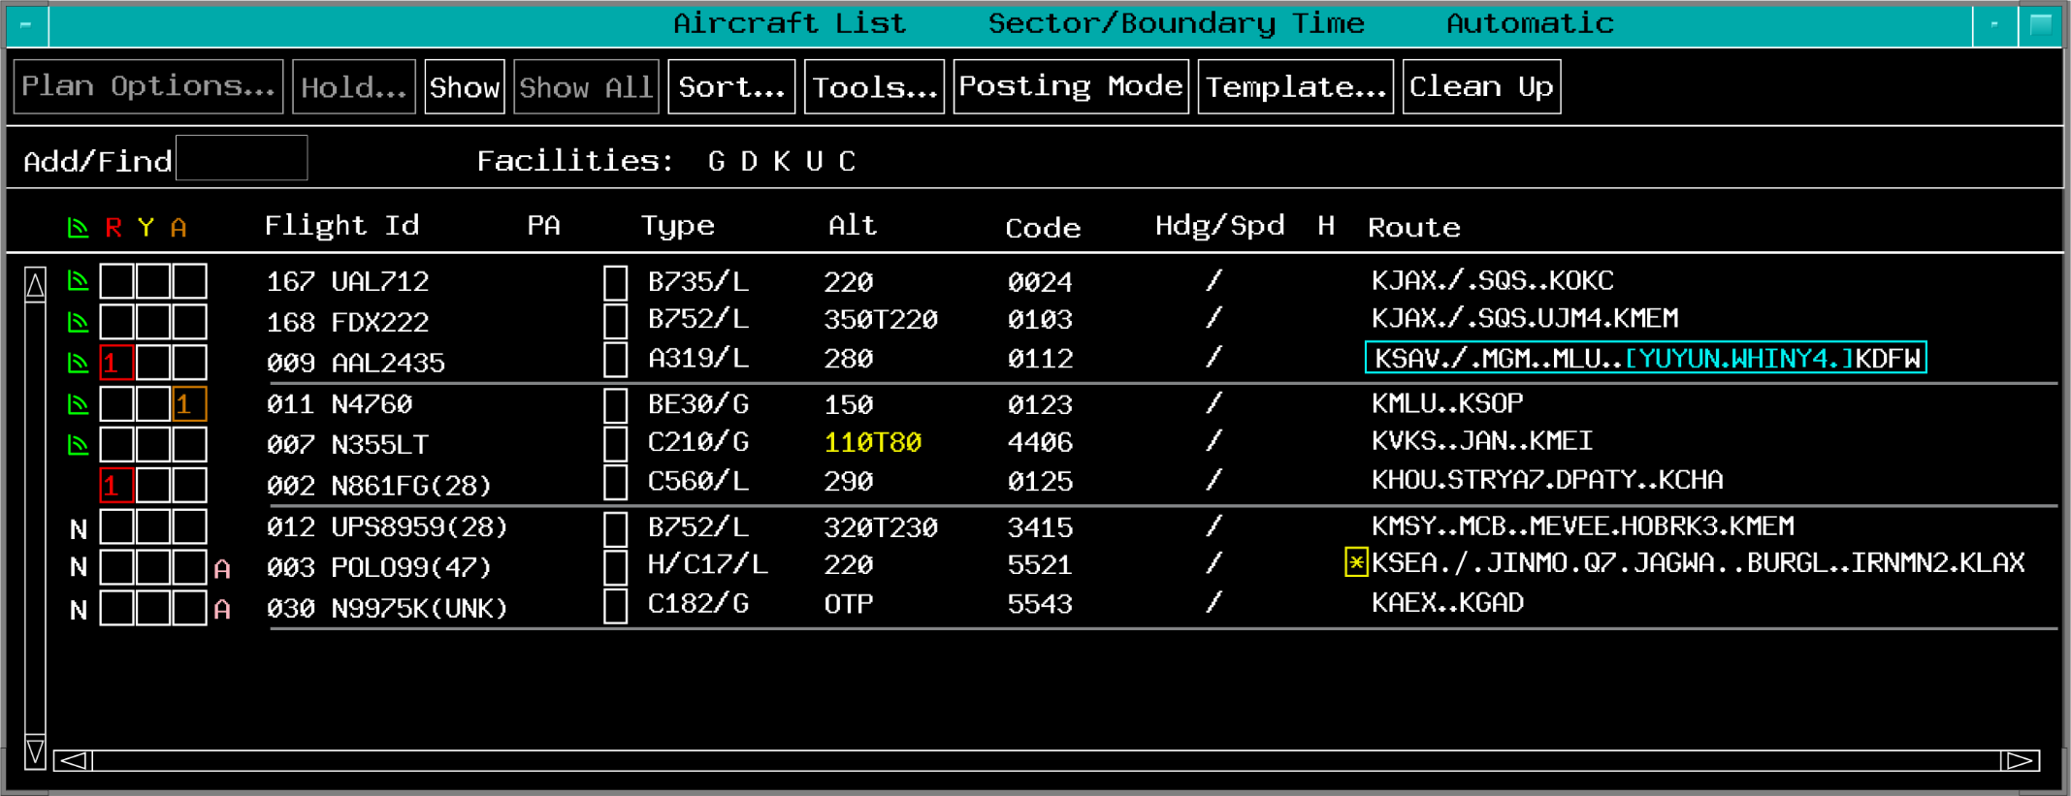
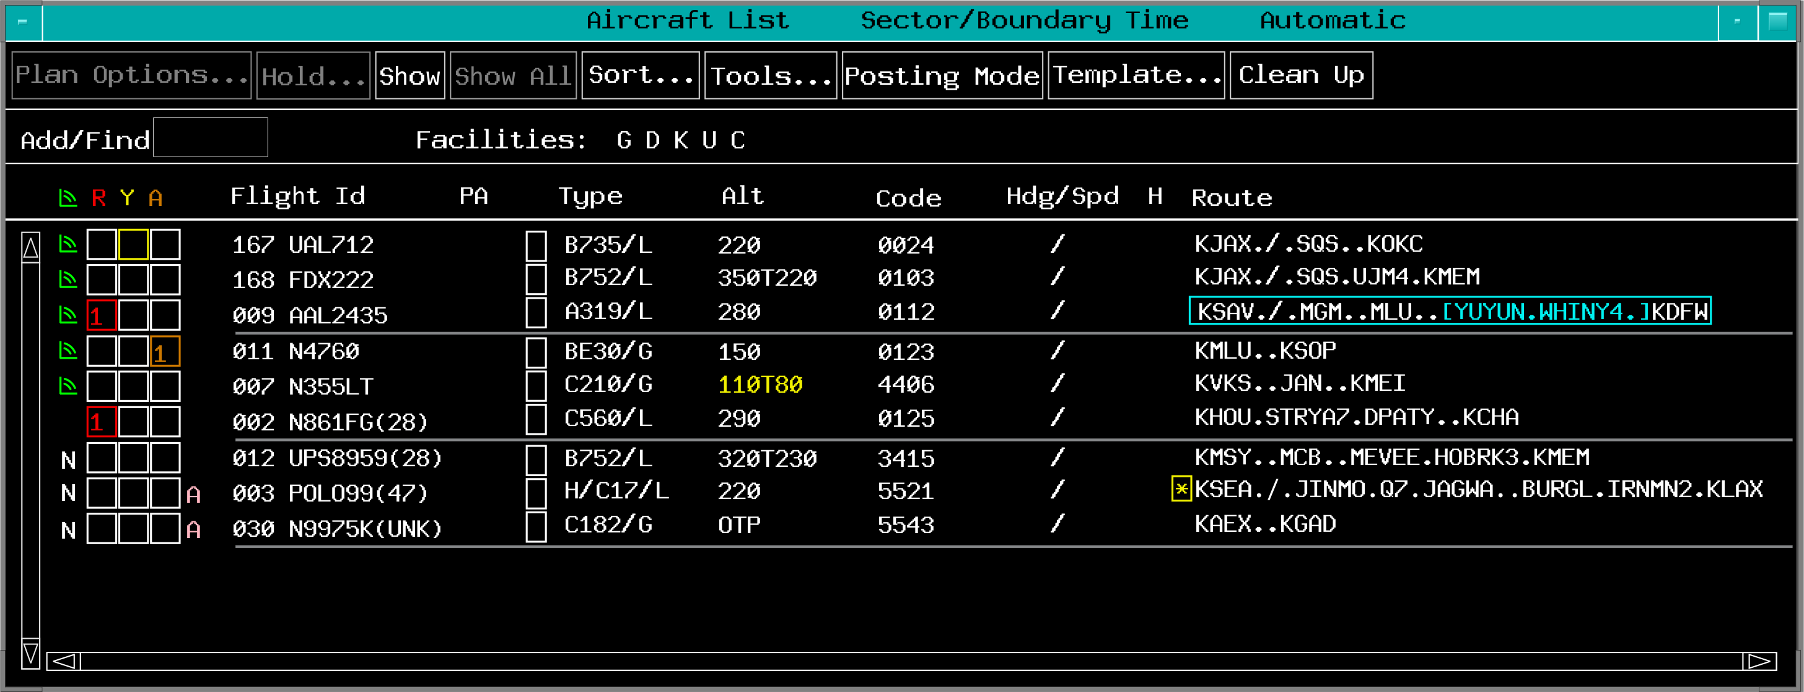
Observing Alerts

Slide 55
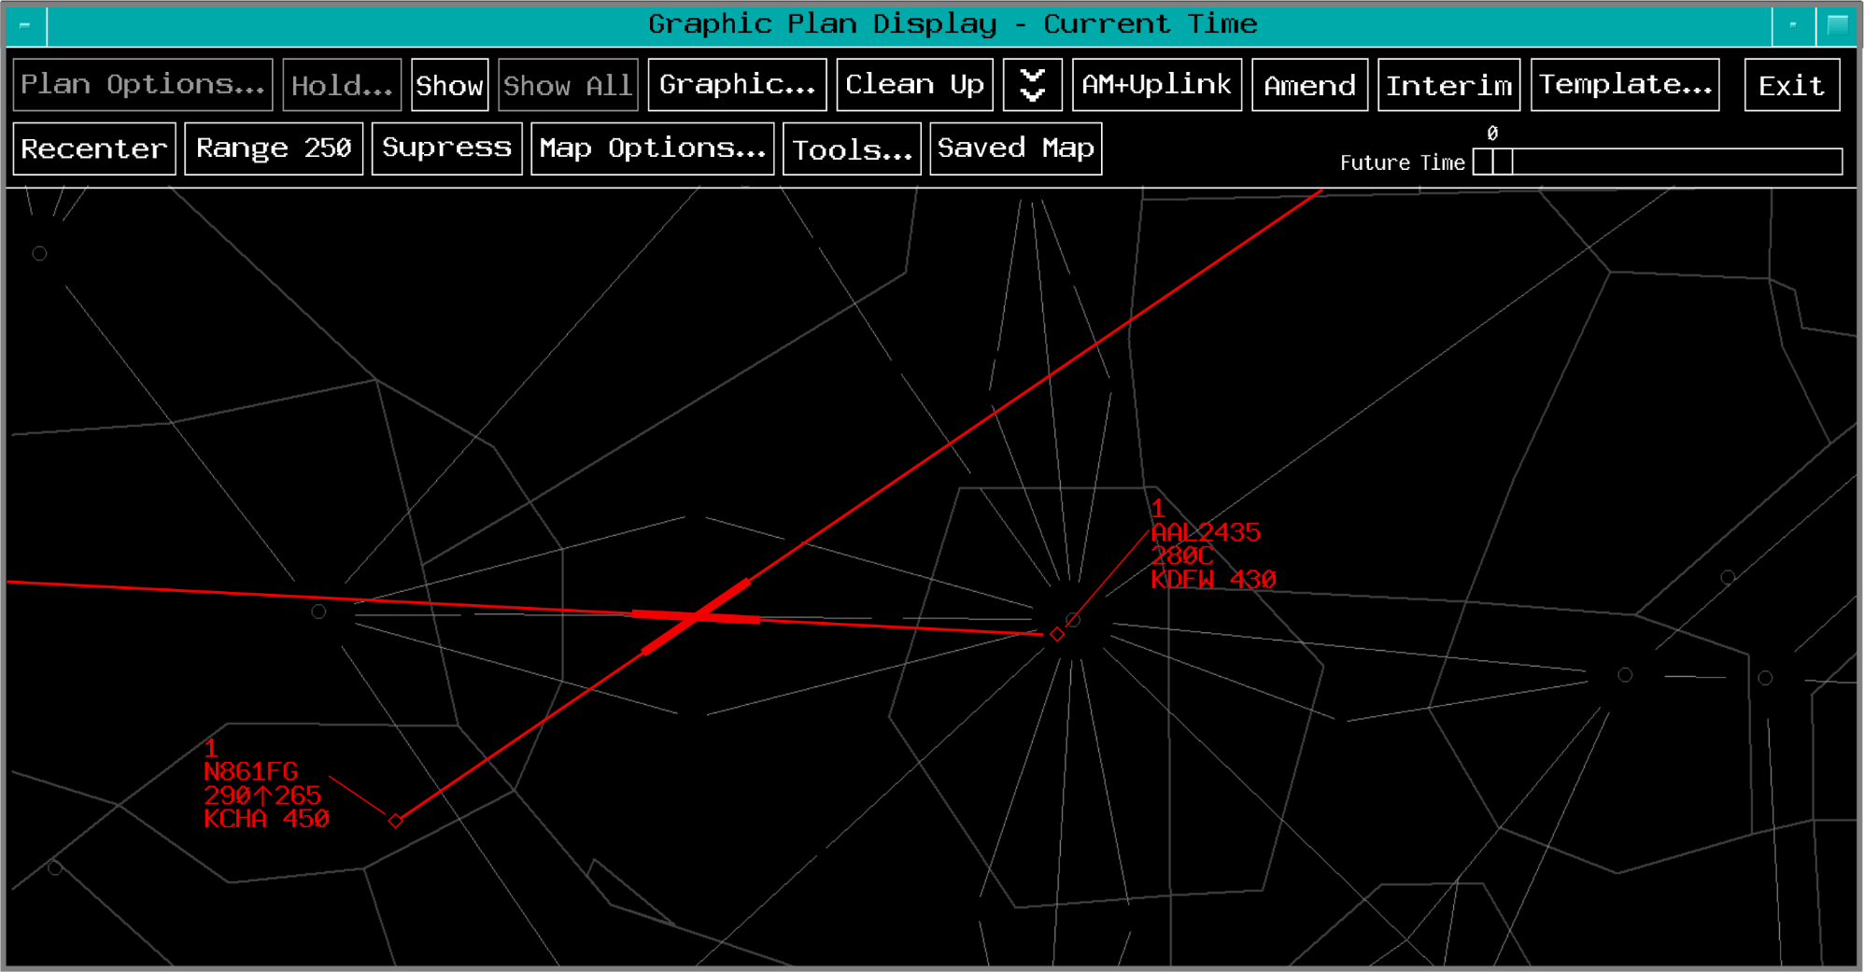
Project and Analyze

Slide 56

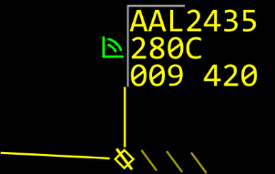
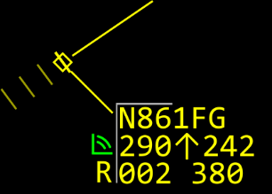
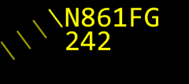
Decide if Action is Necessary
EDST alerts are projections
Display the data block on the situation display

Slide 57
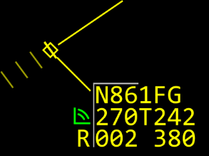
Act - Intervene
Coordinate a new or amended clearance to:
  Eliminate conflicts
  Meet objectives
  Avoid weather

Slide 58
Necessity of Constant Scanning
Continuous scanning and attention to detail is necessary to prevent:
  Complacency
  Laxness
Do not allow your attention to be diverted by:
  Conversations not related to the job,
  Distractions from facility tours, or
  Other personnel in the area

Slide 59
Scanning Activity
Purpose
  Scan scenarios of EDST and data blocks to observe various system notifications
Materials
  Practice exercise from Lesson 14 handout
Directions
  Change your position in class as necessary to read the screen
  Exercise will depict five EDST and five situation display examples
    Scan for alerts and any other indications
    Write down what you see

Slide 60
Scanning
Color coding gets your attention

Slide 61
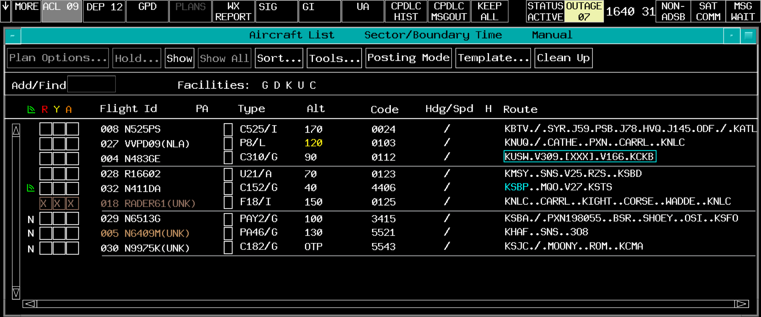
Scenario 1
Time
Scenario 1
Ready?
0
1
2
3
4
5
6
7
8
9
10
11
12
13
14
15
16
17
18
19
20

Slide 62
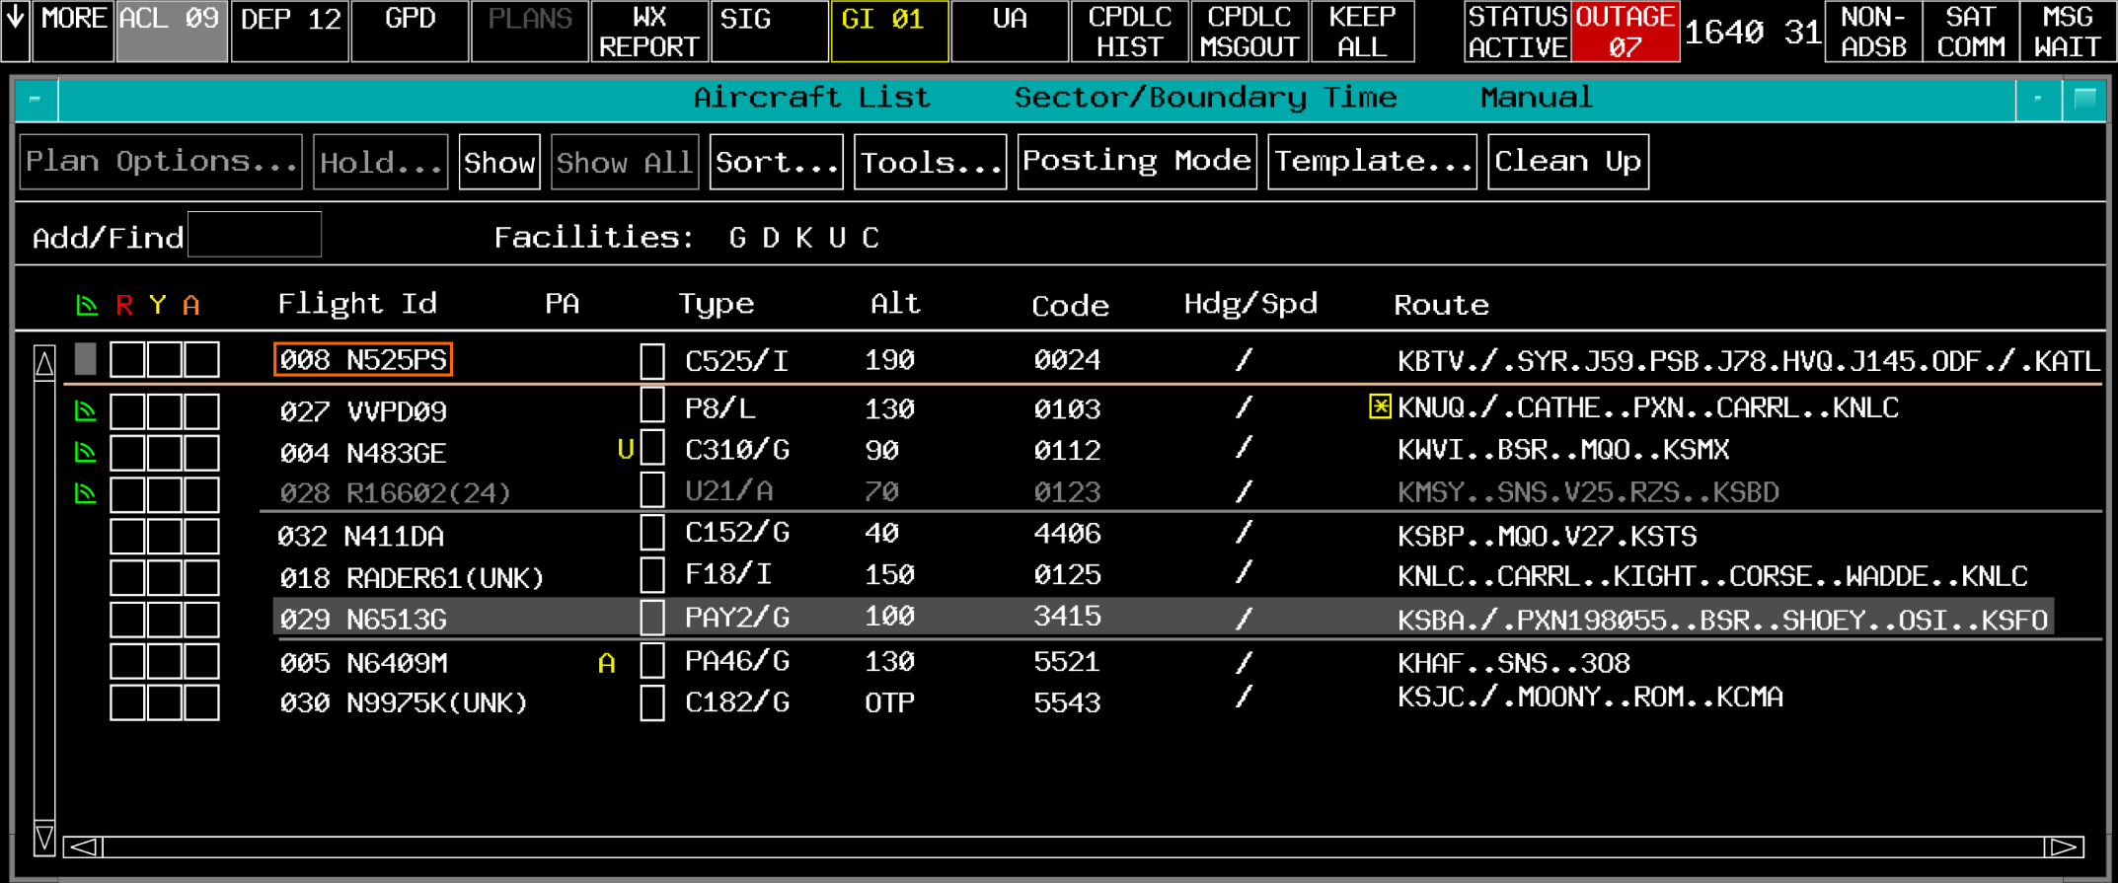
Scenario 2
Time
Scenario 2
Ready?
0
1
2
3
4
5
6
7
8
9
10
11
12
13
14
15
16
17
18
19
20

Slide 63
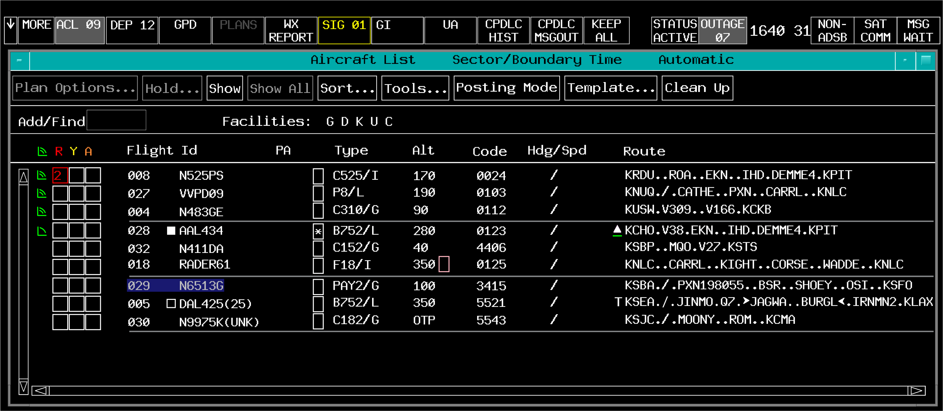
Scenario 3
Time
Scenario 3
Ready?
0
1
2
3
4
5
6
7
8
9
10
11
12
13
14
15
16
17
18
19
20

Slide 64
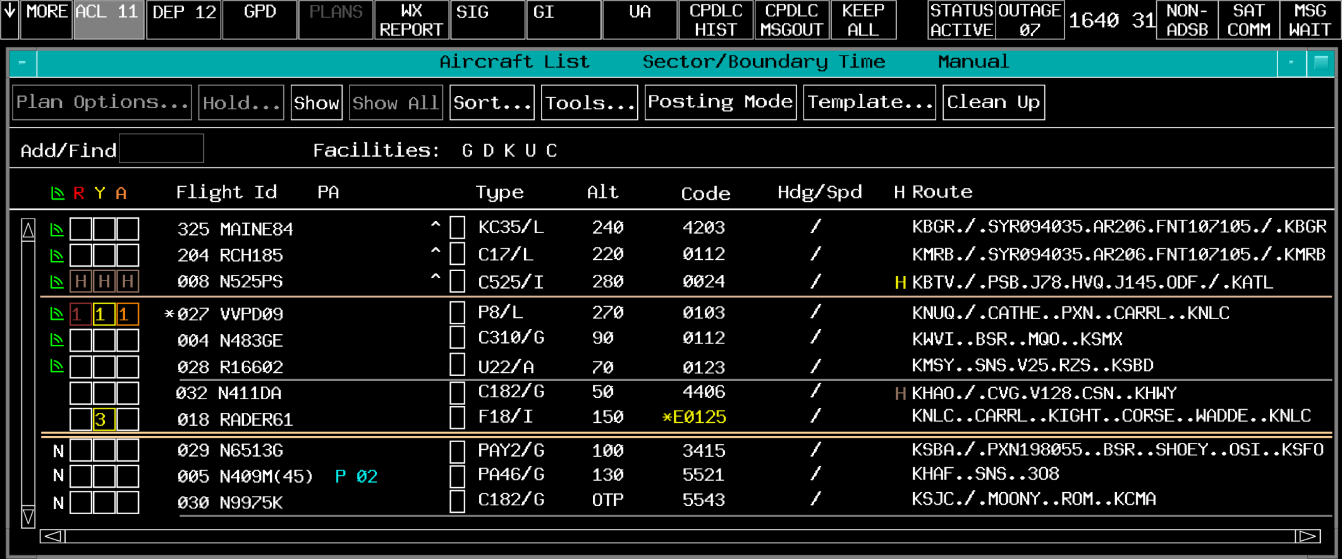




Scenario 4
Time
Scenario 4
Ready?
0
1
2
3
4
5
6
7
8
9
10
11
12
13
14
15
16
17
18
19
20

Slide 65
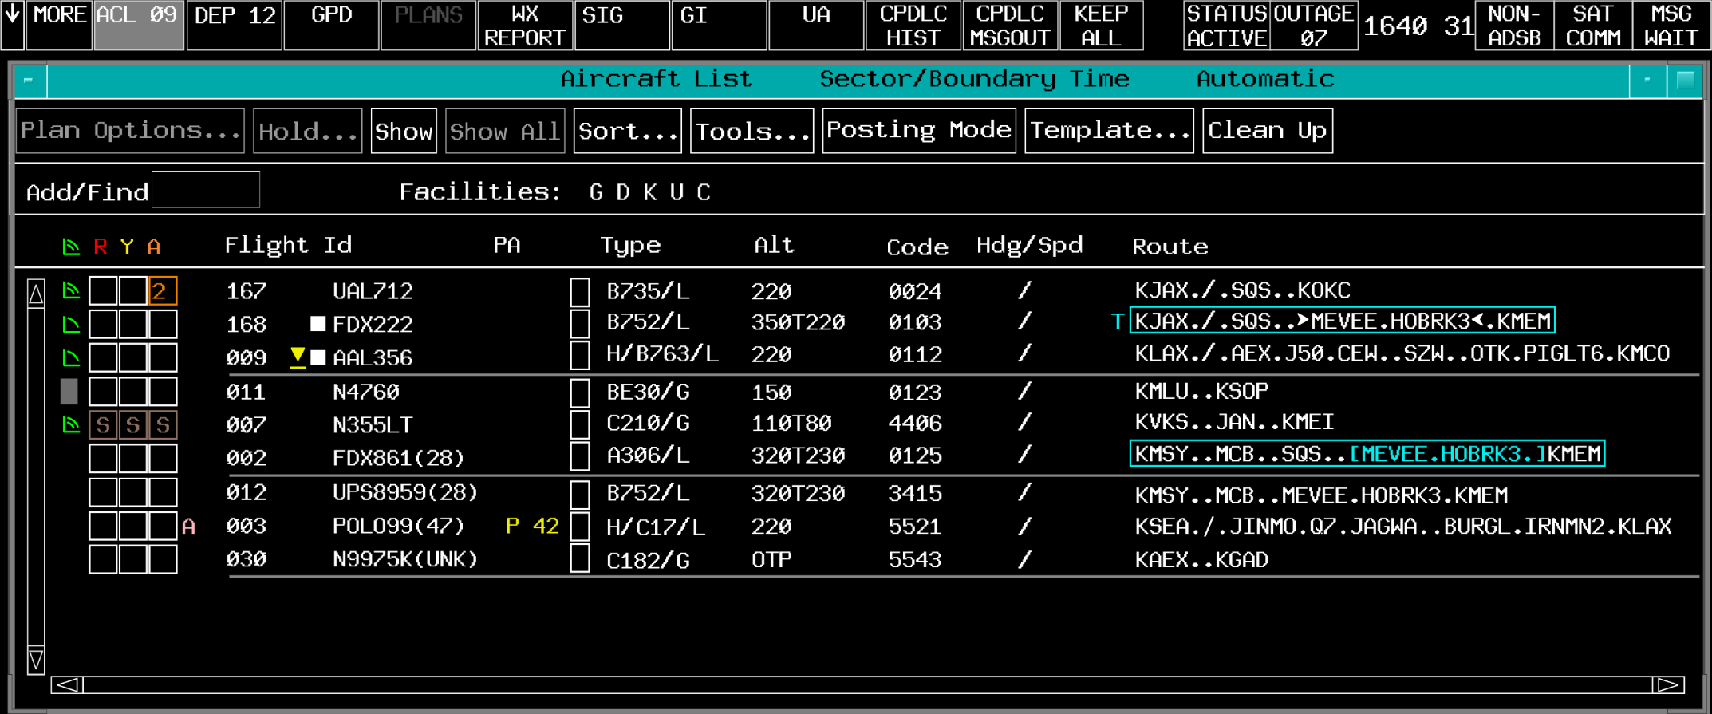



Scenario 5
Time
Scenario 5
Ready?
0
1
2
3
4
5
6
7
8
9
10
11
12
13
14
15
16
17
18
19
20

Slide 66



Scenario 6
Ready?
Time
Scenario 6
0
1
2
3
4
5
6
7
8
9
10
11
12
13
14
15
16
17
18
19
20
UAL624
300C
236 422
KORD
DAL374
190+194
533 510
KEWR
N235SL
70C
539K-49
KAVQ
R
N1762T
90N
204 CST
KAVP
SWA296
330C
045SIDE
KMDW

Slide 67

Scenario 7
Ready?
Time
Scenario 7
0
1
2
3
4
5
6
7
8
9
10
11
12
13
14
15
16
17
18
19
20
MARS71
170N
263FRZN
SLAM21
350 221X
533 510
DAL28
240F315
798 445
N156SB
200C
876O-47
N198M
30C
130MIFF
R
AAL31
290C
830RDOF

Slide 68
Scenario 8
Ready?
Time
Scenario 8
0
1
2
3
4
5
6
7
8
9
10
11
12
13
14
15
16
17
18
19
20
AAL45
200 337
821 410
N292ED
90-86
045 139
N12605
80A
454 111
N24350
90 75#
492 111
N1172W
70C
292FAIL
UAL425
290C
8063402

Slide 69


Scenario 9
Ready?
Time
Scenario 9
0
1
2
3
4
5
6
7
8
9
10
11
12
13
14
15
16
17
18
19
20
N468MT
150C
533 320
JAWS11
310XXXX
533 510
JBU400
350 390
005 550
UAL169
280C
376EMRG
SWA1198
170C
165 EFC
N4577
50C
143 105
A

Slide 70
Scenario 10
Ready?
Time
Scenario 10
JBU441
260N
031 452
0
1
2
3
4
5
6
7
8
9
10
11
12
13
14
15
16
17
18
19
20
NOMAD4380C
251 142
N6040C
30 42
109MSAW
UAL31
260C
806HIJK
N5299D
30C
365MOFF
38
N7188Q
50C
510DATA

Slide 71
The End

