Slide 1

En Route - Radar Associate Controller Training Part C: Advanced Concepts
Lesson 13: Radar Separation and Safety Alerts
Course - 55054003
Version - 1.0 2022.08

Slide 2
Lesson Objectives
At the end of this lesson, you will be able to identify:
Requirements for radar separation
Radar separation minima
Requirements for safety alerts

Slide 3
Requirements for Radar Separation
Radar separation may be applied between:
Radar-identified aircraft
An aircraft taking off and another radar-identified aircraft
A radar identified aircraft and one not radar-identified
A radar identified aircraft and one not radar-identified that is in transit from oceanic airspace or non-radar offshore airspace

Slide 4
Requirements for Radar Separation (Cont’d)
Target separation
Apply radar separation:
Between the centers of primary radar targets
Between the ends of beacon control slashes
Between the end of a beacon control slash and the center of a primary target
For all digital displays, between the centers of digital targets

Slide 5
Requirements for Radar Separation (Cont’d)
Radar separation must be applied to all RNAV aircraft operating at and below FL450 on Q routes or random RNAV routes, excluding oceanic airspace

Slide 6

Radar separation must be applied to all aircraft that are _______.
operating on Q routes at and below FL450
departing a tower controlled airport
operating in RVSM airspace below FL410

Slide 7
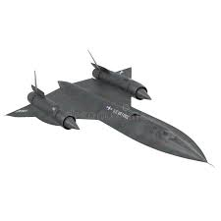
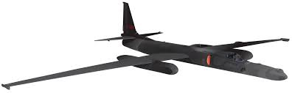


ERAM Radar Separation Minima
10 Miles
FL600
5 Miles

Slide 8


Radar Separation Minima From Adjacent Airspace
SWA28
140
533 510
KDAL
2 ½ miles
Adjacent radar controlled airspace

Slide 9
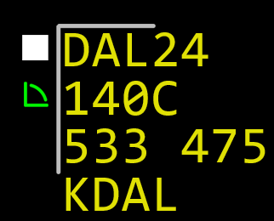
Radar Separation Minima From Obstructions
5 miles

Slide 10
Radar Separation Minima From Adjacent Airspace
SWA28
140
533 510
KDAL
5 miles
Aircraft at FL200 tracked off edge of Situation Display

Slide 11
What is the approved separation minima between aircraft transitioning from approach control to center airspace, when covered by a letter of agreement?
2 miles increasing to 3
3 miles increasing to 5
5 miles increasing to 7

Slide 12
Report Passing
Vertical separation between aircraft on opposite courses may be discontinued when:
You are in communications with both aircraft
You tell the pilot of one aircraft about the other
One pilot reports seeing the other aircraft and reports passing that aircraft
Targets passing observed on radar
Pilots advised if either aircraft is a super or heavy

Slide 13
What is the appropriate number of miles of separation from adjacent airspace below FL600?
2 ½
3 ¼
5 ¾

Slide 14
Safety Alerts
Issue a safety alert to an aircraft if you are aware the aircraft is in a position or altitude that, in your judgment, places it in unsafe proximity to terrain, obstructions, or other aircraft
Duty Priority
Give first priority to separating aircraft and issuing safety alerts

Slide 15
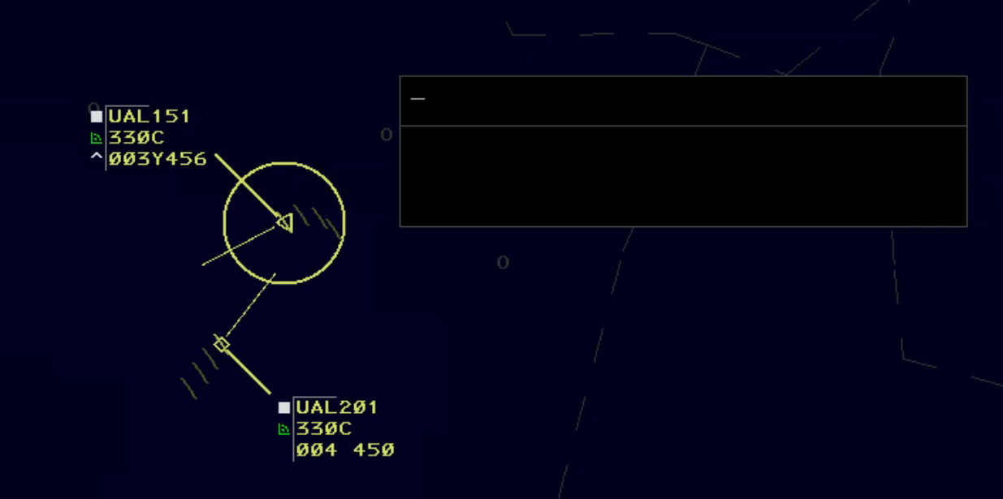
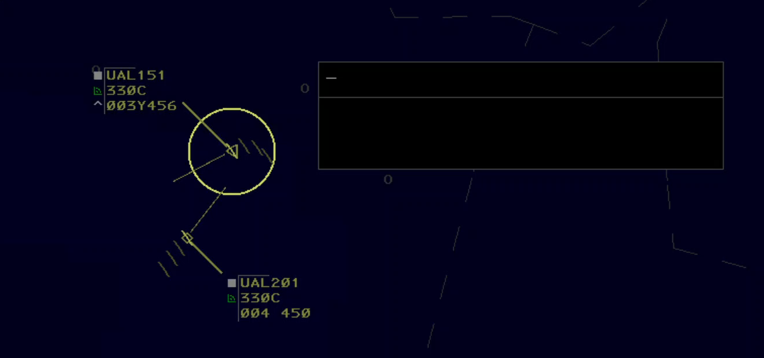
Conflict Alert
Aircraft in close proximity or predicted to be in close proximity

Slide 16
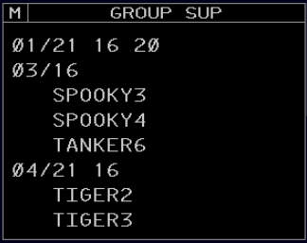
Group Suppression
GROUP SUP View
Sector 21
Group ID
Subscribed Sectors
Flights of Group 03

Slide 17
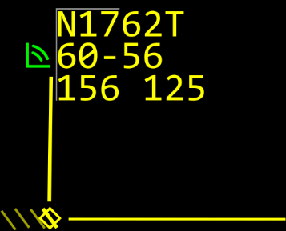
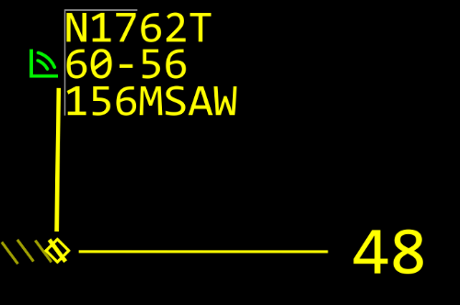
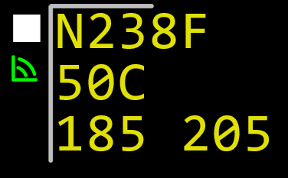
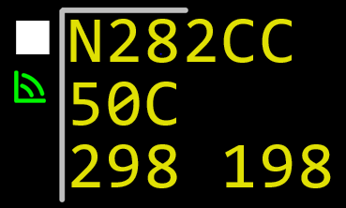




En-Route Minimum Safe Altitude Warning (E-MSAW)

Slide 18
Traffic Alert and Collision Avoidance System (TCAS)
Airborne collision avoidance system based on radar beacon signals, which operates independent of ground based equipment
TCAS-I generates traffic advisories only
TCAS-II generates traffic advisories and resolution advisories, but only in the vertical plane

Slide 19
When must E-MSAW processing be enabled for Mode C equipped VFR aircraft?
At all times regardless of aircraft altitude
When the aircraft is experiencing an emergency
Only when instructed by the supervisor/CIC

Slide 20
Part-Task Exercise
Purpose:
The student will perform tasks related to radar separation and safety alerts
Materials:
TTL part-task exercise: Radar Separation and Safety Alerts
Directions
This exercise takes approximately 30 minutes to complete. Each student must complete the checklist tasks. No headsets are required.

Slide 21
Lesson Summary
This lesson covered:
Requirements for radar separation
Radar separation minima
Requirements for safety alerts

Slide 22

The End

