Slide 2
Lesson Objectives
At the end of this lesson, you will be able to identify:
Terminology for transferring radar identification
Handoff and point out methods
Handoff procedures
Handoff command entry
Point out procedures
Point out command entry

Slide 3
Definitions
HANDOFF
RADAR CONTACT
POINT OUT
POINT OUT APPROVED
AUTOMATED INFORMATION TRANSFER (AIT)
TRAFFIC
TRAFFIC OBSERVED

Slide 4

Knowledge Check
What is the term used to inform the controller initiating a handoff that the aircraft is identified and approval is granted for the aircraft to enter the receiving controller’s airspace?
  RADAR HANDOFF
  RADAR HANDOFF APPROVED
  RADAR CONTACT

Slide 5
Knowledge Check
What is the term used to inform the controller initiating a point out that the aircraft is identified and that approval is granted for the aircraft to enter the receiving controller’s airspace, as coordinated, without a communications transfer?
  POINT OUT APPROVED
  POINT OUT ACCEPTED
  POINT OUT ACKNOWLEDGED

Slide 6


Handoff and Point Out Methods
Transfer Radar Identification

Slide 7
Order of Information
Relay information for handoff, point out, and traffic restrictions in the following order:
  Target position
  Aircraft identification
  Assigned altitude
    Appropriate restrictions
    Information that the aircraft is climbing or descending
  Pertinent information

Slide 8


Landline / Interphone
Sector 1
“DELTA THREE TWENTY-FOUR, POINT OUT APPROVED, U-K”
“POINT OUT EAST OF NOWAY DELTA THREE TWENTY-FOUR, FLIGHT LEVEL THREE ONE ZERO, DIRECT SPARTANBURG”
“D-T”
DAL324
310C
543 400
R
DAL324
310C
543 400
Sector 2

Slide 9
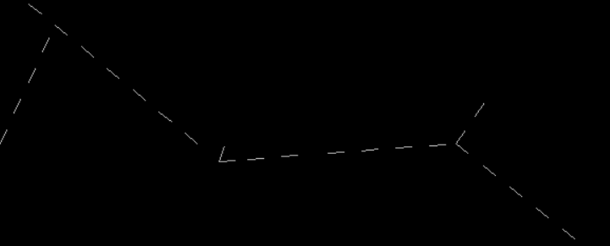



Data Block Coordination During and After Handoff
If you change data in the flight plan or FDB after receiving a handoff from another ERAM facility, before the target leaves the transferring facility's Area of Interest (AOI)
  Any changes made are reflected in the data block and ACL at both facilities
SWA547
330T237
122 451
H240
Facility A
AOR Boundary
Facility B Situation Display
Facility B

Slide 10

4th Line Data Block Usage
Facility A
Heading
Heading and Speed
AOR Boundary
/
Speed
Free Text

Slide 11
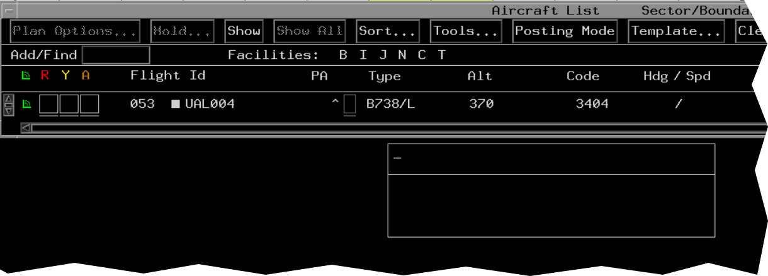

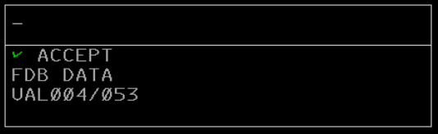
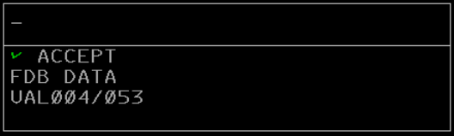

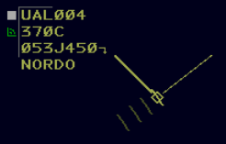
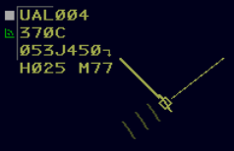
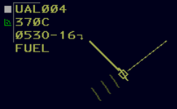

Hdg/Spd or Free Form Text
Enter Command
Enter Command
Entry of Free Form Text removes Hdg/Spd
Entry of Hdg/Spd removes Free Form Text
4th Line

Slide 12

Enter 4th Line Information
Keyboard commands
  Syntax: QS <Heading>/<Speed> <FLID>
  QS <Heading> <FLID>
  QS /<Speed> <FLID>
  QS ○<Free form text> <FLID>

Slide 13
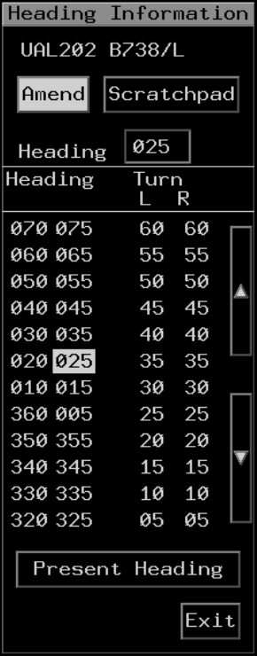
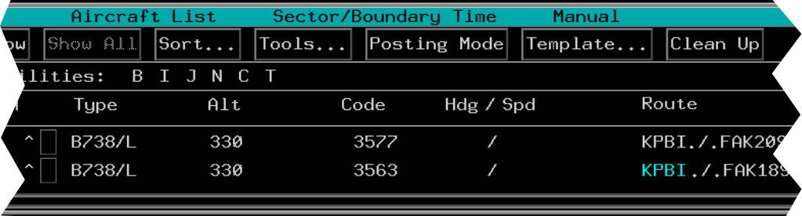



Enter 4th Line Information (Cont’d)
TBP

Slide 14


Remove 4th Line Information
TBH

Slide 15

Altitude Coordination
The altitude field(s) of the data block must always reflect the current status of the aircraft, unless otherwise specified in a facility directive or LOA
SWA547
330T237
122 451
R

Slide 16
Knowledge Check
During a handoff by landline voice communication, what is true of altitude information?
  Only needs to be coordinated if inter/intrafacility automation is out of service
  Must be coordinated, unless facility directives ensure altitude information is known
  Must be coordinated, regardless of facility directives

Slide 17
Knowledge Check
What is true of the altitude field(s) in a data block?
  Must always reflect current status of aircraft, unless otherwise specified in a facility directive
  There is no requirement to reflect temporary altitudes
  When strips are in use, they must always reflect status of aircraft but not the data block

Slide 18






Transferring Controller
Complete a handoff prior to an aircraft entering the airspace delegated to the receiving controller
Receiving Controller
N309
150C
071 295
N309
150C
071H-20
Transferring Controller

Slide 19
Transferring Controller (Cont’d)
Initiate verbal coordination before transferring control of a track when data block displays:
AAL002
370N
009 CST
SWA347
330C
045FAIL
DAL110
370N
160NONE
Handoff is failing
Assigned a beacon code but not received
Coast status

Slide 20

Receiving Controller
Before accepting a handoff ensure:
  Target position corresponds with the position given by the transferring controller
“VERIFY POSITION NOVEMBER THREE SIX TANGO, ONE ZERO MILES NORTH OF JUDD”
Receiving Controller
“AFFIRMATIVE”
N36T
60 27
122DATA
R
R
Transferring Controller

Slide 21
Receiving Controller (Cont’d)
Initiate verbal coordination prior to accepting control of a track when the following indicators are displayed in the data block:
N422
70C
244DATA
SWA347
330N
814 CST
DAL110
370N
009NONE
R
R
R
Either or both facilities do not have radar data
Coast status
Assigned a beacon code but not received

Slide 22
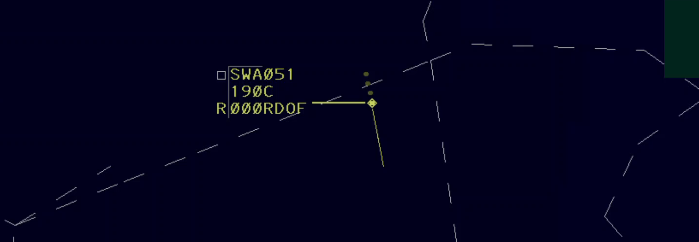
Both Controllers
Within a reasonable amount of time, take appropriate action to establish or restore communications with all aircraft for which a communications transfer or initial contact is expected or required
Transferring Controller
Receiving Controller

Slide 23
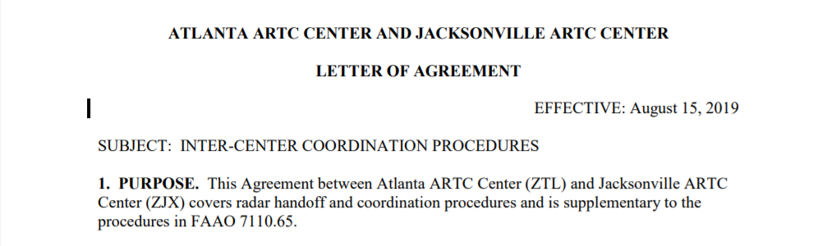
Interfacility Automated Information Transfer
Procedures are specified in AIT directives and LOAs

Slide 24


Prearranged Coordination
Allowing aircraft under your control to enter another controller’s area of jurisdiction may only be approved provided procedures are established and published in a facility directive or LOA
Rainy Area
Sector B
“RAINY AREA RELEASED”
SWA650
410C
134 450
Sector A
“REQUEST RAINY AREA”

Slide 25
Knowledge Check
Unless previously coordinated or covered in an LOA, you must transfer communications of an aircraft before it enters the receiving controller’s airspace.
  True
  False

Slide 26
Knowledge Check
Which FDB indicators would require verbal coordination?
  CST, NONE, SIDE
  SIDE, FAIL, NONE
  CST, FAIL, NONE

Slide 27
Initiate Handoff - Intrafacility
No function key entry required
Syntax:
<sector number or facility> <FLID>
Examples: 30 UAL26
30 526
Before:
After:
UAL26
310C
526H-30
UAL26
310C
526 451
UAL26
310C
526 451
UAL26
310C
526O-30
R
R

Slide 28
Initiate Handoff - Interfacility
No function key entry required
Local facility adaptation can specify a single letter identifier for handoffs
Examples: D30 UAL26 D 526
Before:
After:
UAL26
310C
526 451
UAL26
310C
526 451
UAL26
310C
526OD30
UAL26
310C
526HD30
R
R

Slide 29
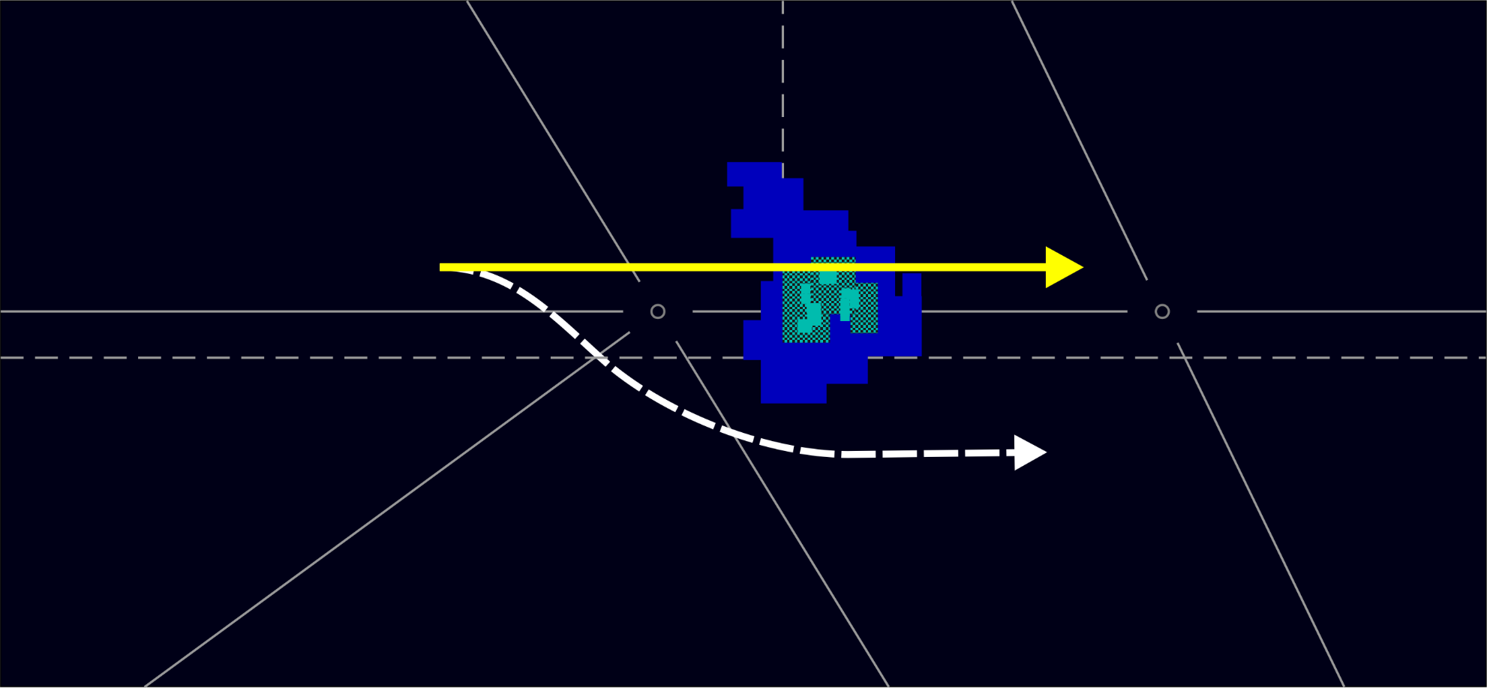
Side Stream Handoff
A side stream handoff can be directed to a sector in an adjacent center that the aircraft’s flight plan does not enter
Facility A
Facility B
UAL26
310T195
526SIDE
Flight Plan Route
Weather
Deviation
Facility C

Slide 30
Field E Data Upon Handoff
Field E Data | Description
H-dd | H/O to sector within facility
HLdd | H/O to sector other facility, or from a STARS facility
HLLL | H/O to STARS
HLdL | H/O to sector within STARS
FAIL | H/O is failing
MISM | Mismatch in target position between two facilities
DATA | An interfacility handoff where either or both the handoff origin facility or the handoff receiving facility does not have radar data for the flight and a paired track is not established
OLD | Crosstell track data has timed out
NONE | Track has an assigned beacon code, and a beacon code is not received
SIDE | Warning to both the initiating and receiving controller that an interfacility (ARTCC to ARTCC) handoff is a side stream handoff. The SIDE indicator is displayed starting when the handoff is initiated and will continue to flash and time share with handoff accept information for a locally adapted period of time.

Slide 31
Knowledge Check
What does DATA appearing in Field E of data blocks indicate?
  There is a discrepancy in the target position between
  the two facilities
  Track is being handed off intercenter or from a STARS facility
  The handoff origin and/or receiving facility does not
  have radar data for this flight

Slide 32
Knowledge Check
What does FAIL appearing in Field E of the data block indicate?
  Handoff was unsuccessful
  Transponder failed
  Radar is inoperative

Slide 33
Accepting Handoff
No function key entry required
  Syntax: <FLID>
  Examples: UAL26
  526
Before:
After:
UAL26
310C
526O-40
UAL26
310C
526H-40
UAL26
310C
526 451
UAL26
310C
526 451
R
R

Slide 34
Accept Handoff - QZ Command
QZ command may be used in place of QN command
  Syntax: QZ <FLID>
While accepting a handoff, the QZ command may also modify flight plan data by:
  Assigning an altitude
  Offsetting a data block
  Offsetting a data block and assigning an altitude

Slide 35
Retract Handoff
No function key entry required
Examples: UAL26
  526
Before:
After:
UAL26
310C
526 451
UAL26
310C
526 451
UAL26
310C
526O-55
UAL26
310C
526H-40

Slide 36
Automatic Handoff
UAL26
310C
526 410
UAL26
310C
526 410
UAL26
310C
526 410
UAL26
310C
526H-40
UAL26
310C
526 410
Route
Adapted Handoff Point
Sector Boundary

Slide 37
Auto Handoff Command
Enable or Inhibit Handoff | Examples
Flight | QA AAL123
Sector | QA 34
STARS Facility | QA ABC
ARTCC | QA M
Multiple Sectors or Facilities | QA 34 ABC M

Slide 38
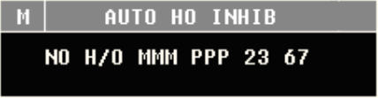
Auto Handoff Inhibit View

Slide 39
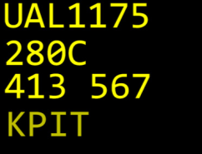
Caret Symbol
A white caret “^” is displayed left of Field D and the Portal Fence when auto handoff is inhibited
Auto Handoff Inhibit
DAL324
310C
543 400
KPIT

Slide 40
Knowledge Check
What letter is displayed in Field E when a handoff has been initiated?
  O
  H
  K

Slide 41
Knowledge Check
Where does a caret “^” appear when a specific aircraft has been inhibited for automatic handoff?
  Above the second character of Field A in a data block
  Left of the Portal Fence and Field D
  Right of the last character of Field E

Slide 42
Knowledge Check
An aircraft is eligible for automatic handoff if it is in _______ Track.
  Flat
  Free
  either Flat or Free

Slide 43

Point Out Procedures
“POINT OUT, TWO ZERO MILES NORTHWEST OF TAYLOR, DELTA TWENTY-TWO TEN, CLIMBING TO FLIGHT LEVEL THREE FIVE ZERO, DIRECT CRAIG”
“DELTA TWENTY-TWO TEN, POINT OUT APPROVED, P-J”
“R-W”
P
DAL2210
350 321
260 407
Sector 1
Sector 2

Slide 44
Knowledge Check
After a flight has been pointed out, which controller is responsible for subsequent point outs?
  Initiating
  Receiving
  Both initiating and receiving

Slide 45
Initiate Automated Point Out
QP Command
  Example: QP 77 260
  Point out sent to sector 77
Sector 77
Before:
After:
P
DAL2210
330 321
260 407
R
DAL2210
321

Slide 46
FDB Automated Point Out Indicator -Initiating Sector
Sector 88 Situation Display after sector 30 acknowledged SWA505 point out
Sector 30
PO Initiated
P
DAL2210
350 321
260 407
SWA547
330C
122 451
A
PO Acknowledged
R
SWA505
310 293
125 433
Sector 88

Slide 47
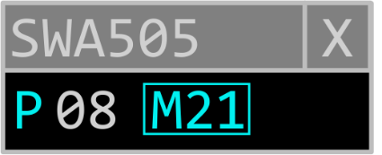
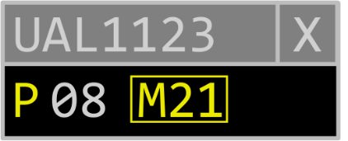
FDB Initiating Sector Pop Up
Radar controller may display a pop up with all sectors receiving the point out
Sector Acknowledged PO
Unacknowledged PO
P
UAL1123
310C
266 450

Slide 48
ACL Automated Point Out Indicator - Initiating Sector
When a point out is initiated, the initiating sector’s ACL will display a yellow “P” followed by the receiving sector identification inside a box, both in yellow
When the point out is acknowledged by the receiving sector, the “P” and the sector ID will change to white and the box is removed
Acknowledged Point Out
Unacknowledged Point Outs

Slide 49
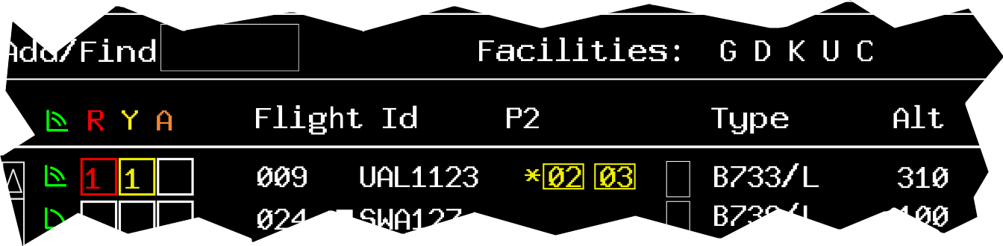
ACL Point Out Column
Up to five sectors can be displayed in the point out column
When point outs exceed the set value, an asterisk “✱” will display instead of the “P”
PO Column Header
Asterisk

Slide 50
FDB Automated Point Out Indicator - Receiving Sector
Sector 30 Situation Display after receiving automated point outs from sector 88
Sector 30
P
DAL2210
350 321
260 407
R
SWA547
330C
122 451
P
SWA505
310 293
125 433
R
Sector 88

Slide 51
FDB Receiving Sector Pop Up
Radar controller may acknowledge point out(s)
Acknowledged PO
Sector Initiating PO
P
SWA505
310 293
125 433
R

Slide 52
ACL Automated Point Out Indicator - Receiving Sector
When a point out is received, the ACL will display a cyan “P” followed by the initiating sector identification inside a box, both in cyan
Unacknowledged Point Outs
Acknowledged Point Out

Slide 53
Acknowledge Point Out Command (QP)
QP A command can be used to acknowledge a point out
  Syntax: QP A <FLID>
Multiple point outs of the same aircraft must be acknowledged individually by adding a specific sector ID to the QP A command
  Syntax: QP A <sector ID> <FLID>

Slide 54
Knowledge Check
What is the status of the point outs to sectors 02 and 03?
  02 has acknowledged point out and 03 has not
  03 has acknowledged point out and 02 has not
  03 has acknowledged point out and a point out is planned for 02

Slide 55
Knowledge Check
What does it mean when an asterisk is displayed in the point out column?
  There are no point outs
  Automated point out failure
  Point outs exceed the set value of the column

Slide 56
Knowledge Check
Will acknowledging a point out remove the pointed out FDB from the Situation Display?
  Yes
  No

Slide 57
Knowledge Check
Which is a command to point out an FDB to multiple sectors?
  QP 30 T21 15 978
  QP 978 30 T21 15
  QP 30 978 T21 15

Slide 58
Part-Task Exercise
Purpose
  Perform Radar Handoff and Point Out tasks as follows:
    Managing FDB Fourth Line Data
    Handoff Procedures
    Handoff and Point Out Command Entries
Materials
  TTL part-task exercise: Radar Handoff and Point Out
Directions
  This exercise takes approximately 30 minutes to complete. Each student must complete the checklist tasks. No headsets are required.

Slide 59
Lesson Summary
This lesson covered:
  Terminology for transferring radar identification
  Handoff and point out methods
  Handoff procedures
  Handoff command entry
  Point out procedures
  Point out command entry

Slide 60
The End

