Slide 2
Altitude reporting transponder and ADS-B requirements
Characteristics of the National Beacon Code Allocation Plan
Beacon code requirements
Beacon code commands

Slide 3
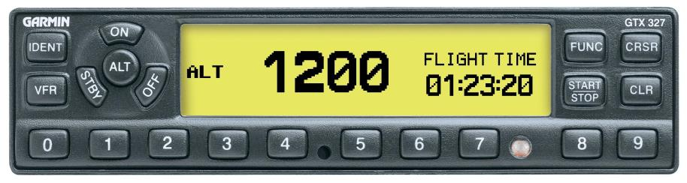
Transponder and ADS-B Out Requirements
Some aircraft must be equipped with a transponder and/or Automatic Dependent Surveillance-Broadcast (ADS-B) Out equipment

Slide 4

Operations Requiring Transponder
Requirements apply to all aircraft operating:
Above the ceiling and within the lateral boundaries of Class B or C airspace designated for specific airports up to 10,000’ MSL
In Class A, B, and C airspace
Within 30 miles and from the surface up to 10,000’ Mean Sea Level (MSL) of specific airports
Gliders and balloons may operate outside of Class A, B, or C airspace within 30 miles if they meet specific criteria
In all airspace of the 48 contiguous states and the District of Columbia at and above 10,000’ MSL:
Excluding airspace at and below 2,500’ Above Ground Level (AGL)
Unless a glider or balloon

Slide 5

Operations Requiring ADS-B Out
Requirements apply to all aircraft operating:
In Class A, B, and C airspace
Within 30 miles and from the surface up to 10,000’ MSL of specific airports
Gliders and balloons may operate outside of Class A, Class B, or Class C airspace within 30 miles if they meet specific criteria
Above the ceiling and within the lateral boundaries of Class B or C airspace designated for a specific airport up to and including 10,000’ MSL
Class E airspace within the the 48 contiguous states and the District of Columbia at and above 10,000’ MSL, excluding airspace at and below 2,500’ AGL
Unless a glider or balloon
In Class E airspace at and above 3,000’ MSL over the Gulf of Mexico from the coastline of the U.S. out to 12 miles

Slide 6
Inflight Deviation Requests
For VFR aircraft with an inoperable transponder or Mode C, or not equipped with Mode C, suggest that the aircraft do one of the following:
Conduct flight in airspace not affected by 14 CFR Part 91.215
File an IFR flight plan
Provide a VFR route of flight and maintain radio contact with ATC
Must be made to the ATC facility having jurisdiction over the concerned airspace

Slide 7

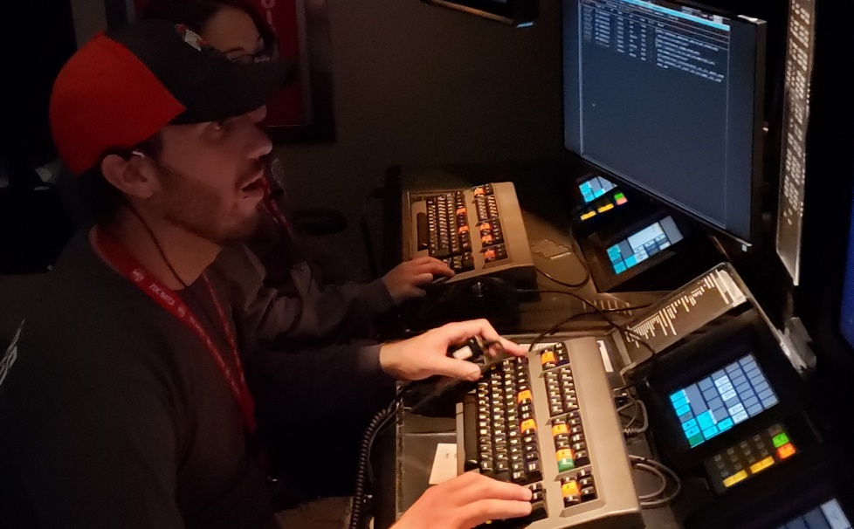
Inflight Deviation Requests (Cont’d)
“TAYLOR LOW APREQ, BONANZA TWO THREE TANGO INOPERATIVE TRANSPONDER AND MODE C, ONE SEVEN THOUSAND”
“APPROVED AS REQUESTED, BC”

Slide 8

Failed Transponder or ADS-B Out
“NOVEMBER SIX SIX KILO GOLF OUR TRANSPONDER HAS FAILED. REQUEST FLIGHT LEVEL TWO ONE ZERO.”
“NOVEMBER SIX SIX KILO GOLF, UNABLE YOUR REQUEST FOR FLIGHT LEVEL TWO ONE ZERO DUE TO PRIMARY RADAR OUTAGE”

Slide 9
Knowledge Check
Transponder requirements apply to all aircraft operating in what classes of airspace?
Classes A, B, and C
Classes B, C, and D
Classes C, D, and E

Slide 10
Knowledge Check
An IFR aircraft has no transponder. The pilot declares an emergency and requests a deviation that will fly through Class A airspace. Can you approve this change?
Yes
No

Slide 11
National Beacon Code Allocation Plan
DISCRETE BEACON CODE - Any one of the 4096 selectable Mode 3/A aircraft transponder codes except, those ending in zero zero.
Examples: 0010, 1201, 2317, 7777
Nondiscrete BEACON code - Any one of the 4096 selectable Mode 3/A aircraft transponder codes ending in zero zero.
Examples: 0100, 1200, 7600, 7700

Slide 12
Code Assignment
Beacon Code assignment - Distribution of codes to specific facilities and special activities based on the National Beacon Code Allocation Plan.
EXTERNAL CODES - codes reserved for computer assignment to a flight plan with one or more route segments that are not contained within a single domestic ARTCC’s airspace.
INTERNAL CODES - codes reserved for computer assignment to a flight plan where all route segments are contained within a single ARTCC’s airspace.

Slide 13
Knowledge Check
Beacon codes that end in numbers other than zero zero are ___________ codes.
mixed
nondiscrete
discrete

Slide 14
Knowledge Check
How are discrete beacon codes assigned?
By pilot request
By the automation system
By the facility manager at each ARTCC

Slide 15

Assignment Criteria
Assign beacon codes to only ADS-B and/or transponder equipped aircraft
Issue beacon codes assigned by the computer

Slide 16
Assignment Criteria – Code 4000
Code 4000 should be assigned when
Operating on a flight plan specifying frequent or rapid changes in assigned altitude in more than one stratum or other category of flight not compatible with a discrete code assignment

Slide 17
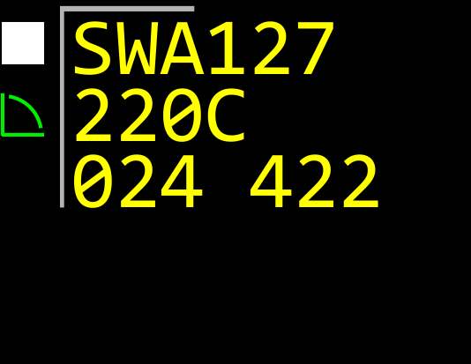

Code Changes
Do not request an aircraft change from the code it is squawking in the transferring facility’s area of responsibility, unless:
Specified in an LOA, or
Coordinated at the time of handoff

Slide 18



Beacon Code Procedures During an Emergency
Assign code 7700 when pilot declares emergency and is not radar identified
After radar contact established, request aircraft to change from 7700 to appropriate code
SWA127
220C
024EMRG
SWA127
330C
024EMRG
SWA127
330C
024EMRG

Slide 19
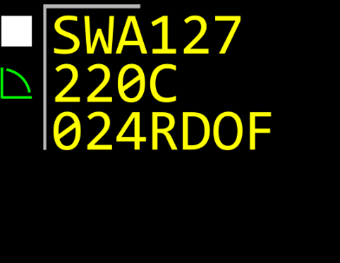
Radio Failure
If two-way communication is lost, pilot will squawk code 7600
RDOF blinks in the data block
If an aircraft is hijacked, it may squawk code 7500
Controller must apply lost communications procedures
If radio communications have not been (re)established with the aircraft after 5 minutes, consider the aircraft’s activity to be suspicious

Slide 20

Unmanned Aircraft Systems (UAS) Lost Link
Code 7400 may be displayed by UAS when control link between aircraft and operator is lost
Determine lost link procedure as outlined in Special Airworthiness Certificate or Certificate of Waiver or Authorization (COA)

Slide 21

Hijacked Aircraft
If an aircraft is hijacked, it may squawk code 7500
HIJK blinks in data block
Use normal flight following and handoff procedures
ATC must honor clearance requests, traffic conditions permitting
If necessary, aid escort aircraft into position

Slide 22
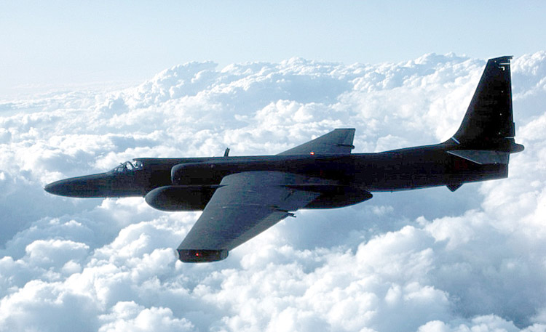

Pressure Suit Flights and Flights above FL600
Code 4400 and discrete codes 4440 through 4465 are reserved for use by:
Pressure suit flights
Aircraft operations above FL600

Slide 23
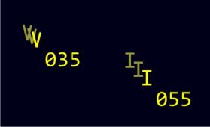


VFR Code Assignments
Assign appropriate function or computer-assigned codes to VFR aircraft receiving radar advisories

Slide 24

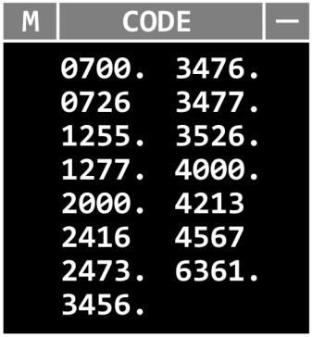
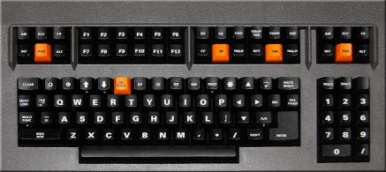

Code Monitor Requirements
Continuously monitor beacon codes applicable to your area of operation or operations in adjacent airspace
1200.
1202.
1255.
1277.
4000.
Manually inserted code

Slide 25
Knowledge Check
Assign beacon codes to _______ equipped aircraft only.
transponder and ADS-B
transponder and ADS-D
transponder

Slide 26
Knowledge Check
What is the beacon code for hijacked aircraft?
7300
7400
7500

Slide 27
Knowledge Check
What aircraft use beacon code 1200?
Military aircraft during pressure suit flights
VFR aircraft not being provided services by an ATC facility
All aircraft flying above FL600

Slide 28
Code Insert or Delete
QB either typed or inserted by pressing CODE button
Syntax: QB dddd
Manually inserted code

Slide 29


Discrete Code Request
Syntax: QB <FLID> (/FLID) (/FLID)
Up to three flight IDs can be entered in one command
Beacon code cannot be a FLID
Syntax: DQ <FLID>
Single FLID only
or
or
(RA Position Only)

Slide 30
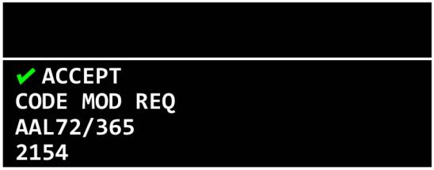
Discrete Code Request Results
System generates new code
New code appears in the MCA

Slide 31
Manual Code Assignment
Syntax: QB <code> <FLID>
FLID cannot be a beacon code
or

Slide 32
Equipment Qualifier Modification
or
Syntax: QB <equipment qualifier> <FLID> (/FLID) (/FLID)
Up to three flight IDs can be entered in one command, separated by a “/”
Beacon code cannot be a FLID

Slide 33
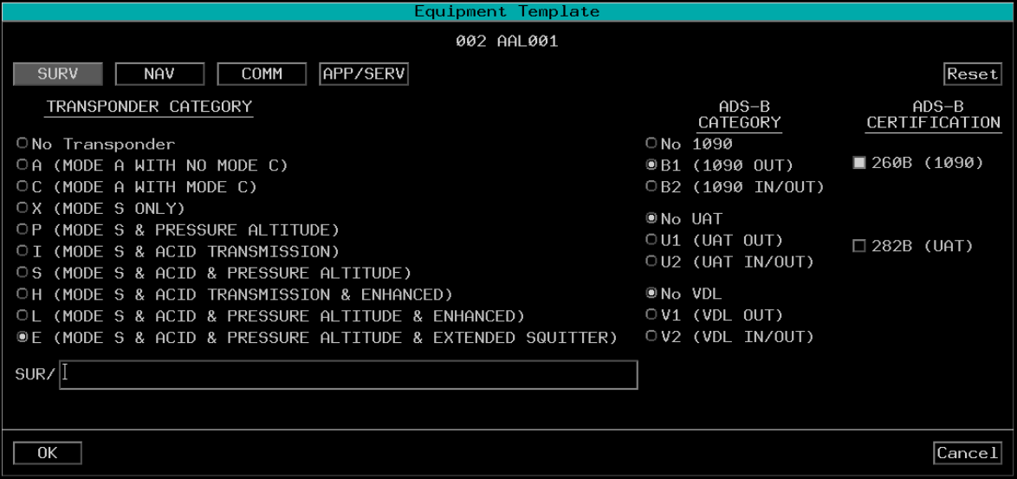
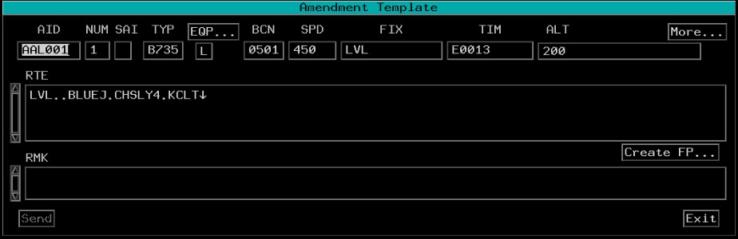
Equipment Template

Slide 34
Knowledge Check
Why should you use the Equipment Template to modify an aircraft’s equipment code?
Opens automatically when the CODE button is pressed
Ensures ICAO data is not inadvertently deleted or amended
Allows CPDLC command to be composed at the same time

Slide 35
Knowledge Check
To request a new beacon code for an aircraft, use the _______command.
BC <FLID>
QB <FLID>
QC <FLID>

Slide 36
Lesson Summary
This lesson covered:
Altitude reporting transponder and ADS-B Out requirements
Characteristics of the National Beacon Code Allocation Plan
Beacon code requirements
Beacon code commands

Slide 37
The End

