Slide 2
Creating a trial plan
Resubmitting an invalid trial plan
Sending an amendment or interim altitude
Graphic trial planning

Slide 3
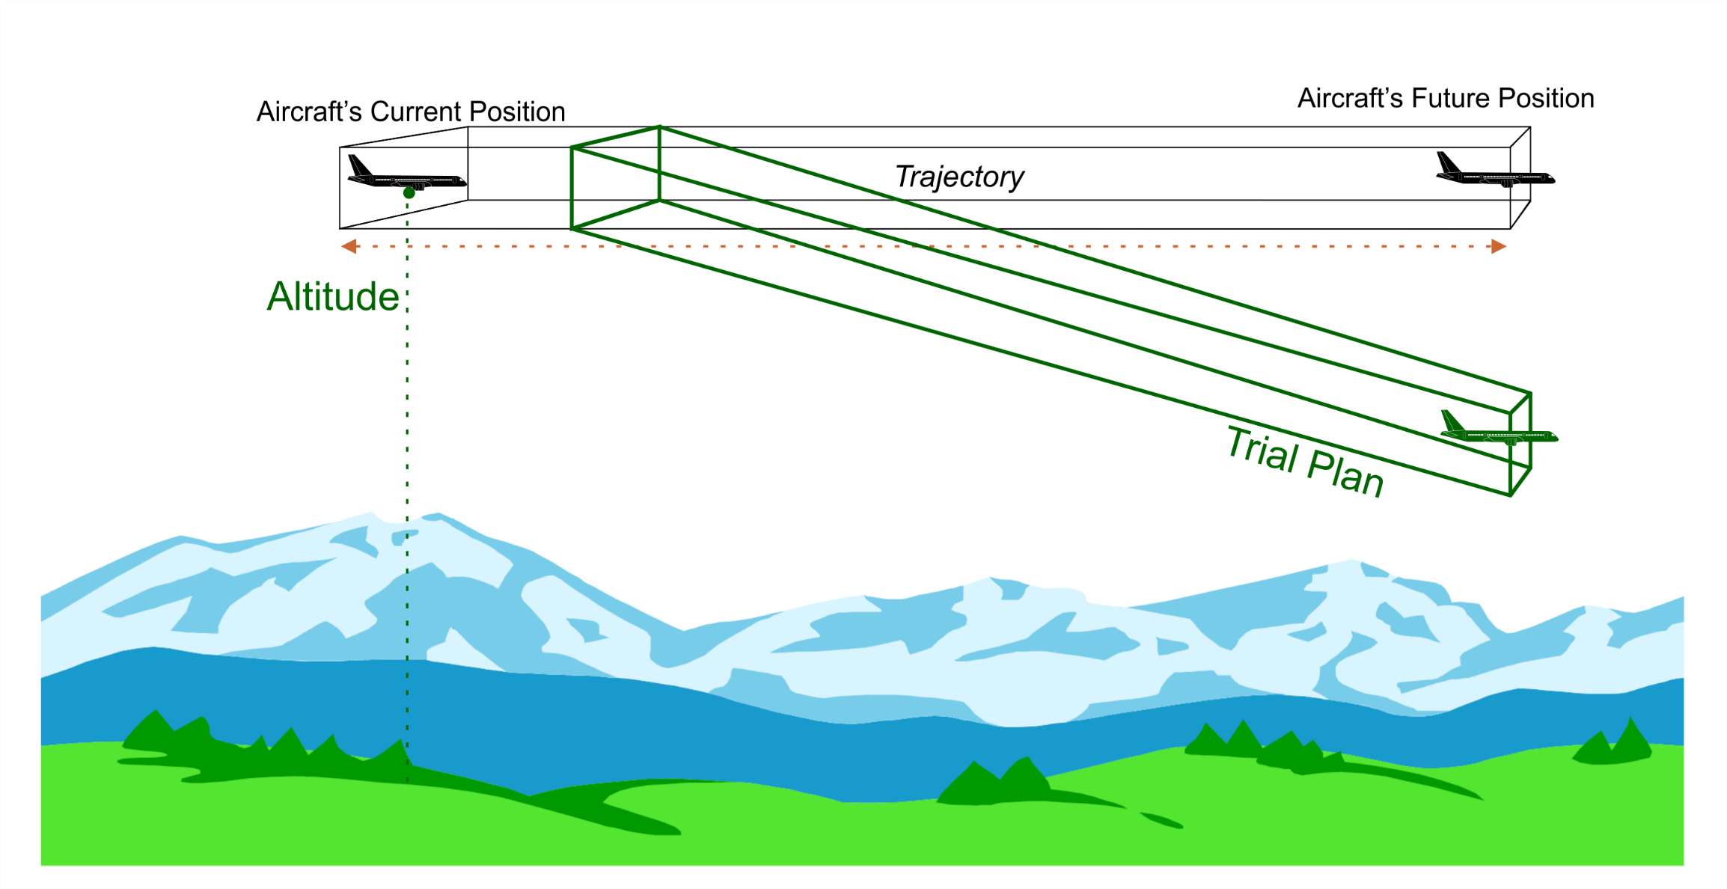
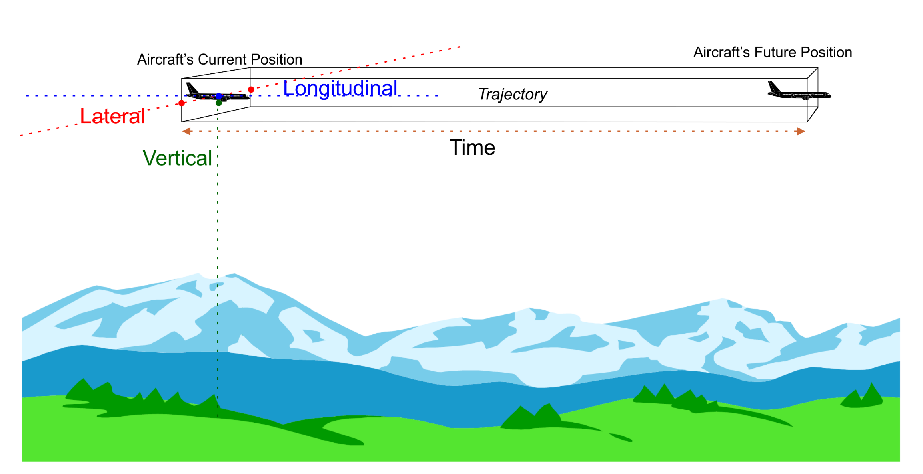

Trial Plans

Slide 4
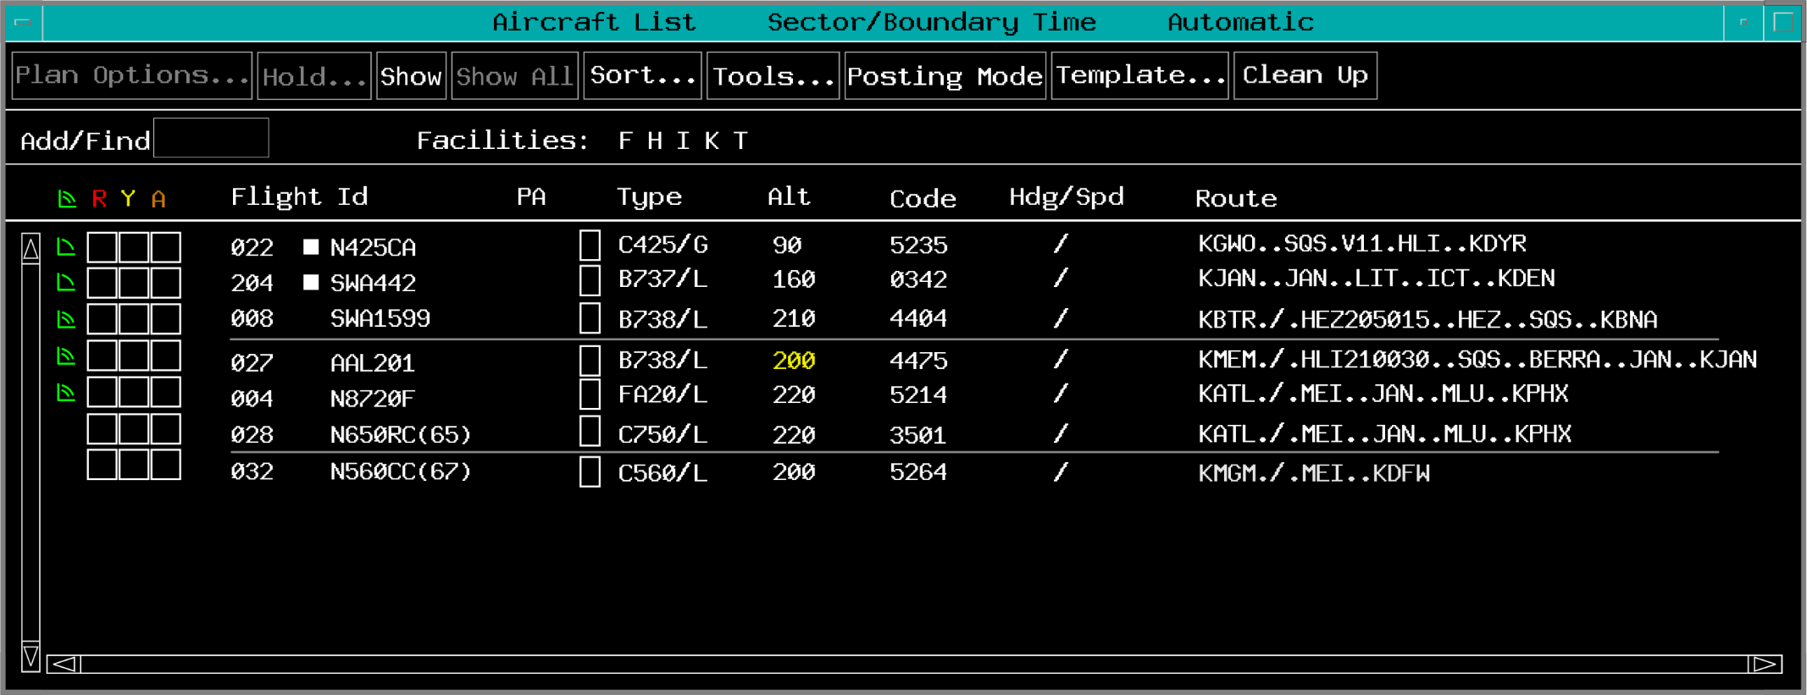
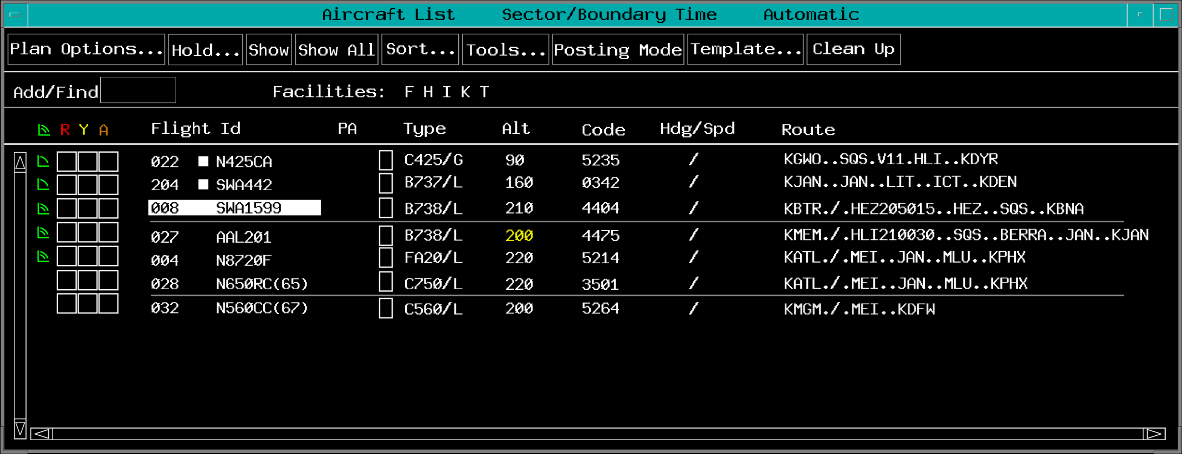
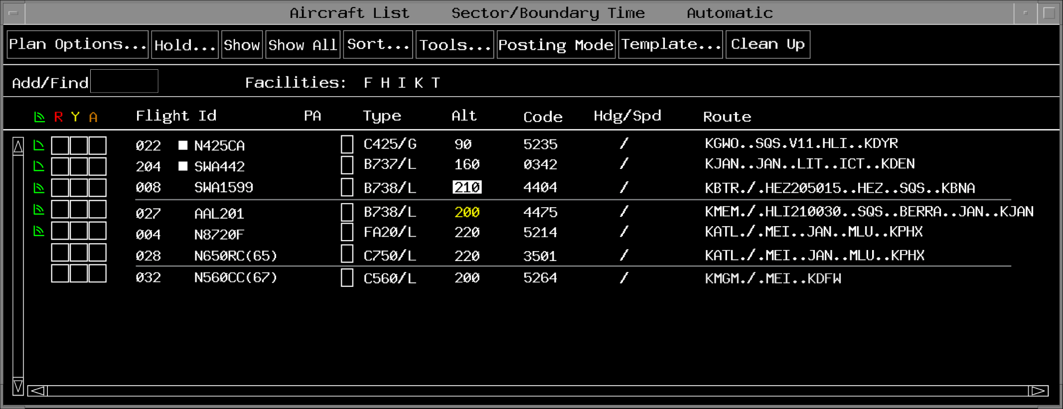
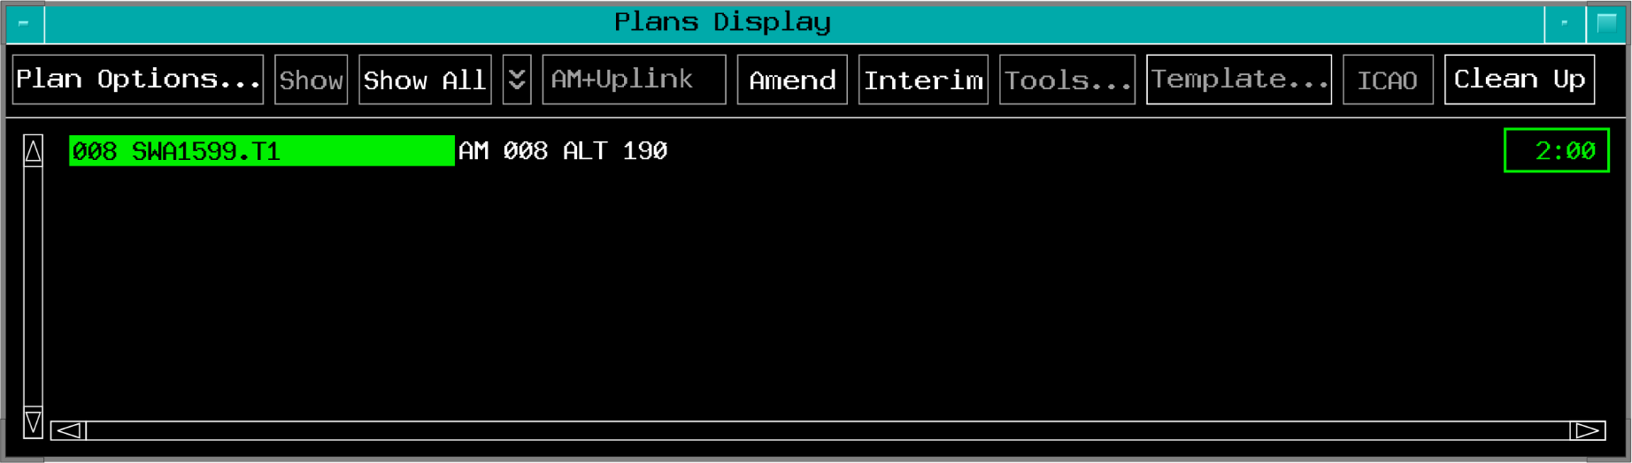
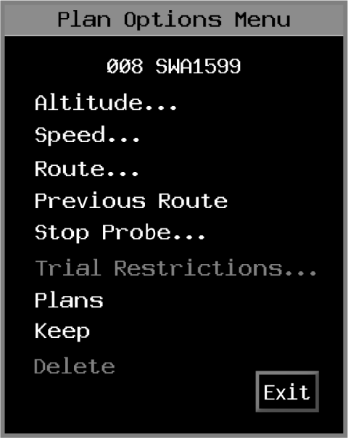
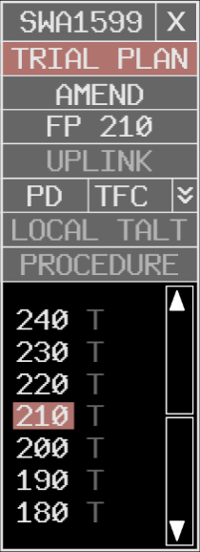
Altitude Trial Plan

Slide 5
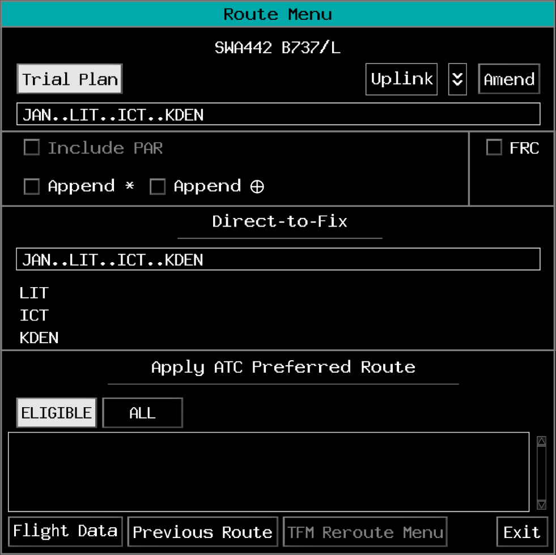

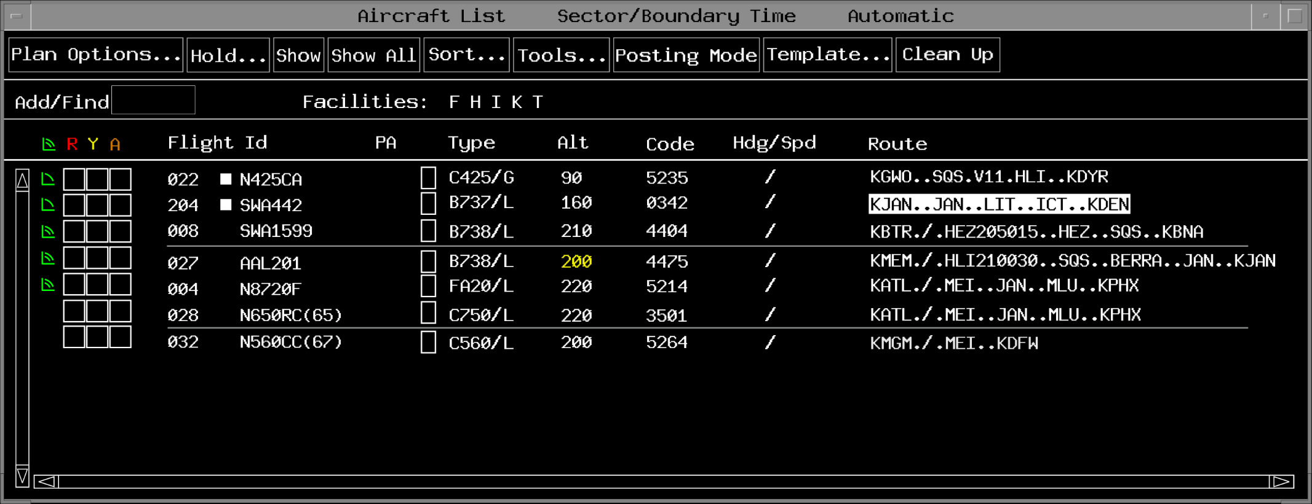
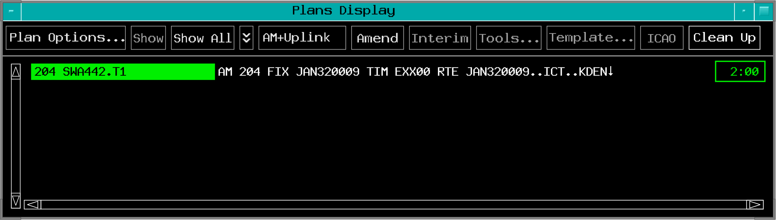
Route Trial Plan

Slide 6
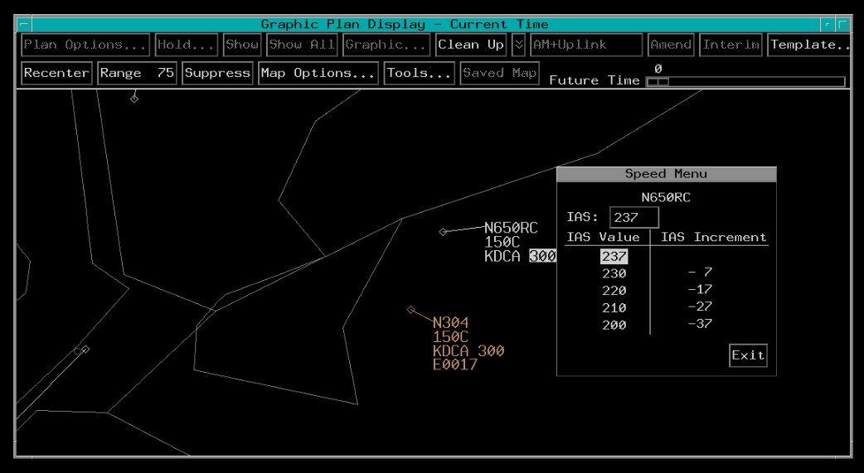
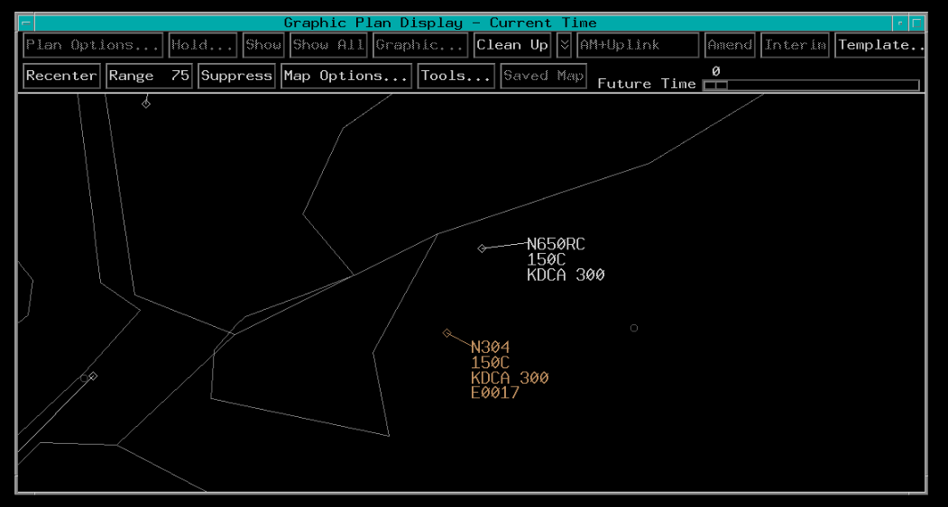
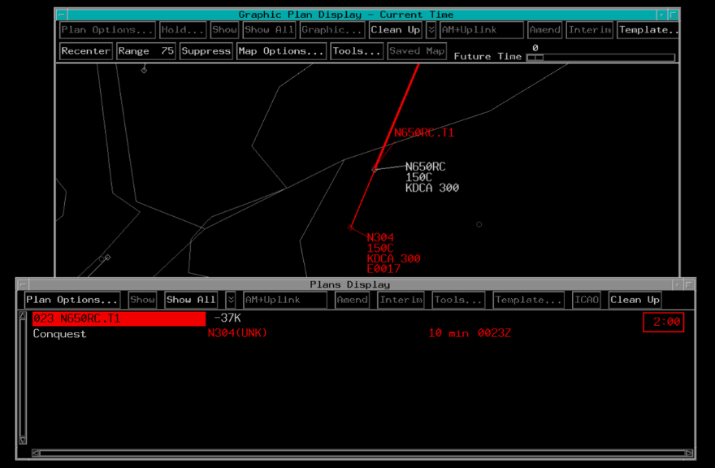
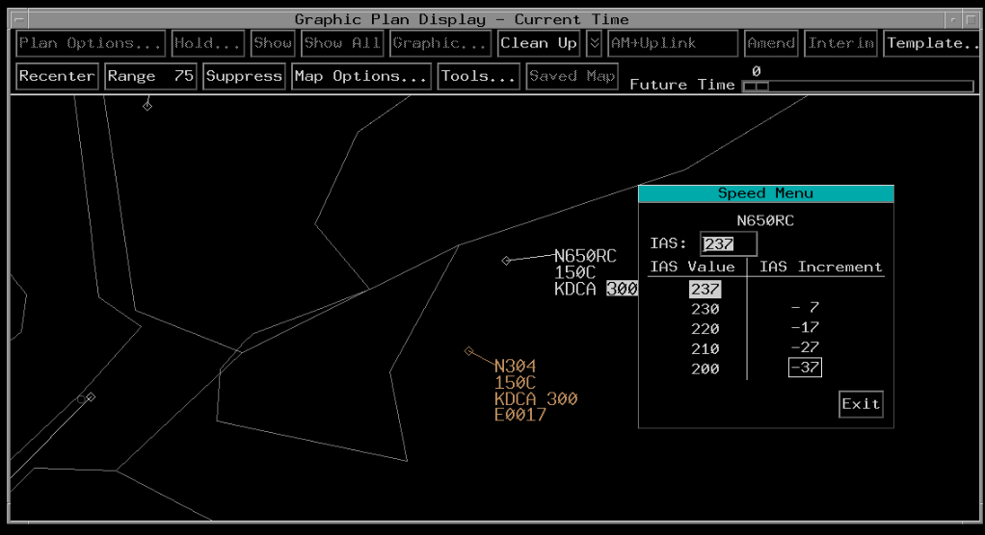
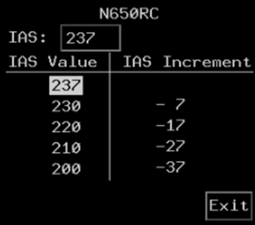

Speed Trial Plan
B

Slide 7
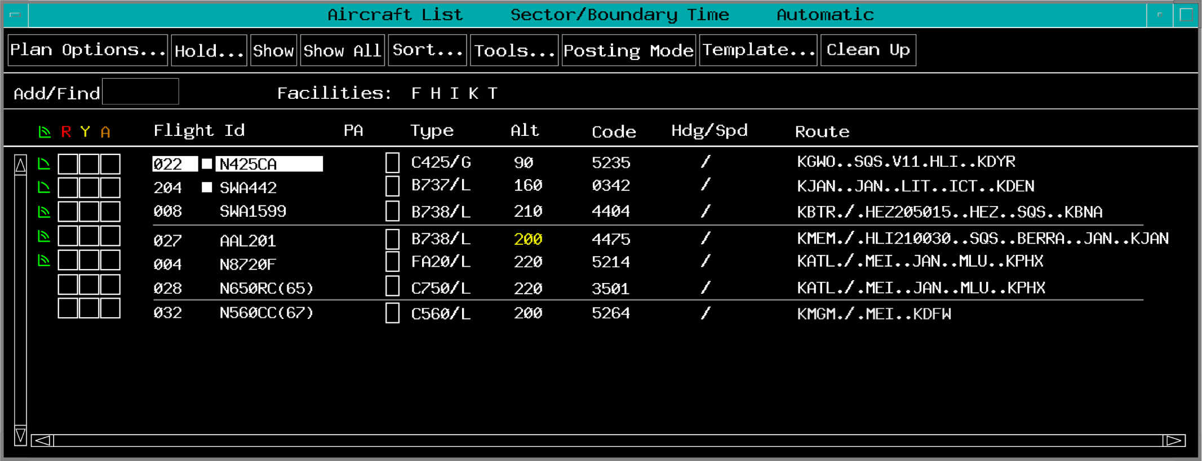
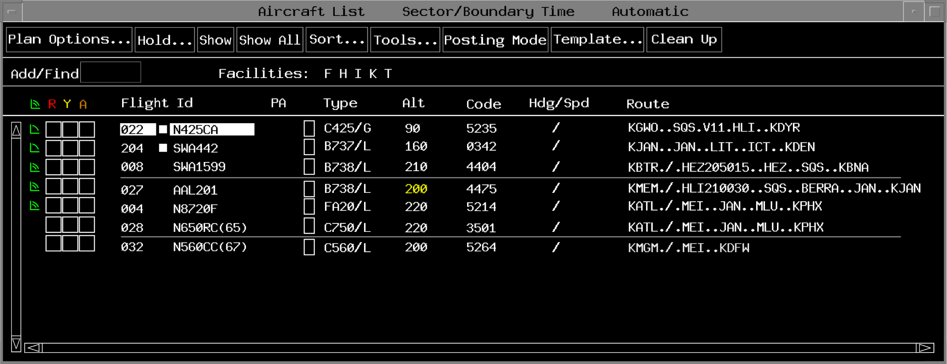
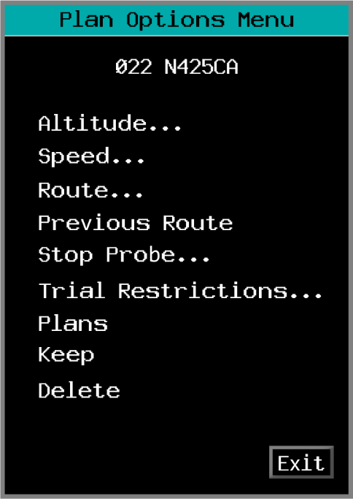
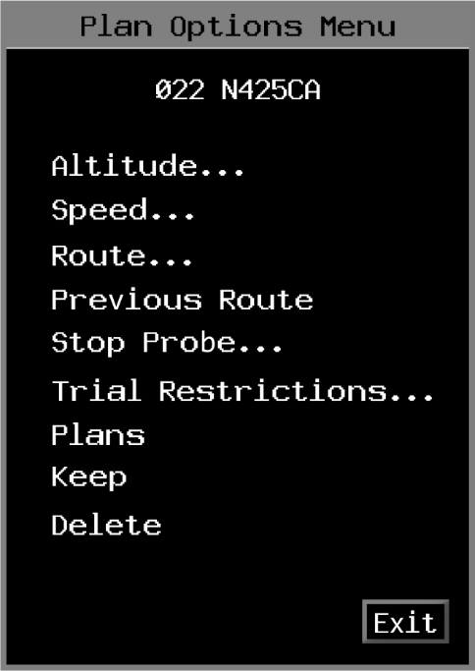
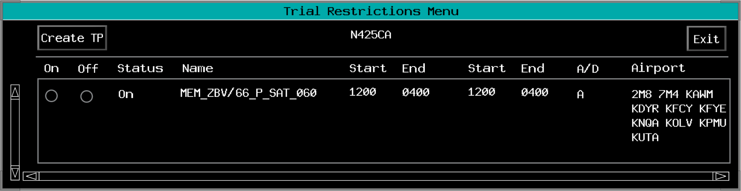
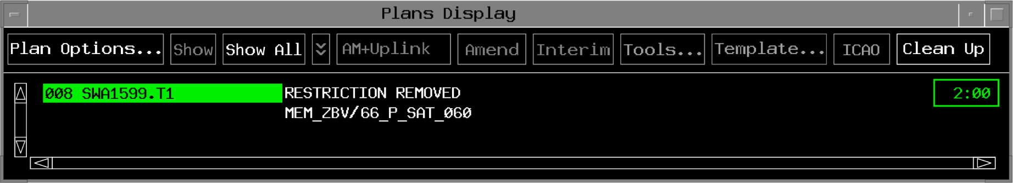
Restrictions Trial Plan

Slide 8
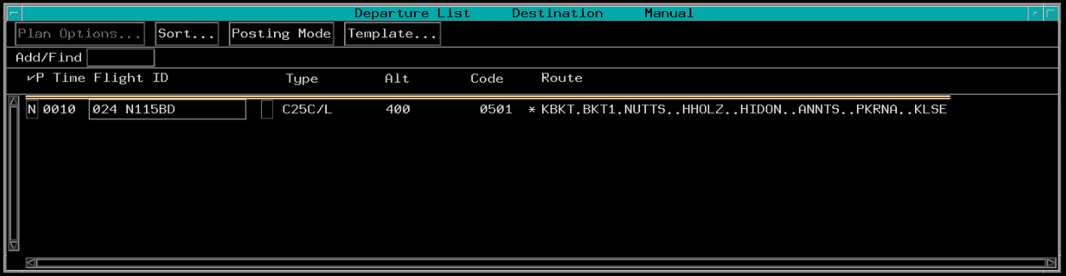
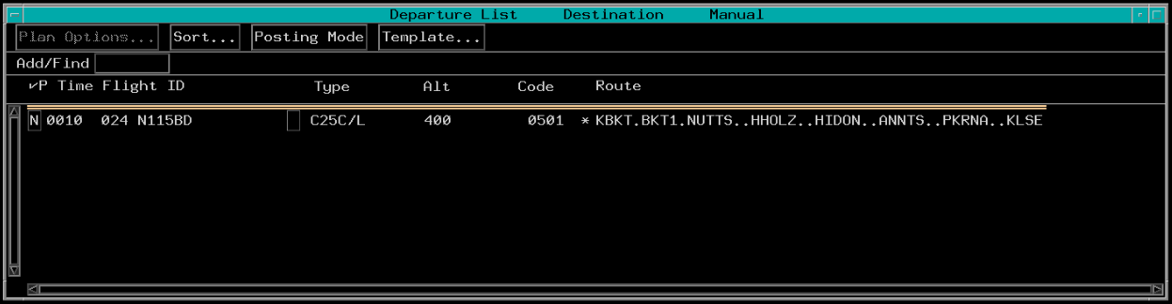
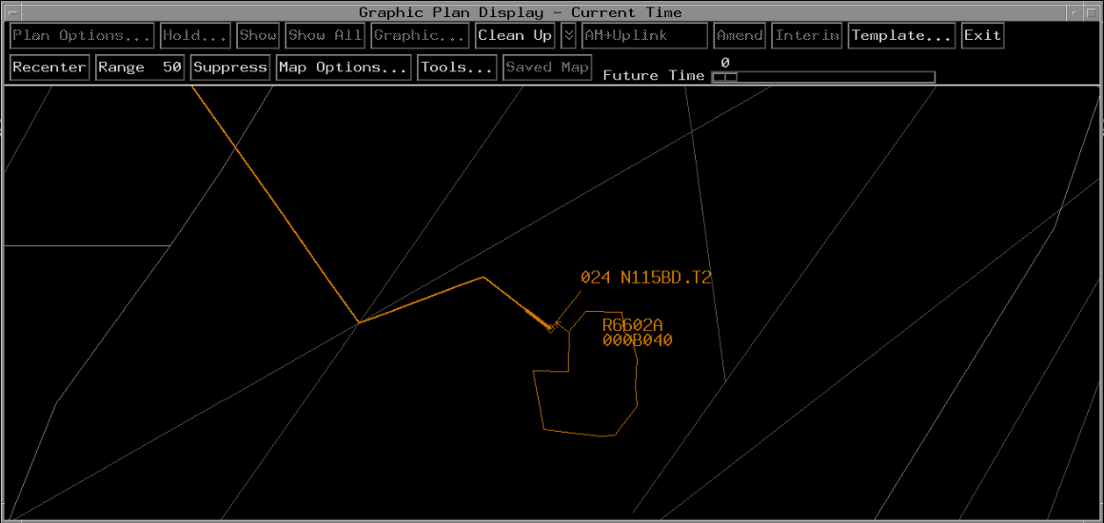
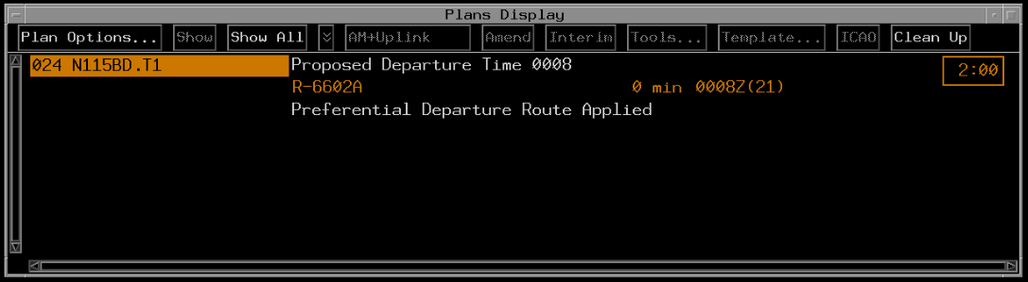
Departure Time - Implied

Slide 9
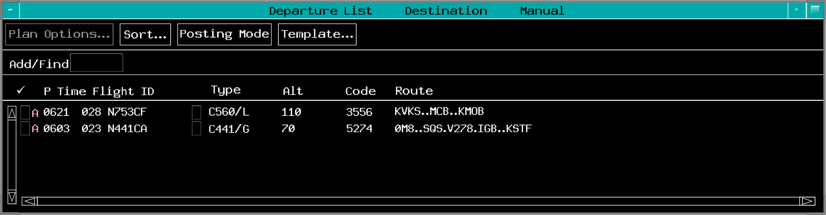
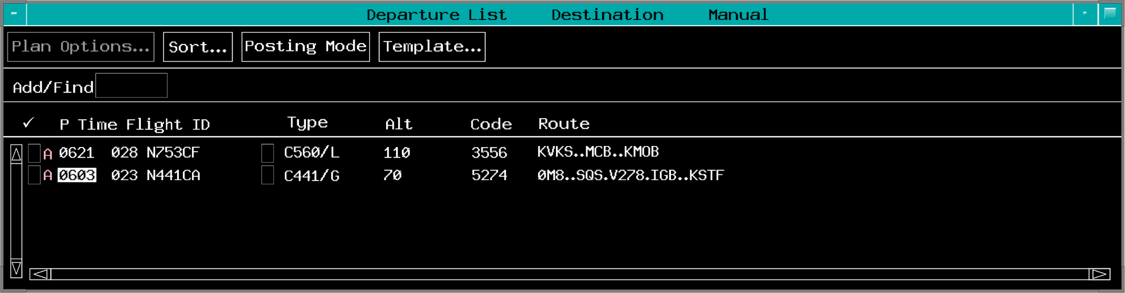
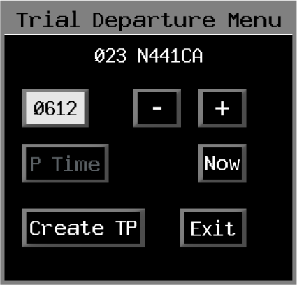
Departure Time - Trial Departure Menu
TBP Trial Departure Menu

Slide 10
Knowledge Check
How is a restriction trial plan created from the ACL?
TBP Trial Restrictions…>Flight ID>Plan Options…
TBP Flight ID>Plan Options…>Trial Restrictions
TBP Plan Options…>Trial Restrictions>Flight ID

Slide 11
Knowledge Check
How do you create a speed trial plan from the GPD?
TBP the Speed menu button
TBP the flight plan route
TBP speed in the GPD data block

Slide 12
Knowledge Check
What is the function of the “+” and “-” buttons on the Trial Departure Menu?
Add or subtract time from the current time
Move the flight entry up or down in the view
Raise or lower the requested altitude

Slide 13
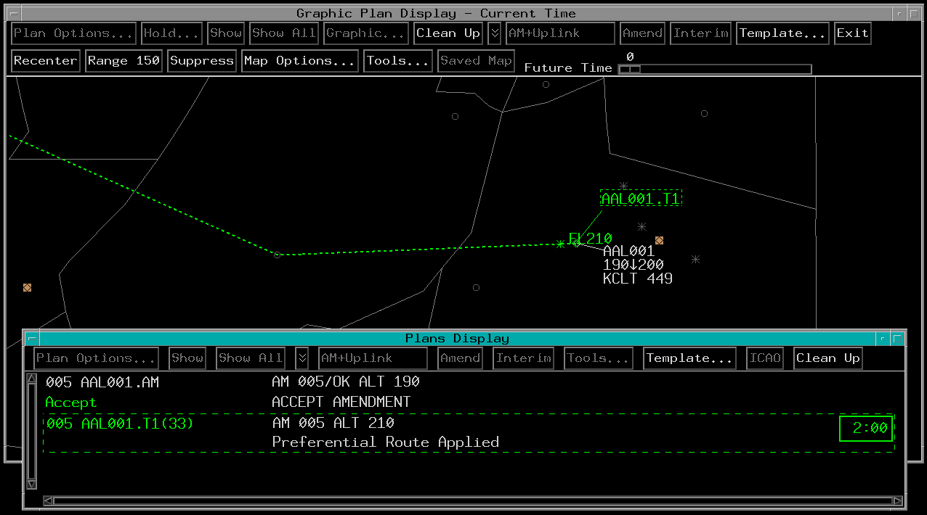
Invalid Trial Plan

Slide 14
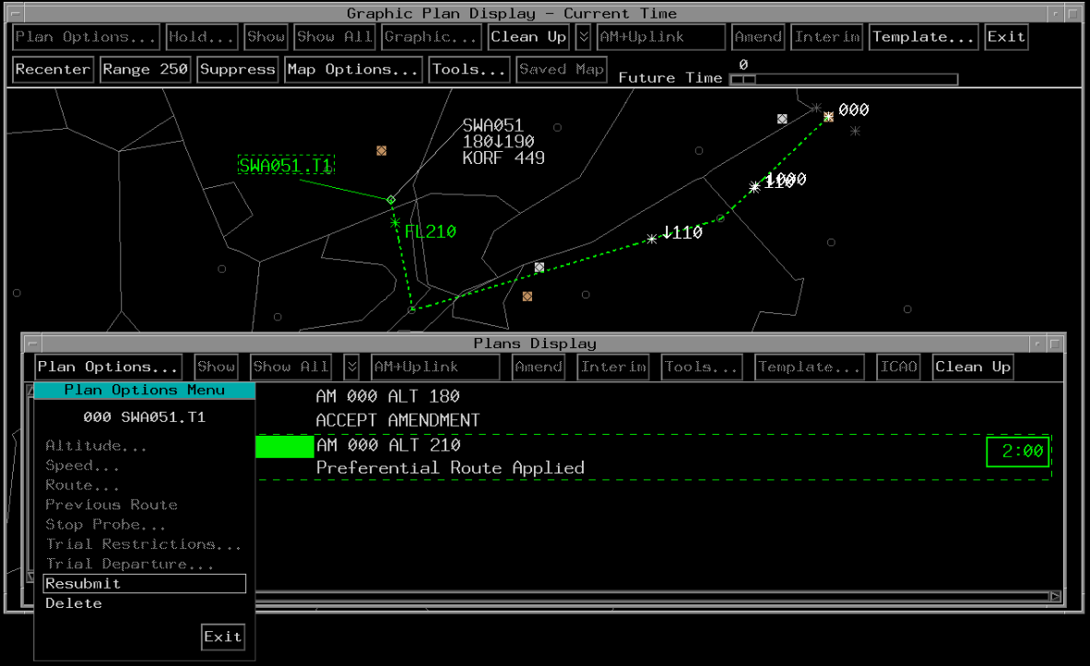
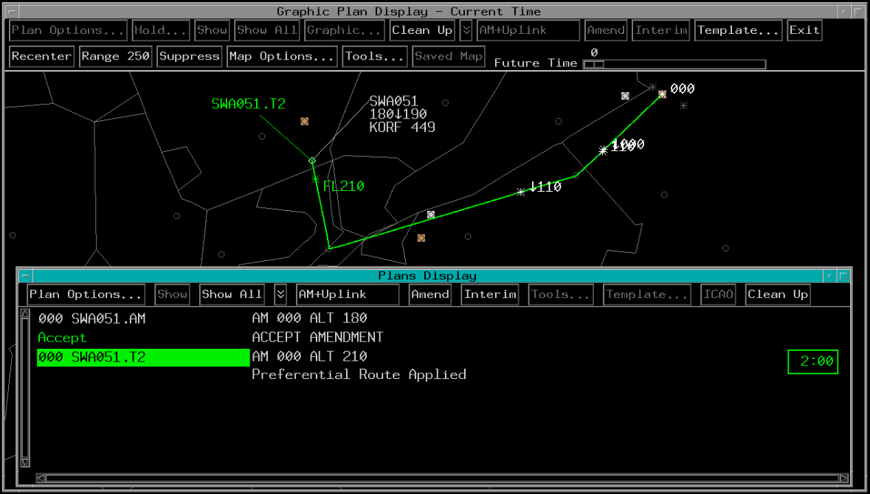
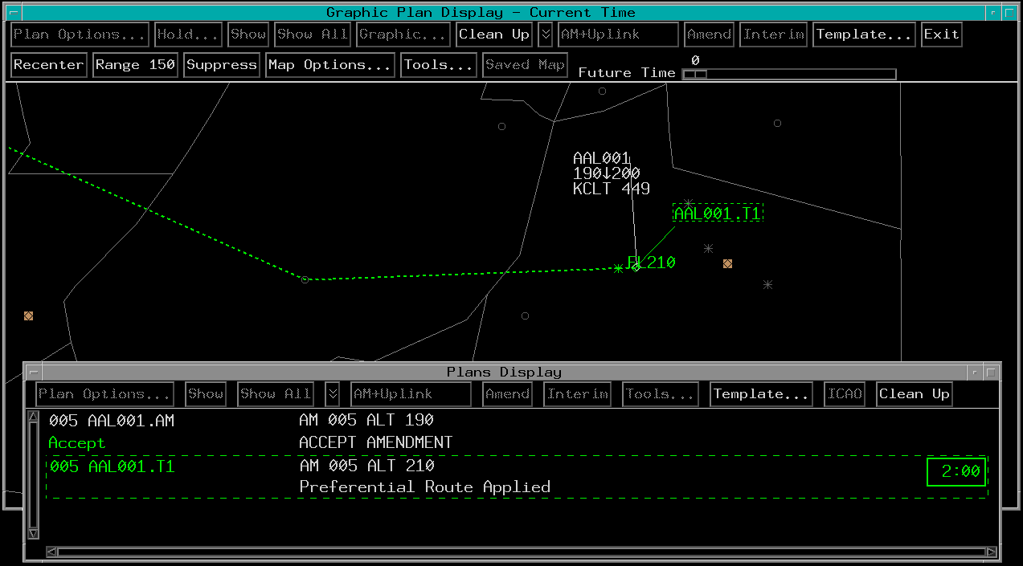
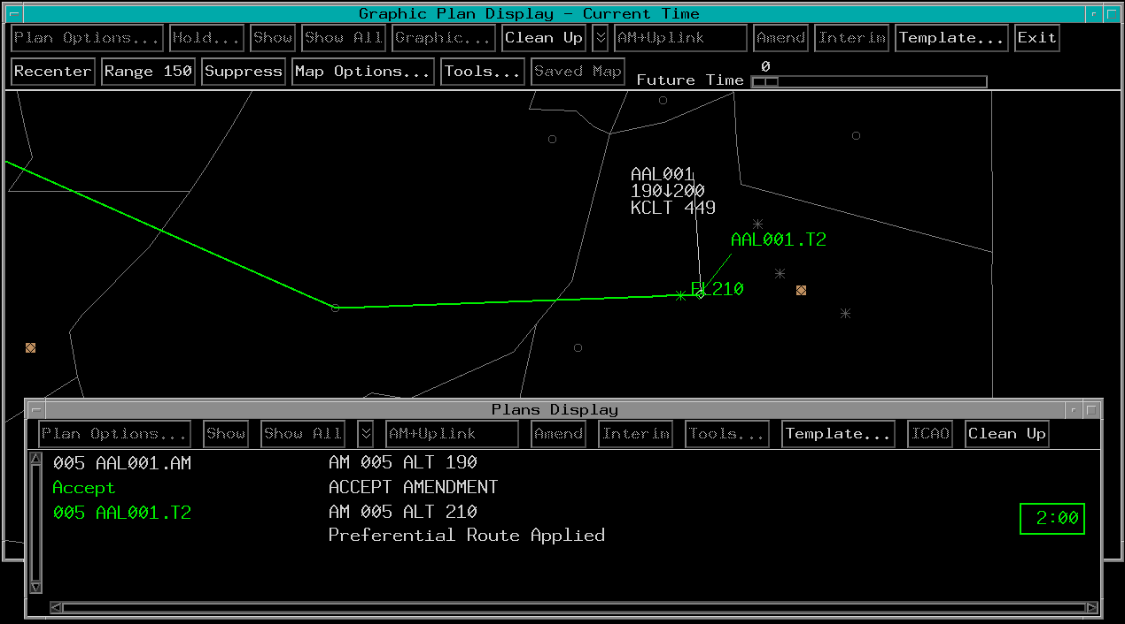
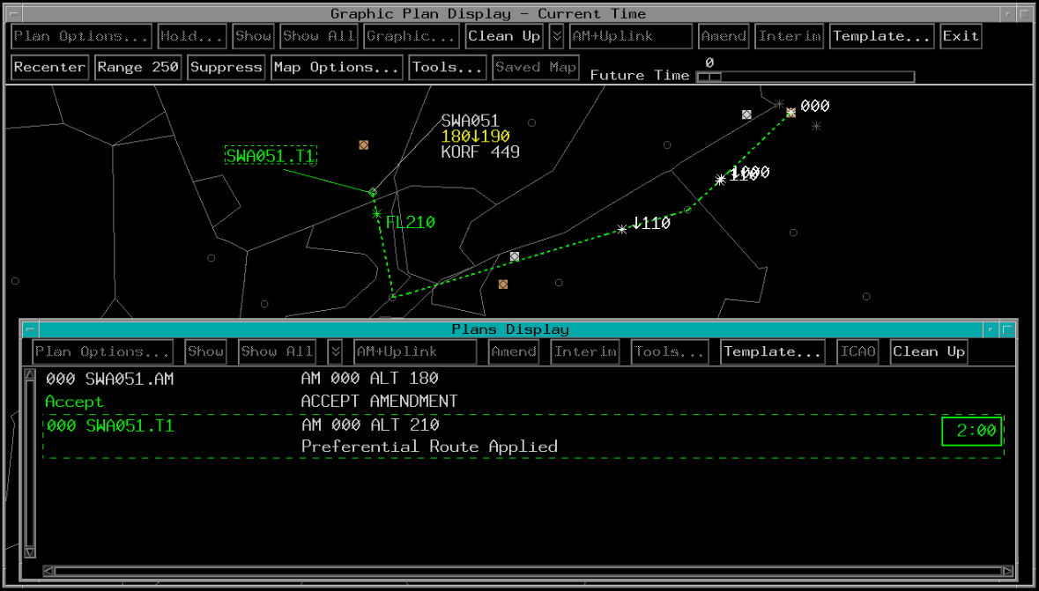
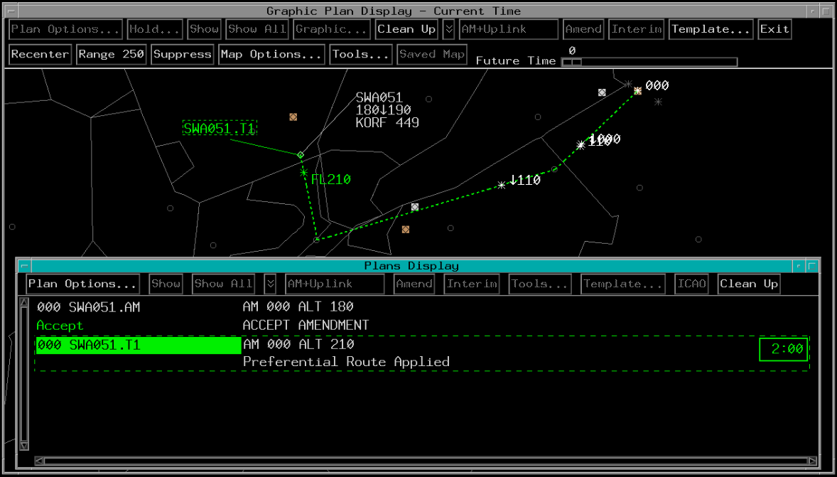

Resubmit Invalid Trial Plan
Implied Command (TBE Trial Plan ID)
Select Command (TBP)- Plans Display

Slide 15



Knowledge Check
Which trial plan ID shows invalid trial plan coding?
Xxx
Xxx
xxx

Slide 16
Knowledge Check
How do you resubmit an invalid trial plan?
TBP Plan Options…>Resubmit>Trial Plan ID
TBP Trial Plan ID>Plan Options…>Resubmit
TBP Invalid List>Trial Plan ID>Resubmit

Slide 17
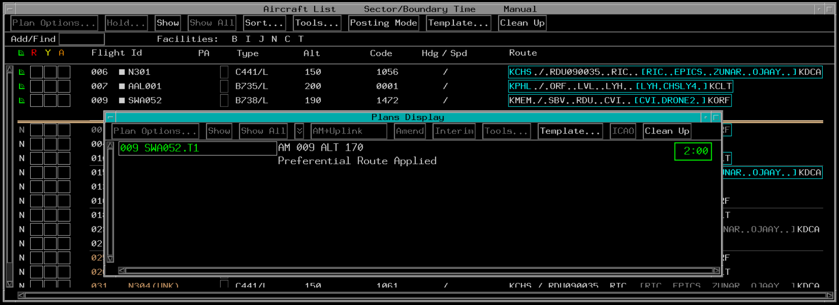
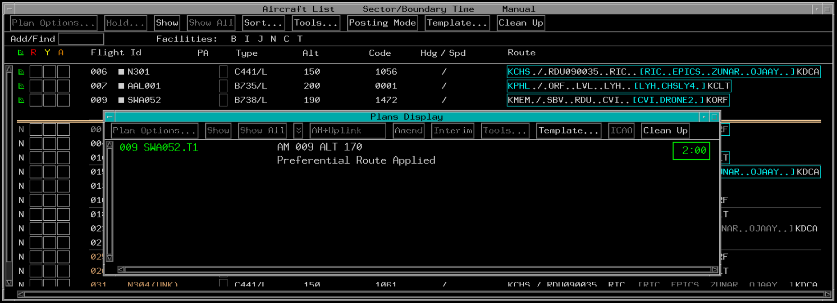
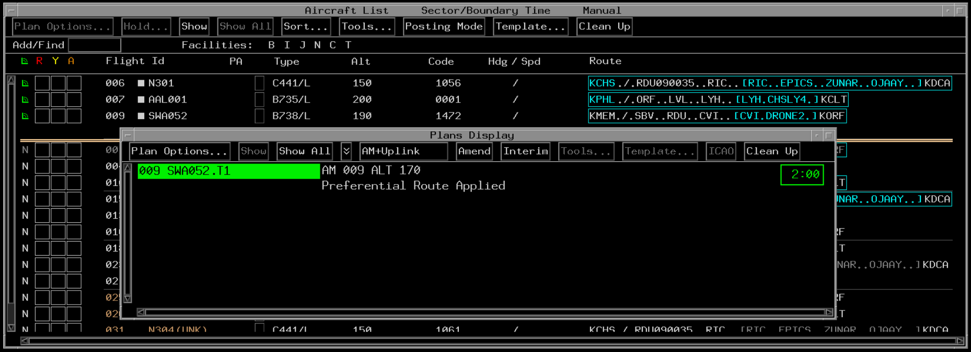
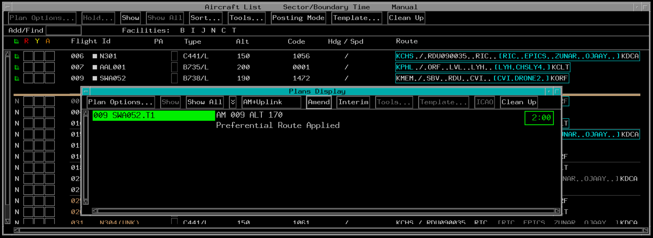
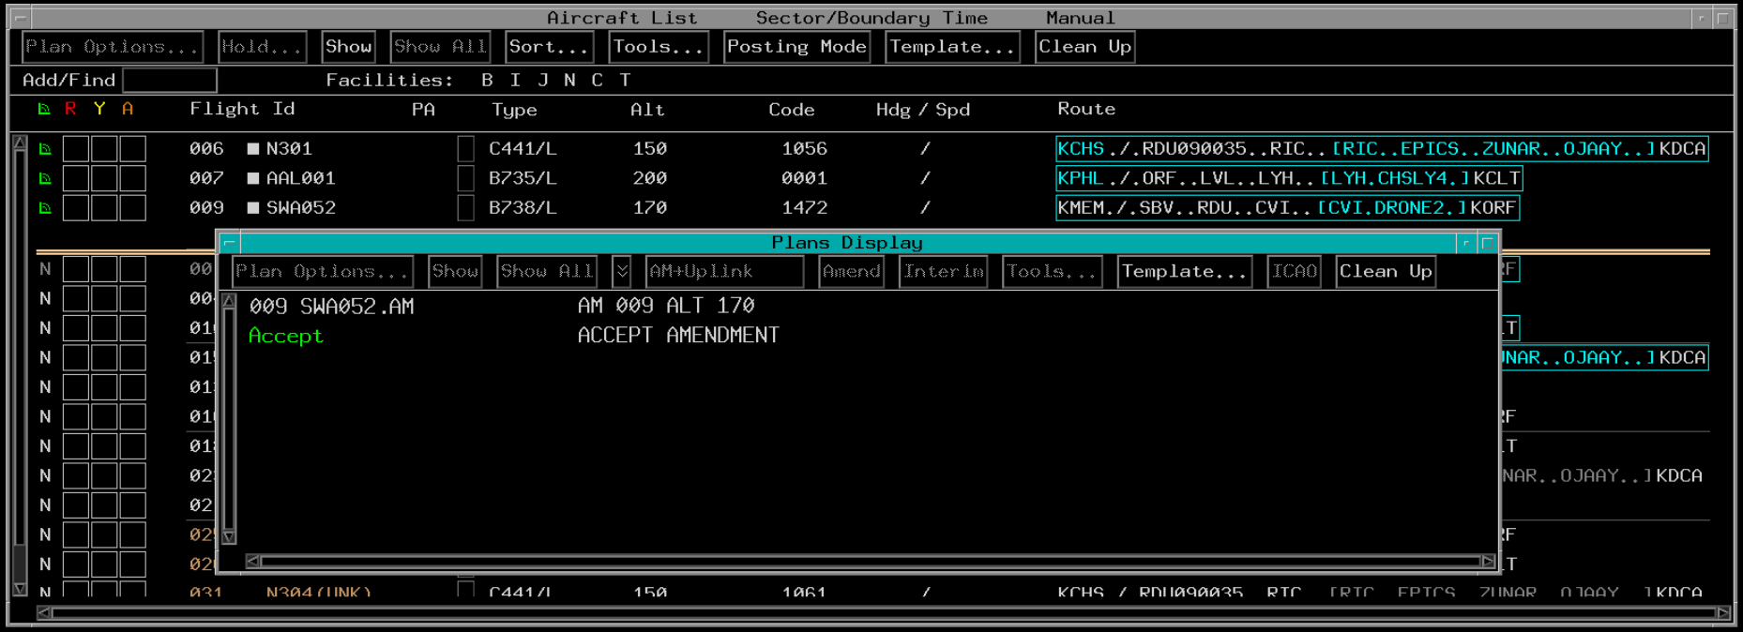
Amendment Trial Plan - Plans Display

Slide 18
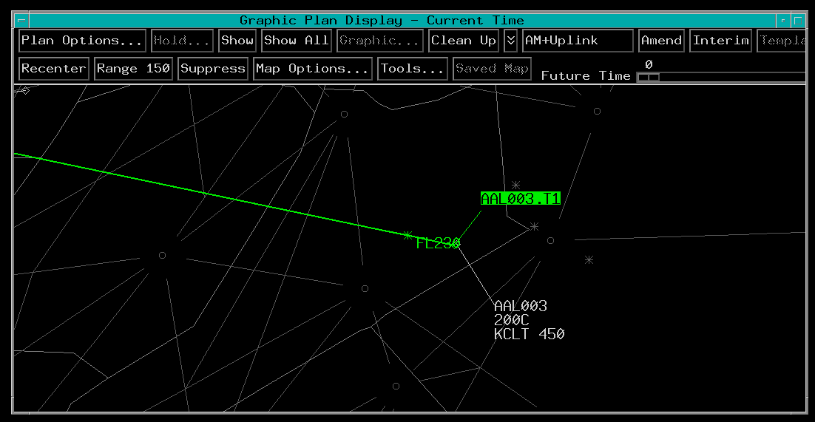
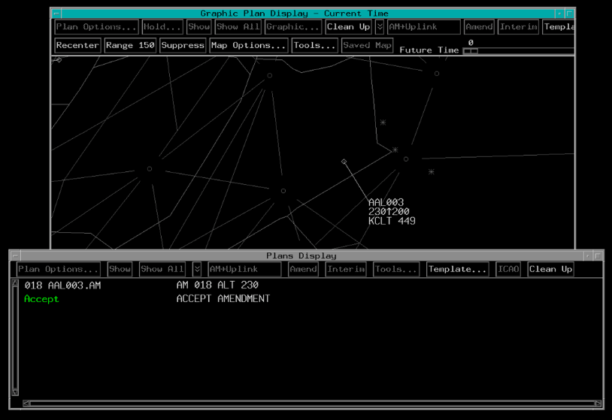
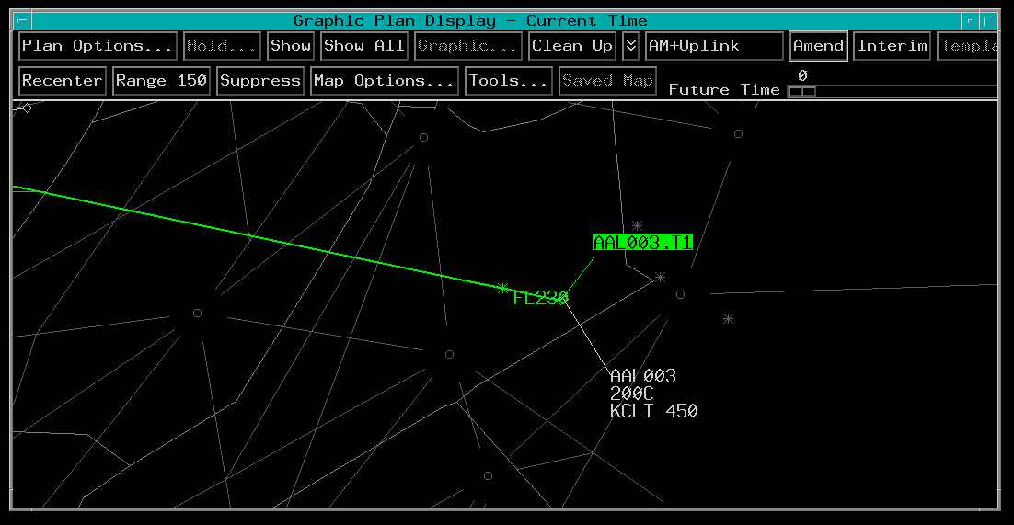
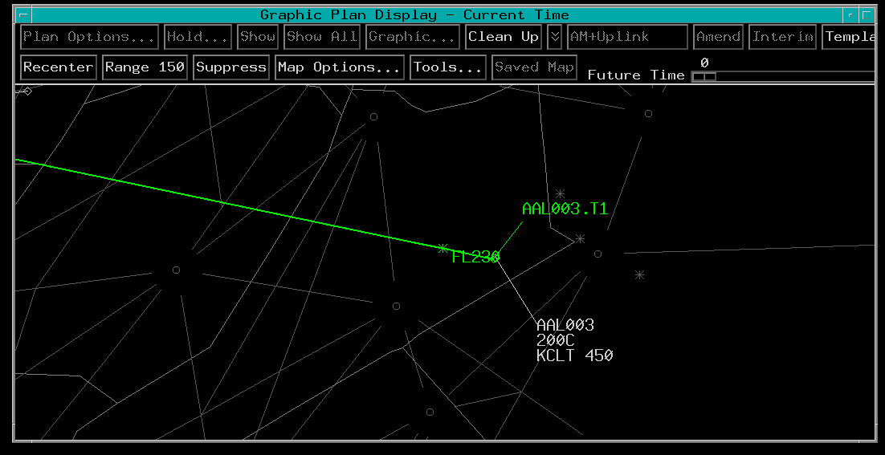
Amendment Trial Plan - GPD

Slide 19
Knowledge Check
Selecting AM+Uplink amends the FP and _____.
sends a CPDLC command to the aircraft
amends the CPDLC command
creates a trial plan

Slide 20
Knowledge Check
How is a trial plan sent as an amendment?
TBP Trial Plan ID>Plan Options…>Amend
TBP Amend>Trial Plan ID
TBP Trial Plan ID>Amend

Slide 21
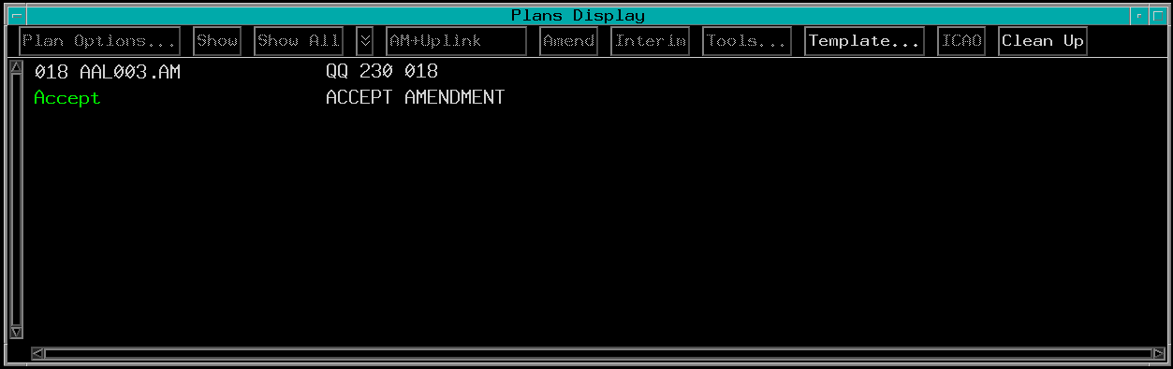
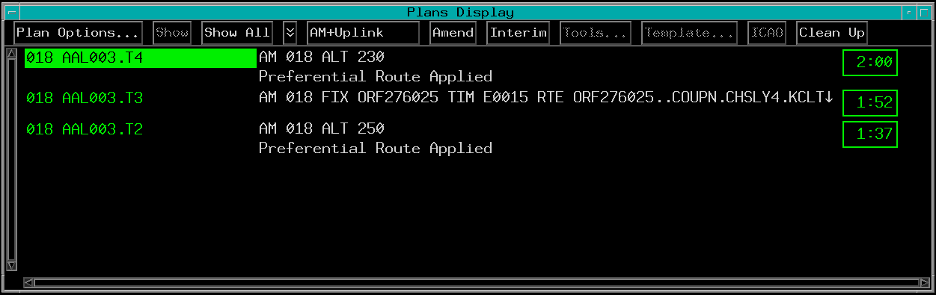
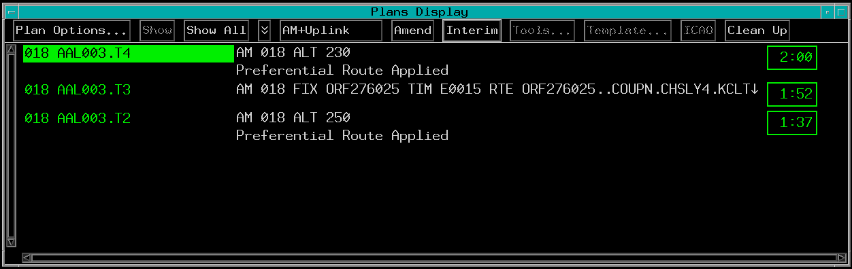
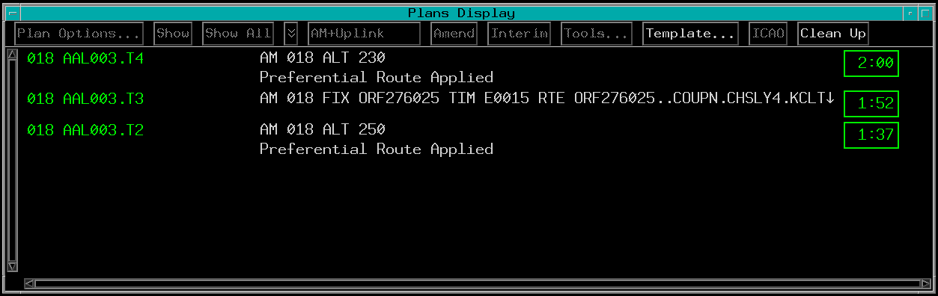
Interim Altitude Trial Plans - Plans Display

Slide 22
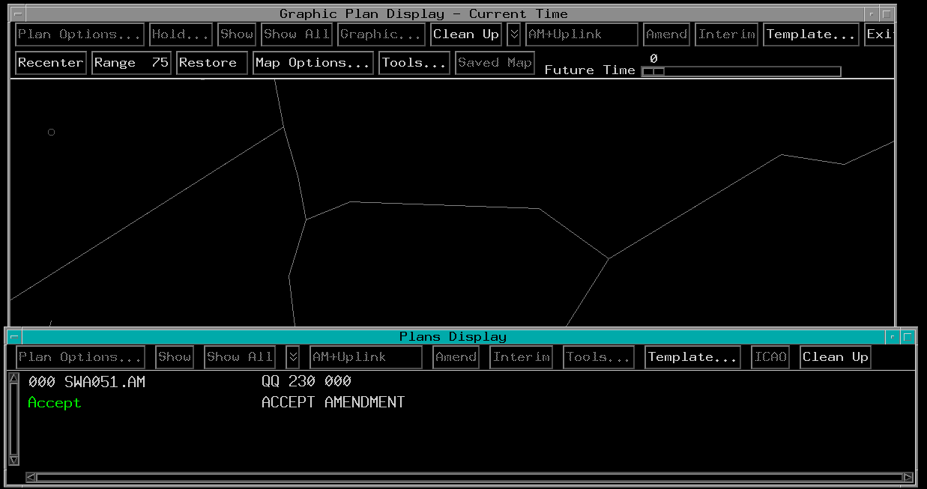



Interim Altitude Trial Plan - GPD

Slide 23
Knowledge Check
How do you enter an interim altitude from a trial plan?
TBP Interim>Plan ID
TBP Trial Plan ID>Interim
TBP Trial Plan ID>T>Send

Slide 24








Create Graphic Trial Plan

Slide 25
Knowledge Check
What is the first step to create a graphic trial plan on the GPD?
TBH the destination in the GPD data block
TBP Graphic from the menu
TBE flight ID

Slide 26
Knowledge Check
Only one point can be designated when creating a graphic trial plan.
True
False

Slide 27
Part-Task Exercise
Purpose
Perform the following tasks:
Creating a trial plan
Resubmitting an invalid trial plan
Sending an amendment or interim altitude
Graphic trial planning
Materials
TTL part-task exercise: Trial Plans
Directions
This exercise takes approximately 30 minutes to complete. Each student must complete the checklist. No headsets are required.

Slide 28
Creating a trial plan
Resubmitting an invalid trial plan
Sending an amendment or interim altitude
Graphic trial planning

Slide 29
The End

