Slide 2
Alert indicators and colors
Alerts on the Graphic Plan Display (GPD)
Automated Problem Detection (APD)
Rules for conflict notification
Stop Probe functionality
Airspace Status View functionality

Slide 3
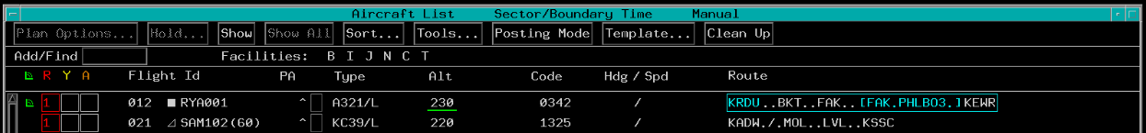
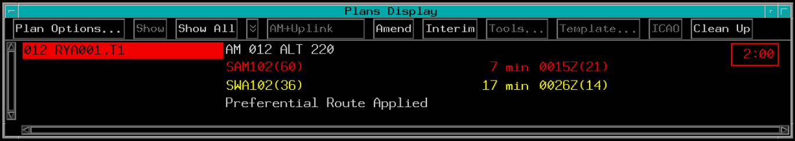
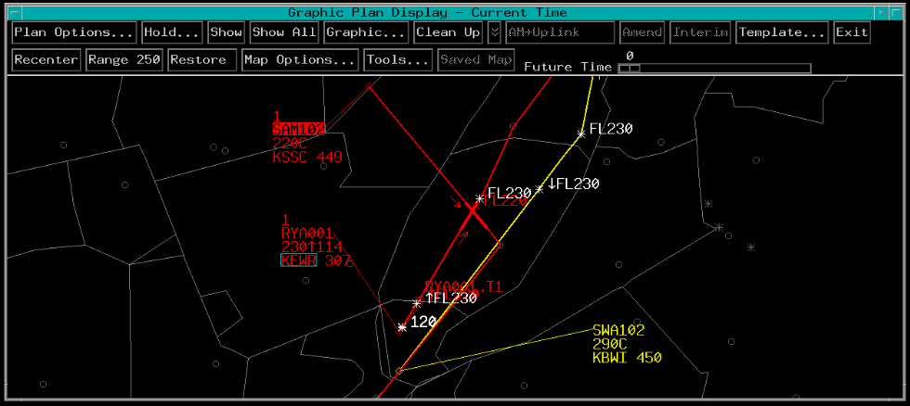
Alert Indicators
ACL
Plans Display
Graphic Plan Display

Slide 4
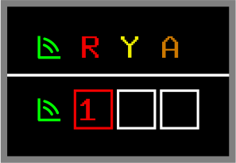
Alert Indicators - Red
When two aircraft are predicted to have less than 5 miles lateral separation
  Alert box changes to red
  Red number indicates total conflicts

Slide 5
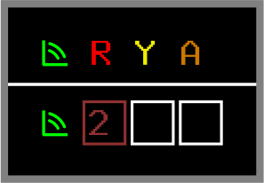
Alert Indicators - Muted Red
When two aircraft are predicted to have less than 5 miles lateral separation and where an altitude change is planned but not issued
  Alert box changes to muted red
  Muted red number indicates total conflicts
  Highest level alert is always shown in the alert box

Slide 6
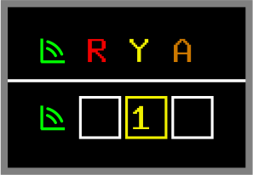
Alert Indicators - Yellow
When two aircraft are predicted to have between 5 and 12 miles lateral separation
  Alert box changes to yellow
  Yellow number indicates total conflicts

Slide 7
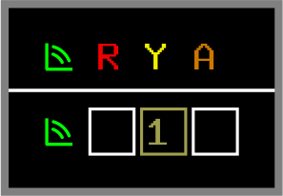
Alert Indicators - Muted Yellow
When two aircraft are predicted to have between 5 and 12 miles lateral separation where an altitude change is planned but not issued
  Alert box changes to muted yellow
  Muted yellow number indicates total conflicts

Slide 8
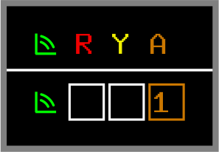
Alert Indicators - Orange
Aircraft-to-airspace violation predicted within 3 miles of active or scheduled Special Activity Airspace (SAA)
  Alert box changes to orange
  Orange number indicates total conflicts

Slide 9
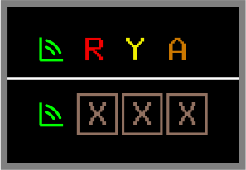
Alert Boxes - Brown X
Brown X in all three alert boxes with brown flight ID signifies that entry is not being probed by system
Flights not probed:
  VFR
  OTP
  ABV
  Untracked

Slide 10
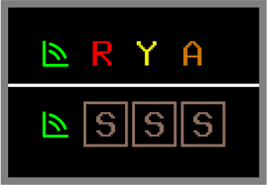
Alert Boxes - Brown S
Brown S in all three alert boxes signifies stop probe is in effect for flight

Slide 11
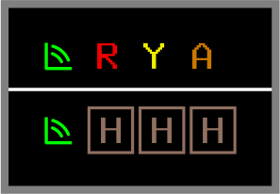
Alert Boxes - Brown H
Brown H in all three alert boxes signifies aircraft is in hold status
  Flight is not probed

Slide 12
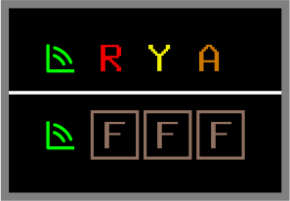
Alert Boxes - Brown F
A brown F in all three alert boxes signifies that a flight is frozen with a QH F command
  Flight is not probed

Slide 13
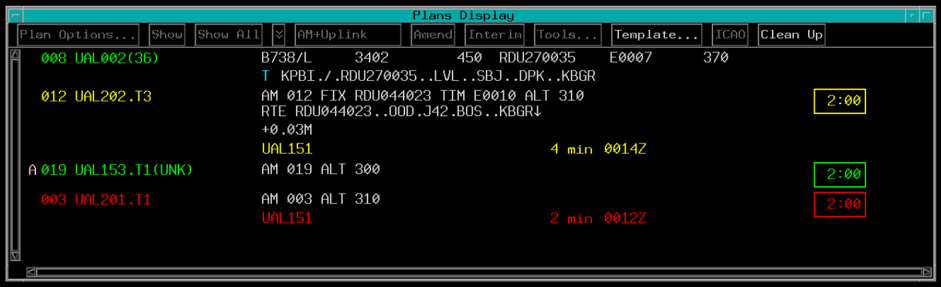

Alert Indicators - Plans Display
FLID color matches the alert
Yellow Alert
Time Until Conflict
No Conflicts
Red Alert
Estimated Time of Conflict
Conflicting Aircraft or SAA

Slide 14
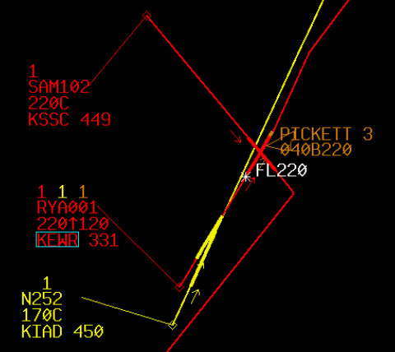
Alert Indicators - GPD Data Block
Line 0 contains a number for each alert type designator assigned to the sector
  Red/muted red
  Yellow/muted yellow
  Orange
Alert Indicators

Slide 15
Knowledge Check
What color alert indicates that two aircraft are predicted to have less than 5 miles lateral separation?
  Red
  Yellow
  Muted red

Slide 16
Knowledge Check
What color alert indicates that an aircraft is predicted to come within 3 miles of scheduled Special Activity Airspace?
  Red
  Yellow
  Orange

Slide 17
Knowledge Check
What color indicates that a conflict between 5 and 12 miles is predicted during a portion of the flight where an altitude change is planned, but the aircraft has not yet been cleared for the change?
  Muted red
  Muted yellow
  Orange

Slide 18
Knowledge Check
What does a brown H in all three alert boxes on the ACL indicate?
  Aircraft is in handoff status
  Aircraft is commanded frozen
  Aircraft is in a hold status

Slide 19
Knowledge Check
The route line color on the GPD indicates the most critical conflict unless _________?
  an aircraft is in hold
  alerts are suppressed
  a lesser alert is selected in Line 0

Slide 20
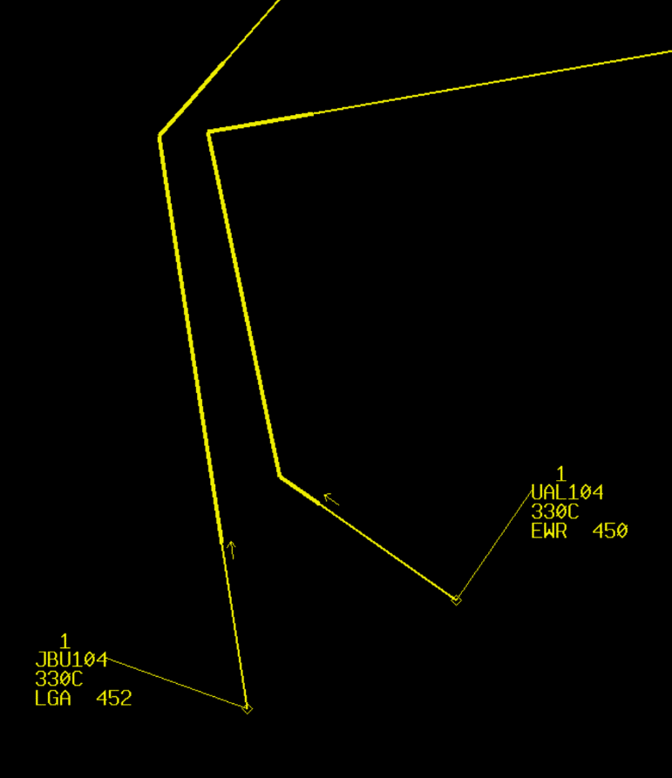
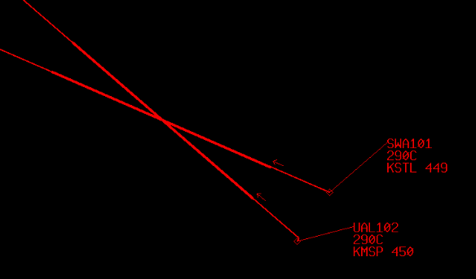
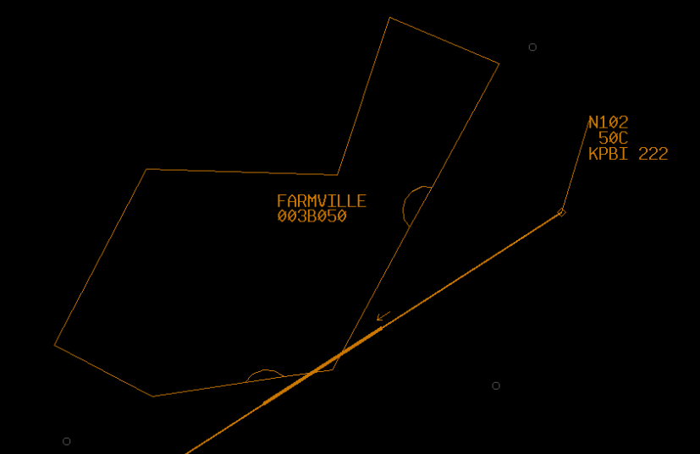
Point of Violation
GPD depicts results of Trial Plans and conflict probe in graphical form
Initial Points of Violation
Initial Points of Violation
Initial Point of Violation

Slide 21
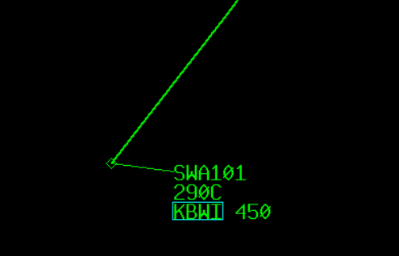
Green Route of Flight
Aircraft is not predicted to have any violations

Slide 22
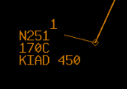
Special Activity Airspace
Orange alert indicator displayed in Line 0 when aircraft is predicted to fly within 3 miles of active or scheduled Special Activity Airspace
Alert Indicator

Slide 23
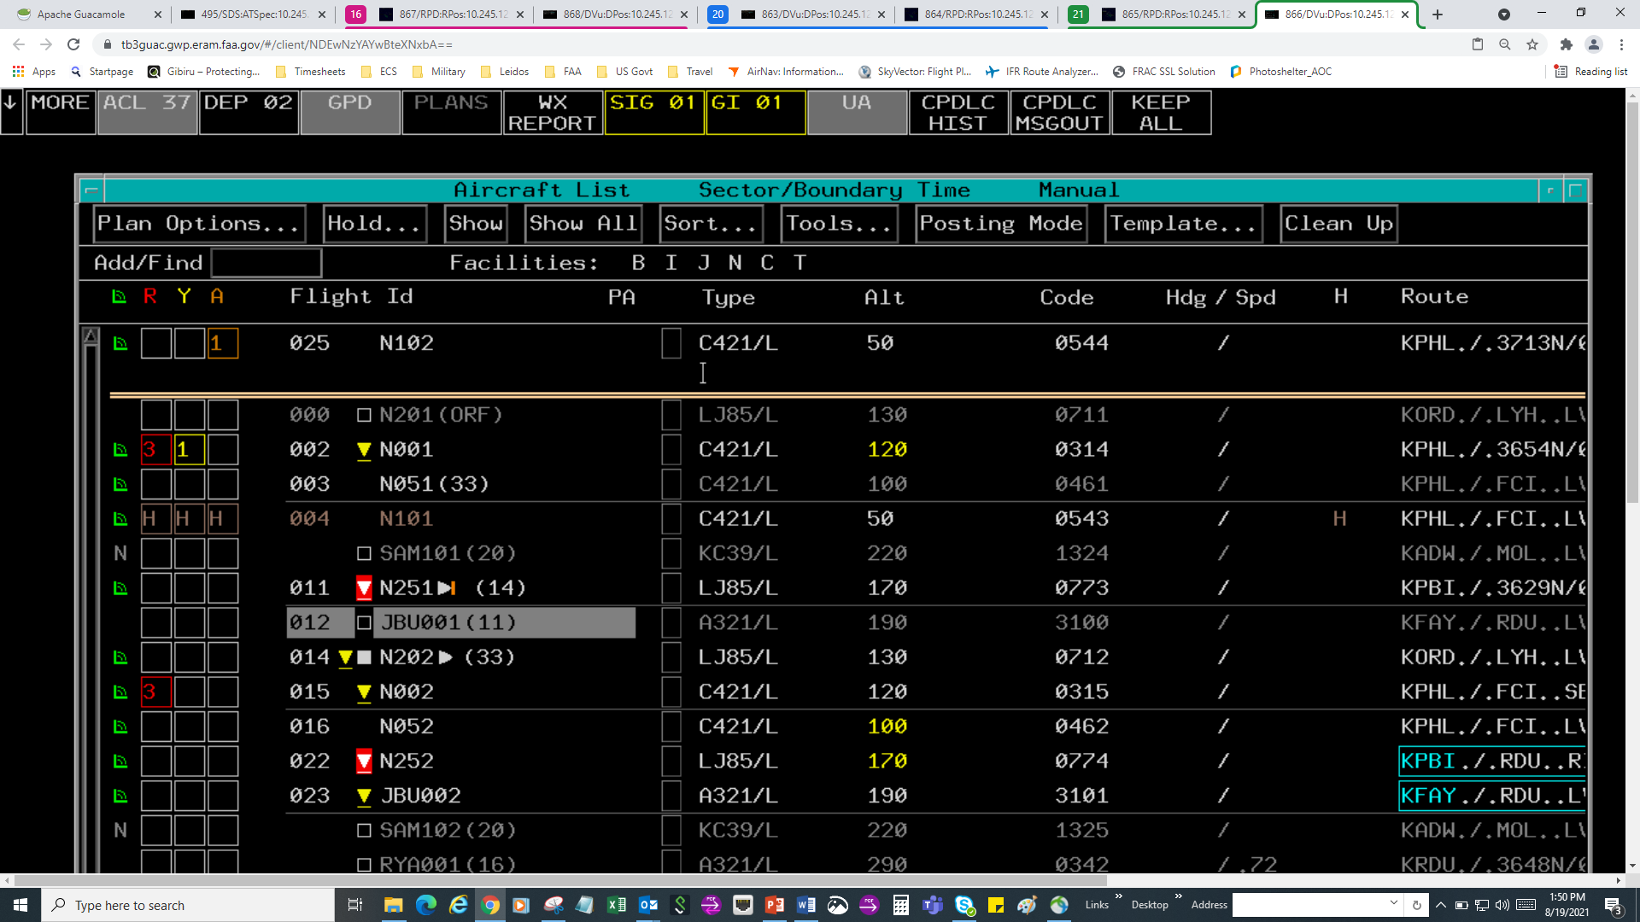
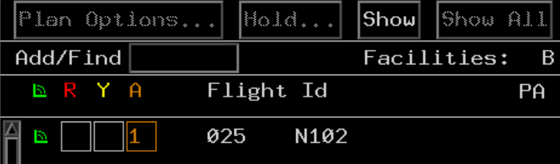
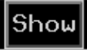
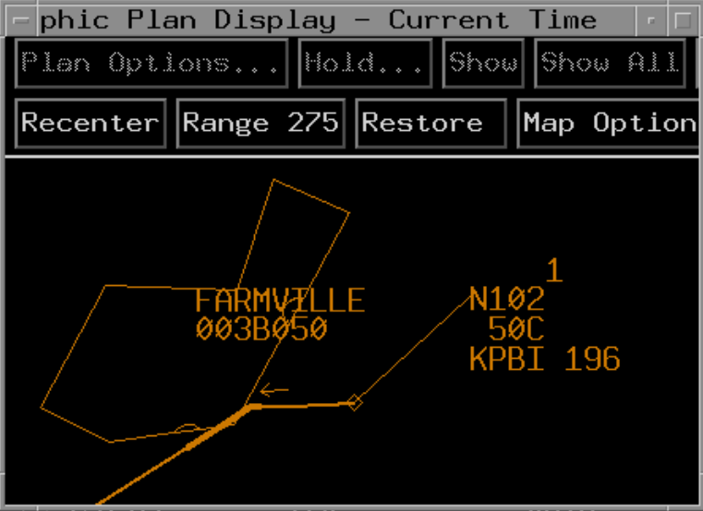

Show Alert Using ACL
The ACL Show button displays the aircraft’s current route and any alert(s) assigned to your sector
2. TBP
1. TBP

Slide 24
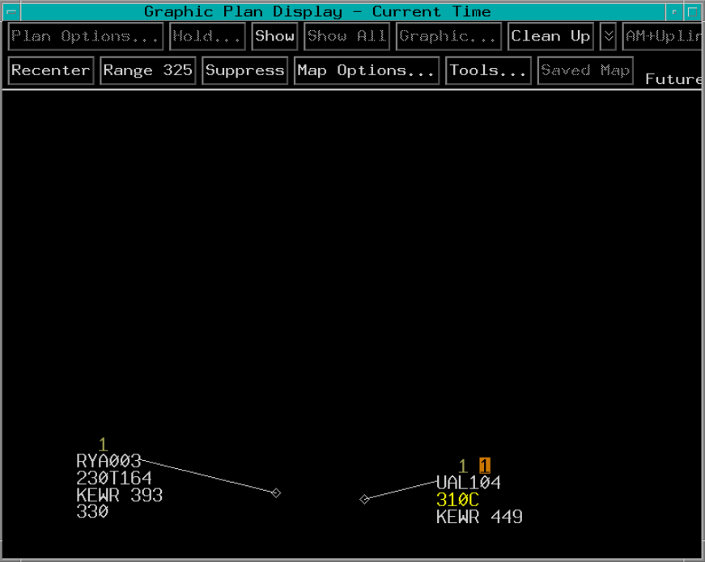
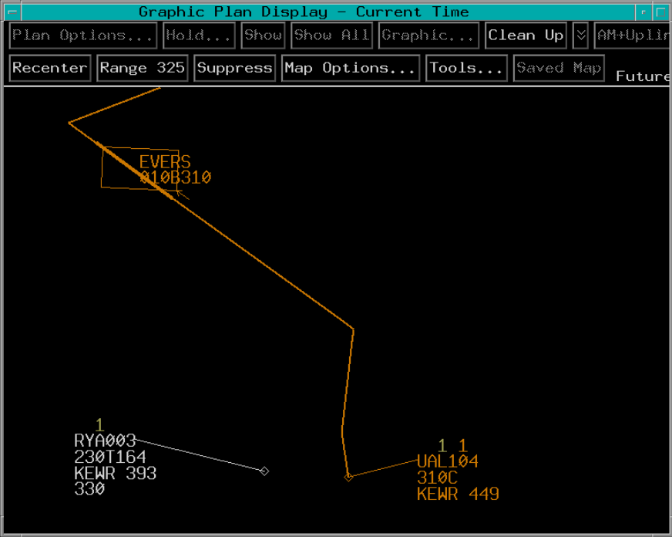
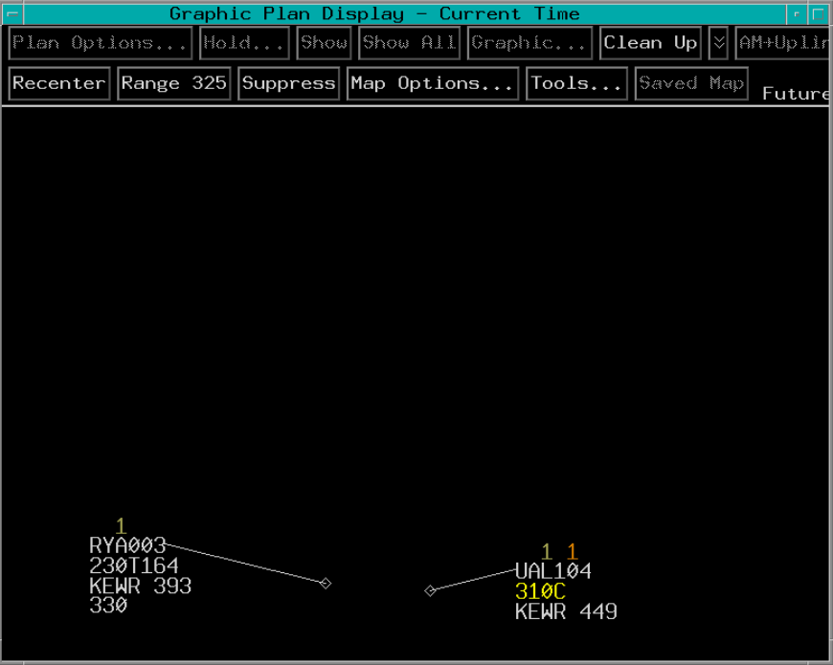
Show Alert Using GPD
2. TBP
1. TBP

Slide 25
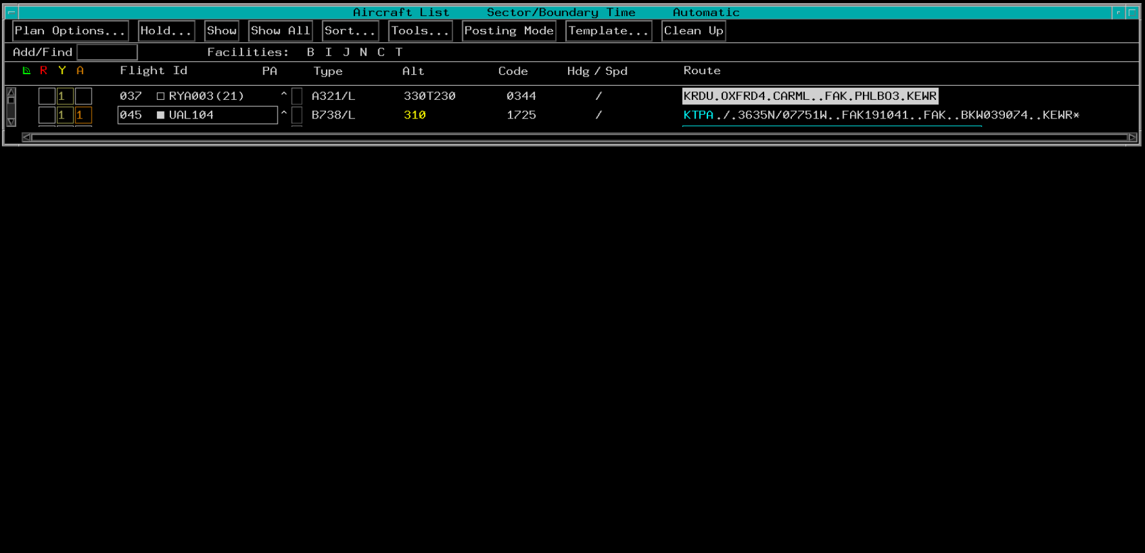
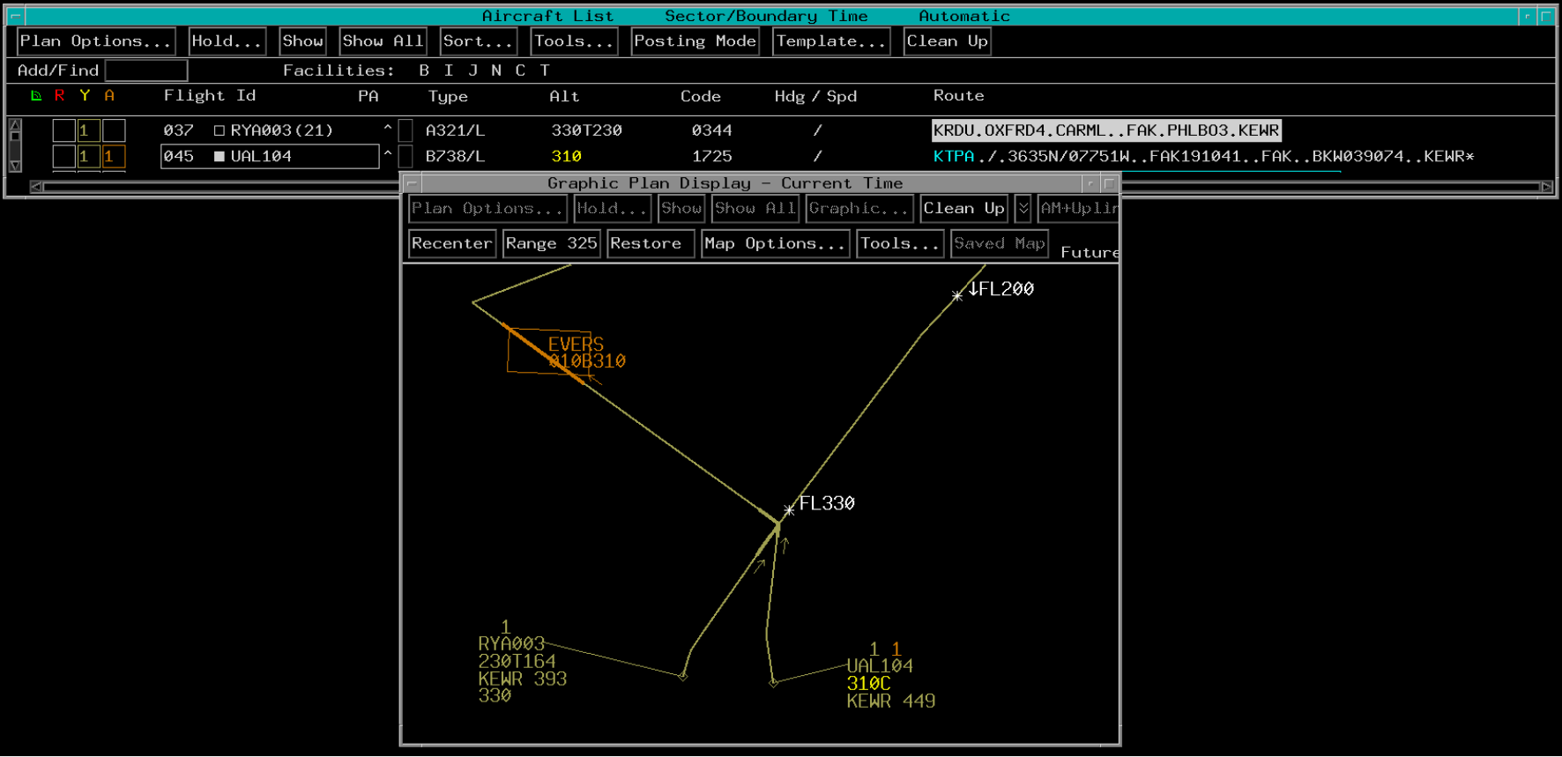
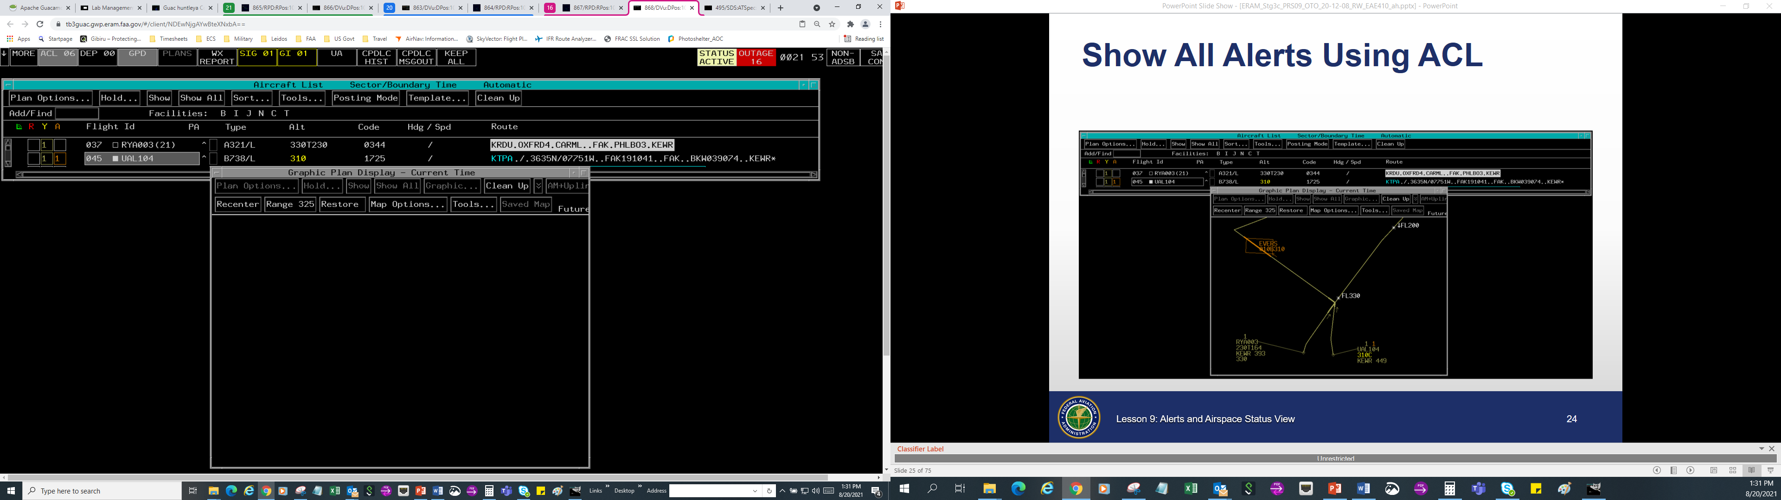
Show All Alerts Using ACL
TBE

Slide 26
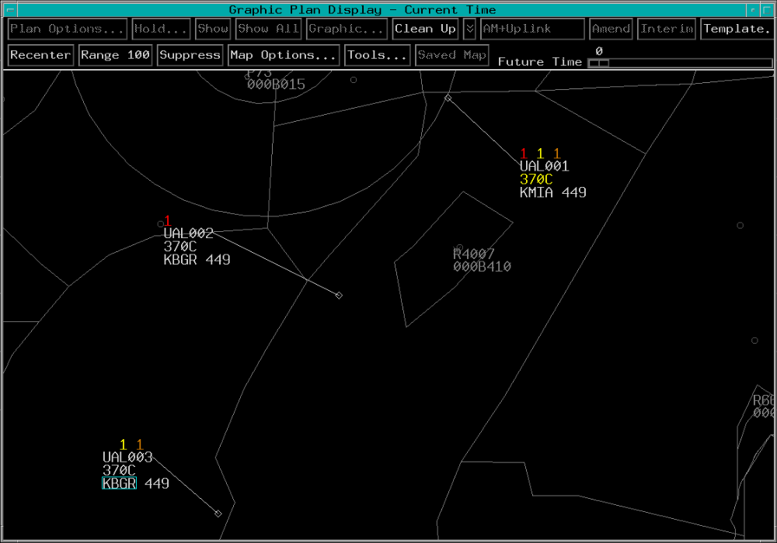
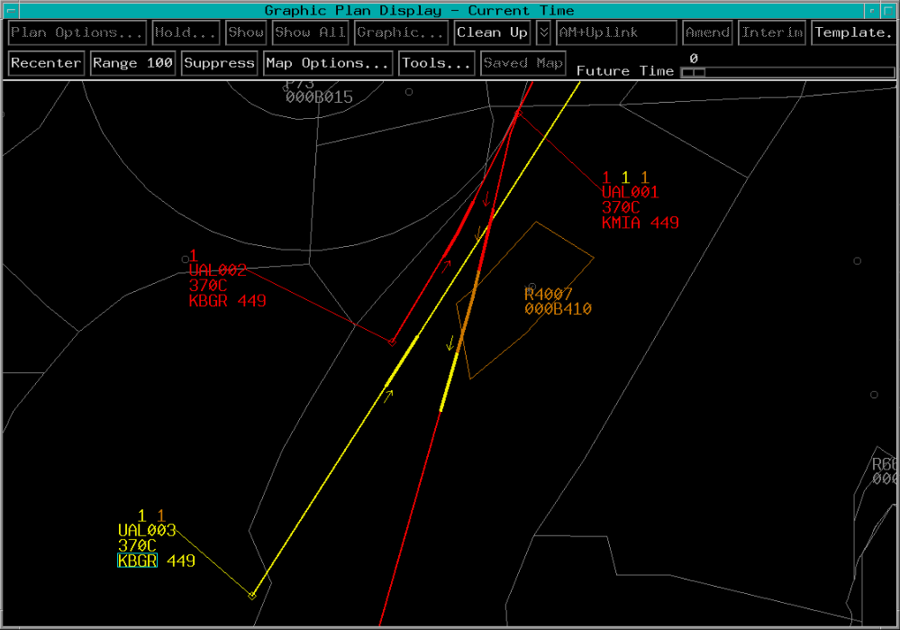
Show All Alerts Using GPD
TBE on GPD entry call sign to display all alerts
TBE

Slide 27
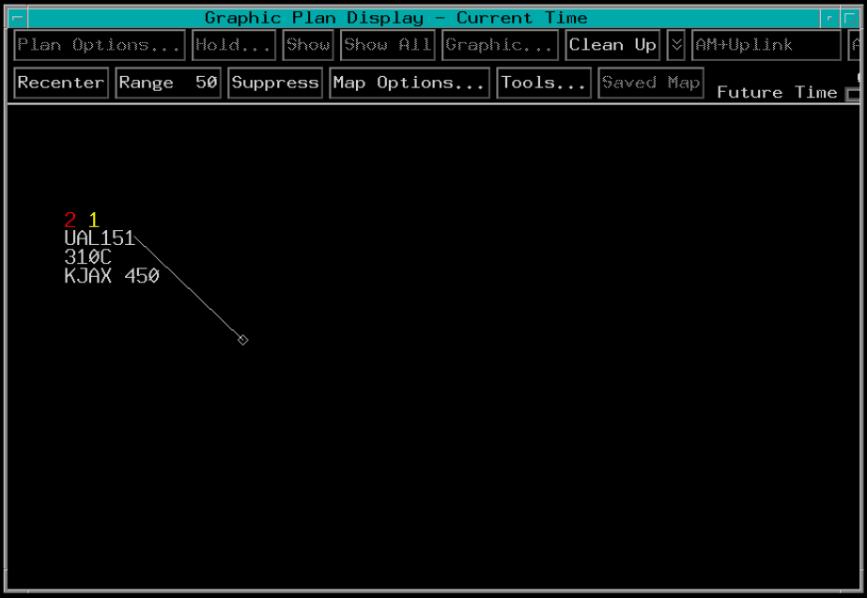
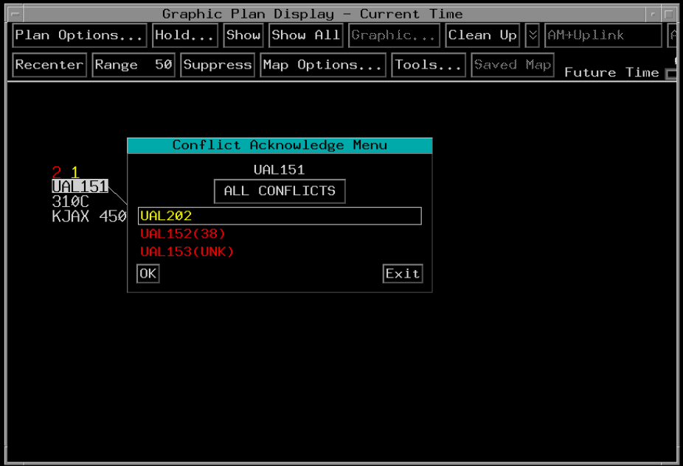
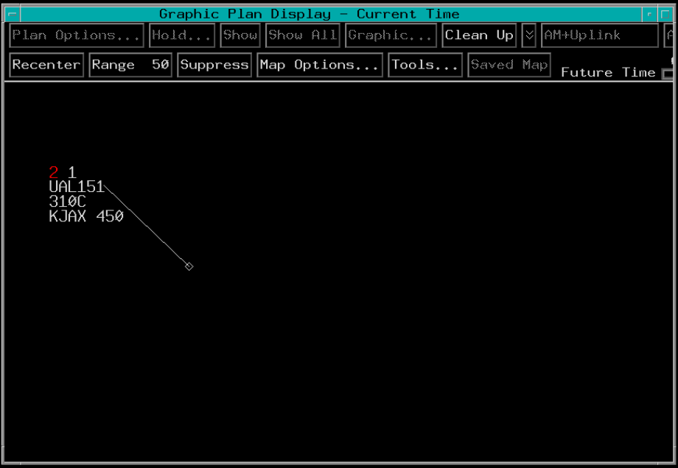
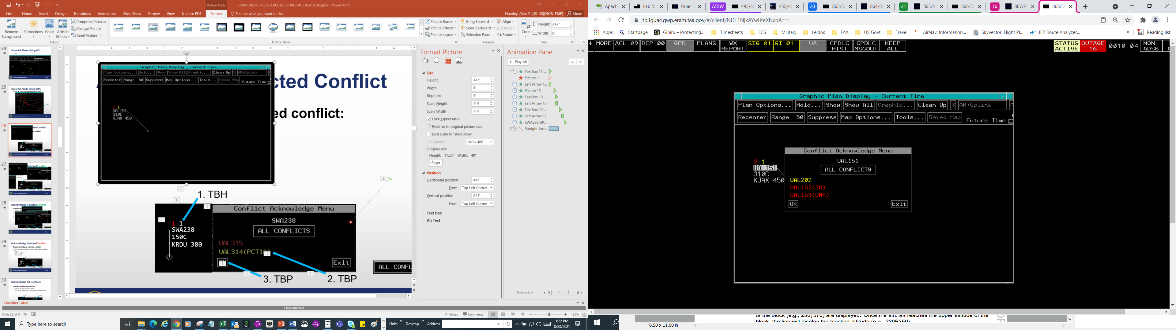
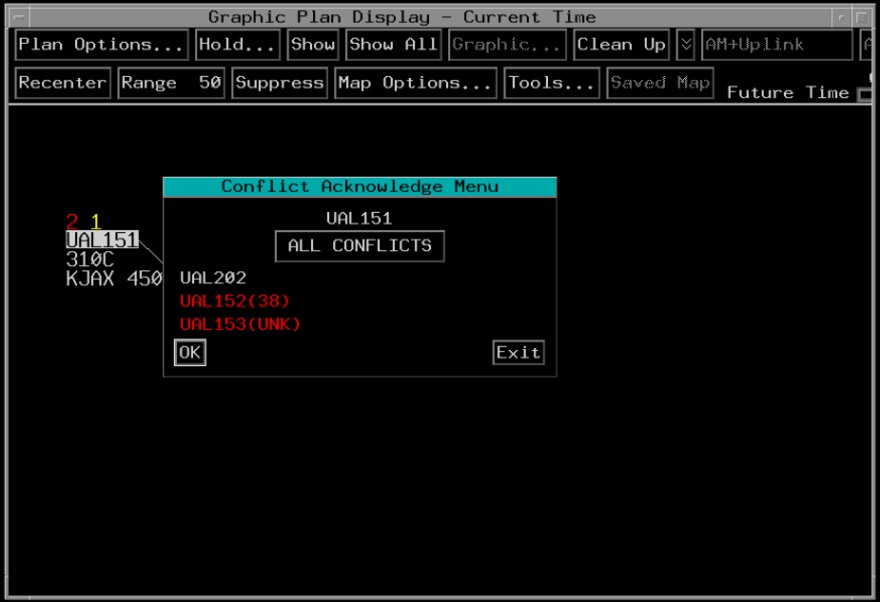
Acknowledge Selected Conflict
To acknowledge a selected conflict:
Result: Acknowledged Alert (White)
1. TBH
2.TBP
3. TBP

Slide 28
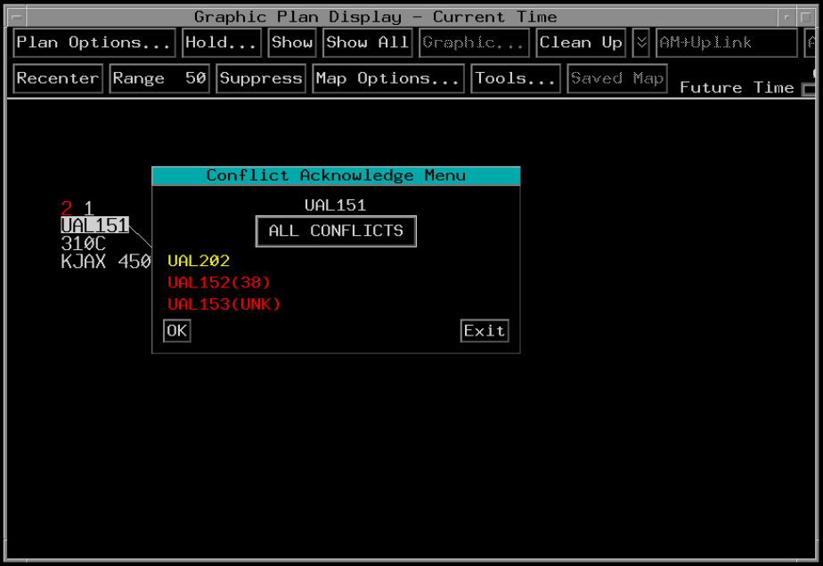
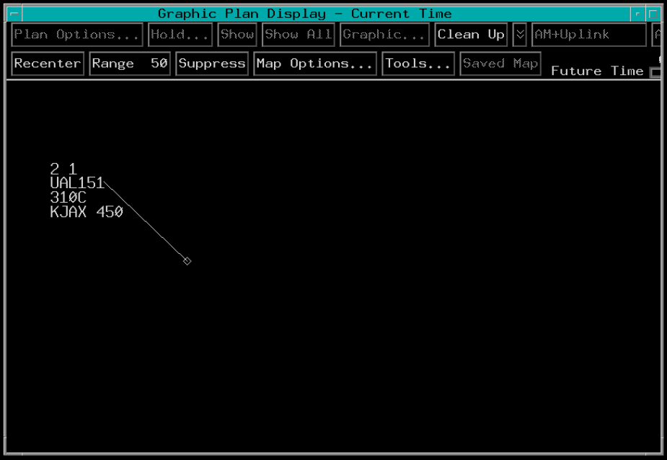
Acknowledge All Conflicts
To acknowledge all conflicts:
2.TBP
Result: Acknowledged Alerts (White)
1. TBH

Slide 29
Knowledge Check
How is a Point of Violation shown on the GPD?
  Dashed line where the conflict is predicted
  Blue line where the conflict is predicted
  Bold line where the conflict is predicted

Slide 30
Knowledge Check
What color is the route of flight when it is displayed for an aircraft that is not predicted to have any violations?
  Orange
  Yellow
  Green

Slide 31
Knowledge Check
What color is the numbered alert indicator in the GPD data block that predicts an airspace violation within 3 miles of active or scheduled Special Activity Airspace?
  Red
  Muted yellow
  Orange

Slide 32
Knowledge Check
Which button is used to graphically display or remove a selected aircraft’s Current Plan and any specific alert(s) assigned to your sector?
  Alert
  Show All
  Show

Slide 33
Knowledge Check
What color does an alert indicator change to when all alerts of that type are acknowledged?
  Red
  Muted yellow
  White

Slide 34
Automated Problem Detection (APD)
Automated Problem Detection (APD) compares trajectories to predict conflicts
  Checks Current Plan trajectory
  Checks Trial Plan trajectory
  Checks Current and Trial Plans against other current plans and airspaces
Neither Current Plans nor Trial Plans are checked against other Trial Plans

Slide 35
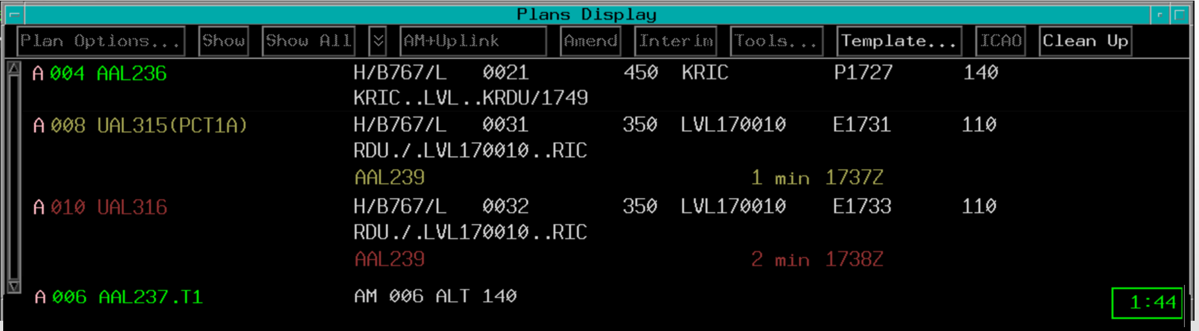
APD - Plans Display
Current Plan entries include CID and FLID
Trial Plan entries appended with .T(#)
  Indicates the number of Trial Plans
Current Plans
Trial Plan

Slide 36
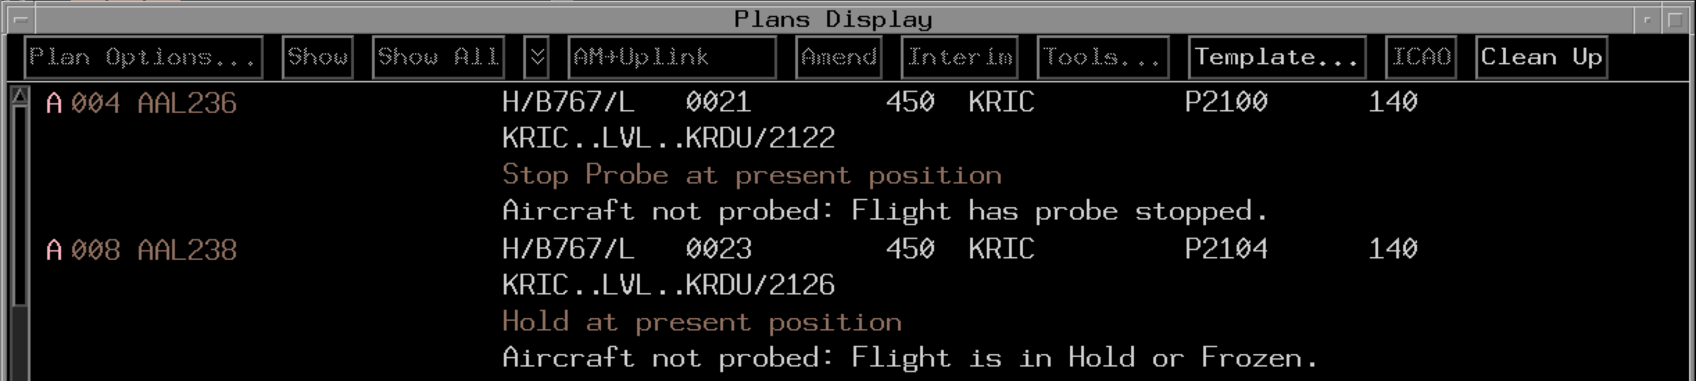
APD Ineligible
Aircraft not probed, no alerts for flight
Reason displayed in Plans Display
APD Ineligible Reasons

Slide 37


APD Separation Values
Lateral Separation
Vertical Separation
Minimum Separation between FL410-FL600 = 1400’
5 NM Total
300’
Minimum Separation
Longitudinal Separation
300’
3 NM Total
Minimum Separation below FL410 = 400’

Slide 38
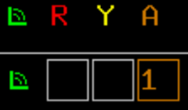


APD Separation Buffer
40 minutes
SAA
Depending on type of SAA,
conflict occurs at either:
Airspace boundary, or
Separation buffer

Slide 39
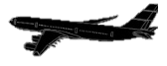


APD Inhibited Areas
Trajectory Probed
APDIA
Trajectory Not Probed
Trajectory Exits APDIA

Slide 40
Knowledge Check
When does Automated Problem Detection (APD) probe a new Trial Plan against other Trial Plans?
  When there are Current Plans to probe against
  Only if there is a conflict
  Never

Slide 41
Knowledge Check
When an aircraft is ineligible to be probed, where is the notification displayed?
  Automatic Problem Detection (APD)
  Aircraft Situation Display
  Plans Display

Slide 42
Knowledge Check
Which type of plan shows the flight the aircraft is currently expected by EAS to fly?
  Trial Plan
  Current Plan
  Future Plan

Slide 43
Knowledge Check
Which type of plan is used to test whether a proposed change to the Current Plan will be conflict free?
  Trial Plan
  Current Plan
  Test Plan

Slide 44
Rules for Conflict Notification
Although APD may detect a conflict, sector may not be notified immediately
When an alert is provided:
  Only one sector receives the alert at a time
  Aircraft-to-aircraft alerts
    Notification is generally provided to the sector where the conflict is first predicted to occur
    Transferred to the next sector upon handoff
  Aircraft-to-airspace alerts
    Sector controlling the aircraft receives the alert

Slide 45
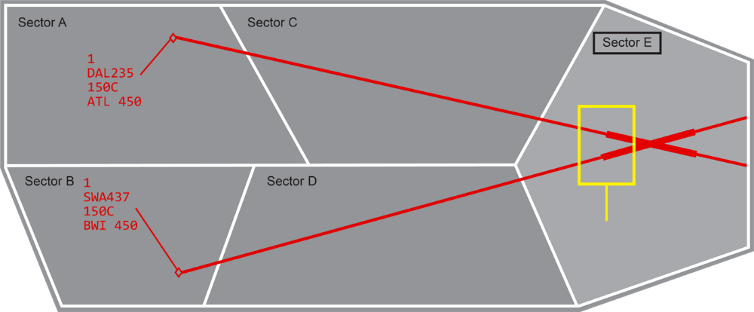
Rules of Sector Control During Conflict Notification - Rule 1
Initial Points of Violation

Slide 46
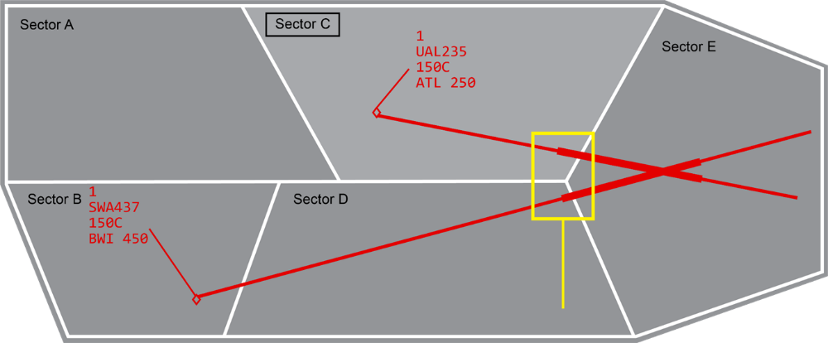
Rules of Sector Control During Conflict Notification - Rule 2
Initial Points of Violation

Slide 47
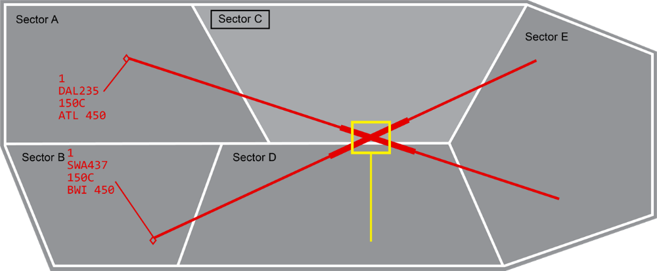
Rules of Sector Control During Conflict Notification - Rule 3
Conflict Intersection

Slide 48
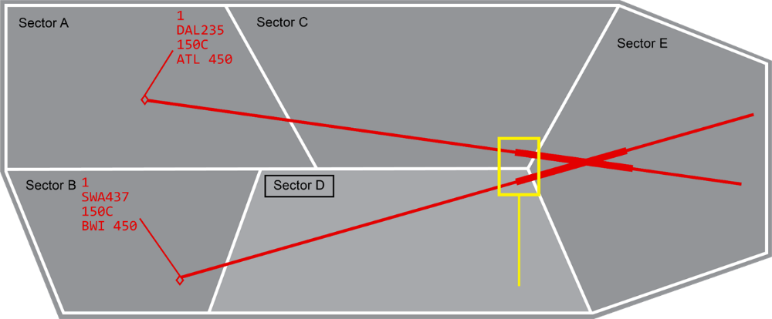
Rules of Sector Control During Conflict Notification - Rule 4
Initial Points of Violation

Slide 49
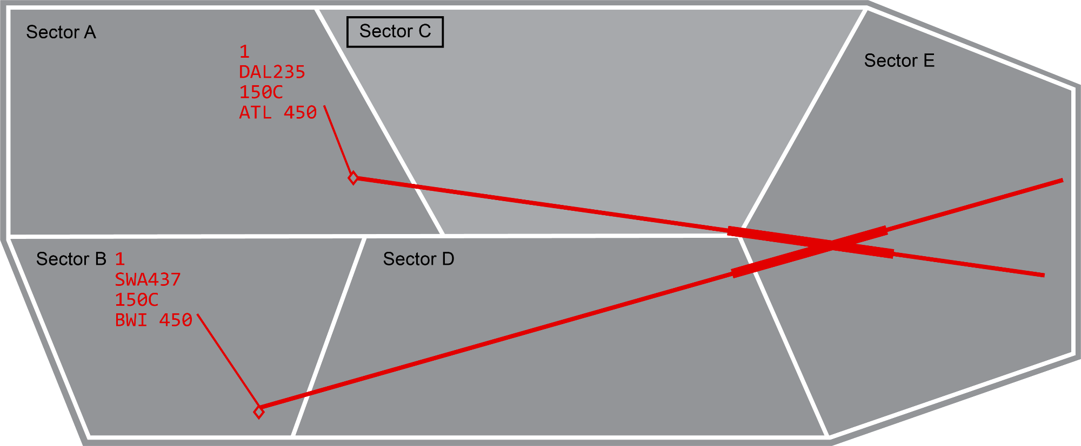
Rules of Sector Control During Conflict Notification - Rule 5

Slide 50
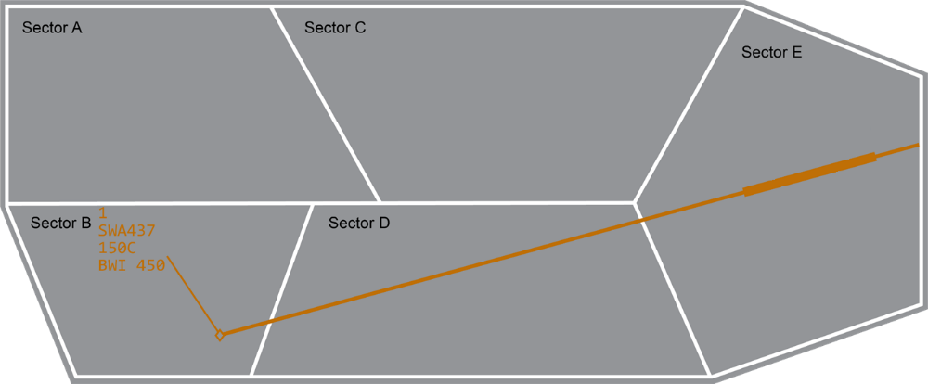
Rules of Sector Control During Conflict Notification - Rule 6
Active
SAA

Slide 51
Knowledge Check
Which sector will receive a conflict notification when an aircraft conflict is predicted to occur?
  Every sector that has control of a problem aircraft
  All sectors that the aircraft are flying through
  Sector where the conflict is first predicted to occur

Slide 52
Knowledge Check
If points of violation are located in different sectors, and only one of these sectors controls an aircraft involved in conflict, which sector would receive conflict notification?
  Every sector that has control of a problem aircraft
  Sector containing a point of violation and currently controlling one of the aircraft
  Sector where the conflict is first predicted to occur

Slide 53
Knowledge Check
Which sector will receive a conflict notification when an aircraft-to-airspace conflict is predicted to occur?
  Every sector that has an FDB displayed for the problem aircraft
  All sectors that the aircraft is flying through
  Sector that has track control of the aircraft

Slide 54
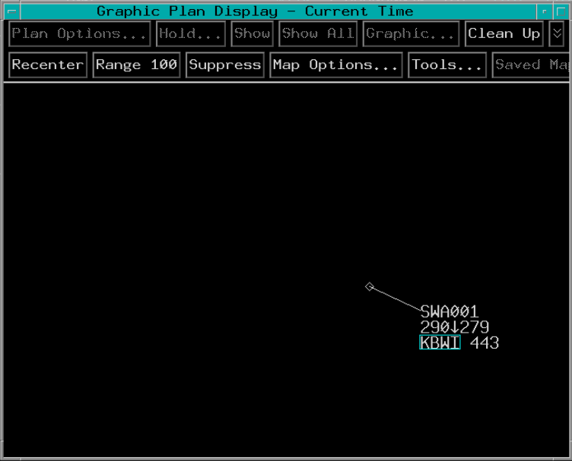
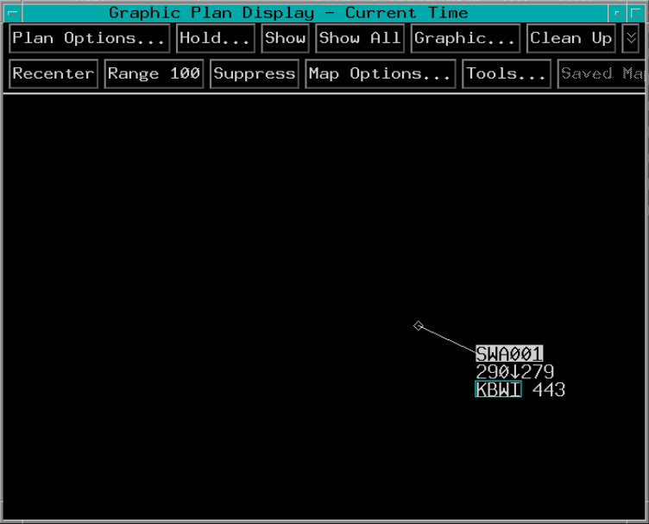




Stop Probe Menu
Access the Stop Probe Menu in Plan Options menu
2. TBP
Present Position
3. TBP
Future Fixes
1. TBP

Slide 55






Present Position Stop Probe
2. TBP
4. TBP
3. TBP
1. TBP

Slide 56








Future Fix Stop Probe
2. TBP
4. TBP
3. TBP
1. TBP
55

Slide 57

Stop Probe - ACL
When a present position stop probe is in effect, a brown S appears in the three alert boxes
When a stop probe will take effect at a future fix, a brown S appears to the right of the three alert boxes

Slide 58

Stop Probe - GPD
When Stop Probe is in effect for an aircraft, on the GPD data block:
  Brown SSS occupies Line 0
  All text is brown

Slide 59





Resume Probe
2. TBP
3. TBP
1. TBP

Slide 60
Knowledge Check
How is a future fix Stop Probe shown on the ACL?
  Brown H next to the alert boxes
  Yellow S next to the alert boxes
  Brown S next to the alert boxes

Slide 61
Knowledge Check
To stop probe at a future fix TBP FLID, then TBP the Plan Options Menu, then ________.
  TBP Stop Probe
  TBP fix name
  TBP Stop Probe, then TBP fix name

Slide 62





Airspace Status View - Accessing
1. TBP
2. TBP

Slide 63




Airspace Status View
View can be expanded or compressed from the Airspace Status View menu
Compressed view displays only the first line of each SAA’s data
Can display SAA of selected adjacent facilities
TBP or TBE for Menu
Expanded View
TBP or TBE
TBP or TBE to Compress View

Slide 64

Airspace Status View - Buttons and Labels
Radio Buttons
Column Labels
White Buttons
Gray Buttons

Slide 65


Airspace Status View - REQ
TBP or TBE
Results
TBP or TBE
64

Slide 66


Airspace Status View - Pending SAA
Select Altitude Range in a Pending SAA

Slide 67



Airspace Status View - ON
2. Enter Altitude Range
1. TBP or TBE
3. TBP or TBE
Results

Slide 68

Airspace Status View - OFF
OFF Button

Slide 69

Airspace Status View - SCH
SCH button filled in when an SAA is scheduled active within the next 48 hours
SCH Button
Pending Status

Slide 70
Knowledge Check
Which view is used to see the status of Special Activity Airspace up to 48 hours in advance?
  Options
  Airport Stream Filter
  Airspace Status View

Slide 71
Knowledge Check
Which button is selected to view planned use of Special Activity Airspace?
  PLAN
  ON
  SCH

Slide 72
Part-Task Exercise
Purpose
  Perform Alert and Airspace Status View tasks
Materials
  TTL part-task exercise: Alerts and Airspace Status View
Directions
  This exercise takes approximately 30 minutes to complete. Each student must complete the checklist tasks. No headsets are required.

Slide 73
Lesson Summary
This lesson covered:
Alert indicators and colors
Alerts on the GPD
Automated Problem Detection (APD)
Rules for conflict notification
Stop Probe functionality
Airspace Status View functionality

Slide 74
The End

Slide 75
APD Separation Buffer
40 minutes
SAA
Depending on type of SAA,
conflict occurs at either:
Airspace boundary, or
Separation buffer

