Slide 2
Lesson Objectives
At the end of this lesson, you will be able to identify characteristics of CPDLC Pilot Initiated Downlinks (PIDs).

Slide 3
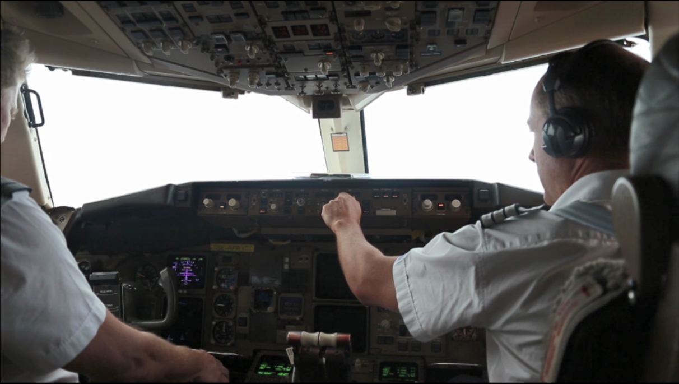
Pilot Initiated Downlinks (PIDs)

Slide 4
Normal PID Indicator - No Uplinks
425
SWA427
B738/L
330
5223
SWA427 330C 425 400

Slide 5
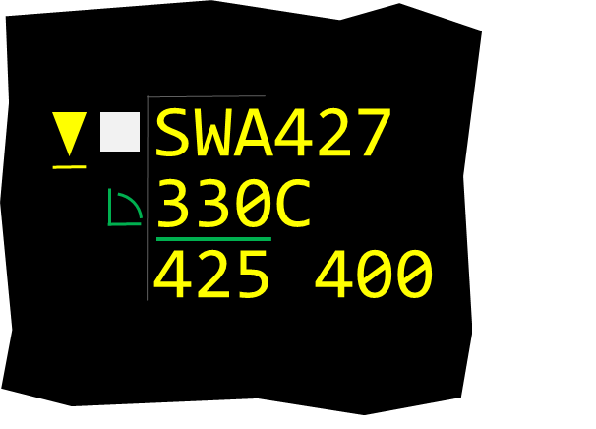
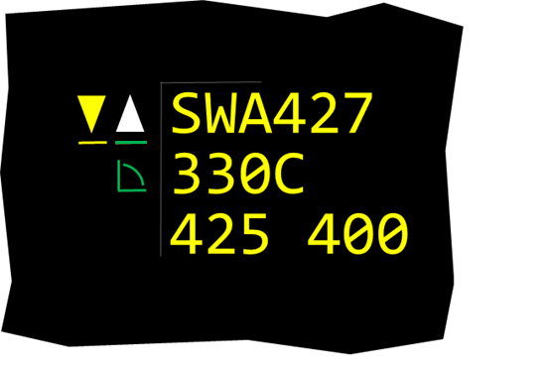

Normal PID Indicator - With Uplinks
425
SWA427
B738/L
330
5223
425
SWA427
B738/L
330
5223
CDA Session with Eligibility
Generic Uplink In Progress

Slide 6
PID Menu
Header
Close Menu Pick Area
SWA427
X
REQ DRCT PXT
REQ 390
REQ VOICE CONTACT
REQ VOICE CONTACT
ROGER
PID Message Area
REQ VOICE CONTACT
UNA
TBP or TBE
PID Response Pop Up
Notes:
ICD-section 1.2 _ AMPM 1.1
Mention the Freeze horizons and RMD parameters will be covered later in this lesson

Slide 7
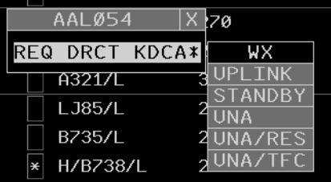
PID Request - Direct-to-Fix
Notes:
ICD-section 1.2 _ AMPM 1.1
Mention the Freeze horizons and RMD parameters will be covered later in this lesson

Slide 8
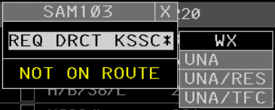
PID Request - Direct-to-Fix Error
Possible Error Text
AUTO ROUTE
TFM REROUTE
NOT ON ROUTE
Notes:
ICD-section 1.2 _ AMPM 1.1
Mention the Freeze horizons and RMD parameters will be covered later in this lesson

Slide 9
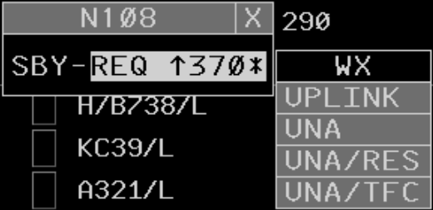
PID Request - STANDBY Sent
STANDBY Not Available
STANDBY Uplink Failure
SBY-ERR
Notes:
ICD-section 1.2 _ AMPM 1.1
Mention the Freeze horizons and RMD parameters will be covered later in this lesson

Slide 10
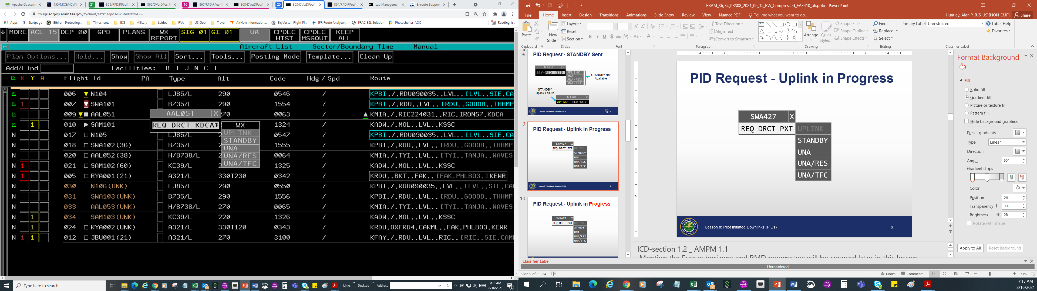
PID Request - Uplink in Progress
Notes:
ICD-section 1.2 _ AMPM 1.1
Mention the Freeze horizons and RMD parameters will be covered later in this lesson

Slide 11
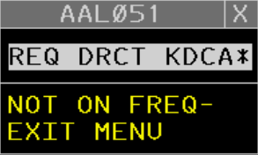
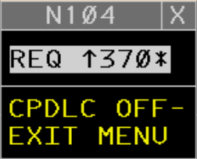
PID Request - Special Conditions
Notes:
ICD-section 1.2 _ AMPM 1.1
Mention the Freeze horizons and RMD parameters will be covered later in this lesson

Slide 12


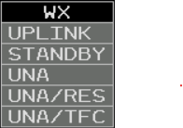
PID Request - Altitude
Due to Reason
Asterisk Indicates Reason
Notes:
ICD-section 1.2 _ AMPM 1.1
Mention the Freeze horizons and RMD parameters will be covered later in this lesson

Slide 13
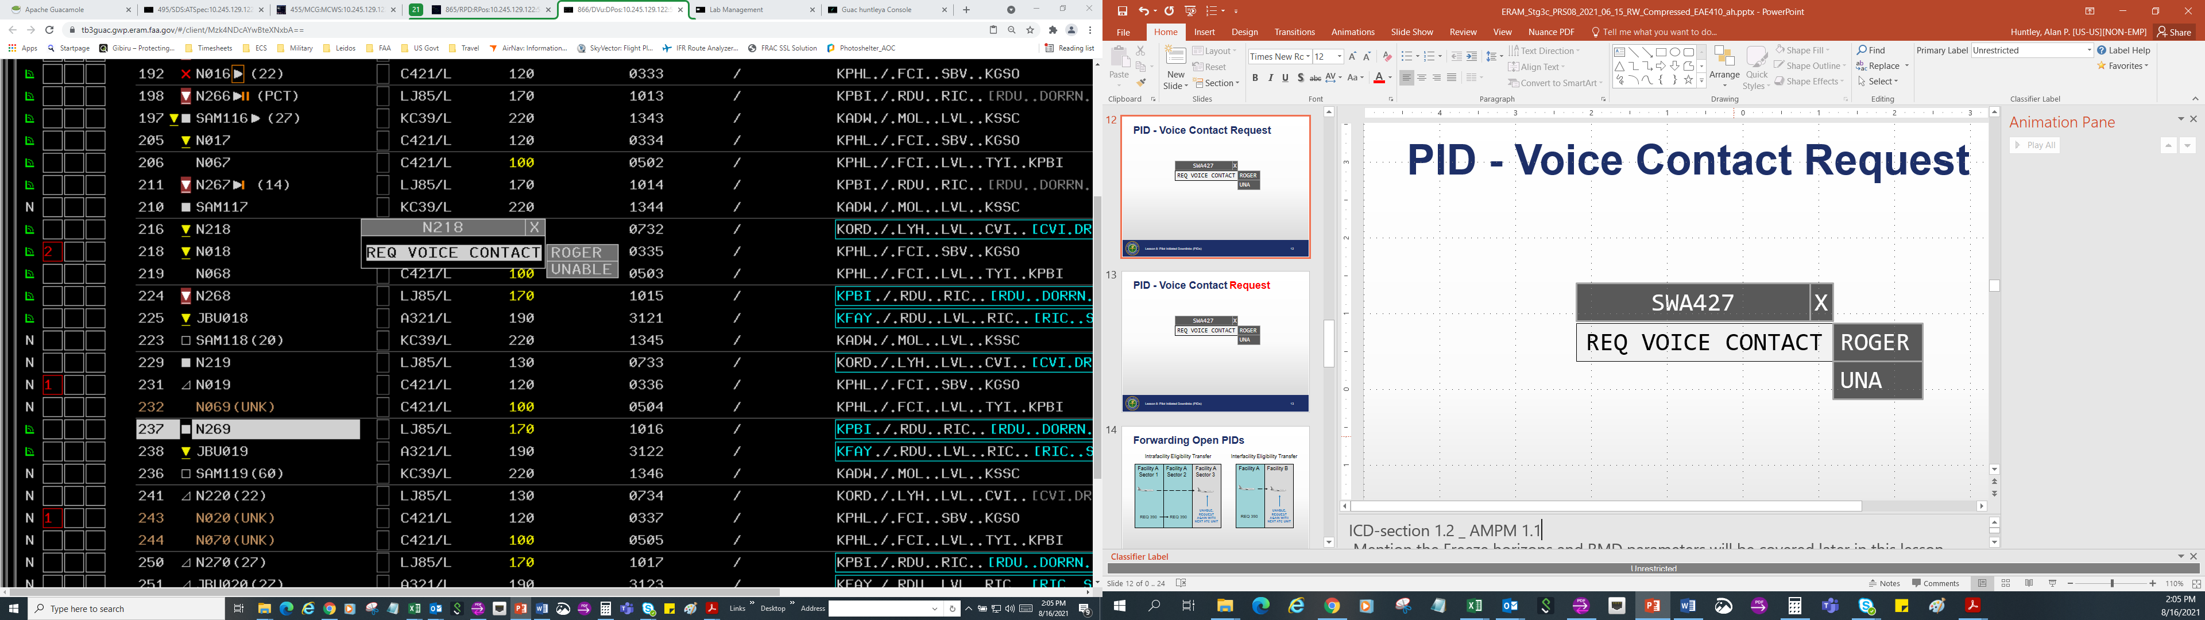
PID Request - Voice Contact
Notes:
ICD-section 1.2 _ AMPM 1.1
Mention the Freeze horizons and RMD parameters will be covered later in this lesson

Slide 14

Forwarding Open PIDs
Intrafacility Eligibility Transfer
Interfacility Eligibility Transfer
Facility A
Facility A
Facility A
Facility A
Facility B
Sector 1
Sector 2
Sector 3
UNABLE, REQUEST AGAIN WITH NEXT ATC UNIT
UNABLE, REQUEST AGAIN WITH NEXT ATC UNIT
REQ 390
REQ 390
REQ 390
Notes:
ICD-section 1.2 _ AMPM 1.1
Mention the Freeze horizons and RMD parameters will be covered later in this lesson

Slide 15


Responding to PIDs
You should respond by using the PID menu
Using voice has the potential to cause confusion and increase both pilot and controller workload
Notes:
ICD-section 1.2 _ AMPM 1.1
Mention the Freeze horizons and RMD parameters will be covered later in this lesson

Slide 16
Knowledge Check
What does the yellow triangle with a yellow line beneath it indicate?
Normal PID - no uplinks
Normal PID - with uplinks
Emergency PID - response is necessary
425
SWA427
B738/L
330
5223

Slide 17
Knowledge Check
Why is the Normal PID indicator offset to the left of the CDA Session with Eligibility symbol?
Answer: There is an altitude uplink in progress.
425
SWA427
B738/L
330
5223 / KMIA./.CHS.
Knowledge Check

Slide 18
Knowledge Check
To display the PID menu, would you TBP or TBE on A, B, or C?
A
B
C
425
SWA427
B738/L
330
5223

Slide 19
Knowledge Check
What does the grayed out UPLINK pick area indicate?
Answer: There is an open Route uplink to this aircraft and the UPLINK response is not available

Slide 20
Knowledge Check
You received a PID request at your sector. You then transferred communication to a sector at an adjacent facility.
Will the system forward that PID request to the next sector after eligibility is transferred to that sector?
Answer: No, the system will not forward PID requests across facilities. The system will automatically uplink an UNABLE, REQUEST AGAIN WITH NEXT ATC UNIT message.

Slide 21
Knowledge Check
Why should you respond to a PID request using the PID menu?
You cannot use voice
To reduce confusion
To allow the pilot extra time to comply

Slide 22
Part-Task Exercise
Purpose
Respond to Pilot Initiated Downlinks
Materials
TTL part-task exercise: Pilot Initiated Downlinks
Directions
This exercise takes approximately 30 minutes to complete. Each student must complete the checklist tasks. No headsets are required.

Slide 23
Lesson Summary
This lesson covered:
CPDLC pilot initiated downlinks
Normal PID Indicator - no uplinks
Normal PID Indicator - with uplinks
PID Menu
PID requests
Forwarding open PIDs
Responding to PIDs

Slide 24
The End

