Slide 2
Lesson Objectives
At the end of this lesson, you will be able to identify characteristics of:
Keyboard route amendments
Route Menu amendments
Traffic Flow Management (TFM) Reroutes
CPDLC route uplinks

Slide 3
Route Definitions
Preferential Departure Route (PDR) - A specific departure route from an airport or terminal area to an en route point where there is no further need for flow control. It may be included in an Instrument Departure Procedure (DP) or a Preferred IFR Route.
Preferential Arrival Route (PAR) - A specific arrival route from an appropriate en route point to an airport or terminal area. It may be included in a Standard Terminal Arrival (STAR) or a Preferred IFR Route.
Preferential Departure and Arrival Route (PDAR) - A route between two terminals which are within or immediately adjacent to one ARTCC’s area.

Slide 4
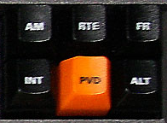
Keyboard Track Reroute Commands (QU)
Syntax: QU <FIX> (FIX)…(FIX) <FLID>
  Maximum of 17 fixes
  Examples:
QU SEA PMD090005 KLAX AAL521
QU 2832/8119 CRG DBN KATL * DAL2040
QU JOT STL270010 3727/8942 FAM KCGI 746

Slide 5

QU Commands - Uplinked
Track Reroute (QU) command provides the ability to amend the route and uplink it to CPDLC eligible aircraft by inserting /U into the command
A Due to Reason may be inserted for the clearance by using one of the following:
  /TFC - Due to traffic
  /RES - Due to airspace restriction
  /WX - Due to weather
Composition:
  CPDLC fields can be entered in any order
  Spaces are optional between CPDLC fields
Examples: QU MCN /U /TFC /FRC 334 QU MCN /FRC/U/TFC 334
QU MCN /FRC/U /TFC 334
  Route element(s) can be before, in between, or after CPDLC fields
Examples: QU /U /WX MCN AMG /FRC 334
QU /U /WX /FRC MCN AMG 334
/U
/<Reason>
/FRC

Slide 6
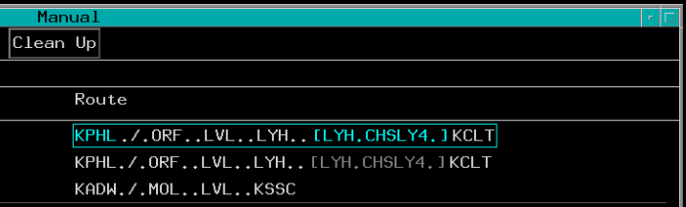
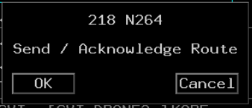
Acknowledge Embedded Route Text
ACL embedded route text:
If preferential route needs to be issued:
  Cyan box around the entire Route field, and
  Cyan brackets around a cyan embedded route
If sector is not eligible for cyan coded text
  Muted brackets around muted embedded route
  Preferential route cannot be acknowledged
Cyan Brackets
Cyan Box
To acknowledge embedded route 1. TBH
Muted Brackets around Muted Route
2. TBP
Resulting Amendment

Slide 7
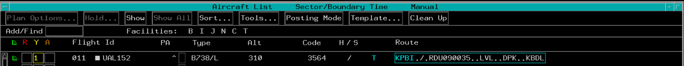
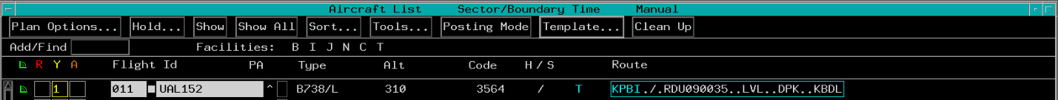
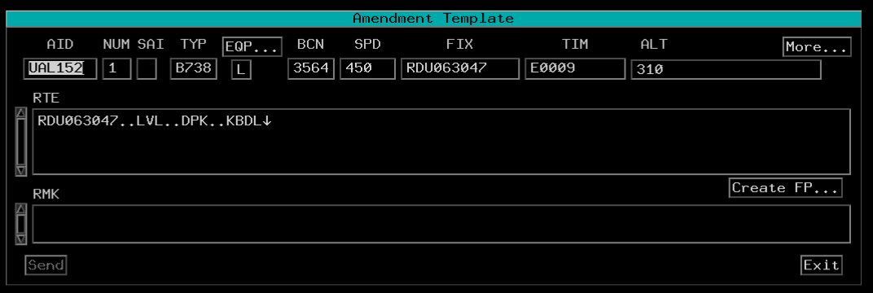

Amendment Template - Route Change
2. TBP
1. TBP
3. TBP or TBE and type to insert amended route
4. TBP Send button or KBE

Slide 8

Knowledge Check
How is an unissued embedded route displayed in the route field?
A.
B.
C.

Slide 9
Knowledge Check
Which of the following is not a valid QU amendment?
  QU SAV CAE090005 KCLT ↓ AAL521
  QU 2832/8119 CRG DBN KATL DAL2040
  QU 746 JOT090005

Slide 10
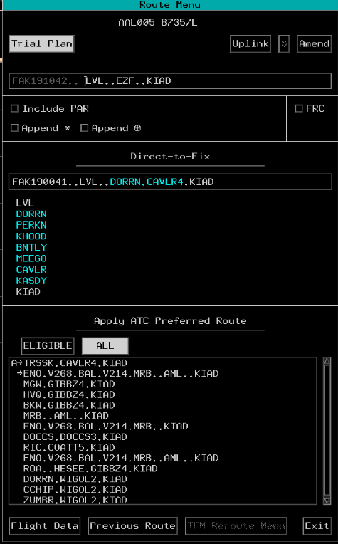
Route Menu
The purpose of the Route Menu is to provide the user with a method for creating a trial plan or amending a FP route of flight
The three types of route amendments available in the Route Menu are:
  Manually typing in a new route in the typing buffer
  Selecting a direct-to-fix option
  Selecting an ATC preferred route option

Slide 11
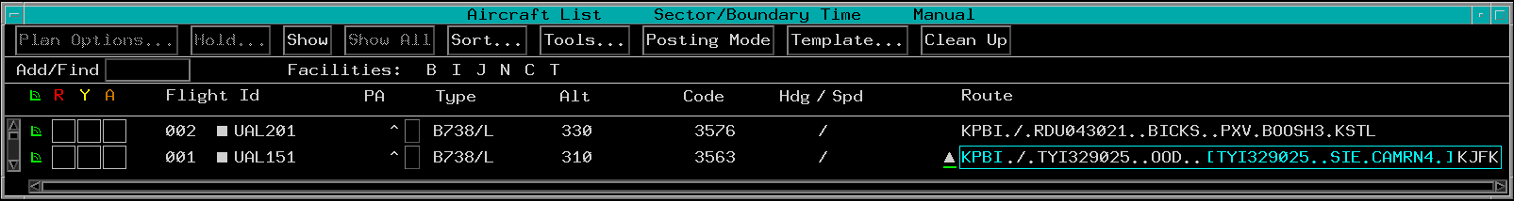
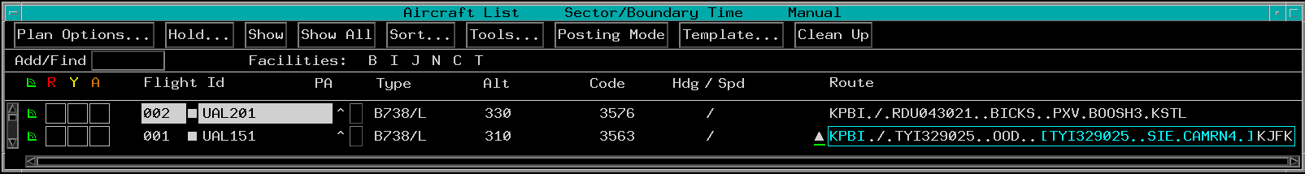
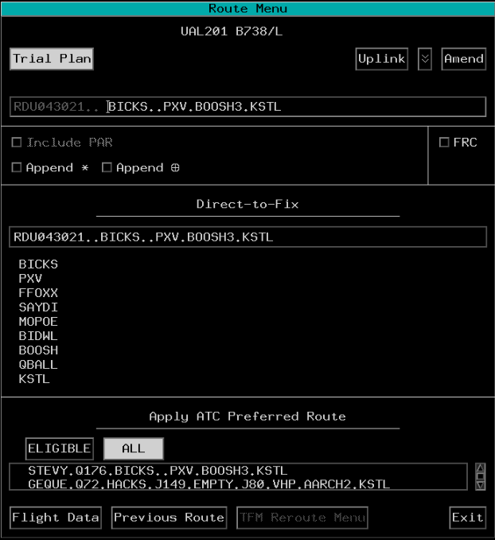
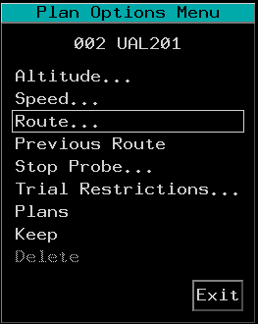
Accessing the Route Menu
1. TBP
Or TBP: Accesses the Route Menu in one step
2. TBP
3. TBP

Slide 12
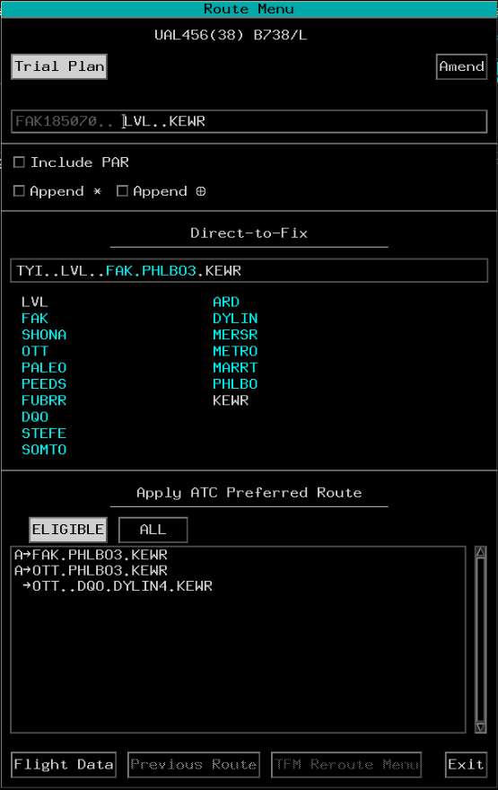
Route Menu Layout
Top Section
Selection Boxes Section
Direct-to-Fix/ ATC Intended Route Section
APR Section
Bottom Section

Slide 13
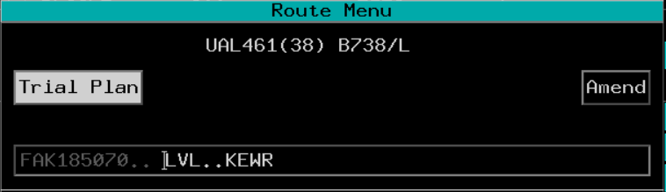

Top Section - Buttons
Aircraft ID and Aircraft Type/Equipment
Due To Chevron
Trial Plan
Uplink
Amend

Slide 14
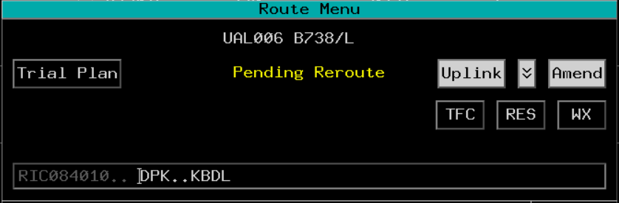
Top Section - Due To Chevron
Due To Chevron Button
Due To Reasons

Slide 15
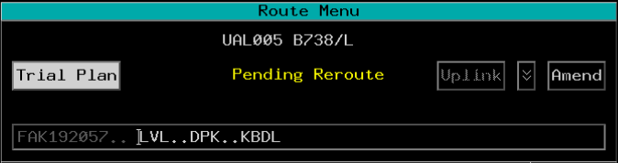
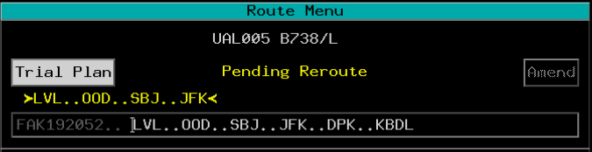
Top Section - Pending Reroute and Typing Buffer
Second row displays Pending Reroute in yellow text, but only if there is a pending reroute for the aircraft
Third row displays the pending reroute, but only if:
  A pending reroute has been trial planned and selected, and
  Route Menu was opened from the Plans Display/Plan Options Menu
Pending Reroute
Fourth Row: Typing Buffer
Non-Editable Element

Slide 16

Top Section - TFM Reroute Applied
Before Pending Reroute is applied:
displayed
After TFM Reroute has been applied:
not displayed
Applied TFM Reroute
Typing buffer route includes applied TFM Reroute

Slide 17
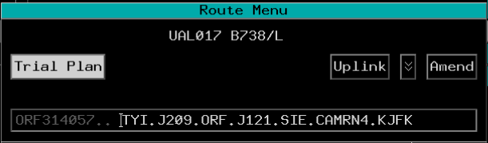
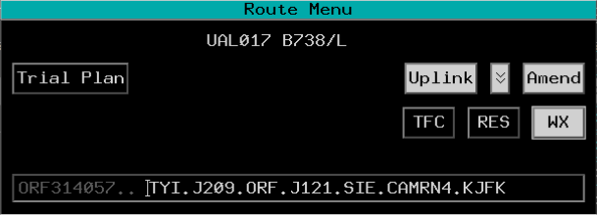

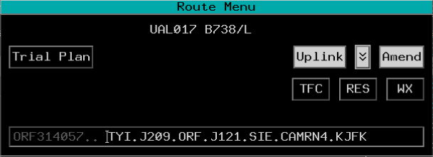
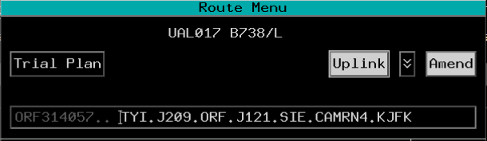
Top Section - Usage
To amend a route:
Selected by default
TBP Uplink or Amend
TBP Due to Chevron
TBP Due to Reason
Complete the amendment using Route Menu:
Typing Buffer, or
Direct-to-Fix section, or
ATC Preferred Route section

Slide 18
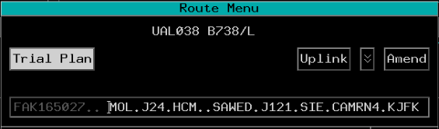
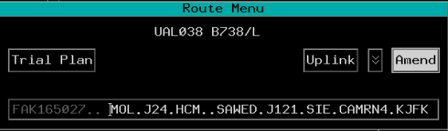
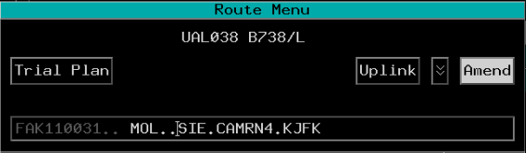
Top Section - Typing Buffer Amendment
1. TBP Amend
Typing Buffer
2. Enter revised route string
3. KBE completes amendment

Slide 19
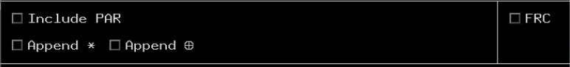
Selection Boxes Section
Include PAR selection box
  Only active if the route to be amended includes an adapted Preferential Arrival Route (PAR)
  Selecting this box prior to selecting the downstream fix results in an amendment from the current position to the selected downstream fix, and includes the appropriate PAR

Slide 20
Selection Boxes Section (Cont’d)
Append ✱, Append ⊕, FRC
Prohibits application of an adapted route
Prohibits application of an adapted Equipment Restricted Route (ERR)
Uplinked route will contain a Full Route Clearance (FRC)

Slide 21
Direct-to-Fix / ATC Intended Route Section
ATC Intended Route
Direct-to-Fixes

Slide 22






ATC Intended Route - Coding
Coding | Condition for Application | Example(s)
Cyan characters | Items are part of an unissued adapted route (AAR, ADAR, or ADR)
White characters in white brackets | Item is part of an auto route with non-field 10 alphanumerics
Underlined coral characters | Flight is not eligible for the item in the route
Cyan characters with coral underline | Items are part of an unissued AAR, ADAR, or ADR for which the flight is not eligible
Yellow chevrons | Surround TFM protected portion of route when TFM reroute is pending for the flight
White chevrons | Surround TFM protected portion of route when a TFM reroute is in effect for the flight
XXX or ??? | Incomplete route indicator

Slide 23
Direct-to-Fix - Coding
Coding | Condition for Application | Example
White chevrons | Fix is part of TFM-protected portion of route
Cyan characters | Fix is part of an unissued AAR that is expected to be issued in a clearance by the local facility and the item is not the route destination
Cyan characters within cyan parentheses | Fix is an part of an unissued AAR that is not expected to be issued in a clearance by the local facility (i.e., expected to be issued by a down route facility) and the item is not the route destination
Gray characters | Fix was generated from a non-field 10 adapted route
Underlined coral characters | Flight is ineligible for this fix
Cyan characters with coral underline | Fix is part of an uncleared AAR, ADAR, or ADR for which the flight is not eligible

Slide 24
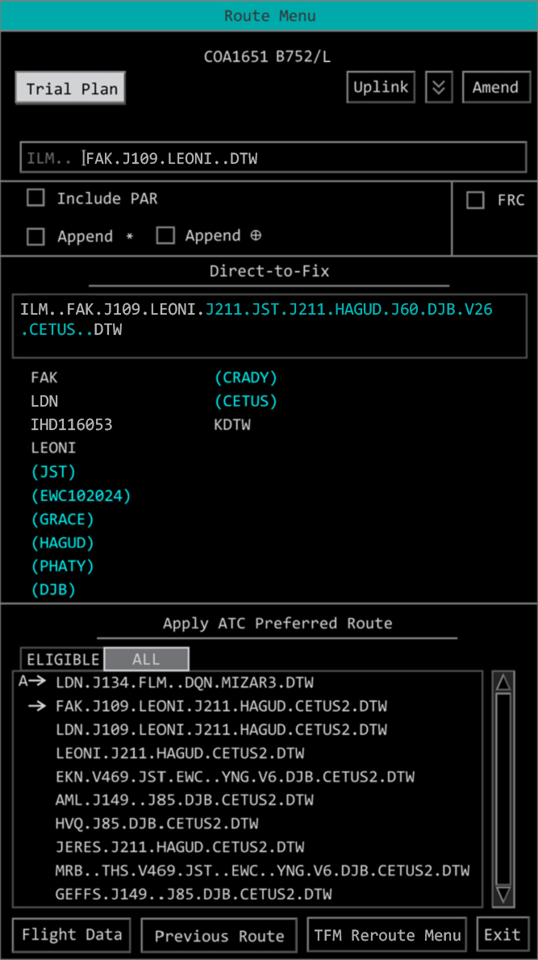
Direct-to-Fix - Amend Route
Use the areas outlined here to amend a route using a Direct-to-Fix

Slide 25
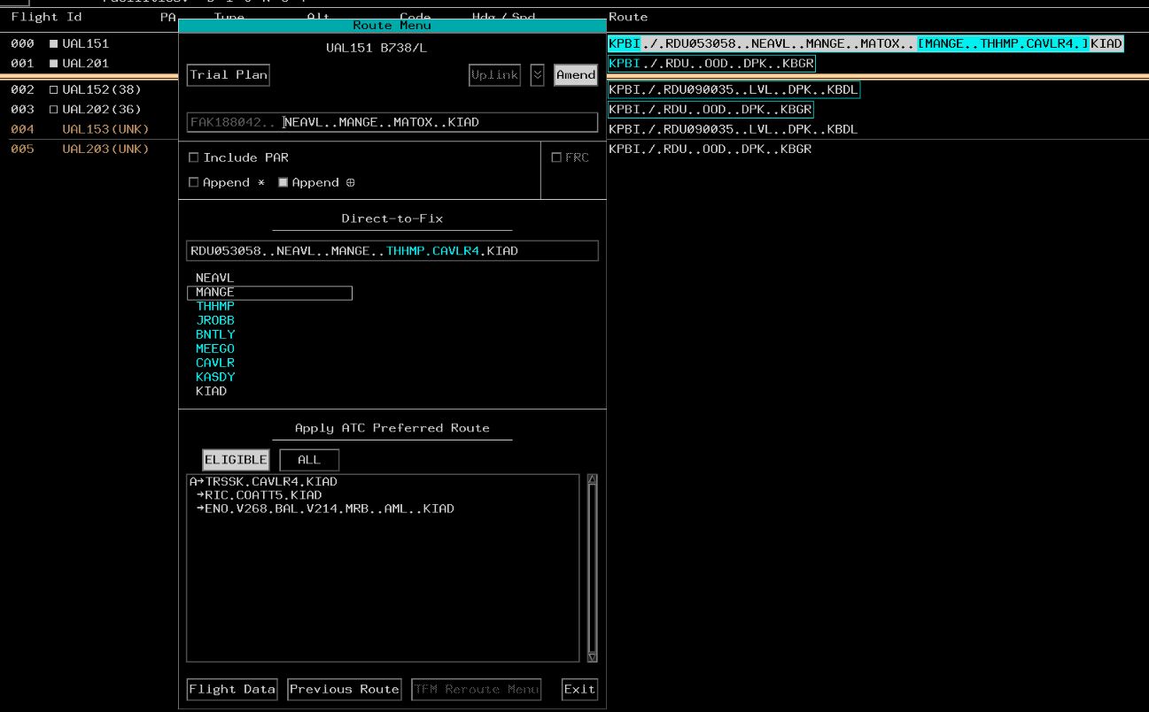
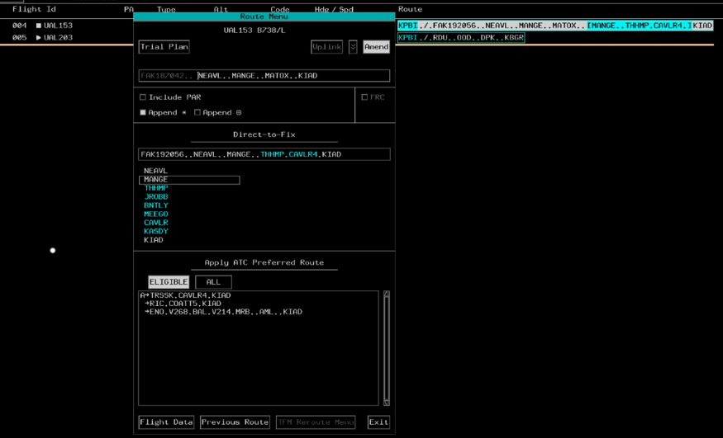
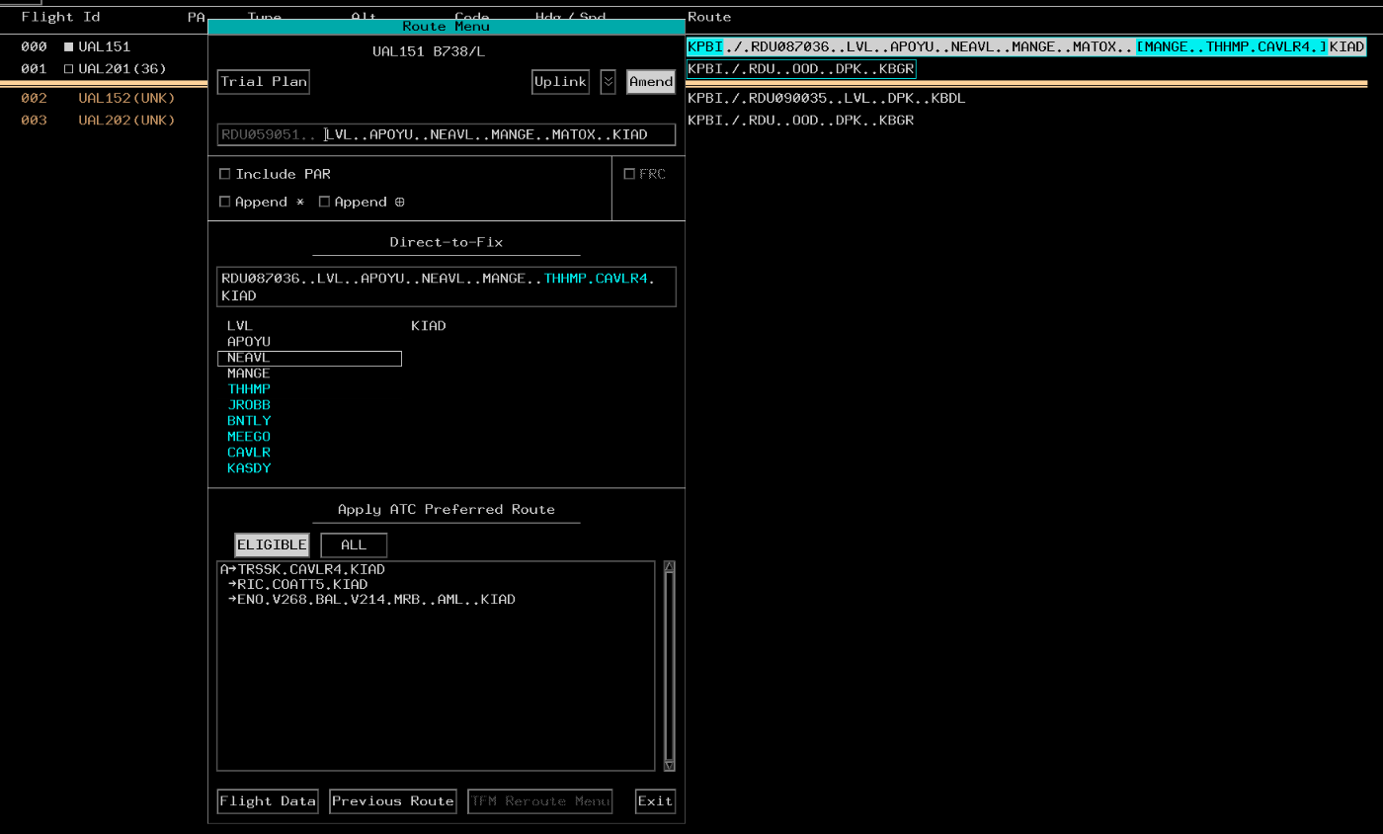
Direct-to-Fix - Include PAR Not Selected
Beginning ACL Route Field
Beginning ACL Route Field
Not selected
Beginning ACL Route Field
Not selected
Not selected
Resulting ACL Route Field
Resulting ACL Route Field
Resulting ACL Route Field
NOTE: No PAR applied.
Selected (White Fix)
[MANGE..THHMP.CAVLR4.] is the suppressed ERR PAR
[MATOX..FAK.COATT5.] is the applied non-ERR PAR.
White Fix Selected
Selected (White Fix)

Slide 26
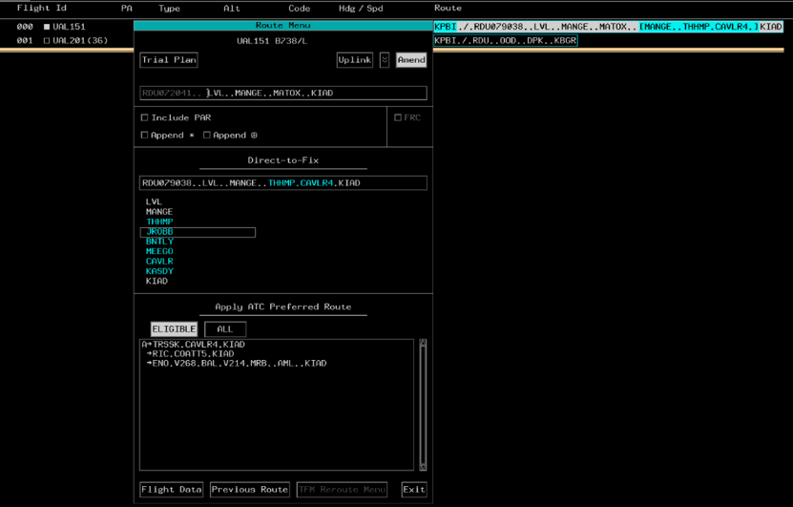
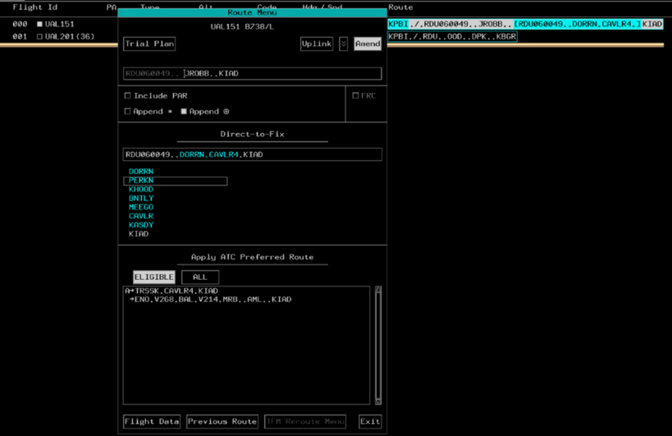
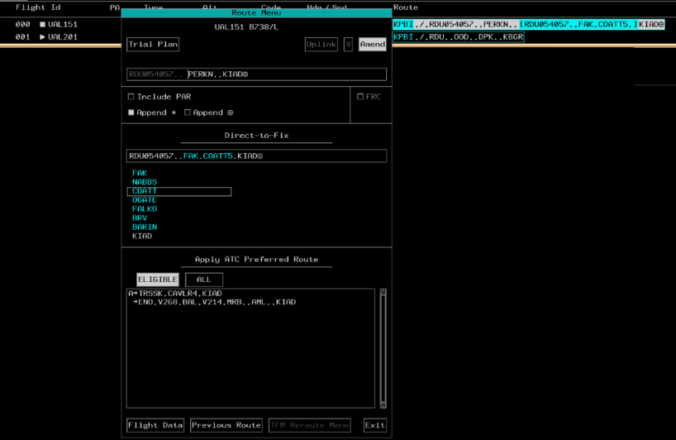
Direct-to-Fix - Include PAR Not Selected (Cont’d)
Beginning ACL Route Field
Beginning ACL Route Field
Beginning ACL Route Field
Not selected
Not selected
Not selected
Resulting ACL Route Field
Resulting ACL Route Field
Resulting ACL Route Field
Selected (Blue Fix)
NOTE: No PAR applied.
Blue Fix Selected
[DORRN.CAVLR4.] is the suppressed ERR PAR
[FAK.COATT5.] is the applied non-ERR PAR
Selected (Blue Fix)

Slide 27
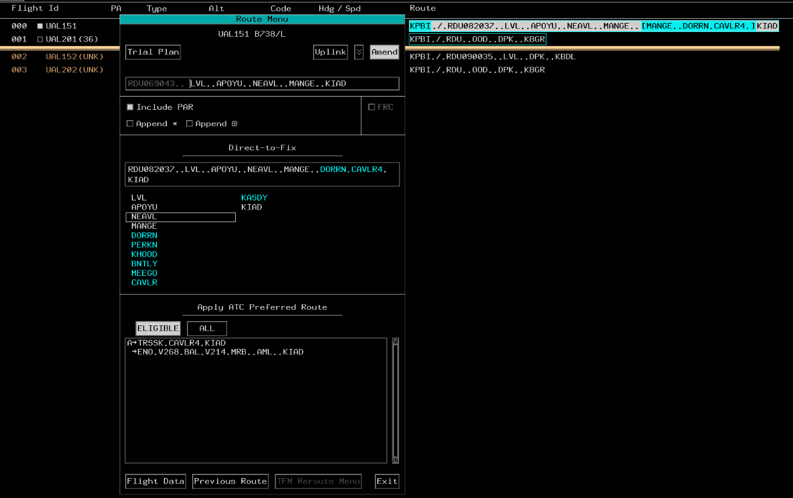
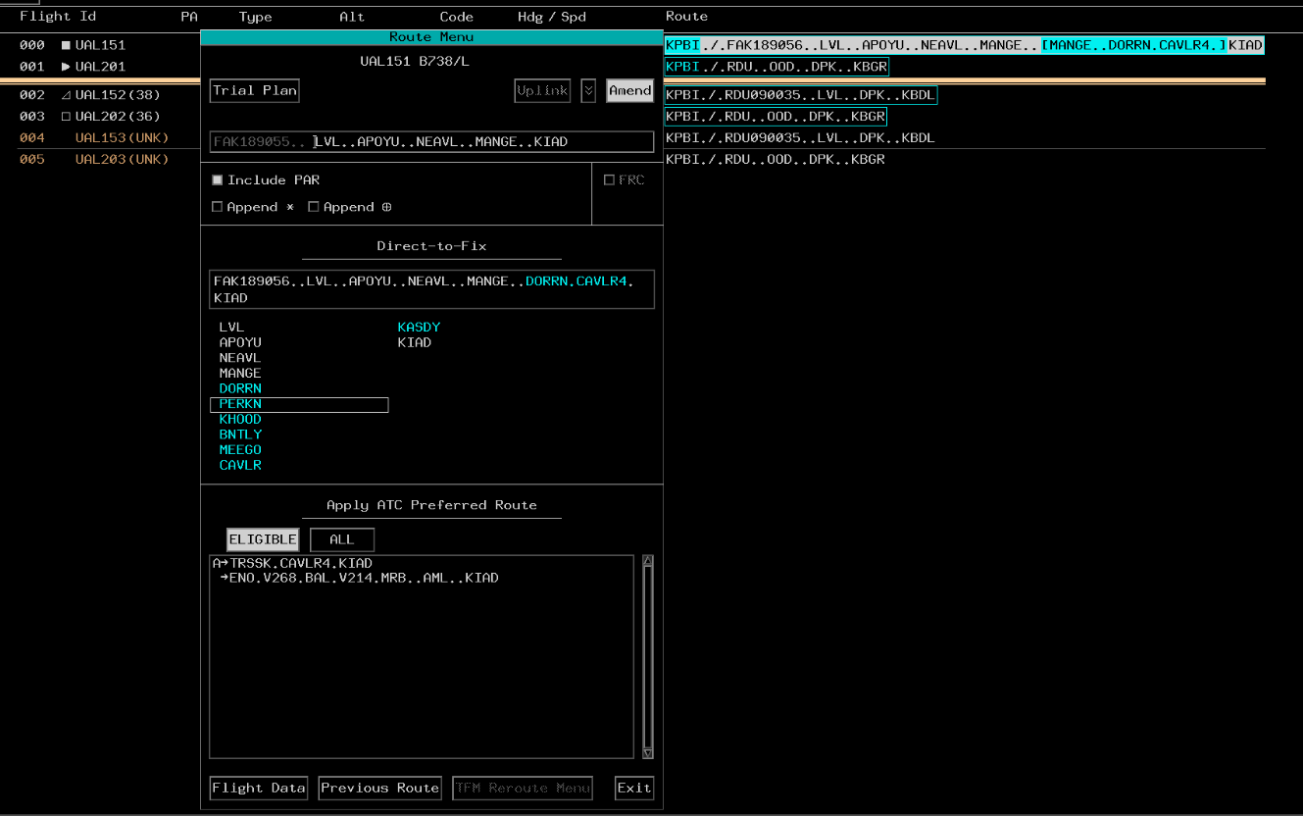
Direct-to-Fix - Include PAR Selected
Beginning ACL Route Field
Beginning ACL Route Field
Selected
Selected
Resulting ACL Route Field
Resulting ACL Route Field
White Fix Selected
Blue Fix Selected

Slide 28
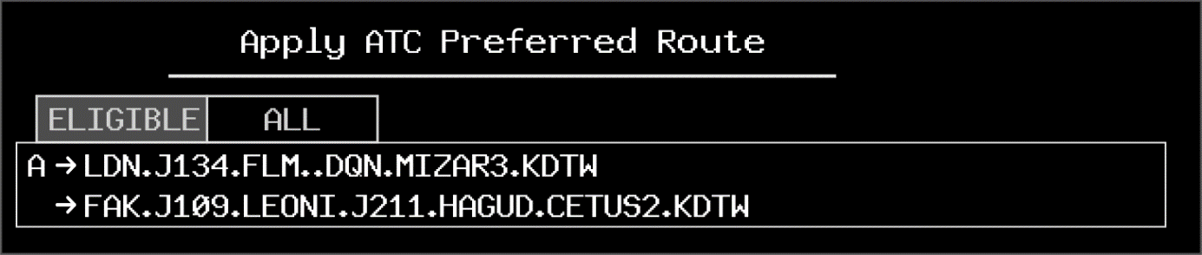
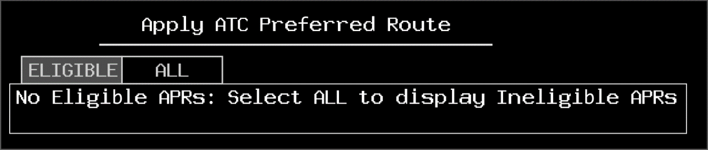
APR Section
ELIGIBLE tab (selected)
ALL tab
No Eligible APRs

Slide 29
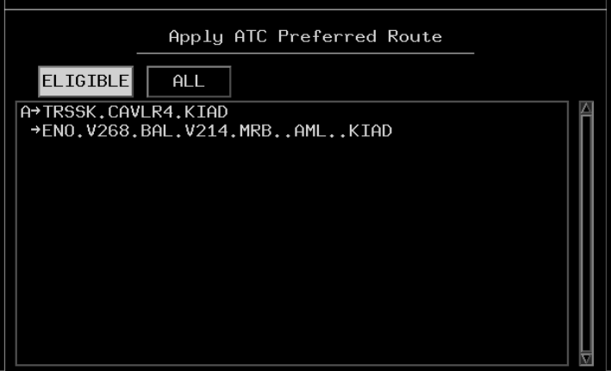
APR Section - ELIGIBLE Tab
Lists sector specific eligible ATC Preferred Routes (APRs)
NOTE: Eligible APR(s) are indicated by a blue departure point in the ACL route of flight.

Slide 30
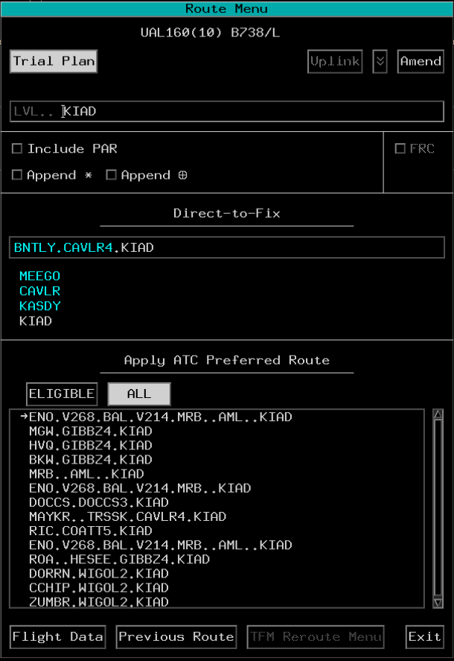
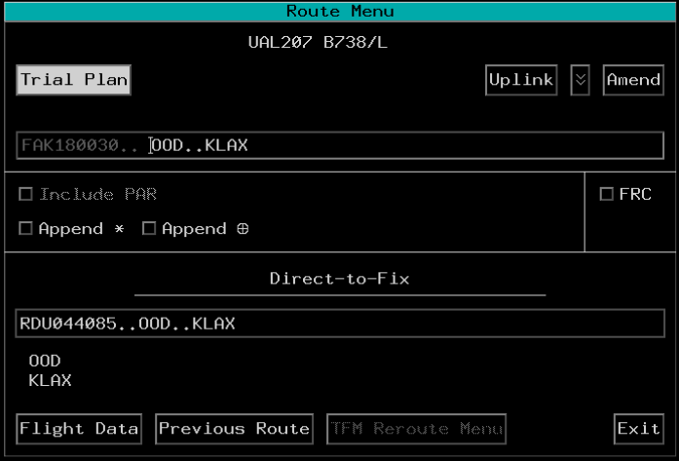
APR Section - All Tab
When no APRs are available: APR Section Removed
All Available APRs

Slide 31
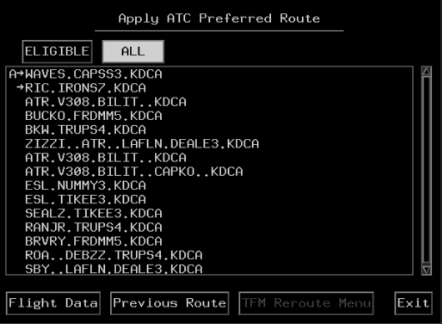
APR Section - Sort Order
Eligible Advanced APR
Eligible Non-Advanced APR
Ineligible APRs

Slide 32

APR - Amend Route
Use the areas outlined here to amend a route using an APR

Slide 33
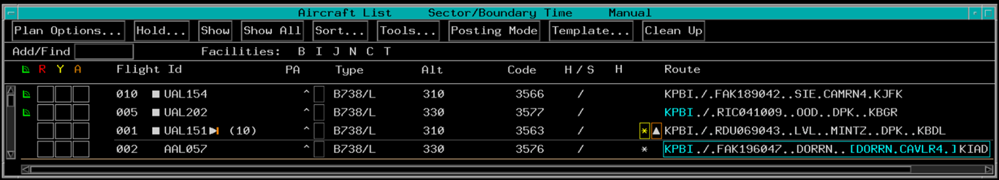
APR - Removal of Blue Departure Point from ACL

Slide 34
Bottom Section
Bottom Section

Slide 35
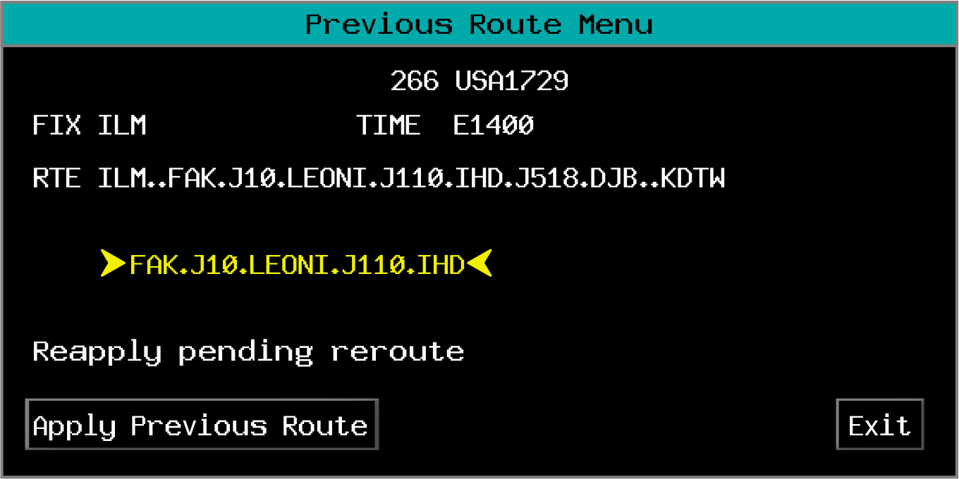
Previous Route
Aircraft ID
Current Coordination Fix & Time
Previous Route
TFM-Protected Segment of Previous Route
TFM-Protected Segment Message
Apply Previous Route Button
Exit Button

Slide 36
Knowledge Check
The Append ✱ selection box inhibits what type of adapted routes?
  Equipment Restricted Routes (ERR)
  Non-ERR
  All

Slide 37
Knowledge Check
In the Route Menu ATC Intended Route, what do the cyan coded elements represent?
  Unissued preferential route
  Pilot requested route
  TFMS Request

Slide 38
Knowledge Check
In which area may you edit the route of flight?
A
B

Slide 39
Knowledge Check
What are the CPDLC Due to Reasons that may be uplinked?
  Airspace; Congestion; Weather
  Traffic; Weather; Airport closure
  Weather; Traffic; Airspace restriction

Slide 40
Knowledge Check
Which is an advanced eligible ATC Preferred Route?
  Top one
  Top two
  All

Slide 41

TFM Reroutes

Slide 42
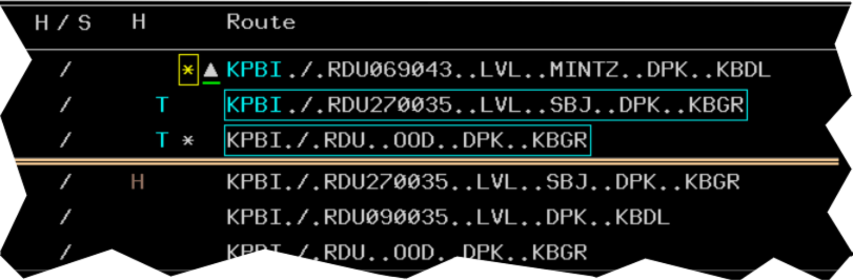
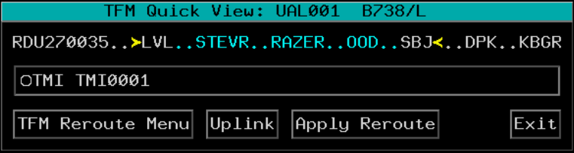
TFM Quick View
To open TFM Quick View
TFM Indicator Field
TBP or TBE

Slide 43
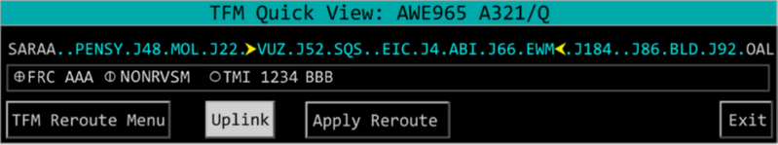

TFM Quick View Layout
Header
Pending Reroute

Slide 44
TFM Quick View Layout (Cont’d)
Pending Remarks

Slide 45
TFM Quick View Layout (Cont’d)
TFM Quick View Buttons

Slide 46
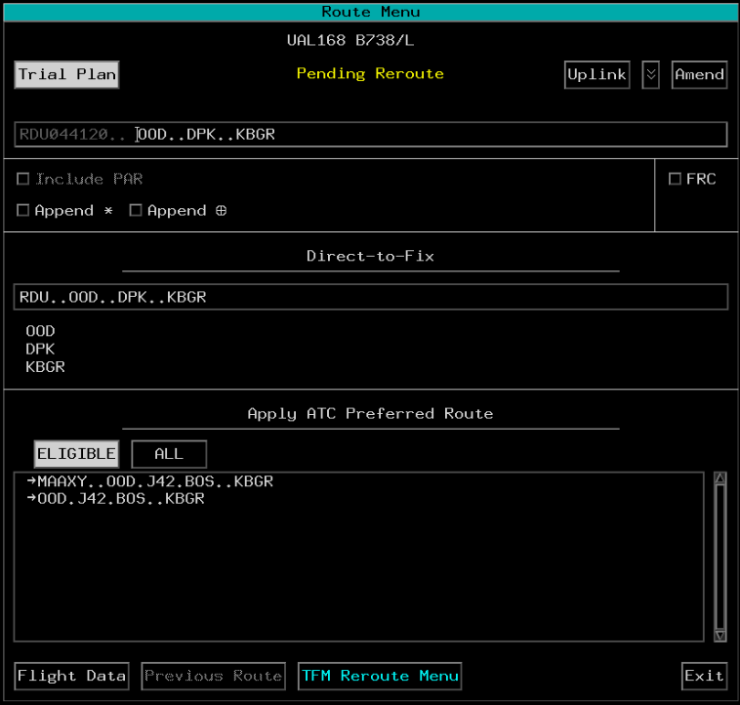
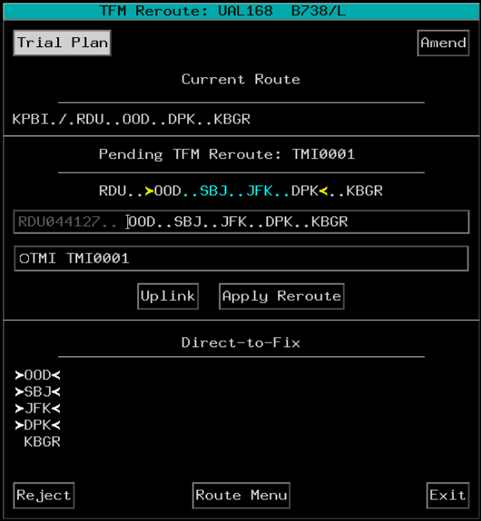
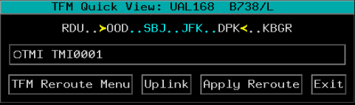
TFM Reroute Menu Access
TBP
Or
TBP

Slide 47
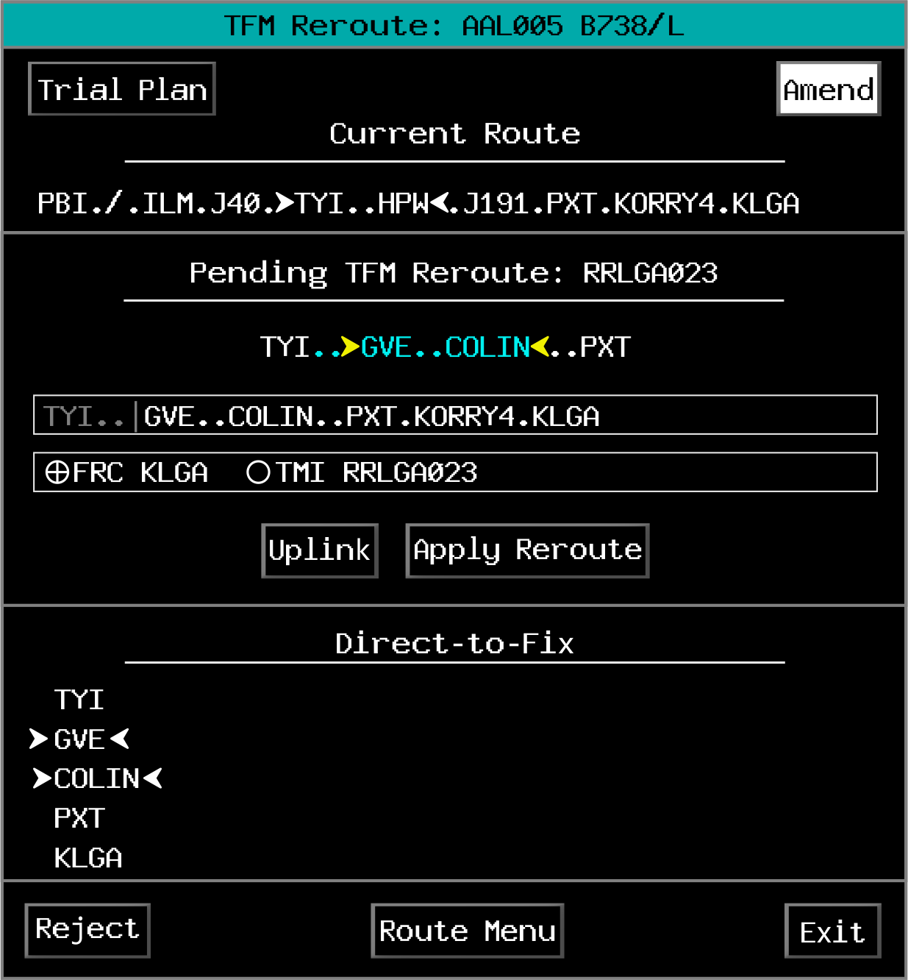
TFM Reroute Menu
Header
Current Route Section
Pending TFM Reroute Section
Direct-to-Fix Section

Slide 48
TFM Reroute Menu (Cont’d)
Pending TFM Reroute Title
Pending TFM Reroute
Typing Buffer
Pending Remarks
Direct-to-Fix Section

Slide 49
TFM Reroute Menu Buttons
TFM Reroute Menu Buttons

Slide 50
TFM Reroute Menu Coding
Data | Coding | Condition for Application | Example
Protected Segment Symbols - Current Route | White chevrons | Current route contains protected segment
Protected Segment Symbols - Pending Reroute | Yellow chevrons around protected portion of route | Pending TFM reroute contains protected segment
Divergent Fix - Pending Reroute | Point (fix) at which aircraft joins reroute or divergent point is in white text | Divergent point is a fix within current flight plan route
Convergent Fix - Pending Reroute | Point (fix) at which aircraft joins current flight plan route or convergent point is in white text | Convergent point is a fix within current flight plan route

Slide 51
TFM Reroute Menu Coding (Cont’d)
Data | Coding | Condition for Application | Example
Pending Reroute String | Cyan text | Portion of route that is not on current route flight plan | See Below
Flight Beyond Divergent Fix Warning | Yellow text | Flight is past divergent fix | See Below
Protected Segment Symbols in Direct-to-Fix List | Each fix that is part of TFM-protected portion of route is displayed with chevrons pointing inward towards the fix, which is white | Fix is part of TFM-protected portion of the route (protected segment)
Menu Item | Underlined coral characters | Flight is ineligible for route fix

Slide 52
TFM Reroute Menu - Apply Reroute
1. TBP
2. TBP and edit
3. TBP

Slide 53
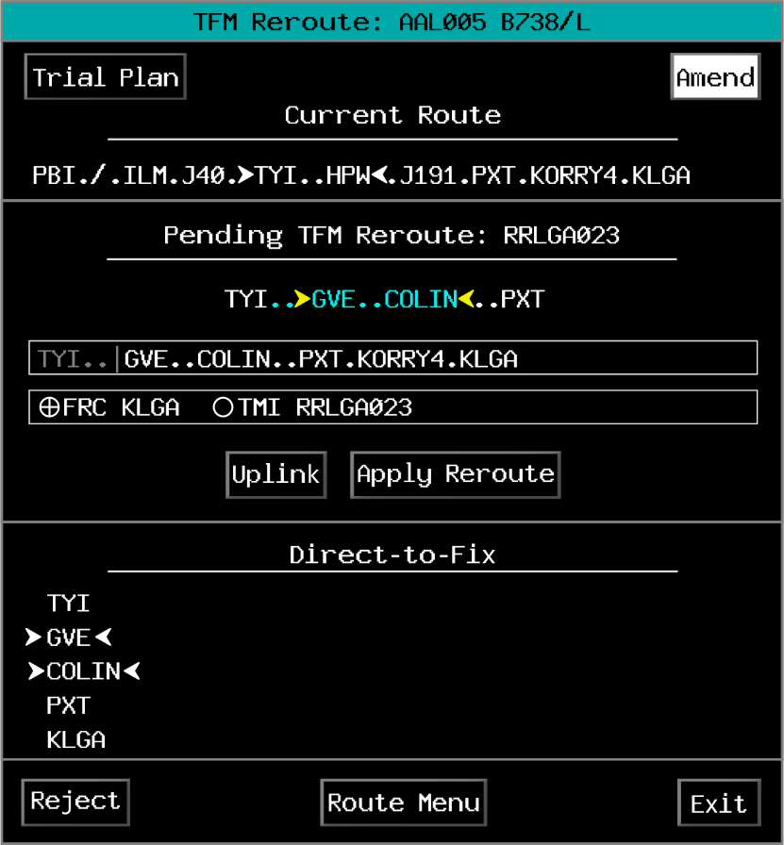
TFM Reroute - Reject Confirmation Pop Up
Sector has track control
1. TBP
2. TBP

Slide 54
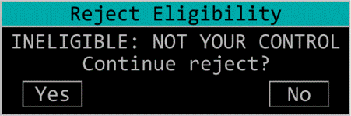
TFM Reroute - Reject Eligibility Pop Up
Sector does not have track control
1. TBP
2. TBP

Slide 55
TFM - Send AM Confirmation Pop Up
Provides notification to the controller that there has been a reroute cancellation while one of the following is open:
  TFM Reroute menu
  TFM Quick View menu
  Plans Display (reroute trial plan)
Provides the means to choose whether to continue to send or cancel an amendment

Slide 56
TFM Reroute Warning Pop Up
TBP

Slide 57

TFM Reroute Becomes Invalid
When a pending TFM Reroute becomes invalid:
  Cyan “T” to the left of the route field in the ACL is removed
  Route is no longer available to be applied

Slide 58


TFM Reroutes Invalidated
1. TBP
2. TBP

Slide 59

TFM Reroute Remarks

Slide 60

TFM Reroute Remarks Functionality
A TFM pending reroute may add or remove remarks in a flight plan

Slide 61

Knowledge Check
How may the TFM Quick View be accessed?
  TBP the flight ID
  TBP the “T” in the TFM indicator field
  TBP the blue coding in the route field

Slide 62

Knowledge Check
What is true of TFM Pending Reroute remarks?
  All remarks may be edited
  All remarks except the TMI ID may be edited
  This field is not selectable and cannot be edited

Slide 63
Knowledge Check
SARAA in the Pending TFM Reroute is the point at which the aircraft will _____ .
  begin protected route segment
  diverge from TFM reroute and join current route
  diverge from current route and join TFM reroute

Slide 64
CPDLC Route Uplink Considerations
Capability to uplink four different types of route clearances
EAS will validate the command, and if valid update the flight plan
  After flight plan is updated, the system builds and sends an uplink message

Slide 65

CPDLC Route Clearance Types
1923Z
ATC UPLINK
1/1
PROCEED DIRECT TO <Position>
CLEARED TO <Position> VIA <Route>
CLEARED <Route>
AT <Position> CLEARED <Route>
STATUS
OPEN
PROCEED DIRECT TO FAK, REST OF ROUTE UNCHANGED
-------------------------------
<STANDBY
WILCO>
<UNABLE
LOAD>
<PRINT

Slide 66


Route Uplink - In Progress
280
5223
/
RDU..ROA..EKN..IHD.N
SWA427
280C
225 300

Slide 67
Route Uplink - Processing
Controller enters route command
EAS validates the command
If command passes validation route will be amended in EAS
CPDLC will build the uplink and evaluate route for any FMS loadability issues
If no FMS loadability issues are identified, CPDLC will uplink the message

Slide 68
Route Uplink - FMS Loadability Issues
Example: BWI LOCAL ADAPTATION IN ROUTE

Slide 69



Route Uplink - System Latency
Do NOT use CPDLC if there is a chance the aircraft will be past the first fix in the route amendment before a response is received from the pilot
CHS
ILM
SAV
SWA123
DIW
TOO CLOSE
CRG
Cleared Route: KMIA./.CRG..SAV..CHS..ILM..DIW..KJFK
Do not uplink direct ILM

Slide 70

Route Uplink - Timeout Indicators
280
5223
/
RDU..ROA..EKN..IHD.N
SWA427
280C
225 300

Slide 71
Knowledge Check
A CPDLC route amendment is always uplinked if the amendment passes validation and is recorded in ERAM.
  True
  False

Slide 72
Knowledge Check
What does the white triangle with green underline indicate?
  Route Timeout
  Altitude Uplink In Progress
  Route Uplink In Progress
280
5223
/
RDU..ROA..EKN..IHD.N

Slide 73
Knowledge Check
What does the white-bracketed triangle indicate?
  Route Timeout
  Altitude Timeout
  Pilot Timeout
280
5223
/
RDU..ROA..EKN..IHD.N

Slide 74
Part-Task Exercise
Purpose
  Perform route amendment tasks, which include CPDLC uplink and Traffic Flow Management Reroute functionality
Materials
  TTL part-task exercise: Route Amendments
Directions
  This exercise takes approximately 45 minutes to complete. Each student must complete the checklist tasks. No headsets are required.

Slide 75
Lesson Summary
This lesson covered:
  Keyboard route amendments
  Route Menu amendments
  Traffic Flow Management (TFM) Reroutes
  CPDLC route uplinks

Slide 76
The End

