Slide 2
Altitude amendment commands and syntax
EDST altitude amendments
CPDLC altitude processing
Mode C validation and altitude confirmation requirements

Slide 3
Types of Altitude Amendments
  Assigned (QZ and AM)
  Interim (QQ)
  Local Interim (QQ L)
  Waiver (QQ W)
  Procedure (QQ P)
  Crossing Restriction (UC)

Slide 4
Supported Altitude Uplinks
Uplink may be accomplished via:
  Keyboard
  EDST menus
When uplinking an altitude, the system will build the appropriate uplink message type
Only single altitudes may be uplinked
  Altitudes other than a single altitude will be rejected, such as:
    ­VFR, OTP, ABV
    ­Block altitudes
    ­ALT/FIX/ALT

Slide 5


Altitude Data Processing
Transferring controller:
Local Interim Altitude displayed in FDB but not displayed in ACL
Receiving controller:
Local Interim Altitude not displayed in FDB or ACL

Slide 6
Flight Plan (FP) Assigned Altitude
Planned altitude for the aircraft
Is the requested altitude, when the flight plan is filed
If available, may be issued in initial clearance
Can be modified using:
  Keyboard commands
  EDST menus

Slide 7
AM Command for FP Assigned Altitude
Without CPDLC uplink
    Syntax: AM <FLID> ALT <ddd>
    Example: AM 348 ALT 120
    or, using field number
    AM 348 08 120
  With CPDLC uplink
    Syntax: AM <FLID> ALT <ddd> /U
    Example: AM 348 ALT 120 /U

Slide 8
QZ Command for FP Assigned Altitude
Without CPDLC uplink
    Syntax: QZ <ddd> <FLID>
    Example: QZ 120 348
  With CPDLC uplink
    Syntax: QZ <ddd> /U <FLID>
    Example: QZ 120 /U 348
    QZ /U 120 348

Slide 9

Knowledge Check
Which altitude is eligible for uplink?
  VFR
  150
  150B170

Slide 10
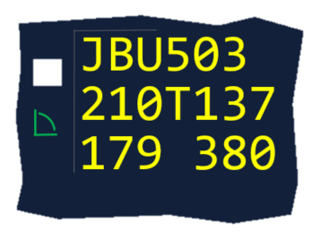
Interim Altitude
Temporary altitudes issued by controllers for:
  Separation
  Meeting flight restrictions
Displayed to the right of the FP assigned altitude in the ACL
Displayed instead of the FP assigned altitude in the FDB
Coordinated with a neighboring ARTCC
Interim
Mode C

Slide 11
QQ Command for Interim Altitude
Without CPDLC uplink
    Syntax: QQ <ddd> <FLID>
    Example: QQ 120 348
  With CPDLC uplink
    Syntax: QQ <ddd> /U <FLID>
    Example: QQ 120 /U 348

Slide 12
Local Interim Altitude
Temporary altitude used for local traffic avoidance
  Not coordinated with neighboring ARTCCs
  Only entered and removed by controller input
  Supersedes existing interim altitude for conflict alert predictions
  Is not modeled in the aircraft trajectory or flight plan trajectory
  Is not displayed in the ACL
  Displayed instead of assigned and interim altitudes in the FDB

Slide 13
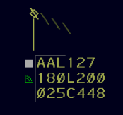
QQ Command for Local Interim Altitude
Without CPDLC uplink
    Syntax: QQ L<ddd> <FLID>
    Example: QQ L200 025
With CPDLC uplink
    Syntax: QQ L<ddd> /U <FLID>
    Example: QQ L200 /U 025

Slide 14
Knowledge Check
Which is true about a local interim altitude?
  Not eligible for uplink
  Only used for block altitudes
  Not coordinated with a neighboring ARTCC

Slide 15
Waiver Altitude
Used operationally as an intermediate altitude prior to the aircraft’s final requested altitude
Uplinked to the aircraft, but not displayed in the FDB or ACL
Used in departure procedures to coordinate between sectors
Adapted by facilities based on the departure airport

Slide 16
QQ Command for Waiver Altitude
  Only eligible for CPDLC uplink
  Syntax: QQ W /U <FLID>
  Example: QQ W /U 348

Slide 17
Procedure Altitude
Assigned to an aircraft that is descending via an arrival route with a published Vertical Navigation (VNAV) profile
  Clearance indicates that a flight has been cleared to fly a published VNAV profile for a published Standard Terminal Arrival Route (STAR)
  Entered into the system, but not uplinked to the aircraft

Slide 18
QQ Command for Procedure Altitude
Procedure altitude is not uplinked to the aircraft
    Syntax: QQ P<ddd> <FLID>
    Example: QQ P120 348

Slide 19
Uplink Crossing Restriction
The Uplink Crossing Restriction (UC) command allows the controller to manually uplink a clearance to cross a position at an altitude, and optionally a speed
Syntax:
UC <Position> <Altitude> (Speed) <FLID>
  The position must be on the aircraft’s current route and must be one of the following:
    Published fix
    FRD
    Lat/Long

Slide 20


Silent Check-ins and Crossing Restrictions
If a pilot is instructed to MONITOR when changing to your frequency, you will not receive notification of any crossing restrictions issued

Slide 21
Knowledge Check
Which is the correct format to uplink a crossing restriction?
  UC BDEGA A120 AAL250
  UC AAL250 BDEGA A120
  UC BDEGA ALT120 AAL250

Slide 22
Knowledge Check
Which altitude will be displayed in the ACL?
  Procedure Altitude
  Local Interim Altitude
  Waiver Altitude

Slide 23
Urgency Indicator
Urgency indicators may be added to any uplinked altitude clearance except crossing restrictions
  Only one urgency indicator may be added to a clearance
  These options inform the pilot if other than standard compliance is needed with the clearance
    /PD - Pilot’s Discretion
    /IMM - Immediately
    /EXP - Expedite

Slide 24
Due to Reason
A Due to Reason may be added to an uplinked clearance, except for crossing restrictions, and combined with an urgency indicator in the same clearance
  These options inform the pilot of the reason for an altitude change:
    /TFC - Due to traffic
    /RES - Due to airspace restrictions
    /WX - Due to weather

Slide 25
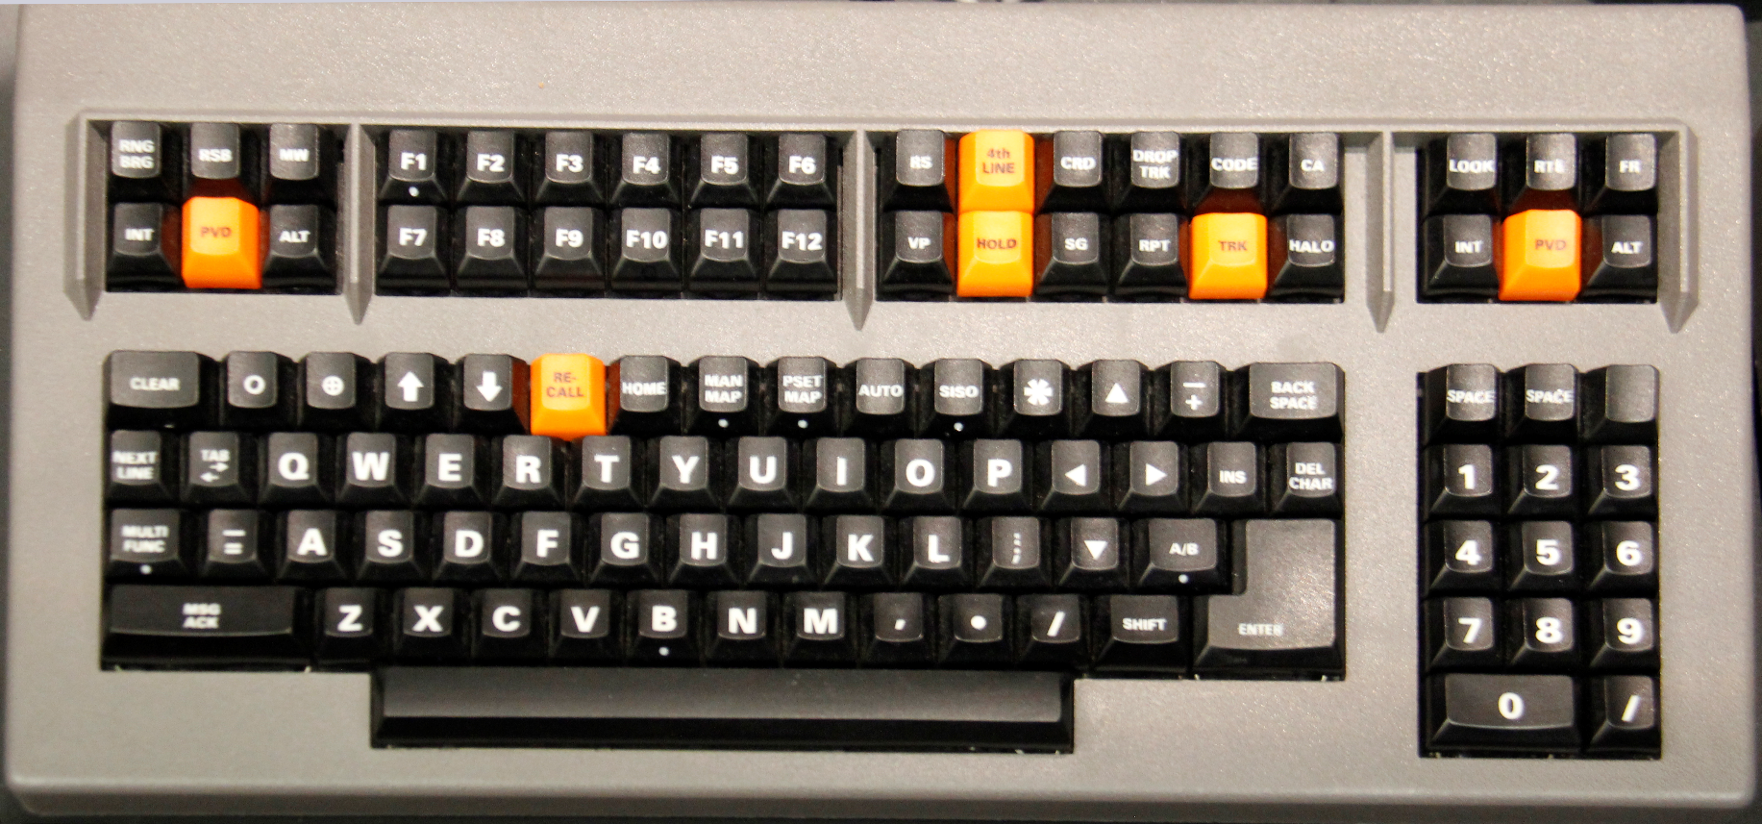
CPDLC Keyboard Keys
CPDLC Key
CPDLC Enter Key

Slide 26
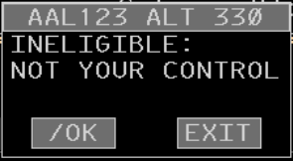
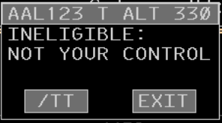
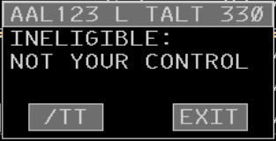
Eligibility Override
Altitudes may be entered by a sector that does not have track control of an FDB
  /OK - To amend an FP assigned altitude
  /TT - To amend, or remove, an interim or local interim altitude
FP Assigned Altitude
Interim Altitude
Local Interim Altitude

Slide 27
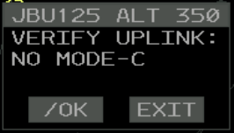
Eligibility Override - No Mode C
The system inhibits uplinks to aircraft that have no surveillance reported or Mode C altitude displayed

Slide 28
Knowledge Check
Which is the eligibility override command to add, remove, or change an Interim Altitude?
  /OV
  /TT
  /TI

Slide 29
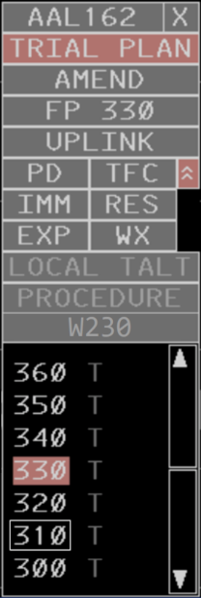
EDST Altitude Menu
The purpose of the Altitude Menu is to provide the user with a method for
  Creating a trial plan
  Amending an FP assigned altitude
  Entering an interim, procedure or waiver altitude
Trial Plan pick area

Slide 30
EDST Altitude Menu Pick Areas
Menu Title (ACID)
Trial Plan pick area
Menu Exit pick area
Amend pick area
Flight Plan Assigned Altitude
Uplink pick area
Reason Expansion pick area
Due to Reason pick areas
Urgency Indicators pick areas
Local Interim Altitude pick area
Procedure Altitude pick area
Assigned Altitude pick area
Waiver Altitude pick area
Interim Altitude pick area
Current Altitude
Dwell emphasis
Menu Scroll pick area

Slide 31
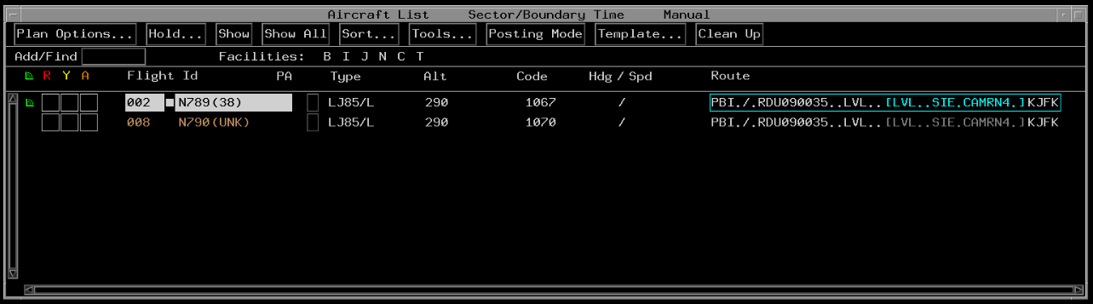
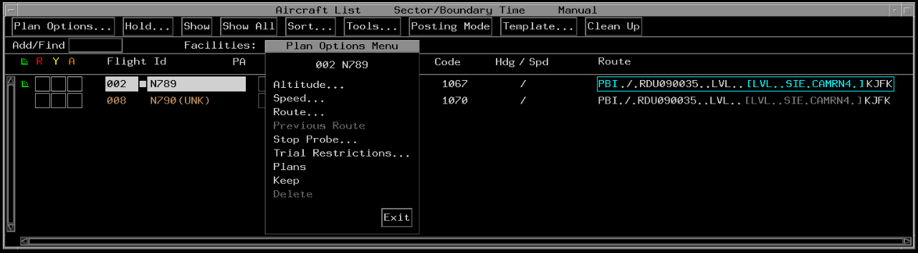
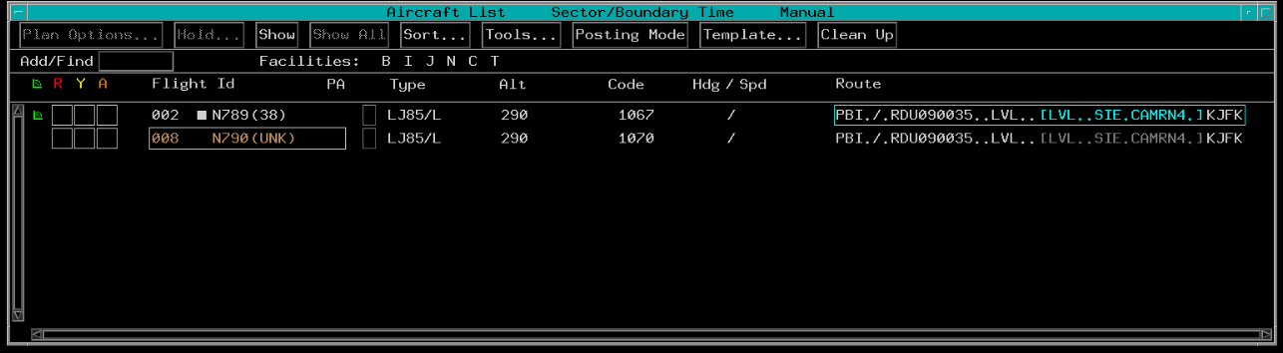
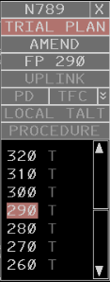
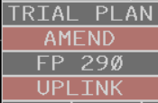



Plan Options Menu
Altitude entries may also be made from the Plan Options Menu
Or- TBP or TBE an Interim Altitude “T”
TBP Plan Options…
TBP Flight Id
TBP Altitude…
TBP or TBE AMEND or UPLINK
TBP or TBE an Assigned Altitude
Or- Type digits of an Assigned Altitude and KBE

Slide 32
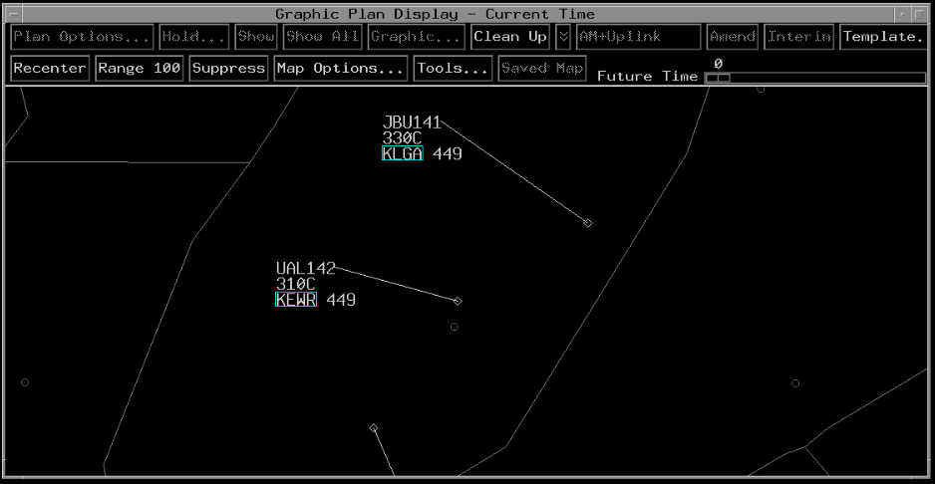
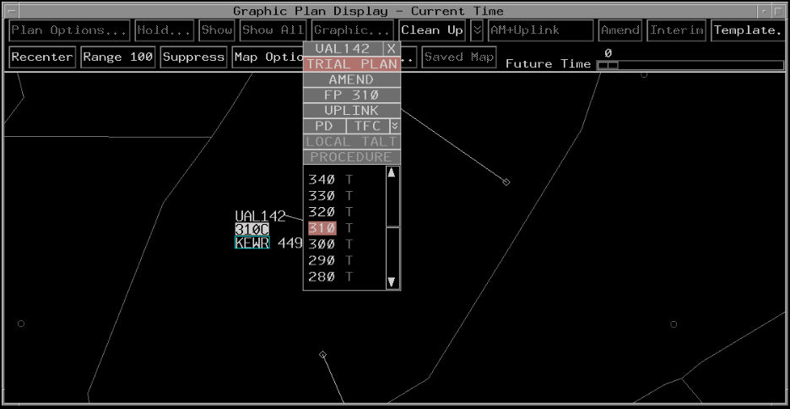
GPD - Altitude Amendment
TBP on Altitude Field
Complete amendment in Altitude menu

Slide 33
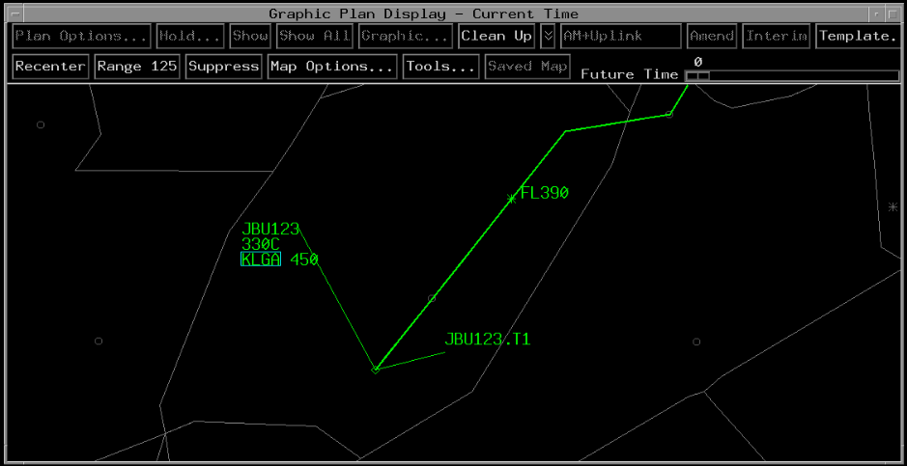
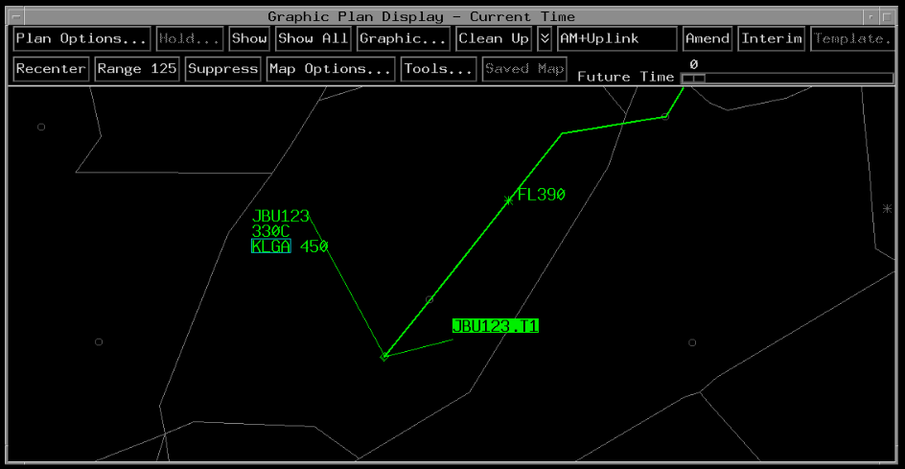
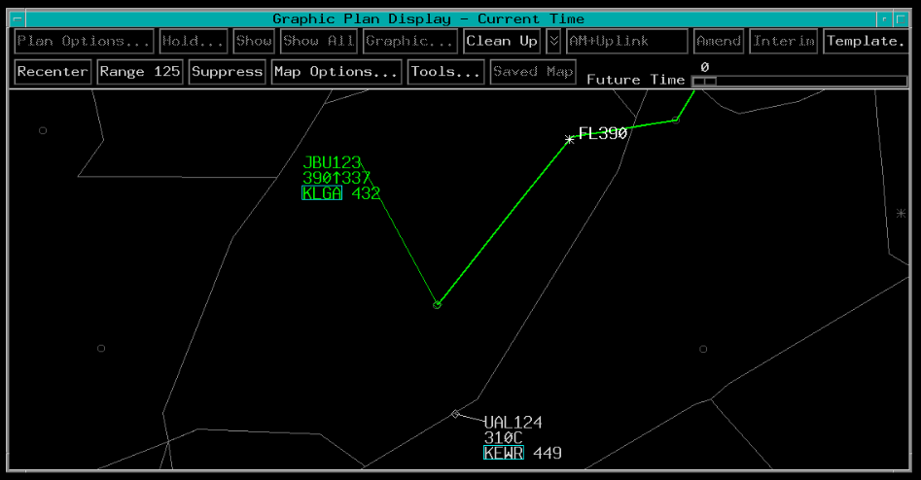
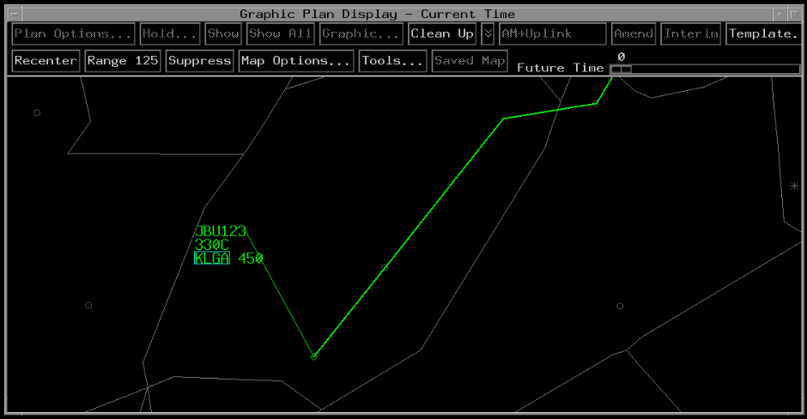
GPD - Amend Trial Planned Altitude
GPD altitude amendments using previous trial planned altitudes
TBP Amend+Uplink for Assigned Altitude and Uplink Clearance
TBP Interim for Interim Altitude
TBP Amend for Assigned Altitude
Resulting Altitude Amendment
Trial Plan Altitude
TBP on Trial Plan Data Block

Slide 34
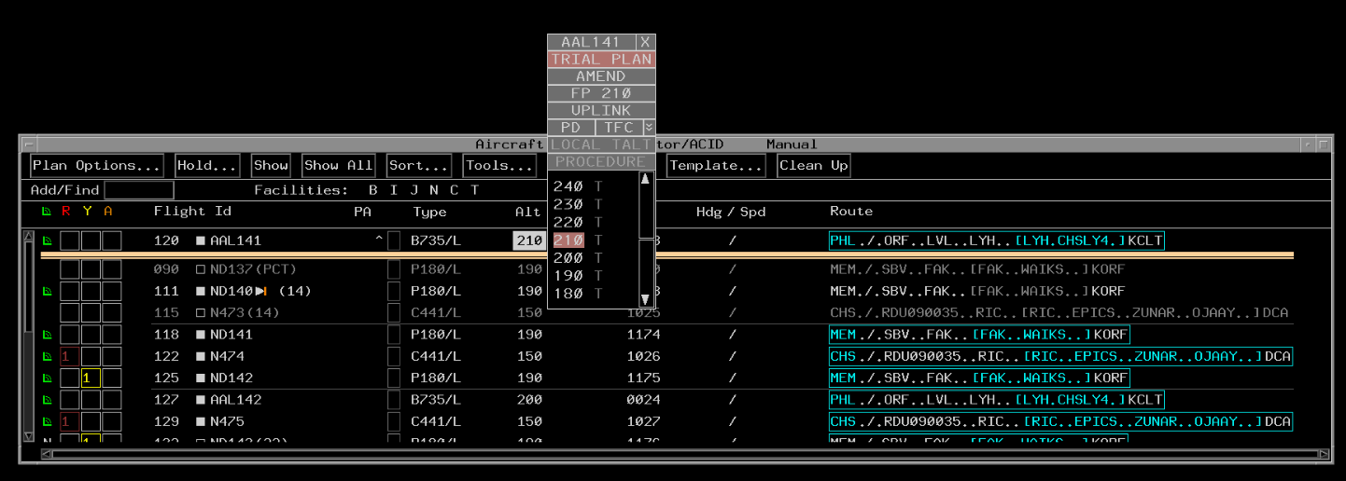
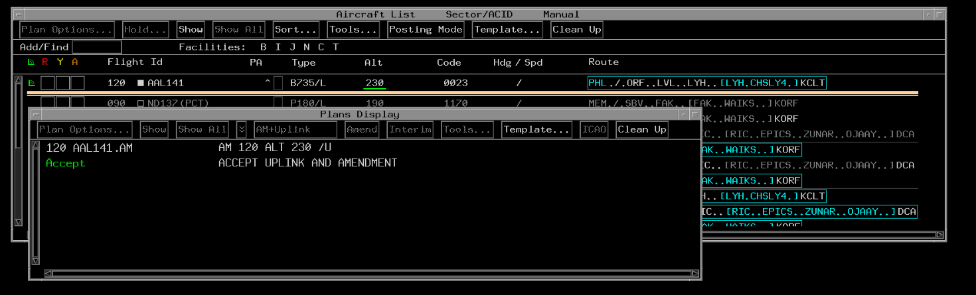
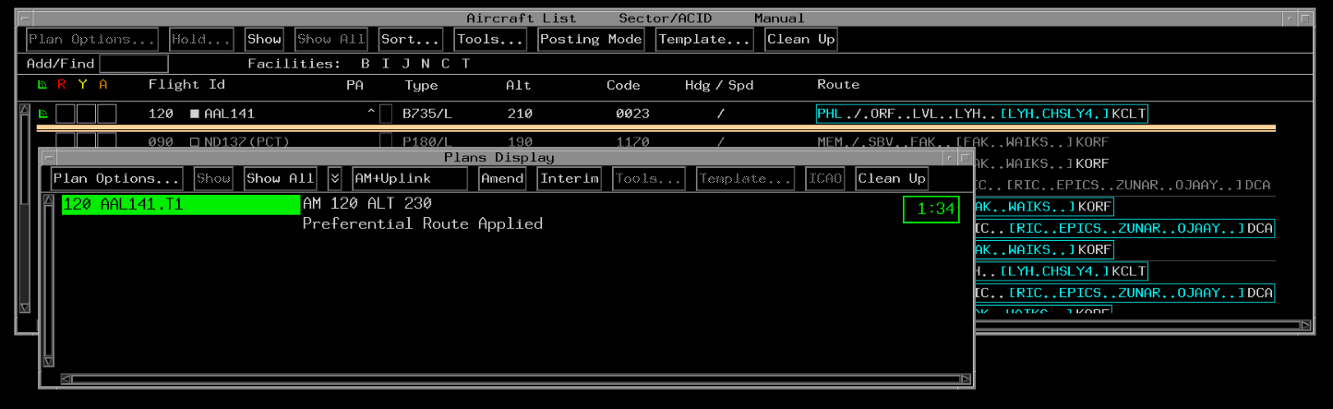
Plans Display -
Amend Trial Planned Altitude
Create a Trial Plan: TBP or TBE altitude or T beside altitude
Accepted AM+Uplink
TBP one of these buttons

Slide 35
Knowledge Check
An altitude clearance cannot be amended and uplinked from a trial plan.
  True
  False

Slide 36
Altitude Uplink Processing
Controller enters altitude command
The system validates the command
If command passes validation flight data will be updated
After flight data is updated, the system will build and send the uplink message

Slide 37

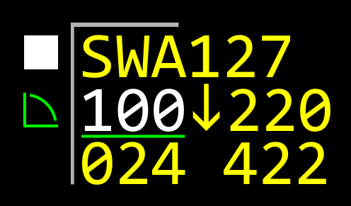



Altitude Uplink in Progress
The Altitude Uplink in Progress indicator is displayed when an altitude is initially sent, until a response is received that closes the uplink

Slide 38

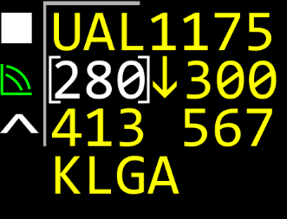

Altitude Uplink Timeout Indicator
Displayed when no response to an altitude uplink has been received within an adapted time period

Slide 39
CPDLC Altitude Validation
CPDLC altitude validation requirements:
  Command can only specify a single numeric altitude
  Local facility has track control
  Sector has eligibility
  Aircraft is marked on frequency
  No open altitude uplinks for the aircraft
  No TOC or frequency uplink in progress
  No unacknowledged IC mismatch alert for the aircraft
  No unacknowledged abnormal uplink for the aircraft
  No unacknowledged emergency PID for the aircraft

Slide 40
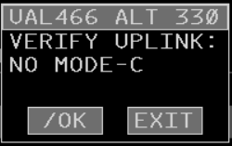
CPDLC Inhibited Uplink
CPDLC altitude uplinks are inhibited when any of several conditions exist
The pop up box allows the controller to either override the inhibition, or cancel the uplink by exiting

Slide 41
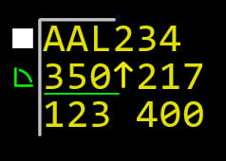
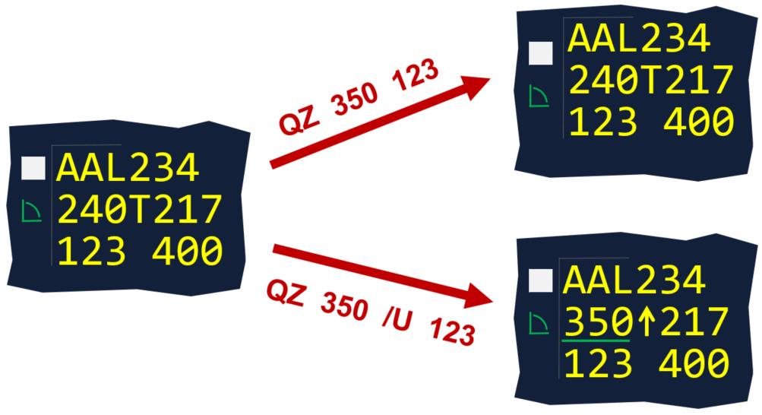
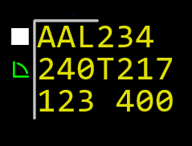
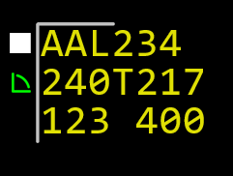
Behavior of Altitude Amendments
ACL
QZ 350 /U 123
QZ 350 123
FDB
QZ 350 /U 123
QZ 350 123

Slide 42
Knowledge Check
Which of these would cause the system to inhibit a CPDLC uplink?
  Aircraft has an Interim Altitude assigned
  Controller is assigning a Local Interim Altitude
  Mode C altitude not being displayed for the aircraft

Slide 43
Requirements for Validating
Mode C Readout
Mode C altitude must be validated:
  After accepting an interfacility handoff, except:
    ­ERAM facilities are not required to validate Mode C altitude readouts after accepting interfacility handoffs from other ERAM facilities
  After initial track start
  After track start from Coast
  During and after the display of a missing, unreasonable, exceptional, or otherwise unreliable Mode C readout indicator
A

Slide 44
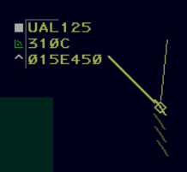
Valid Mode C
Consider an altitude readout to be valid when:
  It varies less than 300’ from the pilot reported altitude, or
  You receive a continuous readout from an aircraft on the airport and the readout varies by less than 300’ from the field elevation, or
  You have correlated the altitude information in your data block with the validated information in a data block generated in another facility

Slide 45
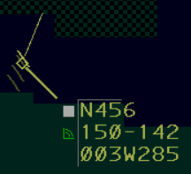
Invalid Altitude Readout
If you observe an invalid altitude readout below FL180:
  The radar controller issues the pilot the correct altimeter and confirms the pilot has accurately reported the altitude
  If altitude readout continues to be invalid:
    Pilot should be instructed to turn off altitude reporting and given a reason
    Sector team notifies the supervisor/CIC

Slide 46
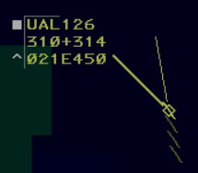
Invalid Altitude Readout (Cont’d)
If you observe an invalid altitude readout at or above FL180, unless the aircraft is descending below class A airspace:
  The radar controller verifies that the pilot is using 29.92 as the altimeter setting and has accurately reported the altitude
  If Mode C readout continues to be invalid, the radar controller instructs the pilot to turn off the altitude reporting portion of the transponder

Slide 47
Altitude Confirmation
Request a pilot to confirm assigned altitude on initial contact unless:
  The pilot states the assigned altitude, or
  You assign a new altitude to a climbing or a descending aircraft, or
  The Mode C readout is valid and indicates that the aircraft is established at the assigned altitude

Slide 48
Knowledge Check
When must you validate an aircraft’s Mode C readout?
  After accepting a handoff from an ERAM facility
  After accepting any handoff above FL450
  After accepting a handoff from a non-ERAM facility

Slide 49
Knowledge Check
When is a Mode C readout considered valid?
  When it varies less than 300’ from the pilot reported altitude
  Anytime an aircraft is on your frequency
  When an aircraft is assigned a STAR

Slide 50
Knowledge Check
What altimeter should a pilot use at or above FL180?
  29.92
  28.92
  30.01

Slide 51
Part-Task Exercise
Purpose:
  Perform altitude amendment tasks
Materials:
  TTL part-task exercise: Altitude Amendments
Directions
  This exercise takes approximate 45 minutes to complete. Each student must complete the checklist tasks. No headsets required.

Slide 52
Lesson Summary
This lesson covered:
  Characteristics of ERAM altitude amendments
  Characteristics of EDST altitude amendments
  Characteristics of CPDLC altitude processing
  Mode C validation and altitude confirmation requirements

Slide 53
The End

