Slide 2
Radar symbols
Full Data Blocks (FDB)
Limited Data Blocks (LDB)
Display views
Weather displays
Miscellaneous displays

Slide 3
Map Symbols
SYMBOL | Map Symbol Name
 | VOR
 | TACAN
 | Intersections and Waypoints
 | Major Airport
 | Satellite Airport
 | Emergency Airport
 | Obstruction

Slide 4
Tracking and Pairing Definitions
TARGET
The indication shown on a display resulting from a primary radar return, a radar beacon reply, or an ADS-B report. The specific target symbol presented to ATC may vary based on the surveillance source and automation platform
TRACK
Information associated with surveillance reports, including position, and if available, Mode C altitude and beacon code
PAIRING
Association of flight data within track

Slide 5

Tracking and Pairing
DAL235
150N
227 CST
Coast track unpaired and not being tracked
Unpaired LDB being tracked
0520
016
Paired FDB being tracked
AAL532
370C
342 410

Slide 6






Target Symbols
SYMBOL | Target Symbol Name
 | Correlated primary
 | Reduced separation (3-mile)
 | Weak primary
 | Uncorrelated beacon
 | Correlated beacon
 | Uncorrelated primary
 | Identing beacon
 | VFR
 | Mode C Intruder (MCI)
Example target symbol
AAL532
370C
342 410

Slide 7




Position Symbols
SYMBOL | Position Symbol Name
 | Coast Track
 | Flight Plan Aided Track (Flat track)
 | Free Track
 | Frozen Track
 | Hold Track
AAL532
370C
342 410
Example position symbol with
target symbol

Slide 8

Velocity Vector Line
DAL235
150C
227 405

Slide 9
Leader Line
DAL235
150C
227 405
Direction: QN d <FLID>
Length: QN /d <FLID>
Direction/Length: QN d/d <FLID>

Slide 10



Distance Reference Indicator (Halo)
5 Mile
3 Mile

Slide 11
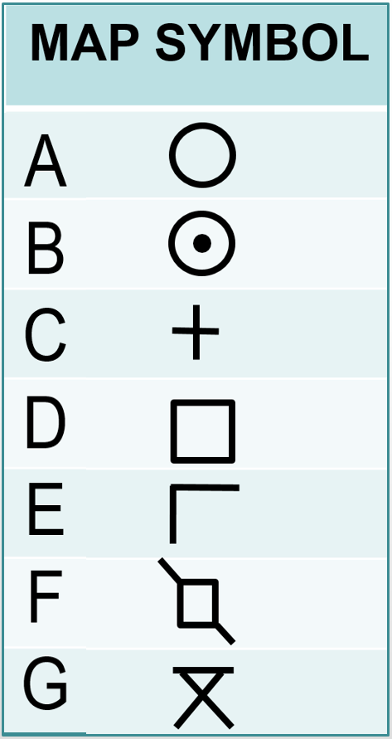
Knowledge Check
Which map symbol is used to depict an obstruction?

Slide 12
Knowledge Check
What type of Distance Reference Indicator is displayed when an aircraft is in a reduced separation area and the system is receiving radar from a preferred sensor?
A
B
C

Slide 13
Knowledge Check
Which map symbol is used to depict an emergency airport?

Slide 14
Full Data Block (FDB)
Portal Fence
Portal Area
Data Area
SWA212 310C 413 425 KLGA
P
Line 0
Line 1
Line 2
R
Line 3
Line 4
Column 0

Slide 15
FDB Fields
SWA212 310 280 413 425 KLGA
P
Field B
Field A
Field C
R
Field E
Field F
(Fourth Line Data)
Field D

Slide 16
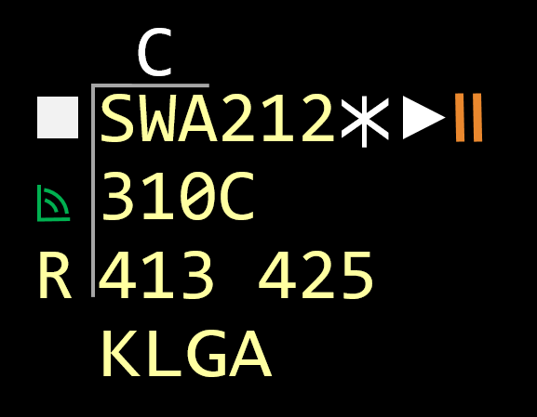
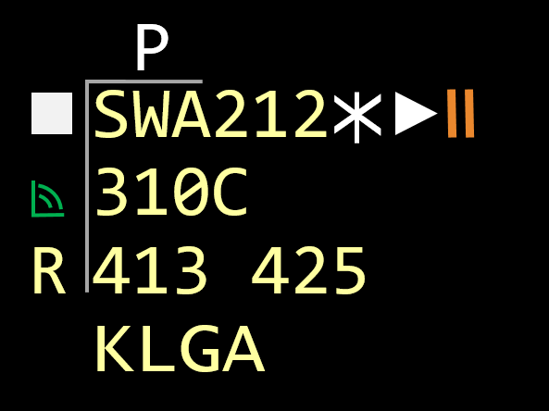
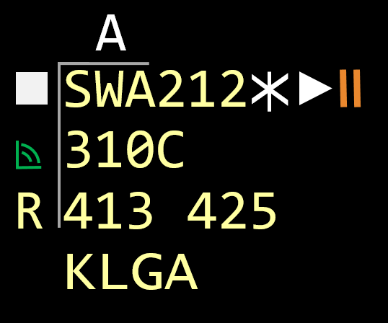
FDB – Line 0
Proposed GIM-S Speed
Point Out Indicator
Point Out Approved

Slide 17
Line 1
FDB Field A
SatComm Indicator
SWA212 310C 413 425 KLGA
P
Prefix Field
X
Suffix Field
R

Slide 18
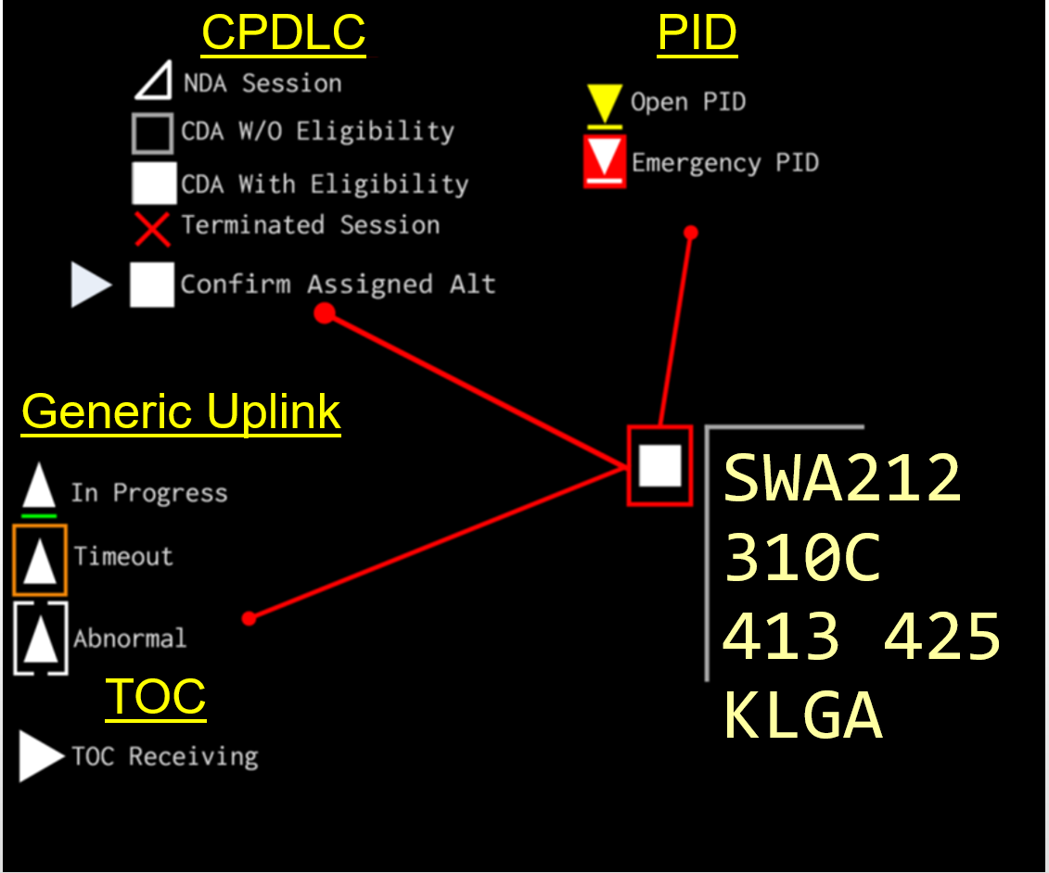


Line 1 Prefix Field

Slide 19
Line 1 Field A
SWA212 310C 413 425 KLGA
P
X
R

Slide 20
Line 1 SatComm Indicator
SWA212 310C 413 425 KLGA
P
X
R

Slide 21

Line 1 CPDLC Indicator Suffix Field
SWA212 310C 413 425 KLGA
P
X
TOC In Progress Transfer
TOC Abnormal Transfer
R
Held TOC Single
Held TOC Multiple
Held TOC Abnormal

Slide 22


Line 2 Field B1-B3
Assigned Altitude
VFR
OTP
ABV
SWA235
330C
532 405
N12345
ABV/135
532 205
N12345
VFR/135
532 205
N12345
OTP/135
532 205
Altitude Uplink Indications
SWA235
330 310
532 405
SWA235
330 310
532 405
SWA235
330 310
532 405
In Progress
Timeout
Abnormal

Slide 23
Line 2 Field B4
SWA235
330C
532 405
Field B4 Examples
AAL532
160L200
225 350
DUDE32
220B220
222 300
N235A
200+208
202 275

Slide 24
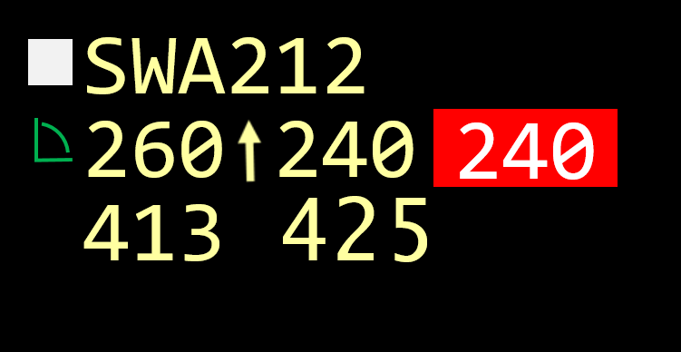
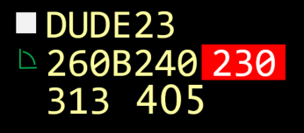
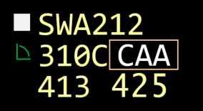

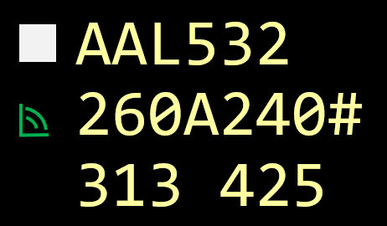
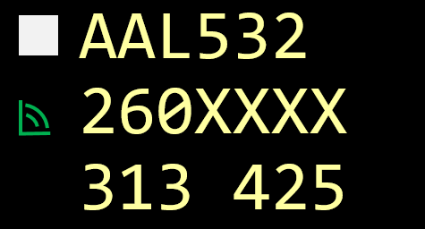
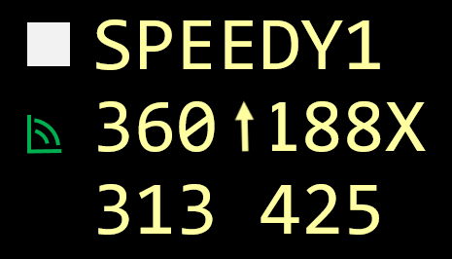
Line 2 Field C Special Coding
IC Mismatch
Single Altitude
IC Mismatch Block Altitude
Abnormal CAA
CAA
Controller Reported
Lost Mode C
Exceptional Vertical Rate

Slide 25
Line 3 Field D
Route Uplink Indicators
AAL002
370 296
413 450
KLGA
XAPOH
370 296
413 450
KLGA
AAL003
330 296
413 450
KLGA
In Progress
Timeout
Abnormal

Slide 26
Line 3 Field E
Field E Examples
Locally Adapted Single Character Destination
AAL802
370C
083 445 KJFK
DAL425
370C
268U455
KCLT
Ground Speed
AAL002
370C
413EMRGKLGA
DAL005
370C
235FRZN
KLGA
SWA235
110C
413FAIL
KLGA
Code 7700
Frozen
Handoff is failing

Slide 27
Line 3 Field E (Cont’d)
Field E Data | Explanation
EMRG | 7700 beacon return - emergency code
HIJK | 7500 beacon return - hijack code
LLNK | 7400 beacon return - UAS lost link
RDOF | 7600 beacon return - radio communications failure
EFC | Expect Further Clearance (only if locally adapted)
FAIL | Handoff is failing
OLD | Crosstell track data has timed out (no track update messages)
MSAW | E-MSAW alert for an aircraft
MIFF | E-MSAW alert indefinitely suppressed
MOFF | E-MSAW alert is suppressed on a track for a specific alert

Slide 28
Line 3 Field E (Cont’d)
Field E Data | Explanation
HUNK | Track is being transferred to an unknown (UNK) facility
OUNK | Track control transfer has been accepted by an unknown (UNK) facility
CST | Coast status
dddd | The beacon code received, if it is different from the facility assigned code
NONE | The track has an assigned beacon code, but a beacon code is not received
Ddd, CAS: (d)dd, MAS: Mdd | The ground speed (range 001 to 999). Accepted GIM-S speed
<code> | Temporarily displays the primary beacon code when an alert condition (e.g., 7700) is causing a special beacon code to be displayed
FRZN | Frozen status
SIDE | A side stream, ERAM to ERAM handoff
PLAN | A multiple FP condition exists for an aircraft which needs to be manually resolved
DATA | An interfacility handoff does not have complete radar data for the flight and a paired track is not established

Slide 29
Line 3 Field E (Cont’d)
Field E Data | Explanation
H-dd, O-dd, K-dd | Transferred to sector dd intracenter
HLdd, OLdd, KLdd | Transferred intercenter or from a STARS facility. L will contain the receiving center’s one letter designator, and dd will contain the two digit ID of the receiving sector.
HLLL, OLLL | Transferred to a STARS facility where LLL is the facility identifier
HL | Intercenter, automatically or manually transferred with sector 00 entered
HLdL, OLdL, KLdL | Intercenter or from a STARS facility. L will contain the receiving center’s one letter designator, and dd will contain the two-digit ID of the receiving sector.
HLLdL, OLLdL | Transferred to a specific position dL in a STARS facility (first L)
HLLx, OLLx, KLLx | Transferred to a position x in a STARS facility LL
LLdd | Host-Non-Host (HNH) qualified track is in crosstell status from an external STARS facility. The first L is the one letter, external STARS facility identifier, the second L will be the one letter receiving NAS center identifier, and dd will be the sector to which the handoff is routed.

Slide 30
Line 3 Field E (Cont’d)
Display priority for timesharing items:
Handoff
Beacon data
MSAW
Interfacility supplemental data
Side stream handoff
Plan data display item
Hold and ground speed, or destination

Slide 31

Line 3 Field E (Cont’d)
Flight Event List (FEL) Display Indicator
Displayed for:
24-BIT MISMATCH
DUPLICATE 24-BIT
MULTIPLE CODES
CALLSIGN MISMATCH
Heading or Speed or Free Form Text (HSF) Display or Suppress Indicator
Toggles heading, speed, free form text
DAL235
150C
227 436

Slide 32

Line 4
Heading and/or Speed
Free Form Text
Aircraft Data
SWA235
310C
532 405
H240 M75
SWA235
310C
532 405
RQ/NEUTO
SWA235
310C
532 405
B738/L
SWA235
310C
532 405
KPHL
SWA235
310C
532 405
H240 M75
SWA235
310C
532 405
D20L
Destination
GIM-S Indicator
En Route Usage

Slide 33

Column 0
Auto VCI
Manual VCI
SWA235
110C
532 305
SWA235
110C
532 305
Line 2
SWA235
110C
532 305
SWA235
110C
532 305
Line 3
R
Not Your Control Indicator
Auto Handoff Inhibited Indicator (Caret ^)

Slide 34
Other FDB Indicators
Continuous Range Readout (CRR)
TFM Reroute Indicator
N235KY
220C
325 205
N235KY
220C
325 205
A
T 28.3
0743 6
Scheduled Time
of Arrival (STA)
Delay Countdown Time (DCT)
Non-ADS-B Indicator

Slide 35
Knowledge Check
If automatic handoff has been inhibited, what character is displayed in column 0?
^
#
*

Slide 36
Knowledge Check
What character would be displayed in Field B4 if an aircraft’s Mode C is unreliable or not being received?
ABV
X
T

Slide 37
Knowledge Check
When may a Portal Fence be displayed?
It is only displayed when an aircraft is in handoff
It is always displayed
When there is at least one indicator eligible to be displayed in the Portal Area

Slide 38

Limited Data Block (LDB)
Paired LDB
• ACID and altitude
Unpaired LDB
• Beacon code and altitude if known
Unpaired Beacon
Emergency
Radio Failure
N1532
201
1723
095
EMRG
RDOF
Unpaired ADS-B LDB
• ACID and altitude
1537
035
3226
060
N235SK
201
Unpaired Beacon No Mode C
VFR
Mode C Intruder

Slide 39
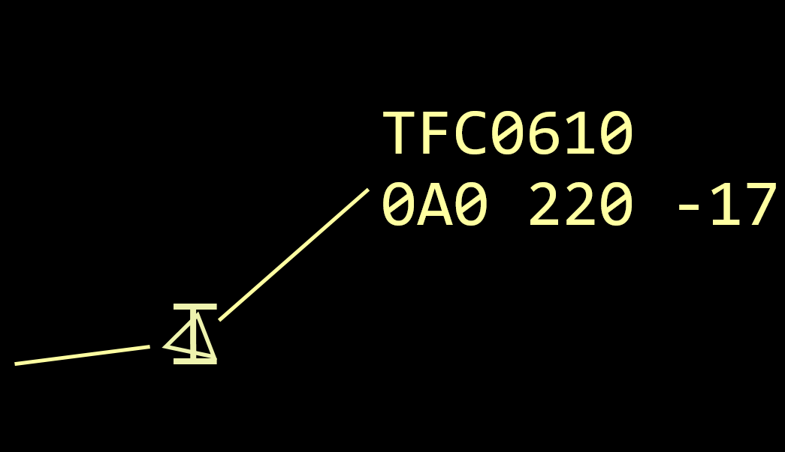
Conflict Data Block
Tracked ﬂight in conﬂict with a Mode C intruder
Same as first two lines of FDB
Vertical Rate Indicator (VRI)
Position symbol
Intruder track number
Velocity vector line
FDB elements
VRI
Position symbol
Velocity vector line
Intruder track number

Slide 40
Knowledge Check
What type of data block is displayed when a tracked flight is in conflict with a Mode C Intruder?
Range Data Block
Mode C Intruder Data Block
Conflict Data Block

Slide 41
Practice Exercise
Purpose
Interpret and record information displayed in ERAM data blocks
Materials
Practice exercise from Lesson 4 handout
Directions
Exercise consists of twelve data block examples
Read the questions provided for each data block
Write your answers in the spaces provided

Slide 42






Slide 1
A
SWA24
350C
348 482
B738/L
G
B&C
D
E
F
H

Slide 43



Slide 2
A
N734DW
270 197
159 345
B350/G
G
B&C
E
D
F
H

Slide 44

Slide 3
A
UAL561
250T227
157 415
A319/L
UAL561
250T227
1574521
A319/L
G
B&C
R
E
D
F
H

Slide 45
Slide 4
A
SLAM24
250B260
311H-16
F15/I
SLAM24
250B260
311 510
F15/I
G
B&C
D
E
F
H

Slide 46

Slide 5
A
N36TT
90 101
256 255
E55P/L
N36TT
90 101
256O-22
E55P/L
G
B&C
R
E
D
F
H

Slide 47


Slide 6
A
N70KC
70-66
146 165
M20T/G
N70KC
70-66
146K-16
M20T/G
G
B&C
R
E
D
F
H

Slide 48

Slide 7
A
N270L
110N
476 CST
PA31/G
G
B&C
E
D
F
H

Slide 49
Slide 8
A
N54CR
110A
209FAIL
C421/G
N54CR
110A
209 256
C421/G
G
B&C
E
D
F
H

Slide 50

Slide 9
A
AAL1106
250 350
203 390
H090 M.77
G
B&C
E
D
F
H

Slide 51



Slide 10
A
DAL739
250+255
311 480
KORD
G
B&C
D
E
F
H

Slide 52


Slide 11
A
N376CS
110 65#
309 124
C172/X
G
B&C
D
E
F
H

Slide 53



Slide 12
A
LOBO32
110N130
448O-47
A10/I
LOBO32
110N130
448FRZN
A10/I
G
B&C
E
D
F
H
LOBO32
125

Slide 54
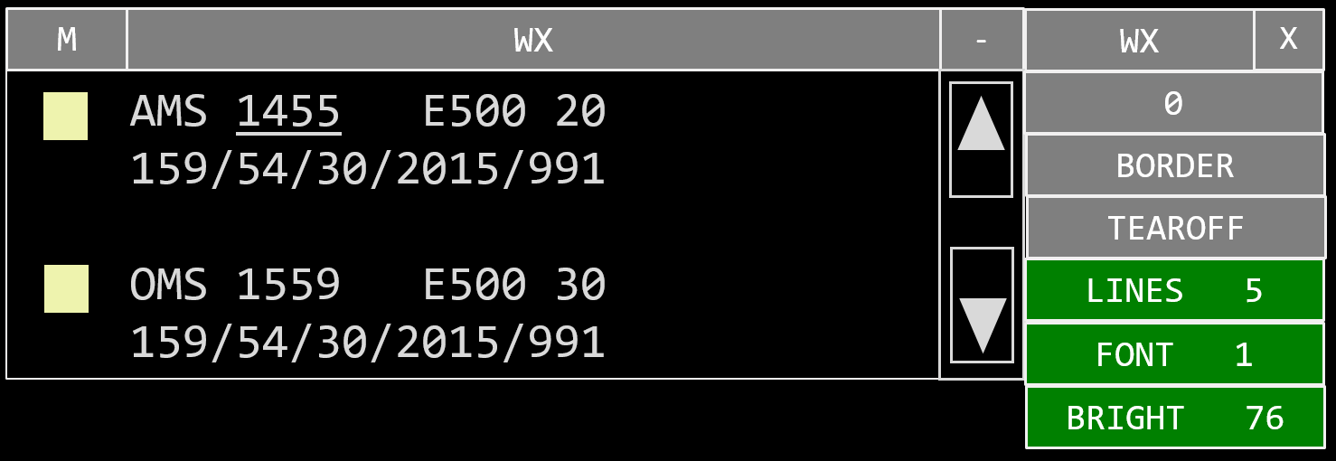
Views Menu
View Close button
View Menu button
View Title
Toolbar
View
Menu Items
Tear-off
Example View
Scroll Bar

Slide 55
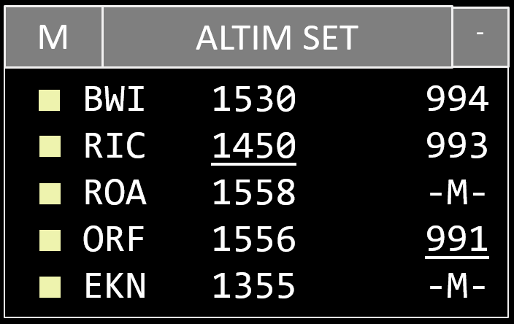
Altimeter Settings View (ALTIM SET)
Station identifier
Altimeter setting
Tear-off
Stale
Missing
Below 29.92
Too old to use
Observation time

Slide 56
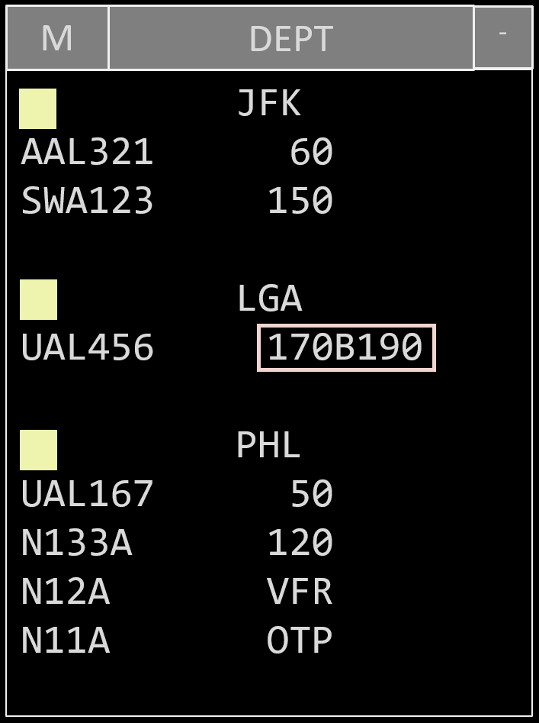
Departure List View (DEPT)
Sublist title - Departure airport
Call sign
Requested altitude

Slide 57


Auto Handoff Inhibit View (AUTO HO INHIB)
Re-enter: QA 20
Enables all automated handoffs to sector 20
Enter: QA 20
Inhibits all automated handoffs to sector 20
Facilities
Sectors

Slide 58
Continuous Flight Plan Readout View (CFR)
Display a Flight Plan (FP):
QF <FLID>
QF SWA473

Slide 59
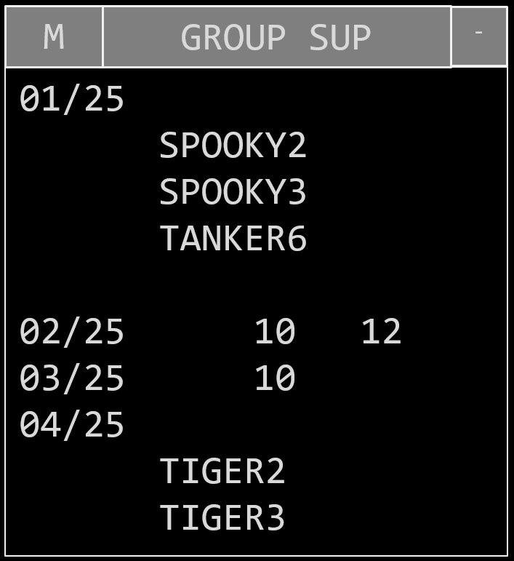
Group Suppression View (GROUP SUP)
Group Suppression ID
Flights of Group 01
SubscribedSector IDs

Slide 60
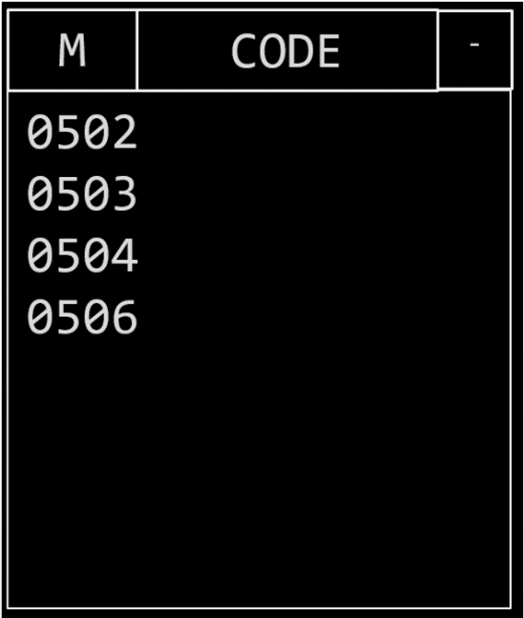
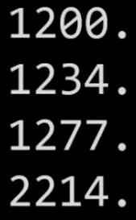
Beacon Code View (CODE)
System
Codes
Manually
Entered
Codes

Slide 61
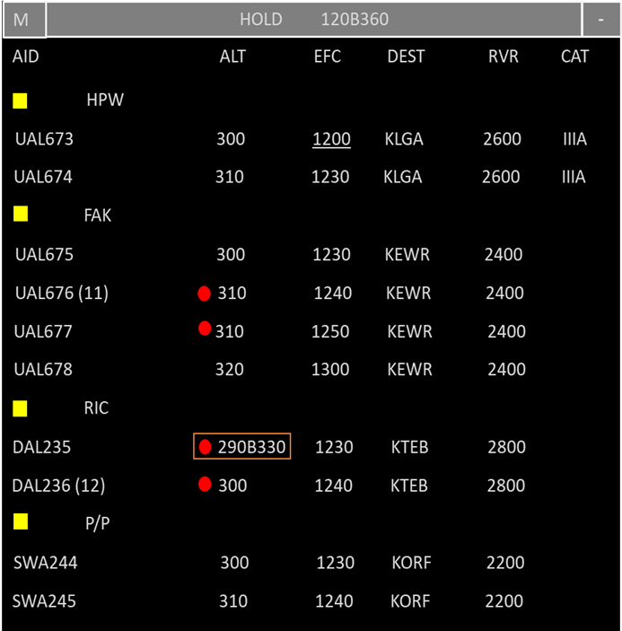
Hold View (HOLD)
Altitude
Landing category
Aircraft ID
Holding fix
CAT
Destination (DEST) or Alternate Airport (ALA)
Non-RVSM indicator
Conflict
Expect Further Clearance time
Block altitude
Runway
Visual Range
Present position

Slide 62
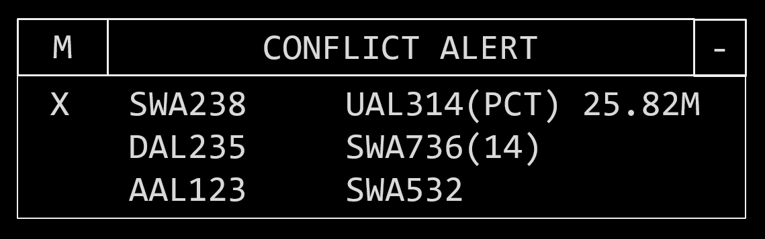
Conflict Alert View (CONFLICT ALERT)
Conflicting aircraft pairs
Suppression indicator
Distance between targets
Controlling facility or sector
Suppress or request conflict alert:
CO <FLID>/<FLID>

Slide 63
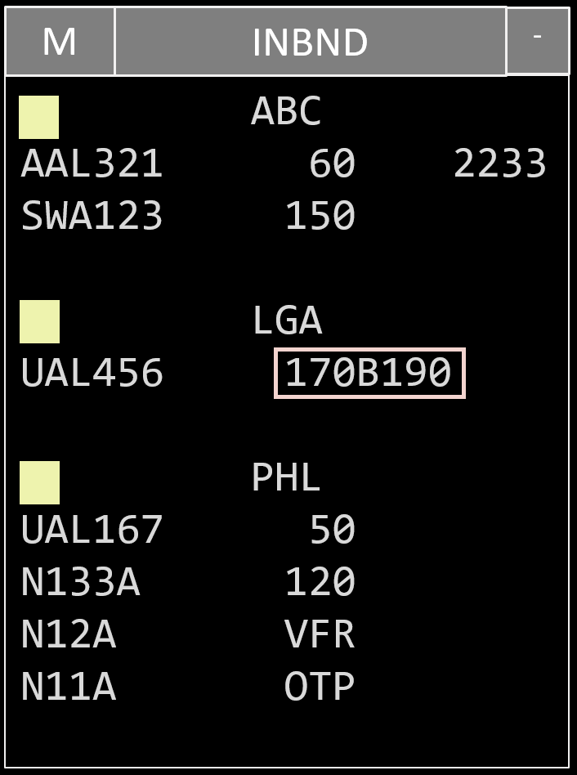
Inbound List View (INBND)
Sublist Title (Fix)
Beacon Code
ACID
Altitude

Slide 64
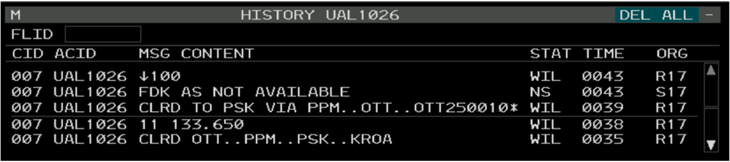
CPDLC Message History View

Slide 65
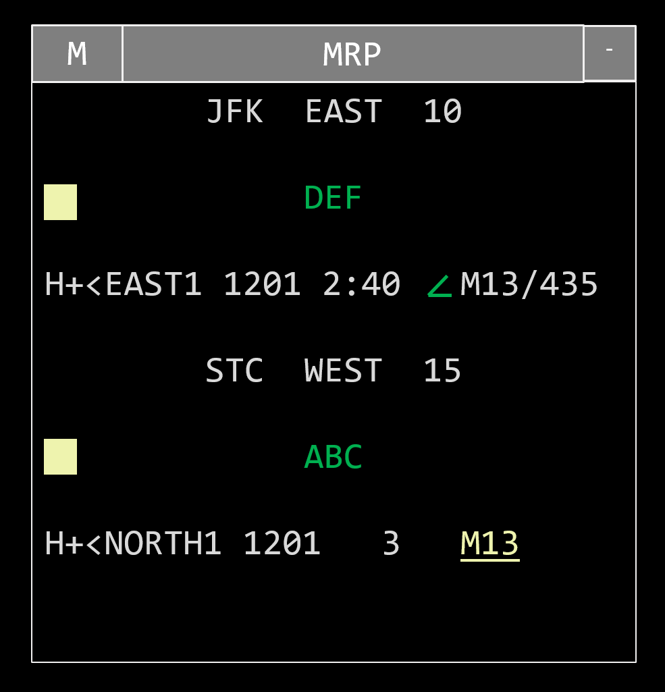

Meter Reference Point View (MRP)
Stream Name
Stream fix
GIM-S Accepted Speed
GIM-S Proposed Speed
Remove an aircraft from the list QP M <FLID>
Manually Swap MW <FLID> <FLID>
Resequence Aircraft SQ <FLID> <FLID>

Slide 66
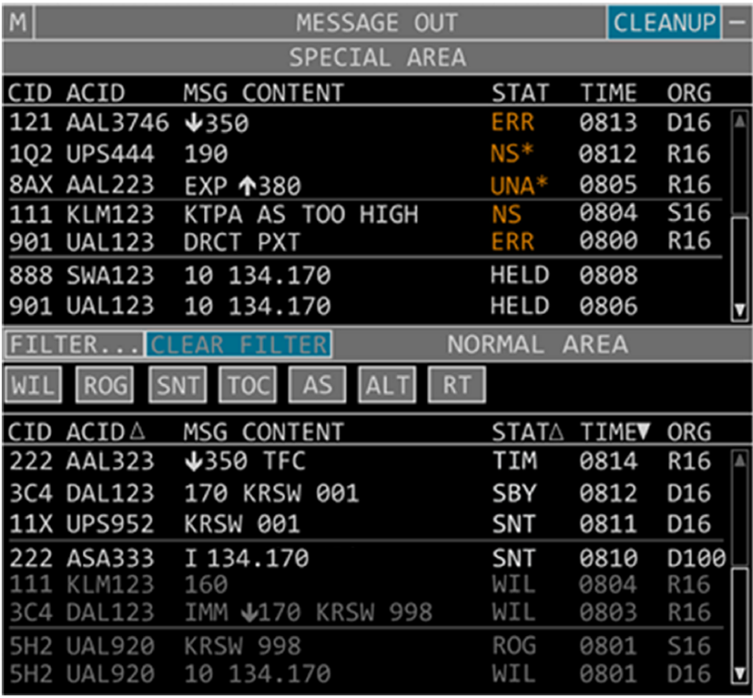
CPDLC Message Out View
Special Area
Normal Area

Slide 67
Special Activity Airspace Filter View (SAA FILTER)
Tear-off buttons
SAA label
SAA Filter Setting
SAA FILTER
-
COLD HOT DISPLAY
BAL
BLUE RIDGE SOARING
BL
BAL
CHESSIE A
SAA Display button
CHESSIE A1
BL
BA
CHESSIE B
CAPELLA TRACK
B
B
CHESSIE B1

Slide 68

Update Area View (UA)
Message Waiting Indicator

Slide 69
Continuous Range Readout View (CRR)
M
CRR
-
112.6
38.4
14.7
98.4
30.1
12.5
ABBEY
UAL167
DAL352
N133A
GSG
SWA123
POT
UAL456
SWA235
Create a group:
LF //<FIX> (label)
Create a group and add aircraft:
LF //<FIX> (label) <CID>(/CID)(/CID)(/CID)
Add aircraft to a preexisting group:
LF <FIX or label> <CID>(/CID)(/CID)(/CID)
Group

Slide 70
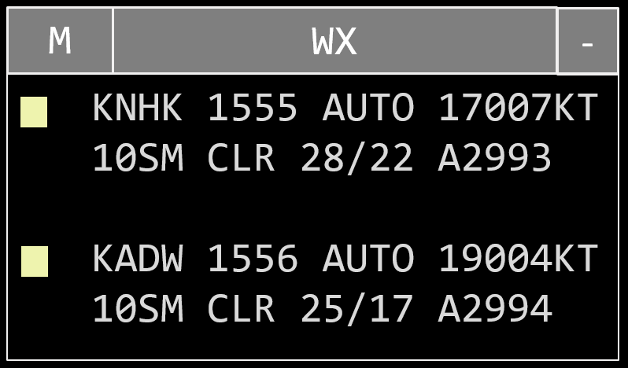
Weather Station Report View (WX)
Time of report
Weather station
Weather information

Slide 71
Knowledge Check
How can you create a new CRR list and add aircraft to it in one command?
LF //<FIX> (label)
LF //<FIX> (label) <CID>(/CID)(/CID)(/CID)
LF <FIX or label> <CID>(/CID)(/CID)(/CID)

Slide 72
Knowledge Check
Which view is used to manage conflict alert suppression groups and manipulate group suppression information?
GROUP SUP
CA
CA GRP SUP

Slide 73
Knowledge Check
In the beacon code view, what does a “.” after a code indicate?
System generated code
Manually entered code
Unusable code

Slide 74



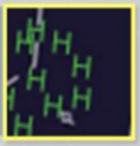


Weather Displays
(Blue)
Moderate
Moderate
Precipitation
(Blue-Cyan)
Heavy
Heavy to
Extreme
Precipitation
(Cyan)
Extreme
Combination
of above
NEXRAD Weather
ATC Weather

Slide 75
Knowledge Check
How is heavy precipitation depicted on a NEXRAD weather display?
Checkered red
Checkered blue-cyan
Green Hs

Slide 76
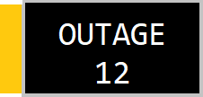
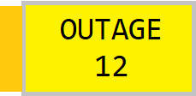
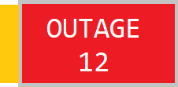
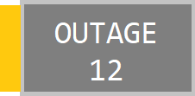
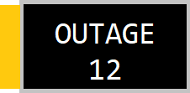
Outage View Button
BUTTON | Definition
 | No outages, view suppressed
 | Unacknowledged outage changes, view suppressed
 | Critical outage, red coding has precedence over yellow coding and will display when both types of outages exist
 | View displayed
 | Acknowledged outage exists, view suppressed

Slide 77

Outage View
Unacknowledged critical outage
OUTAGE12
FLIGHT DATA DOWN
Unacknowledged normal outage
ABC/BCN OTS
TYR/BCN OTS
NEXRAD UP
Acknowledged normal outage
Outage that has been returned to service

Slide 78
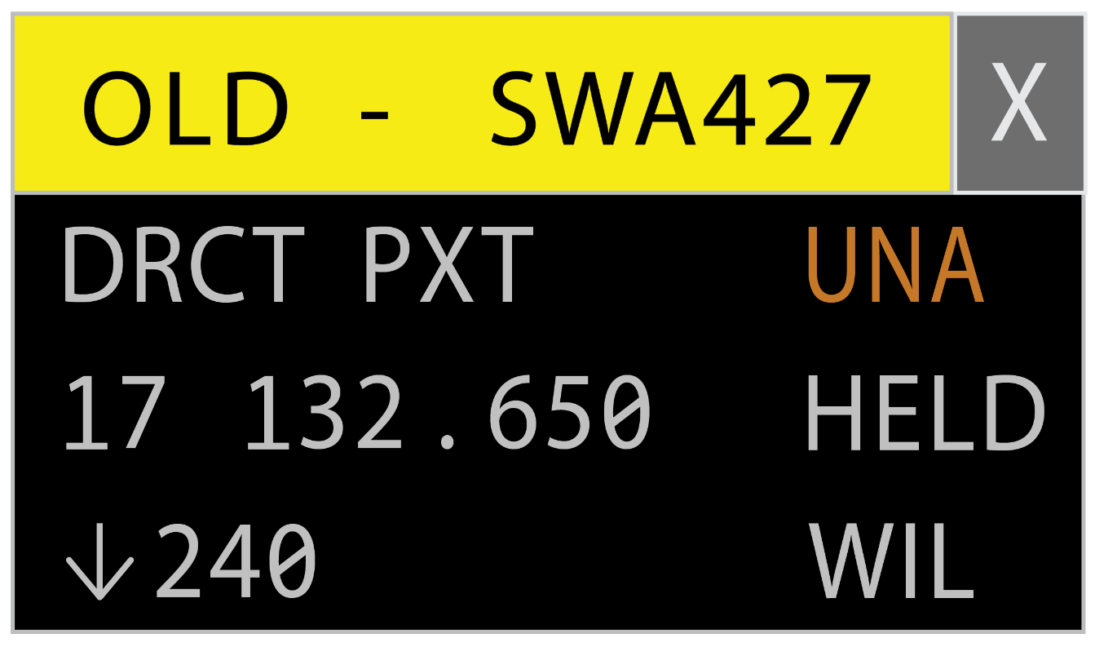
OLD Coding

Slide 79
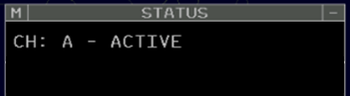


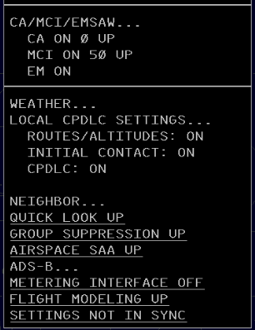
Status View (STATUS)
Position Status Information
Current Channel & Mode
Critical Outages
Alert Settings
Alternate Channel if in BACKUP Mode
Additional Settings and Outages
TBP or TBE to Expand Sublist

Slide 80
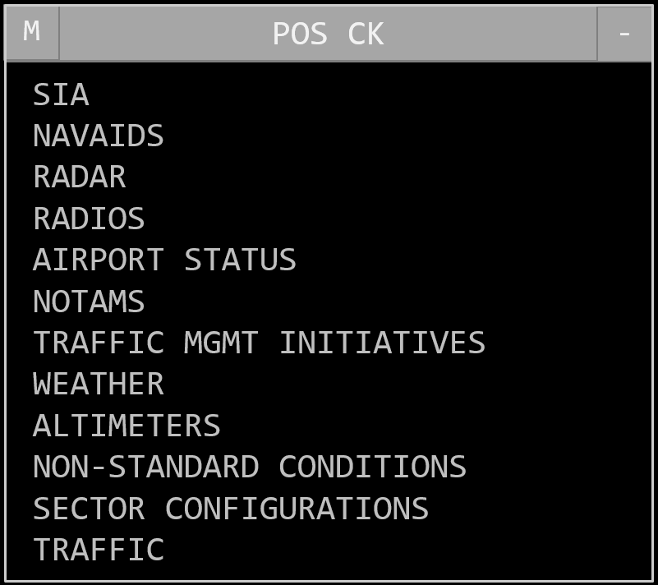
Position Relief Checklist (POS CHECK)

Slide 81
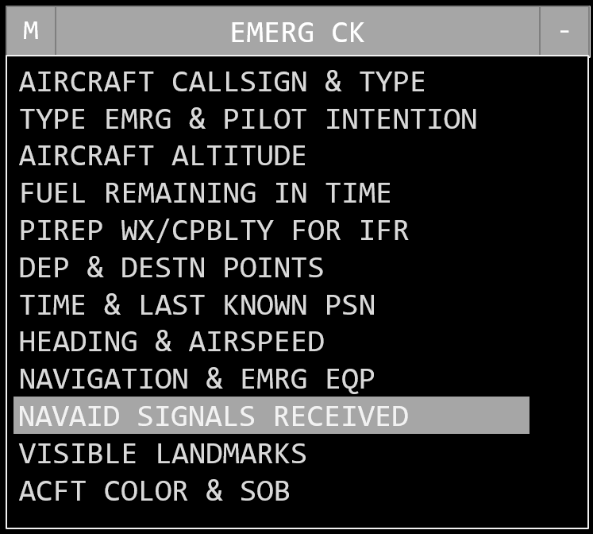
Emergency Checklist (EMERG CK)

Slide 82
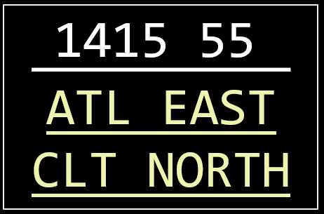
Time View
Current UTC Time
Sector Message
Notification Area

Slide 83
Message Composition Area (MCA)
Preview Area
_
QZ 240 UAL12
X REJECT - SECTOR 20 HAS CONTROL
ASSIGNED ALT UAL12
QZ 240 UAL12
Feedback Area

Slide 84
Response Area
Flight Plan Readout
0346
330 SAM500 FLR I WAK L
EQP DGVWJ4R SRV EB1 OTH
++PBN/ D1 DAT/
1FANSPER2PDC REG/ SAM500
CODE/ 00062A++ ADB 260B
RNV D1A1E1
0020
A 049 SWA235 B38M/L 2477 467 KPHL E0025 340 T
KPHL..PTW.PTW320.SARAA
.J64.HLC.J80.OAL.MOD9
.KSFO
Coral “A” -
non-ADS-B
Indicator
Cyan “T” -
TFM-pending
reroute notification
Display a flight plan:
QF <FLID>
QF SWA235
Display flight plan in ICAO format:
QF I <FLID>
QF I 330

Slide 85
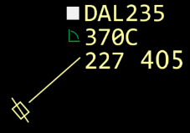

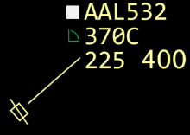
Route Display
Re-entrant Data
Block Overlap
Route Display
Route Display
Re-entrant Data Block
DAL235
AAL532
584
DAL235
201
DAL235
201
Display/remove specific route:
QU <FLID>
Route with specific minutes:
QU <1 to 99> <FLID>
Remove displayed lines:
QU
Display/remove specific route:
QU <FLID>
Route with specific minutes:
QU <1 to 99> <FLID>
Remove displayed lines:
QU
DAL235
DAL235
AAL532

Slide 86

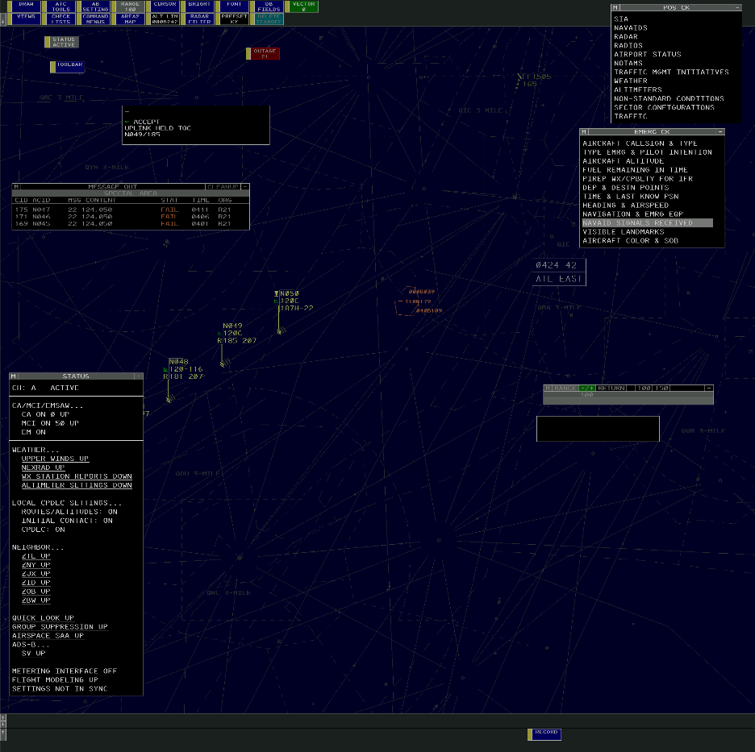
Position Failure

Slide 87
Failure of ADS-B Radio Station
ADS-B Radio Station Outage Indicator

Slide 88
Knowledge Check
Which view shows the active channel?
Position Failure View
Status View
Channel Display View

Slide 89
Knowledge Check
Which display is used to enter messages from the R Position and is divided into the Preview and Feedback areas?
Message Composition Area
Message Preview Area
Message Feedback Area

Slide 90
Knowledge Check
What does a cyan “T” in the response area denote?
Transponder equipped aircraft
Track update in progress
TFM-pending reroute

Slide 91
Part-Task Exercise
Purpose
Perform the following tasks:
Identify and interpret symbology from the ERAM situation display
Identify and manipulate data from selected ERAM display views
Materials
TTL part-task exercise: Radar Position Situation Display
Directions
This exercise takes approximately 30 minutes to complete. Each student must complete the checklist tasks. No headsets are required

Slide 92
Lesson Summary
This lesson covered:
Radar Symbols
Full Data Blocks
Limited Data Blocks
Display Views
Weather Displays
Miscellaneous Displays

Slide 93
The End

