Slide 2
Features of the Tools Menu
Steps to interact with NOTAMs, GIs, and SIGMETs views
Weather and altimeter displays of EDST
Functions of the Graphic Plan Display
EDST free form text

Slide 3
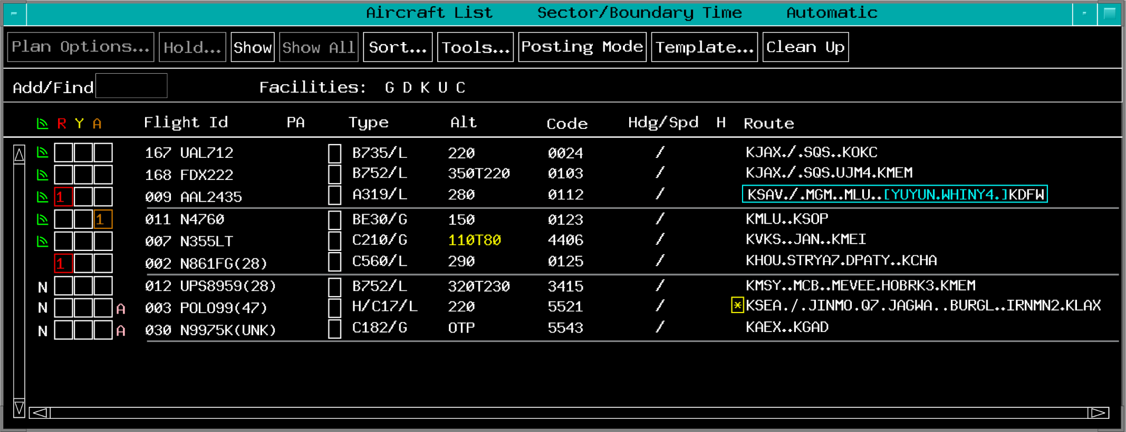
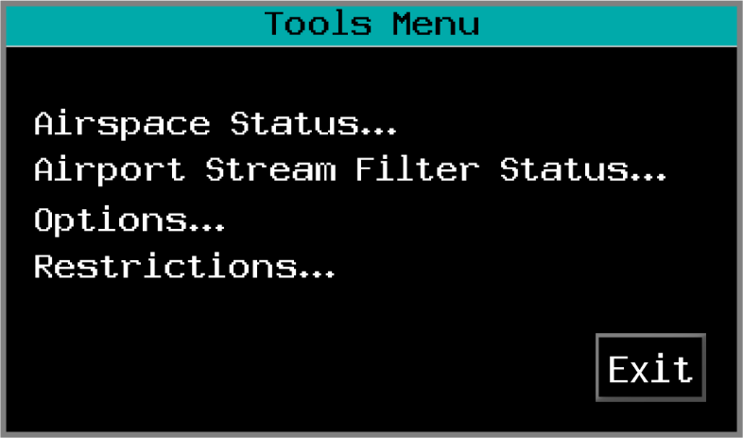
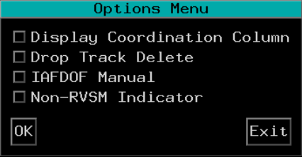
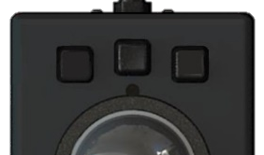

Options Menu
TBP

Slide 4
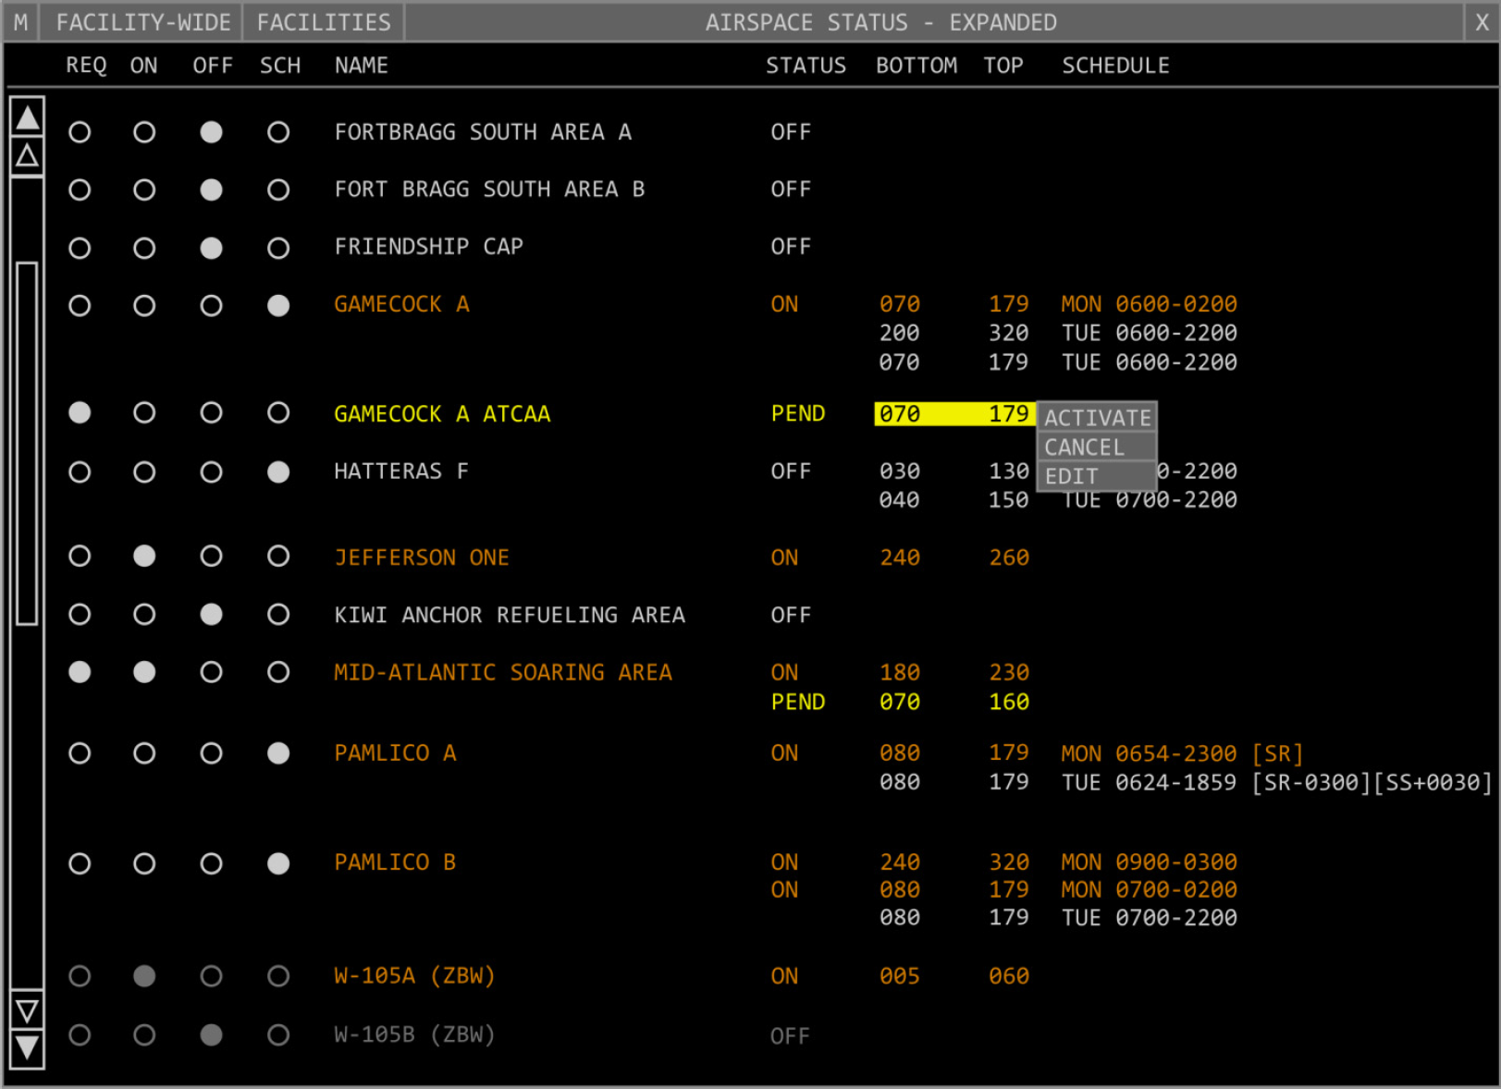
Airspace Status View
TBP

Slide 5
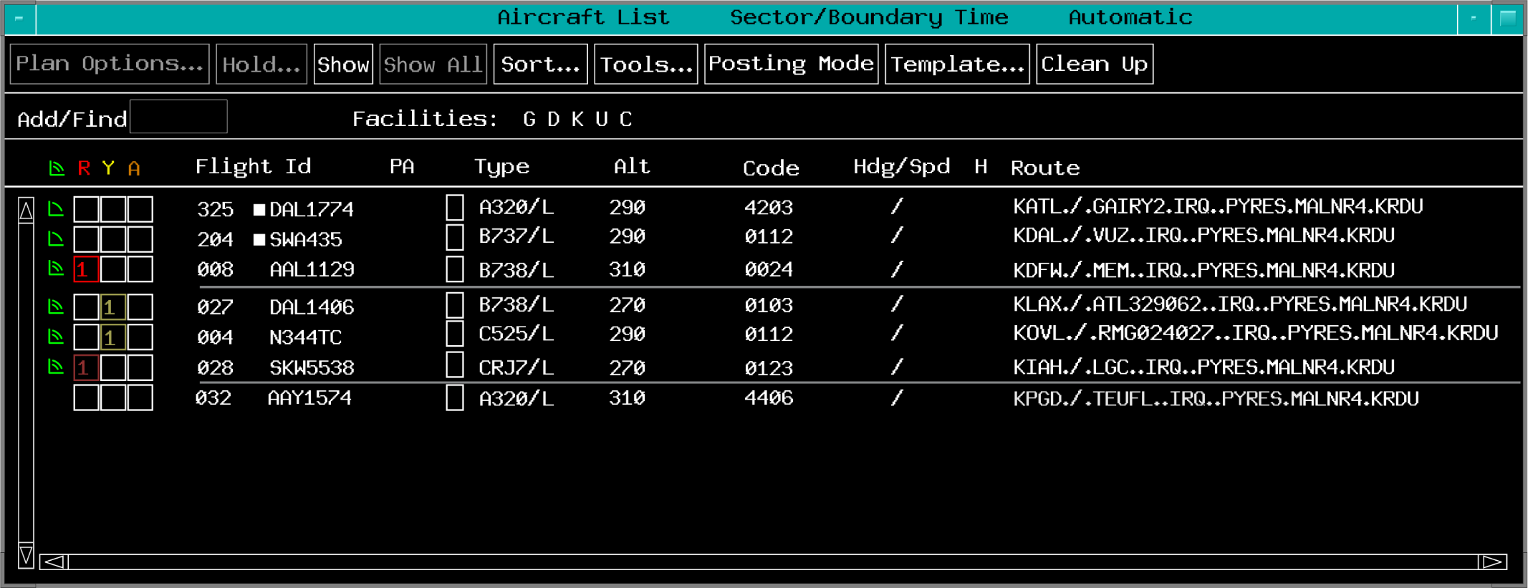
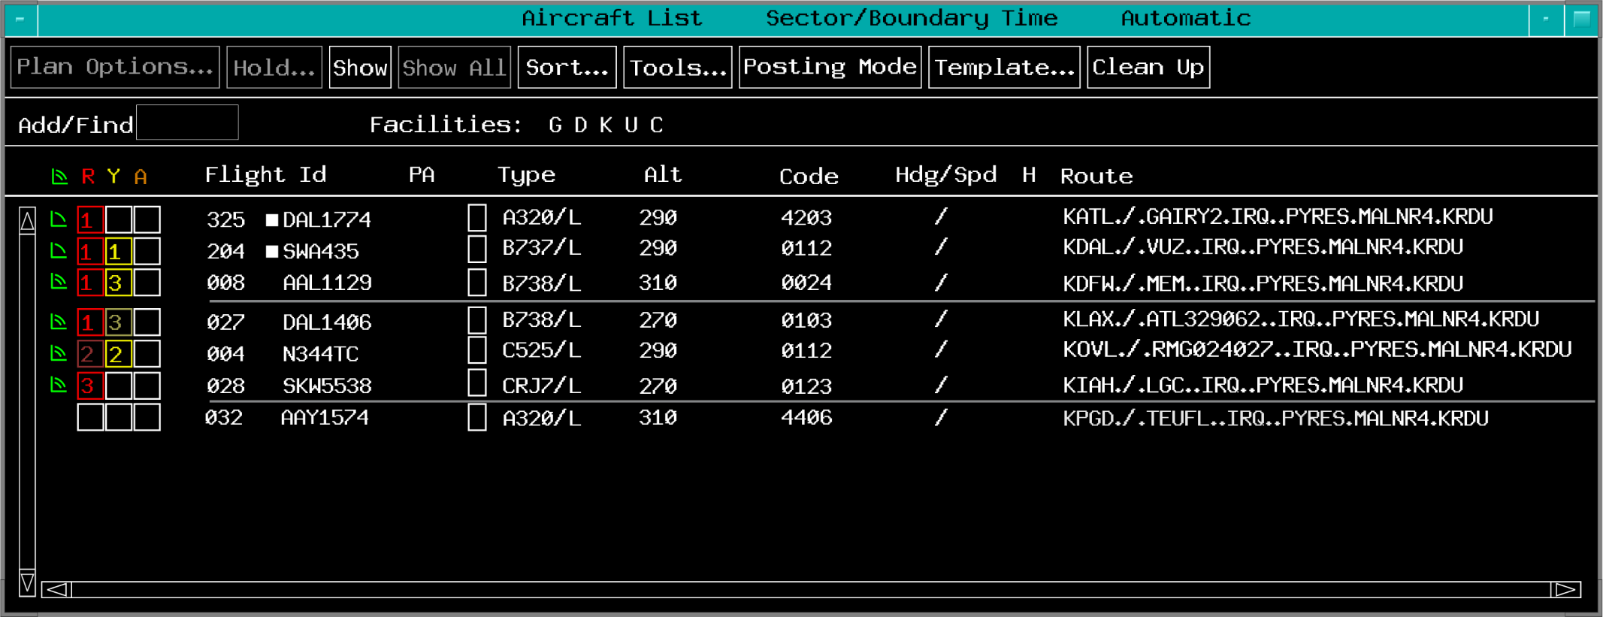
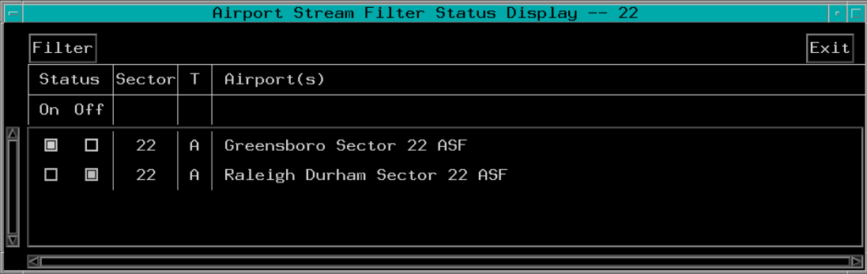
Airport Stream Filter Status
TBP

Slide 6
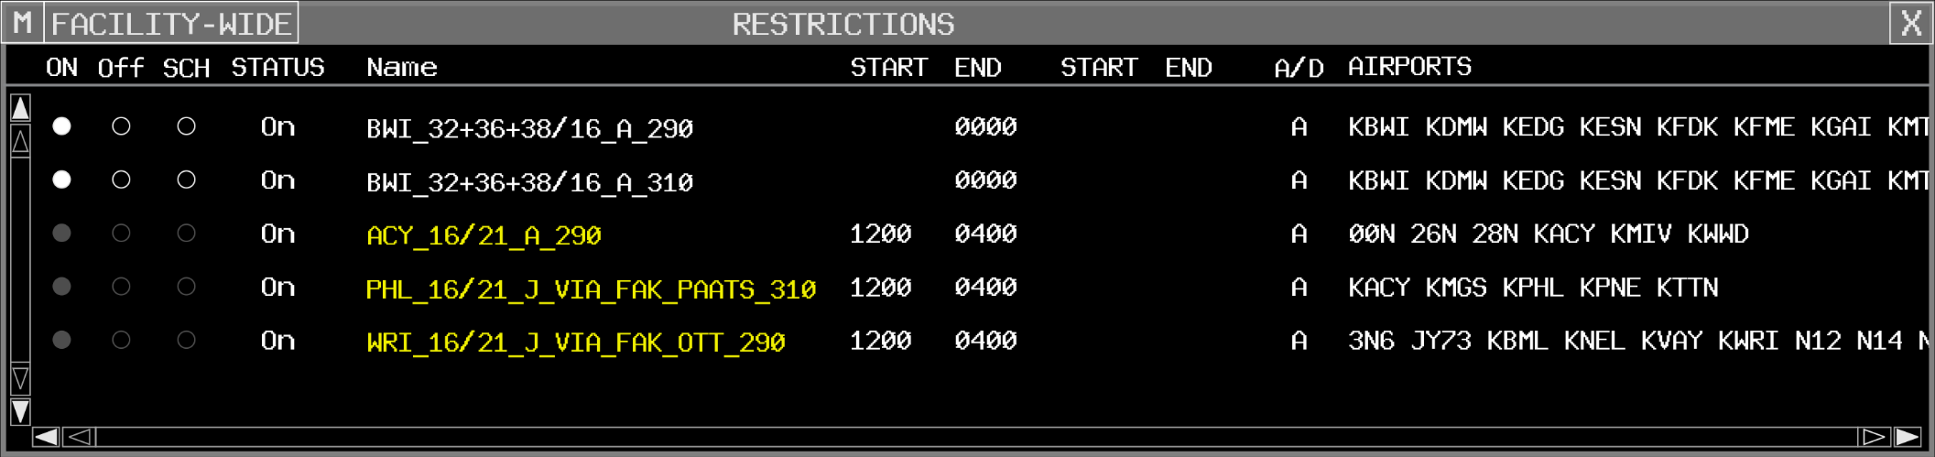
Restrictions View
TBP

Slide 7
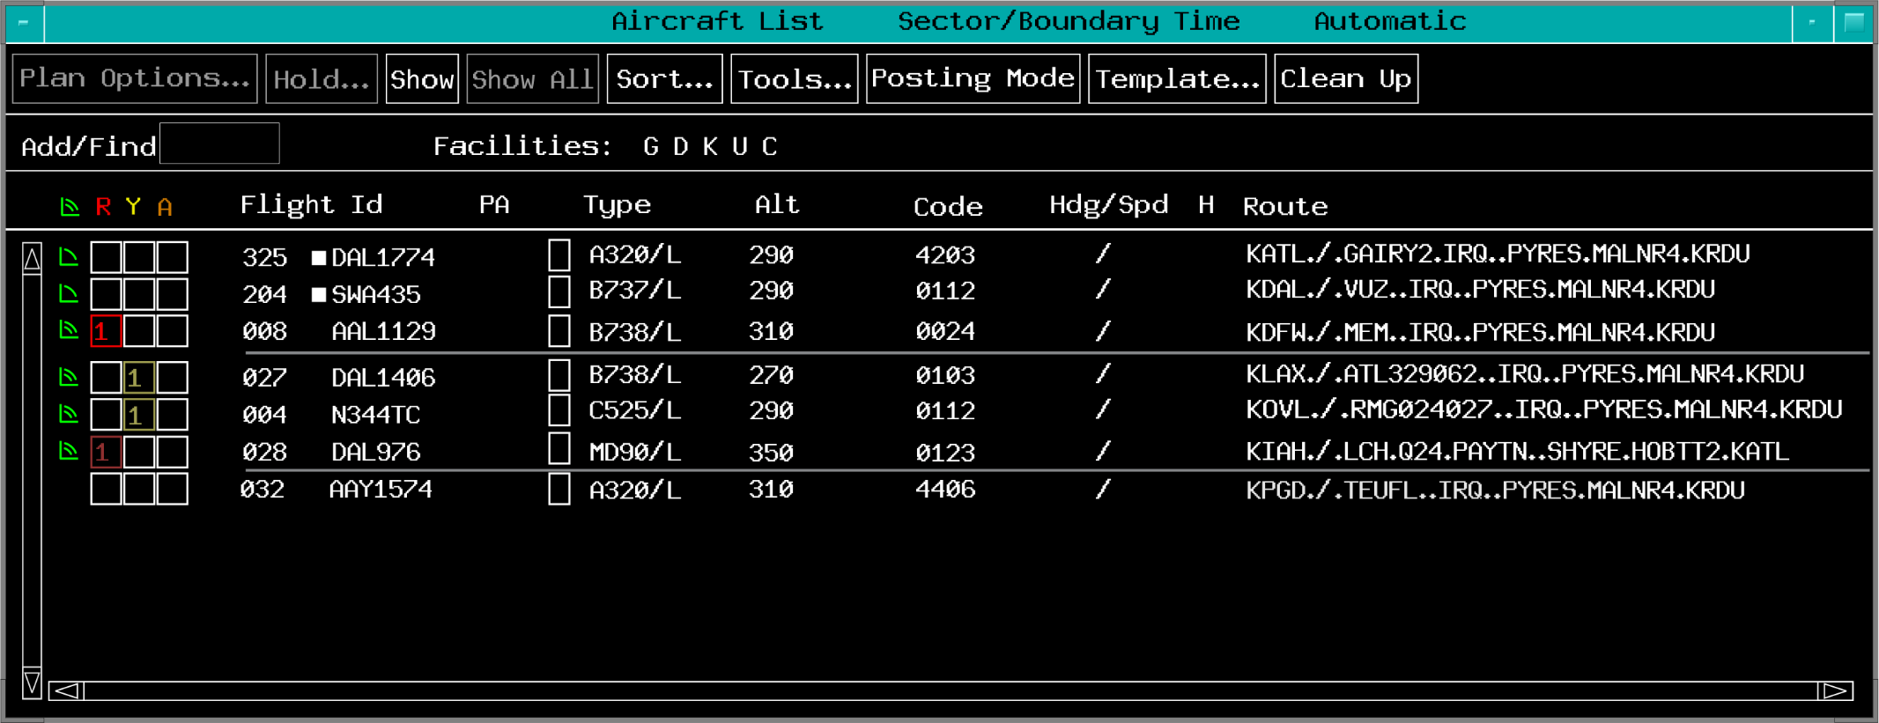
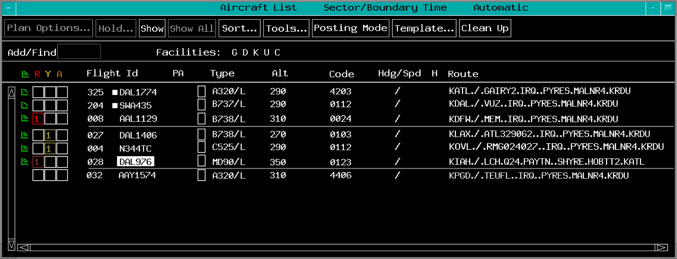
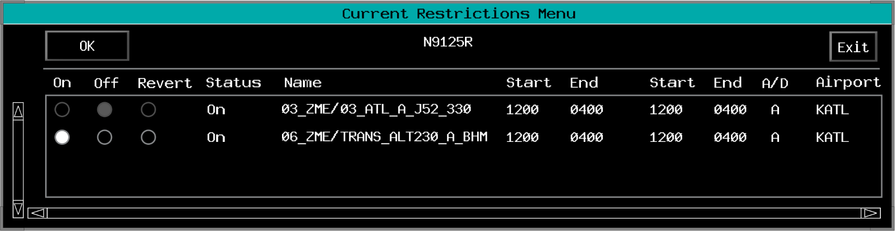
Current Restrictions Menu
TBP

Slide 8
Knowledge Check
What is displayed in the Current Restrictions view?
  Restrictions you have verbally placed on other sectors
  Center-wide restrictions
  Adapted restrictions for a specific flight

Slide 9
Knowledge Check
What is the purpose of Airport Stream Filters?
  Suppresses aircraft-to-aircraft alerts for the specific airport(s)
  Filters the display to only show flights for a single airport
  Displays all entries following similar routes

Slide 10
Knowledge Check
Which view displays the status of active Special Activity Airspace?
  Flight Restrictions View
  Special Activity Area View
  Airspace Status View

Slide 11
Knowledge Check
What are the steps to set IAFDOF to manual?
  TBP Settings>Altitude>IAFDOF Manual
  TBP Tools…>Options…>IAFDOF Manual
  TBP Plans…>IAFDOF Manual

Slide 12
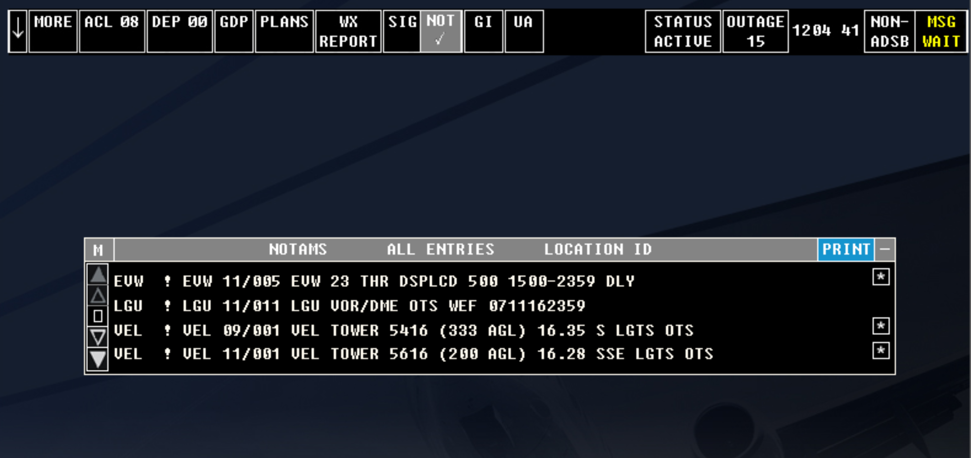
NOTAMS View
Select the NOT button

Slide 13
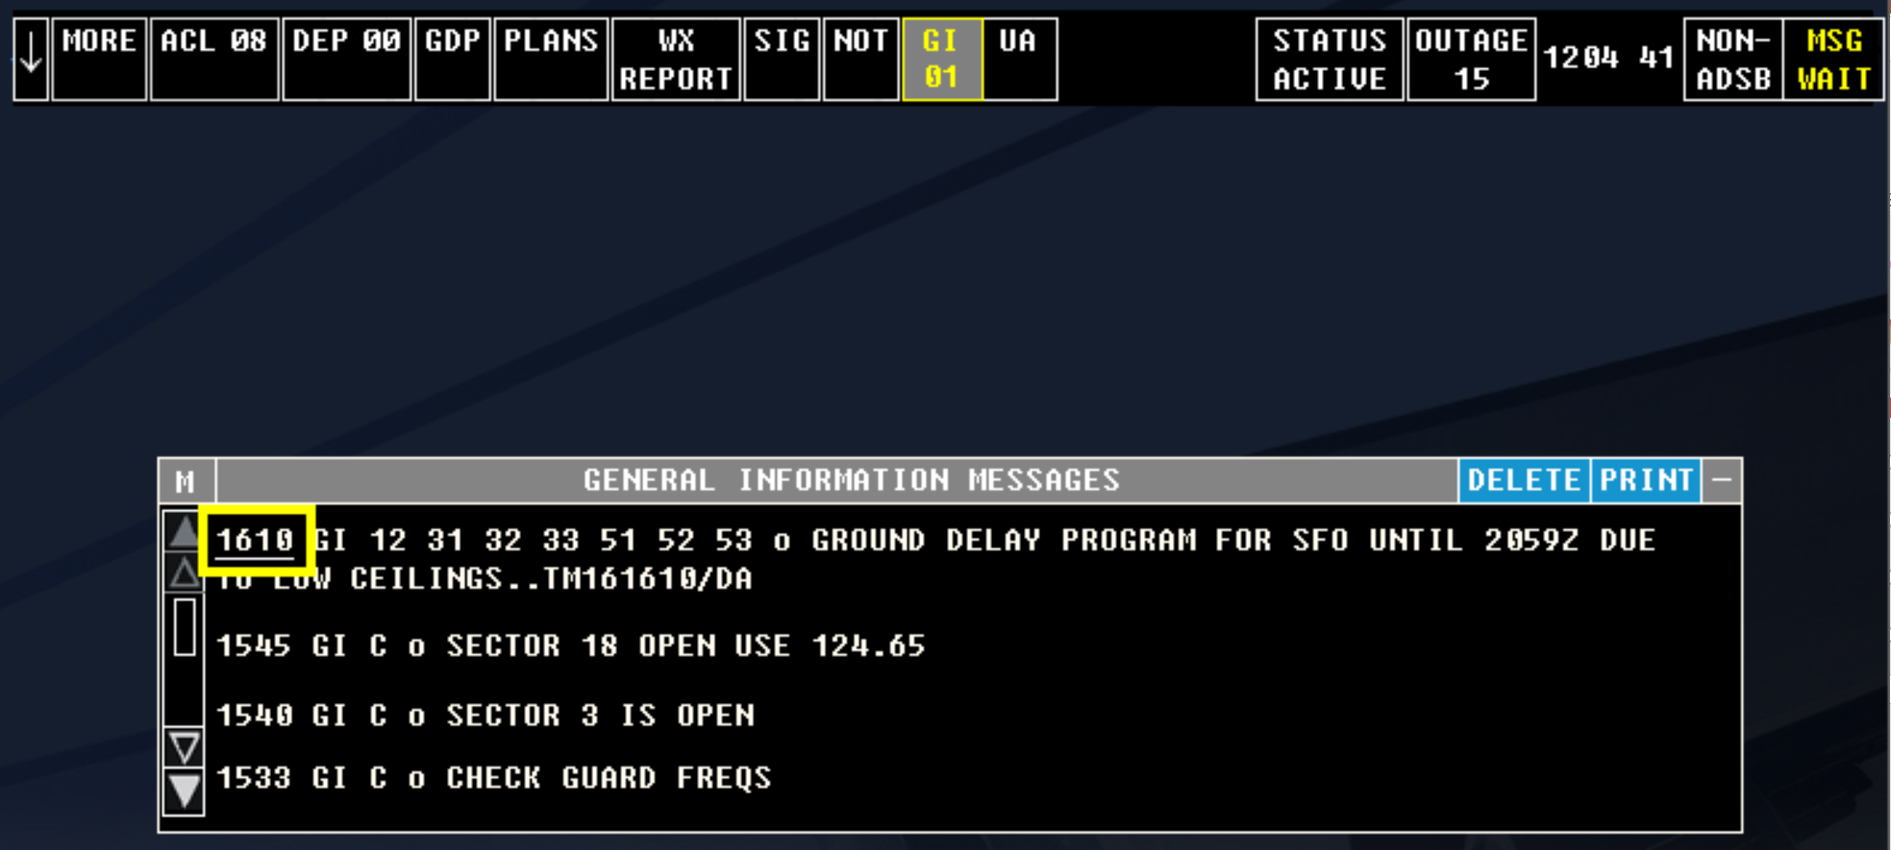
GI Messages View
Opened by TBP or TBE on the GI button
Time of new messages underlined

Slide 14
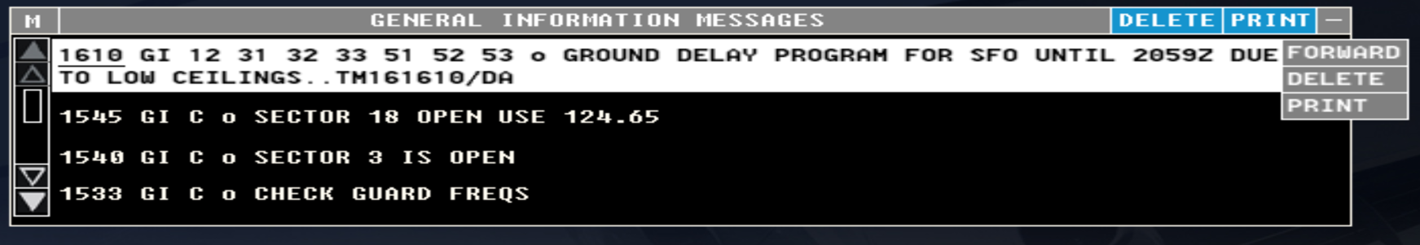
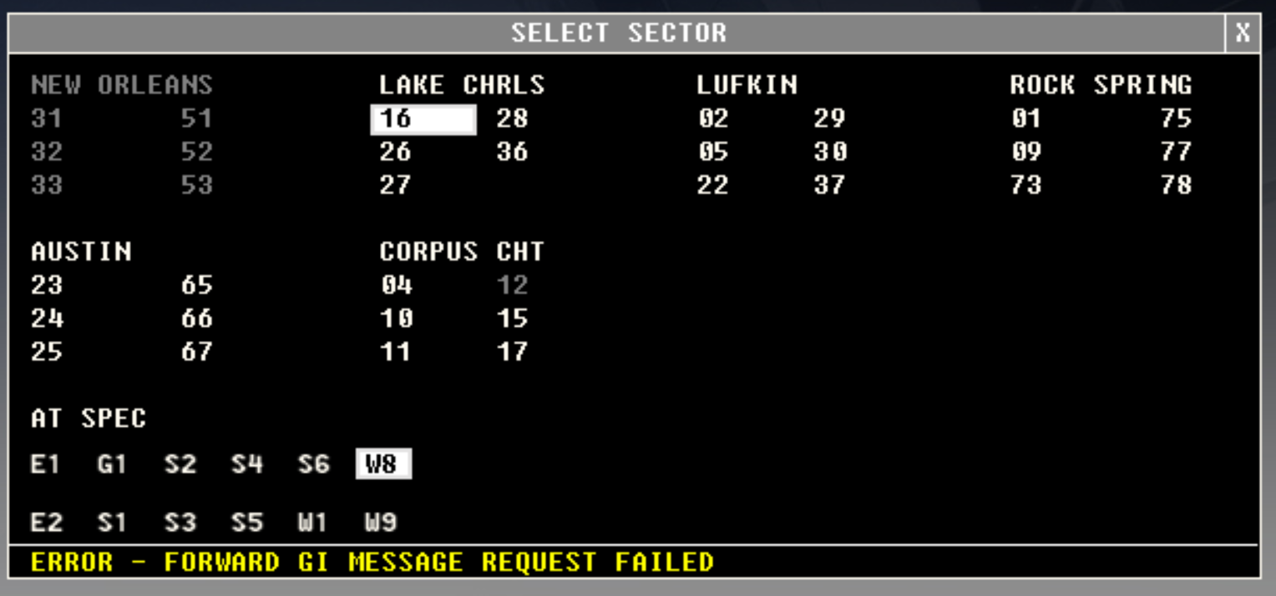
Forwarding GI Messages
1
2
3
4

Slide 15
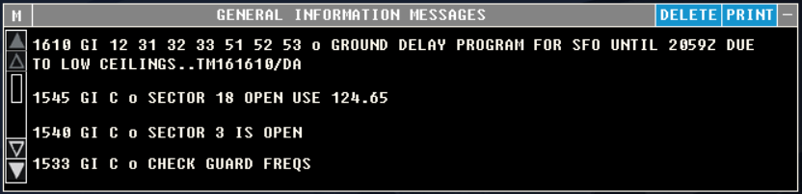
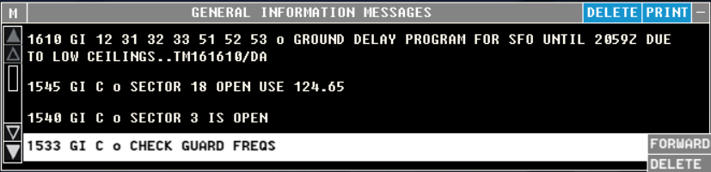

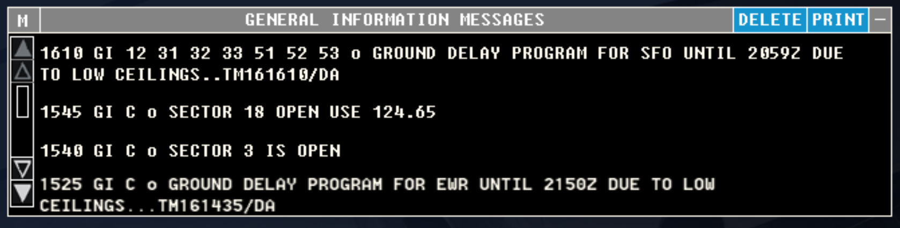
Deleting a Single GI Message
TBP or TBE click entry, then…
Resulting GI Message View

Slide 16
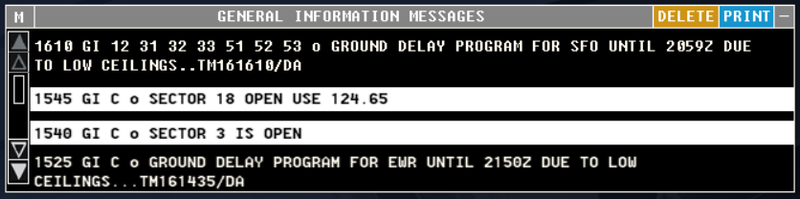
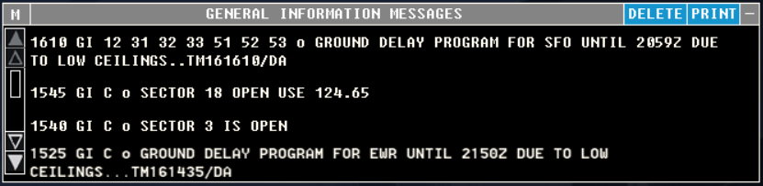
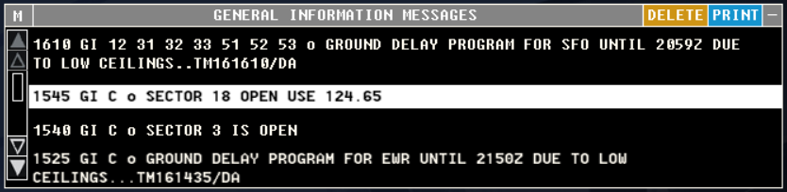
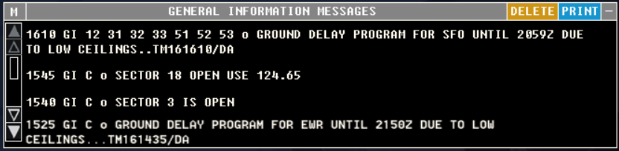
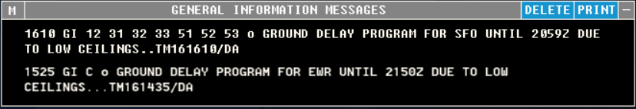
Deleting Multiple GI Messages
TBP
TBE
Resulting GI Message View

Slide 17





Knowledge Check
How are new GI Messages indicated on the GI button in the toolbar?
  Yellow text and check mark
  Yellow text and asterisk
  Yellow text and number

Slide 18
Knowledge Check
How can you delete multiple GI messages at one time?
  TBP or TBE each GI>TBE DELETE in the header
  TBP or TBE DELETE in the header>TBP each GI but the last>TBE the final GI
  TBH or TBE SELECT in header>TBE on each GI>TBE on final GI

Slide 19
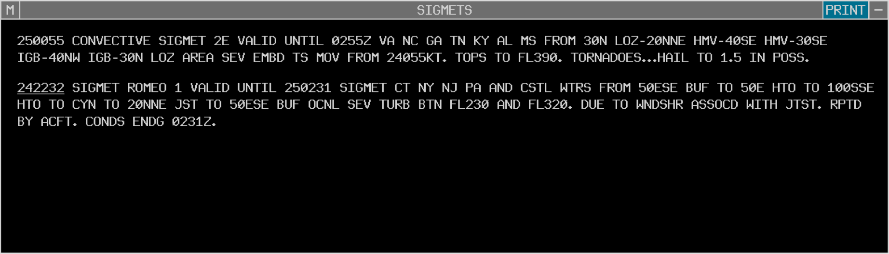

SIGMETS View
New messages indicated by yellow text and number
TBP or TBE opens view
TBP or TBE to acknowledge message

Slide 20
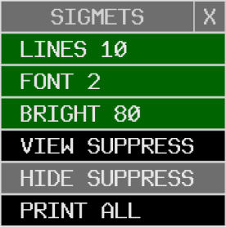
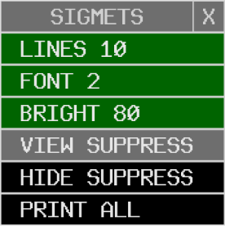
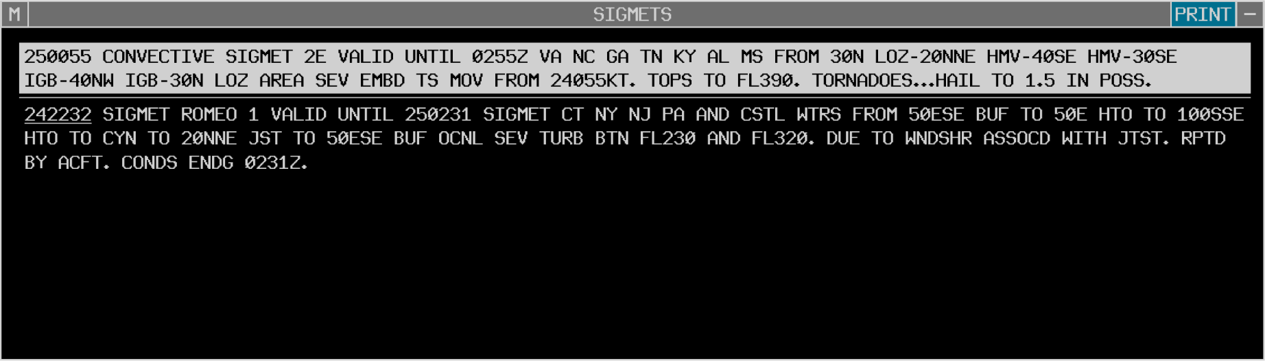
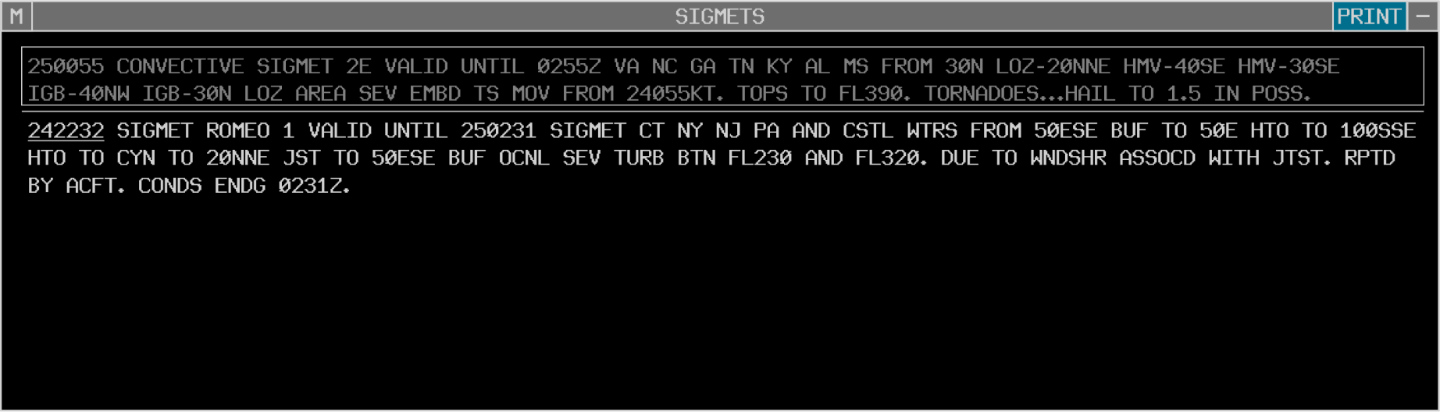

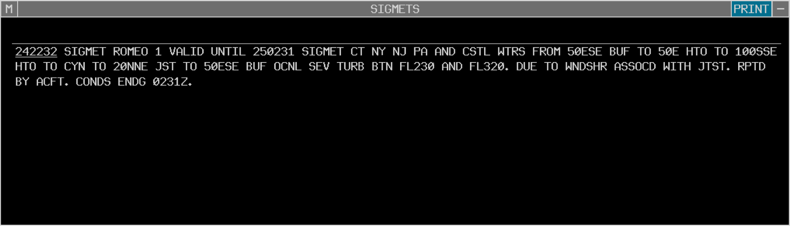
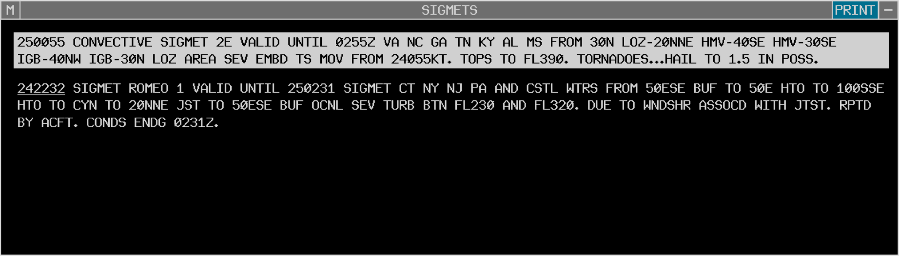



SIGMETS View- Suppress/Restore
TBP or TBE

Slide 21
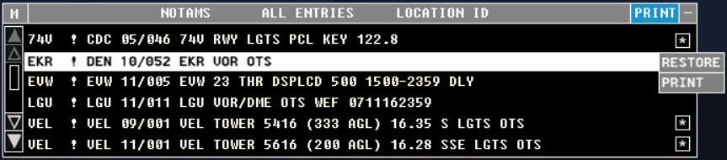
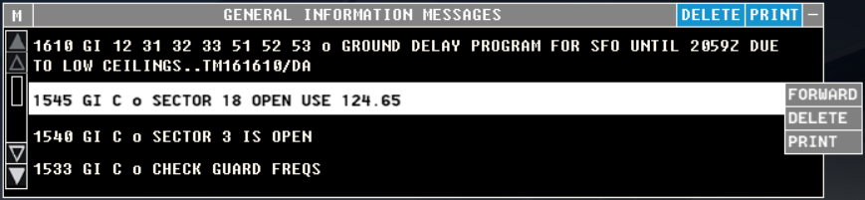

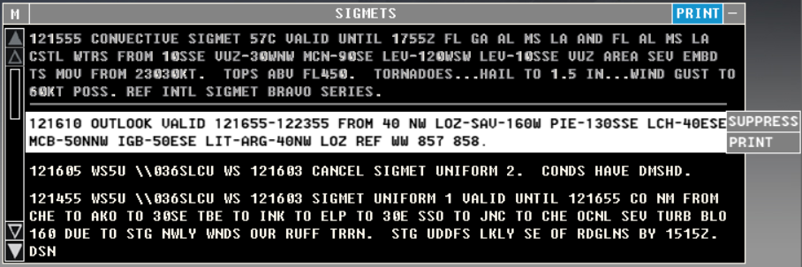

Printing - NOTAMs, GI Messages, and SIGMETs

Slide 22
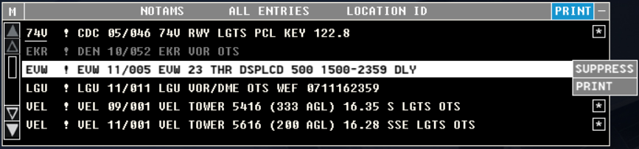
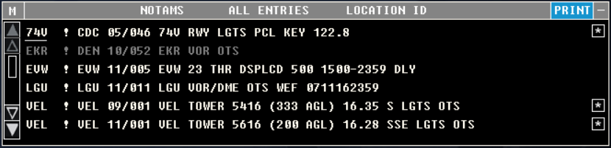
Printing a Single Entry
Select the SIG button
TBP or TBE PRINT - prints entry on a Flight Strip Printer

Slide 23
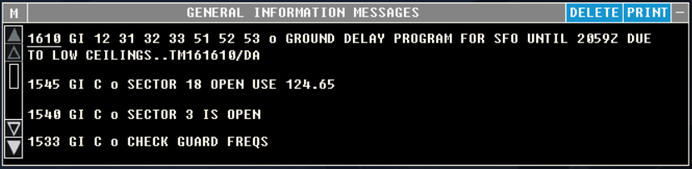
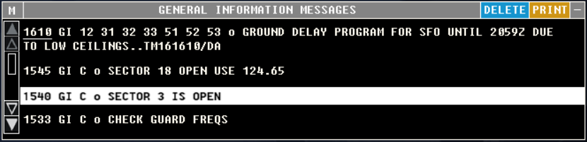
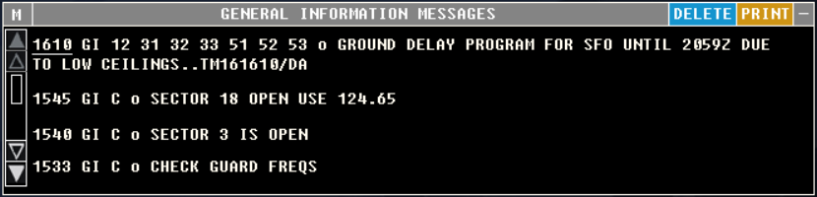
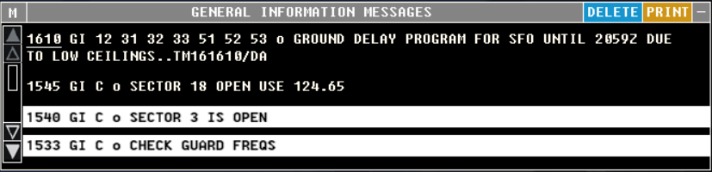
Printing Multiple Entries
TBP on all entries, except last entry, to be printed
TBE on last entry to be printed

Slide 24
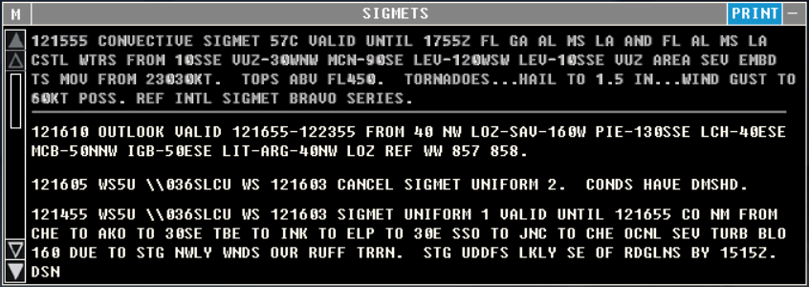
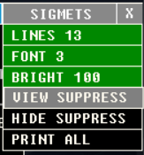
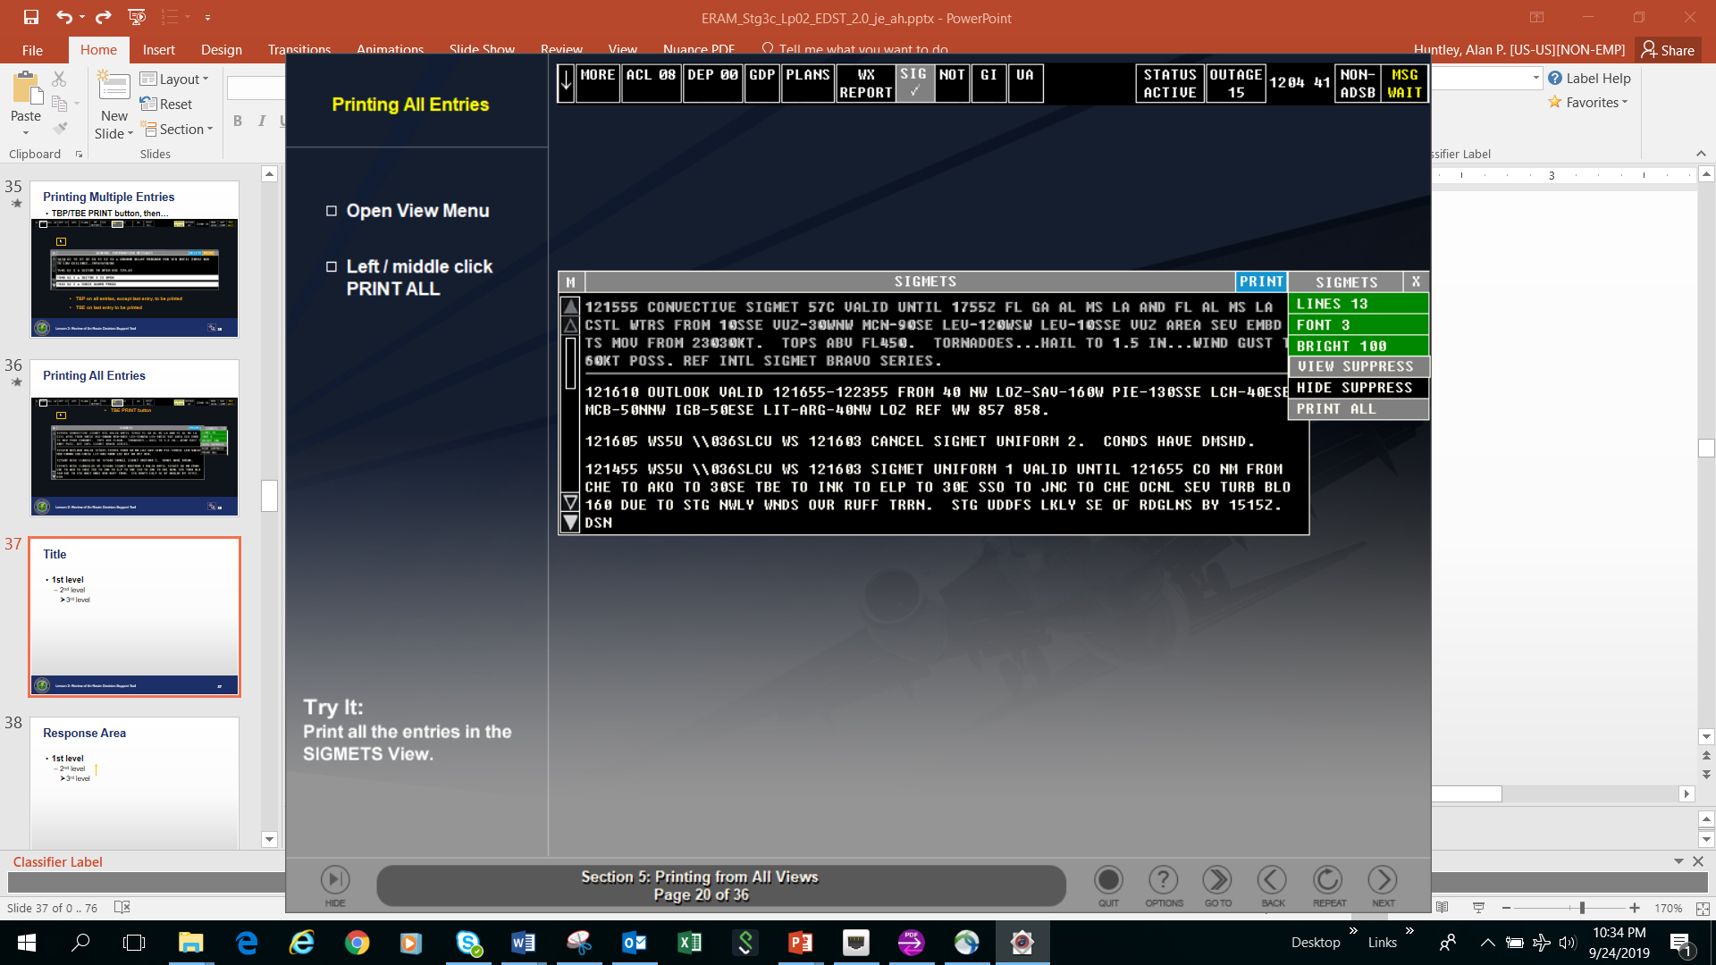
Printing All Entries
All entries will print after TBE on PRINT ALL button

Slide 25
Knowledge Check
When printing more than one GI message, _____ on all except _____ on the last entry.
  TBP; TBE
  TBP; TBP
  TBE; TBE

Slide 26
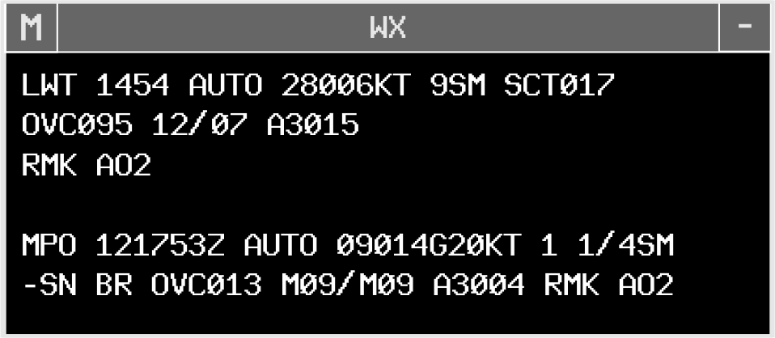
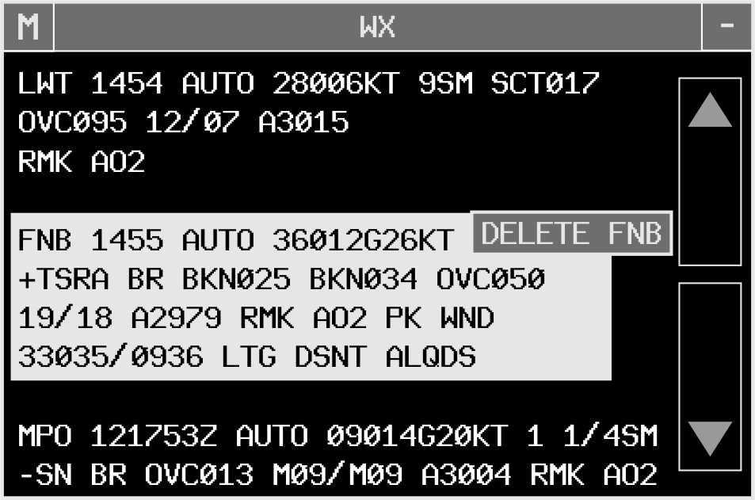
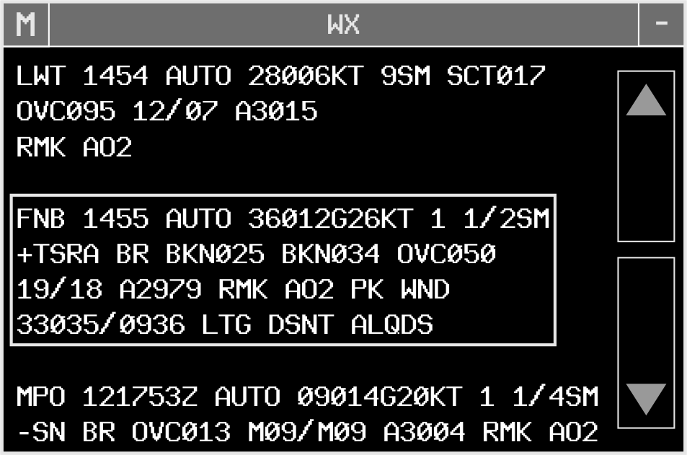
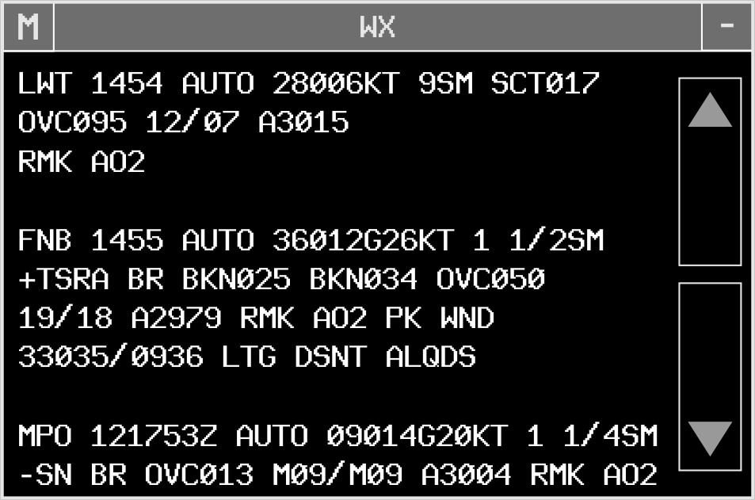
Weather Station Report View
Menu
Pick
Area
Minimize View Pick
Area

Slide 27
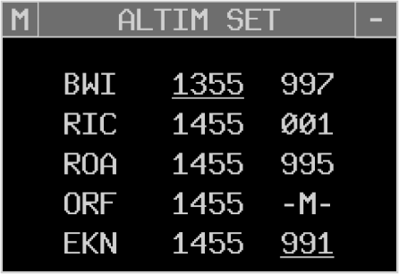
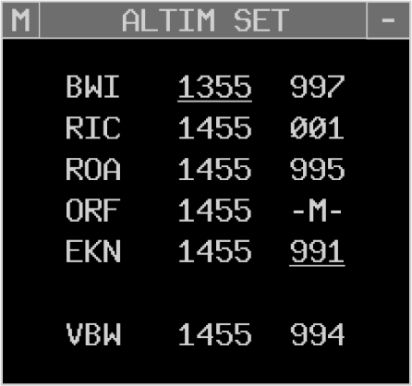
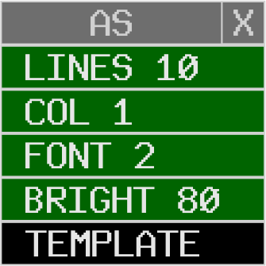





Altimeter Settings View
View Title Pick
Menu
Pick
Area
Minimize View Pick
Area

Slide 28
Knowledge Check
What will happen if you enter WR DCA on the keyboard and the WX view already contains the DCA report?
  You will receive an error message
  DCA report will update to the most current weather report
  DCA report will be deleted from the view

Slide 29
Knowledge Check
How do you access the template for the ALTIM SET view?
  TBP or TBE “M” in the header
  TBP or TBE Tools>Template
  TBP or TBE ALTIM SET on the view

Slide 30
Knowledge Check
You attempt to enter an altimeter station into the ALTIM SET template and you get an invalid response. What does this mean?
  The altimeter setting is missing
  The altimeter is more than one hour old
  The station ID entered is incorrect

Slide 31
Knowledge Check
How do you remove a weather report with the trackball?
  TBP or TBE DELETE in the header>TBP or TBE the report
  TBP or TBE the report>TBP or TBE DELETE
  TBP or TBE “M” in the header>TBP or TBE the report

Slide 32


Wind Grid - Layout and Function
Date
Time

Slide 33




Wind Grid - Recenter
Begin with TBP

Slide 34
Wind Grid - Change Range
TBE to increase - TBP to decrease

Slide 35




Wind Grid - Change Altitude
1. TBP Altitude button
2. TBP desired Altitude
To exit TBP

Slide 36

Wind Grid - Problem Indicators
Stale Weather indicator

Slide 37
Knowledge Check
What is the keyboard command to show the wind grid display at a specified altitude?
  UU <altitude> W
  UU <altitude>
  UU W <altitude>

Slide 38

Knowledge Check
After TBP on Recenter, how do you recenter the map over an intersection?
  TBP over intersection where you want the map centered
  TBE over intersection where you want the map centered
  TBH the intersection where you want the map centered

Slide 39
Knowledge Check
How do you decrease the range by one 25 mile increment?
  TBE on Range button
  TBP on Range button
  TBH on Range button

Slide 40











Opening the GPD
Toolbar Button
Flight ID
Alert
UU G

Slide 41


GPD Title Bar
White Border
Notes:
61%, 130%

Slide 42



















GPD Menu Bar - General
Recenter
Range
Suppress
Map Options
Notes:
61%

Slide 43











GPD Map Symbols
TACAN
VOR / VORTAC
Sector Boundaries
Victor Airways
SAA Labels
Waypoints
Jet Routes
NAVAIDs
Airports
MSP
SAA
Notes:
61%

Slide 44












GPD Aircraft Display Menu
AC Display Menu
MSP
Notes:
61%

Slide 45





















GPD Menu Bar - Flight Specific
Notes:
61%

Slide 46


GPD Menu Bar - Plan Specific
Notes:
61%

Slide 47





GPD Main Display Area
Non-ADSB
Chevron
Position Symbol
Flight Path
Notes:
61%

Slide 48






GPD Data Block
Notes:
61%

Slide 49







Using GPD Data Block
TBP Drag
Data Block
TBP Alt.
TBP Speed
TBP Dest.
TBP Drag
Leader Line
MSP
Notes:
61%

Slide 50











GPD Future Time Bar
TBP & Drag
TBP
TBE
White Border
Notes:
61%

Slide 51
Knowledge Check
How can you determine if a GPD track has no ADS-B?
  Red ADS-B in line 0 of the GPD data block
  Coral “A” adjacent to the track symbol
  GPD data block will not display a projected route

Slide 52

Knowledge Check
What does 280 mean in this GPD data block?
  Speed
  Heading
  Assigned altitude

Slide 53
Knowledge Check
How can you determine if the GPD is displaying future time?
  Future time is displayed in the GPD header
  EDST clock will indicate plus time in minutes
  GPD target symbols look like an hourglass

Slide 54
Knowledge Check
What is the keyboard command to open the GPD?
  UU GPD
  UU G
  UU GP

Slide 55
Knowledge Check
How would you access the menu to display or remove SAA labels on the GPD?
  TBP Tools>Airspace Status…
  TBP Military…>Area Names…
  TBP Map Options>Map Features

Slide 56
Knowledge Check
How are TFM-protected routes depicted on the GPD?
  White chevrons bisecting the route
  Cyan “T” adjacent to the GPD position symbol
  Projected route segments are colored cyan

Slide 57



Free Form Text

Slide 58


Authorized Abbreviations
Free Text Areas cannot accept all manual strip marking symbols

Slide 59
Knowledge Check
When must the free text area be open and visible?
  Any time a flight is within your sector
  When a flight is nonradar
  If it contains control instructions

Slide 60
Knowledge Check
When can plain language be used in the free text area for control instructions?
  Never
  To aid in understanding information
  When free text is automatically forwarded at handoff

Slide 61
Part-Task Exercise
Purpose
  Perform the following tasks:
    Identify features of the Tools Menu
    Demonstrate GI Message View and SIGMETS View features
    Identify weather and altimeter displays
    Interact with the GPD
Materials
  TTL part-task exercise: EDST Part 2
Directions
  This exercise takes approximately 45 minutes to complete. Each student must complete the checklist tasks. No headsets are required.

Slide 62
Features of the tools menu
Steps to interact with NOTAMs, GIs, and SIGMETs views
Weather and altimeter displays of EDST
EDST free form text

Slide 63
The End

