Slide 2
Steps to manage the EDST
Aircraft List (ACL) and Departure List (DL) layout, sort orders, and modes
ACL and DL columns, symbols, colors and coding
Steps to interact with flight plan entries
Procedures for using templates to edit or create flight plans
Hold Data Menu

Slide 3
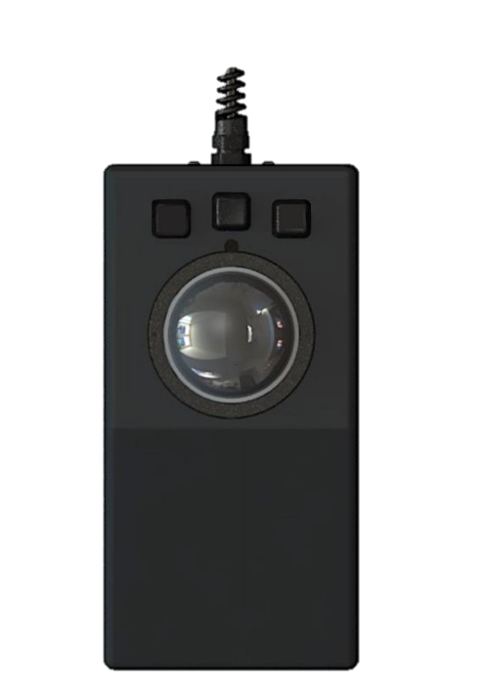
RA Trackball
TBE
TBP
TBH
Left-Click
Trackball pick (TBP)
Middle-Click
Trackball enter (TBE)
Right-Click
Trackball home (TBH)

Slide 4

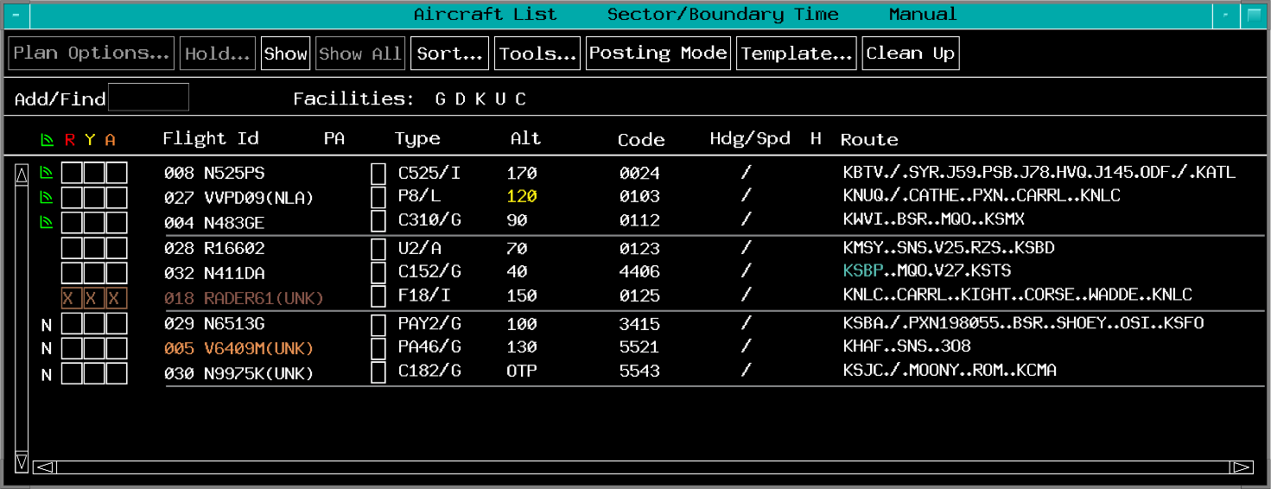
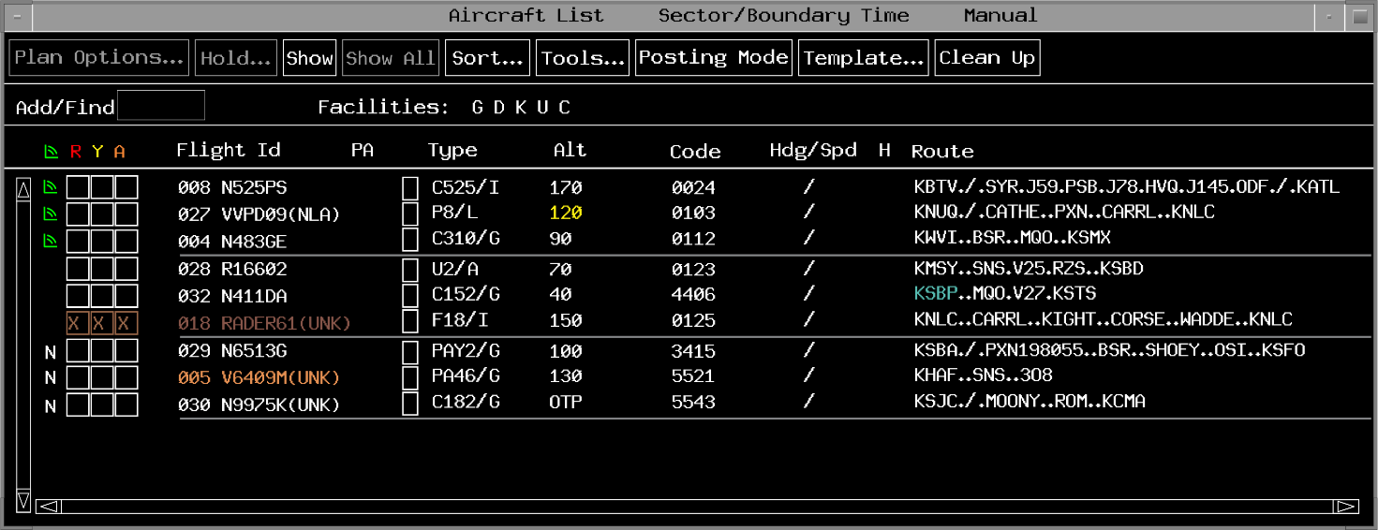
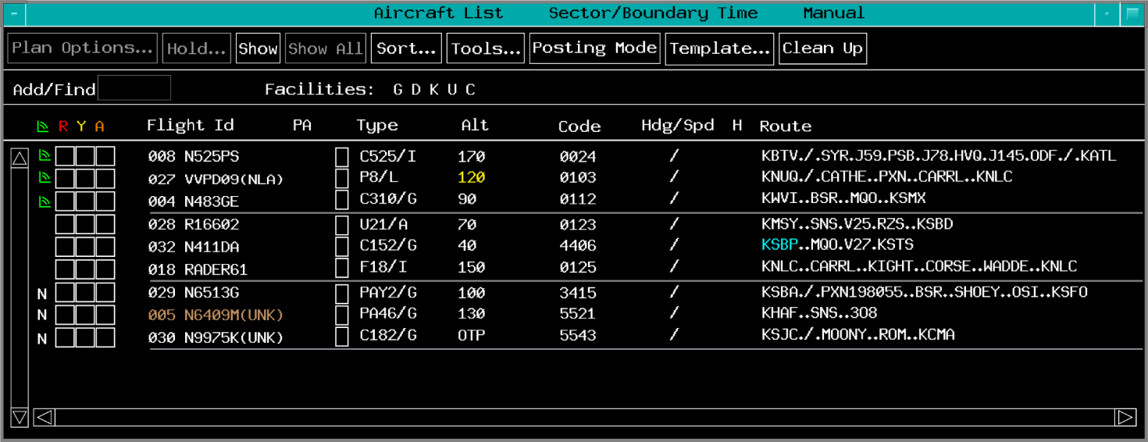
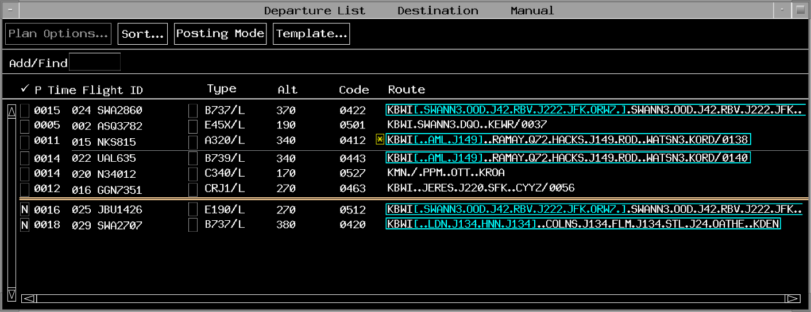
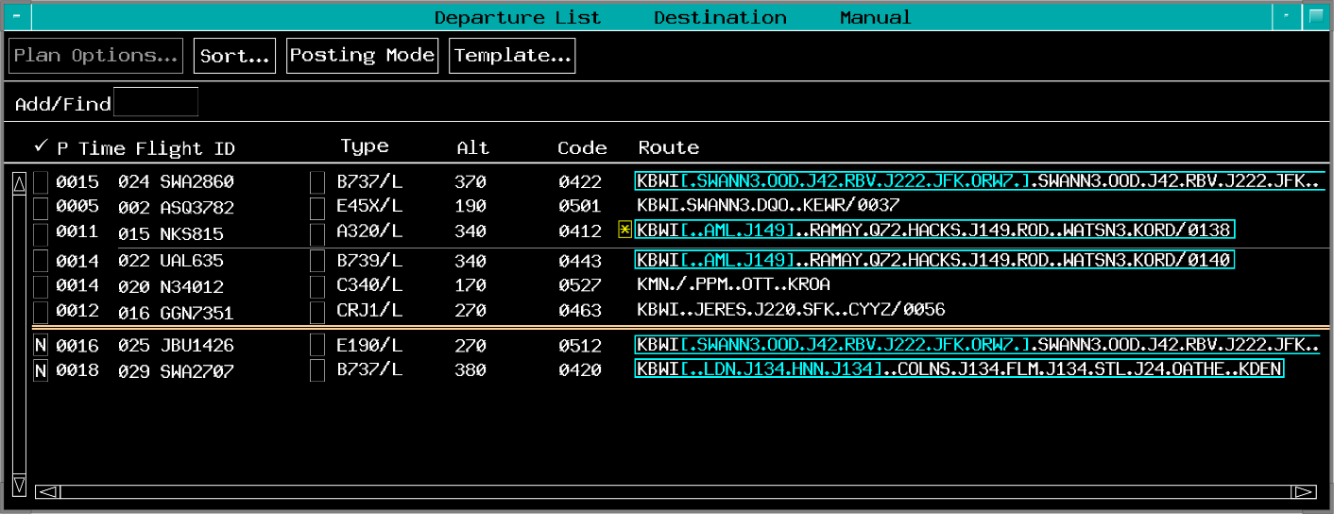

Window Focus
TBP

Slide 5
EDST Toolbar
Display and suppress views on the monitor
MORE shows additional display options
Arrow moves toolbar to top or bottom

Slide 6
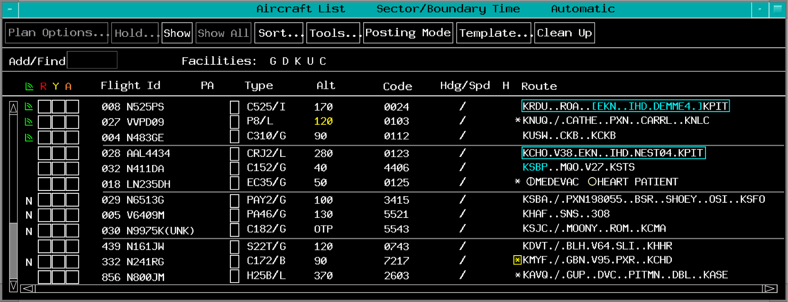
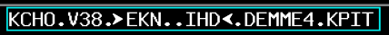
Adjust Views
View Menu, Minimize, Maximize
Drag Corner
Drag Side
Move
Scroll

Slide 7
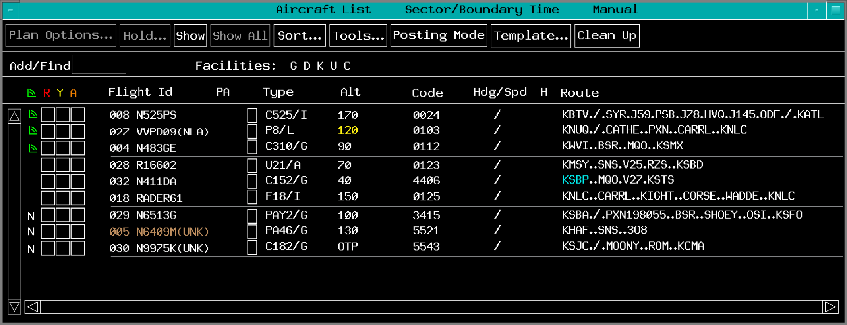
Dwell and Selection Emphasis
Dwell emphasis is provided on selectable fields

Slide 8
Menu Bar Buttons
Active - white
Inactive - gray
Submenu is displayable - if an ellipsis follows text label of a selectable button

Slide 9
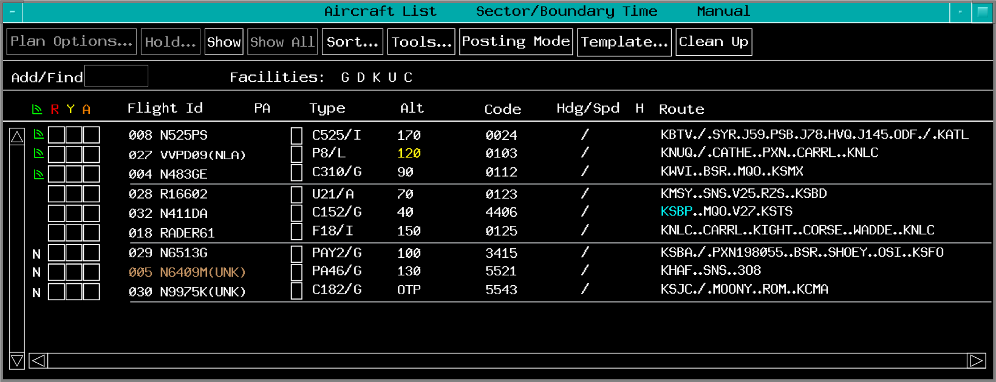
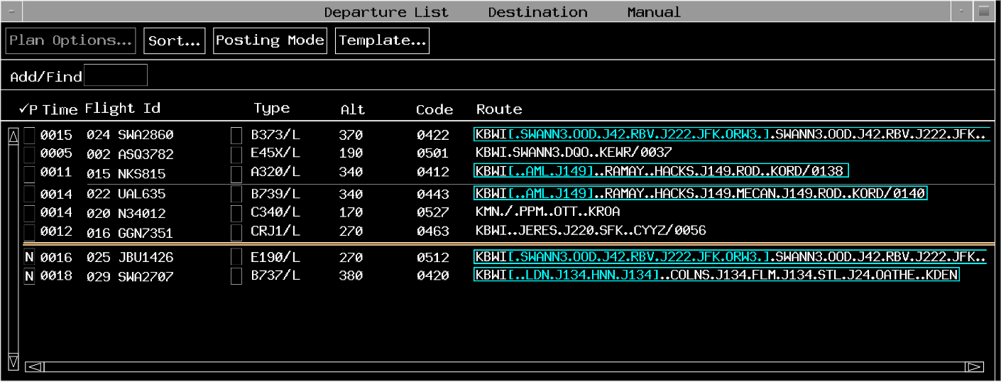
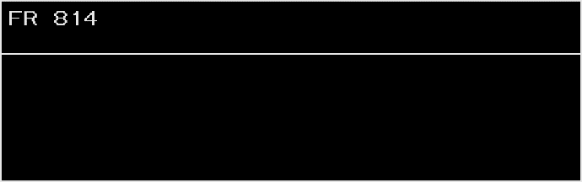
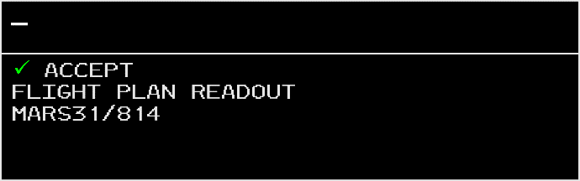
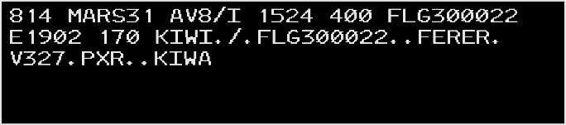
Response Area View
View forced to top

Slide 10
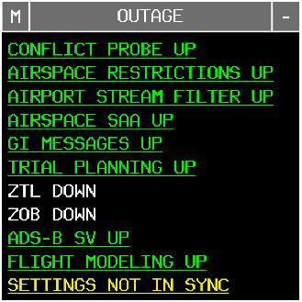
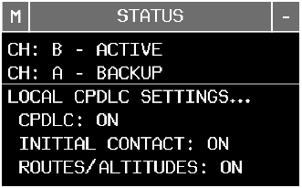
Status and Outage Views

Slide 11
Knowledge Check
What is the name of this trackball button?
Pick (TBP)
Home (TBH)
Enter (TBE)

Slide 12
Knowledge Check
How do you move a view?
Click and drag a side
Click and drag a corner
Click and drag the header

Slide 13
Knowledge Check
What is the name of this trackball button?
Enter (TBE)
Pick (TBP)
Home (TBH)

Slide 14
Knowledge Check
How do you move the toolbar to the bottom of the display?
TBP the MOVE menu>TBP BOTTOM
TBP and drag the toolbar header
TBP the arrow at the left

Slide 15
Knowledge Check
How can you determine which view is active on the display?
View header is cyan
ACTIVE appears in the header
View border is gray

Slide 16
Knowledge Check
What is the function of the MORE button on the toolbar?
Displays more toolbar buttons
Displays more flight entries in the active view
Displays more of the message composition area

Slide 17
Knowledge Check
How do you acknowledge an outage?
TBP or TBE the outage button
KBE the outage name
TBP or TBE the outage name

Slide 18
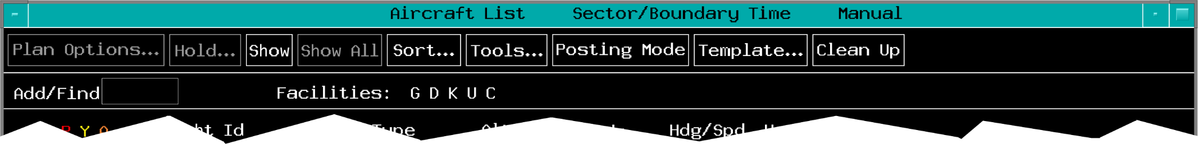
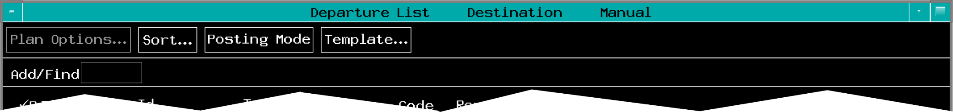
Layout and Characteristics
Title Bar
Menu Bar
Main Display Area, including:
Add/Find Input Field
Facilities Field

Slide 19
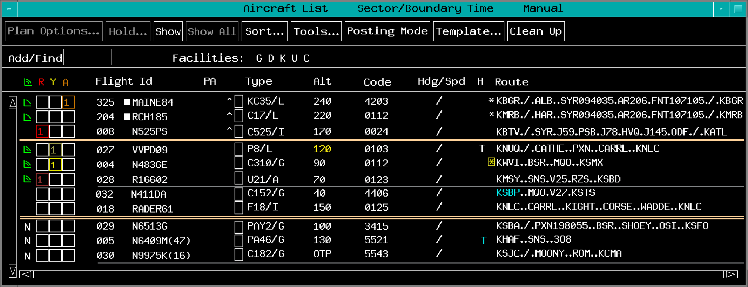

Posting Areas
Special Posting Area
Normal Posting Area
Manual Posting Area

Slide 20
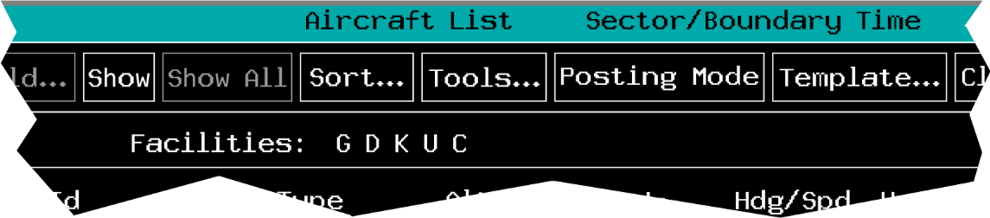
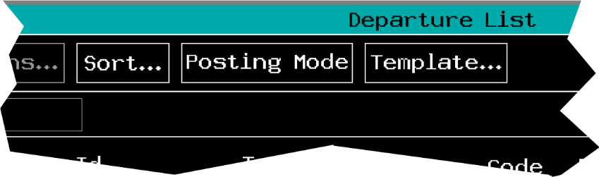
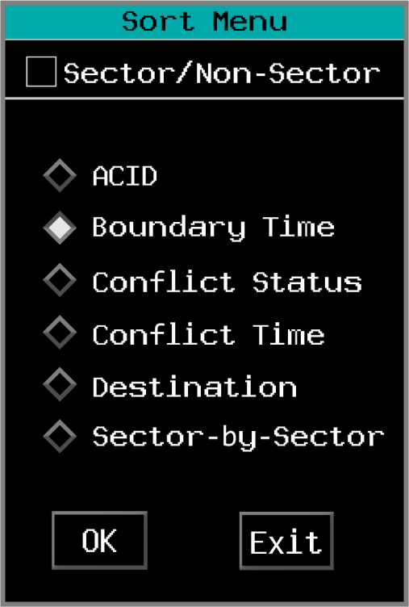
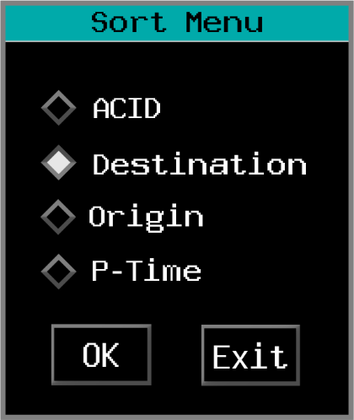
Sorting Normal Posting Areas

Slide 21
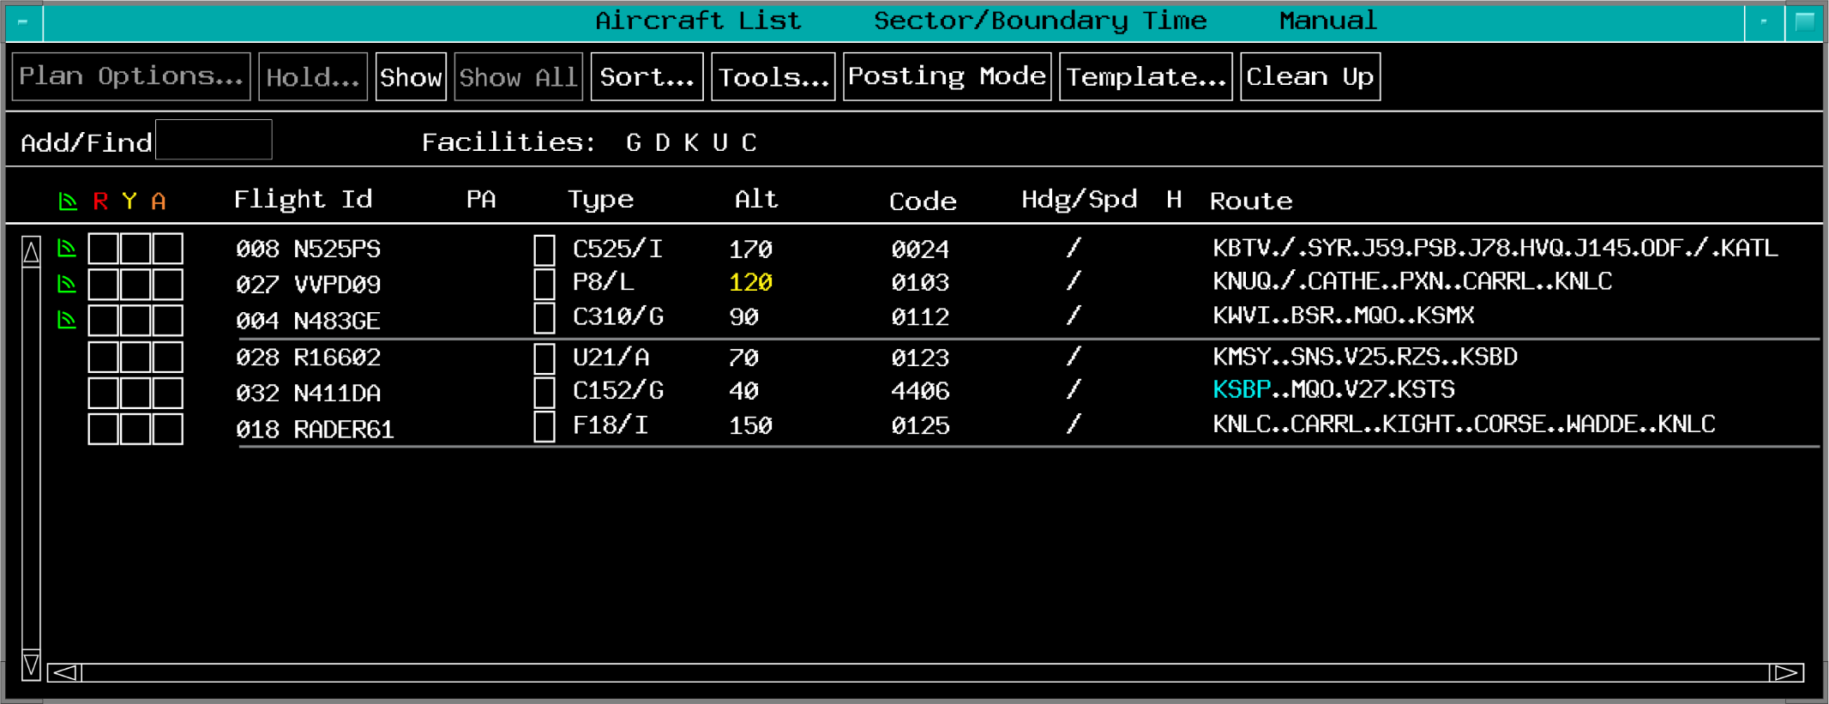
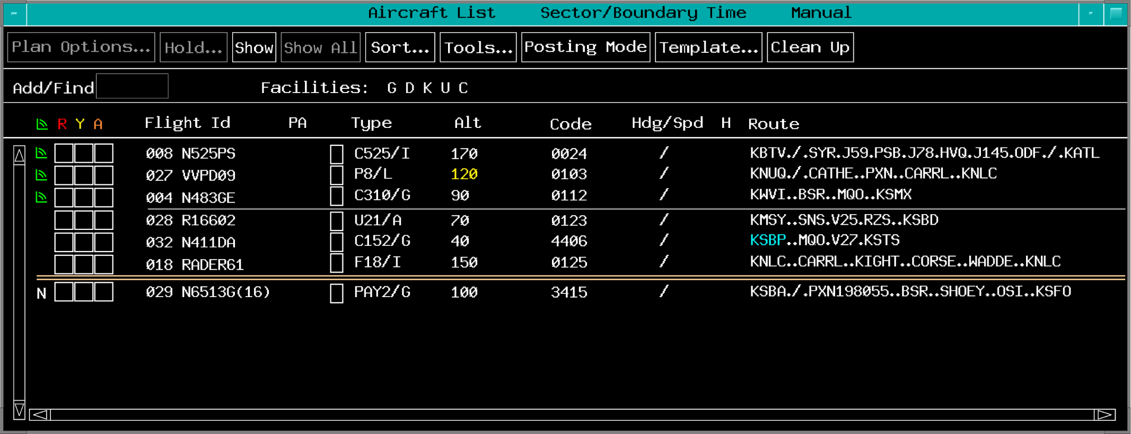
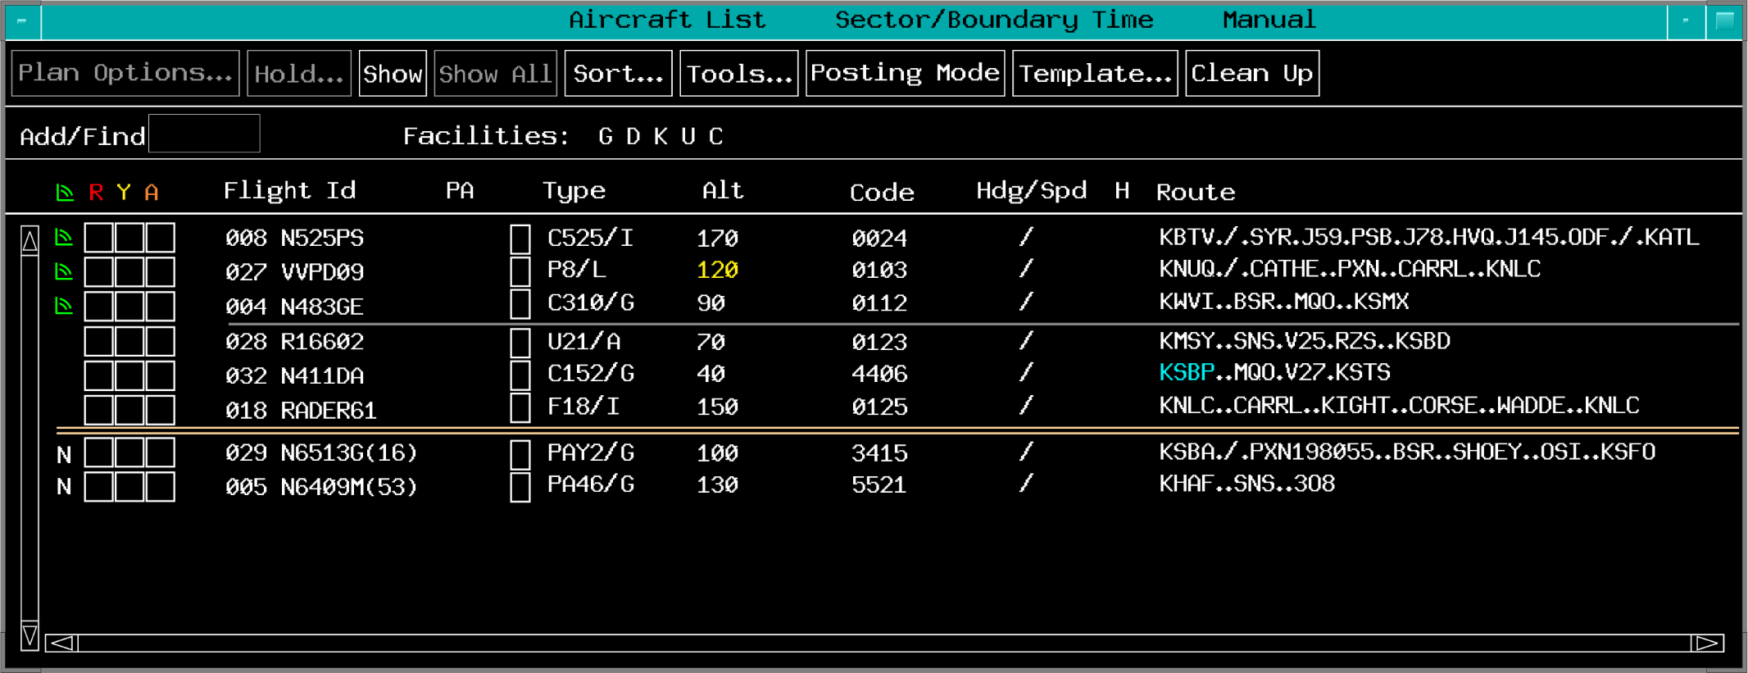
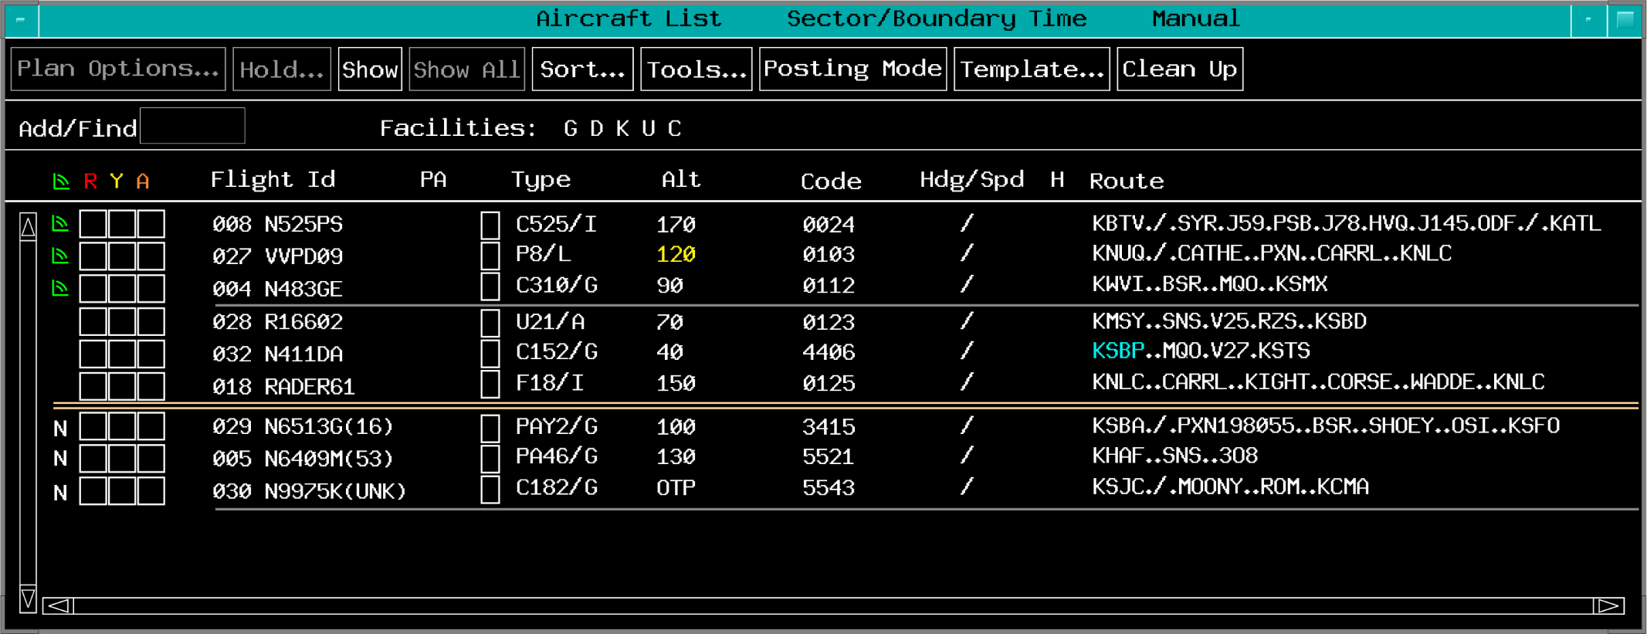
Manual Posting Mode
Entries appear in the Manual Posting Area below the separator bar

Slide 22
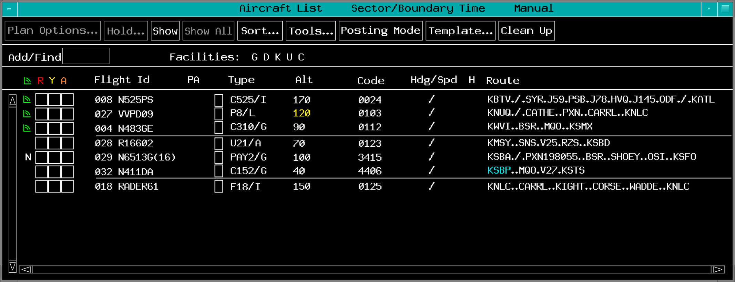
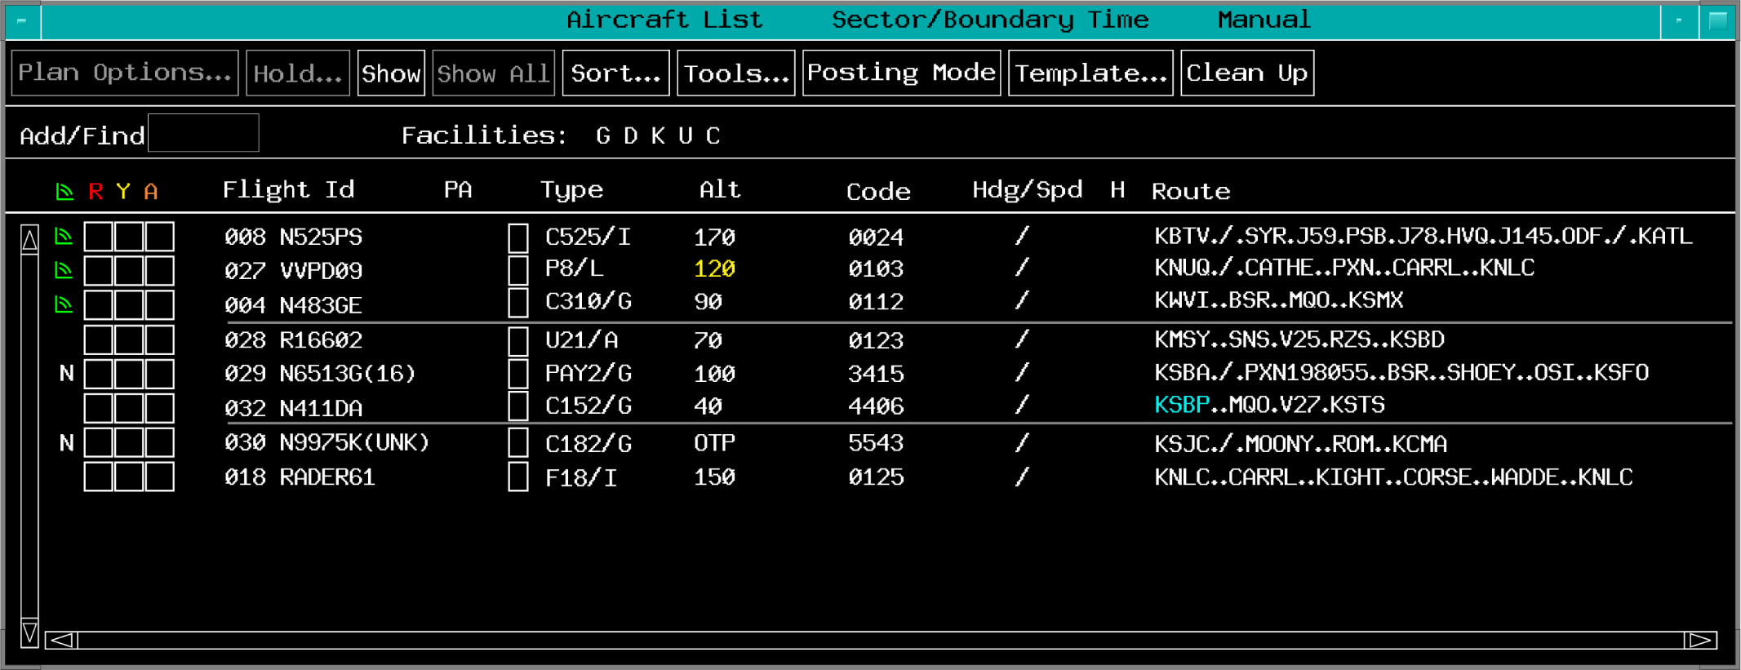
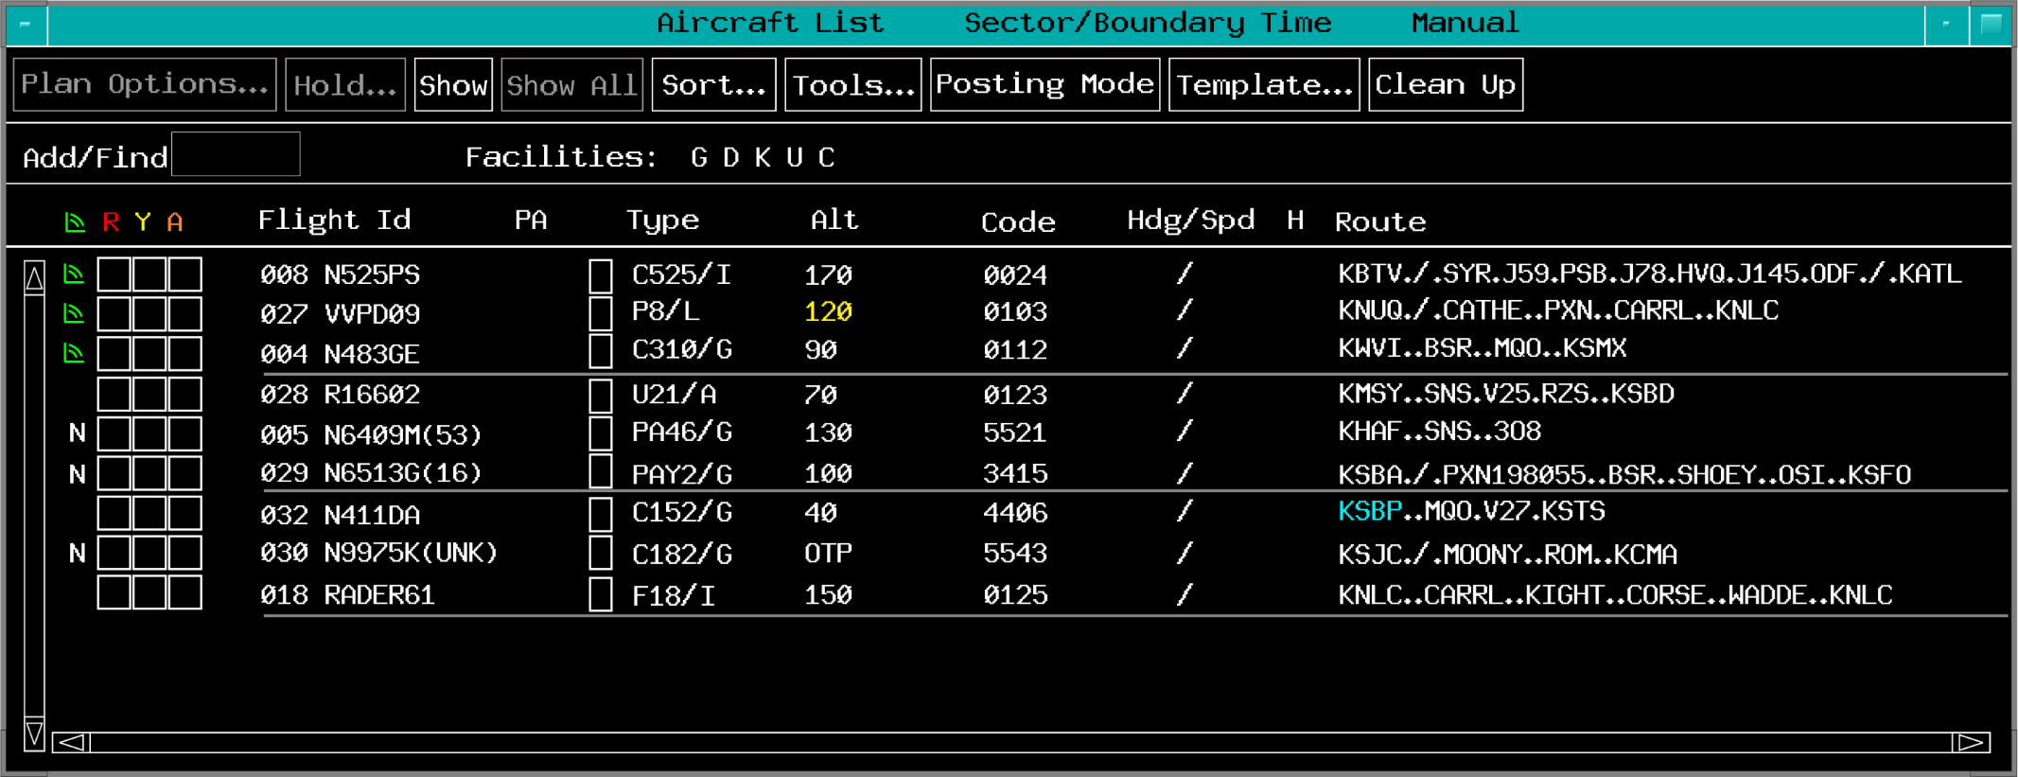
Automatic Posting Mode
Entries appear based on sort selection

Slide 23
Knowledge Check
Which ACL menu bar button allows you to specify how flight entries are displayed?
Template
Sort
View

Slide 24
Knowledge Check
When do flight entries appear in the Manual Posting Area?
When ACL is set to Manual Mode
When ACL is sorted in Manual Mode
When ACL is sorted by Boundary Time

Slide 25
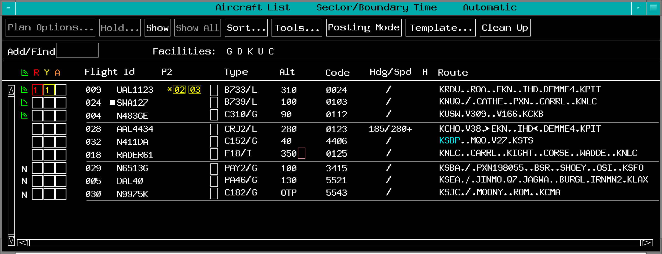
ACL Columns

Slide 26
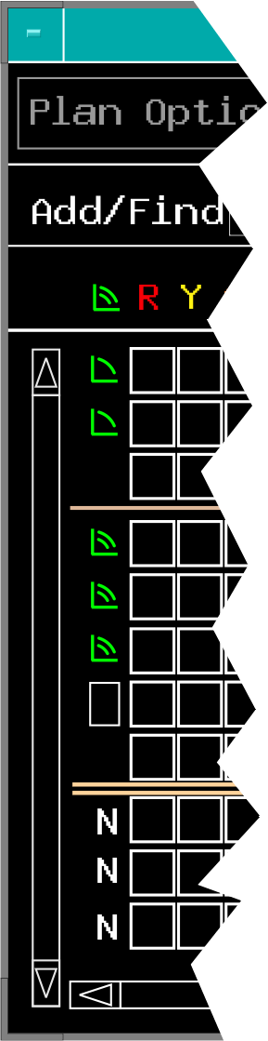
Bookkeeping Column
First column in the far left of the display
Bookkeeping Box contains:
New entry coding “N”
Indicates new entry in the ACL
Voice Communication Indicator (VCI)
Indicates aircraft is on frequency
Blank area
Indicates entry has been acknowledged

Slide 27
Remove New Entry Coding
TBP

Slide 28
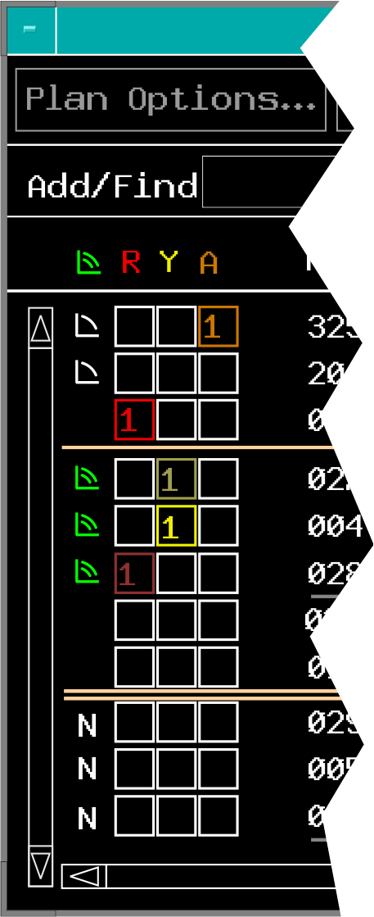
Alerts
Color coded based on type of alert:
Red
Muted red
Yellow
Muted yellow
Orange

Slide 29
Knowledge Check
How do you contract a column?
TBP on the entry in the column
TBP on the column title
TBP show/hide columns from the menu option

Slide 30
Knowledge Check
What does “N” represent in the Bookkeeping Box?
New entry coding
Non-RVSM
No Mode C

Slide 31
Knowledge Check
What is the conflict distance for yellow and muted yellow alerts?
Within 5 miles of other aircraft
Within 3 miles of Special Activity Airspace
Between 5 and 12 miles of other aircraft

Slide 32
Knowledge Check
How does a muted red alert differ from a red alert?
A muted red alert indicates an aircraft is cleared to an interim altitude and a conflict of less than 5 miles would exist if the aircraft was cleared to the requested or anticipated altitude.

Slide 33
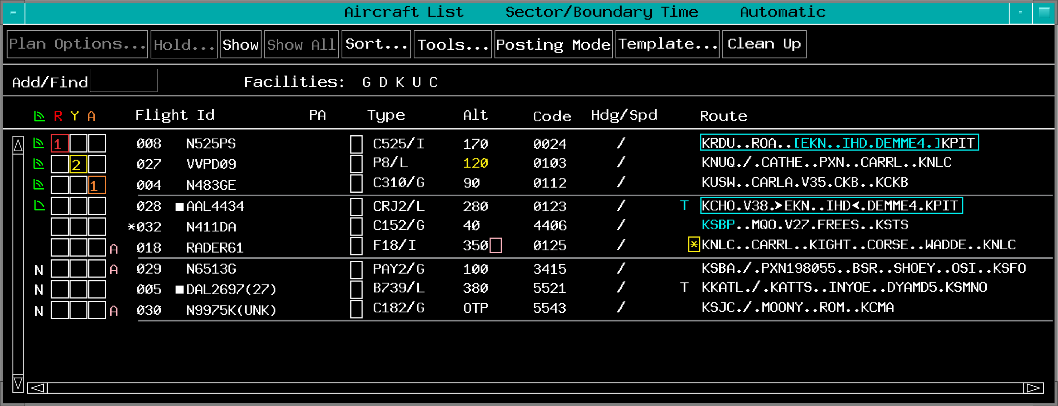
Flight Information
Remarks Indicator
Beacon Code
Non-ADSB
Route Field
Flight Id
Altitude
Type

Slide 34
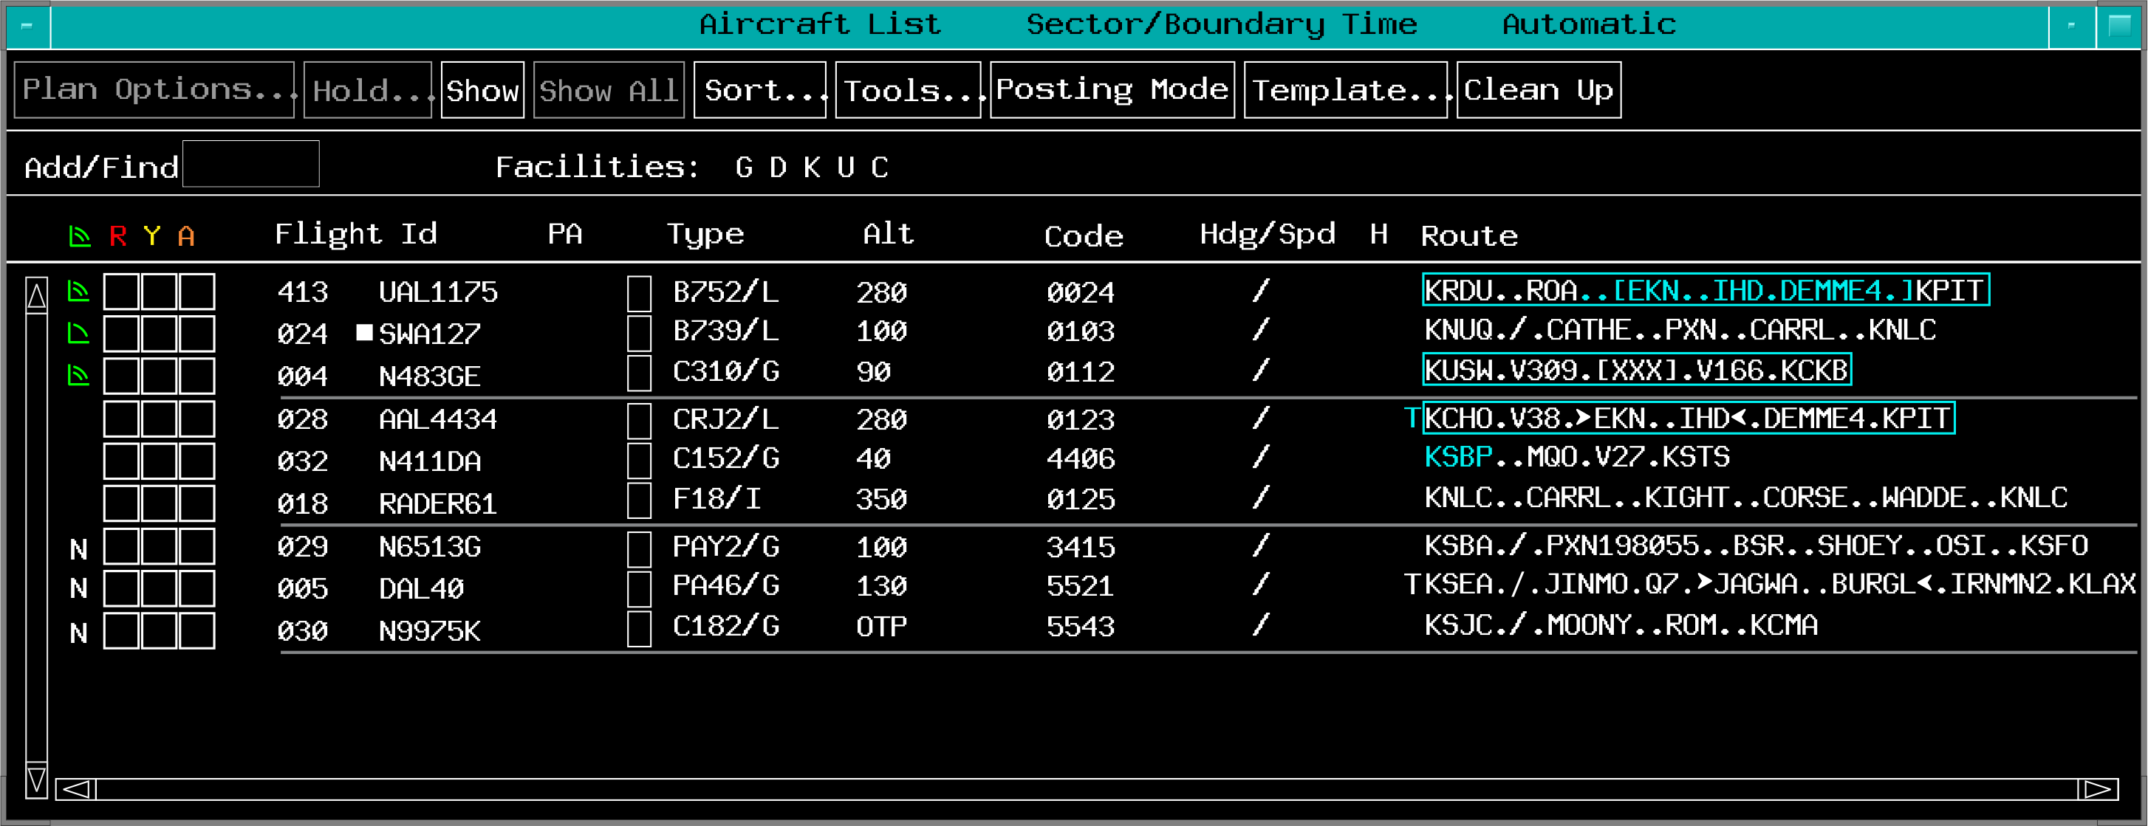
Route Field Coding

Slide 35
Knowledge Check
What does a white asterisk “✱” represent when immediately to the left of the route field?
Entry has remarks that have been viewed
Entry has a suppressed preferred route
Entry has remarks that have not viewed

Slide 36
Knowledge Check
What does a cyan “T” represent when immediately to the left of the route field?
Tower en route airway change
TFM protected segment needs to be issued
Filed T route is out of service

Slide 37
Knowledge Check
How do you display the beacon code needing to be assigned to an aircraft with an external code?
TBP the current code
TBP the FLID
TBP the asterisk left of the beacon code

Slide 38
Knowledge Check
What does a yellow coded altitude indicate?
Inappropriate altitude for direction of flight
Unsuccessful transmission of altitude
Aircraft is non-RVSM

Slide 39
Knowledge Check
How can you view the remarks of a flight entry?
TBP on route menu
TBP on Flight ID
TBP on the asterisk left of route

Slide 40
Knowledge Check
What does an asterisk “✱” signify when it precedes a CID in aircraft list?
Special handling is requested
Flight plan remarks are available
Multiple flight plans exist for this call sign

Slide 41
Knowledge Check
How can you apply or remove IAFDOF coding to indicate coordination with the next sector?
TBH on the altitude
Double click TBE on the altitude
TBP IAFDOF

Slide 42
Knowledge Check
How are non-RVSM aircraft indicated?
Coral box surrounding the altitude
Coral “A” adjacent to the altitude
Coral box right of the altitude

Slide 43
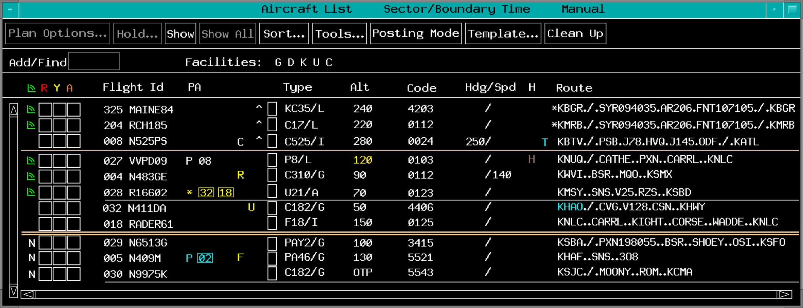


Point Out Column

Slide 44
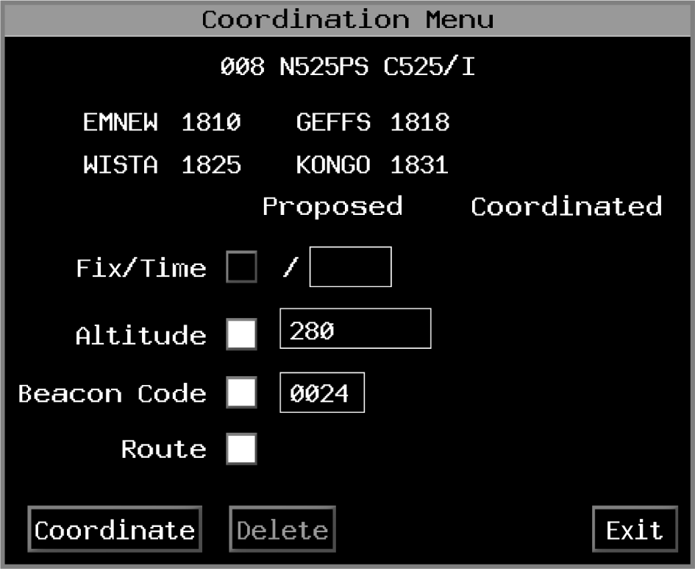
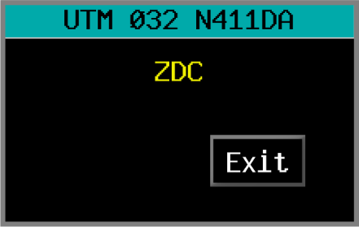
Coordination and UTM Columns
UTM Column
Coordination Column

Slide 45
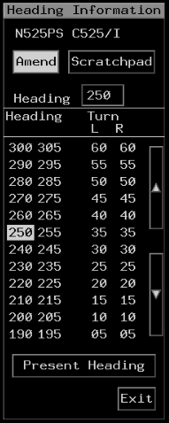
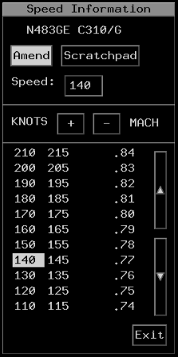
Heading and Speed Column
Speed
Heading

Slide 46
Hold and TFM Columns
Hold Column
TFM Column

Slide 47
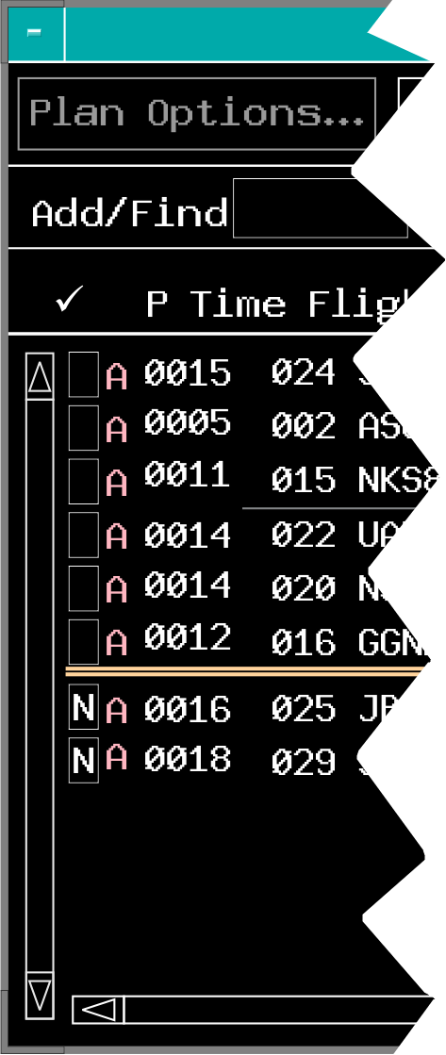
DL Specific Columns
The P Time column displays the proposed departure time for each Departure list entry
To the right of the Bookkeeping column is the non-ADS-B Indicator
The Bookkeeping column has a check mark “✓” as a header

Slide 48
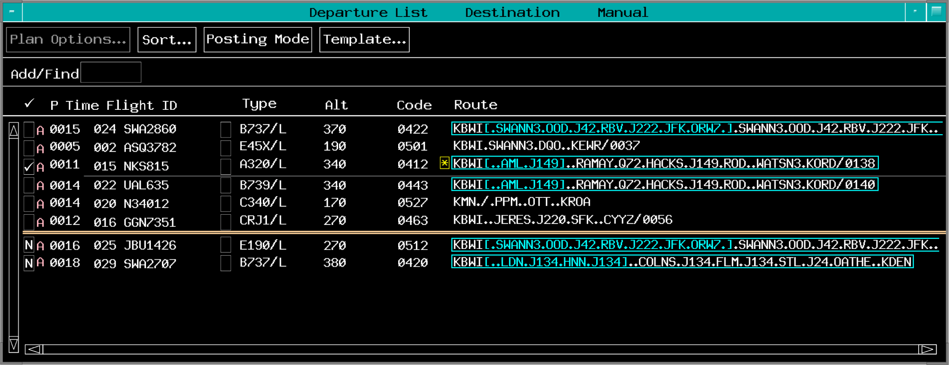

DL Specific Columns (Cont’d)
TBP

Slide 49
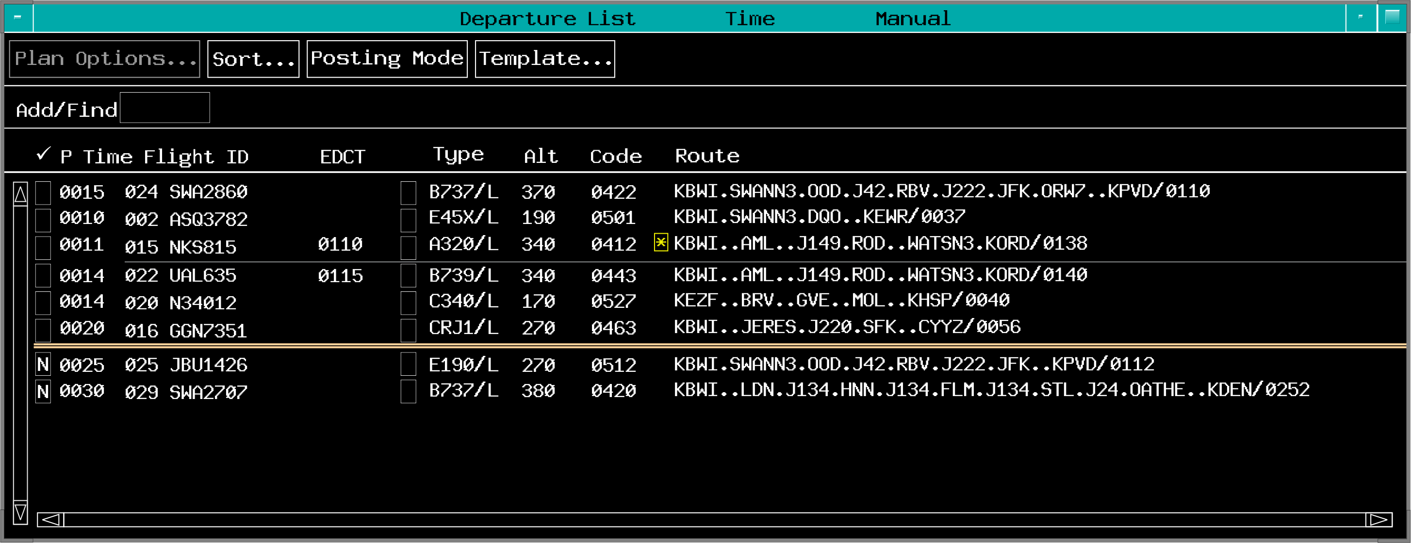
EDCT Column

Slide 50
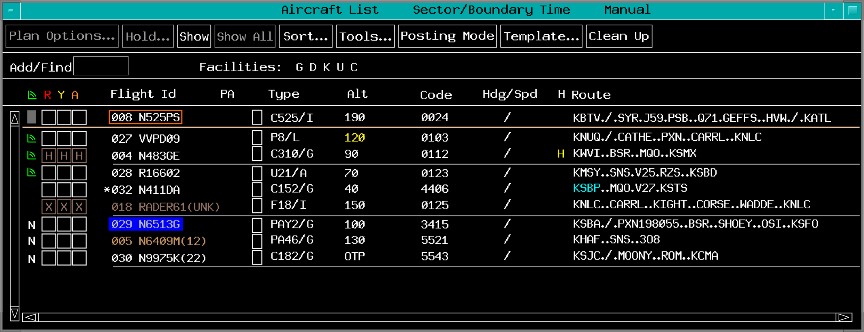
ACL and DL Entry Coding

Slide 51
Knowledge Check
What does a coral “A” to the right of the Bookkeeping Box in the Departure List represent?
Altitude alert
Non-ADS-B aircraft
Alert for off route

Slide 52
Knowledge Check
What does PA indicate in the ACL Point Out Indicator header?
Point outs to the sector are automatically approved by the system
Point outs from approach controls are automatically suppressed
Point out column will automatically expand and contract as needed

Slide 53
Knowledge Check
When will an “H” appear in the Hold Column on the ACL?
When a flight has reached the holding fix or is placed in a present position hold
Ten minutes prior to a flight reaching the holding fix if the hold is published
Only if a planned hold conflicts with a active military area

Slide 54
Keep All Entries
TBP

Slide 55
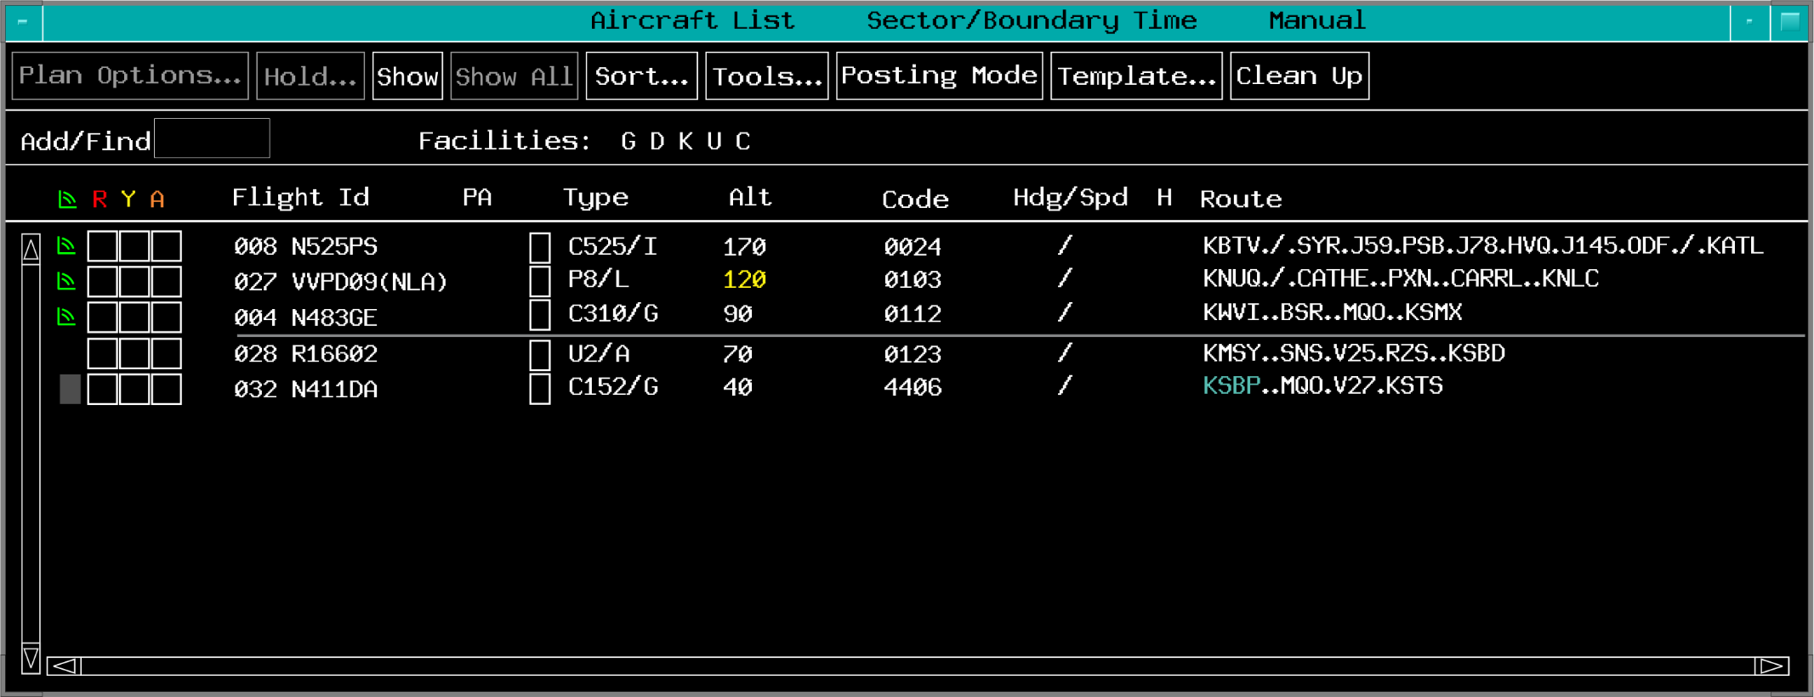
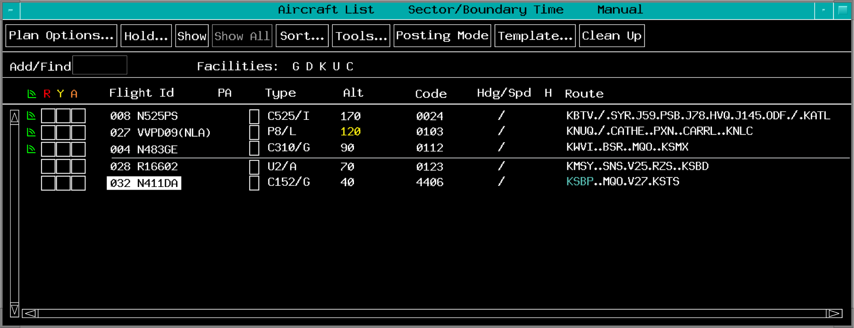

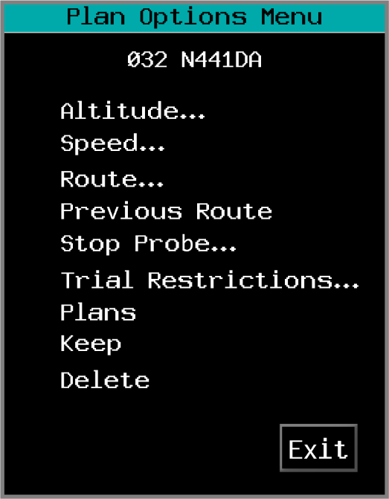
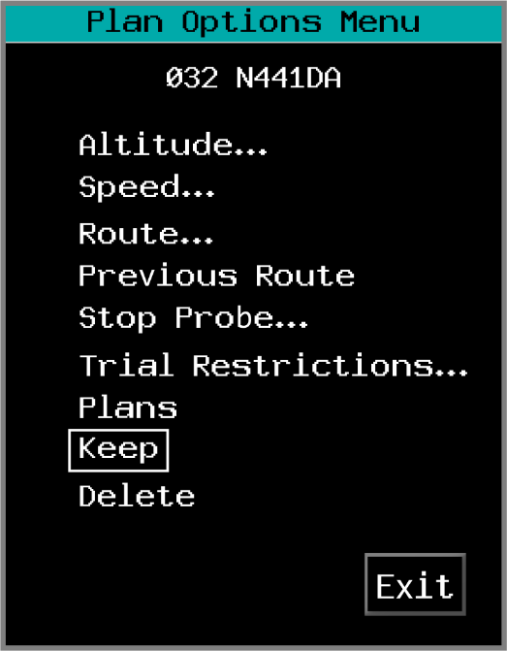
Keep Individual Entries
TBP

Slide 56
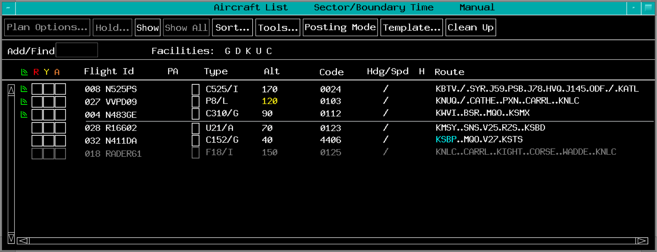
Delete an Entry
TBP
TBH

Slide 57
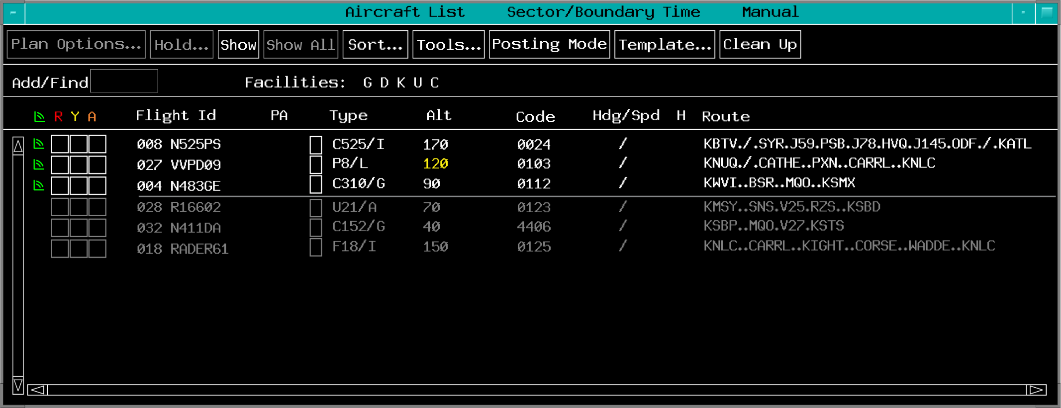

Clean Up
TBP

Slide 58




Add/Find Box
TBP

Slide 59





Hotbox
TBE
Move to/from SPA
Highlight
Free Form Text
TBP
TBH

Slide 60




Move - Special Posting Area
TBP

Slide 61


Plans Display
TBP

Slide 62



Knowledge Check
Which graphic includes the Hotbox?

Slide 63
Knowledge Check
Which menu would you use to delete a flight entry?
Plan Options
Tools
Posting mode

Slide 64
Knowledge Check
What keyboard command is used to add or find a flight in the ACL?
UU F <FLID>
UF <FLID>
UU <FLID>

Slide 65
Knowledge Check
How do you move an entry within the Special Posting Area?
TBP move symbol>Place cursor at new location>TBP
TBP move symbol>Press up/down arrows to move entry>TBP
TBP move symbol>Scroll trackball to move entry>TBP

Slide 66
Knowledge Check
How do you keep an individual flight plan entry?
TBP on the Flight ID>TBP Keep in the Plan Options Menu
TBP on the “K” in Bookkeeping Box
TBP on the Hotbox>TBP Keep in the Plan Options Menu

Slide 67
Knowledge Check
Clean Up removes all grayed entries that are coded for deletion except ______.
kept and overdue entries
entries that are not probed
VFR and military entries

Slide 68

Flight Plan Template

Slide 69

Amendment Template

Slide 70

Flight Plan Template, More…
TBP

Slide 71

Equipment Template SURV Tab

Slide 72


Equipment Template NAV Tab

Slide 73

Equipment Template COMM Tab

Slide 74

Equipment Template APP/SERV Tab

Slide 75
Knowledge Check
How do you edit the equipment qualifier of an ICAO flight plan?
TBP Flight ID>Template…>EQP…>SURV
TBP Template...>type Flight ID>EQP…
TBP SURV>Template…>EQP…

Slide 76
Knowledge Check
A flight has lost RVSM capabilities. Which equipment template would you edit?
SURV
NAV
COMM

Slide 77
Knowledge Check
What is the first step to remove or edit flight plan remarks preceded with the scattered weather symbol?
Amend field 11 of the flight plan
TBP and edit in the route fields of the ACL or DL
Select More… button in the Flight Plan Template

Slide 78



Hold Data Menu
TBP

Slide 79
Knowledge Check
How do you enter the holding fix?
TBP fix box>Enter the fix in the Hold Data Menu
TBP a fix in the Hold Data Menu
TBP on the fix in the Route Menu

Slide 80
Knowledge Check
What do the numbers next to the fixes in the Hold Data Menu mean?
Altitude at the fix
Projected EFC time
Estimated time at that fix

Slide 81
Knowledge Check
How do you open the Hold Data Menu?
TBP Hold…>Type Flight ID
TBP Flight ID>Hold…
TBP Flight ID>Template>Hold…

Slide 82
Part-Task Exercise
Purpose
Demonstrate managing RA displays, view layout, sort orders and coding, interact with flight entries
Materials
TTL part-task exercise: EDST Part 1
Directions
This exercise takes approximately 45 minutes to complete. Each student must complete the checklist. No headsets are required.

Slide 83
Steps to manage the EDST
Aircraft List (ACL) and Departure List (DL) layout, sort orders, and modes
ACL and DL columns, symbols, colors and coding
Steps to interact with flight plan entries
Procedures for using templates to edit or create flight plans
The Hold Data Menu

Slide 84
The End

