Slide 2
Lesson Objectives
At the end of this lesson, you will be able to identify the characteristics of:
Primary radar systems
Radar beacon systems
Digitized radar systems
Automatic Dependent Surveillance Broadcast (ADS-B) Systems
Area of Interest (AOI)

Slide 3
Definitions
RADAR - A radio detection device which provides information on range, azimuth and/or elevation of objects
PRIMARY RADAR - A radar system which uses reflected radio signals
SECONDARY RADAR – A radar system in which a radio signal transmitted from a radar station initiates the transmission of a radio signal from another station (transponder)

Slide 4
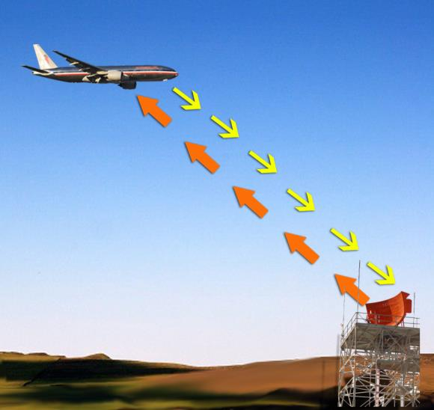

Primary Radar
Situation Display
Primary Target , not good quality, not paired to a flight plan
Primary Target, good quality, not paired to a flight plan
Slant Range
Primary Target paired to a flight plan
Pulse Echo
Pulse
Primary Targets

Slide 5


Range
Situation Display
Slant Range
Radar Site*
Altitude
Slant Range
Range
* Radar Site symbols are locally adaptable

Slide 6
Azimuth
Situation Display
310°
360°
030°
Reference Line
+
+
270°
090°
Target On 310° Bearing
Target On 030° Bearing
180°

Slide 7

What is the term used for distance measured by radar, from directly below the aircraft to the radar antenna?
  Mileage
  Range
  Slant range

Slide 8
What two items of information are furnished by primary radar?
  Altitude and distance
  Azimuth and altitude
  Azimuth and range

Slide 9
Which is the term for the bearing of a target measured clockwise from a reference line?
  Azimuth
  Range
  Offset

Slide 10
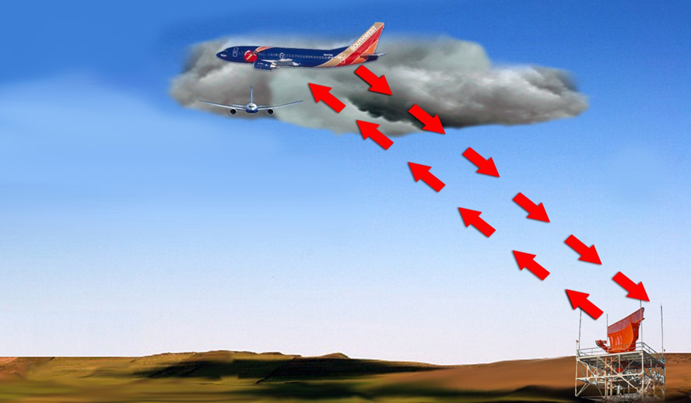
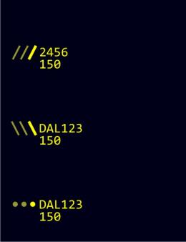
Radar Beacon System
Situation Display
Triggered Transponder Reply Pulse
Unpaired Limited Data Block
Paired
Limited Data Block
Interrogator
Pulse
Paired Limited Data Block Eligible for Reduced Separation

Slide 11
Radar Beacon Modes
Modes 1 and 2 - Military use only
  Mode 1 provides 2 digit 5 bit mission code
  Mode 2 provides 4 digit octal unit code
Mode 3/A
  Used by ATC for target tracking and identification
  Provides a 4 digit octal identification code for the aircraft
Mode C
  Provides the aircraft’s altitude in 100’ increments and is usually combined with Mode 3/A
Mode S (Select)
  Transmits information about the aircraft to the Secondary Surveillance Radar (SSR) system, to TCAS receivers and to the ADS-B system

Slide 12
What is the type of radar that relies on an interrogator pulse and return, not a reflected signal from the aircraft?
  Primary
  Secondary
  Digitized

Slide 13


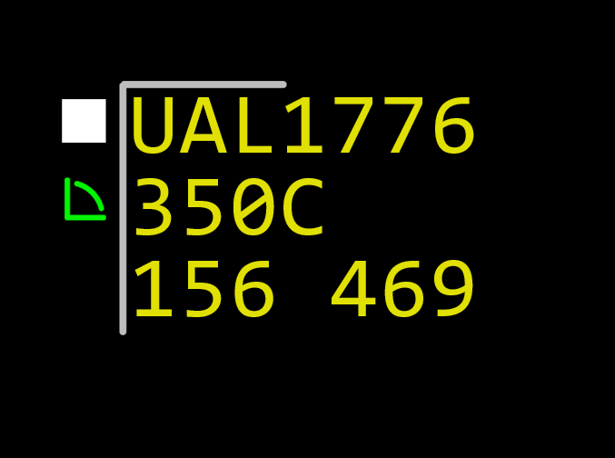
Digitized Radar System
Uses surveillance information from all sources
Combined with flight plan information in ERAM
Displays digital target symbol and data in alphanumeric form (data block)
Radar Antenna
Processor
Display

Slide 14

Characteristics of Digitized Radar
Data Block and Target
  Visual altitude information
  Visual ground speed
  Conflict alert detection
  Minimum Safe Altitude Warning (MSAW)
  Flight plan modification (Trackball reroute)
  Automatic flight plan updating

Slide 15
Characteristics of Digitized Radar (Cont’d)
Situation Display
  Uniform target and data size
  Uniform display intensity
  Automatic target tracking
  Automatic pairing of target with active flight plan
  Digitized weather
  Mode C Intruder function

Slide 16
Factors Affecting Radar Data Display
Target Fades
Intermittent or
weak targets
caused by:
  Antenna tilt
  Terrain
  Weather
  Marginal radar
  coverage
Electronic Attack (EA) or Jamming
Interference with radar for military purposes
EA types:
  Electronic (Strobing)
  Chaff

Slide 17
Automatic Dependent Surveillance Broadcast (ADS-B)
  A surveillance system in which an aircraft to be detected is fitted with cooperative equipment in the form of a data link transmitter

Slide 18
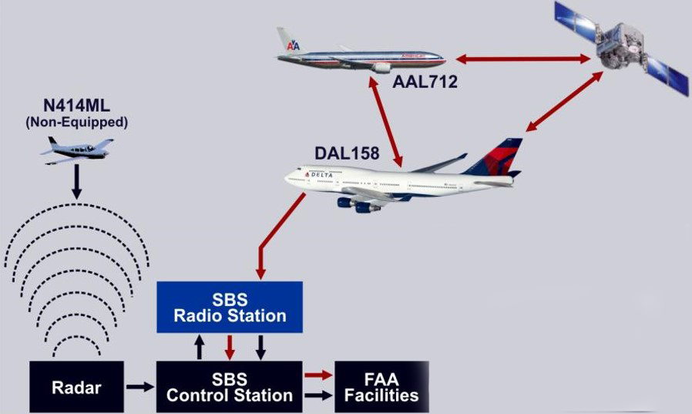
ADS-B System
SBSS
Radio Station
SBSS
Control Station
FAA Facilities
Radar

Slide 19
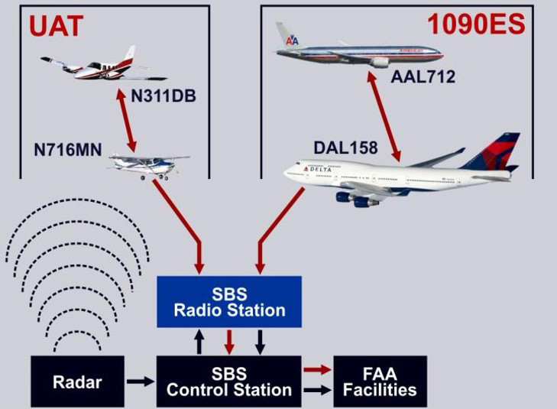


ADS-B Link Options
SBSS
Radio Station
SBSS
Control Station
FAA Facilities
Radar

Slide 20
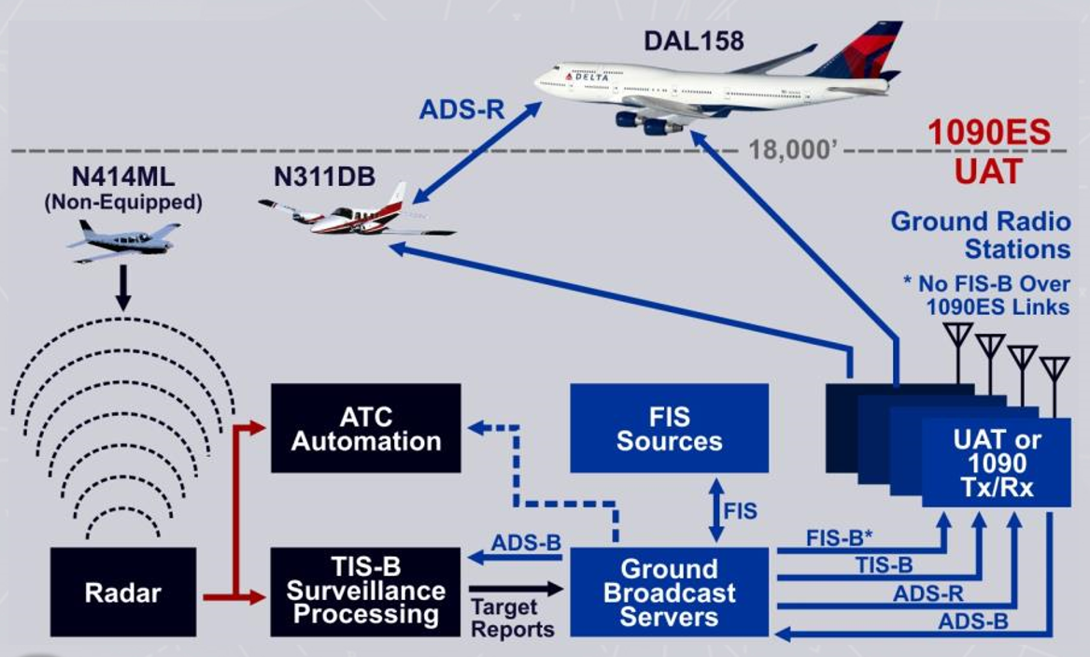
ADS-B Broadcast Services
1090ES
UAT & 1090ES
UAT or
1090ES
Tx/Rx

Slide 21

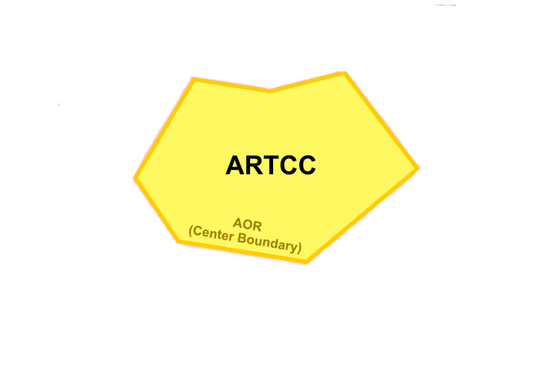
Area of Responsibility (AOR)

Slide 22
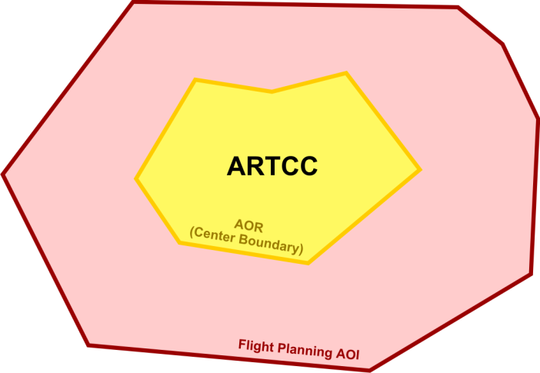
Flight Planning Area of Interest (AOI)
Flight Planning AOI

Slide 23
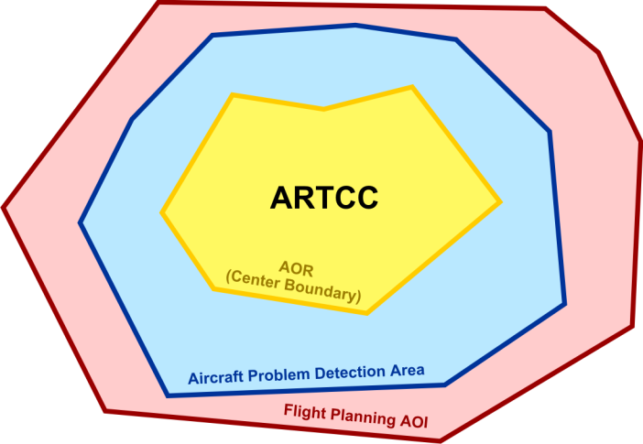
Aircraft Problem Detection Area
Aircraft Problem Detection Area

Slide 24
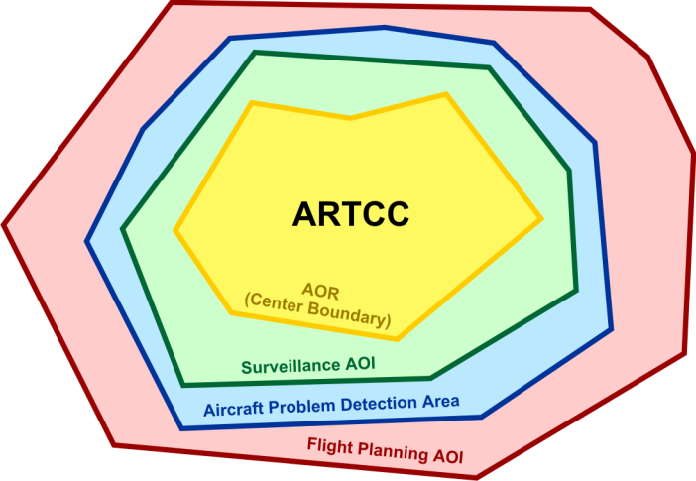
Surveillance Area of Interest (AOI)
Surveillance AOI

Slide 25
ERAM Adapted Boundary Areas
Flight Planning Area of Interest (AOI) - The area outside the center boundary where flight plan data is available from other ERAM facilities
Surveillance AOI - Area where the controllers will see targets, safety alerts, and data blocks. Includes information from the Aircraft Problem Detection Area and the Flight Planning AOI
Aircraft Problem Detection Area - The area inside the Flight Planning AOI that will receive Conflict Probe alerts. Includes information from the Flight Planning AOI

Slide 26
Lesson Summary
This lesson covered:
Primary radar systems
Radar beacon systems
Digitized radar systems
Automatic Dependent Surveillance Broadcast (ADS-B) systems
Area of Interest (AOI)

Slide 27

The End

