Slide 2
Lesson Objectives
At the end of this lesson, you will be able to recall the attributes of:
  Formation flights
  Aerial refueling
  Military training routes
  Special operations

Slide 3
Definitions
  Formation flight
  Standard formation
  Nonstandard formation
  Cell formation

Slide 4

Formation Flights
Control formation flights as a single aircraft
  All instructions are issued to the flight leader
Flight leader and other pilots of the flight are responsible for separation between aircraft within the formation
Support formation flight join-up for aircraft when all of the following occur:
  Requested by any participating pilot
  All pilots must concur when entering a formation
  One of the participating pilots reports the other(s) in sight

Slide 5
Formation Flights - RVSM
  If all aircraft in flight are RVSM capable:
    Use RVSM vertical separation standards
  Formation flight above FL290 which does not consist of all RVSM approved aircraft:
    Use non-RVSM vertical separation standards

Slide 6
Standard Formation - Lateral Separation
Add 1 mile to the appropriate radar separation minima for each of the following:
  Other aircraft
  Adjacent airspace
  Obstructions
Separate two standard formation flights by adding 2 miles to the appropriate radar separation minima

Slide 7
Standard Formation - Beacon Code Assignment
  Assign a beacon code to flight lead only
  Ensure all other aircraft squawk standby

Slide 8
Nonstandard Formation - Lateral Separation
  Apply the appropriate separation minima to:
    Perimeter of the airspace encompassing the nonstandard formation,
    or
    The outermost aircraft of the nonstandard formation

Slide 9
Nonstandard Formation - Beacon Code Assignment
  Each aircraft should squawk an ATC assigned beacon code
    Controller discretion allows aircraft in a nonstandard formation to squawk standby if operationally advantageous

Slide 10
Nonstandard Formation - Procedures
  A nonstandard flight must be approved by ATC
    Assign block altitudes which allow 500’ of vertical separation between each aircraft in the flight
    Control these operations as MARSA until approved separation is established and acknowledged by ATC
    Separate a nonstandard formation flight by applying the appropriate separation minima to the perimeter of the airspace encompassing the nonstandard formation, or from the outermost aircraft of the nonstandard formation, whichever applies

Slide 11
Flight Breakup
Issue control instructions and/or clearances which will result in approved separation
    Pilots are responsible for separation until approved separation has been attained and MARSA terminated
Ensure the correct equipment suffix has been assigned to each aircraft departing the flight

Slide 12
What is required to apply RVSM separation standards to a formation flight?
  Only the lead aircraft is required to be RVSM capable
  All aircraft in the flight must be RVSM capable
  If standard formation, none are required to be RVSM capable

Slide 13
How many miles of separation must be added between a standard formation flight and other aircraft?
  No extra separation is required with a standard flight
  1 additional mile for each aircraft contained within the flight
  1 additional mile added to the entire flight, regardless of how many aircraft

Slide 14
Which aircraft are assigned beacon codes in a standard formation flight?
  Only the flight lead
  Each aircraft within the flight
  Only the first and last trailing aircraft

Slide 15
Definitions
Air Refueling Initial Point (ARIP)
Air Refueling Control Point (ARCP)
Navigational Check Points
Exit Point

Slide 16
Aerial Refueling Types
Tracks and Anchors

Slide 17


Track Refueling
Components:
REFUELING ALTITUDES
(e.g., FL210/FL230)
ARCP
ARIP
NAV CHECK POINTS
EXIT POINT

Slide 18
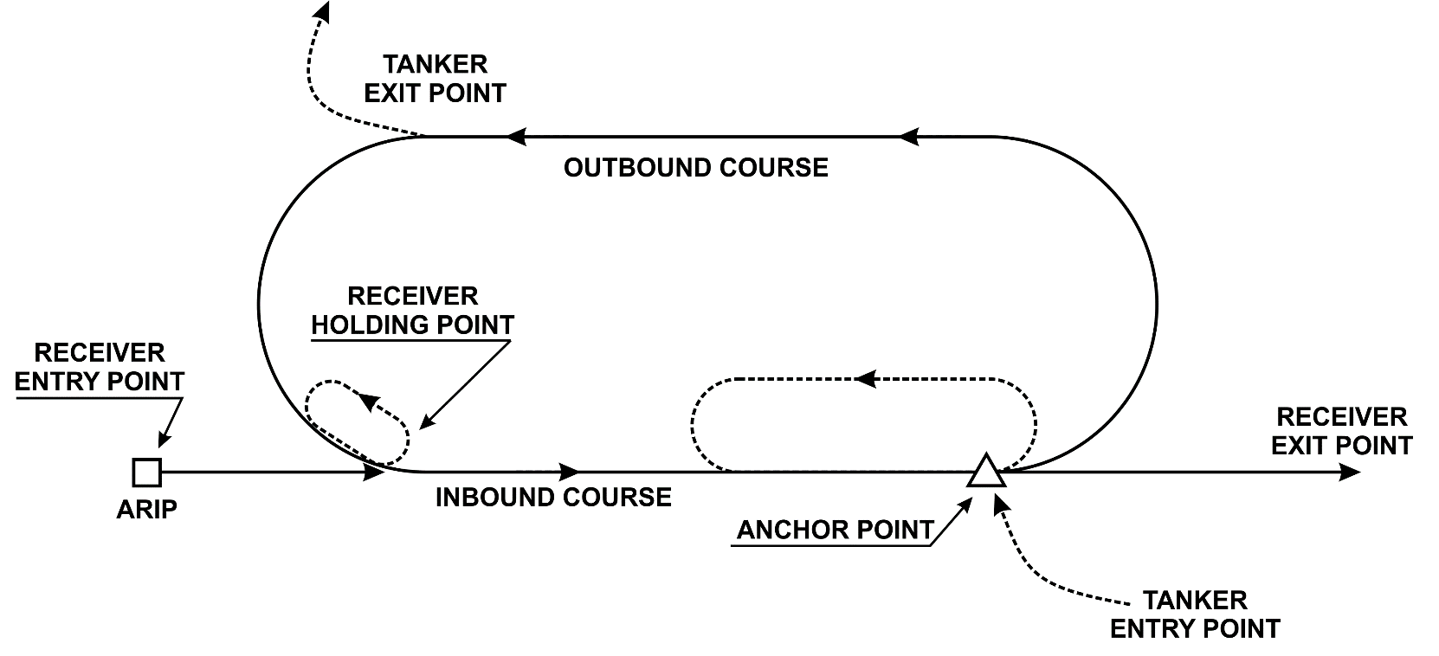
Anchor Refueling
Components:
    One or more entry points
    ARIP
    Anchor Point
    Anchor track turn points
    One or more exit points
    Designated refueling altitude block(s)
REFUELING ALTITUDES
(e.g., FL240/FL330)

Slide 19
Deviations from Tracks/Anchors
  When established tracks and anchors do not support military requirements, the FAA may authorize alternative aerial refueling options
    Random refueling occurs along the filed flight path of the formation flight
    The tanker and receiver may start and stop refueling at any point along the route; however they still need an ATC clearance to split up from the flight

Slide 20
What is the geographical point at which the receiver aircraft enters the refueling track/anchor, initiates radio contact with the tanker, and begins maneuver to rendezvous?
  Air Refueling Initial Point (ARIP)
  Air Refueling Control Point (ARCP)
  Air Refueling Start Point (ARSP)

Slide 21
What are two types of aerial refueling?
  Paths and Moorings
  Trails and Hooks
  Tracks and Anchors

Slide 22
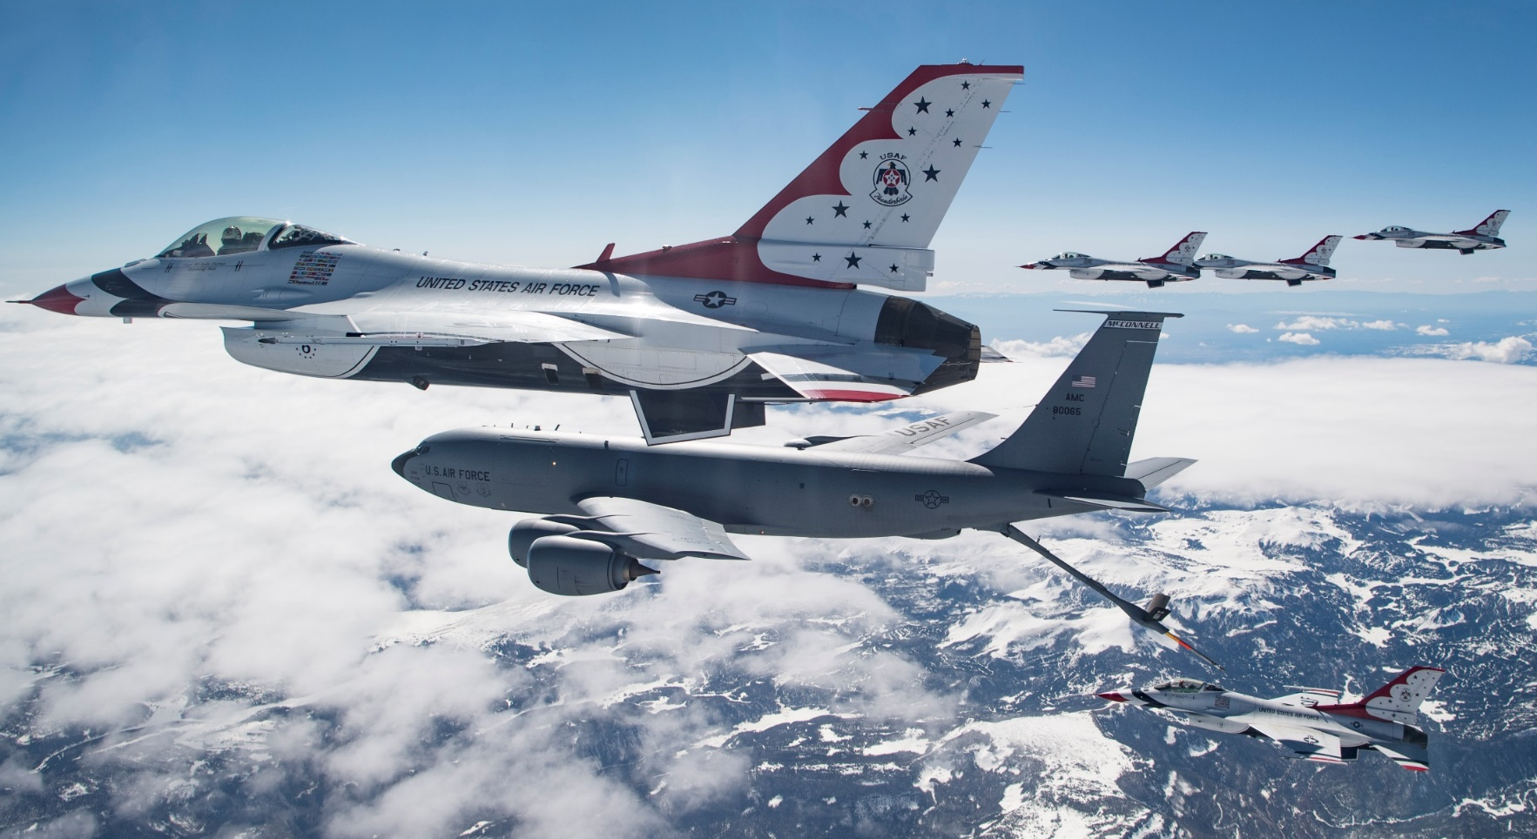
Aerial Refueling Procedures
  The tanker is responsible for communications with ATC, navigation, and declaring MARSA

Slide 23
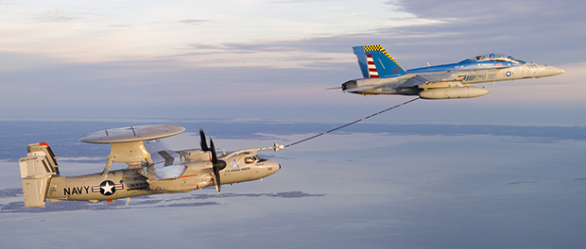

Nonparticipating Aircraft Separation
  Aerial refueling routes are not sterilized and other aircraft may transit this airspace provided vertical or lateral separation is provided from refueling aircraft

Slide 24
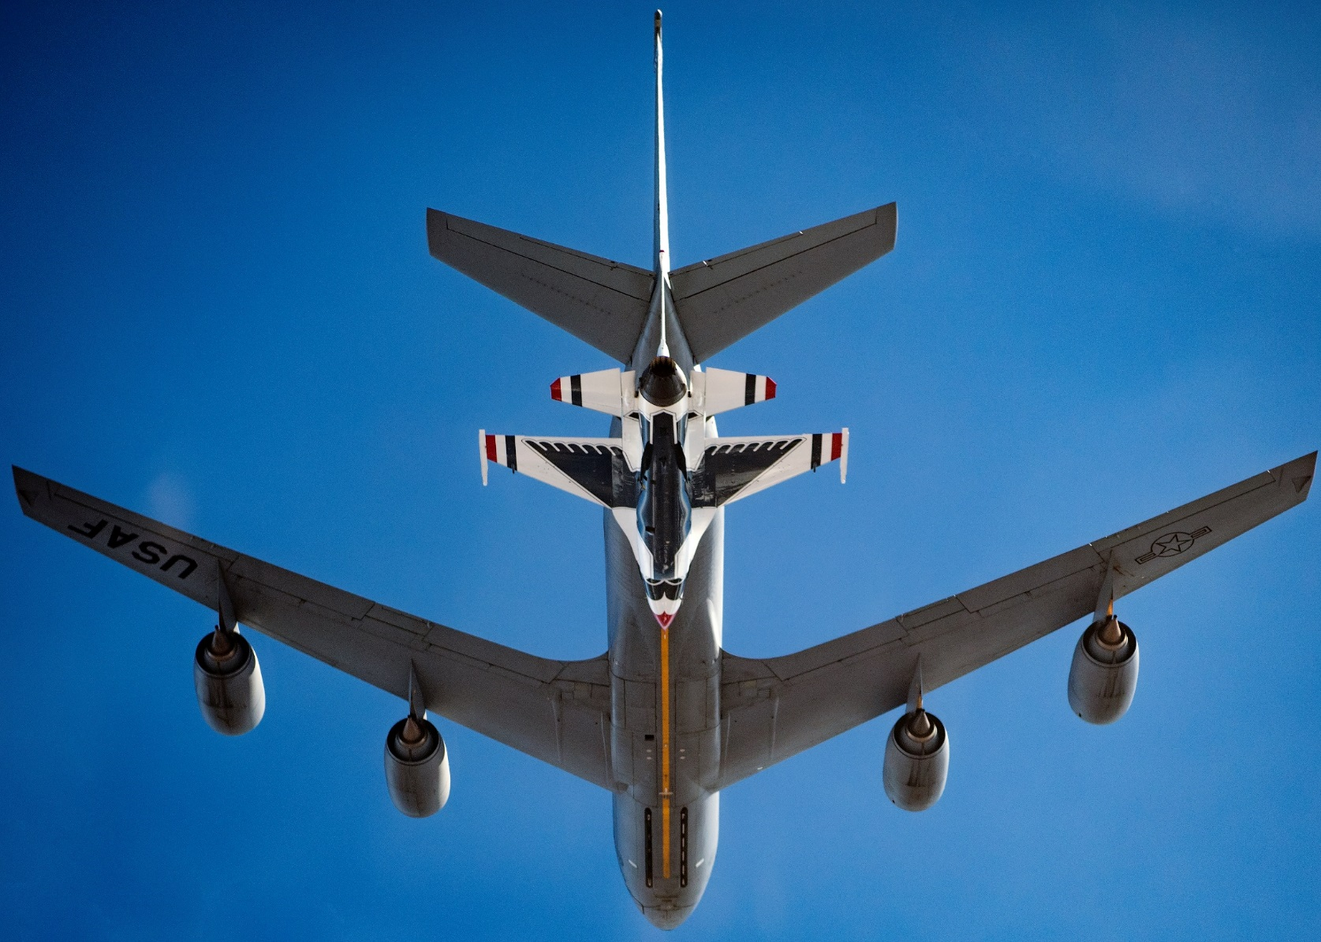
Code Changes

Slide 25
Lost Communications Procedures
  Aircraft will squawk 7600 for at least 2 minutes prior to departing track/anchor
    Tanker departs track/anchor from highest altitude in block
    Receiver departs track/anchor from lowest altitude in the block

Slide 26
When may headings be issued to refueling aircraft without voiding already declared MARSA?
  Prior to rendezvous
  After rendezvous
  After Air Refueling Initial Point

Slide 27
NORDO refueling aircraft will squawk 7600 for at least ____ minutes prior to departing the track.
  2
  5
  10

Slide 28
Minimum separation of nonparticipating aircraft from refueling track/anchor operations is best described by which of the following?
  Aircraft must be vertically separated from the track if within 5 miles of its centerline
  Aircraft must be separated from the protected airspace of the track by 5 miles
  Aircraft are allowed to fly in the airspace of the track as long as separation is maintained from refueling aircraft

Slide 29
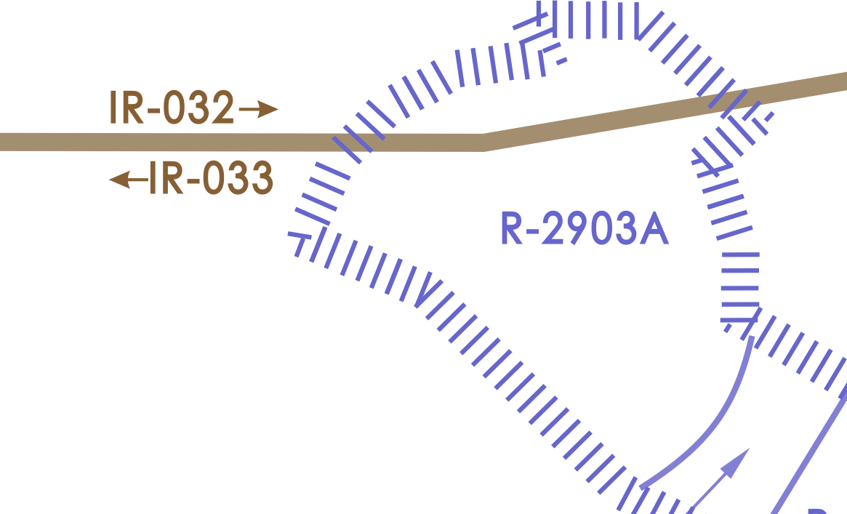
Military Training Routes

Slide 30

MTR Components
Entry Fix
Route Width
Alternate Exit Fix
Alternate Entry Fix
Exit Fix

Slide 31
Which is true of both IR and VR Military Training Routes?
  Aircraft may never exceed 250 knots
  Aircraft may exceed 250 knots
  Aircraft are only speed limited below 3,000’ AGL

Slide 32
What is the width of a Military Training Route?
  The width is determined by the pilot
  The width changes depending on the number of aircraft using the route
  Sufficient size to contain all planned activities

Slide 33
IFR Military Training Routes (IR)
  Conducted on IFR or ALTRV flight plans
  Designated as follows:
    IR followed by three numbers for IRs that include one or more segments above 1,500’ AGL
    IR followed by four numbers for IRs with no segments above 1,500’ AGL

Slide 34
Prior to IR Entry
  Prior to aircraft entering an IR, request:
    Estimate for the exit/alternate exit fix
    Requested altitude after exit
    Number of re-entries if applicable

Slide 35
IR Entry Procedures
  When clearing aircraft into an IR, provide ATC separation between successive aircraft, except when:
    Other aircraft are operating in the same ALTRV
    Other procedures are established by a LOA

Slide 36
IR Exit Procedures
  Unless covered in a LOA, clear aircraft to exit an IR
  Example: “FOX TWO ONE CLEARED TO HUNTER ARMY AIRFIELD FROM I-R FORTY SIX POINT JULIETT VIA DIRECT SAVANNAH DIRECT, CLIMB AND MAINTAIN FLIGHT LEVEL TWO THREE ZERO”

Slide 37
IR Lost Communications - Pilot Procedures
  If communications are lost during:
    VFR Conditions: Continue VFR and land as soon as able
    IFR Conditions: Maintain to the exit/alternate exit fix the higher of the following altitudes:
      The minimum IFR altitude for each of the remaining route segment(s) remaining on the route
      The highest altitude assigned in the last ATC clearance

Slide 38
IR Delays
  If nonparticipating IFR traffic conflicts with planned IR usage, you should:
    Not deny use of the IR route
    but
    Impose delays to eliminate conflict
    and
    Advise pilot of expected length and reason for delay

Slide 39
Low Altitude Air to Air Training (LOWAT)
  Must be accomplished only on specifically designated IRs
  Specific procedures covered in LOAs
  Training maneuvers conducted on IRs are limited

Slide 40
VFR Military Training Routes (VR)
  VRs are designated as follows:
    VR followed by three numbers for VRs that include one or more segments above 1,500’ AGL
    VR followed by four numbers for VRs with no segments above 1,500’ AGL

Slide 41
Which is the phraseology to clear an aircraft to operate via an IR?
  “CLEARED ON I-R SIXTEEN, MAINTAIN POSTED ALTITUDES”
  “CLEARED INTO I-R SIXTEEN, MAINTAIN I-R SIXTEEN ALTITUDES”
  “CLEARED INTO I-R SIXTEEN, ALTITUDES AT PILOT’S DISCRETION”

Slide 42
What items must be requested prior to giving clearance into the IR?
  Estimate for exit fix, requested altitude after exit
  Estimate for entry fix, requested altitude after exit
  Estimate for exit fix, requested altitude in IR

Slide 43
What should you do if nonparticipating aircraft conflict with the assignment of an IR?
  Impose a delay
  Deny clearance into IR
  Offer clearance into alternate IR

Slide 44
Special Use Frequencies
Assign special use frequency to:
    USAF, U.S. Navy (USN), and Air National Guard single-pilot jet aircraft formations when operating:
      At night
      In instrument weather conditions
      Formations of five or more USAF aircraft deploying to a U.S. staging base or nonstop to an overseas location, usually within an Altitude Reservation (ALTRV)

Slide 45
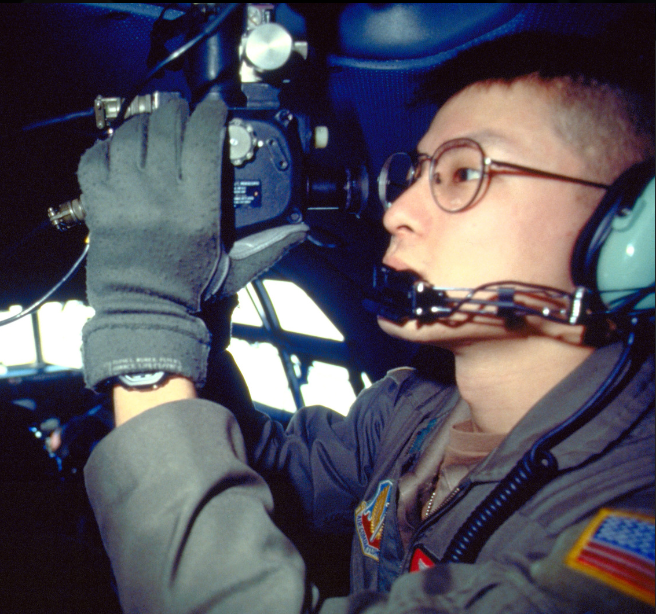
  Celestial Navigation Training
  Pilot must obtain ATC clearance prior to beginning celestial navigation training
  Flight must remain within 30 miles of route centerline unless otherwise approved by ATC

Slide 46
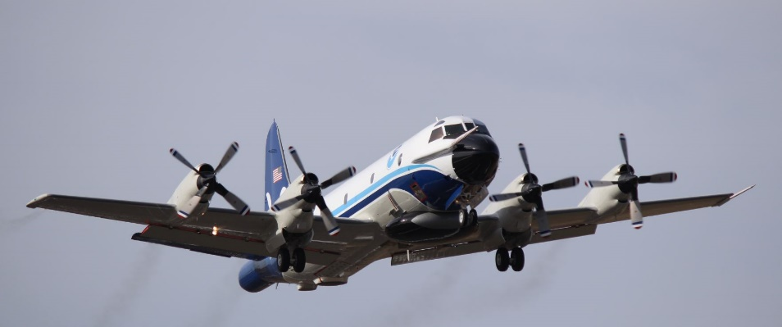
  Weather Reconnaissance Flights
  Responsible for flying weather reconnaissance/research missions
  Call signs
    TEAL - 53rd Weather Recon Squadron (WRS)
    NOAA

Slide 47

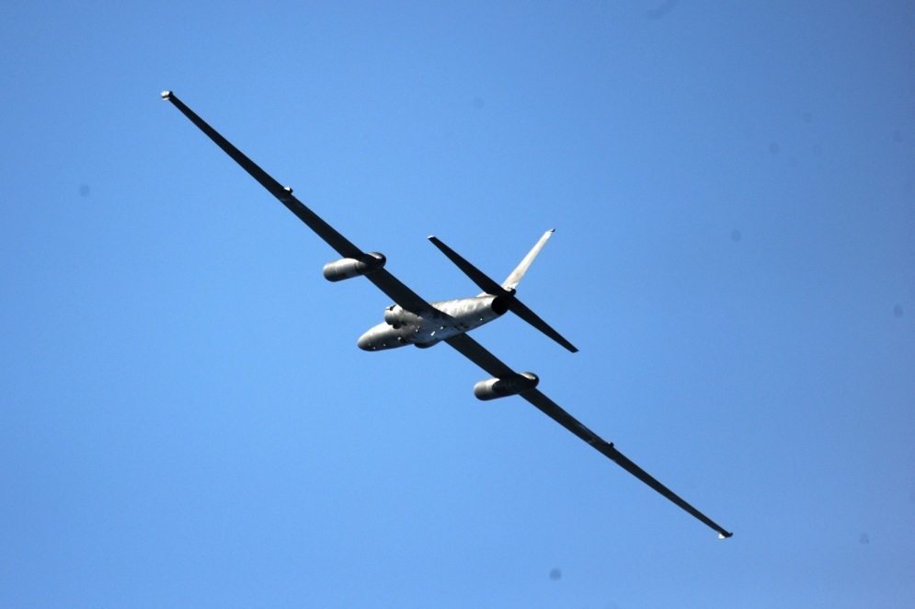
  Military Operations Above FL600
  Route of flight must be defined by at least one high altitude fix within each ARTCC

Slide 48
When should aircraft be assigned a special use frequency?
  All formation flights
  Pressure suit flights
  All flight breakups

Slide 49
What is the appropriate vertical separation minima for military aircraft operating above FL600?
  3,000’
  5,000’
  1,000’

Slide 50
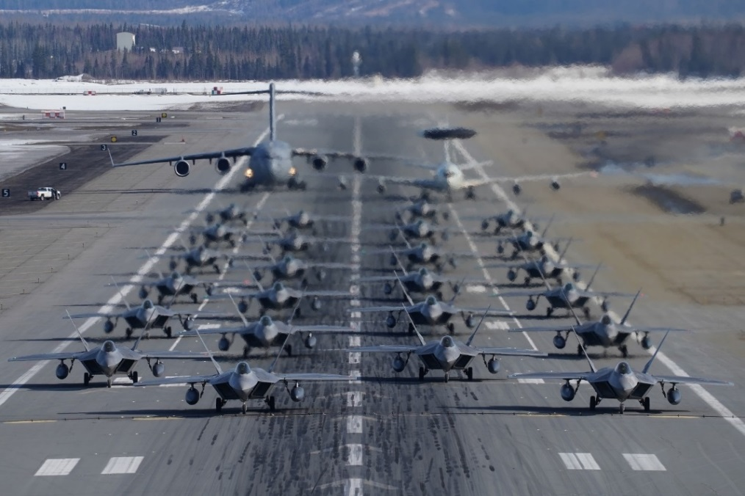
  Flush/Dispersal Operations
  NORAD is required to flush/disperse interceptor and E-3 aircraft to:
    Initiate early attack against a hostile force, or
    Enhance their survival, or
    Provide sufficient testing of the flush operations

Slide 51

  Flynet
  The code name Flynet indicates that an aircraft is transporting a nuclear emergency team or a disaster response team to the location of a potential or actual nuclear, chemical agent, or hazardous material accident

Slide 52
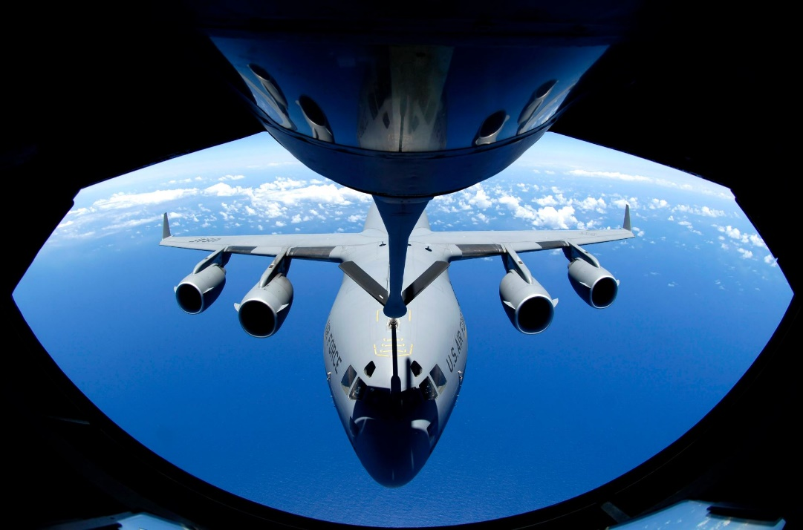
  Bust Out
  Term used to notify ATC facilities and NORAD of No-Notice launch of US Strategic Command (USSTRATCOM) positive control force, dispersing reconnaissance aircraft, and associated tankers

Slide 53
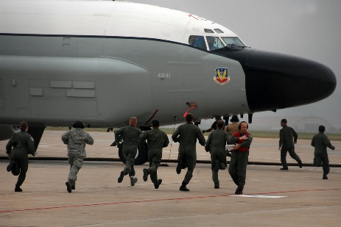
  Buggy Ride
  Term used to notify FAA facilities of the need for expeditious departure from an Air Combat Command (ACC)/Air Mobility Command (AMC) base due to a civil disturbance or disaster

Slide 54
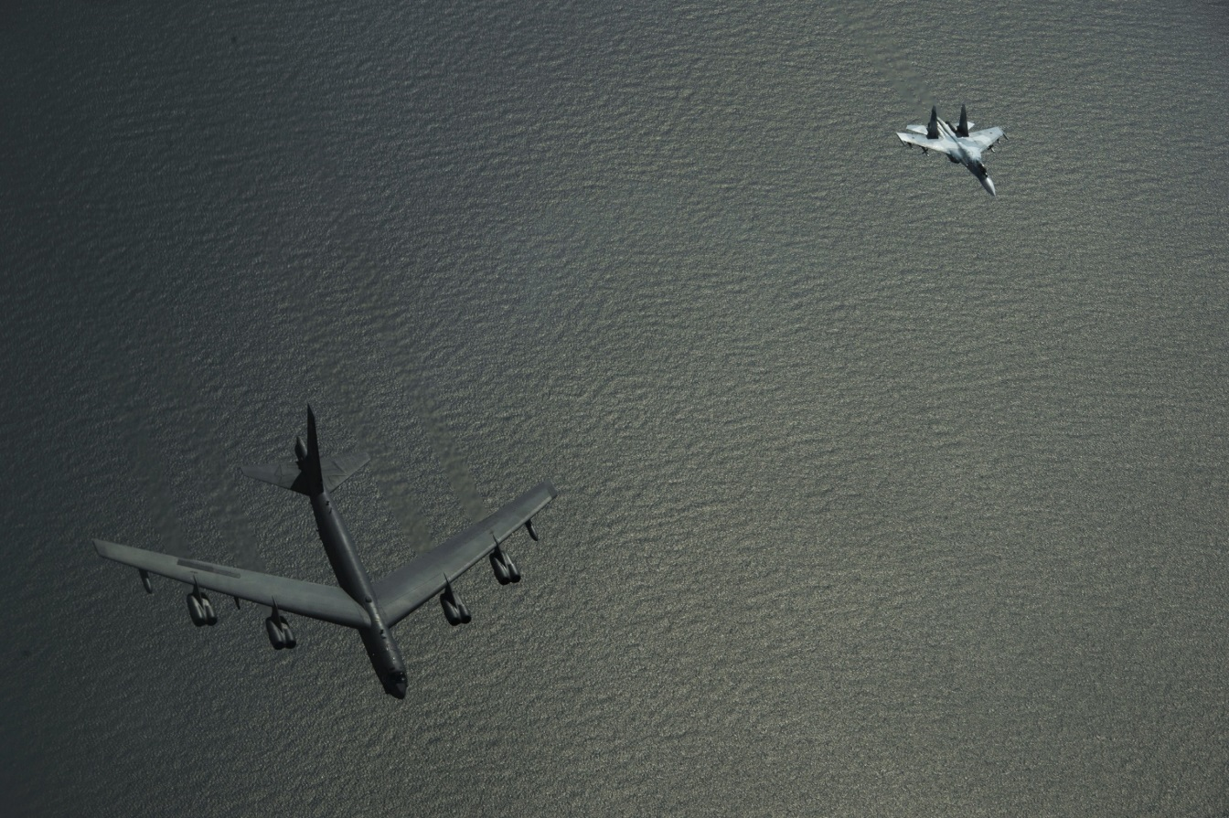
  Due Regard
  A phase of flight wherein an aircraft commander of a State-operated aircraft assumes responsibility to separate his/her aircraft from all other aircraft

Slide 55
  Night Watch
  The National Airborne Operations Center (NAOC) is a special military operation named Night Watch
  Provide priority handling to Night Watch aircraft when NAOC is indicated in:
    Remarks section of the flight plan; or
    Air/ground communications

Slide 56
Post Attack Command and Control System Aircraft
  Olympic Shot is the unclassified name used to notify ATC and NORAD of launching of USSTRATCOM Attack Command and Control System (SCACS) aircraft under emergency conditions
  Giant Shot is the training version of Olympic Shot

Slide 57
Nuclear Weapon Accident (Broken Arrow)
  Upon receipt of notification of a Broken Arrow, the center must:
    Clear the predicted hazardous area of over-flying IFR traffic; land or divert traffic as requested by the military
    Expedite the arrival of Flynet aircraft
    Expedite all aeromedical aircraft and any other aircraft specified by the military

Slide 58
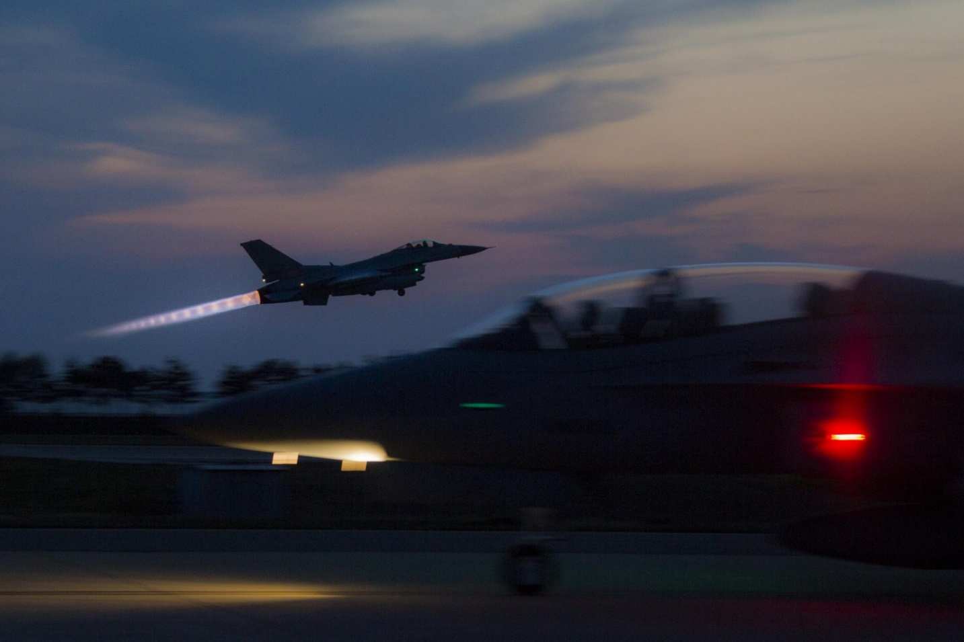
  Scramble Orders
  Command and authorization for flight requiring immediate takeoff

Slide 59
What term is used to notify ATC and NORAD of No-Notice launch of USSTRATCOM positive control force, dispersing reconnaissance aircraft, and associated tankers?
  Bust Out
  Night Watch
  Airborne Orders

Slide 60
When is the term Broken Arrow used?
  Nuclear testing
  Nuclear launch
  Nuclear weapon accident

Slide 61
  Electronic Attack (EA) Mission
  DOD operations where electromagnetic signals or chaff are used to cause RFI to other military units
  Applicable to non-GPS missions only
  Electronic warfare environment for:
    DOD testing
    Training
    Combat exercises
  Refer all EA activity requests to your supervisor/CIC

Slide 62
  EA Mission Phraseology
  Suspend activity:
    BIG PHOTO (identification, if known) (name) CENTER/TOWER/APPROACH CONTROL. STOP STREAM/BURST IN AREA (area name) (degree and distance from facility),
    or
    STOP BUZZER ON (frequency band or channel).
  Resume activity:
    RESUME STREAM/BURST,
    or
    RESUME BUZZER ON (frequency band or channel).

Slide 63
  GPS Interference Mission
  Electromagnetic signals are radiated to cause Radio Frequency Interference (RFI)
  Electronic warfare environment for:
    DOD testing / Training / Combat exercises
  ATC should use STOP BUZZER to suspend GPS interference missions for:
    Safety of flight concerns
    VIP aircraft
    OPEN SKIES Treaty priority flight (F or D)
    Other reasons specified by System Operations Security

Slide 64
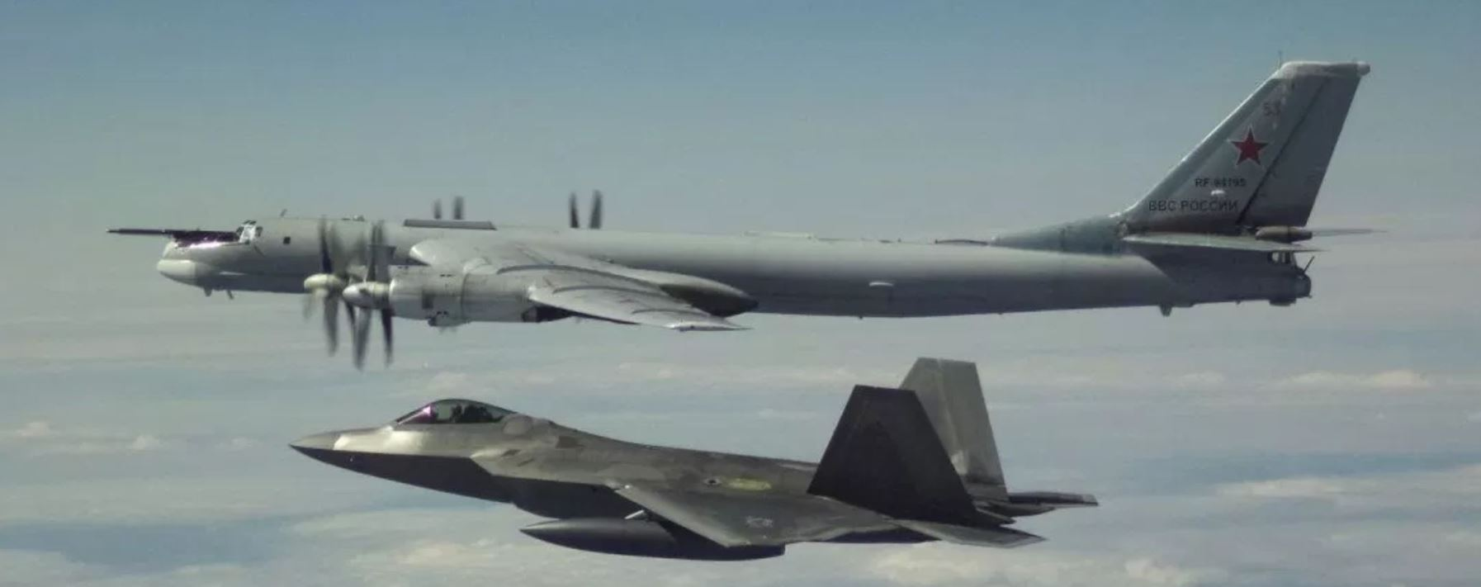
Authorization for Interceptor Operations (AFIO)
  Procedures:
    ATC
    ADCF
    Interceptor

Slide 65
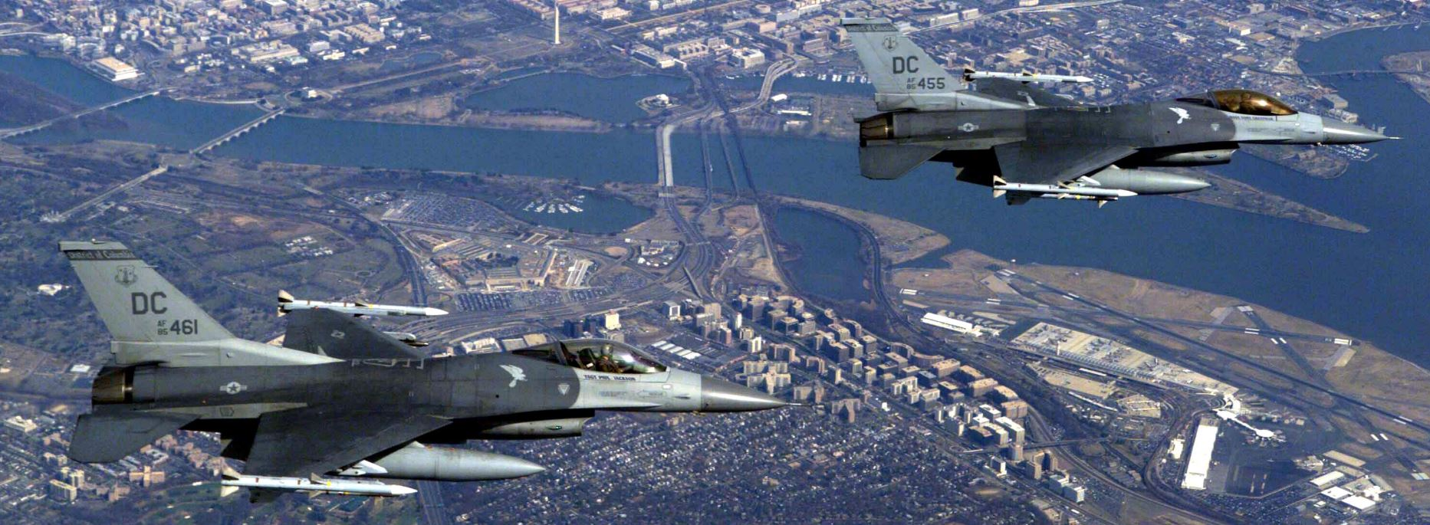
Emergency Security Control of Air Traffic (ESCAT)
  Security control of civil and military air traffic during various emergency conditions

Slide 66
What term should ATC use to suspend Electronic Attack (EA) missions?
  CEASE OPERATIONS
  HALT MISSION
  STOP BUZZER

Slide 67

  Counterdrug Operations
  Priority and special handling will be afforded aircraft participating in drug interdiction missions
  Authorization For Interceptor Operations (AFIO) must not be invoked
  Priority and special handling will be afforded aircraft participating in drug interdiction missions
  Authorization For Interceptor Operations (AFIO) must not be invoked

Slide 68
Counterdrug Surveillance Procedures
ATC must use discrete UHF frequencies whenever possible
ATC should assist the pilot to a position where the surveillance aircraft can acquire the suspect aircraft on airborne radar or visual contact
Surveillance aircraft must be in radar contact at all times

Slide 69
  Assist a pilot of a counterdrug aircraft with routing or vectors to approximately _______ behind and within ________ above suspect aircraft.
  5 miles / 3,000’
  10 miles / 5,000’
  3 miles / 1,000’

Slide 70
Lesson Summary
This lesson covered:
Formation flights
Aerial refueling
Military Training Routes
Special operations

Slide 71

The End

