Slide 2
Objectives
At the end of this lesson, you will be able to:
  Identify Special Use Airspace (SUA), ATC Assigned Airspace (ATCAA), and stationary ALTRV
  Recall agency and facility requirements for SUA, ATCAA, and stationary ALTRV
  Identify separation requirements for SUA, ATCAA, and stationary ALTRV

Slide 3
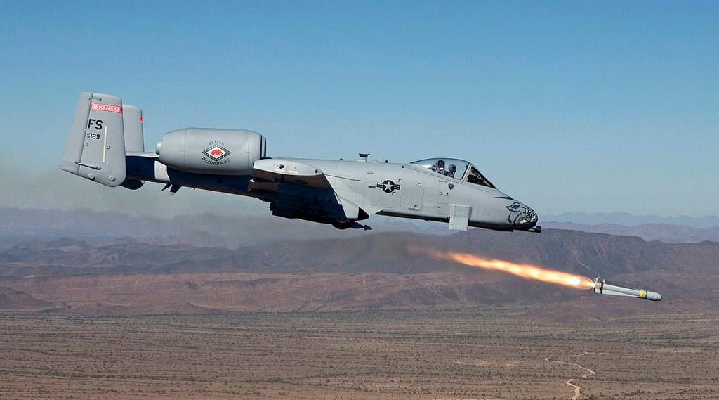
Special Use Airspace
Airspace of defined dimensions identified by an area on the surface of the earth wherein activities must be confined because of their nature and/or wherein limitations may be imposed upon aircraft operations that are not a part of those activities

Slide 4
Types of SUA
Restricted Area
Prohibited Area
Alert Area
Controlled Firing Area (CFA)
Military Operations Area (MOA)
  National Security Area (NSA)
  Warning Area

Slide 5
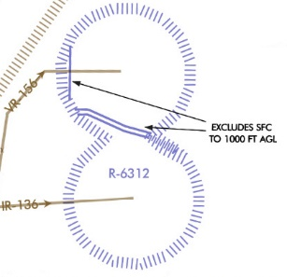
Restricted Area

Slide 6

Prohibited Area

Slide 7
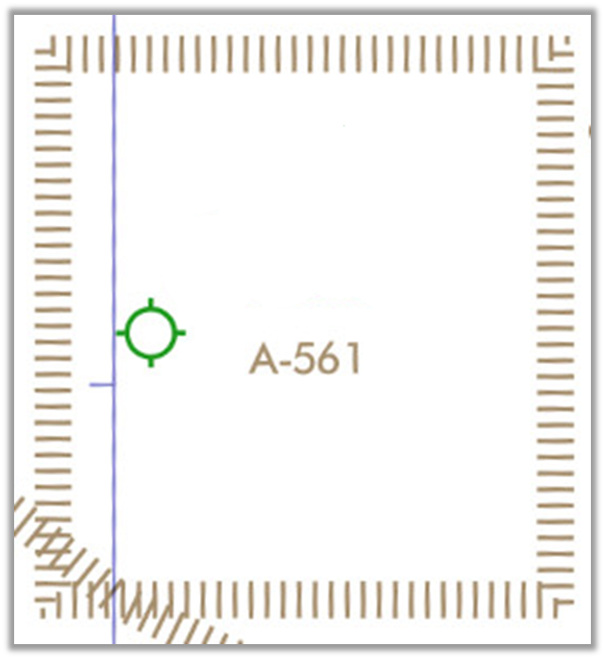
Alert Area

Slide 8
Controlled Firing Area (CFA)
Airspace wherein activities:
  Are controlled to eliminate hazards to nonparticipating aircraft
  Are controlled to ensure safety of persons and property on the ground
  Must be suspended when an aircraft might approach the area
    Determined by spotter aircraft, radar, or ground lookout

Slide 9
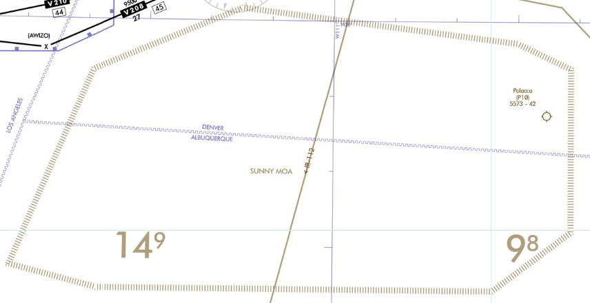

Military Operations Area (MOA)
SUNNY MOA

Slide 10
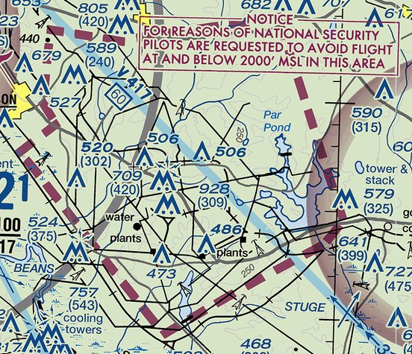
National Security Area (NSA)

Slide 11
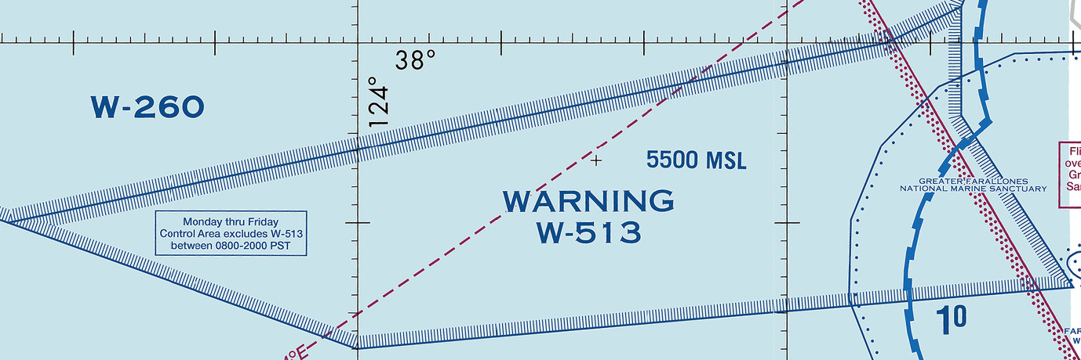
Warning Area

Slide 12

Knowledge Check
Which SUA is shown on IFR En Route charts?
CFA
Temporary Restricted Area
Warning Area

Slide 13
Knowledge Check
Which is true of Controlled Firing Areas (CFAs)?
Pilots are briefed on CFA activity prior to flight
Activities conducted are controlled to eliminate hazards to nonparticipating aircraft
Activities conducted are also within another SUA which protects nonparticipating aircraft

Slide 14
Knowledge Check
Which SUA extends from 3 miles outward from the coast of the United States?
Warning Area
Restricted Area
National Security Area

Slide 15
ATC Assigned Airspace (ATCAA)
Airspace of defined vertical/lateral limits, assigned by ATC, for the purpose of providing air traffic segregation between the specified activities being conducted within the assigned airspace and other IFR air traffic
  ATCAA is similar to SUA, some exceptions:
    Not depicted on IFR En Route or VFR Charts
    Not described in JO 7400.10, Special Use Airspace

Slide 16
Knowledge Check
Which airspace is not depicted on IFR En Route charts?
Permanent Restricted Areas
Warning Areas
ATC Assigned Airspace (ATCAA)

Slide 17
Definitions
ALTITUDE RESERVATION (ALTRV) - Airspace utilization under prescribed conditions normally employed for the mass movement of aircraft or other special user requirements which cannot otherwise be accomplished. ALTRVs are approved by the appropriate FAA facility and are classified as either moving or stationary.
STATIONARY ALTRV - An altitude reservation which encompasses activities in a fixed area. Stationary ALTRVs may include activities such as special tests of weapons systems or equipment; certain U.S. Navy carrier, fleet, and anti-submarine operations; rocket, missile, and drone operations; and certain aerial refueling or similar operations.
MOVING ALTRV - An altitude reservation which encompasses en route activities and advances with the mission progress, i.e., the reservation moves with the aircraft or flight.

Slide 18
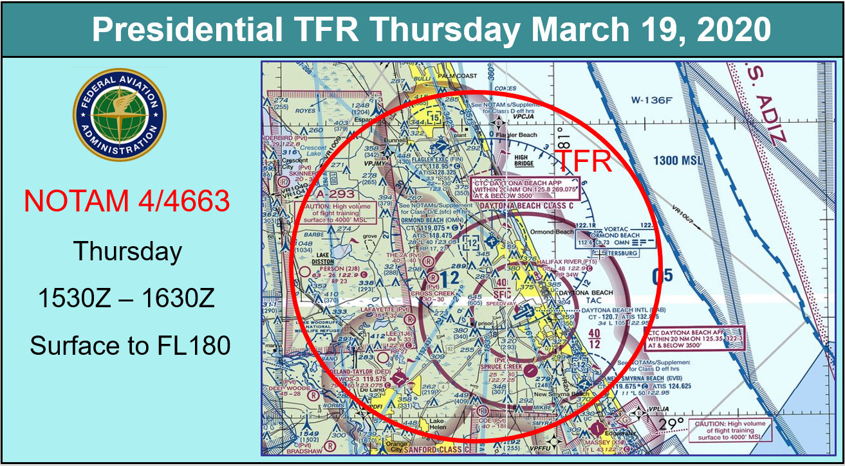
Definitions (Cont’d)
TEMPORARY FLIGHT RESTRICTION (TFR)
-

Slide 19
Knowledge Check
Which airspace, not depicted on charts, may contain activities such as special tests of weapons systems or equipment; certain U.S. Navy carrier, fleet, and anti-submarine operations; rocket, missile, and drone operations?
Permanent Restricted Areas
Stationary ALTRV
National Security Area

Slide 20
Military Radar Unit (MRU)
Any fixed or mobile ground-based unit under the operational jurisdiction of the military services excluding commissioned ATC facilities
  MRUs will provide services in accordance with the letter of agreement with the appropriate ATC facilities
  MRUs must not provide ATC services

Slide 21
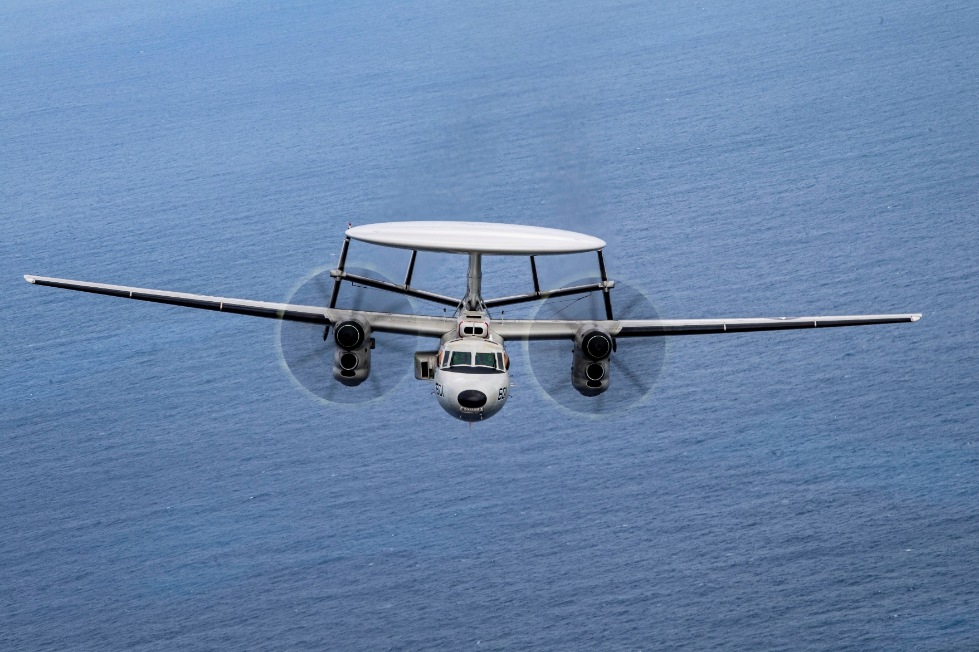
Airborne Radar Unit (ARU)
An extension of a military radar unit during planned exercises and daily training missions

Slide 22
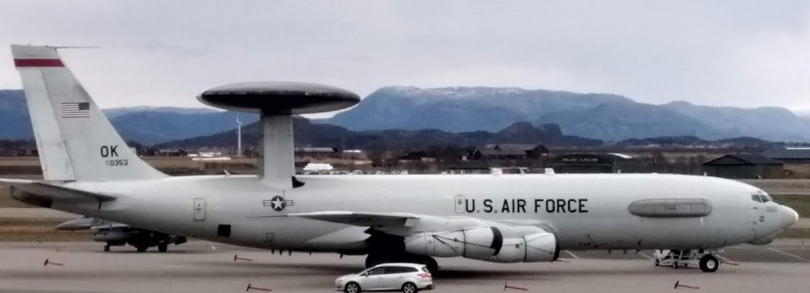
Airborne Warning and Control System (AWACS)
An airborne military radar unit engaged in radar surveillance and/or control of aircraft for the purpose of training, exercise, air defense, and counter-drug operations

Slide 23
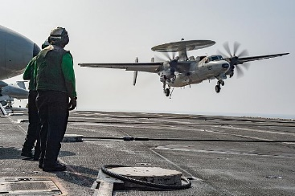
Non-ATC Facilities
MRU/ARU/AWACS are not commissioned ATC facilities
Must not be authorized nor requested to provide ATC services

Slide 24

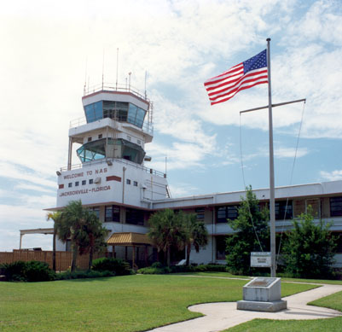
Fleet Area Control and Surveillance Facility (FACSFAC)
A U.S. Navy fixed ground Air Traffic Control facility which manages offshore and inland operating areas including warning areas, restricted areas, and other assigned airspace

Slide 25
Knowledge Check
What must be done before a nonparticipating IFR aircraft enters an active MOA released to an MRU?
MRU returns airspace
Point out aircraft to MRU
MRU is unable to assist

Slide 26
Knowledge Check
Which entity may provide services to civil aircraft as spelled out in letters of agreement?
Airborne Radar Unit (ARU)
Military Radar Unit (MRU)
Fleet Area Control and Surveillance Facility (FACSFAC)

Slide 27
Using Agency
The military unit or other organization whose activity established the requirement for the SUA/ATCAA/stationary ALTRV
NOTE: An ATC facility may be the using agency for joint use areas when the facility is specified in a letter of procedure as having priority for use of the area.

Slide 28
Scheduling Agency
The designated military unit responsible for scheduling all military flights intending to use the airspace for a particular MOA/ATCAA

Slide 29
Controlling Agency
The FAA ATC facility that exercises control of the airspace when an SUA area is not activated
  A military ATC facility may be assigned as the controlling agency, subject to the concurrence of the service area office and the concerned ARTCC
  A controlling agency must be designated for each joint-use SUA/ATCAA/stationary ALTRV

Slide 30
Knowledge Check
Can you point out a nonparticipating aircraft to an MRU?
Yes
No

Slide 31
Knowledge Check
When an SUA is no longer in use, to which agency does the airspace return?
Scheduling agency
Controlling agency
Using agency

Slide 32
Nonparticipating Aircraft
Separate nonparticipating aircraft from:
No separation is required for nonparticipating aircraft from:
Prohibited Area | MOA
Restricted Area | ATCAA
Warning Area | Stationary ALTRV
Alert Area | NSA
Controlled Firing Area

Slide 33
Vertical Separation Minima - SUA/ATCAA/Stationary ALTRV
IFR operations
  Assign an altitude which is at least 500’ (above FL290 - 1,000’) above/below the upper/lower limit of the airspace
VFR-on-top operations
  Inform the pilot to conduct flight VFR-on-top at least 500’ above the upper limit or below the lower limit of the airspace

Slide 34
Lateral Separation Minima - SUA/ATCAA/Stationary ALTRV
IFR operations
  Clear aircraft on airways or routes whose widths or protected airspace do not overlap the peripheral boundary
  Provide radar separation of 3 miles (FL600 and above - 6 miles) from the airspace
VFR-on-top operations
  Clear the aircraft via a routing which provides approved separation from the airspace

Slide 35
Separation Minima Exceptions
Vector nonparticipating aircraft to remain clear of the peripheral boundary of:
  Prohibited/restricted/warning areas when:
    Established for security reasons, or containment of hazardous activities not involving aircraft operations, and
    Facility management has identified these areas
  Stationary ALTRV issued for the purpose of space launch or reentry operations

Slide 36
Knowledge Check
What is the lateral separation minima for an active Controlled Firing Area in use surface through FL230?
3 miles
6 miles
None

Slide 37
Knowledge Check
What is the vertical separation minima above and below an active warning area in use FL180 through FL280?
500’
1,000’
None

Slide 38
Knowledge Check
What is the lateral separation minima for an active restricted area in use surface through FL230?
3 miles
6 miles
Remain clear

Slide 39
Knowledge Check
A restricted area has been identified by facility management as containing hazardous activities not involving aircraft operations. What is the lateral separation minima at FL600?
3 miles
6 miles
Remain clear

Slide 40
Transiting Active SUA/ATCAA
If an LOA/LOP has been coordinated with the Using Agency and permission has been granted to transit the area:
  Comply with the instructions/clearances issued by the Using Agency
  Provide the applicable separation minima between aircraft when two or more aircraft are transiting the area

Slide 41
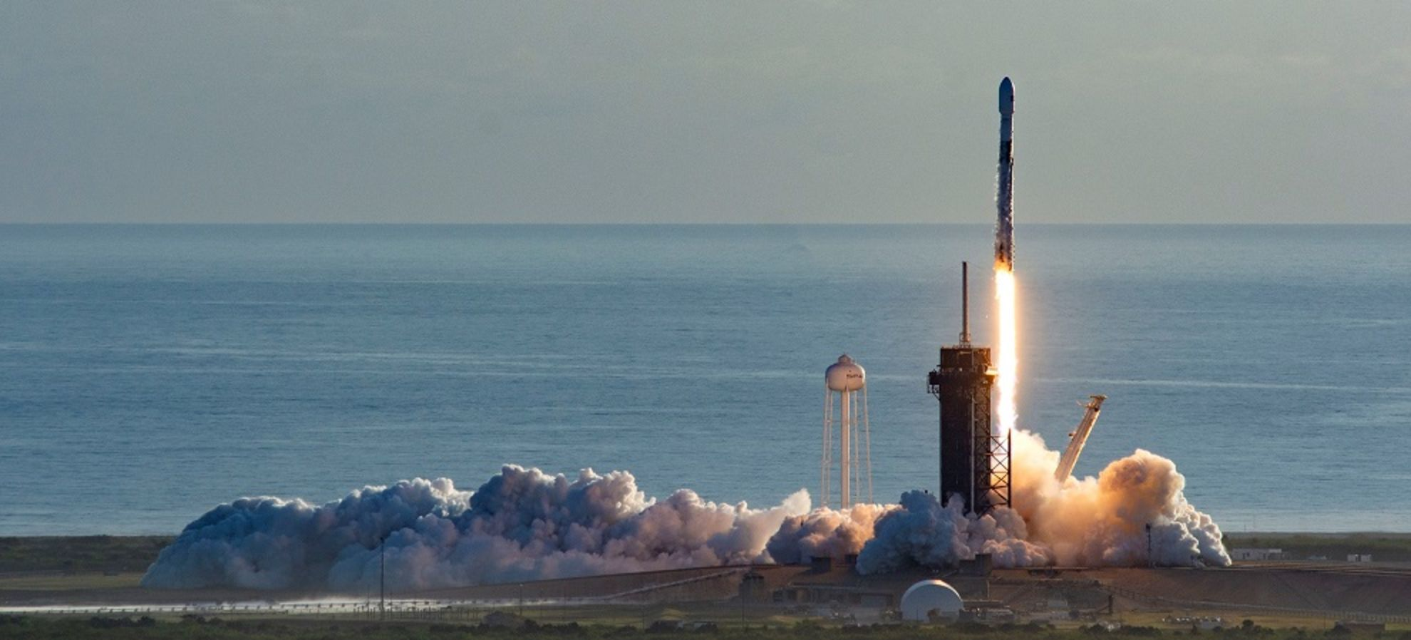
Transiting Stationary ALTRV

Slide 42
Knowledge Check
Which is true of an active warning area?
Nonparticipating aircraft must always remain clear by the appropriate separation minima
Nonparticipating aircraft never have to remain clear
Nonparticipating aircraft may be cleared through, if provided for in an LOA

Slide 43
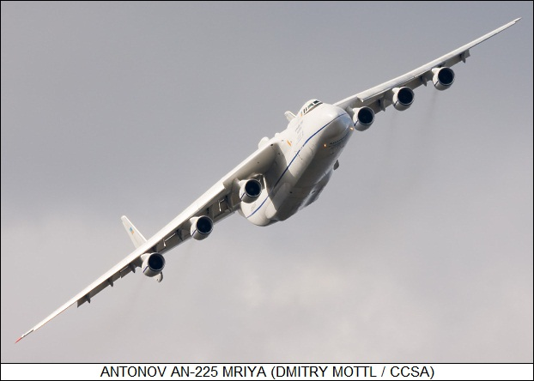
Priority Over SUA/ATCAA - Open Skies
Open Skies Treaty permits any participating country to conduct short-notice, unarmed, observation flights over other participating countries to collect data on military forces and activities

Slide 44
Knowledge Check
Which Open Skies flight does not have priority over SUA/ATCAA?
OSY524D
OSY987T
OSY100F

Slide 45
Knowledge Check
What should you do as the controller of an Open Skies aircraft if you are unable to confirm with the using agency that all conflicting activities in the SUA/ATCAA have ceased?
The aircraft must not be permitted access to the SUA/ATCAA
The aircraft is permitted access to the SUA/ATCAA
The aircraft is permitted access to the SUA/ATCAA after notifying the pilot of the activity

Slide 46
ATC CONTROL WITHIN MOA/ATCAA
MOA and ATCAA may be controlled by an ATC facility
Every effort should be made to provide IFR service within these areas when requested by the military

Slide 47
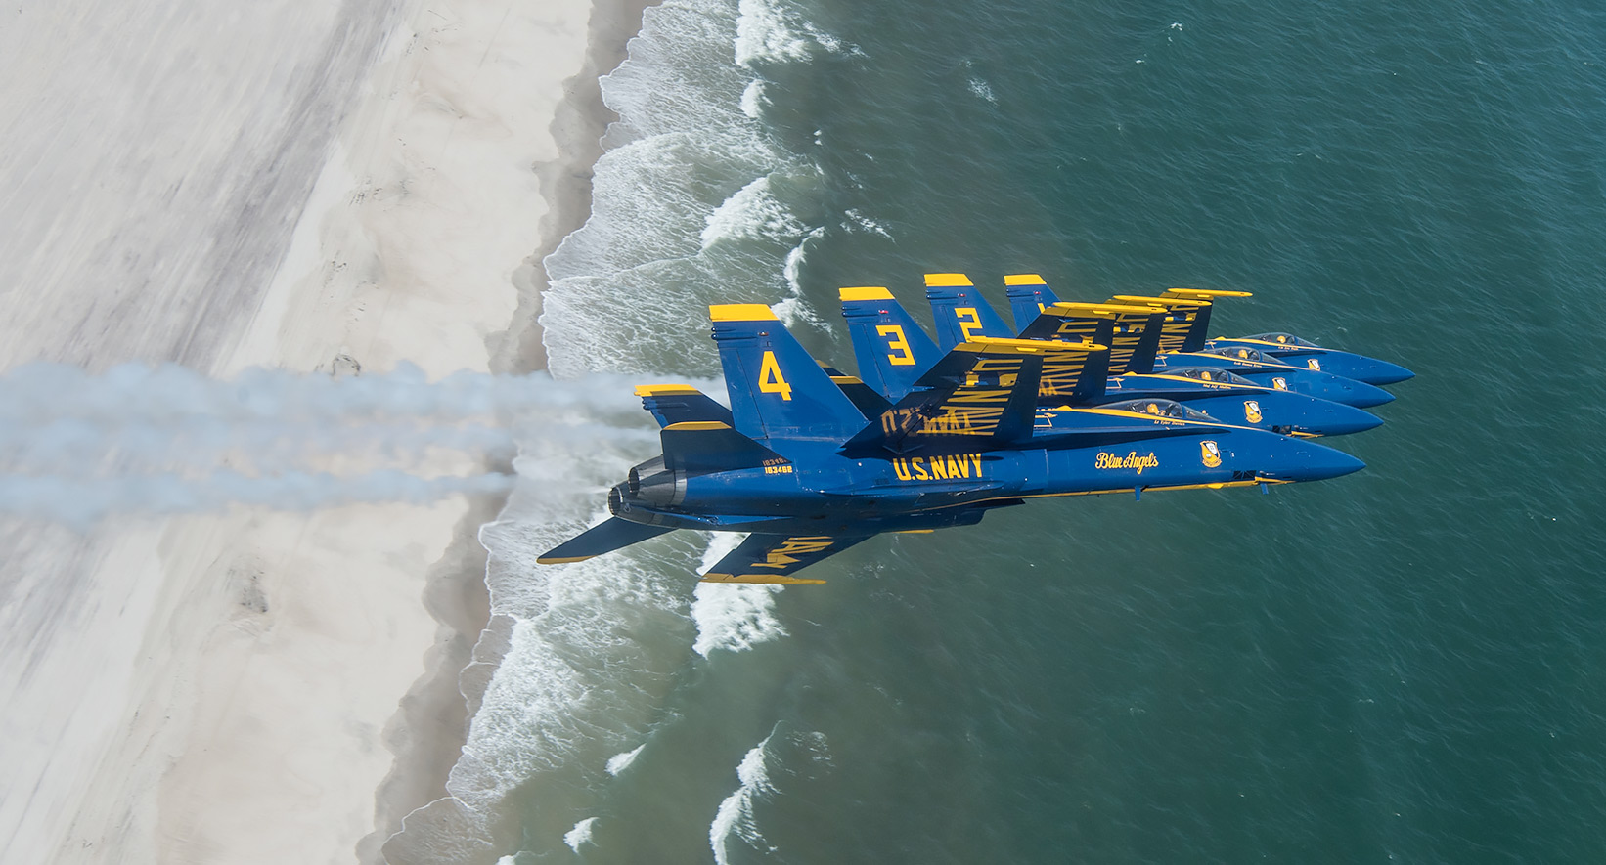
MARSA

Slide 48
Knowledge Check
ATC is providing service within a MOA. Who is responsible for providing separation within the MOA?
ATC, until you declare MARSA
MRU, until radar contact is established
ATC, unless MARSA is established

Slide 49
Knowledge Check
Who may not invoke or deny MARSA?
ATC facility controller
Military fighter pilot
Military tanker pilot

Slide 50
DOD Single Altimeter Setting
Some Department of Defense (DOD) aircraft are authorized to operate in restricted areas, MOAs, and ATCAAs on single altimeter settings
  These aircraft conduct high speed tactical maneuvers that include frequent transits of FL180
  The pilot will use standard altimeter 29.92 or a current station altimeter

Slide 51
DOD Single Altimeter Setting Responsibilities
The DOD is responsible for conducting all single altimeter setting operations within the boundaries of MOAs, restricted areas, and ATCAAs
Under a LOA, the DOD provides safe altitude clearance between DOD aircraft and other aircraft operating within, above, and below the MOAs, restricted areas, and ATCAAs with appropriate clearance of terrain

Slide 52
Knowledge Check
Who is responsible for ensuring that aircraft conducting single altimeter setting operations remain within a restricted area, MOA, or ATCAA?
En Route Controller
Department of Transportation
Department of Defense

Slide 53
Lesson Summary
This lesson covered:
  Special Use Airspace (SUA), ATC Assigned Airspace (ATCAA), and stationary ALTRV
  Agency and facility requirements for SUA, ATCAA, and stationary ALTRV
  Separation requirements for SUA, ATCAA, and stationary ALTRV

Slide 54

The End

