Slide 2
Lesson Objectives
At the end of this lesson, you will be able to identify:
  VFR and VFR-on-top requirements
  VFR and VFR-on-top procedures
  Attributes of visual separation

Slide 3
Definitions
Visual Flight Rules (VFR)
VFR-on-top (OTP)
Visual Separation
Special Use Airspace (SUA)
Military Operations Area (MOA)

Slide 4
Definitions (Cont’d)
ATC Assigned Airspace (ATCAA)
Altitude Reservation (ALTRV)
Military Training Route (MTR)

Slide 5
VFR Climb or Descent
Clear aircraft to maintain VFR conditions if the pilot of an aircraft on an IFR flight plan requests a VFR climb or descent
If flight in VFR conditions becomes impractical, issue an alternative clearance
In Class A airspace, do not apply visual separation or issue VFR or VFR-on-top clearances

Slide 6
Visual Phraseology
MAINTAIN VFR CONDITIONS
MAINTAIN VFR CONDITIONS UNTIL (time or fix)
MAINTAIN VFR CONDITIONS ABOVE/BELOW (altitude)
CLIMB/DESCEND VFR and if required,
BETWEEN (altitude) AND (altitude)

Slide 7

Knowledge Check
When would alternative instructions to a pilot requesting a VFR climb be issued?
To prevent the pilot from climbing VFR through
the altitude of an IFR aircraft
To prevent the pilot from climbing through
meteorological obscurations
To ensure separation if VFR climb becomes impractical

Slide 8
VFR-on-top Clearances
Clear aircraft to maintain VFR-on-top if the aircraft is on an IFR flight plan and requested by the pilot
Pilot responsibilities:
  Fly at appropriate VFR altitude
  Comply with VFR visibility requirements
  See and avoid other aircraft
  Comply with instrument flight rules that are applicable to this flight

Slide 9
VFR-on-top Clearances (Cont’d)
Aircraft may be cleared to climb through clouds, smoke, haze or other meteorological formations, then maintain VFR-on-top, if:
  Pilot requests the clearance
  You ensure separation from other traffic
  Pilot is informed of the reported height of the tops of the meteorological formation, or that no tops report is available

Slide 10
VFR-on-top Phraseology
CLIMB TO AND REPORT REACHING V-F-R-ON-TOP
  and,
  TOPS REPORTED (altitude)
  or,
  NO TOPS REPORTS
  Alternative instructions,
  IF NOT ON TOP AT (altitude), MAINTAIN (altitude), AND ADVISE

Slide 11
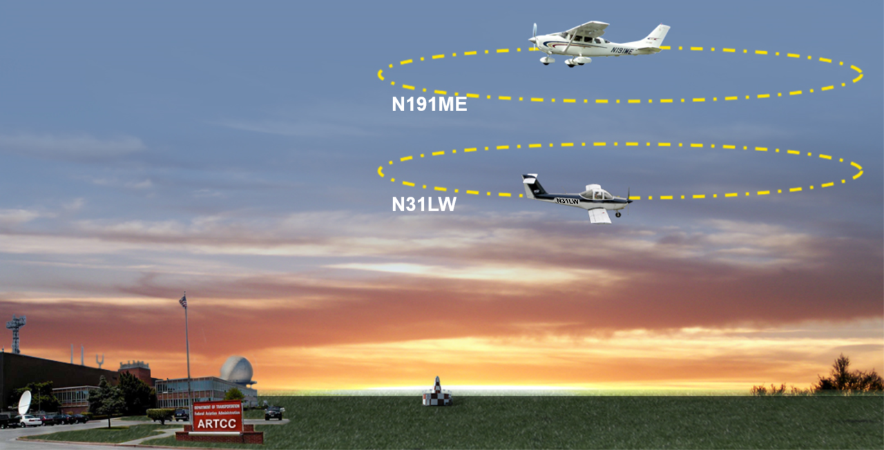
Holding VFR-on-Top Aircraft
Apply Vertical Separation OR Restrict VFR-on-Top
“CESSNA ONE MIKE ECHO, MAINTAIN VFR-ON-TOP AT OR ABOVE EIGHT THOUSAND”
“TOMAHAWK ONE LIMA WHISKEY, MAINTAIN VFR-ON-TOP AT OR BELOW SEVEN THOUSAND”

Slide 12
Knowledge Check
What is the phraseology to clear N126Y to VFR-on-top, with no traffic, or tops reported?
“NOVEMBER TWO SIX YANKEE MAINTAIN V-F-R-ON-TOP NO TOPS REPORTS”
“NOVEMBER TWO SIX YANKEE CLIMB TO AND REPORT REACHING V-F-R-ON-TOP NO TOPS REPORTS”
C. “NOVEMBER TWO SIX YANKEE CLIMB IN V-F-R CONDITIONS MAINTAIN V-F-R-ON-TOP”

Slide 13
VFR Altitudes
VFR and VFR-on-top altitudes for direction of flight:
  Zero degrees through 179 degrees magnetic:
      Any odd cardinal altitude plus 500’
  180 degrees through 359 degrees magnetic:
      Any even cardinal altitude plus 500’

Slide 14
Traffic Advisories
Issue traffic advisories to all aircraft, IFR or VFR, when:
  Proximity may diminish to less than the applicable separation minima
Where no separation minima exist:
  Issue traffic advisories to those aircraft when, in your judgement, their proximity warrants it

Slide 15
SUA/ATCAA Separation Minima
VFR Aircraft:
  May not enter prohibited or active restricted areas
  May enter an active MOA, alert area, warning area, MTR, or ALTRV, however, advisories should be issued
VFR-on-top Aircraft:
  May not enter prohibited or active restricted areas
  May not enter an active MOA, MTR, or ALTRV
  Must maintain at least 500’ vertical separation above or below SUA

Slide 16
Knowledge Check
What is the required minimum vertical separation for a VFR-on-top aircraft above or below an active SUA?
A. 500’
1000’
C. 2000’

Slide 17
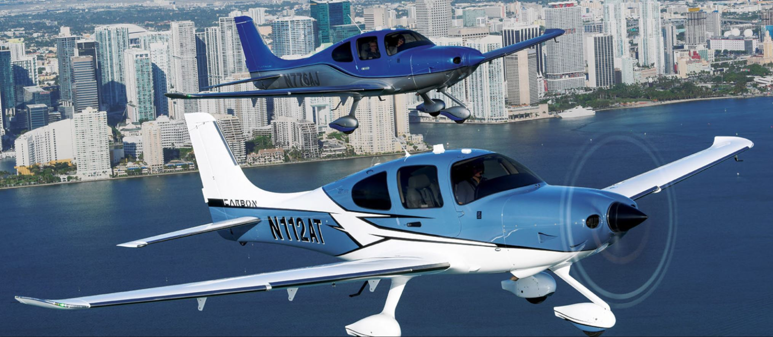
Visual Separation

Slide 18
Application Considerations
  Visual separation may be applied when other approved separation is assured before and after application of visual separation
  To ensure that other separation will exist consider:
    Aircraft performance
    Wake turbulence
    Closure rate
    Routes of flight
    Known weather conditions
    Aircraft position

Slide 19
Application
  Visual Separation may be used:
  Between successive departures when routes and/or aircraft performance assure maintaining separation
  In conjunction with visual approach procedures
  Up to but not including FL180 with constraints
  NOTE: Visual separation is not authorized when the lead aircraft is a super.

Slide 20
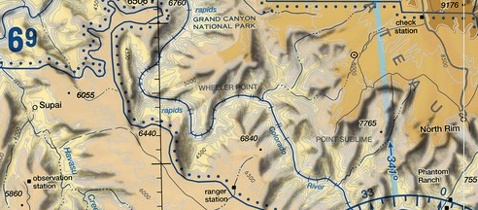

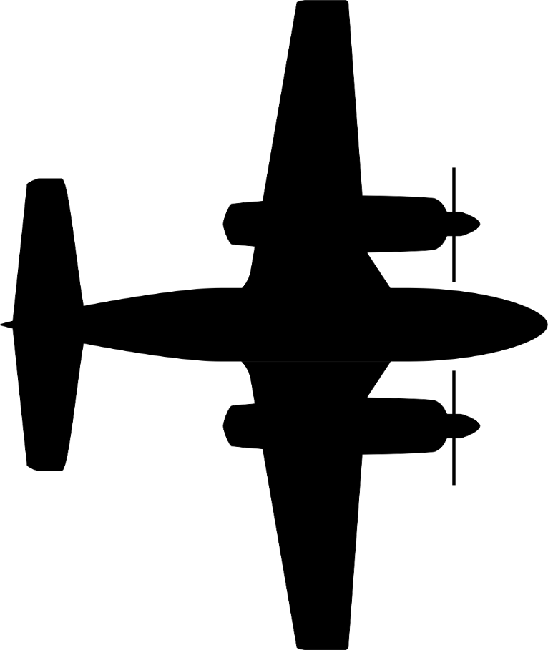
Phraseology
ATC – “CHEROKEE TWO-ONE-TANGO, MAINTAIN VISUAL SEPARATION, DESCEND AND MAINTAIN NINER THOUSAND”
ATC – “CHEROKEE TWO-ONE-TANGO, TRAFFIC, ONE O’CLOCK, THREE MILES, SOUTHEAST BOUND, NAVAJO, AT NINER THOUSAND, REPORT AIRCRAFT IN SIGHT”
“CHEROKEE TWO-ONE-TANGO, MAINTAINING VISUAL SEPARATION, DESCENDING TO NINER THOUSAND”
“CHEROKEE TWO-ONE-TANGO, TRAFFIC IN SIGHT”

Slide 21
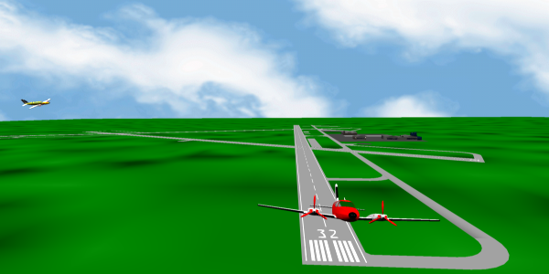
Nonapproach Control Towers
You may authorize a VFR tower to provide visual separation within surface areas or designated areas

Slide 22
Knowledge Check
  N316K is on approach. N13Y requests clearance to depart. What phraseology would the center controller use to authorize the tower to provide visual separation?
A. “VISUAL SEPARATION APPROVED BETWEEN N13Y AND N316K. N13Y RELEASED.”
“RELEASE N13Y YOUR DISCRETION WHEN N316K IS IN SIGHT.”
C. “APPLY VFR BETWEEN N13Y AND N316K.”

Slide 23
Knowledge Check
Visual separation may be used ______ when direct communication is maintained with one of the aircraft involved and there is an ability to communicate with the other.
Up to but not including FL190
Up to and including FL180
Up to but not including FL180

Slide 24
Lesson Summary
This lesson covered:
VFR and VFR-on-top requirements
VFR and VFR-on-top procedures
Attributes of visual separation

Slide 25

The End

