Slide 1


Slide 2
Lesson Objectives
At the end of this lesson, you will be able to identify:
Emergency situations
FAA responsibilities in an emergency
Procedures for handling emergencies
Specific emergency situations
Procedures for handling overdue aircraft

Slide 3
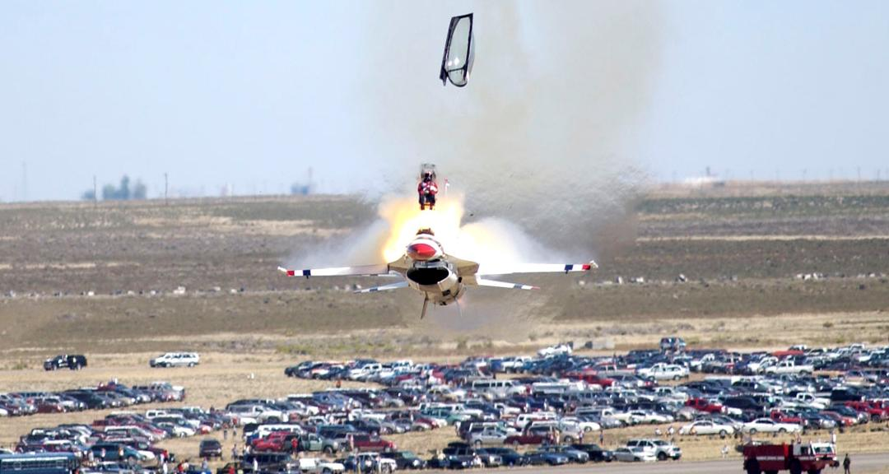
Emergency Keywords

Slide 4
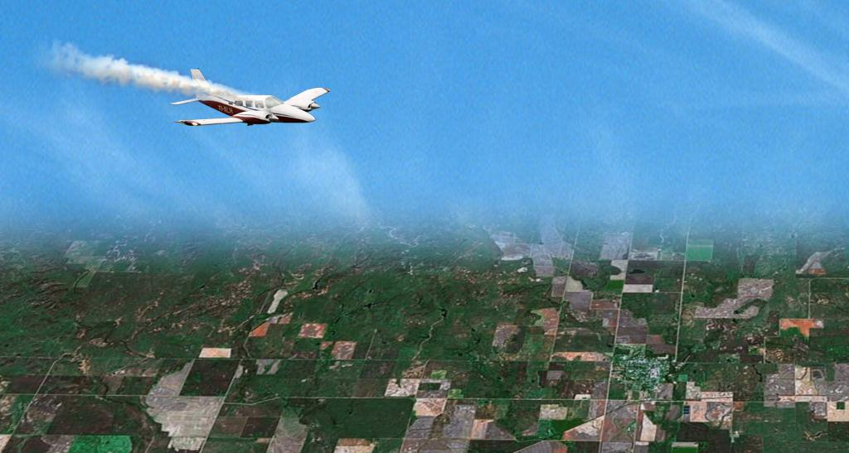

Emergency Keywords Not Used
“CLEVELAND CENTER, NOVEMBER SIX TWO PAPA. WE HAVE SMOKE IN THE COCKPIT AND WE’D LIKE TO LAND AS SOON AS POSSIBLE.”
“NOVEMBER SIX TWO PAPA, CLEVELAND CENTER, CLEARED TO SEVEN SPRINGS AIRPORT VIA RADAR VECTORS, FLY HEADING TWO SEVEN ZERO, DESCEND AND MAINTAIN FIVE THOUSAND. AIRPORT TWELVE O’CLOCK, SIX MILES...”

Slide 5
Emergency Declaration
Consider an emergency to exist when any of the following occurs:
When declared by:
Pilot
Controller or supervisor/CIC
Officials responsible for operation of the aircraft
A system-generated transmission from an aircraft
Unexpected loss of radar contact and radio communications with IFR or VFR aircraft
Report of forced landing or is imminent
Crew abandoned aircraft or about to do so
Consider an emergency to exist when any of the following occurs:
Emergency radar beacon response received
Code 7700 - Causes EMRG to blink in Field E of data block
Intercept or escort services required
Need for ground rescue appears likely
Emergency Locator Transmitter (ELT) signal heard or reported

Slide 6
Obtaining Information
Use the information provided or solicit more information as necessary to assist the distressed aircraft
Provide assistance that is consistent with the requests of the pilot
If an emergency was declared by an Emergency Autoland system, the aircraft may transmit information

Slide 7
Providing Assistance
Provide maximum assistance to aircraft in distress
When pilot requests or controller deems necessary
Enlist services of radar facilities, and emergency services and facilities operated by the:
FAA
Military
Federal Communications Commission (FCC)

Slide 8
Knowledge Check
If you are in doubt as to whether an emergency exists, ________.
wait for the pilot to squawk 7700
treat the situation as an emergency
wait until the pilot declares an emergency

Slide 9
Knowledge Check
Which of these authorities may declare an emergency?
FCC
FSS
Controller

Slide 10
Knowledge Check
When an aircraft encounters an urgency condition, the pilot should make this known by beginning the initial radio contact with the word(s) ________.
MAYDAY
PAN-PAN
FLYNET

Slide 11
FAA Responsibilities
ARTCCs serve as the central points for:
Collecting information
Coordinating with Search and Rescue (SAR)
Conducting communications search, including distributing Alert Notices (ALNOTs)
Receiving and relaying all pertinent Emergency Locator Transmitter (ELT) signal information to appropriate authorities
FSS serves as central point for collecting and disseminating information on overdue/missing VFR aircraft

Slide 12
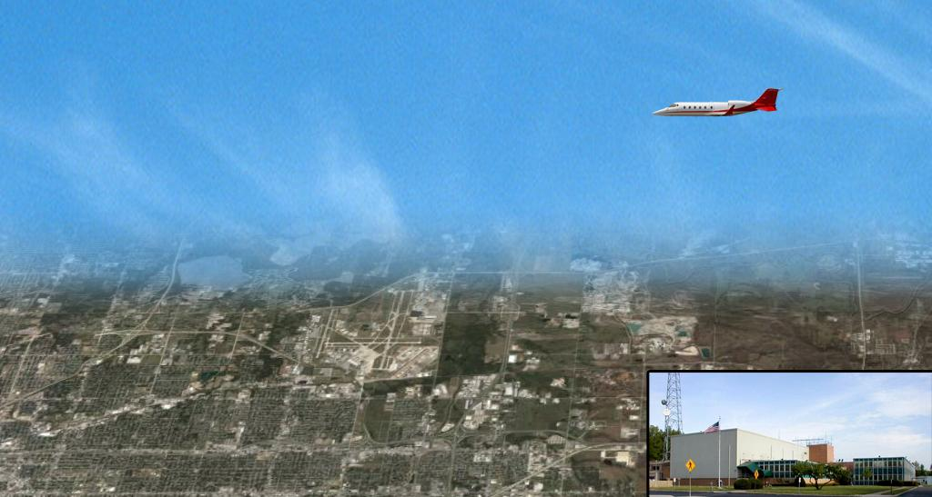
Controller Responsibilities
“KANSAS CITY CENTER, TULSA APPROACH, I HAVE AN EMERGENCY TWO FIVE MILES NORTHEAST OF TULSA AT ONE ZERO THOUSAND LANDING TULSA, REQUEST CONTROL”
“I HAVE NO TRAFFIC. THE EMERGENCY AIRCRAFT IS YOUR CONTROL”

Slide 13
Controller Responsibilities (Cont’d)
Before determining if the aircraft in distress requires an escort by another aircraft:
Consider whether maneuver takes the aircraft through clouds
Ask pilots if they are familiar with and capable of formation flight

Slide 14
Knowledge Check
All pertinent ELT signal information shall be received and relayed to the appropriate authorities by the ________.
flight service station
control tower
air route traffic control center

Slide 15

Minimum Information Requirements
“CLEVELAND CENTER, KING AIR SEVEN NINER NINER...”
“We have smoke in the cockpit…”
Aircraft Identification and Type
Nature of Emergency
“We would like to land as soon as possible...”
Pilot’s Desires

Slide 16
Pertinent Information
After initiating action, obtain any other pertinent information from the pilot or aircraft operator, as necessary
NOTE: Normally, do not request this information from military fighter-type aircraft that are at low altitudes (i.e., on approach, immediately after departure, on a low level route, etc.).

Slide 17
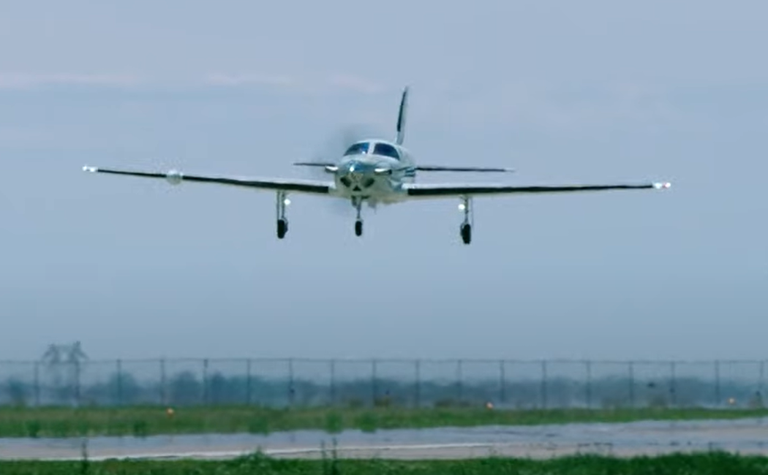
Emergency Autoland

Slide 18
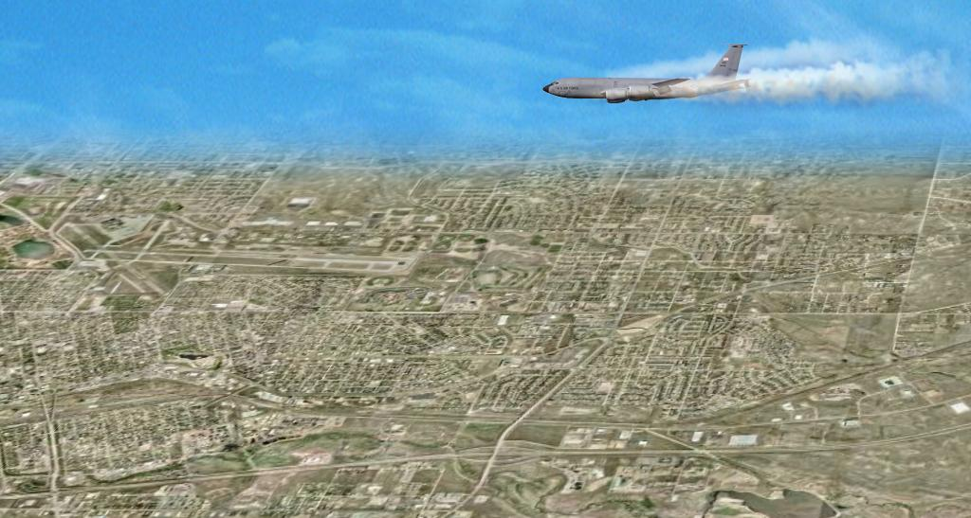
Coordination
Cheyenne Tower
“CHEYENNE TOWER, DENVER CENTER, AIR FORCE ONE TWO THREE FOUR REQUESTS FIREFIGHTING EQUIPMENT STANDING BY…”

Slide 19
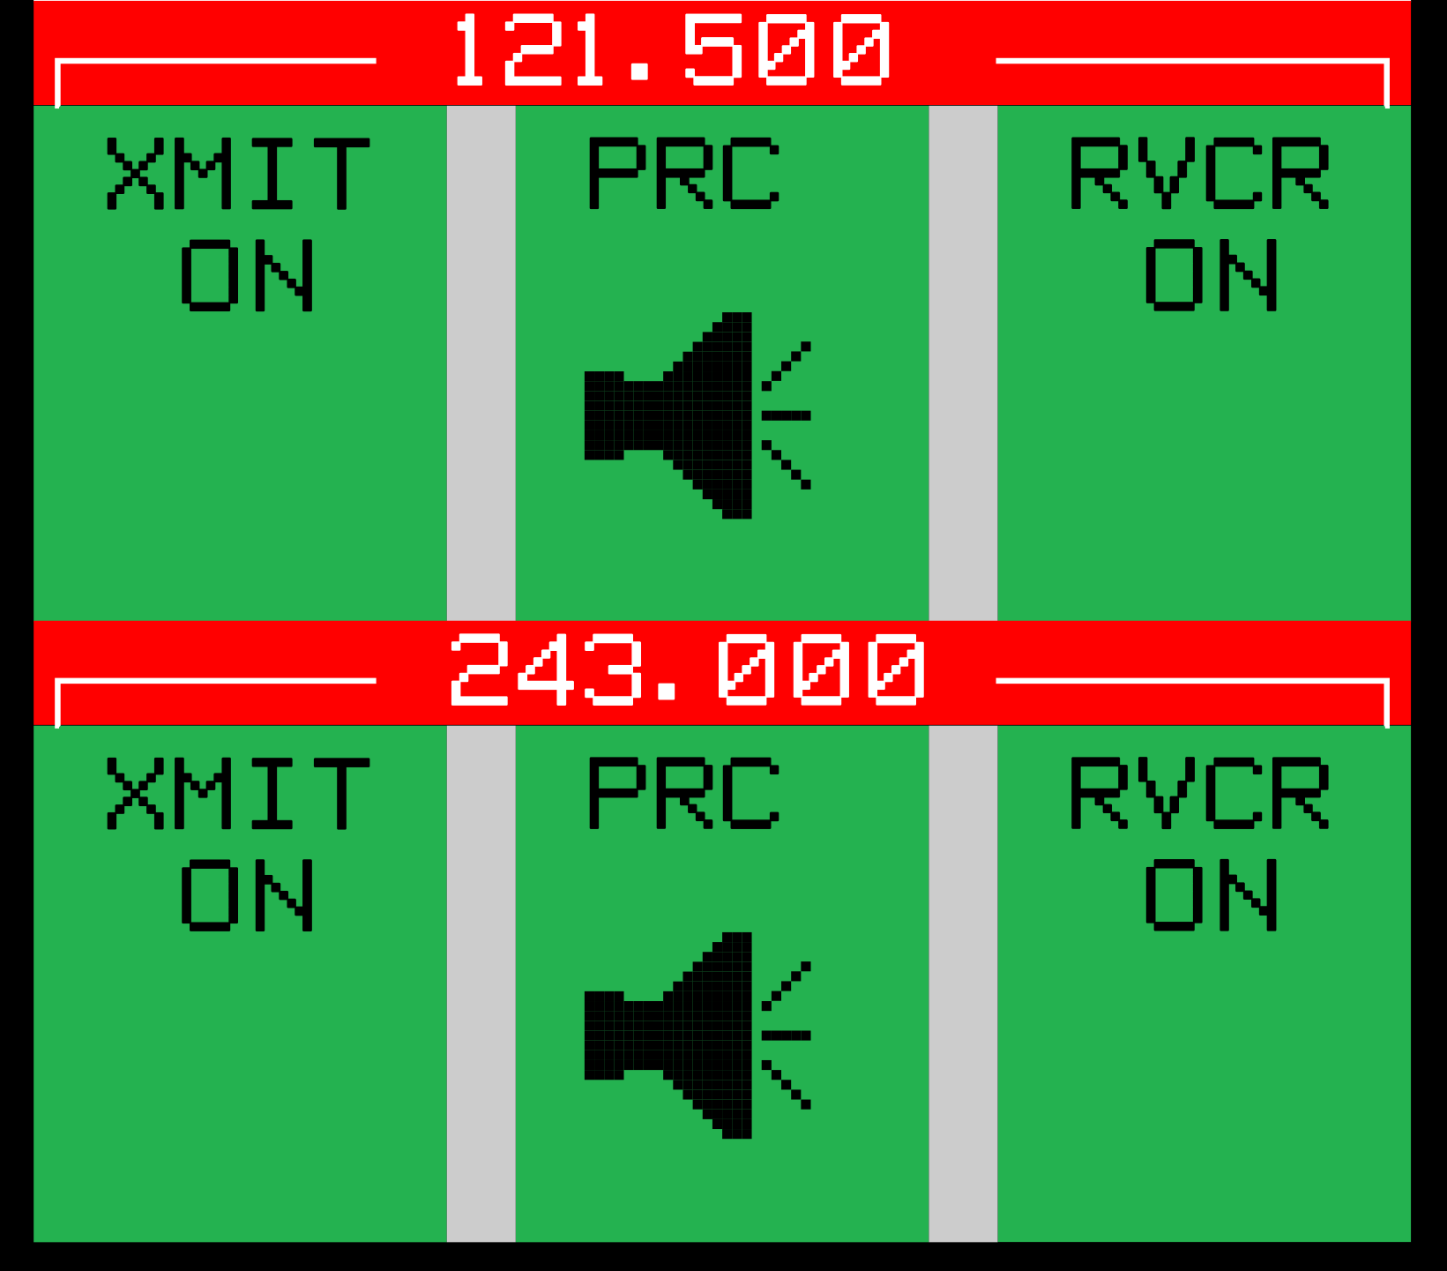
Frequency Changes
121.5 and 243.0 MHz are emergency frequencies
It might be best to keep the aircraft on the initial contact frequency
Change frequencies only when there is a valid reason

Slide 20
Emergency Code Assignment
Assign code 7700 to aircraft when pilot declares emergency and aircraft is not radar identified
“SQUAWK MAYDAY ON 7700”
After radar contact is established, request aircraft to change from 7700 to appropriate code
“RADAR CONTACT (position). IF FEASIBLE, SQUAWK (code)”

Slide 21
Knowledge Check
If an unidentified aircraft declares an emergency on your frequency, you should assign the aircraft code ________.
7700
7500
7100

Slide 22
Knowledge Check
The minimum initial information required to assist an inflight emergency is the aircraft identification, type aircraft, pilot’s desires, and ________.
nature of emergency
fuel remaining
aircraft location

Slide 23
Knowledge Check
When should you change an emergency aircraft from the initial contact frequency to the emergency frequency?
Immediately, because all emergencies must be worked on 121.5/243.0 MHz
After obtaining the minimum information
Only when there is valid reason

Slide 24
Aircraft Orientation
Orient an aircraft by the means most appropriate to the circumstances. Recognized methods include:
Radar
NAVAIDs
Pilotage
Sighting by other aircraft

Slide 25
Altitude Change for Improved Reception
When you consider it necessary, and if weather and circumstances permit, recommend that the aircraft maintain or increase altitude to improve:
Communications
Radar

Slide 26
Emergency Airport Recommendation
Consider multiple factors when recommending an emergency airport
Remaining fuel in relation to airport distances
Weather conditions
Airport conditions
NAVAID status
Aircraft type
Pilot’s qualification
Vectoring or homing capability to the emergency airport

Slide 27
Emergency Airport Guidance
Several methods are available for guidance to the airport
Radar
Following another aircraft
NAVAIDs
Pilotage by landmarks
Compass headings

Slide 28
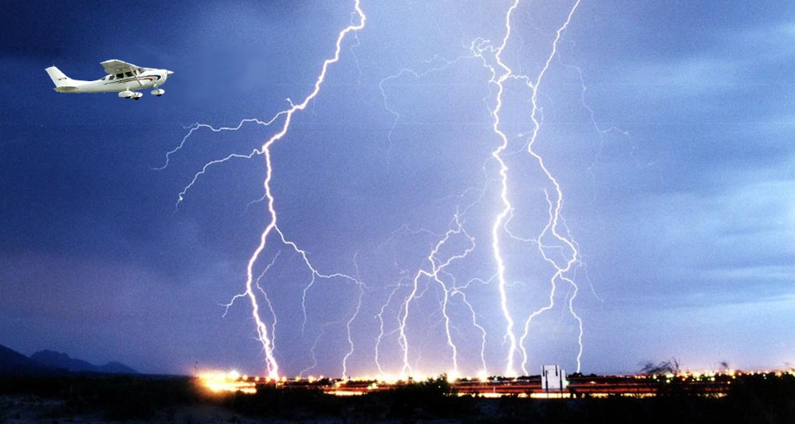
VFR Aircraft in Weather Difficulty

Slide 29
Provide Radar Assistance if Requested
Ask pilot if he/she is qualified for and capable of conducting IFR flight
If the pilot is qualified for and capable of IFR:
Request that the pilot file an IFR flight plan
Issue clearance to destination airport

Slide 30

Minimum Altitude

Slide 31
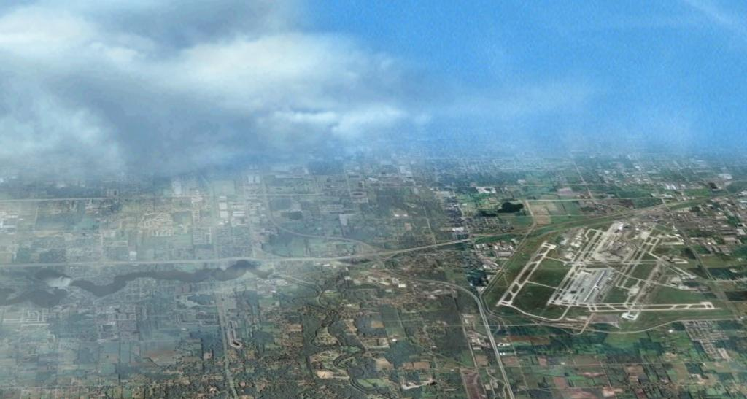


Radar Assistance Techniques
“NOVEMBER SIX SIX KILO GOLF IS NOW IN VFR CONDITIONS”
“NOVEMBER SIX SIX KILO GOLF, AREA OF PRECIPITATION ENDS AT TWELVE O’CLOCK ONE MILE”
“NOVEMBER SIX SIX KILO GOLF, ADVISE YOU LOWER GEAR AND SLOW TO APPROACH SPEED”

Slide 32
Emergency Locator Transmitter (ELT) Signals
Notify your supervisor/CIC when an ELT signal:
Is heard or reported
May be emanating from or near an airport
Is located
Is terminated

Slide 33
Knowledge Check
If you determine that a VFR aircraft is encountering IFR weather conditions and is NOT in your area of control responsibility, you should ________.
request aircraft contact appropriate control facility
provide assistance
advise pilot to reverse course

Slide 34
Threat Levels
Aircrew may use a four-tiered scheme of threat levels to relay the status of their situation
Level 1: Disruptive behavior - suspicious or threatening
Level 2: Physically abusive behavior
Level 3: Life-threatening behavior (weapon)
Level 4: Attempted or actual breach of the flight deck

Slide 35

Hijacked Aircraft

Slide 36
ATC/Aircrew Communications
In the event of hijack, air carrier/cargo crews should communicate or respond to routine ATC transmissions in clear, plain English. If unable, alternate means may be used to communicate with ATC such as:
Aircraft Communications Addressing and Reporting System (ACARS) messages may be relayed by airline operations centers
If uncertain as to the pilot’s intent, ATC may ask, without using the word hijack, if there is a problem

Slide 37
Pilot Messages/Signals
In the event of a hijack, the pilot may:
Make a clear, plain English radio transmission of a hijack
Make a radio transmission indicating the possibility of hijack without squawking 7500
Set the transponder to code 7500

Slide 38
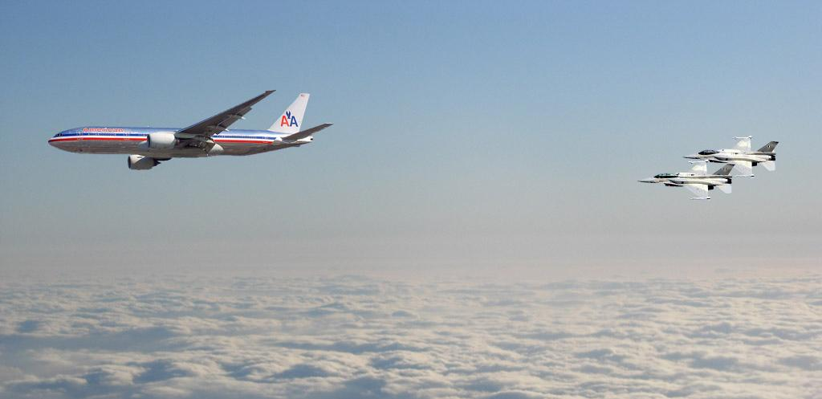
ATC Procedures

Slide 39
Knowledge Check
Whenever you observe an aircraft squawking code 7500, notify ________.
SAR
FCC
your supervisor/CIC

Slide 40
Knowledge Check
One of your targets is displaying code 7500. You have attempted to verify this, but have received no reply from the aircraft. You should ________.
continue calling until the aircraft replies
assume the flight is being hijacked and notify your supervisor/CIC
attempt to contact the aircraft on 121.5 MHz

Slide 41
Knowledge Check
When a pilot says “Threat Level 1,” what type of behavior is occurring?
Life-threatening
Physically abusive
Disruptive

Slide 42
Suspicious Aircraft/Pilot Activity
Use sound judgment and notify your supervisor/CIC when suspicious activity could be indicated by one of the following situations:
After 5 minutes or more, radio communications are not established or reestablished
An aircraft fails to turn on or changes from its assigned transponder code
An aircraft deviates from its assigned route of flight or altitude and refuses to return to it when asked
Phantom or inappropriate transmissions are made

Slide 43

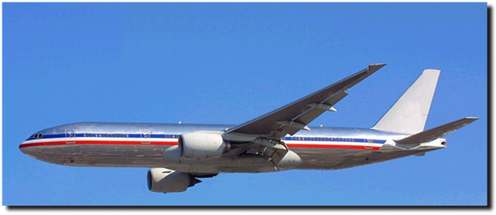
Bomb Threat
“WE JUST RECEIVED A BOMB THREAT!”

Slide 44

Bomb Threat on the Ground
At airports where tower control or FSS advisory service is not available:
Recommend delay of takeoff until pilot or aircraft operator establishes that a bomb is not on board
If pilot insists on taking off and it will not adversely affect other traffic, issue or relay an ATC clearance

Slide 45
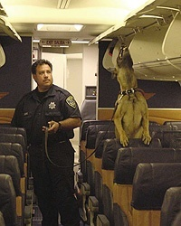
Explosive Detection K-9 Teams

Slide 46
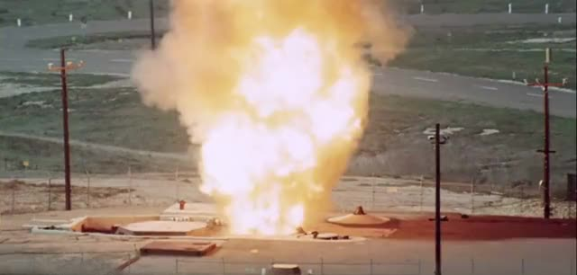
Ground Missile Emergencies

Slide 47
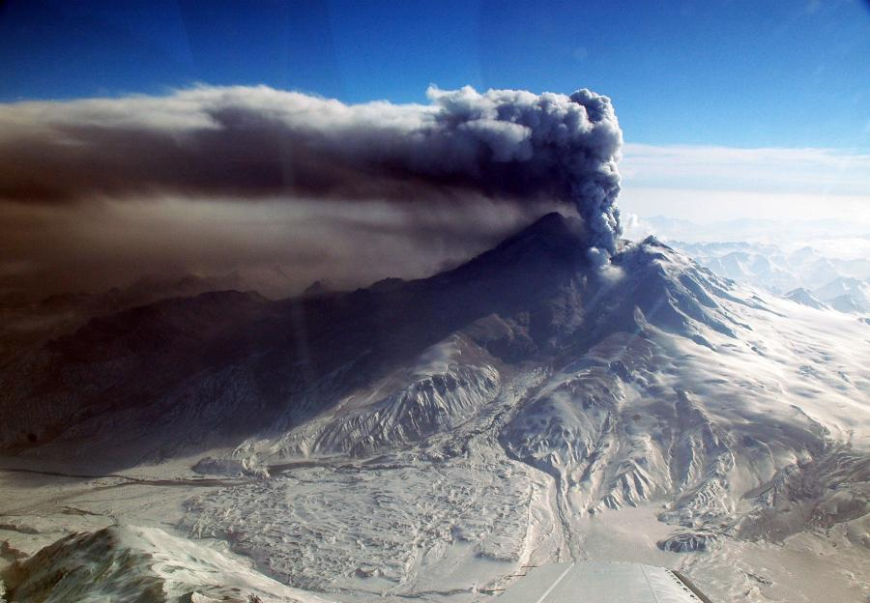
Volcanic Ash

Slide 48
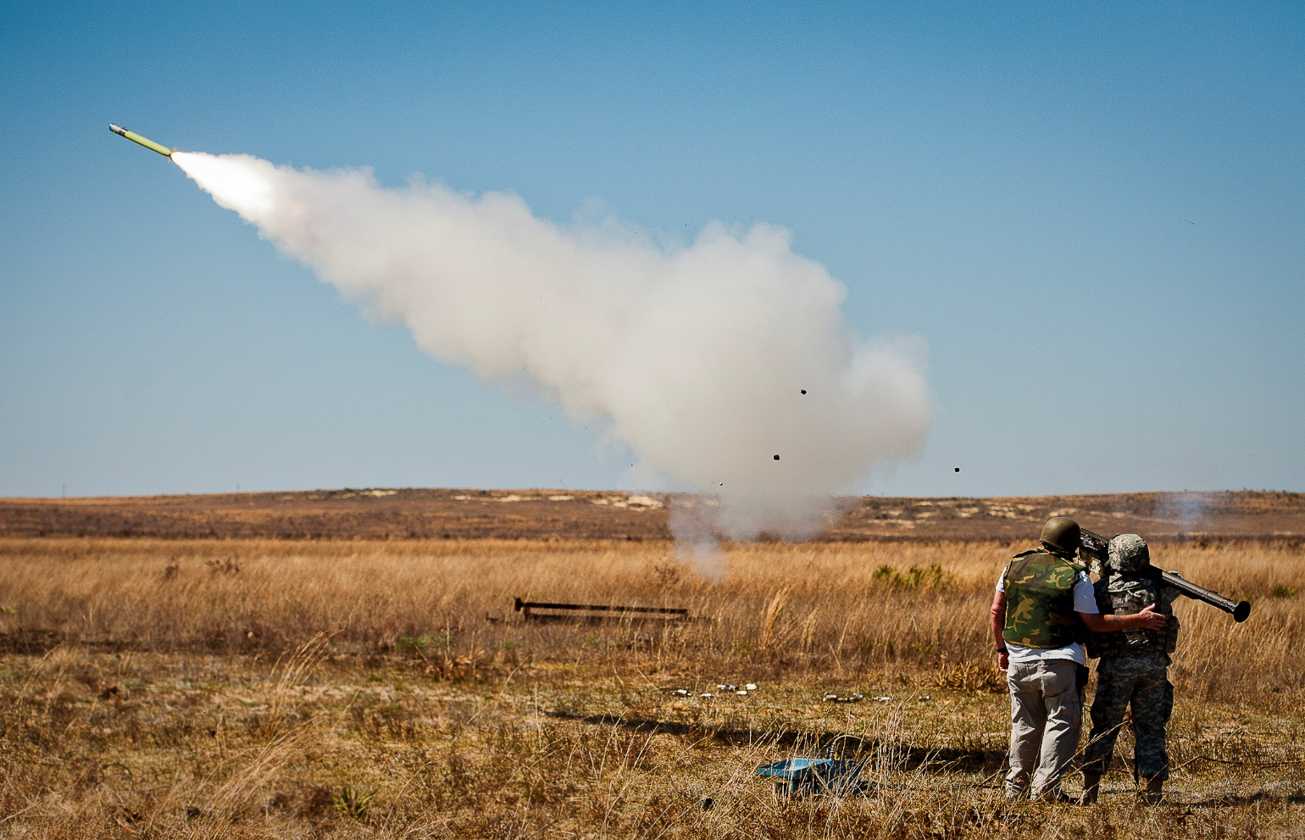
MANPADS Alert

Slide 49
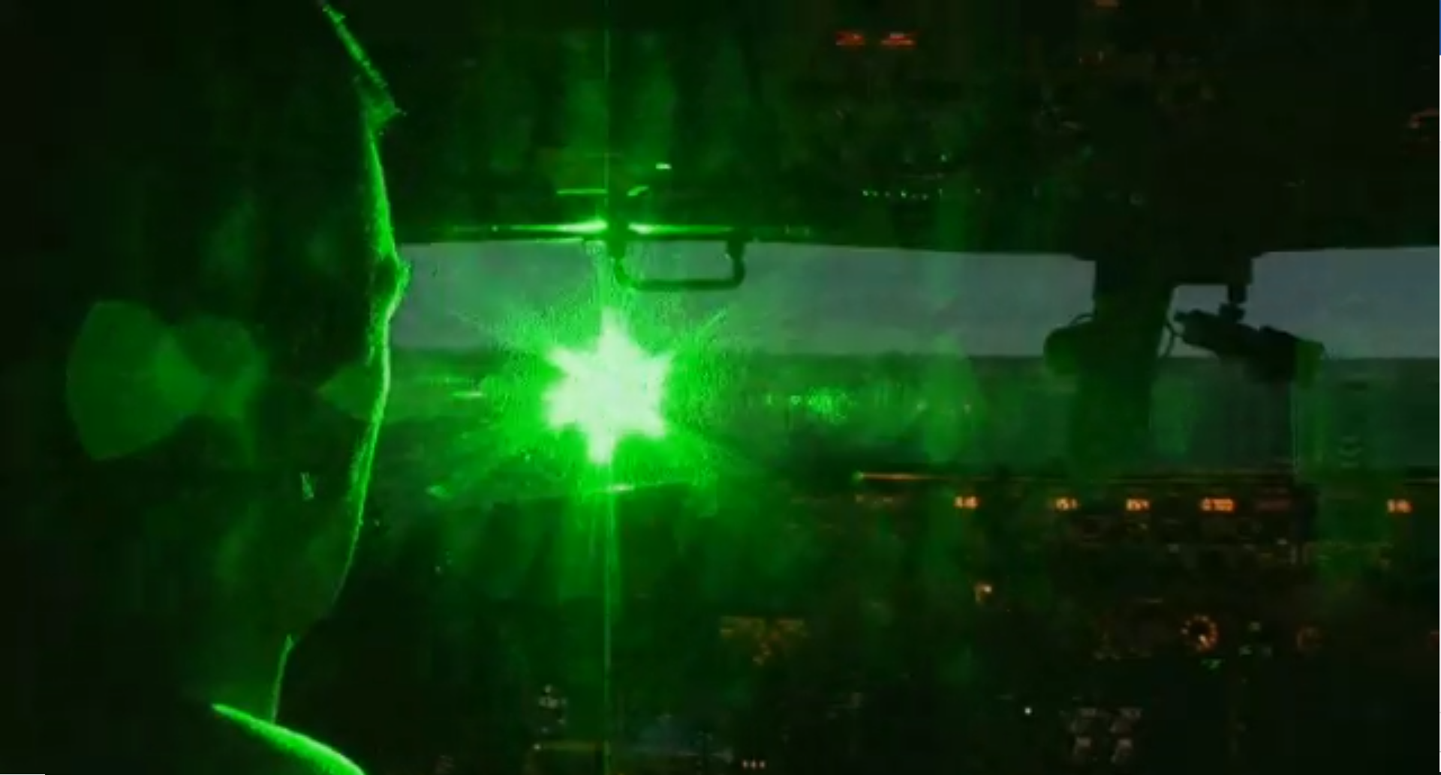
Unauthorized Laser Illumination of Aircraft

Slide 50

Derelict Balloons

Slide 51
Knowledge Check
When a bomb threat has been received involving an aircraft you are working, you should ________.
notify your supervisor/CIC and comply with pilot requests
assign the aircraft code 7700
instruct the pilot to land as soon as possible

Slide 52
Knowledge Check
MANPAD threats are classified as secret. Therefore, aircraft need not be notified of these threats.
True
False

Slide 53
Knowledge Check
A turbojet aircraft has entered a volcanic ash cloud. You should ________.
issue a climb clearance
issue clearance to the closest appropriate airport
let the pilot determine the escape route

Slide 54
Knowledge Check
Which is the phraseology to notify of a laser event?
“WARNING, LASER ILLUMINATION EVENT, (LOCATION), (ALTITUDE)”
“UNAUTHORIZED LASER ILLUMINATION EVENT, (LOCATION), (ALTITUDE)”
“DANGEROUS LASER ILLUMINATION EVENT, (LOCATION), (ALTITUDE)”

Slide 55
Overdue Aircraft
Consider an aircraft to be overdue when:
Neither communications nor radar contact can be established and 30 minutes have passed since:
ETA over specified or compulsory reporting point in your area or clearance limit in your area
Clearance void time
A VFR or IFR aircraft arriving at an airport not served by an air traffic control tower or flight service station fails to cancel a flight plan after receiving instructions on how to cancel
Center in whose area the aircraft is first overdue/unreported will make this determination

Slide 56



ALNOT is issued from last reported position to destination
Alert Notice (ALNOT)
50 Miles
Last Reported Position
To Destination
Position
Report
Position
Report
50 Miles
Departure
Point
Destination Airport

Slide 57


Rescue Coordination Center (RCC)
ARTCC will transfer responsibility to RCC for further search when one of the following occurs:
Thirty minutes have elapsed after estimated fuel exhaustion time
Aircraft has not been located within one hour after ALNOT issued
ALNOT search was completed with negative results

Slide 58
Control Actions
IFR traffic which could be affected by an overdue or unreported aircraft must be restricted or suspended unless radar separation is used
The facility responsible shall restrict or suspend IFR traffic for a period of thirty minutes
00:30

Slide 59
Knowledge Check
Between which points should an ALNOT be issued?
Point of last departure to the last reported position of the aircraft
Last reported position of the aircraft to the destination
Departure point to destination

Slide 60
Knowledge Check
If an aircraft is overdue, restrict IFR traffic for ____ minutes based upon time approach clearance was given.
10
20
30

Slide 61
Lesson Summary
This lesson covered:
Emergency situations
FAA responsibilities in an emergency
Procedures for handling emergencies
Specific emergency situations
Procedures for handling overdue aircraft

Slide 62

The End

