Slide 2
Pilot procedures for a communications failure
Unmanned Aircraft Systems (UAS) lost link procedures
ATC procedures for a communications failure

Slide 3
Pilot Procedures
If a communications failure occurs in VFR conditions, or if VFR conditions are encountered after the failure, the pilot must continue under VFR and land as soon as practicable
It is not intended that the requirements to land as soon as practicable be construed to mean as soon as possible. Pilots retain the prerogative of exercising their best judgement

Slide 4


IFR Aircraft In VFR Conditions
If a communications failure occurs in VFR conditions, the pilot must:
Continue the flight under VFR conditions
Squawk Code 7600
Land as soon as practicable

Slide 5
IFR Conditions - Route
If a communications failure occurs in IFR conditions, the pilot must continue the flight according to the following:
Last route assigned
On a radar vector:
Direct route to the fix, route, or airway specified
No assigned route:
Route in EFC
No assigned route or EFC:
Route filed in the flight plan

Slide 6
IFR Conditions - Altitude
A pilot who experiences communications failure must maintain the highest of the following altitudes for the route segment being flown:
Altitude assigned in the last ATC clearance
Minimum altitude for IFR operations
Altitude ATC has advised may be expected in an EFC

Slide 7
IFR Conditions - Altitude (Cont’d)
If an EFC with a higher or lower altitude has been received:
Maintain the highest of the following until time or fix:
Last assigned altitude, or
Minimum altitude for IFR operations
Upon reaching the time or fix, commence climb or descent to altitude advised to expect
If failure occurs after the time or fix, the altitude to be expected is not applicable

Slide 8
Depart Clearance Limit
If clearance limit is a fix from which an approach begins:
Commence descent and approach as close as possible to the EFC time
If no EFC time, commence descent and approach as close as possible to the Estimated Time of Arrival (ETA)

Slide 9
Depart Clearance Limit (Cont’d)
If clearance limit is not a fix from which an approach begins:
Depart clearance limit at EFC time
Proceed to a fix from which an approach begins
Commence descent and approach as close as possible to ETA
If no EFC time, depart clearance limit upon arrival over clearance limit
Proceed to a fix from which an approach begins
Commence descent and approach as close as possible to ETA

Slide 10
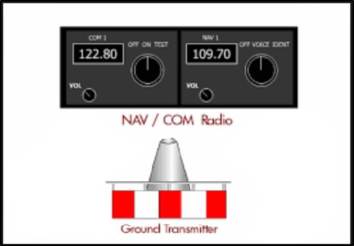
IFR COM Failure - NAVAID Voice
The pilot should monitor the NAVAID voice feature, then attempt to reestablish communications:
On previously assigned frequency, or
With an FSS

Slide 11
Reestablishing Communications
Contact ATC on the previously assigned frequency
Contact an FSS
Advise radio communications have been lost
Request further clearance from the controlling facility
Monitor 121.5/243.0 Mhz
Use any other means of communications, e.g., contract datalink service provider

Slide 12

Knowledge Check
What is one method of issuing a clearance to an aircraft when two-way communications have been lost?
Use NAVAID text feature
Issue clearances through Search and Rescue
Use NAVAID voice feature

Slide 13
Knowledge Check
N482W
BE20/G
T275
RBL
1649
08
160
OED
KSAC SAC V23 BTG
KVUO
6335
17
F
08
FJS
EFC V495 BTG
N482W was cleared to FJS and advised to expect further clearance via the routing indicated. If communications failure occurs, what action should the pilot take?
Hold indefinitely at FJS
Proceed to BTG via V23
Proceed to BTG via FJS V495

Slide 14
Knowledge Check
N15M
BE36/G
T160
70
PNC
KRDD RBL V332 HNW
KJAQ
4566
D-A
1502
KRDD P1500
70
N15M experienced a communications failure after departing from KRDD on an IFR flight plan. The aircraft reached VMC at 7,000 feet. What should the pilot do?
Descend in IFR conditions and land at KRDD
Continue in VMC conditions and land as soon as practicable
Maintain 7,000’ to KJAQ

Slide 15
Knowledge Check
N31P
BE36/L
T160
RBL
1304
60
KSAC V23 RBL KRDD
4314
21
H
13
NE
1328
23
KRDD
N13P experienced communications failure. At what time will the pilot commence an approach?
1328Z
1321Z
1323Z

Slide 16
UAS Lost Link
When you observe LLNK, do the following:
Determine lost link procedure, as outlined in Special Airworthiness Certificate or Certificate of Waiver or Authorization (COA)
Coordinate, as required, to allow UAS to execute lost link procedure
Advise supervisor/CIC, when feasible, so event can be documented

Slide 17
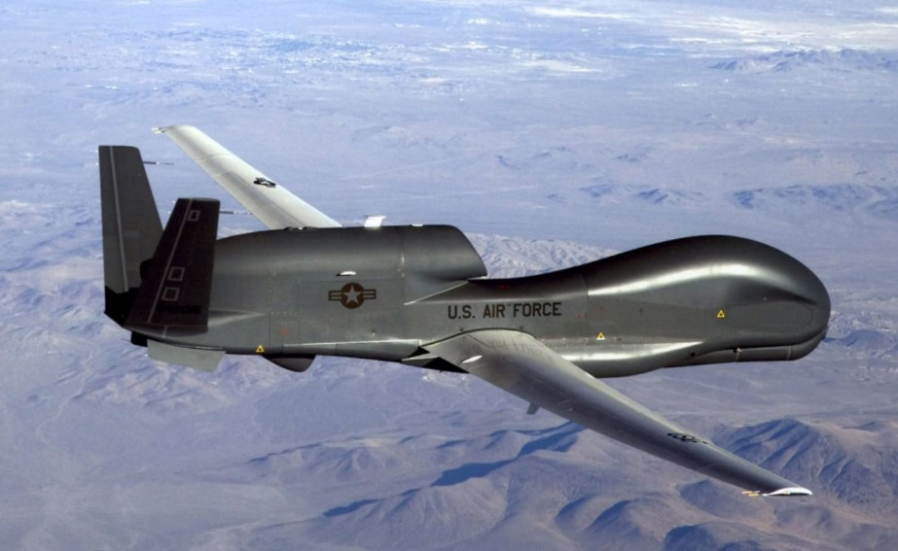
Global Hawk Lost Link
Global Hawk aircraft may be unable to squawk 7400
If the aircraft is unable to squawk 7400, it will squawk 7600
ATC must apply the same procedures whether 7400 or 7600 is squawked

Slide 18
Knowledge Check
What code may be displayed by unmanned aircraft systems (UAS) when the control link between the aircraft and the pilot is lost?
7300
7400
7700

Slide 19
Unacknowledged Clearances - Controller Actions
When a clearance has been issued, but not acknowledged by the pilot, you must protect:
If an altitude was issued, all altitudes between the previously cleared, and the newly issued altitudes
If a route was issued, the previously cleared, and newly issued routes
Verbally coordinate with any controllers on the route of flight, that the clearance was not acknowledged

Slide 20
Reestablish Communications
Attempt to reestablish communications using:
Emergency frequencies
NAVAIDs with voice capability
Flight Service Station (FSS)
Datalink service provider
Aircraft Communications Addressing and Reporting System (ACARS)
Selective calling

Slide 21

Receiver Only Aircraft Acknowledgement
If one way communications are established, have the aircraft do any of the following to acknowledge a clearance:
IDENT
Squawk Code 7600
Squawk STANDBY
Issue turns

Slide 22

Suspicious Activity Coordination
If communications have not been (re)established after 5 minutes:
Consider the aircraft’s or pilot’s activity to be suspicious
Report it to your supervisor/CIC

Slide 23
Overdue Aircraft - Traffic Restrictions
Suspend IFR traffic for 30 minutes from:
Time approach clearance issued
EFC
Arrival time at NAVAID serving destination airport
Release time or clearance void time
Current estimate, (controller’s or pilot’s), whichever is later, at:
Appropriate en route NAVAID or fix
NAVAID serving the destination airport

Slide 24
Overdue Aircraft - Lighting Requirements
At nontower or non-FSS locations, request airport management to light all:
Runway lights
Approach lights
Other required airport lighting systems
Lighting requirements begin
30 minutes before the ETA of the aircraft
Lighting requirements end
When aircraft has been located, or
30 minutes after its fuel supply is estimated to be exhausted

Slide 25
Overdue Aircraft - Traffic Resumption
Resume airport operations after a 30 minute suspension, with other pilots or aircraft operators concurrence
Concurrence must be maintained for 30 minutes after the suspension period has expired

Slide 26
Knowledge Check
An en route aircraft is maintaining FL290 and requests to climb to FL330. The clearance is issued, but the pilot does not acknowledge. What IFR altitude(s) must be blocked?
FL290 only
FL290-FL330
FL330 only

Slide 27
Knowledge Check
How long must airports lights be left on for an overdue aircraft?
30 minutes past aircraft fuel exhaustion time
3 hours past aircraft fuel exhaustion time
6 hours past the aircraft ETA at destination airport

Slide 28
Knowledge Check
When an aircraft is overdue, other IFR traffic shall be suspended or restricted for 30 minutes after the ________.
Time that the approach clearance was delivered to the pilot
Time the aircraft is located
Estimated fuel exhaustion time

Slide 29
Knowledge Check
If radio communications have not been (re)established with the aircraft after _____ minutes, consider the aircraft’s or pilot’s activity to be suspicious and report it to the supervisor/CIC.
15
20
5

Slide 30
Lesson Summary
This lesson covered:
Pilot procedures for a communications failure
UAS lost link procedures
ATC procedures for a communications failure

