Slide 2
Holding procedures
Holding clearances

Slide 3
Definitions
Hold Procedure
Clearance Limit
Holding Fix
Minimum Holding Altitude (MHA)
Traffic Management Initiatives (TMIs)

Slide 4

Knowledge Check
What is a clearance limit?
  Specified fix used as a reference point in a clearance
  The fix or point to which an aircraft is cleared
  The distance an aircraft may fly based upon their fuel limit

Slide 5
Turns
STANDARD PATTERN: RIGHT TURNS
NONSTANDARD PATTERN: LEFT TURNS
ABEAM
HOLDING SIDE
FIX END
OUTBOUND
END
FIX
NON-HOLDING SIDE
HOLDING COURSE

Slide 6
Airspeed
All aircraft may hold at the following altitude and maximum holding airspeeds:
  MHA to 6,000’ 200 knots
  6001’ to 14,000’ 230 knots
  Above 14,000’ 265 knots

Slide 7
Standard Leg Lengths
STANDARD PATTERN: RIGHT TURNS
NONSTANDARD PATTERN: LEFT TURNS
ABEAM
HOLDING SIDE
OUTBOUND
OUTBOUND
END
FIX END
INBOUND
RECIPROCAL
FIX
NON-HOLDING SIDE
HOLDING COURSE
AT OR BELOW
14,000’ MSL
ABOVE
14,000’ MSL
INBOUND LEG
1 MIN
1½ MIN

Slide 8

No-Course-Signal Zone
NO-COURSE-SIGNAL ZONE
FL250
6NM
FL210
5NM
17,000
4NM
12,000
3NM
8,000
2NM
4,000
1NM

Slide 9

DME Holding Toward the NAVAID
YES
NO
HOLDING FIX
OUTSIDE
NO COURSE
SIGNAL ZONE
FIX END OF
THE HOLDING
AREA OVERLAPS
NO COURSE
SIGNAL ZONE
HOLDING FIX INSIDE
NO COURSE SIGNAL
ZONE
VORTAC
FIX
FIX
NO COURSE
SIGNAL ZONE
HOLDING COURSE
TOWARD NAVAID
HOLDING COURSE
TOWARD NAVAID

Slide 10

DME Holding Away From the NAVAID
YES
NO
HOLDING AREA CLEARS NO-
COURSE-SIGNAL ZONE
HOLDING AREA OVERLAPS
NO-COURSE-SIGNAL ZONE
FIX
VORTAC
FIX
NO-COURSE-
SIGNAL ZONE
HOLDING COURSE AWAY
FROM NAVAID
HOLDING COURSE AWAY
FROM NAVAID

Slide 11
Holding at an Unmonitored NAVAID
V15
UNMONITORED
NAVAID
ALTITUDE
7,000’
ALTITUDE
7,000’
V5
V5
MONITORED
NAVAID
MONITORED
NAVAID
V15
V1

Slide 12
Holding Pattern Protected Airspace
The protected airspace of a holding pattern is determined by holding altitude and/or aircraft speed
The higher and/or faster the aircraft holds, the larger the protected airspace becomes

Slide 13


Holding Flight Path Deviation
Pilot requests left turns to avoid weather.

Slide 14
Knowledge Check
What should you always specify when issuing holding instructions?
  Direction of turns and holding fix
  Direction of turns if left turns are to be made
  Leg length in minutes or miles

Slide 15

Clearance to Holding Fix
CLEARANCE LIMIT
Consider operational factors:
  Length of delay, etc.
Issue holding instructions at least 5 minutes prior to clearance limit
Issue:
  Clearance limit
  Holding instructions
  EFC time
NOTE: Non-DME holding is shown
HOLDING FIX

Slide 16
Clearance Limit
Issued when assigning holding
  Clearance limit may be omitted if issued in a previous clearance
May be a fix, point, or location
  When the clearance limit is a NAVAID, intersection, or waypoint, state the type of fix, if known

Slide 17
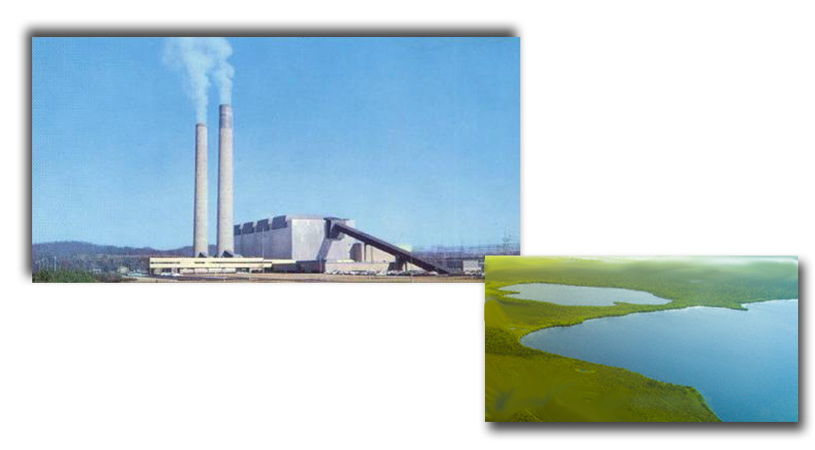
Visual Holding Fix Examples
Two Lakes
Steam Plant

Slide 18
Knowledge Check
What is required to issue holding at a visual holding fix?
  Defined in a Letter of Agreement
  Described to the pilot
  Familiar to the pilot

Slide 19
Knowledge Check
UAL210 is estimating FMG at 1623. What is the latest time to issue holding instructions?
  1613
  1618
  1620

Slide 20
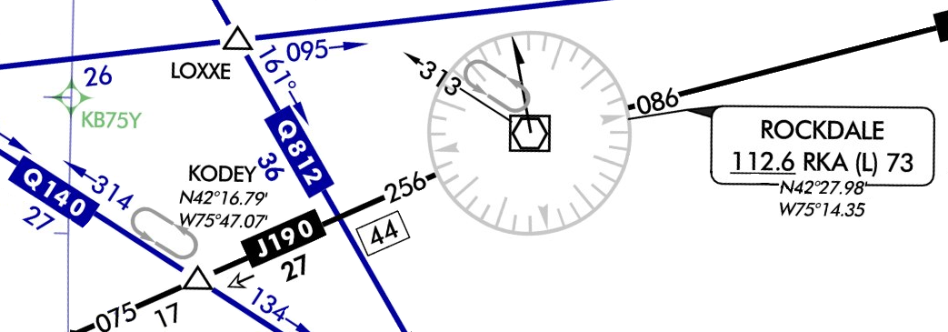
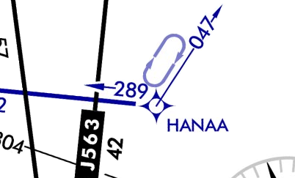
Charted Holding Pattern
NAVAID
Intersection
Waypoint

Slide 21
Unpublished Holding
N56LW
C337/G
T240 G222
02
711 03
ILA
1309
160
KAPC ILA RBL KRBL
3105
20
13
H-
NW
V23
1330
20
RBL
“NOVEMBER FIVE SIX LIMA WHISKEY, CLEARED TO RED BLUFF VORTAC, HOLD NORTHWEST ON VICTOR TWENTY THREE, EXPECT FURTHER CLEARANCE ONE THREE THREE ZERO”

Slide 22
Holding Instructions -
Clearance Limit Issued First
Holding fix may be omitted if included at the beginning of the transmission as the clearance limit
Example:
“UNITED FIFTY-TWO, CLEARED TO THE MUSTANG VORTAC, HOLD NORTHEAST ON ZERO THREE ZERO RADIAL, LEFT TURNS, EXPECT FURTHER CLEARANCE ONE ONE TWO ZERO”

Slide 23
Knowledge Check
What is the first item specified when issuing holding instructions if the clearance limit has been issued previously?
  Radial, airway, or route on which to hold
  Leg length
  Direction of holding from fix

Slide 24

Clearance Beyond Fix
Aircraft approaching clearance limit requiring clearance beyond it
Issue:
New clearance limit or approach clearance
Route of flight
Altitude, if different

Slide 25
Knowledge Check
If possible and no delay is anticipated, when should you issue a clearance beyond the clearance limit?
  At least 1 minute prior to the aircraft reaching the fix
  At least 5 minutes prior to the aircraft reaching the fix
  As soon as the aircraft reaches the fix

Slide 26
Knowledge Check
What is the phraseology for specifying the route of flight when clearing an aircraft beyond a clearance limit?
  “…VIA LAST ROUTING CLEARED”
  “…VIA FLIGHT PLAN ROUTE”
  “…CLEARED AS FILED”

Slide 27
Expect Further Clearance (time)
CLEARANCE LIMIT
“AMERICAN TWENTY CLEARED TO CRAIG VORTAC, NO DELAY EXPECTED”
  Issue an EFC anytime an aircraft is expected to enter holding
  Do not issue an EFC if no delay is expected

Slide 28
Knowledge Check
What else should be issued when a delay is anticipated and the direction has been issued with a charted holding pattern?
  Leg length
  Direction of turns
  EFC time

Slide 29
Delays
Advise your supervisor/CIC, or Traffic Management Unit (TMU) when:
  Aircraft are delayed
  Delays are expected
When arrival delays reach, or are expected to reach 30 minutes:
  Issue total delay information as soon as possible after the aircraft enters your center’s area

Slide 30
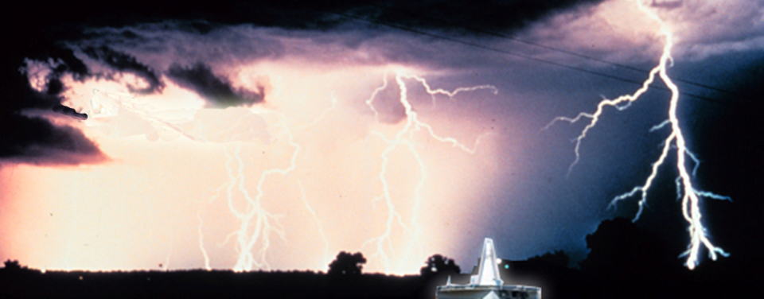

Indefinite Delays
“AMERICAN TEN, CLEARED TO TULSA VORTAC, HOLD NORTHWEST, AS PUBLISHED. DELAY INDEFINITE DUE TO WEATHER, EXPECT FURTHER CLEARANCE ONE SEVEN ONE FIVE.”
TUL

Slide 31
Additional Delays
AAL560
B738/L
T420 G420
02
633 02
PNC
1140
FSM
KGCK GCK V10
HUT V73 TUL V74
FSM KFSM
4664
50
170
11
H-NW
1220
50
TUL
ZME
“AMERICAN FIVE SIXTY CLEARED TO TULSA VORTAC, HOLD NORTHWEST AS PUBLISHED, EXPECT FURTHER CLEARANCE ONE TWO TWO ZERO, ANTICIPATE ADDITIONAL THREE ZERO MINUTE EN ROUTE DELAY AT FORT SMITH”

Slide 32
Knowledge Check
Who should you advise when you delay aircraft, or anticipate delays?
  The sector or approach control that will be affected
  Your supervisor/CIC or the Traffic Management Coordinator
  The Air Traffic Control System Command Center

Slide 33
Knowledge Check
What is the phraseology for issuing an EFC time for a lengthy delay?
  DELAY INDEFINITE, (reason, if known), STAND BY
  EXPECT FURTHER CLEARANCE IN ONE HOUR, (reason, if known)
  DELAY INDEFINITE, (reason, if known), EXPECT FURTHER CLEARANCE (time)

Slide 34
Lesson Summary
This lesson covered:
Holding procedures
Holding clearances

Slide 35
The End

