Slide 2
Lesson Objectives
At the end of this lesson, you will be able to identify:
Characteristics of an Instrument Approach Procedure (IAP) chart
Requirements for approaches
Procedures for approaches

Slide 3

Definition
INSTRUMENT APPROACH PROCEDURE (IAP) - A series of predetermined maneuvers for the orderly transfer of an aircraft under instrument flight conditions from the beginning of the initial approach to a landing or to a point from which a landing may be made visually. It is prescribed and approved for a specific airport by competent authority.
  IAP Types
  U.S. Civil Standard Instrument Approach
  U.S. Military Standard Instrument Approach
  Special Instrument Approach

Slide 4
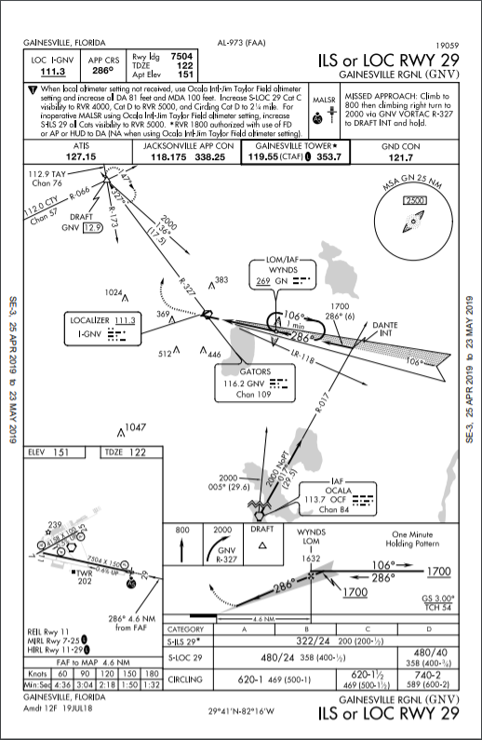
IAP Types
U.S. Civil Standard Instrument Approach Procedure:
  Instrument approach procedure that is approved by the FAA as prescribed under 14 CFR Part 97 and are available for public use

Slide 5
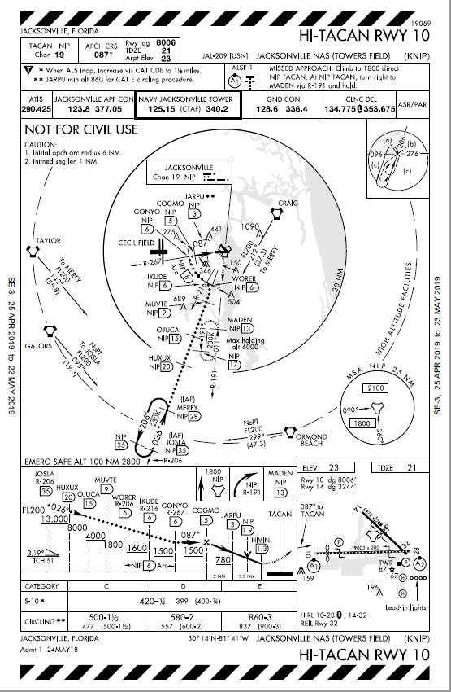
IAP Types (Cont'd)
U.S. Military Standard Instrument Approach Procedure:
  Instrument approach procedure that is approved and published by the Department of Defense (DOD)

Slide 6
IAP Types (Cont'd)
Special Instrument Approach Procedure:
  Approved by the FAA for individual operators
  Is not published for public use
    Pilots planning flights to locations served by special instrument approach procedures should obtain advance approval from the owner of the procedure
  Some special instrument approach procedures:
    Require certain crew qualification training in order to execute the approach
    Are based on privately owned NAVAIDS

Slide 7
Definitions
PRECISION APPROACH PROCEDURE - A standard instrument approach procedure in which an electronic glideslope or other type of glidepath is provided.
NONPRECISION APPROACH PROCEDURE -
  A standard instrument approach procedure in which no electronic glideslope is provided.
APPROACH WITH VERTICAL GUIDANCE (APV) -
  RNAV approach procedures that provide lateral and vertical guidance, but do not meet the requirements to be considered a precision approach.

Slide 8
Knowledge Check
Which type of instrument approach procedure is approved by the FAA for individual operators?
  U.S. Civil Standard
  U.S. Military Standard
  Special

Slide 9
Knowledge Check
Which type of approach has no electronic glideslope?
  Precision Approach
  Nonprecision Approach
  Instrument Landing System (ILS)

Slide 10
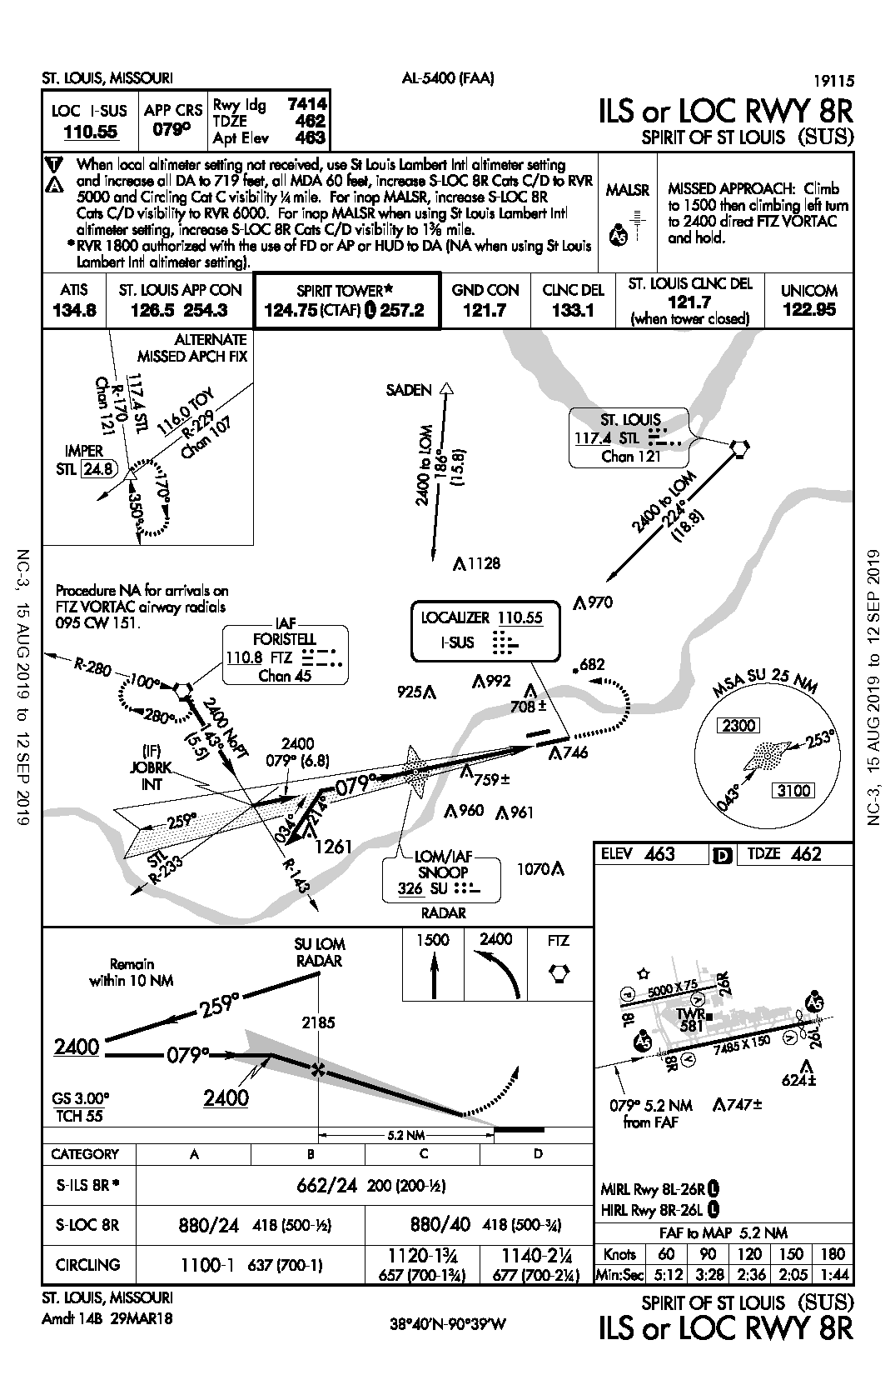
IAP Chart Layout
Margin Information
Pilot Briefing Information
Planview
Airport Sketch Box
Missed Approach Icons
Profile Box
Minimums
Margin Information

Slide 11
Margin Information
City and State
Top Margin
Procedure Name
ST. LOUIS, MISSOURI
Rwy ldg 7414 TDZE 462 Apt Elev 463
AL-5400 (FAA)
LOC I-SUS
110.55
APP CRS 079º
ILS or LOC RWY 8R
SPIRIT OF ST. LOUIS (SUS)
Reference Number and Approving Authority
Airport Name
Airport Identifier
City and State
Bottom Margin
ST. LOUIS, MISSOURI
Amdt 14B 29MAR18
SPIRIT OF ST. LOUIS (SUS)
38°40’N — 90°39’W
ILS or LOC RWY 8R
Airport Coordinates
Procedure Version
Procedure Name

Slide 12
Pilot Briefing Information
Primary NAVAID Information
Available Landing Distance
Full Text Description Of Missed Approach
Icons indicating any nonstandard alternate and/or takeoff minimums
Approach Course
Touchdown Zone and Airport Elevations
LOC I-SUS 110.55
Rwy ldg 7414 TDZE 462 Apt Elev 463
APP CRS 079º
Approach Lighting
Notes And Limitations
A
When local altimeter not received, use St Louis Lambert Intl altimeter setting…
MALSR
MISSED APPROACH: Climb to 1500 then climbing left turn to 2400 direct FTZ VORTAC and hold.
A
5
ST. LOUIS CLNC DEL 121.7 (when tower closed)
ATIS
134.8
ST. LOUIS APP CON 126.5 254.3
SPIRIT TOWER
124.75 (CTAF) 257.2
GND CON 121.7
CLNC DEL 133.1
ST. LOUIS RADIO 122.95
Frequencies - Listed In Normal Order Of Use

Slide 13
Planview
MSA SU 25 NM
SADEN
Minimum Safe Altitude
2300
2400 186° (15.8)
Mileage Information
253°
NAVAID
1251
River
2400 224° (18.8)
043°
3100
Transition Route
IAF
.. .
Obstruction (MSL)
1128
…
Holding Pattern
FORISTELL
ST. LOUIS
110.8 FTZ
..
970
. ..
Chan 45
117.4 STL
Chan 121
Altitude Information
682
R-280
2400 NoPT to LOM 143° (5.5)
992
708
Missed Approach
100°
925
280°
MM
Outbound Radial
R-143
751
Procedure Turn
759
..
LOCALIZER 110.55
I-SUS
079°
…
Runways
..
Approach NAVAID
…
Inbound Course
Locator Outer Marker
259°
214°
034°
LOM/IAF
Navigation Frequency Information
Localizer
…
SNOOP
326 SU
..
1070
IAP Notes Area
RADAR
Distance Circle - 10 NM
10 NM

Slide 14
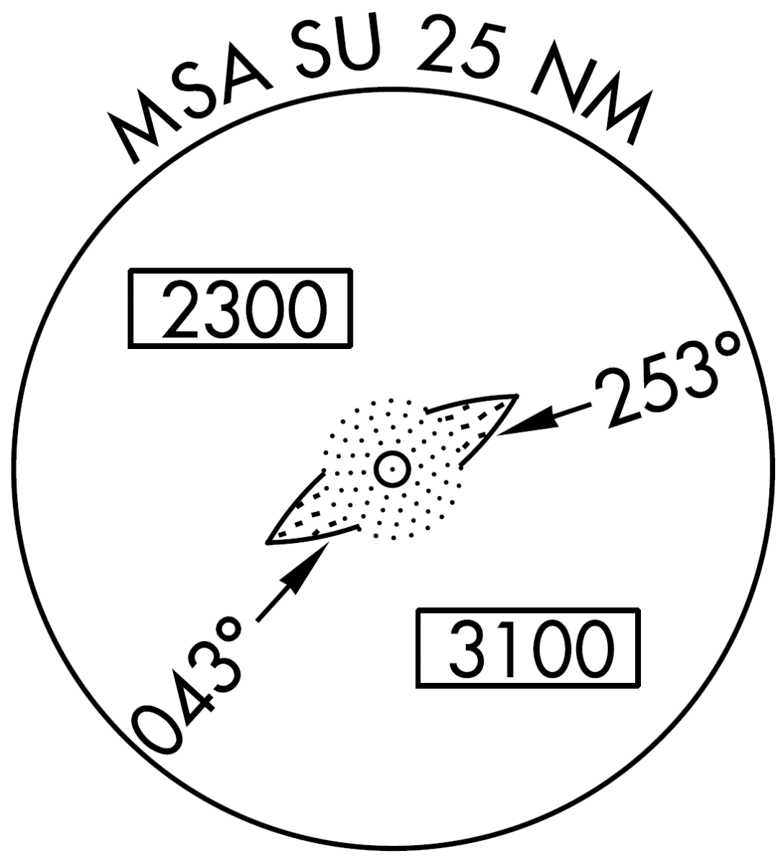
Minimum Safe Altitude (MSA)
Minimum Altitude
in the Northern Portion of the Area
Minimum Altitude
in the Southern Portion of the Area

Slide 15
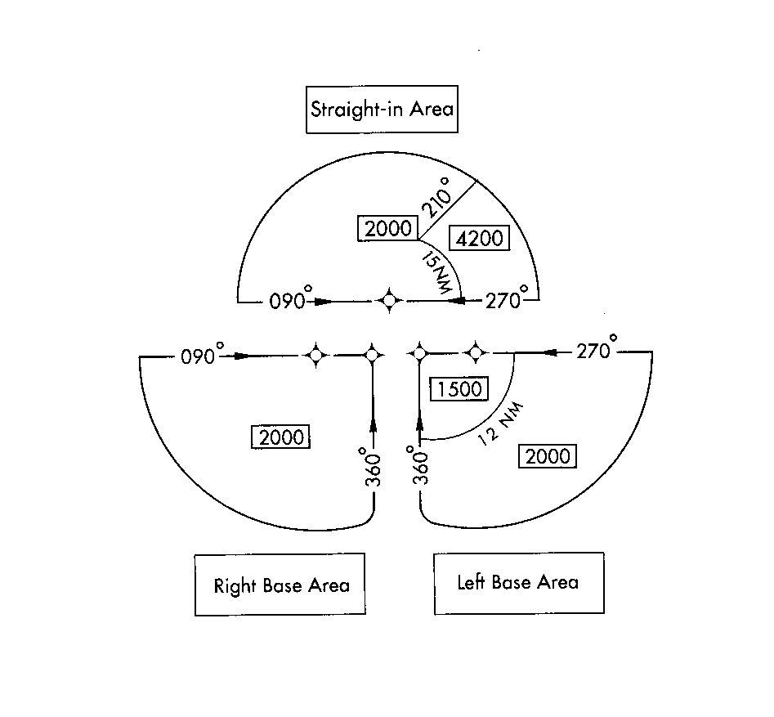
Terminal Arrival Area (TAA)
STRAIGHT-IN AREA
30NM Radius Centered on the Initial Approach Fix
Altitudes Provide at Least 1,000’ Obstacle Clearance
Right Base Area
Left Base Area

Slide 16

Airport
Sketch Box
Airport
Elevation
ELEV 463
TDZE 462
Rwy 8R ldg 7245’
Touchdown Zone Elevation
Rwy 26L ldg 7004’
Approach Lighting Symbols
Notes
5000 x 75
26R
A
P
V
5
8L
581
26L
A
V
5
7485 x 150
8R
V
624
Obstructions
076°
5.2 NM
747
Runway Lighting Aids Available
from FAF
Displaced Threshold
MIRL Rwy 8L-26R
L
HIRL Rwy 8R-26L
FAF Distance
L
FAF to MAP 5.2 NM
Time/Speed Table
Knots
60
90
120
150
180
Min:Sec
5:12
3:28
2:36
2:05
1:44

Slide 17
Missed Approach
Icons
Textual Description
1500
2400
FTZ
MISSED APPROACH: Climb to 1500 then climbing left turn to 2400 direct FTZ VORTAC and hold.
Climb Straight Ahead to 1500
Then Direct FTZ
Followed by a Climbing Left Turn to 2400

Slide 18

Profile View - Precision Approach
Procedure Turn Completion Altitude
Glideslope Altitude At LOM
Final Approach Fix
SU LOM
RADAR
1500
2400
FTZ
Remain
within 10 NM
259°
2185
MM
2400
079°
2400
GS 3.00°
TCH 55
4.7 NM
0.5
Glideslope Angle
Course
Glideslope Intercept Altitude
Glideslope
Missed Approach Track

Slide 19
Knowledge Check
On an approach chart, what does an altitude without horizontal lines above or below the numbers indicate?
  Minimum altitude
  Mandatory altitude
  Recommended altitude

Slide 20
Knowledge Check
Where can symbols used on an IAP chart be found within U.S. Terminal Procedures Publications?
  Legend
  Margin
  Profile View

Slide 21
Profile View - Nonprecision Approach
Maximum Distance Of Procedure Turn From LOM
LOM
1500
2400
FTZ
Remain
within 10 NM
259°
2400
079°
2400
079°
3.46°
TCH 45
5.2 NM
Minimum Altitude Over FAF
Visual Descent Angle
Missed Approach Point
Missed Approach Track

Slide 22
Landing Minimums
The landing minimums section describes:
  The lowest altitude to which the approaching aircraft may descend in IFR conditions before the missed approach procedure must be executed
  The lowest visibility needed to execute the approach procedure
    Visibility may be in statute miles or hundreds of feet

Slide 23
Precision Minimums Section
Approach Procedure Variations
Aircraft Categories
Height of DH Above Touchdown Zone [AGL]
Decision Height
Visibility
CATEGORY
A
B
C
D
S-ILS 8R
662/24 200 (200-½)
S-LOC 8R
880/24 418 (500-½)
880/40 418 (500-3/4)
CIRCLING
1100-1
637 (700-1)
1120-1¾
657 (700-1¾)
1140-2¼
677 (700-2¼)
Height of MDA Above Touchdown Zone [AGL]
Minimum Descent Altitude (MDA)
Military Minimums
Height of MDA Above Airport [AGL]

Slide 24
Nonprecision Minimums Section
Approach Procedure Variations
Minimum Descent Altitude
Height of MDA Above Touchdown Zone [AGL]
Aircraft Categories
Visibility
CATEGORY
A
B
C
D
S-12R
1100-1 540 (600-1)
1100-1¼
540 (600-1¼)
CIRCLING
1100-1 529 (600-1)
1100-1½
529 (600-1½)
1140-2
569 (600-2)
DUAL VOR OR VOR/DME MINIMA
S-12R
940-1 380 (400-1)
CIRCLING
1000-1
429 (500-1)
1040-1
469 (500-1)
1040-1½
469 (500-1½)
1140-2
569 (600-2)
Variations Of Approach Procedure (With Specific Airborne Equipment Required)
Circling MDA
Height of MDA Above Airport [AGL]

Slide 25
Knowledge Check
For a category B civilian aircraft, what is the DH for a straight-in ILS runway 29 approach?
  200’
  1,071’
  2,400’
CATEGORY
A
B
C
D
S-ILS 29
1071/24 200 (200-½)
S-LOC 29
1300/24 429 (500-½)
1300/40
429 (500-¾)
1300/50
429(500-1)
CIRCLING
1340-1 465 (500-1)
1340- 1½
465 (500-1½)
1520-2
645 (700-2)

Slide 26
Knowledge Check
Controllers are responsible for determining that landing minimums exist prior to allowing an aircraft to execute an approach.
  True
  False

Slide 27
Knowledge Check
What is the altitude for a precision approach at which a missed approach must be initiated if the required visual reference to continue the approach has not been established?
  Minimum Descent Altitude (MDA)
  Decision Height (DH)
  Height Above Airport (HAA)

Slide 28
Approach Clearance
APPROACH CLEARANCE - Authorization by ATC for a pilot to conduct an instrument approach.
Issue an approach clearance only after the preceding aircraft has landed or cancelled IFR, except when applying:
  Radar procedure
  Timed or visual approaches

Slide 29
Pilot’s Choice of Approach
  FSS Location
  VFR Tower Location
N47PL
LJ24/L
T450 G450
02
131 03
N55LW
C421/G
T220 G228
02
131 01
OKC
1509
APCH
OSW
1700
130
KOKC OKC KSRE
APCH
20
150
KICT V350 CNU OSW
KMIO
10
3737
15
3737
17
CPT
CPT
S
180
20
10
1720
APCH
1707
APCH
1513
23NW/1707
KMIO
CTL
KSRE
“NOVEMBER FIVE FIVE LIMA WHISKEY, CLEARED APPROACH MIAMI AIRPORT, CONTACT MIAMI RADIO PROCEDURE TURN.”
“LEAR FOUR SEVEN PAPA LIMA CLEARED APPROACH, CONTACT SEMINOLE TOWER ONE ONE EIGHT POINT TWO PROCEDURE TURN.”

Slide 30
Phraseology for Various Types of Approaches
RCH215
H/C17/L
T420 G454
02
421 03
OKC
1605
90
KOKC OKC V14
TOTES KCQB/1625
APCH
30
5526
16
30
APCH
1620
KCQB
30W/1620
“REACH TWO ONE FIVE CLEARED:
V-O-R APPROACH.”
I-L-S RUNWAY THREE SIX APPROACH.”
TACAN APPROACH.”
A-D-F APPROACH.”
R-NAV APPROACH.”

Slide 31
Communications Release
If an IFR aircraft intends to land at an airport not served by a tower or FSS, approve a change to advisory frequency when you no longer require direct communications
  Permits the aircraft to receive timely local airport traffic information

Slide 32
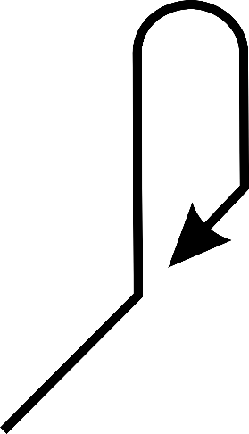

Aircraft on an Unpublished Route
V40
APPROACH
PROCEDURE
V68
ABC
4,000’ PEAK
N1 @ 10,000’
V23

Slide 33
GPS Testing and Anomalies
When GPS TESTING NOTAMS are published and testing is actually occurring:
  Inform pilots requesting or cleared for a RNAV approach that GPS may not be available and request intentions
  Do not resume RNAV approach operations until certain that GPS interference is no longer a factor or such GPS testing exercise has ceased

Slide 34
Altitude Assignment
Specify altitude in the approach procedure when necessary for separation
  Example:
  “MAINTAINED FOUR THOUSAND UNTIL ESTABLISHED ON THE LOCALIZER”

Slide 35
Knowledge Check
What is the phraseology to release an aircraft to change to advisory frequency?
  “CHANGE TO ADVISORY FREQUENCY APPROVED”
  “CHANGE TO ADVISORY FREQUENCY”
  “CHANGE TO ADVISORY”

Slide 36
Knowledge Check
What is the phraseology for giving a pilot the choice of which approach to fly?
  “…CLEARED FOR ANY APPROACH”
  “…CLEARED PILOT’S CHOICE”
  “…CLEARED APPROACH”

Slide 37
Approach Information
Provide current approach information to aircraft at airports for which you provide approach control services
Include the following information, if needed:
  Approach clearance or type of approach to expect
  Runway
  Surface wind
  Ceiling and visibility
  Altimeter for destination airport

Slide 38
Pilot Unfamiliar with Approach
Specify the following in the approach clearance if the pilot is unfamiliar with the procedure:
  Initial approach altitude
  Direction and distance from the holding fix within which procedure turn is to be completed
  Altitude at which the procedure turn is to be made
  Final approach course and altitude
  Missed approach procedures if considered necessary

Slide 39
Contact Approach
Requirements:
  Must be requested by pilot
  Reported ground visibility must be at least one statute mile
  Standard or Special IAP must be published and functioning for airport
  Approved separation must be applied between other IFR or Special VFR aircraft
  Issue alternative clearance when weather conditions are such that a contact approach may be impracticable

Slide 40
Visual Approach
An approach conducted on an IFR flight plan that authorizes the pilot to proceed visually and clear of clouds to the airport
Pilot must, at all times, have either the airport or the preceding aircraft in sight
Must be authorized and under the control of the appropriate air traffic control facility
Reported weather at the airport must be VFR

Slide 41
Unsuccessful Visual Approach
Visual Approach is not an Instrument Approach Procedure
No missed approach segment
If aircraft is unable to complete visual approach:
  Aircraft should overfly the runway while climbing to traffic pattern altitude and enter the traffic pattern via the crosswind leg (i.e., go around)
  ATC must maintain applicable IFR separation

Slide 42
Vectoring for Visual Approach
Radar controllers may vector aircraft for a visual approach at airports
  With weather reporting service, if:
    Ceiling is at least 500’ above Minimum Vectoring Altitude/ Minimum IFR Altitude (MVA/MIA); and
    Visibility is 3 miles or greater
Without weather reporting service, if:
  There is reasonable assurance (e.g., area weather reports, PIREPs, etc.) descent and flight to airport can be made visually, and
  Pilot informed weather information not available

Slide 43
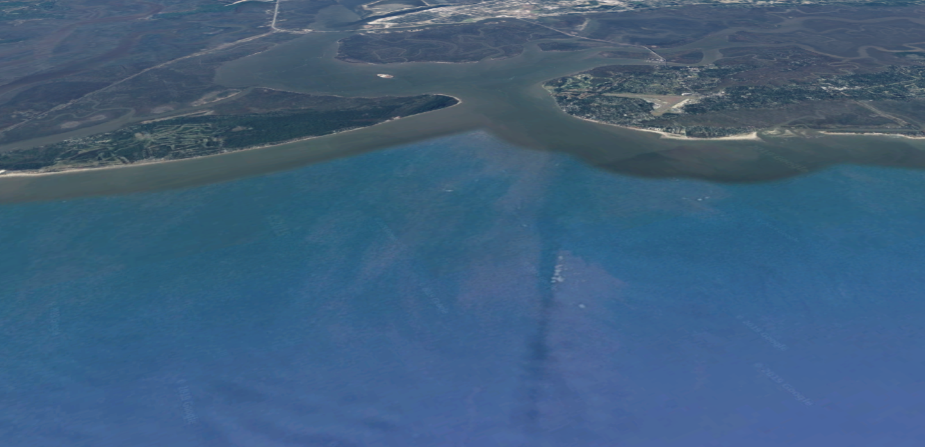
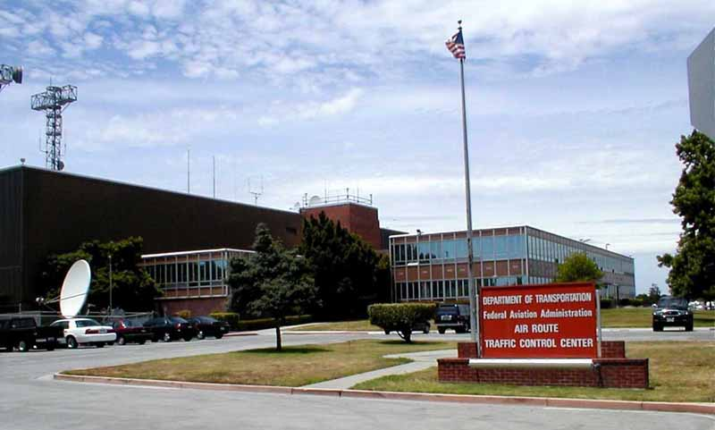

Visual Approach Procedures
Visual Approach: Airports in Close Proximity
Controller may initiate, or pilot may request, a visual approach even when being vectored for an instrument approach and the pilot subsequently reports:
  Airport in sight at airports without a control tower
  Airport or runway in sight at airports with operating control towers
Jekyl Island
St. Simons Island
“Which one?”
“November Four Two FOUR VICTOR, cleared visual approach.”
ARTCC

Slide 44
Visual Approach: Pilot Responsibilities
Accept responsibility for wake turbulence separation
Contact ATC as soon as possible if unable to land
Advise ATC if unable to:
  Continue following designated traffic
  Remain in VFR conditions
Advise ATC if a visual approach is not desired
Proceed to the airport in a normal manner or follow designated traffic
Remain VFR at all times
Maintain a safe landing interval behind preceding traffic

Slide 45
Knowledge Check
An aircraft unable to complete a visual approach should do what?
  Overfly the runway while climbing to MSA and attempt another visual approach
  Overfly the runway while climbing to last assigned altitude and request further routing
  Overfly the runway while climbing to traffic pattern altitude and enter the traffic pattern via the crosswind leg

Slide 46
Knowledge Check
Which statement is not true of a contact approach?
  Reported ground visibility must be at least one statute mile
  Controller may initiate or pilot may request
  Standard or Special IAP must be published and functioning for airport

Slide 47





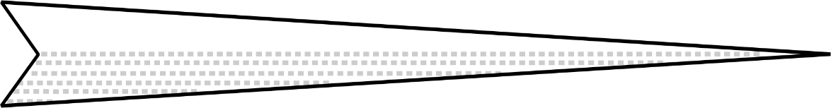



Timed Approaches
Glide
Path
NO. 3
NO. 2 Aircraft Passed LOM @ 1002
NO. 2
LOM
LMM
NO. 3 Aircraft Will Depart The LOM @ 1004
NO. 1 Aircraft Passed LOM @ 1000
5 Miles
Approximately

Slide 48
Timed Approaches (Cont'd)
Interval Minima
  Use 2 minute or a 5 mile radar interval as the minimum between successive approaches
Wake Turbulence Interval Minima
  Heavy behind Super - 3 minutes or 6 miles
  Large behind Super - 3 minutes or 7 miles
  Small behind Super - 4 minutes or 8 miles
  Small behind Heavy - 3 minutes or 6 miles

Slide 49
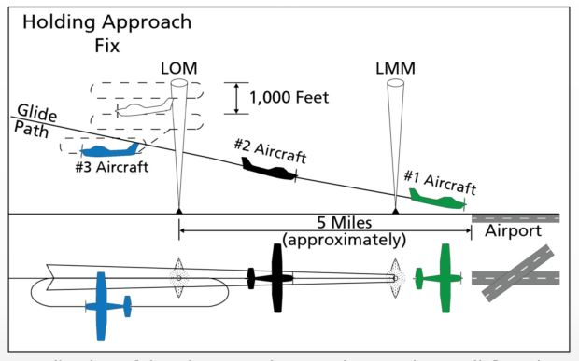
Example - Timed ILS Approaches
Timed approaches using an ILS and applying longitudinal separation only
Using an interval of two minutes, #1 and #2 aircraft have already passed the LOM on final approach.
Profile View
#3 aircraft has been cleared for approach and to depart LOM two minutes after #2 aircraft reported leaving LOM inbound on final approach.
Top-down View

Slide 50
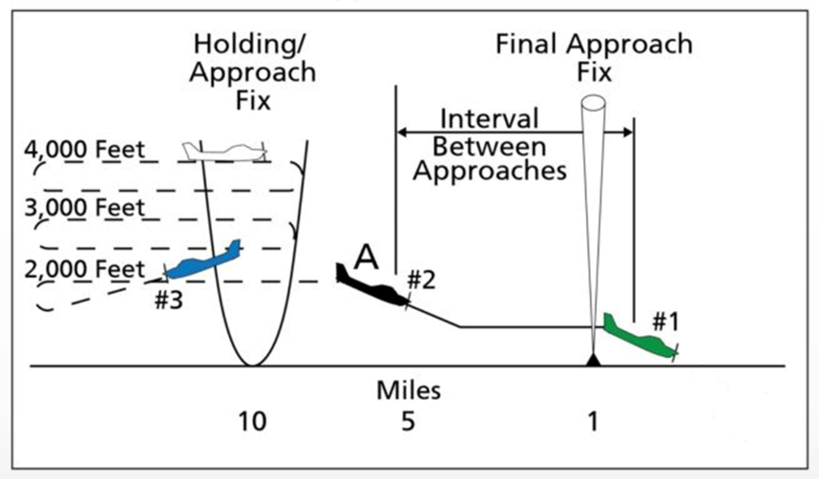
Example - Timed NDB Approaches
Timed approaches using a bearing of an NDB and longitudinal and vertical separation
#2 aircraft departed fix inbound at designated time, maintaining 2,000’ until cleared for approach at point A
#1 aircraft sighted by tower, enabling approach clearance to #2 aircraft at point A.
#3 aircraft instructed to descend to 2,000’ after #2 aircraft reported departing fix inbound and leaving 2,000’ at point A.

Slide 51
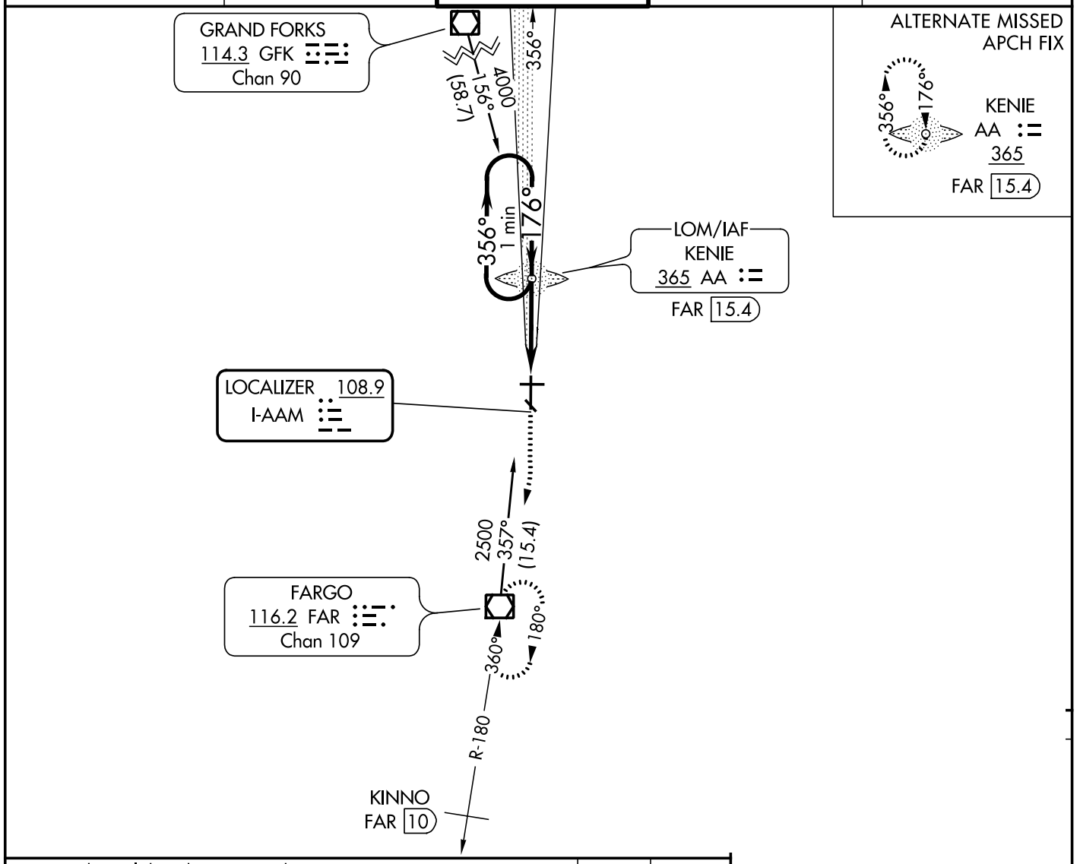
Timed Approaches - Missed Approach
ILS or LOC RWY 18
FARGO (KFAR)
Missed Approach: FAR VOR/DME
Alternate Missed Approach: KENIE LOM

Slide 52
Knowledge Check
What type of facility must service an airport in order to use timed approaches?
  Tower
  Flight service station
  Approach control

Slide 53
Knowledge Check
If an alternative missed approach procedure is not available and weather conditions are less than required, clear the succeeding aircraft for an approach when the preceding aircraft has_________ .
  Landed or canceled its IFR flight plan
  Passed the final approach fix inbound
  Passed the outer marker on the approach

Slide 54
Knowledge Check
When conducting timed approaches, what must be issued before specifying a time to leave the initial approach fix inbound?
  An Expect Further Clearance (EFC) time
  Altitude restriction
  Time check

Slide 55
Cancellation of IFR Flight Plan
If arriving at an airport not served by a tower or FSS, instruct pilot how to cancel IFR flight plan before instructing pilot to change to the Common Traffic Advisory Frequency (CTAF)

Slide 56
Frequency Changes for Military Aircraft
Military single piloted turbojet aircraft conducting an approach wholly, or partly in IFR conditions, or at night:
  Avoid frequency and radar beacon code changes to the maximum extent that communications capabilities and traffic will permit

Slide 57
Circling Approach
May only be given for aircraft landing at airports with operational control towers
Include in the approach clearance instructions to circle to the runway in use if landing will be made on a runway other than that aligned with the direction of instrument approach
  CIRCLE TO RUNWAY (number)

Slide 58
Missed Approach
An approach clearance automatically authorizes the aircraft to execute the missed approach procedure depicted for the instrument approach being flown
An alternate missed approach procedure as published may be assigned when necessary

Slide 59
Practice Approach
Ensure that neither VFR nor IFR practice approaches disrupt the flow of other arriving and departing IFR or VFR aircraft
  EXCEPTION: Military aircraft operating at military airfields
Authorize, withdraw authorization, or refuse to authorize practice approaches as traffic conditions require
  Approaches in progress should not be terminated

Slide 60
Practice Approach Separation
Apply approved IFR separation minima to:
  IFR aircraft practicing instrument approaches until
    The aircraft lands and flight is terminated, or
    Pilot cancels flight plan
  VFR aircraft practicing instrument approaches where procedures require application of IFR separation

Slide 61
Practice Approach: Missed Approach
IFR aircraft are automatically authorized to execute missed approach depicted for instrument approach being shown
  Unless alternative instructions have been issued
VFR aircraft are NOT automatically authorized to execute missed approach procedure

Slide 62
Knowledge Check
Which is true of circling approaches?
  May only be given for aircraft landing at airports with operational control towers
  May only be given at airports with operational control towers or Flight Service Stations
  May be given at any airport

Slide 63
Knowledge Check
When is approved IFR separation minima applied to IFR aircraft practicing approaches?
  Never
  Until the aircraft lands and flight is terminated
  Until the VFR tower gets the aircraft in sight

Slide 64
Lesson Summary
This lesson covered:
Characteristics of an Instrument Approach Procedure (IAP) chart
Requirements for approaches
Procedures for approaches

Slide 65
The End

