Slide 1


Slide 2
Procedures for issuing altimeter settings
Requirements for altitude assignments
Phraseology for altitude assignments
Requirements for minimum altitudes

Slide 3
Altimeter Settings
An Altimeter Setting is the barometric pressure reading used to adjust a pressure altimeter for variations in existing atmospheric pressure, or to the standard altimeter setting of 29.92
The current setting shall be obtained from:
Direct reading instruments
Weather reporting stations

Slide 4
Altimeter Setting Issuance
Issue the current altimeter setting to:
All en route aircraft operating below FL180 at least one time while operating within your area of jurisdiction
Arriving aircraft approximately 50 miles from destination if airport is not served by an approach control facility
Issue the destination altimeter setting
Aircraft cleared below the lowest usable flight level
Issue an altimeter setting obtained from weather reporting station nearest point aircraft will descend through lowest usable flight level

Slide 5
Lowest Usable Flight Level
The lowest usable flight level is determined by atmospheric pressure in the area of operation
Use the following table to determine the lowest usable flight level to clear aircraft at or above 18,000’ Mean Sea Level (MSL)
Altimeter Setting | Lowest Usable Flight Level
29.92 or higher | 180
29.91 to 28.92 | 190
28.91 to 27.92 | 200

Slide 6
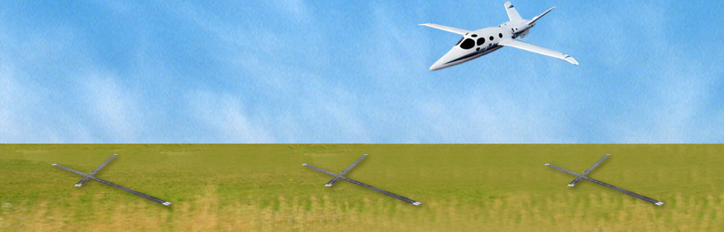

Knowledge Check
100 MILES
FL180
FL180
Destination
Napa Weather Station
Oakland Weather Station
Which altimeter setting should be issued?
Destination
Napa
Oakland

Slide 7
Altitude for Direction of Flight
Below 3,000’ Above Ground Level (AGL)
Assign any altitude for any direction of flight
At and below FL410
On course of 0 through 179 degrees magnetic, use odd cardinal altitudes
NOTE: Mnemonic “NEOD” - North/East Odd
On course of 180 through 359 degrees magnetic, use even cardinal altitudes
NOTE: Mnemonic “SWEVEN” - South/West Even

Slide 8
RVSM Procedures
RVSM airspace is exclusively for RVSM capable aircraft
Certain approved types of non-RVSM aircraft may be accommodated workload permitting
Aircraft not approved for RVSM operations may transition through RVSM airspace to operate above or below it
Apply appropriate separation standards and remove any aircraft from RVSM airspace that advises unable RVSM due to equipment

Slide 9
VFR-On-Top Altitudes
Aircraft operating VFR-On-Top (OTP) more than 3,000’ AGL, up to but not including FL180
On course 0 through 179 degrees magnetic:
Odd cardinal altitudes plus 500’
On course 180 through 359 degrees magnetic:
Even cardinal altitudes plus 500’

Slide 10
Exceptions to Flight Direction Rule
With prior approval from the affected sector or facility, you may assign an altitude regardless of flight direction when:
Traffic conditions prevent the assignment of an appropriate altitude
Aircraft is experiencing meteorological conditions such as icing, turbulence, or weather activity
Military aircraft is operating on a random route
Pilot informs you the available appropriate altitude exceeds the aircraft’s operational limitations

Slide 11
Knowledge Check
An IFR aircraft is flying a magnetic course of 330 degrees; what is an appropriate altitude for direction of flight?
7,000’
7,500’
8,000’

Slide 12
Altitude Assignment Phraseology
“DELTA TEN, MAINTAIN ONE THREE THOUSAND UNTIL ONE EIGHT ONE TWO, CLIMB AND MAINTAIN ONE FIVE THOUSAND, TIME ONE EIGHT ONE ZERO”
“AMERICAN TWO FIFTY, CLIMB AND MAINTAIN FLIGHT LEVEL TWO SEVEN ZERO”
“NOVEMBER TWO TWO LIMA, CRUISE SIX THOUSAND”
“SKYMASTER FIVE ONE PAPA, CROSS RED BLUFF AT OR ABOVE ONE FOUR THOUSAND, MAINTAIN ONE SIX THOUSAND”

Slide 13
Pilot’s Discretion
Pilot’s Discretion Examples:
“AMERICAN TEN, DESCEND AT PILOT’S DISCRETION, MAINTAIN ONE TWO THOUSAND”
“SOUTHWEST FIVE TWELVE, DESCEND NOW TO FLIGHT LEVEL TWO EIGHT ZERO, THEN DESCEND AT PILOT’S DISCRETION TO FLIGHT LEVEL TWO ZERO ZERO”
Cancelling Pilot’s Discretion:
“SPEEDBIRD TWO, AMEND ALTITUDE MAINTAIN FLIGHT LEVEL TWO FOUR ZERO”

Slide 14
Block Altitudes
Allows the assignment of more than one altitude to an aircraft
When issuing a block altitude, issue the lower altitude first
Example: “ASPEN ONE TWO, MAINTAIN BLOCK ONE TWO THOUSAND THROUGH ONE FOUR THOUSAND”

Slide 15
Vertical Navigation SIDs/STARs
Vertical Navigation (VNAV) - A function of area navigation (RNAV) equipment which calculates, displays, and provides vertical guidance to a profile or path
When assigned, allow the pilot to climb or descend via an assigned procedure while complying with any crossing restrictions and/or assigned speeds published in the procedure

Slide 16

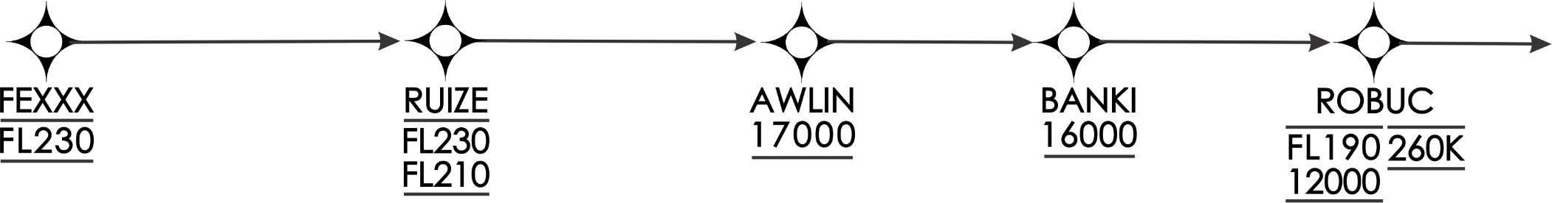
Vertical Navigation SIDs/STARs
FL230
FL230
RUIZE
FL210
FEXXX
AWLIN
FL190
17000
BANKI
16000
“…DESCEND VIA ROBUC THREE ARRIVAL”
ROBUC
12000
260K

Slide 17
Vertical Navigation SIDs/STARs
FL230
FL230
RUIZE
FL210
FL220
FEXXX
“…DESCEND VIA ROBUC THREE ARRIVAL, EXCEPT CROSS AWLIN AT FLIGHT LEVEL TWO TWO ZERO”
AWLIN
FL190
17000
BANKI
16000
ROBUC
12000
260K

Slide 18
Time to Climb or Descend
When a time restriction is issued on a climb or descent:
Reference the UTC clock reading with a time check
If issued through an authorized communications provider, such as Flight Service, advise the operator to issue the current time to the pilot

Slide 19
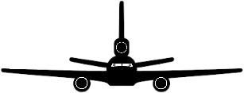
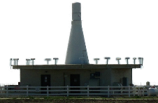
Altitude Assignment
FL290
“UNITED TEN CAN’T MAKE THAT RESTRICTION”
FL250
“UNITED TEN DESCEND AND MAINTAIN FIGHT LEVEL TWO FIVE ZERO”
FL250
FL240
FL230
“UNITED TEN DESCEND AND MAINTAIN FLIGHT LEVEL TWO FIVE ZERO”
“UNITED TEN CROSS LINCOLN AT AND MAINTAIN FLIGHT LEVEL TWO THREE ZERO”
LNK
VORTAC

Slide 20
Anticipated Altitude Change
Active SAA FL180 and above
17,000’
“…EXPECT HIGHER IN TWO ZERO MILES”
Inform aircraft when to:
Expect climb/descent clearance
Request altitude change from another facility

Slide 21
Knowledge Check
Which is the phraseology for issuing more than one altitude to a single aircraft?
“MAINTAIN FIVE THOUSAND THROUGH SEVEN THOUSAND”
“MAINTAIN BLOCK TWO THOUSAND TO FIVE THOUSAND”
“MAINTAIN BLOCK SIX THOUSAND THROUGH EIGHT THOUSAND”

Slide 22
Altitude Confirmation - Nonradar
Request the pilot to confirm assigned altitude:
On initial contact
On each position report
Exceptions:
The pilot states the assigned altitude on initial contact
If assigning a new altitude to a climbing or descending aircraft

Slide 23
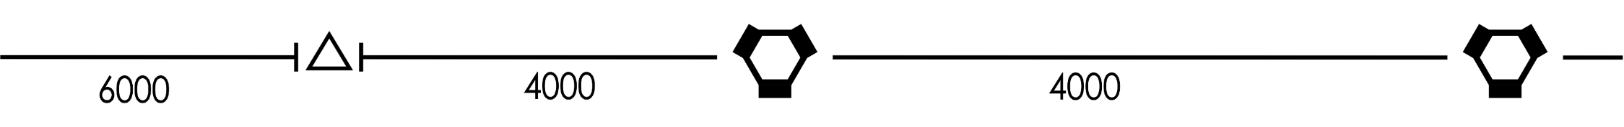
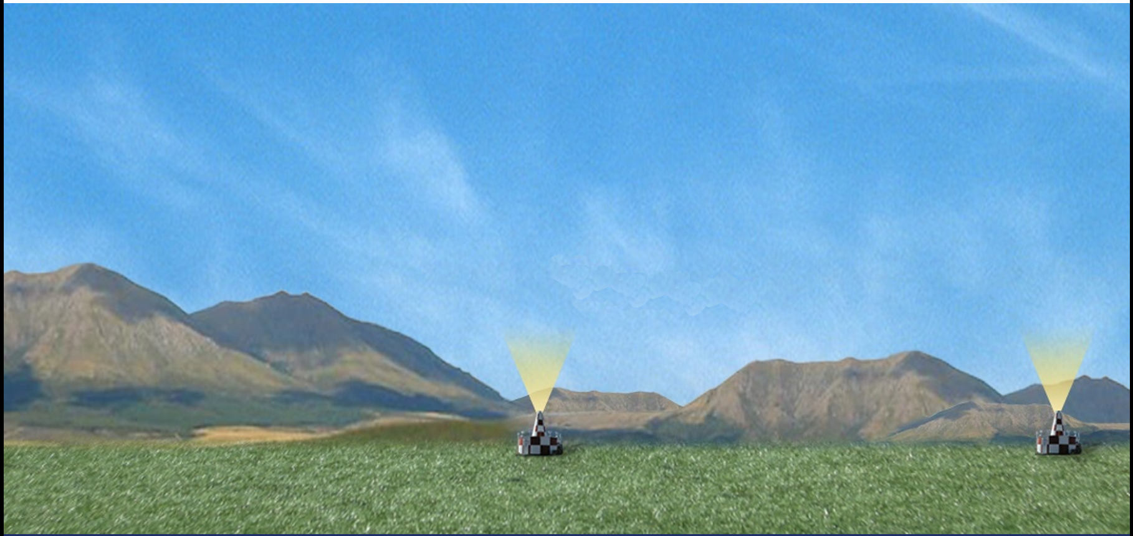
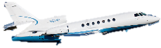
Minimum En Route IFR Altitude (MEA)
MEA changes NOT at NAVAIDs
MEA 6000
MEA 4000

Slide 24
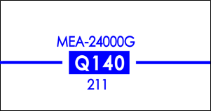
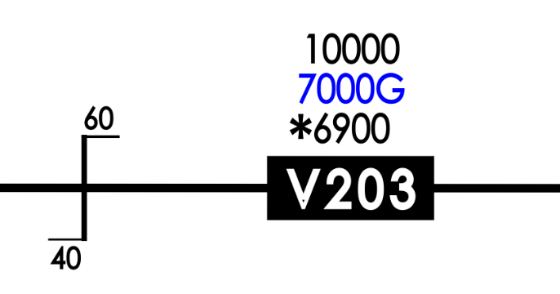
Global Navigation Satellite System (GNSS) MEA
Minimum IFR altitude on ATS routes which ensures GNSS reception and obstacle clearance requirements

Slide 25
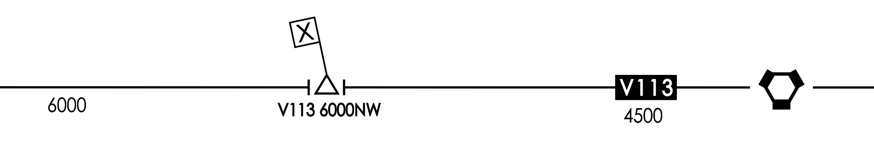

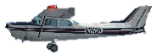
Minimum Crossing Altitude (MCA)
X
MEA 6000
V113 MCA
6000 NW
V113
MEA 4500

Slide 26

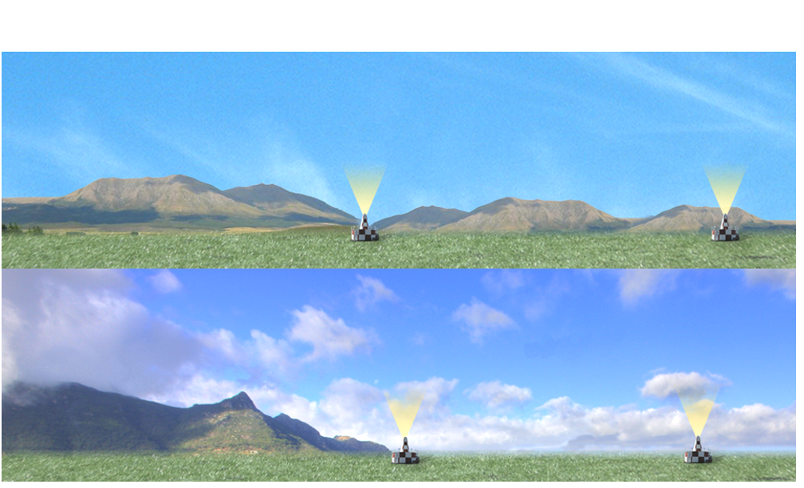

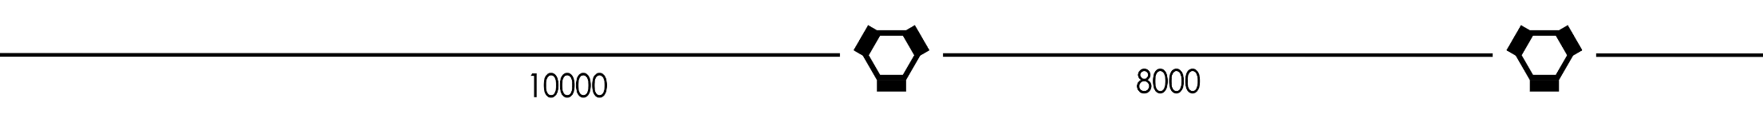

MEA for Route Segment without MCAs
MEA 6000
MEA 4000
MEA 10000
MEA 8000

Slide 27


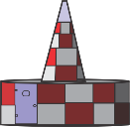
Minimum Obstruction Clearance Altitude (MOCA)
Nonradar Procedures usable here
MEA 5500
22 NM
MOCA 2800
NAVAID reception not assured in this area

Slide 28
Knowledge Check
What two actions must be taken when clearing an aircraft to the MOCA while using radar procedures?
Provide altitude instructions and issue alternate routing
Provide radar guidance and issue lost communication procedures
Provide traffic information and issue alternate routing

Slide 29
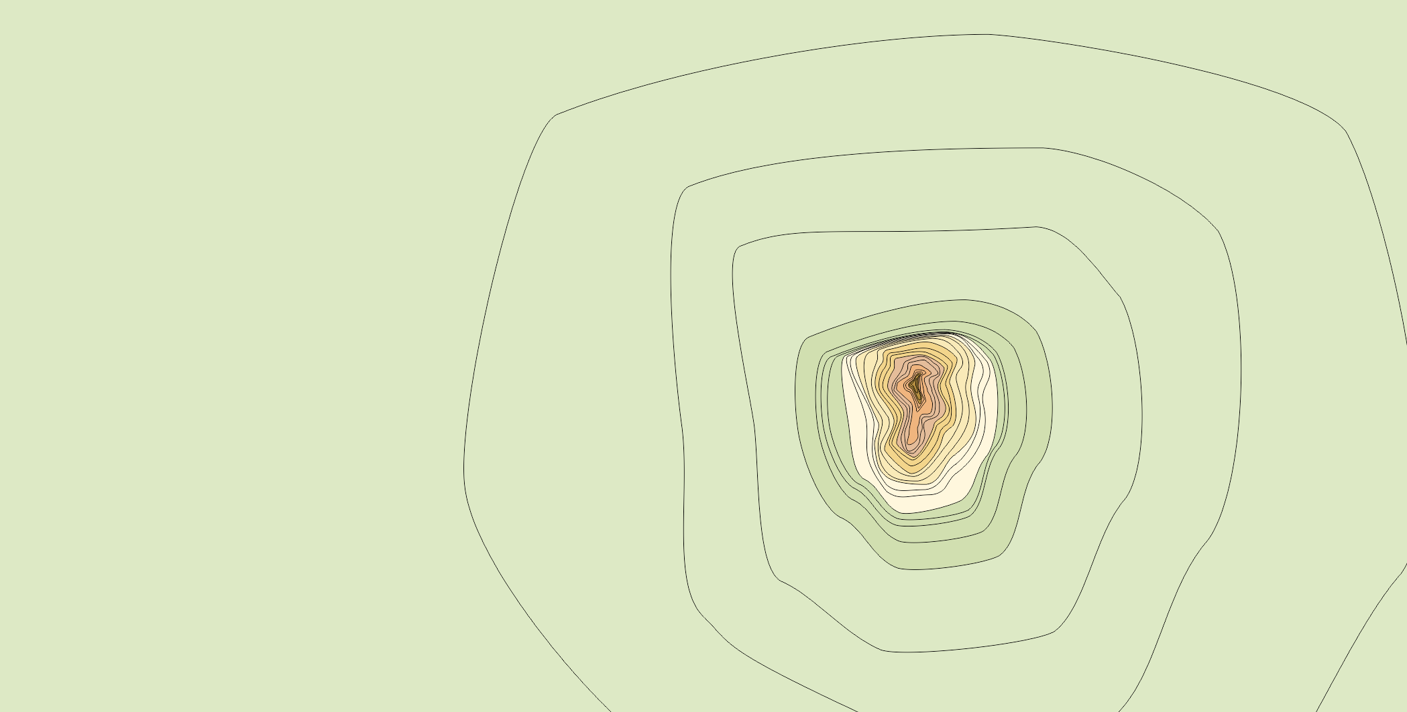
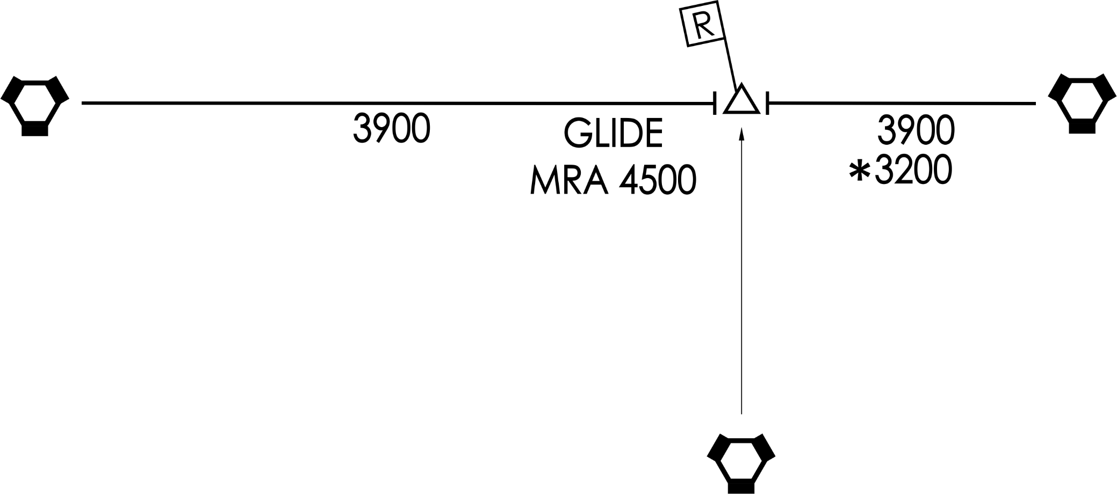
Minimum Reception Altitude (MRA)

Slide 30
Knowledge Check
When may an aircraft be cleared to the lower MEA along a route segment?
Prior to reaching the fix where the lower MEA applies
Within 22 NM of the NAVAID where the lower MEA applies
When the aircraft is over or past the fix where the lower MEA applies

Slide 31
No MEA Established
Clear aircraft at or above the Minimum Safe Altitude (MSA) for IFR operations prescribed by CFR 91.177
Mountainous areas
2,000’ above the highest obstacle within a horizontal distance of 4 NM from the course being flown
Any other areas
1,000’ above the highest obstacle within a horizontal distance of 4 NM from the course being flown

Slide 32
Knowledge Check
When no MCA is established, when must an aircraft be cleared to climb to meet a higher MEA?
Prior to, or immediately after passing the fix where the new MEA applies
Only after crossing the fix where the new MEA applies
Only before crossing the fix where the new MEA applies

Slide 33
Knowledge Check
When no MEA is established for a route segment, how can you ensure an aircraft cleared on that route would meet obstacle clearance requirements?
Clear the aircraft at or above the MSA
Clear the aircraft at or above the MCA
Reroute the aircraft

Slide 34
Lesson Summary
This lesson covered:
Procedures for issuing altimeter settings
Requirements for altitude assignments
Phraseology for altitude assignments
Requirements for minimum altitudes

Slide 35

The End

