Slide 2
Clearance requirements
Procedures for departing IFR aircraft
Procedures for IFR clearances

Slide 3
ATC Clearances
Instructions issued by ATC to authorize flight within controlled airspace for the purpose of avoiding collision between known aircraft and/or terrain
Contains items such as:
Clearance limit
Route of flight
Altitude data

Slide 4
Clearance Structure
Issue the following clearance items, as appropriate, in the order listed below:
Aircraft ID
Clearance Limit
Standard Instrument Departure (SID)
Route of flight
Altitude data
Mach number
Holding instructions
Any special instructions
Frequency and beacon code information

Slide 5
Aircraft Identification
All clearances begin with the proper aircraft identification
Examples:
“DELTA TWENTY-TWO CLEARED…”
“KINGAIR FOUR FOUR HOTEL KILO CLEARED…”

Slide 6
Clearance Limit, Destination Airport
The point to which an aircraft is granted an air traffic control clearance
Normally the airport of intended landing
Include the airport name and the word “AIRPORT”
Examples:
“CLEARED TO DALLAS LOVE AIRPORT…”
“CLEARED TO SEDONA AIRPORT…”
“CLEARED TO LAGUARDIA AIRPORT…”

Slide 7
Clearance Limit, Intermediate Fix
Under certain conditions, a short range clearance is issued to a NAVAID, intersection, or waypoint
Include the type if known
If a delay is expected, issue complete holding instructions
If no delay expected, state NO DELAY EXPECTED
Examples:
“CLEARED TO YORK VORTAC, NO DELAY EXPECTED”
“CLEARED TO FORT UNION VORTAC HOLD NORTHEAST AS PUBLISHED…”

Slide 8
Standard Instrument Departure (SID)
Assign a SID
Include a transition if necessary
Example:
“STROUDSBURG ONE DEPARTURE”
“STROUDSBURG ONE DEPARTURE, SPARTA TRANSITION”

Slide 9
Route of Flight
The route to be flown based on the altitude requested by the pilot
Below FL180: Victor airways, T Routes
FL180 and above: Jet Routes, Q Routes
Any altitude: Course, heading, azimuth, arc, or vector
Also include:
Routing expected if any part of the route beyond a short range clearance limit differs from that filed
Example:
“…EXPECT DIRECT TAOS VORTAC VICTOR EIGHTY-THREE…”

Slide 10
Altitude Data
Issue altitude data in the order flown
If the altitude assigned is different from the altitude requested inform the pilot when to expect climb or descent clearance to the requested altitude

Slide 11
Mach Number
Assign speed adjustments using a Mach number, if applicable
Example:
“MAINTAIN MACH POINT SEVEN FOUR OR GREATER”
NOTE: The use of Mach numbers is restricted to turbojet aircraft with Mach meters.

Slide 12
Holding Instructions
Issue the following:
Clearance limit
If any part of the route beyond a clearance limit differs from the last routing cleared, issue the route the pilot can expect beyond the clearance limit
Holding instructions
May be eliminated when no delay is expected
Expect Further Clearance (EFC) time
Do not specify this item if no delay is expected

Slide 13
Special Information
Issue any special information needed

Slide 14
Frequency and Beacon Code Information
Frequency
Issue appropriate frequency
Time or location for contacting ATC
Beacon Code
Issue the Mode 3/A transponder code

Slide 15

Clearance Example
UNITED FIFTY-FIVE, CLEARED TO O’HARE AIRPORT VIA AKUNA SEVEN DEPARTURE MCALESTER SPRINGFIELD JAY 105 WELTS SHAIN ONE. CLIMB AND MAINTAIN FIVE THOUSAND, EXPECT FLIGHT LEVEL THREE ONE ZERO, ONE ZERO MINUTES AFTER DEPARTURE. CONTACT BRAVO CENTER ONE TWO FIVE POINT ZERO. SQUAWK THREE ONE SIX TWO.
Aircraft identification
Clearance limit
Standard Instrument Departure
Route of flight
Altitude data in order flown
Mach number, if applicable
Holding instructions, Any special instructions
Frequency
Beacon Code Information

Slide 16
Clearances to USAF Aircraft
When issuing a clearance to an airborne USAF aircraft containing an altitude assignment, do not include more than one of the following in the same transmission:
Frequency change
Transponder change
Heading
Altimeter setting
Traffic information containing an altitude

Slide 17
Knowledge Check
You are issuing a short range clearance to a departing aircraft with a different route than filed. Which statement is correct?
The pilot is responsible for further routing after the clearance limit
Have the new route ready and wait for the pilot to request the route
Include the new expected route in the clearance

Slide 18
Knowledge Check
Which phraseology example is correct when issuing a clearance limit?
"CLEARED TO DALLAS LOVE AIRPORT VIA...”
"CLEARED TO DALLAS LOVE FIELD VIA...”
"CLEARED TO DALLAS LOVE VIA…”

Slide 19
Knowledge Check
Which statement is correct concerning clearances to airborne USAF aircraft that contain an altitude?
Issue as many additional instructions as needed in the following order: frequency, transponder, heading, altimeter setting, traffic information containing an altitude
Do not include more than one of the following: frequency, transponder, heading, altimeter setting, traffic information containing an altitude
USAF aircraft have no restrictions

Slide 20
Knowledge Check
What is the proper order to issue altitude information in a departure clearance?
Issue starting at the requested altitude and work down
Issue in the order flown
Issue all the altitudes then include any restrictions

Slide 21
Knowledge Check
Which statement is correct about issuing a short range clearance limit?
Issue a short range clearance limit only when requested by the pilot
Issue short range clearances only in a radar environment
Issue complete holding instructions or “NO DELAY EXPECTED”

Slide 22
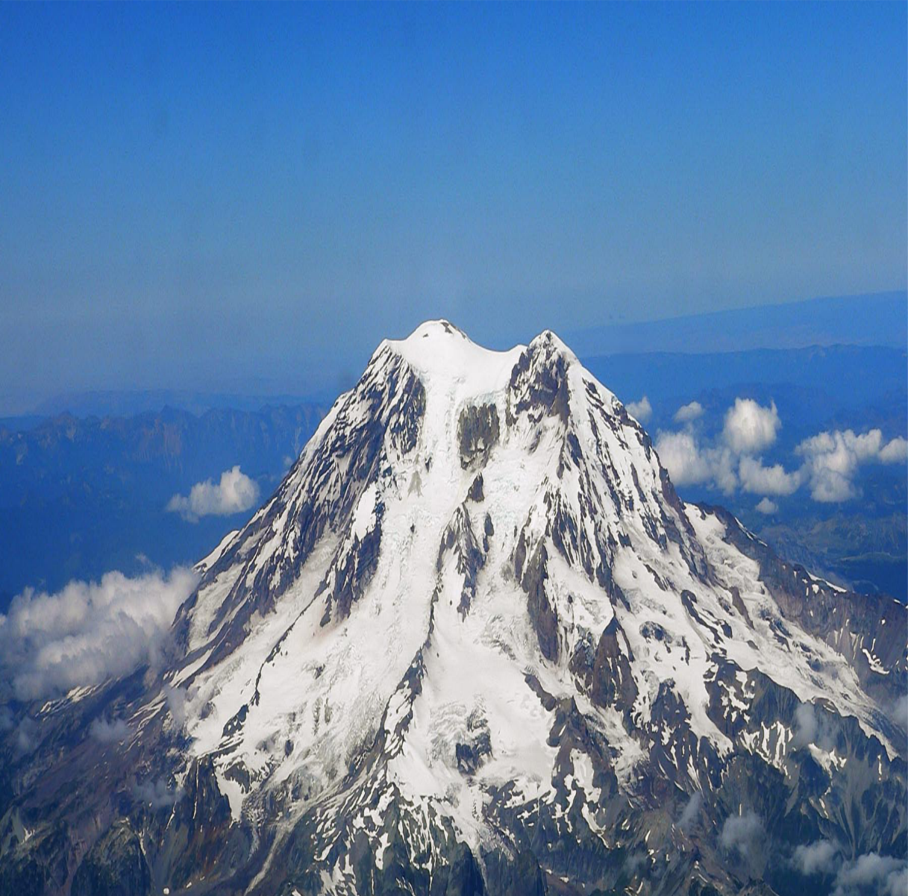
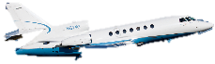



Prefix Clearances for Relay
“ATC CLEARS SKYLANE…”
Clearances are relayed verbatim
Prefix with:
“ATC CLEARS”
“ATC ADVISES”
“ATC REQUESTS”
FSS must prefix a clearance appropriately
“ATC CLEARS SKYLANE…”

Slide 23
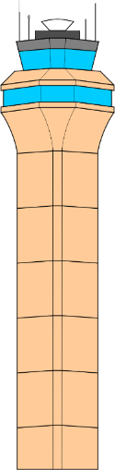

Departure Terminology
Avoid using:
“TAKEOFF”
Use these terms when necessary:
“DEPART”
“DEPARTURE”
“FLY”
Control Towers Only
“CLEARED FOR TAKEOFF RUNWAY…”

Slide 24
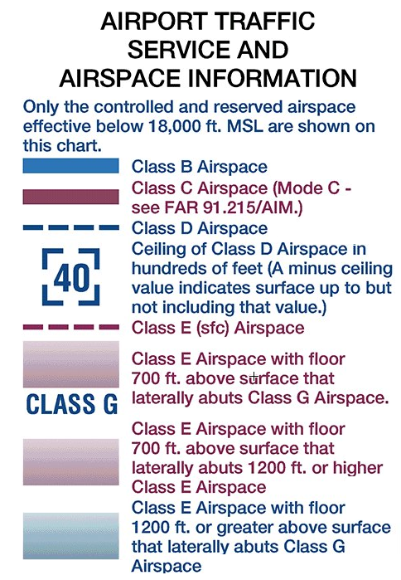
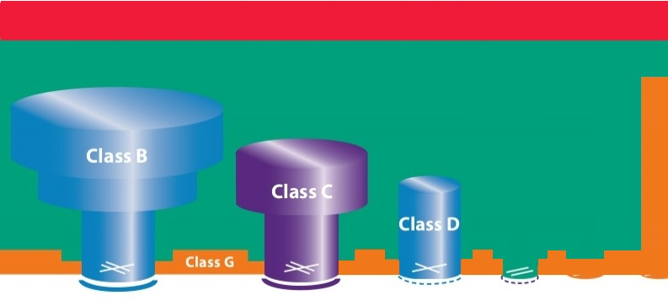
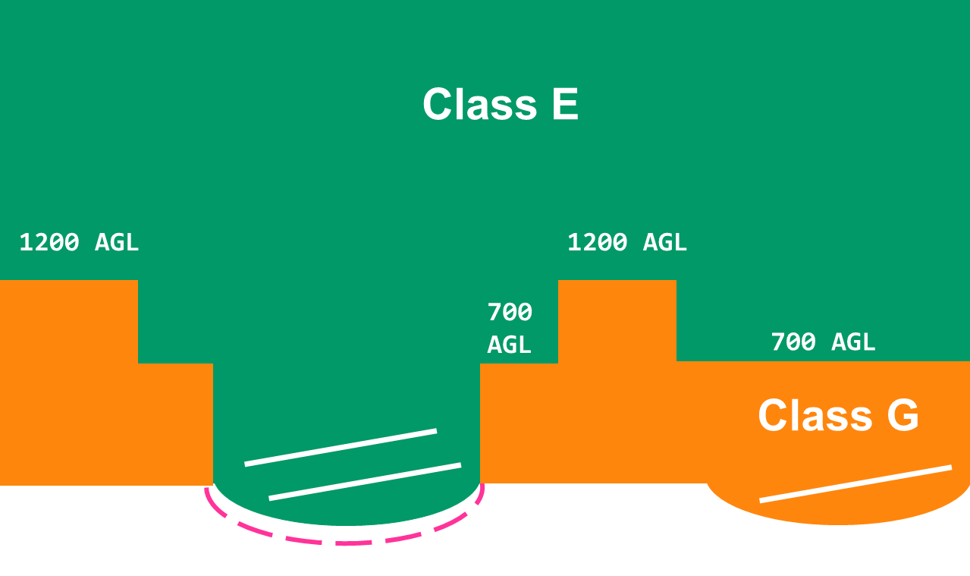

Airspace Review
FL 600
Class A
18,000 MSL
14,500 MSL
Class E
Class E surface Area
Class G
1200 AGL
700 AGL
Notes:
TIE-IN: …This is an expanded view showing how Class D/E Surface Areas are depicted on Sectional Charts

Slide 25
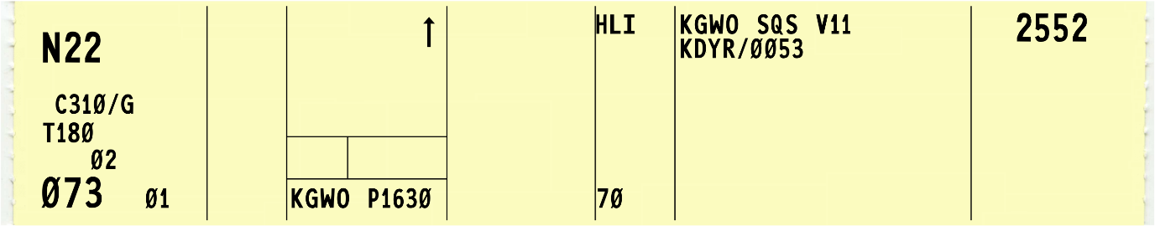
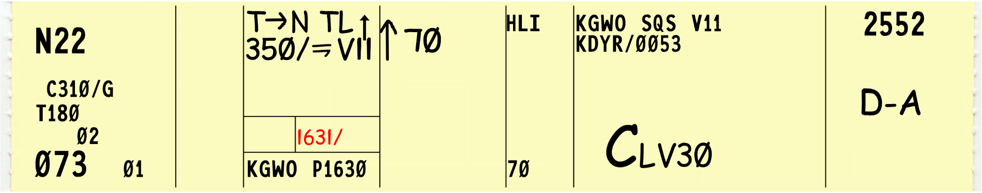
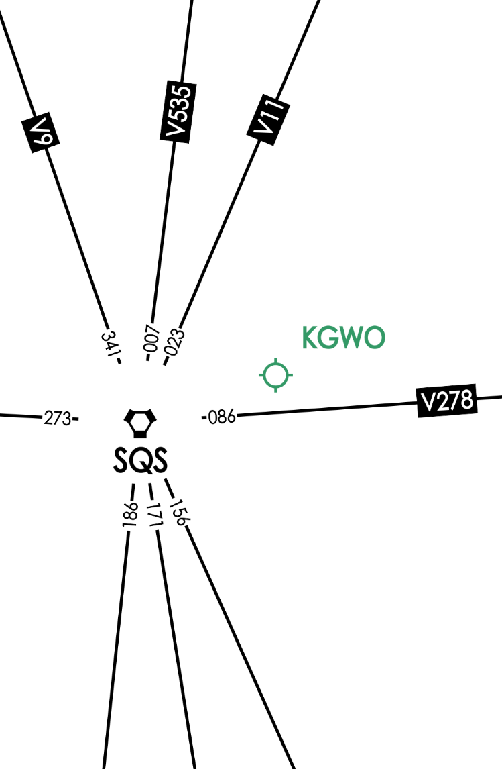
Departure Instructions: Class D
“TWIN CESSNA TWO TWO, CLEARED TO DYERSBURG AIRPORT VIA DEPART NORTH, TURN LEFT, FLY HEADING THREE FIVE ZERO UNTIL JOINING VICTOR ELEVEN, VICTOR ELEVEN DYERSBURG. CLIMB AND MAINTAIN SEVEN THOUSAND, CONTACT BRAVO CENTER ONE TWO FIVE POINT ZERO LEAVING THREE THOUSAND, SQUAWK TWO FIVE FIVE TWO.”
350°

Slide 26
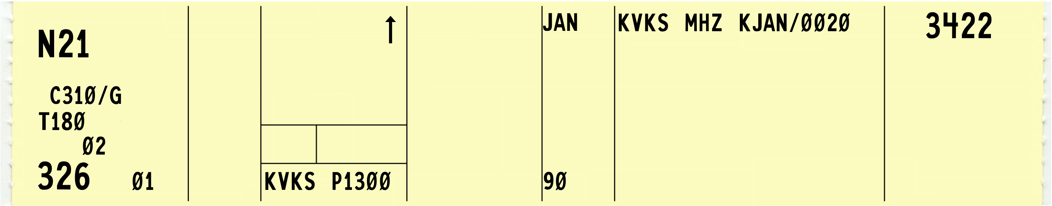
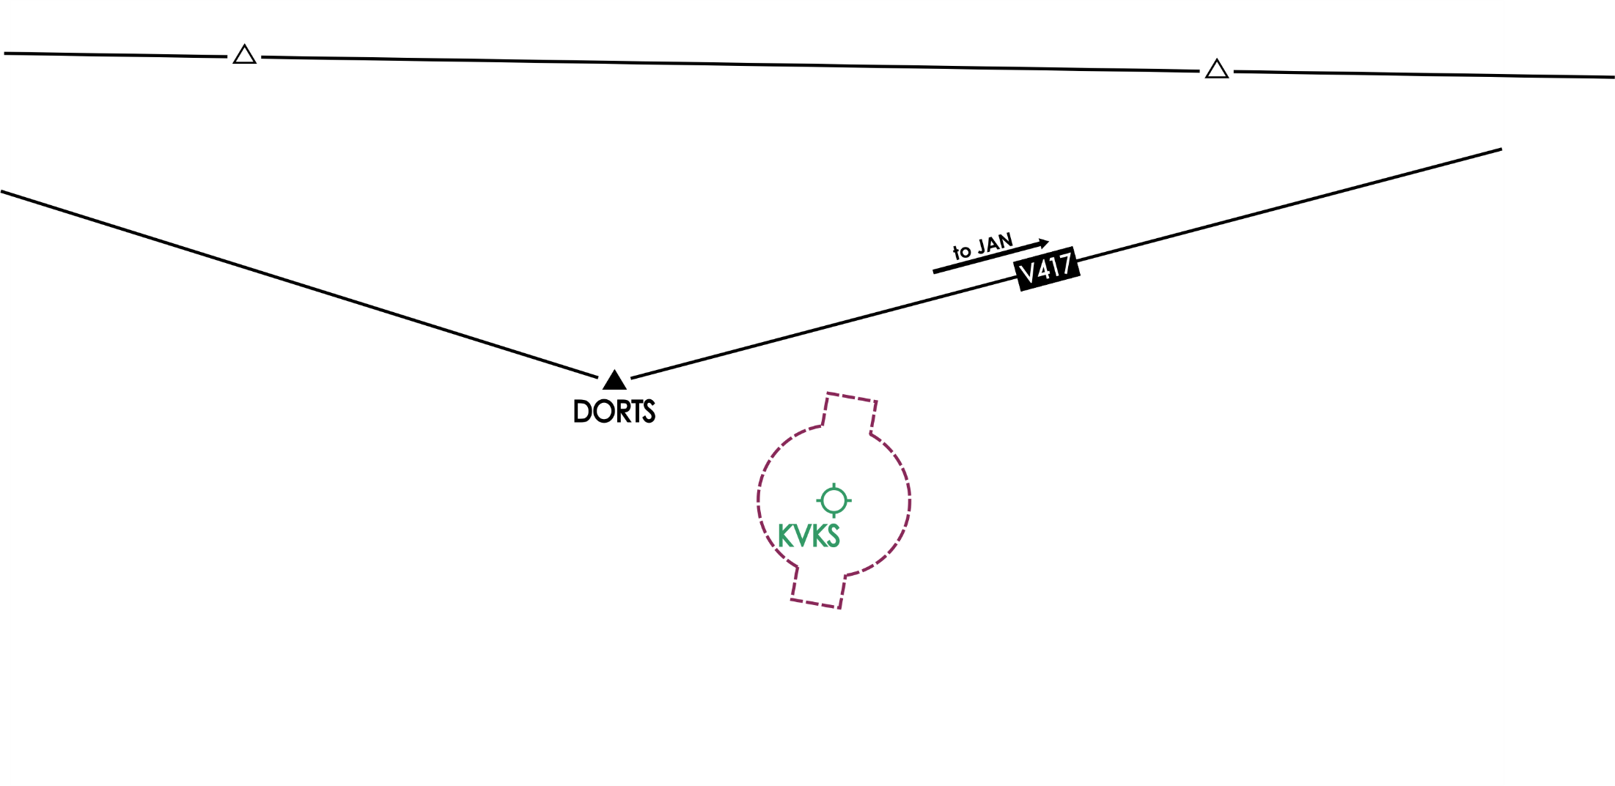
Class E Surface Area: Solicit Pilot Concurrence
FSS: “REQUEST CLEARANCE FOR CESSNA TWO ONE TO JACKSON”
Controller: “WILL CESSNA TWO ONE ACCEPT A NORTH DEPARTURE WITH TURNS?”
FSS: “AFFIRMATIVE”
Controller: “CLEARANCE…”

Slide 27
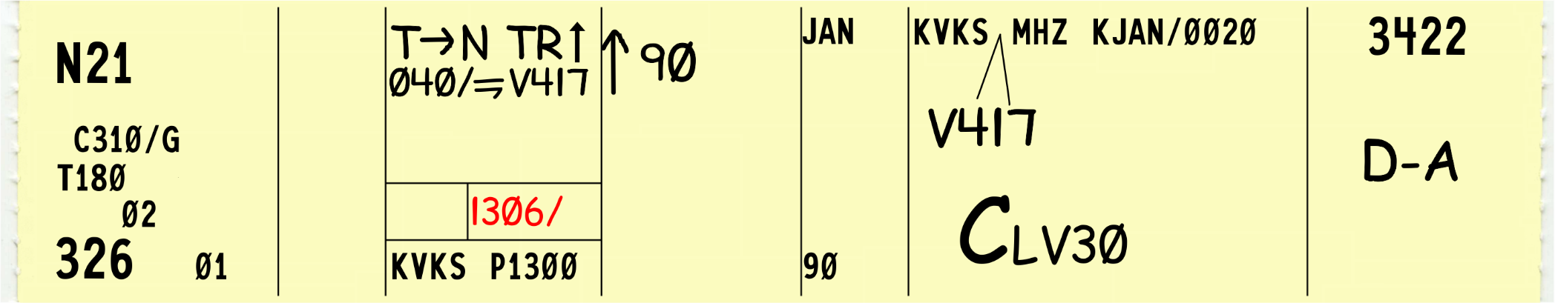
Class E Surface Area: Issue Clearance
“CESSNA TWO ONE CLEARED FROM VICKSBURG AIRPORT TO JACKSON AIRPORT VIA DEPART NORTH, TURN RIGHT, FLY HEADING ZERO FOUR ZERO UNTIL JOINING VICTOR FOUR SEVENTEEN, VICTOR FOUR SEVENTEEN MAGNOLIA VORTAC, THEN AS FILED. CLIMB AND MAINTAIN NINER THOUSAND. CONTACT BRAVO CENTER ONE TWO FIVE POINT ZERO LEAVING THREE THOUSAND. SQUAWK THREE FOUR TWO TWO. ADVISE CESSNA TWO ONE RELEASED FOR DEPARTURE.”

Slide 28
Class E Surface Area: Verify Clearance
“CESSNA TWO ONE CLEARED FROM VICKSBURG AIRPORT TO JACKSON AIRPORT VIA DEPART NORTH, TURN RIGHT, FLY HEADING ZERO FOUR ZERO UNTIL JOINING VICTOR FOUR SEVENTEEN, VICTOR FOUR SEVENTEEN MAGNOLIA VORTAC, THEN AS FILED. CLIMB AND MAINTAIN NINER THOUSAND. CONTACT BRAVO CENTER ONE TWO FIVE POINT ZERO LEAVING THREE THOUSAND. SQUAWK THREE FOUR TWO TWO. VERIFY THIS CLEARANCE WILL ALLOW COMPLIANCE WITH TERRAIN OR OBSTRUCTION AVOIDANCE.”

Slide 29
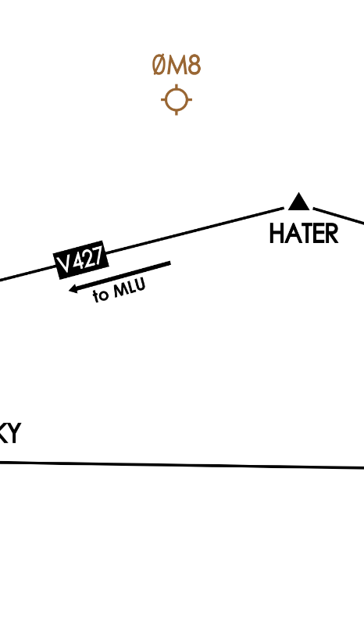
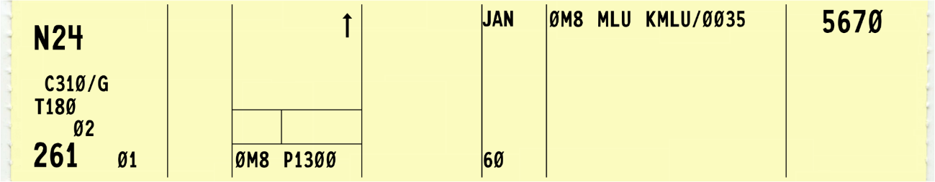
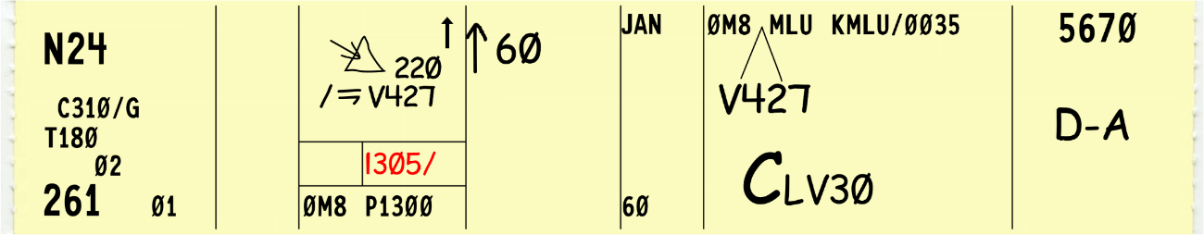
Departure Instructions: Other Airports
“CESSNA TWO FOUR CLEARED FROM LAKE PROVIDENCE AIRPORT TO MONROE AIRPORT. WHEN ENTERING CONTROLLED AIRSPACE, FLY HEADING TWO TWO ZERO UNTIL JOINING VICTOR FOUR TWENTY-SEVEN, VICTOR FOUR TWENTY-SEVEN. CLIMB AND MAINTAIN SIX THOUSAND. CONTACT BRAVO CENTER ONE TWO FIVE POINT ZERO LEAVING THREE THOUSAND. SQUAWK FIVE SIX SEVEN ZERO. VERIFY THIS CLEARANCE WILL ALLOW COMPLIANCE WITH TERRAIN OR OBSTRUCTION AVOIDANCE.”

Slide 30
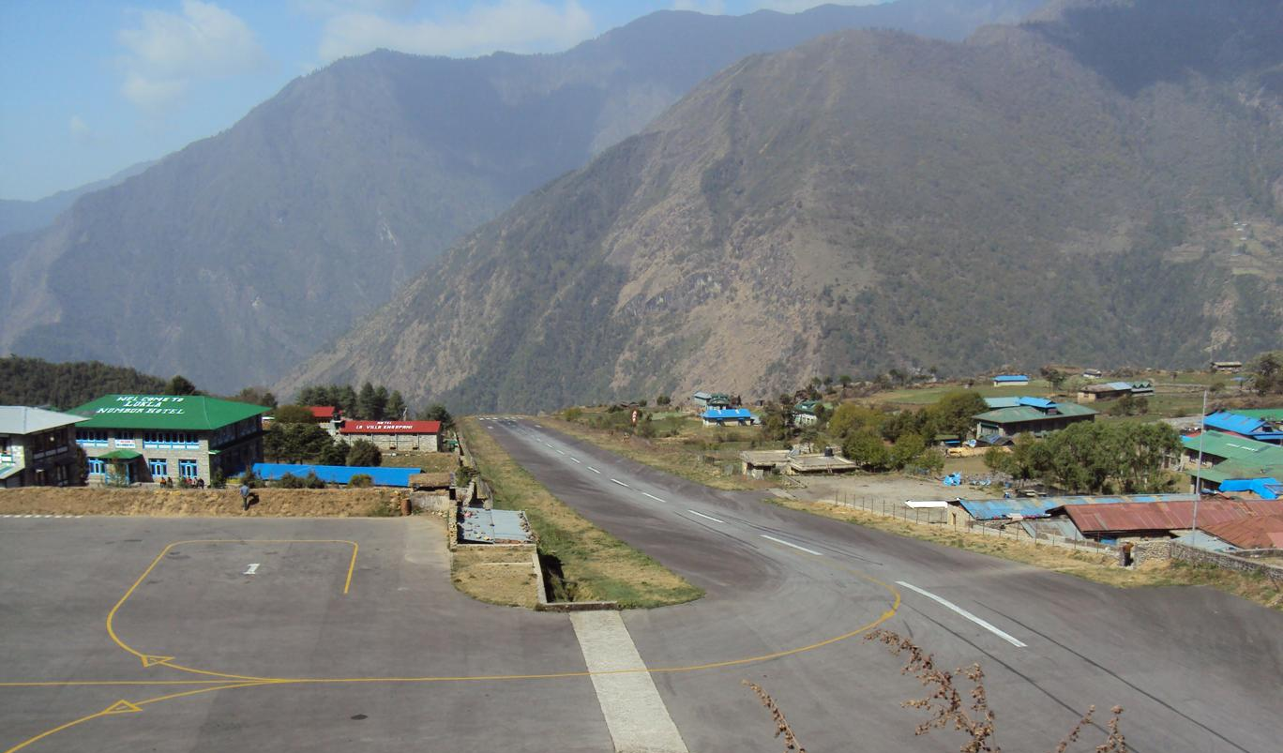
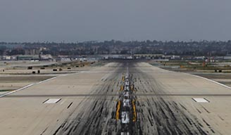
Instrument Departure Procedures
Some airports have few obstructions
Others are more hazardous

Slide 31

Instrument Departure Procedures (Cont’d)
Preplanned IFR procedures provide obstruction clearance from the terminal area to the en route structure
Obstacle Departure Procedures (ODP)
Printed textually or graphically
May be flown without clearance
Standard Instrument Departures (SID)
Always printed graphically
Provide obstruction clearance
ATC clearance must be received prior to flying

Slide 32
Visual Climb Over Airport (VCOA)
Used in VMC equal to or greater than the specified visibility and ceiling
Allows climbing turns over the airport to the published “at or above” altitude
If an ODP is included in the clearance and VCOA is requested by the pilot or assigned by ATC when it is the only procedure published in the ODP, include an instruction to remain within the published visibility of the VCOA

Slide 33
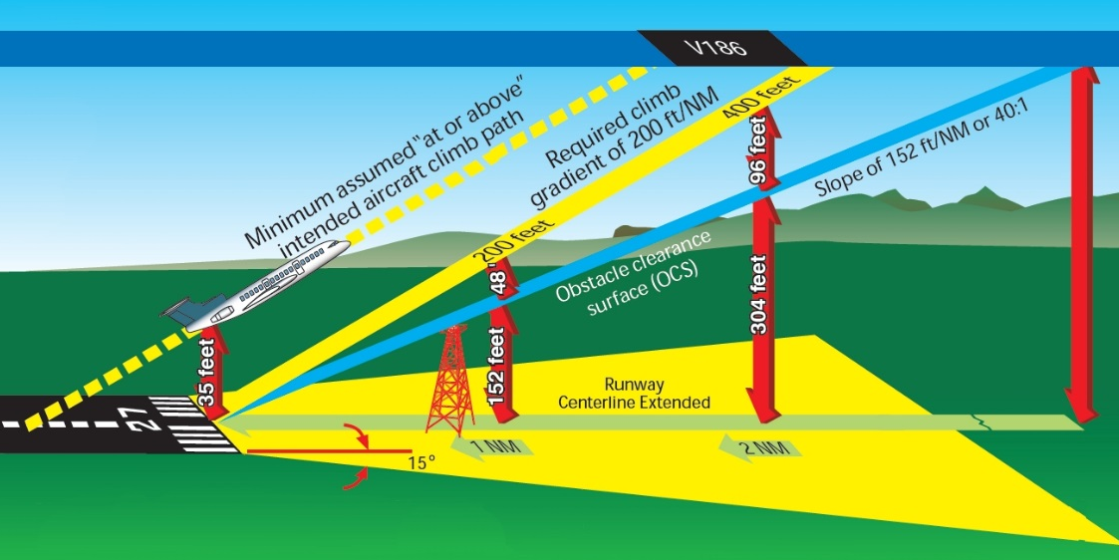
Aircraft Performance Expectations

Slide 34
ODP Examples
KVKS - Vicksburg Municipal Airport, Mississippi
KJAC - Jackson Hole Airport, Wyoming
KRUT - Rutland Regional Airport, Vermont

Slide 35
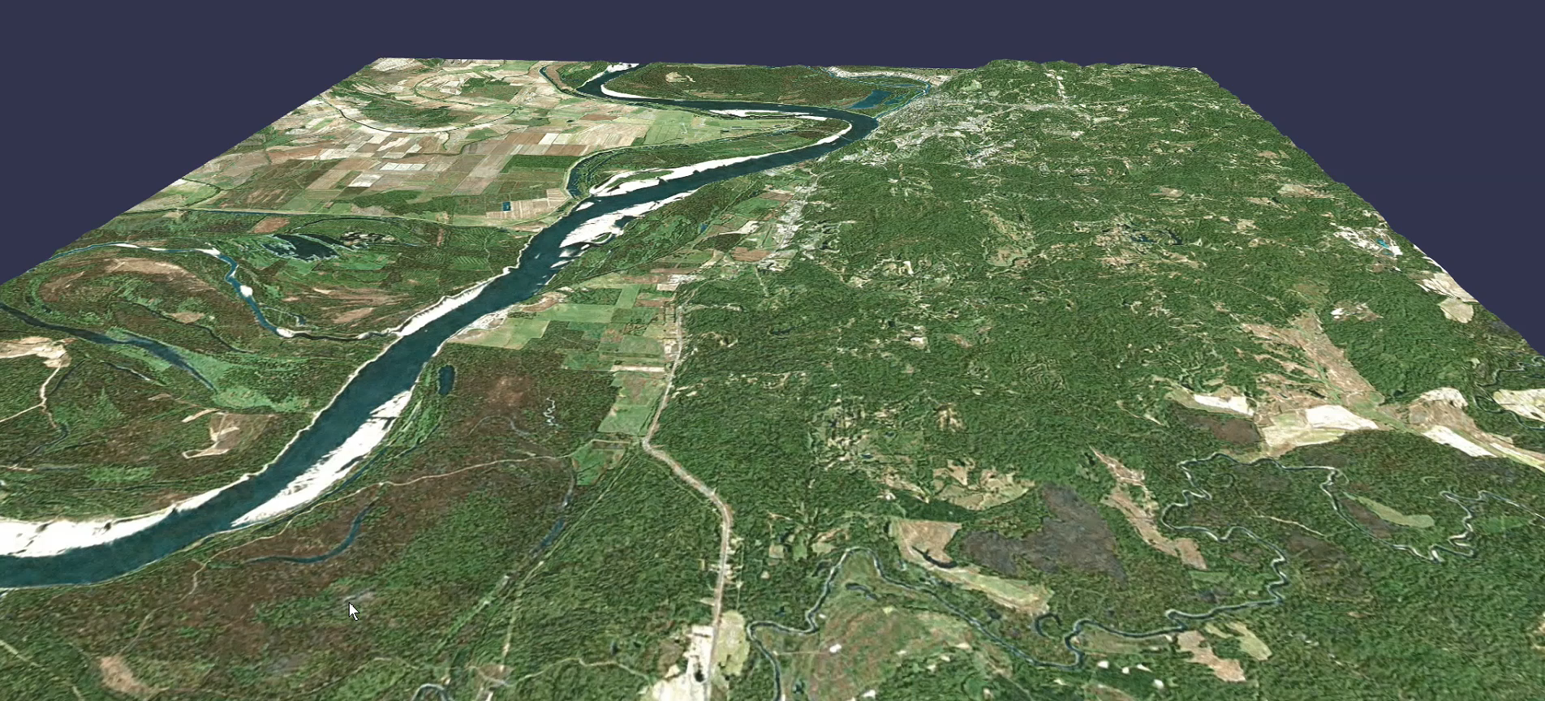
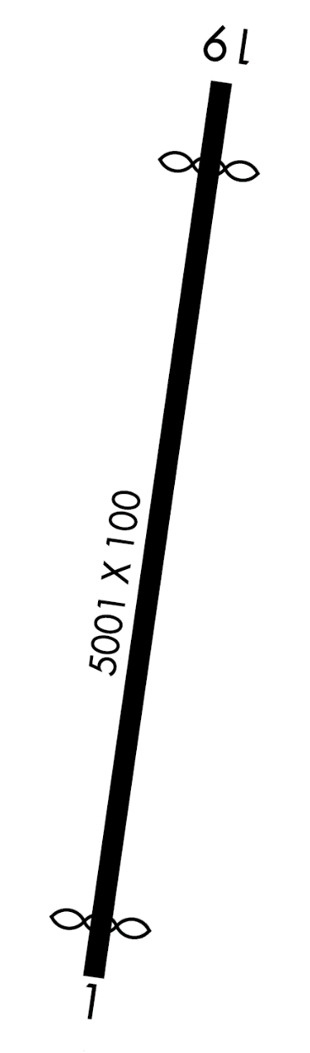
Higher Takeoff Minimums, VCOA - KVKS
VICKSBURG, MS
VICKSBURG MUNI (VKS)
TAKEOFF MINIMUMS AND (OBSTACLE)
DEPARTURE PROCEDURES
AMDT 3 08NOV18 (18312) (FAA)
TAKEOFF MINIMUMS:
Rwy 1, std. w/min. climb of 290’ per NM to 800
or 900 2-1/2 for VCOA. Rwy 19, 300-2 or std.
w/min. climb of 425’ per NM to 400.
VCOA: Rwy 1, obtain ATC approval for VCOA
when requesting IFR clearance. Climb in
visual conditions to cross Vicksburg Muni
airport at or above 900 before proceeding
on course.
Vicksburg Municipal Runway

Slide 36
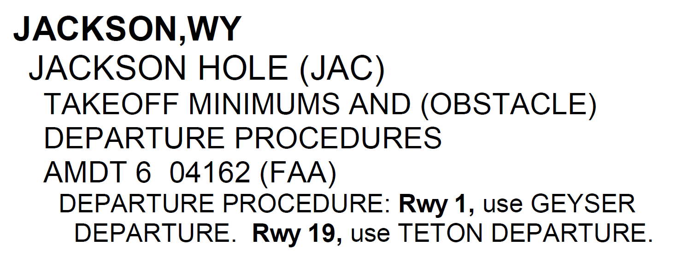
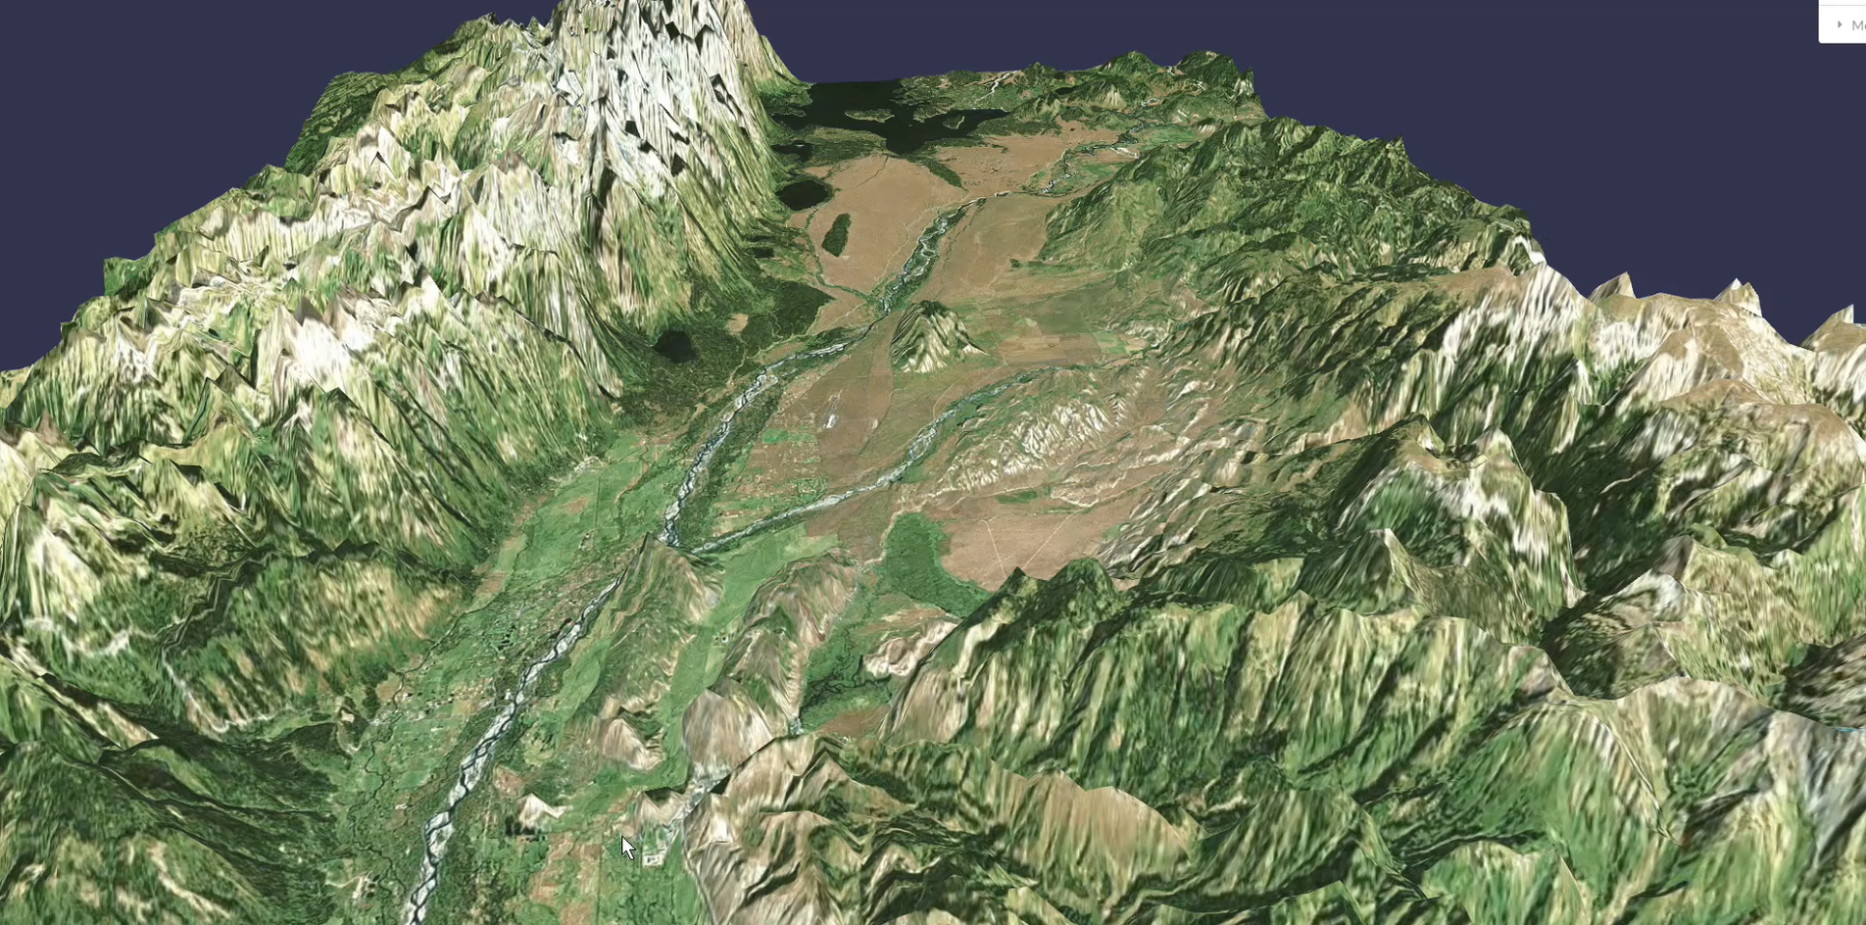
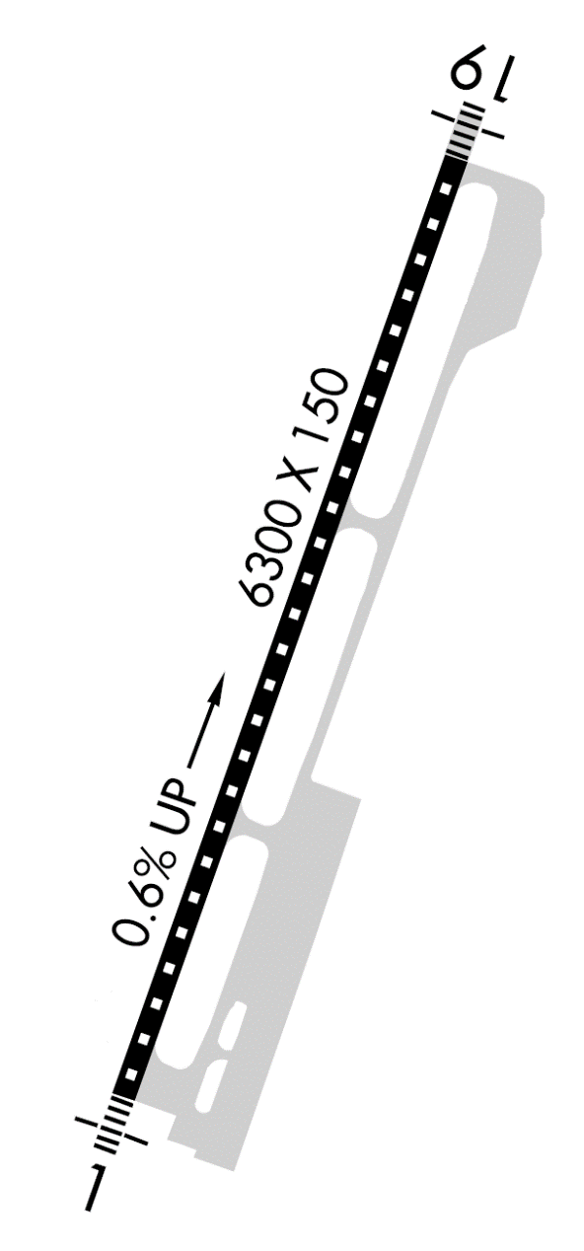
Charted DP and SID - KJAC
Jackson Hole Runway

Slide 37
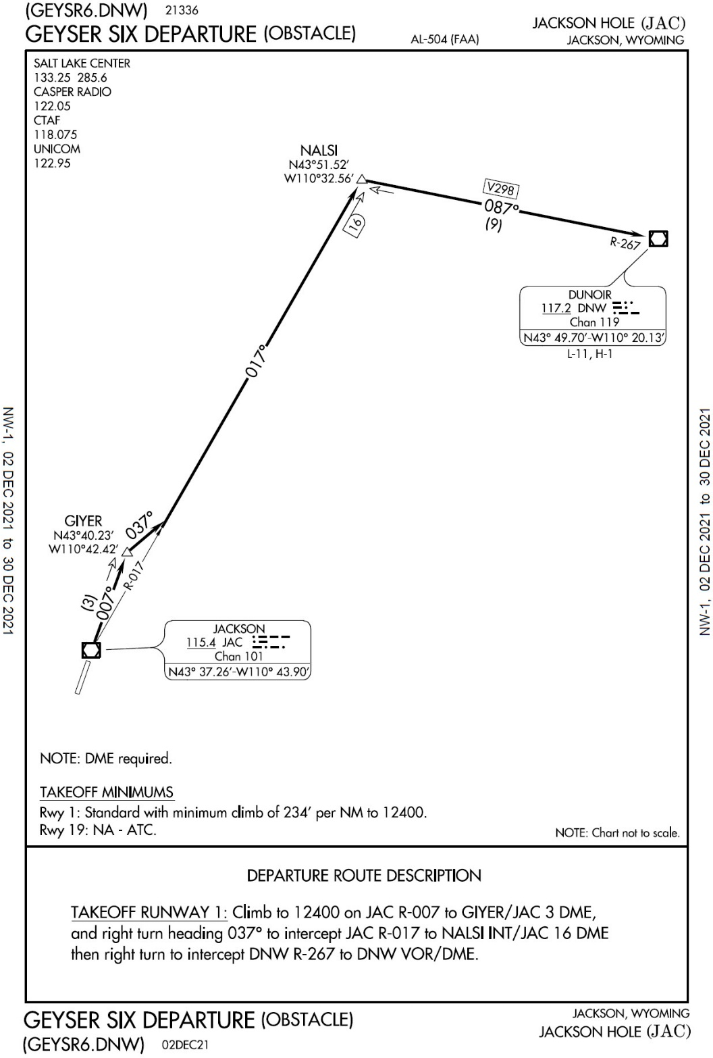
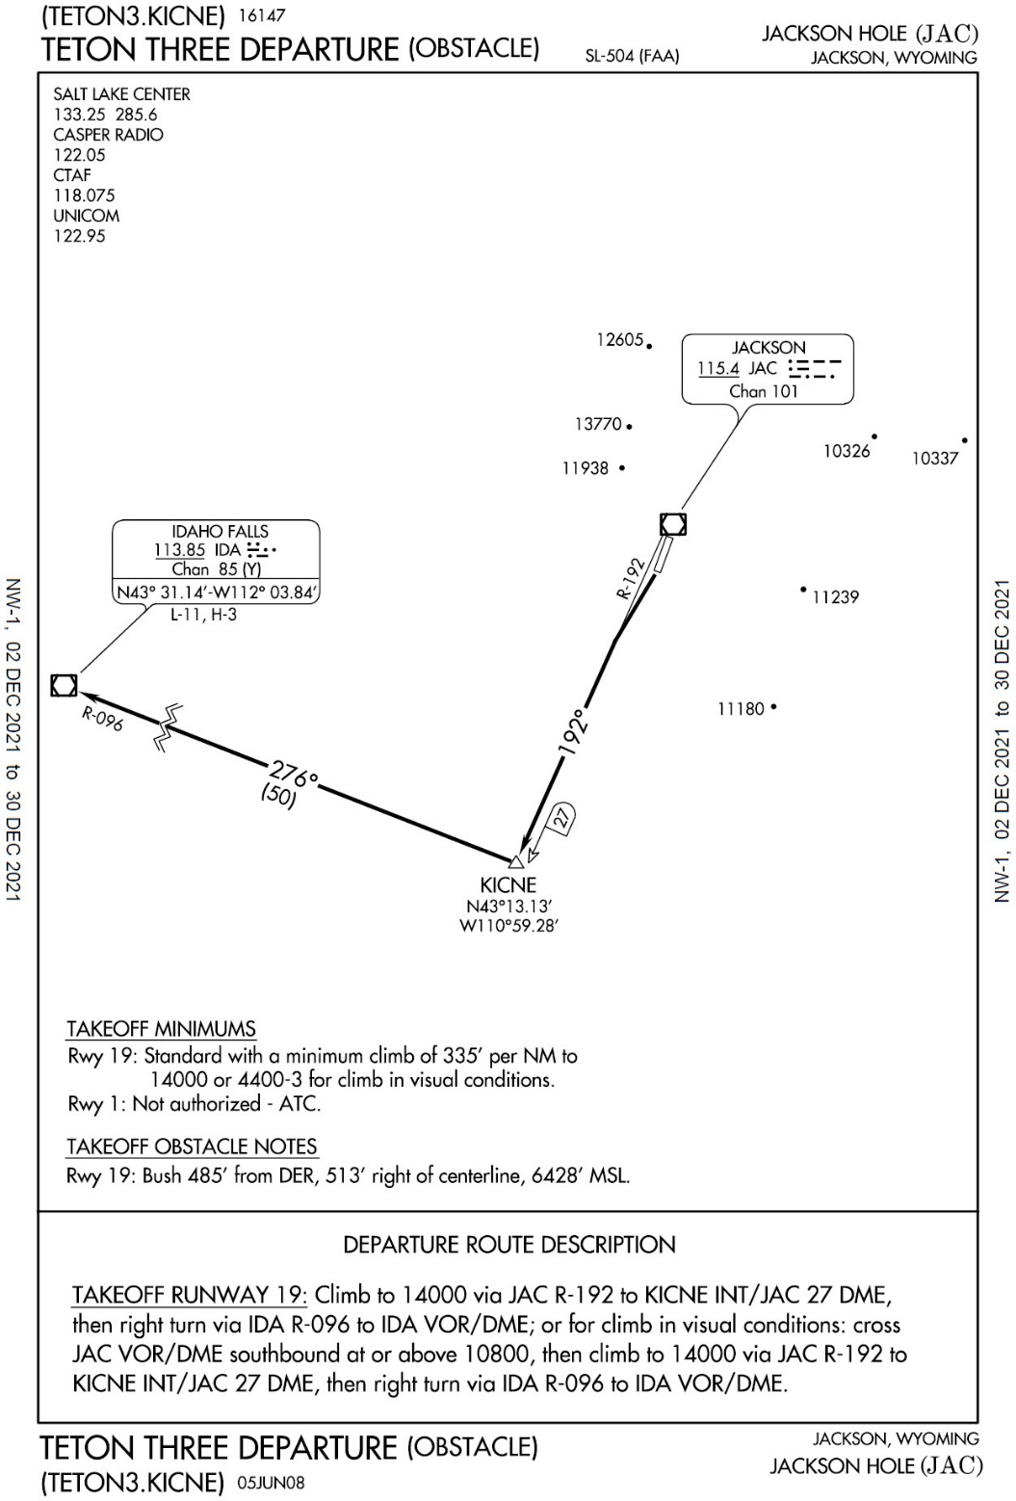
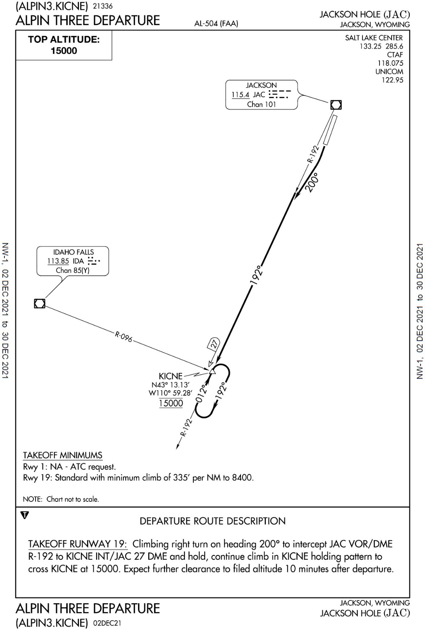
Charted DP and SID - KJAC
(GEYSR6.NALSI) 21336
GEYSR SIX DEPARTURE (OBSTACLE)
(TETON3.KICNE) 16147
TETON THREE DEPARTURE (OBSTACLE)
(ALPIN3.KICNE) 21336
ALPIN THREE DEPARTURE

Slide 38
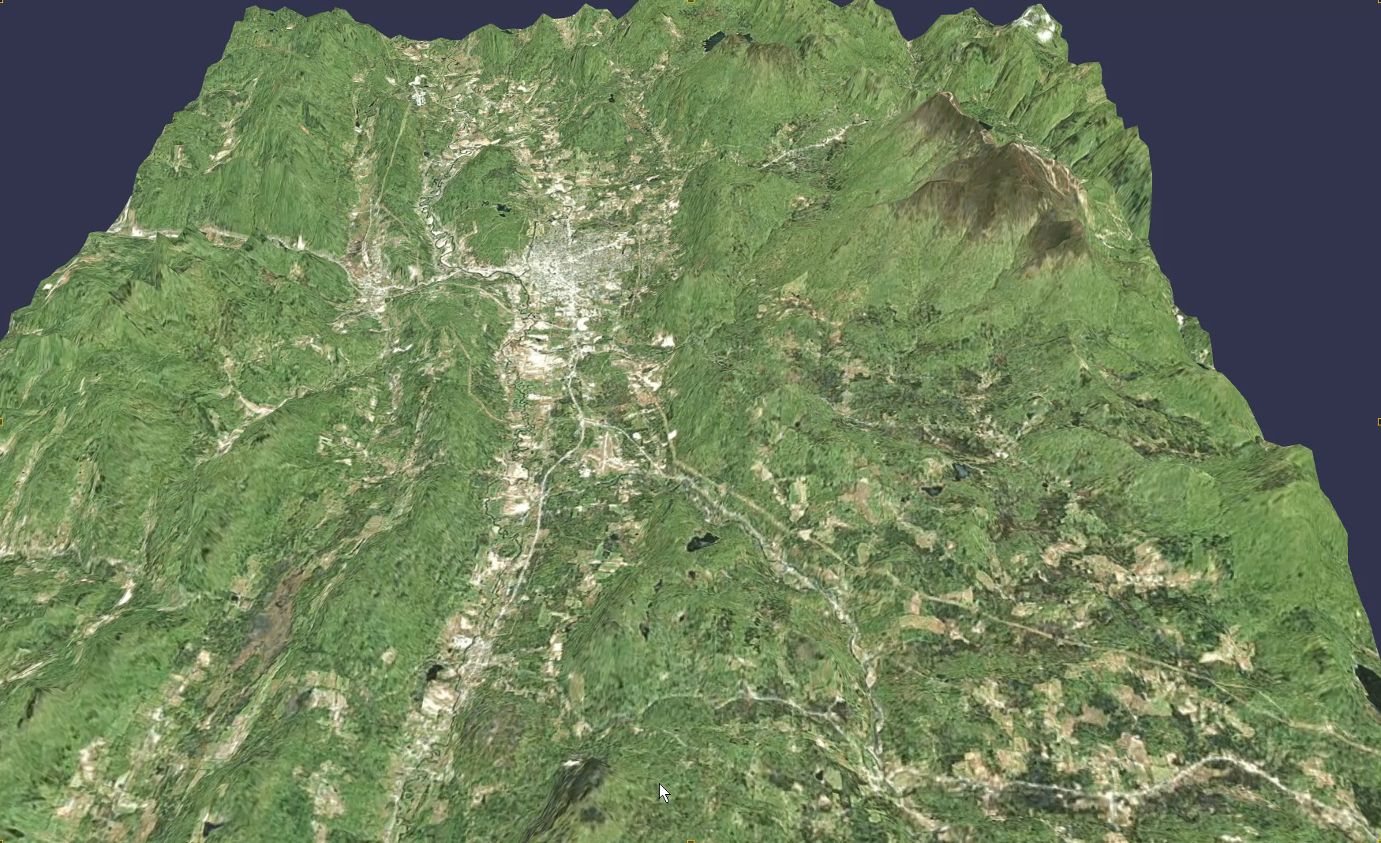
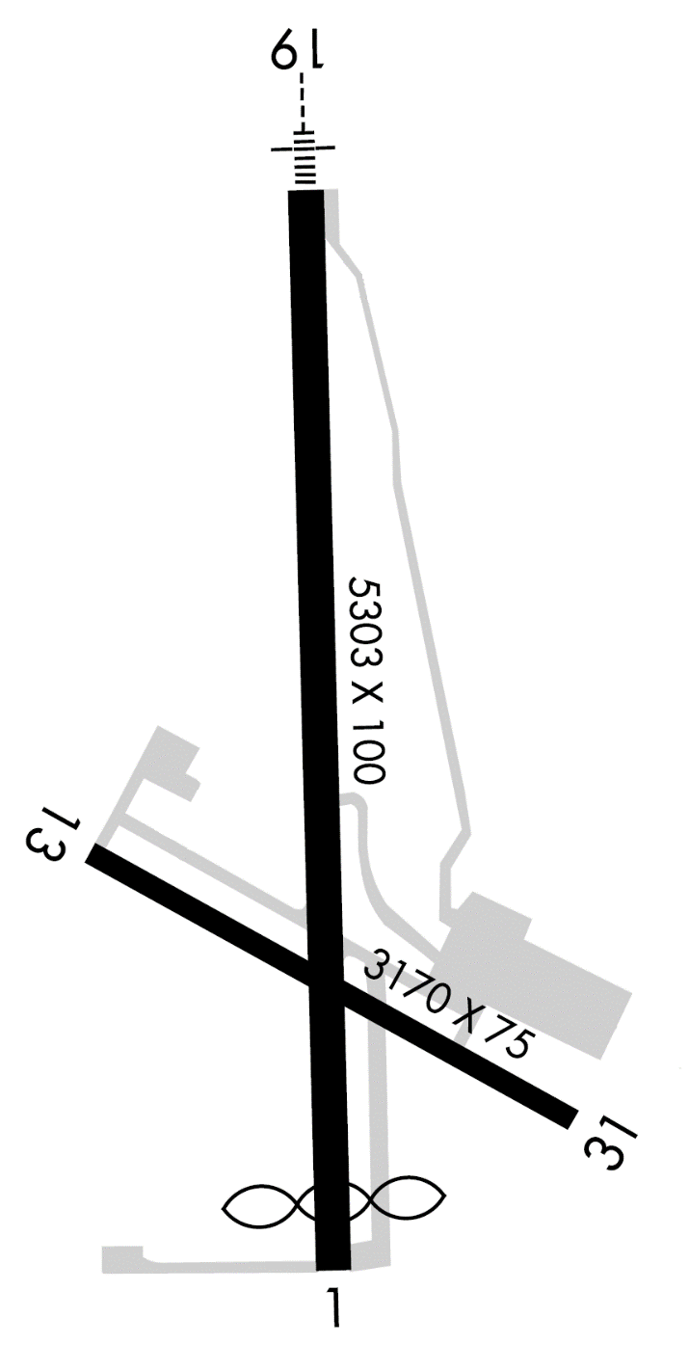
Higher Takeoff Minimums, Runway Restriction, VCOA, Text DP - KRUT
Rutland Runways

Slide 39
KRUT Airport
RUTLAND, VT
SOUTHERN VERMONT RGNL (RUT)
TAKEOFF MINIMUMS AND (OBSTACLE)
DEPARTURE PROCEDURES
AMDT 4A 07FEB13 (13038) (FAA)
TAKEOFF MINIMUMS:
Rwy 1, std. w/ min. climb of 439’ per NM to
3000, or 3600-3 for climb in visual conditions.
Rwy 13, NA-obstacles.
Rwy 19, std. w/ min. climb of 470’ per NM to
3300, or 3600-3 for climb in visual conditions.
Rwy 31, std. w/ min. climb of 500’ per NM to
4500, or 3600-3 for climb in visual conditions.
DYO
NDB
X
DEPARTURE PROCEDURE:
Rwy 19, climb heading 194° to 1400, then
climbing right turn on 025° course to DYO NDB,
cross DYO NDB at or above 6000, if not at 6000,
depart DYO NDB on bearing 325° to 6000 before
proceeding on course. For climb in visual
condition: cross Rutland-Southern Vermont RGNL
airport at or above 4300 before proceeding on
course. When executing VCOA, notify ATC prior to
departure.
DEPARTURE PROCEDURE:
Rwy 31, climb heading 329° to 1600, then
climbing right turn on 025° course to DYO NDB,
cross DYO NDB at or above 6000, if not at 6000,
depart DYO NDB on bearing 325° to 6000 before
proceeding on course. For climb in visual
condition: cross Rutland-Southern Vermont RGNL
airport at or above 4300 before proceeding on
course. When executing VCOA, notify ATC prior to
departure.
DEPARTURE PROCEDURE:
Rwy 1, climb on 013°course to DYO NDB, cross
DYO NDB at or above 6000, if not at 6000, depart
DYO NDB on bearing 325° to 6000 before
proceeding on course. For climb in visual
condition: cross Rutland-Southern Vermont RGNL
airport at or above 4300 before proceeding on
course. When executing VCOA, notify ATC prior to
departure.

Slide 40
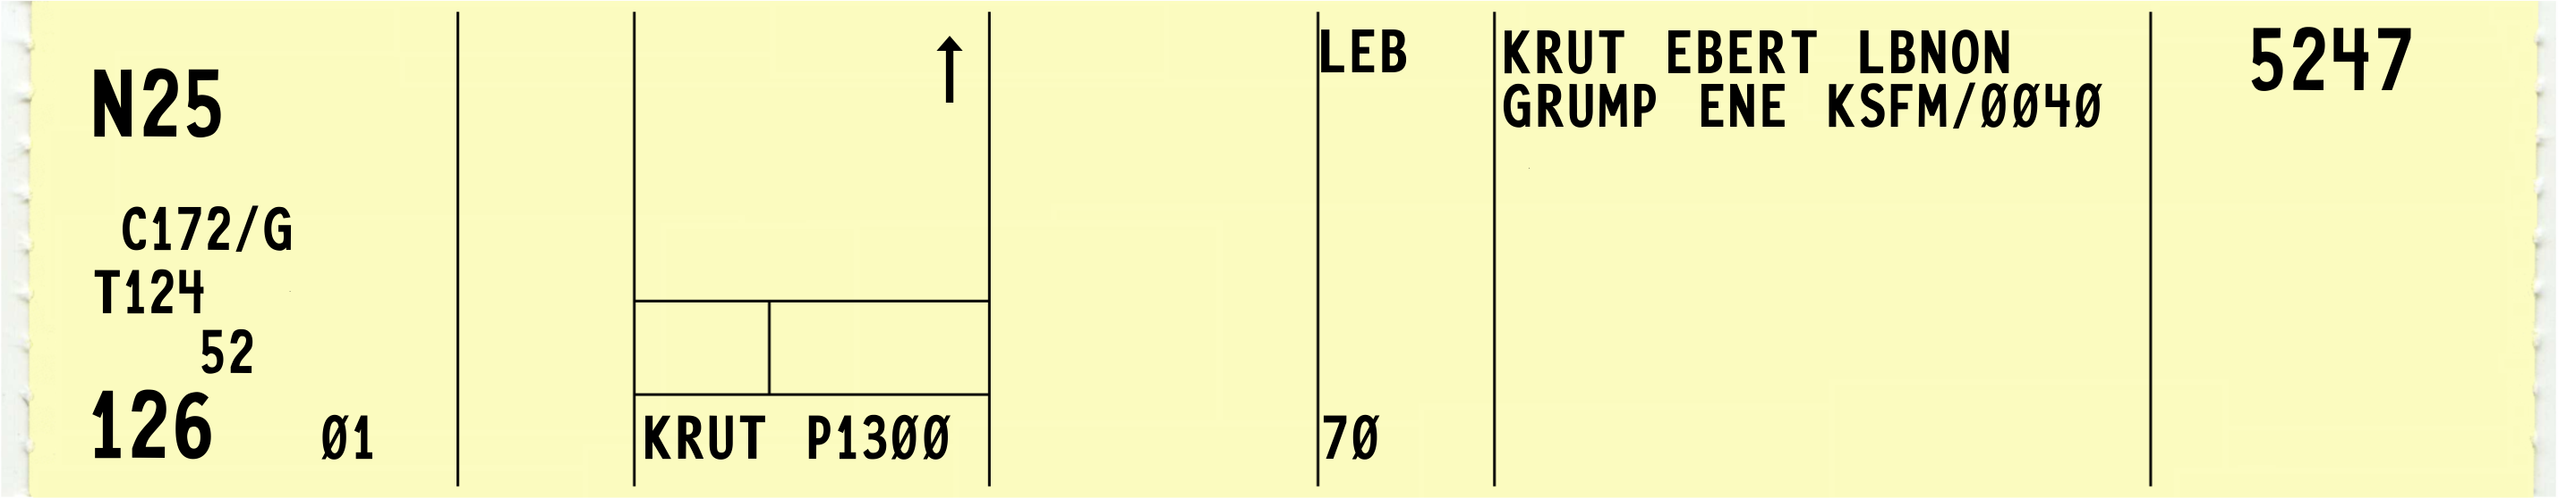
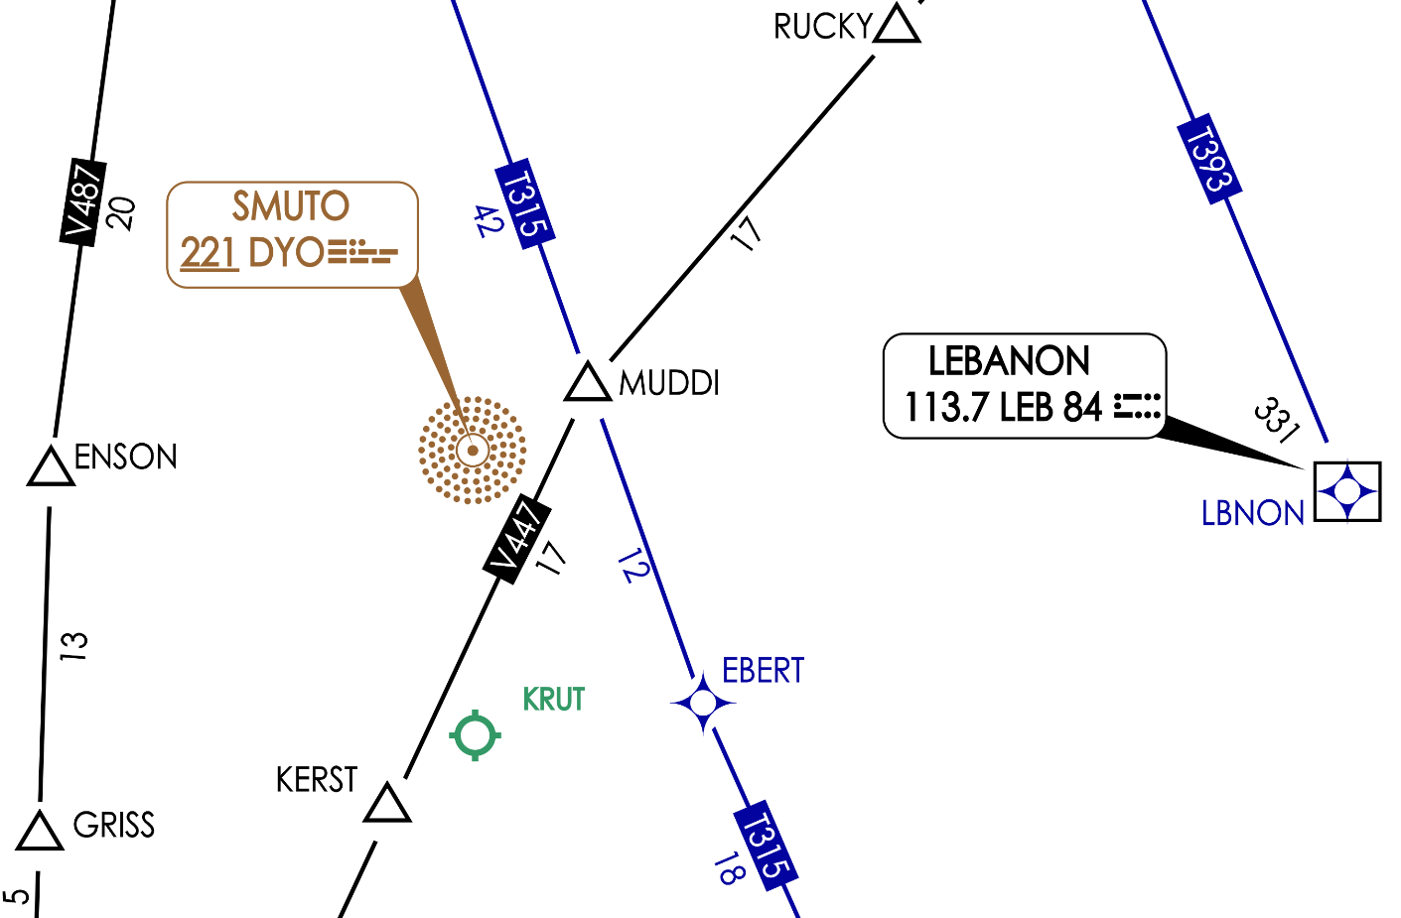
KRUT ODP Example
Pilot files KRUT EBERT…
You must protect ODP over DYO and 330° until at or above 6,000’
KRUT to DYO 11NM
Pilots Flight Path
Cleared Route

Slide 41
Assigning a SID
SIDs are primarily designed for system enhancement to expedite traffic flow and to reduce pilot/controller workload
At busier airports they increase efficiency and reduce communications and departure delays
Assign SIDs, as necessary, for traffic management and convenience
If it is necessary to assign a crossing altitude, which differs from the SID altitude, emphasize the change to the pilot

Slide 42
Altitude Assignments
Issue one of the following:
Altitude requested by the pilot
Altitude as near as possible to altitude requested by the pilot
Inform pilot when to expect requested altitude unless instructions are contained in the specified SID
If the requested altitude is not expected to be available, inform the pilot what altitude can be expected and when/where to expect it

Slide 43
Altitude Assignments (Cont’d)
When a SID:
Does not contain published crossing restrictions and/or
Is a SID with a Radar Vector segment, or
Is a Radar Vector SID, or
Is constructed with a Radar Vector segment and contains published crossing restrictions after the vector segment
Instruct aircraft to:
MAINTAIN (altitude)
or
CLIMB AND MAINTAIN (altitude). EXPECT (requested altitude) AT (time or fix).

Slide 44
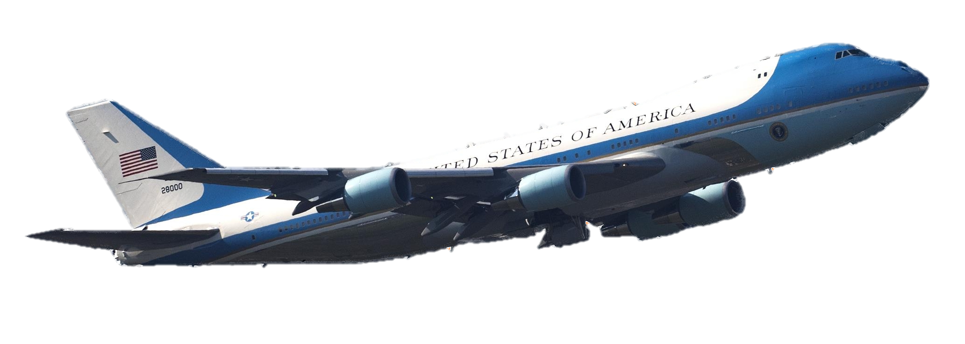
Clearances to Air Force One
Clearance limit
Do not specify the destination airport
NOTE: Presidential detail is responsible for ensuring the accuracy of the destination airport.
Phraseology: “…DESTINATION AS FILED”
Initial altitude
9,000’ AGL or higher
If unable the highest available altitude

Slide 45
Knowledge Check
What is the proper way to issue departure headings to aircraft departing from airports within Class G airspace?
“…DEPART NORTH, FLY HEADING…”
“…FLY RUNWAY HEADING UNTIL ENTERING CONTROLLED AIRSPACE…”
“…WHEN ENTERING CONTROLLED AIRSPACE, FLY HEADING…”

Slide 46
Knowledge Check
What prefix phrase must you use to relay a clearance to an aircraft through another aircraft?
“ATC CLEARS”
“ATC RELAYS”
“ATC WANTS”

Slide 47
Knowledge Check
At airports within a Class E surface area where airport traffic control service is NOT provided, when can you specify the initial heading to be flown after takeoff?
Anytime you decide, if necessary to expedite the departure
After obtaining/soliciting the pilot’s concurrence concerning these items
Only on pilot request

Slide 48
Knowledge Check
You issue a departure clearance at an airport with a published Obstacle Departure Procedure (ODP). Which statement is correct?
The pilot may fly the ODP when cleared for departure
You must assign the ODP to all departures
ODPs apply only to pilots unfamiliar with the local terrain

Slide 49
Knowledge Check
What is the minimum altitude you should assign to Air Force One if traffic is not a factor?
FL180
9,000’ AGL
9,000’ MSL

Slide 50
Knowledge Check
Which example is the phraseology for issuing a departure direction?
“TAKEOFF NORTH…”
“DEPART NORTH…”
“EXIT THE TRAFFIC PATTERN NORTH…”

Slide 51
Knowledge Check
Which statement is correct concerning a Standard Instrument Departure (SID)?
SIDs may be flown without a specific ATC clearance
SIDs are never published in graphical form
SIDs always provide terrain clearance

Slide 52
Knowledge Check
You issue a departure clearance, but due to traffic, you cannot assign the requested altitude. What should you do?
Issue a safe altitude and inform pilot when to expect clearance to the requested altitude
Delay the departure until the requested altitude is available
Issue the lowest safe altitude and wait for the pilot to request higher

Slide 53
Knowledge Check
What is the proper way to issue a clearance limit to Air Force One?
“CLEARED TO ANDREWS AIRPORT VIA…”
“CLEARED TO ANDREWS AIR FORCE BASE VIA…”
“CLEARED TO DESTINATION AS FILED"

Slide 54
Knowledge Check
You are issuing a clearance through FSS/ARTCC Flight Data Units. What must be included in the clearance?
Prefix “ATC CLEARS…”
Airport of departure
Time check if a clearance void time is used

Slide 55
Knowledge Check
You issue a departure clearance with a climb via standard instrument departure but want the aircraft to stop below the highest published altitude. What is the phraseology?
"CLIMB VIA SID EXCEPT MAINTAIN..."
"CLIMB VIA SID STOP CLIMB AT..."
"AMEND CLIMB VIA SID ALTITUDE TO..."

Slide 56
Practice Exercise: Departure Clearances
Purpose
Issuing departure clearances using appropriate phraseology
Materials
Practice Exercise: Departure Clearances
Pencil or pen
Directions
This exercise will take approximately 30 minutes to complete. The instructor will present traffic situations and specific departure criteria. You will be required to write out a clearance incorporating these criteria in the proper format. Each situation will be presented individually and reviewed before proceeding to the next.

Slide 57
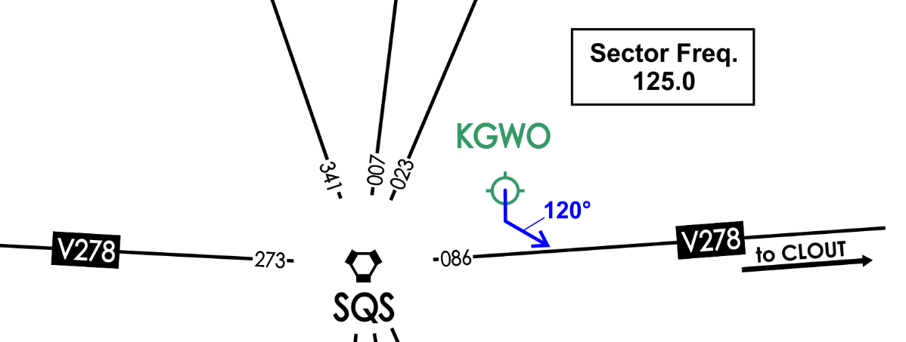
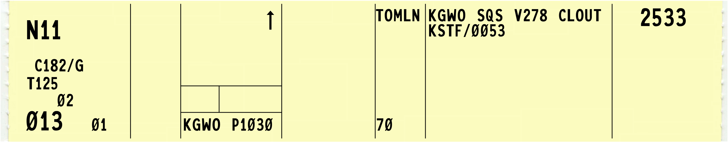
Practice Exercise: Departure Clearances
1.

Slide 58
Practice Exercise: Departure Clearances
1.
CESSNA ONE ONE CLEARED TO STARKSVILLE AIRPORT VIA DEPART SOUTH FLY HEADING ONE TWO ZERO UNTIL JOINING VICTOR TWO SEVENTY-EIGHT, VICTOR TWO SEVENTY-EIGHT CLOUT INTERSECTION DIRECT. CLIMB AND MAINTAIN SEVEN THOUSAND. CONTACT BRAVO CENTER ONE TWO FIVE POINT ZERO LEAVING THREE THOUSAND. SQUAWK TWO FIVE THREE THREE.

Slide 59
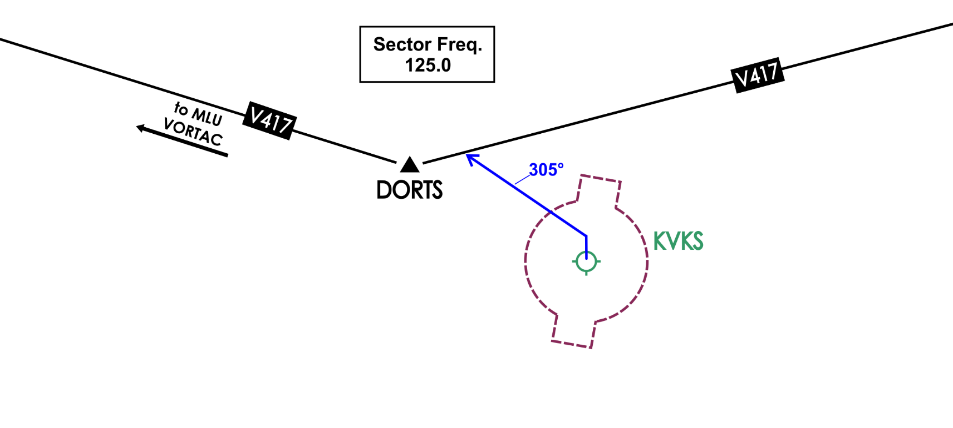
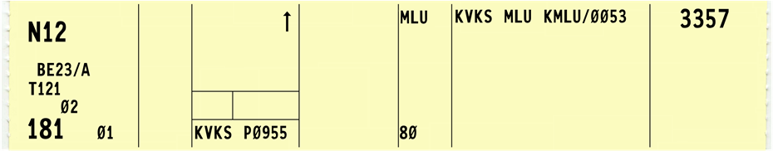
Practice Exercise: Departure Clearances
2.

Slide 60
Practice Exercise: Departure Clearances
2.
Obtain/solicit pilot concurrence for direction of takeoff and turn, OR at end of clearance “Verify this clearance will allow compliance with terrain or obstruction avoidance.”
SUNDOWNER ONE TWO CLEARED FROM VICKSBURG AIRPORT TO MONROE AIRPORT VIA DEPART NORTH, TURN LEFT, FLY HEADING THREE ZERO FIVE UNTIL JOINING VICTOR FOUR SEVENTEEN, VICTOR FOUR SEVENTEEN MONROE. CLIMB AND MAINTAIN EIGHT THOUSAND. CONTACT BRAVO CENTER ONE TWO FIVE POINT ZERO LEAVING THREE THOUSAND. SQUAWK THREE THREE FIVE SEVEN. ADVISE SUNDOWNER ONE TWO RELEASED FOR DEPARTURE.

Slide 61
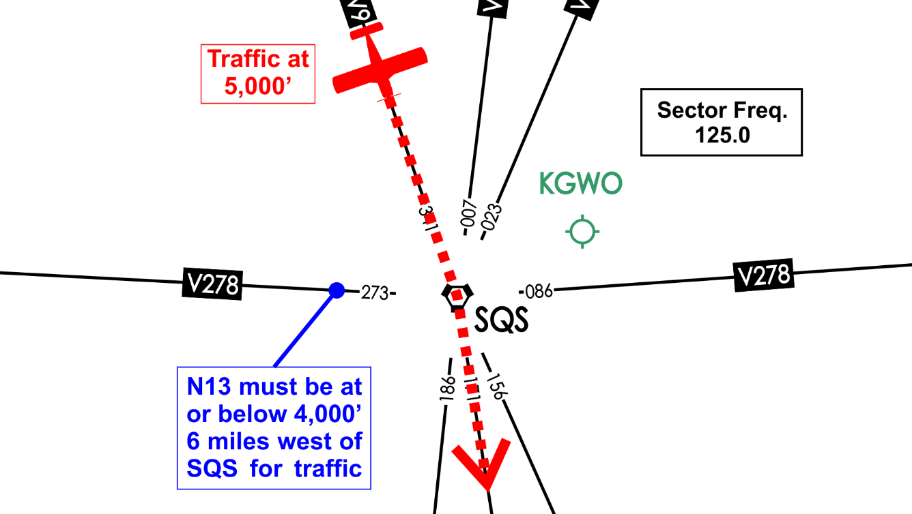
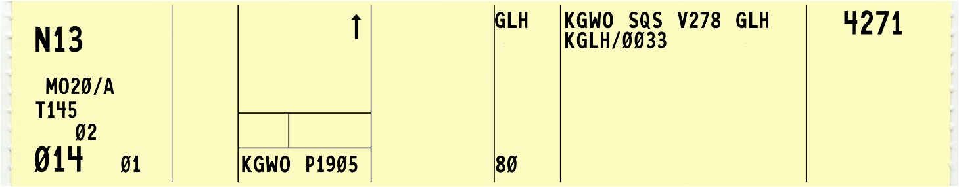
Practice Exercise: Departure Clearances
3.

Slide 62
Practice Exercise: Departure Clearances
3.
MOONEY ONE THREE CLEARED TO GREENVILLE AIRPORT VIA SIDON VORTAC VICTOR TWO SEVENTY-EIGHT GREENVILLE DIRECT. CROSS SIX MILES WEST OF SIDON AT OR BELOW FOUR THOUSAND, CLIMB AND MAINTAIN EIGHT THOUSAND. CONTACT BRAVO CENTER ONE TWO FIVE POINT ZERO LEAVING THREE THOUSAND. SQUAWK FOUR TWO SEVEN ONE.

Slide 63
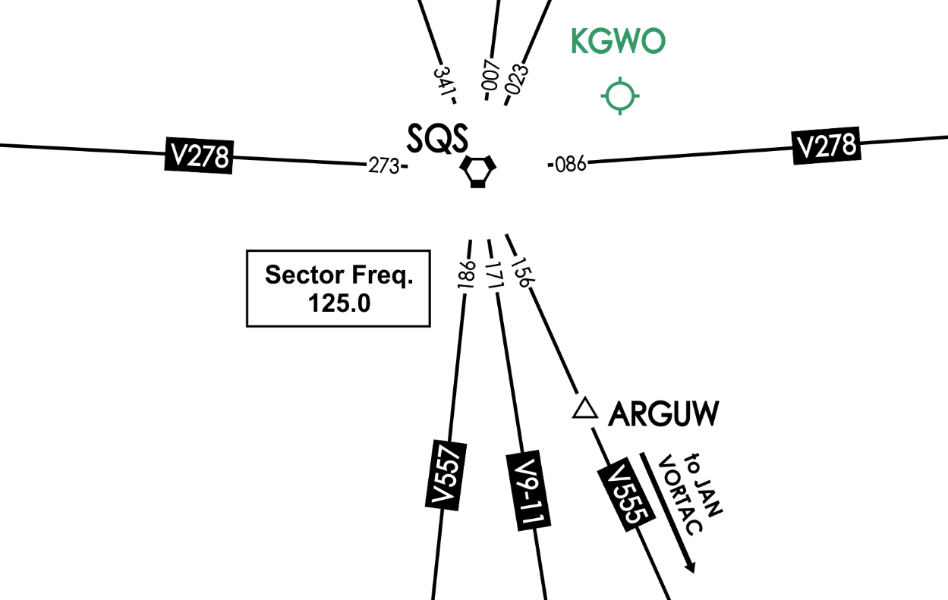
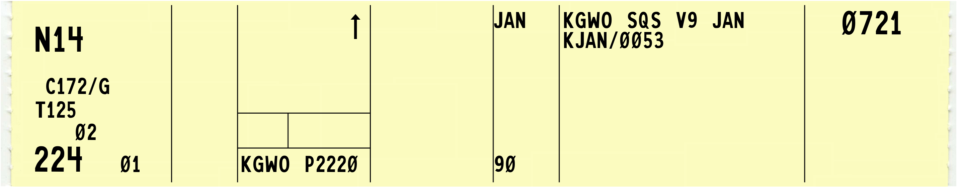
Practice Exercise: Departure Clearances
4.

Slide 64
Practice Exercise: Departure Clearances
4.
SKYHAWK ONE FOUR CLEARED TO ARGUW INTERSECTION VIA SIDON VORTAC VICTOR FIVE FIFTY-FIVE NO DELAY EXPECTED. EXPECT FURTHER ROUTING VIA VICTOR FIVE FIFTY-FIVE JACKSON VORTAC DIRECT. CLIMB AND MAINTAIN FIVE THOUSAND, EXPECT SEVEN THOUSAND AT ARGUW. NINER THOUSAND IS NOT AVAILABLE. CONTACT BRAVO CENTER ONE TWO FIVE POINT ZERO LEAVING THREE THOUSAND. SQUAWK ZERO SEVEN TWO ONE.

Slide 65
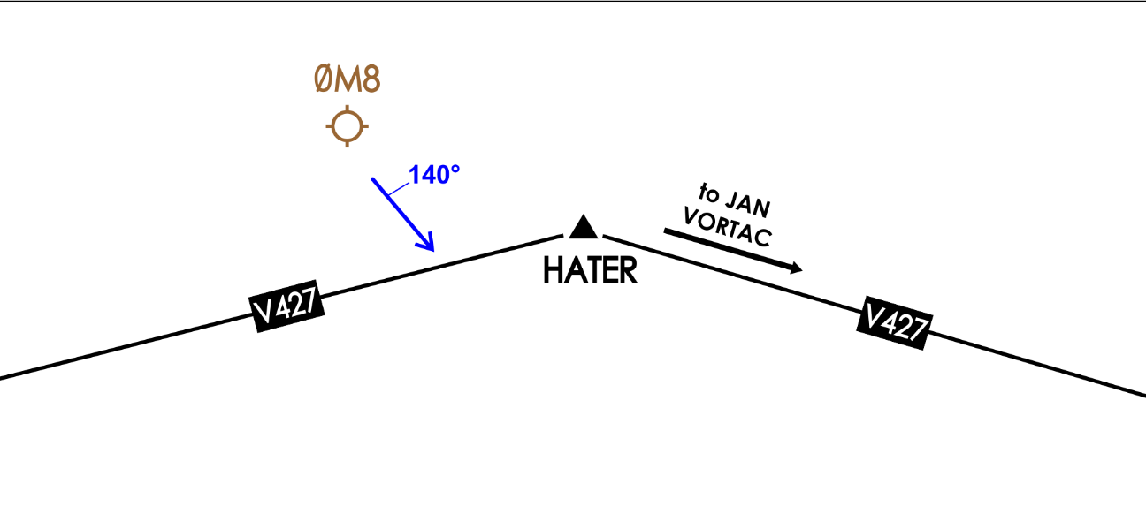
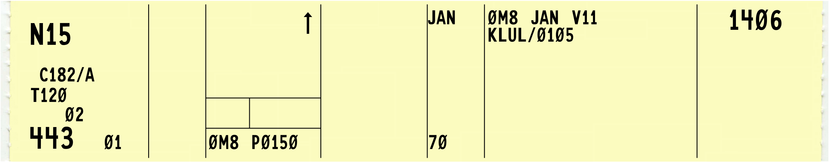
Practice Exercise: Departure Clearances
5.

Slide 66
Practice Exercise: Departure Clearances
5.
CESSNA ONE FIVE CLEARED FROM LAKE PROVIDENCE AIRPORT TO LAUREL AIRPORT. WHEN ENTERING CONTROLLED AIRSPACE FLY HEADING ONE FOUR ZERO UNTIL JOINING VICTOR FOUR TWENTY-SEVEN, VICTOR FOUR TWENTY-SEVEN JACKSON VICTOR ELEVEN LAUREL. CLIMB AND MAINTAIN SEVEN THOUSAND. CONTACT BRAVO CENTER ONE TWO FIVE POINT ZERO LEAVING THREE THOUSAND. SQUAWK ONE FOUR ZERO SIX. VERIFY THIS CLEARANCE WILL ALLOW COMPLIANCE WITH TERRAIN OR OBSTRUCTION AVOIDANCE.

Slide 67
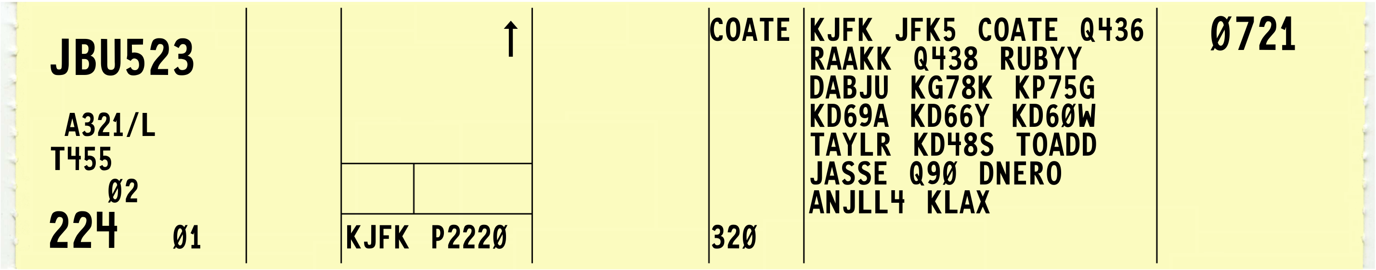
Abbreviated Departure Clearance
“JET BLUE FIVE TWENTY-THREE CLEARED TO LOS ANGELES AIRPORT VIA KENNEDY FIVE DEPARTURE COATE TRANSITION, THEN AS FILED. CLIMB AND MAINTAIN FIVE THOUSAND, EXPECT FLIGHT LEVEL THREE TWO ZERO ONE ZERO MINUTES AFTER DEPARTURE. CONTACT DEPARTURE ONE TWO FIVE POINT ZERO. SQUAWK ZERO SEVEN TWO ONE.”
“JET BLUE FIVE TWENTY-THREE CLEARED TO LOS ANGELES AIRPORT VIA KENNEDY FIVE DEPARTURE COATE TRANSITION Q-FOUR THIRTY-SIX RAAKK Q FOUR THIRTY-EIGHT RUBYY DABJU KILO GOLF SEVEN EIGHT KILO, KILO PAPA SEVEN FIVE GOLF, KILO DELTA SIX NINE ALPHA, KILO DELTA SIX SIX YANKEE, KILO DELTA SIX ZERO WHISKY, TAYLR KILO DELTA FOUR EIGHT SIERRA, TOADD JASSE Q-NINETY DNERO ANJLL FOUR. CLIMB AND MAINTAIN FIVE THOUSAND, EXPECT FLIGHT LEVEL THREE TWO ZERO, ONE ZERO MINUTES AFTER DEPARTURE. CONTACT DEPARTURE ONE TWO FIVE POINT ZERO. SQUAWK ZERO SEVEN TWO ONE.”

Slide 68
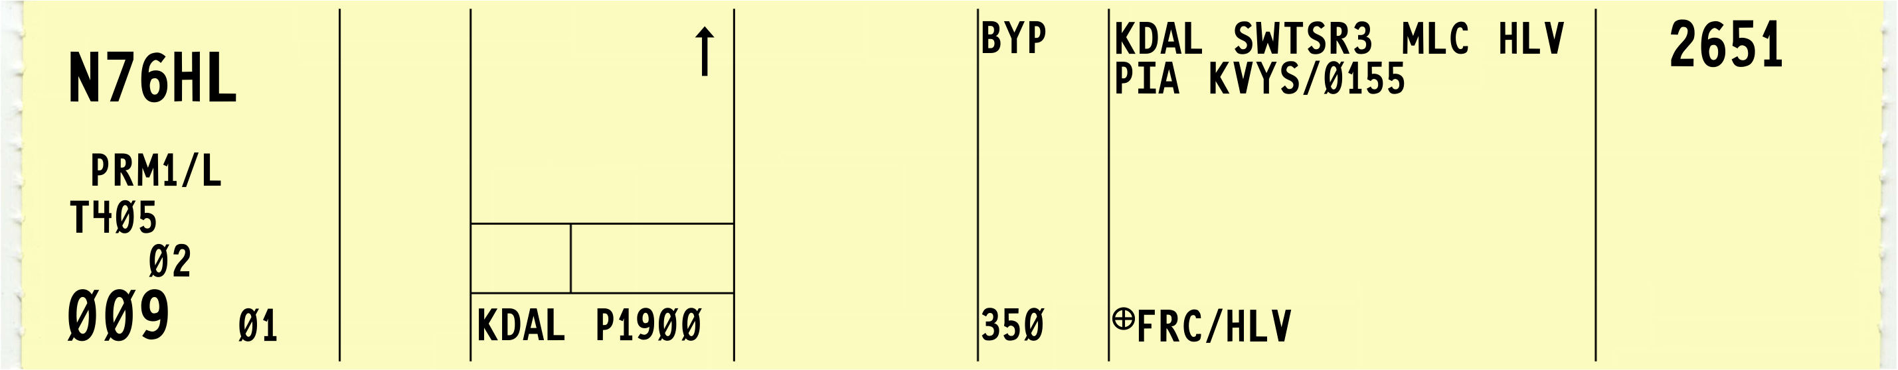

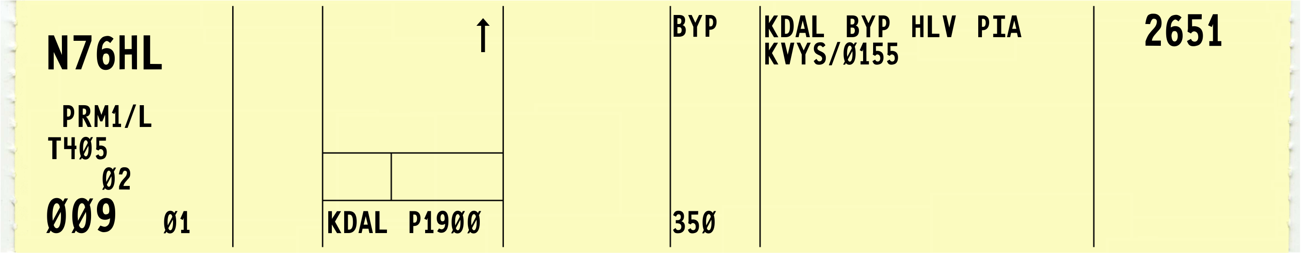
Abbreviated Departure Clearance Modifications to Route
If route must be modified include one of the following in remarks
FRC
FRC/(fix)
Issue full route to specified fix or destination airport
Always first item of intracenter remarks

Slide 69
Abbreviated Departure Clearance
Nonradar environment, specify one, two, or more fixes as necessary to identify the initial route of flight
Do not apply these procedures when a pilot requests a detailed clearance or to military operations conducted within:
ALTRVs
Stereo routes
Operations above FL600
Other military operations requiring special handling

Slide 70
Knowledge Check
What is an abbreviated departure clearance?
Departure clearance containing no altitude information
Departure clearance using “Cleared as filed…”
Departure clearance for ALTRVs

Slide 71
Knowledge Check
What does “FRC/OVR” in remarks signify?
Fly Right Course Over the airport
Full Return Capable Overseas Flight
Full Route Clearance to OVR

Slide 72
Knowledge Check
Which flight group is authorized to receive an abbreviated departure clearance?
Operations above FL600
General aviation aircraft
Stereo Routes

Slide 73
Departure Restrictions
Assign the following to separate departures from other traffic or to restrict or regulate the departure flow:
Departure release
Release time
Hold for release
Expect departure clearance time
Call for release
Clearance void time
Ground stop

Slide 74
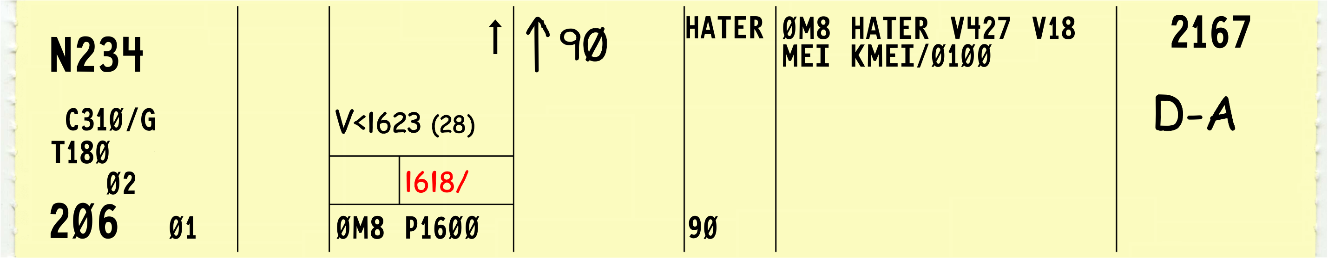
Departure Release
“…ADVISE NOVEMBER TWO THREE FOUR RELEASED FOR DEPARTURE”

Slide 75
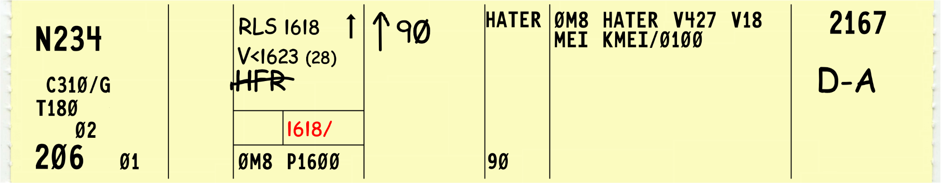
Release Time
“…RELEASED FOR DEPARTURE AT ONE SIX ONE EIGHT…”

Slide 76
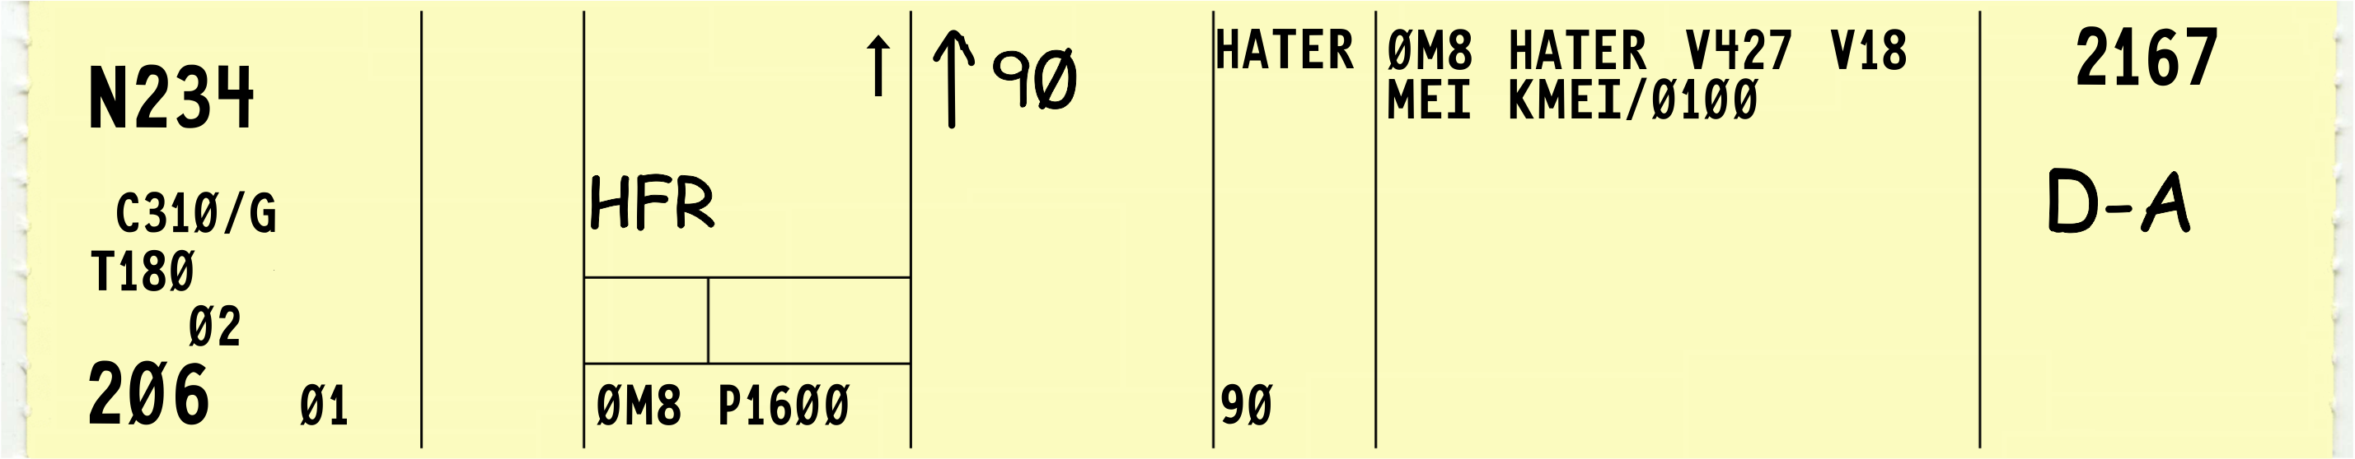
Hold For Release
Used by ATC to delay an aircraft for traffic, weather, volume, etc.
Hold for release instructions are used to inform a pilot or a controller that an IFR departure clearance is not valid until a release time or additional instructions have been received

Slide 77
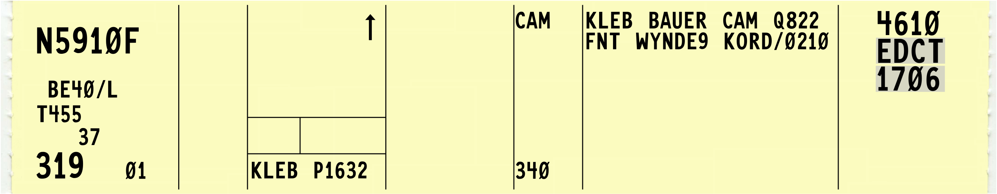
Expect Departure Clearance Time
Runway release time assigned to an aircraft in a traffic management program

Slide 78
Call For Release (CFR)
When aircraft take a delay on the ground
Issue departure clearances in the order in which the requests were made
Inform approach control facilities and/or towers of anticipated departure delays

Slide 79
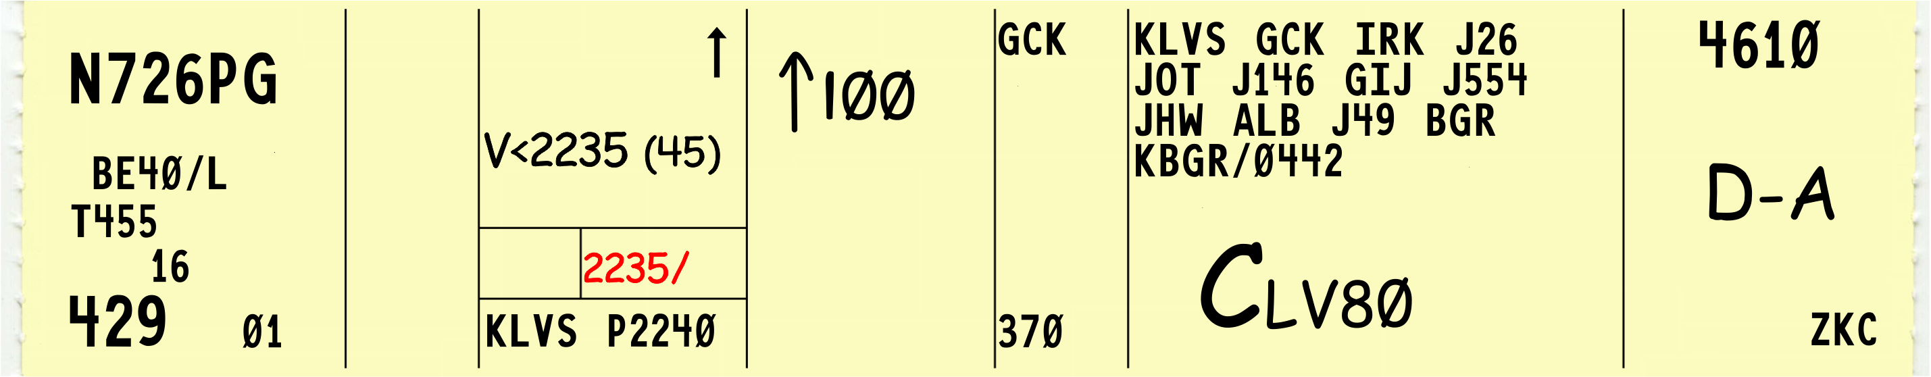
Clearance Void Time
“…CLEARANCE VOID IF NOT OFF BY TWO TWO THREE FIVE. IF NOT OFF BY TWO TWO THREE FIVE, ADVISE BRAVO CENTER NOT LATER THAN TWO TWO FOUR FIVE OF INTENTIONS.”

Slide 80
Ground Stop
Requires aircraft meeting specific criteria to remain on the ground
The criteria may be:
Airport specific
Airspace specific
Equipment specific
Do not release aircraft on an EDCT if a ground stop applicable to that aircraft is in effect

Slide 81
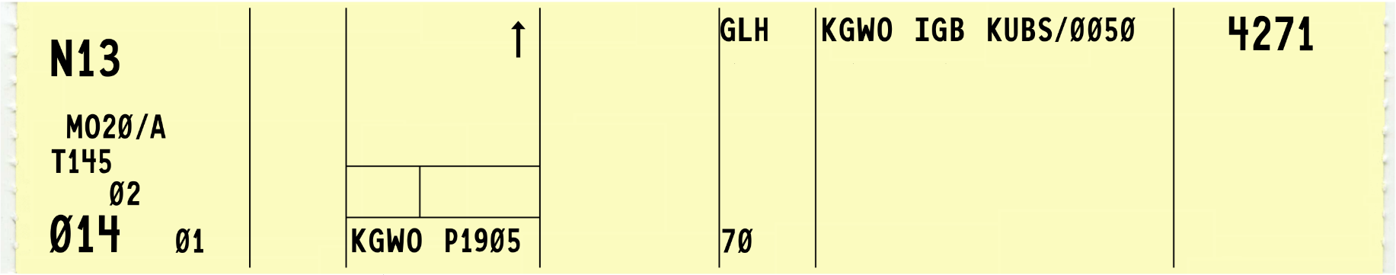


Coordination with Receiving Facility
Coordinate if less than 15 minutes flying time from the transferring facility’s boundary
If automatic transfer of data between automated systems will occur flying time may be reduced to 5 minutes
24 NM
12 Min.

Slide 82
Information Forwarded to Receiving Facility
Forward the following information to the receiving facility:
Aircraft identification
Number of aircraft
Assigned altitude and ETA over last reporting point/fix
Altitude entering receiving facility
True airspeed
Point of departure
Route of flight
Destination airport and clearance limit
ETA at destination airport
Altitude requested if differs from requested altitude
Beacon code
Longitudinal separation, if needed
Additional information

Slide 83
VFR Release of IFR Departures
Aircraft on an IFR flight plan requests a VFR departure through a terminal facility, FSS, or air/ground communications station:
You may authorize an IFR flight planned aircraft to depart VFR
Inform the pilot of the proper frequency
State where or when to contact the facility
If unable to issue clearance, inform pilot and:
Suggest delay be taken on the ground
If pilot insists on departing VFR inform the facility/sector holding the flight plan

Slide 84
Knowledge Check
Who must issue a time check for clearance void times?
FBO at the departure field
Facility issuing the clearance to the pilot
Flight dispatcher

Slide 85
Knowledge Check
What is the departure window associated with a Call For Release (CFR)?
2 minutes prior and ends 1 minute after the assigned time
5 minutes prior and ends 5 minutes after the assigned time
10 minutes prior and ends 5 minutes after the assigned time

Slide 86
Knowledge Check
What should be included with a HFR time?
High flow route clearance
A clearance void time
Departure delay information

Slide 87
Knowledge Check
Actual departure times must be forwarded to an external facility if assumed departure time differs by what amount?
3 minutes
5 minutes
10 minutes

Slide 88
Knowledge Check
A pilot with an IFR flight plan requests a VFR departure but due to volume, you know a clearance cannot be issued in the near future. What should you do?
Issue a provisional SVFR clearance to aid the pilot
Clear the pilot to depart “AT YOUR OWN RISK”
Suggest a delay be taken on the ground

Slide 89
Knowledge Check
What must be issued to departures from airports without an operating control tower?
Wind and altimeter check
Departure release
Runway heading alignment confirmation

Slide 90


Through Clearance
Cleared for approach and through to final destination
To Destination
You may clear aircraft through intermediate stops
Issue departure restrictions as necessary

Slide 91
Airfile Aircraft Guidelines
Process airfile aircraft as follows:
Ensure aircraft is within your area of jurisdiction, unless coordinated
Obtain information necessary to provide IFR service
Issue clearance to:
Destination airport
Short range clearance limit
Instruct pilot to contact FSS if flight plan cannot be processed

Slide 92
IFR to VFR
Clear an aircraft planning IFR operations for the initial part of the flight and VFR for the latter part to the fix at which the IFR part ends

Slide 93
VFR to IFR
Treat an aircraft planning VFR operations for the initial part of the flight and IFR for the latter part as a VFR departure
Issue a clearance to this aircraft when it requests IFR clearance approaching the fix where it proposes to start IFR operations

Slide 94
North American Route Program (NRP)
If the aircraft is moved due to weather, traffic, or other tactical reasons
“NRP” must be retained in remarks
If the route is altered due to a pilot request
“NRP” must be removed from remarks
“NRP” must not be entered in the remarks unless:
Prior coordination is accomplished

Slide 95
Route Structure Transitions
Transitions within or between route structures, may be accomplished via multiple methods. Clear aircraft by one or more of the following:
Vector aircraft:
Assign a SID/STAR
Clear departing or arriving aircraft:
To climb or descend via radials, courses, or azimuths of the ATS route assigned
Direct to or between the NAVAIDs forming the ATS route assigned

Slide 96
Route Structure Transitions (Cont’d)
Clear aircraft to climb or descend via:
ATS route, specified radials, courses, or azimuths of NAVAIDs
Clear RNAV aircraft between designated or established ATS routes via random RNAV routes to a NAVAID, waypoint, airport or fix on the new route
Provide radar monitoring to RNAV equipped aircraft transitioning via random RNAV routes
Offset from published or established ATS route at a specified distance and direction for random (impromptu) RNAV Routes

Slide 97

DME Arcs of NAVAIDS
Flight track a constant distance from the station or waypoint
Predicated on DME collocated with a facility
Cannot be based on an ILS or LOC DME source
DME arcs on approach plates will have a lead radial
Assign a DME arc by stating
Distance from the NAVAID followed by “MILE ARC”
Direction from the NAVAID
Eight principal points of the compass
“OF,” and the name of the NAVAID

Slide 98
Radius of a NAVAID
Courses, azimuths, bearings, quadrants, or radials within a radius of a NAVAID
State direction from NAVAID in terms of the quadrant; e.g., NE, SE, SW, NW
Quadrant - A quarter part of a circle, centered on a NAVAID, oriented clockwise from magnetic north as follows:
NE quadrant 000-089
SE quadrant 090-179
SW quadrant 180-269
NW quadrant 270-359

Slide 99
Knowledge Check
What is the definition of “quadrant” from the Pilot/Controller Glossary?
Four-part departure with 90º turns
Quarter part of a circle centered on a NAVAID
Military Operations Area shaped like a square

Slide 100
Knowledge Check
A flight with “NRP” in remarks changes the route of flight at the pilot’s request. What is the proper procedure?
Deny all route requests from “NRP” aircraft
Allow the New Route Possible request and leave “NRP” in the remarks
Remove “NRP” from remarks

Slide 101
Knowledge Check
What is the phraseology used to issue a DME arc south of Pendleton VORTAC at 15 miles?
“ONE FIVE MILE ARC SOUTH OF PENDLETON VORTAC”
“DME ARC SOUTH OF PENDLETON VORTAC AT ONE FIVE MILES”
“DME ARC OF PENDLETON VORTAC AT ONE FIVE MILES SOUTH”

Slide 102
Knowledge Check
What is the phraseology to clear an aircraft to fly a parallel course to an air traffic service route?
“OFFSET EIGHT MILES RIGHT OF VICTOR SIX”
“PARALLEL VICTOR SIX EIGHT MILES RIGHT”
“FLY ALONG SIDE VICTOR SIX BY EIGHT MILES”

Slide 103
Knowledge Check
What magnetic radials make up the southeast quadrant of a NAVAID?
100-180°
120-200°
090-179°

Slide 104
Knowledge Check
What is a key factor when issuing a clearance to airfile aircraft?
Displaying the current altimeter
Ensure the aircraft is within your area of jurisdiction
Advise the pilot to remain clear of clouds

Slide 105


Substitute Routes
When any part of an airway or route is unusable because of NAVAID status, clear aircraft that are not RNAV capable via one of the following alternative routes:
Route depicted on current U.S. Government charts/publications
Use the word “substitute” immediately preceding the alternative route in issuing the clearance
Route defined by specifying NAVAID radials, courses, or azimuths
Route defined as direct to or between NAVAIDs
Vectors

Slide 106
Class G Airspace
Include routes through Class G airspace only when requested by the pilot
Flight plans filed for random RNAV routes through Class G airspace are considered a request by the pilot
Flight plans containing military training route segments in/through Class G airspace are considered a request by the pilot

Slide 107

Clearance Amendments
Amend route of flight in a previously issued clearance by one of the following:
State which portion of the route is being amended, and then state the amendment
State the amendment to the route, and then state that the rest of the route is unchanged

Slide 108
Arrival Information
If flight is within a surface area for which the tower has responsibility:
Coordinate with the nonapproach control tower
Unless otherwise specified in a letter of agreement
Transfer radio communications
Before an aircraft enters the receiving controller’s area
If an IFR aircraft intends to land at an airport not served by a tower or FSS
Approve a change to the advisory service frequency when you no longer require direct communications

Slide 109
Knowledge Check
What is the phraseology used when you no longer require direct communication to aircraft landing at an airport without a tower or FSS?
“CHANGE TO ADVISORY FREQUENCY APPROVED”
“CONTACT UNICOM FREQUENCY”
“CALL YOUR ARRIVAL ON THE CTAF FREQUENCY”

Slide 110
Knowledge Check
What is the phraseology used at the end of a route change clearance to indicate the remainder is the same as the current route of flight?
“…REMAINDER OF ROUTE IS THE SAME”
“…REST OF ROUTE UNCHANGED”
“…NO CHANGE TO REST OF ROUTE”

Slide 111
Clearance requirements
Procedure for departing IFR aircraft
Procedures for IFR clearances

