Slide 2
Lesson Objectives
At the end of this lesson, you will be able to identify:
Duty priority
Expeditious compliance
Operational priorities
Requirements for reporting essential information
General control procedures

Slide 3
ATC Service
Prevent Collisions
Safe
Orderly
Expeditious

Slide 4
ATC Service (Cont’d)
Provide Additional Services
Not optional
Services may be precluded by:
Volume of traffic
Frequency congestion
Quality of surveillance
Controller workload
Higher priority duties
Physical inability to scan and detect situations falling in this category

Slide 5
ATC Service (Cont’d)
Control in accordance with JO 7110.65
Unless a deviation to conform with:
ICAO Documents
National Rules of the Air
Special agreements where the U.S. provides air traffic control outside the U.S. and its possessions
Other procedures/minima prescribed LOA, FAA directive, or a military document
A deviation is necessary to assist an aircraft when an emergency has been declared

Slide 6
Duty Priority
Separate aircraft and issue safety alerts
Support national security and homeland defense activities
Provide and/or solicit weather information
Provide additional services

Slide 7
Procedural Preference
Use automation procedures in preference to non-automation procedures
Use radar separation in preference to nonradar separation when it will provide an operational advantage
Use nonradar separation in preference to radar separation when an operational advantage will be gained

Slide 8

Knowledge Check
Nonradar separation cannot be used within a radar environment.
True
False

Slide 9
Knowledge Check
What is the first duty priority of an air traffic controller?
Solicit weather information
Separating aircraft and issuing safety alerts
Support to national security
Provide additional services

Slide 10
Expeditious Compliance Terms
Use the word “IMMEDIATELY” to avoid an imminent situation
Include the reason if time permits
Use the word “EXPEDITE” for prompt action to avoid the development of an imminent situation
Include the reason if time permits

Slide 11
Safety Alerts
Issue a safety alert if you are aware of an aircraft at position or altitude which places it in unsafe proximity to:
Terrain
Obstruction
Another aircraft
Do NOT assume another controller has acted to correct the unsafe situation
Inform the controller responsible for issuing the safety alert

Slide 12
Knowledge Check
Which statement is correct about safety alerts?
Safety alerts are a pilot’s responsibility
Safety alerts have equal priority with separation
Safety alerts are advisory in nature

Slide 13
Knowledge Check
What term is used to specify prompt action in a clearance?
Expedite
Immediately
Promptly

Slide 14
Knowledge Check
Which of the following has the highest priority?
Relaying control information
Issuing a safety alert to a VFR aircraft
Providing airport weather information

Slide 15
Operational Priority
Aircraft in distress have the right of way
Provide air traffic on a “first-come, first-served” basis, except:
Air ambulance flights
Provide priority handling when the pilot verbally identifies the flight by stating MEDEVAC
When verbally requested, provide priority handling to AIR EVAC, HOSP, and scheduled air carrier/air taxi flights
Presidential or Vice Presidential aircraft and any escort aircraft

Slide 16
Operational Priority (Cont’d)
Search and Rescue (SAR) aircraft while performing a SAR mission
Interceptor aircraft on active air defense missions
NIGHT WATCH aircraft
FLYNET (Flights, Nuclear Emergency Teams)
GARDEN PLOT
SAMP (Atmospheric Sampling for Nuclear Contamination)
Special Air Mission aircraft “SCOOT”
TEAL and NOAA

Slide 17
Operational Priority (Cont’d)
OPEN SKIES observation and demonstration flights
Flight Check aircraft
IFR aircraft over SVFR
North American Route Program (NRP) are not subject to route limiting restrictions
Diverted Flights
FALLEN HERO flights

Slide 18
Knowledge Check
Which of the following has the highest priority?
Aircraft in distress
FLYNET Nuclear Emergency Teams
OPEN SKIES Aircraft
NIGHT WATCH National Airborne Operations

Slide 19
Knowledge Check
When is an AIR EVAC flight provided priority handling?
When requested by the pilot
When carrying patients as indicated in remarks
Always

Slide 20
Knowledge Check
What is the operational priority for providing air traffic control services?
Arriving aircraft over departing aircraft
SVFR aircraft over IFR aircraft
First-come, first-served

Slide 21
Knowledge Check
Which of the following normally would NOT receive priority handling?
Turbojet arrival
FLYNET mission
Flight Check mission

Slide 22
Reporting Essential Flight Information
Report, information concerning components of the NAS or flight conditions that may adversely affect air safety to the appropriate:
FSS
Airport manager’s office
ARTCC
Approach control facility
Operations office
Military office

Slide 23
NAVAID Malfunctions
When an aircraft reports a NAVAID malfunction, request a report from another aircraft
If second aircraft reports normal:
Continue use
Inform pilot making malfunction report
Inform your supervisor/CIC

Slide 24
NAVAID Malfunctions (Cont’d)
If second aircraft confirms malfunction, or if unable to get a second report:
Request monitor facility to activate standby equipment
If normal operation is reported after going to standby equipment:
Continue use of NAVAID
Inform your supervisor/CIC

Slide 25
GPS or WAAS Anomaly
Record the following:
Aircraft make, model, and callsign
Location or position, and altitude
Date/time of occurrence
Request a report from a second aircraft
Inform your supervisor/CIC
Inform other aircraft of the anomaly

Slide 26
Supervisory and Pilot Notification
Ensure supervisor/CIC is aware of conditions affecting sector operations, including:
Weather
Equipment status
Potential sector overload
Emergency situations
Special flights/operations
Possible suspicious aircraft/pilot activity

Slide 27
Blue Lightning Events
Reports of possible human trafficking
Ensure that the supervisor/CIC is notified

Slide 28
Pilot Deviation Notification
When it appears that the actions of a pilot constitute a pilot deviation notify the pilot, workload permitting
(Identification) POSSIBLE PILOT DEVIATION ADVISE YOU CONTACT (facility) AT (telephone number)

Slide 29
Knowledge Check
A pilot reports not receiving a NAVAID signal. What is your next action?
Immediately activate the standby system
Request a report from another aircraft
Log the report on FAA form 7230-4

Slide 30
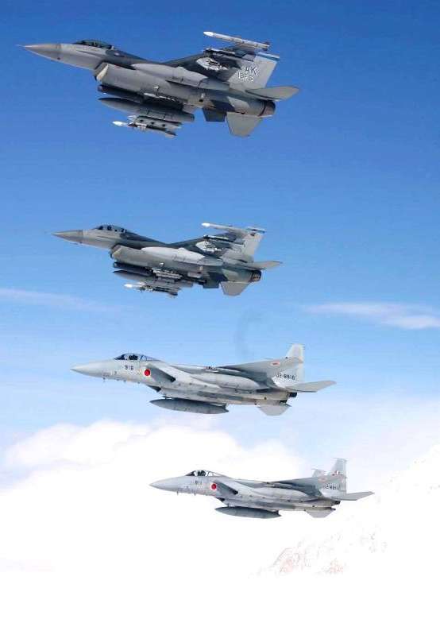
Formation Flights
Control formation flights as a single aircraft
Issue control instructions to formation leader
Ensure flight plan data accurately reflects the number of aircraft

Slide 31





Coordinate Use of Airspace
“BRAVO CENTER, REQUEST LOWER”
Coordinate before you control in or aircraft enters another’s jurisdiction
Before issuing:
Headings
Route
Speed
Altitude
Unless specified in an LOA or facility directive
GLJ
LO
Your
Sector
MLU
APCH

Slide 32








Control Transfer
Control Transfer Fix
Transfer at:
A prescribed or coordinated location, time, fix, or altitude; or
Time a radar handoff and frequency change to the receiving controller have been completed
SWA28
140 210
156 425
SWA28
140 210
156O-18
R
R
H/O Complete

Slide 33
Radio Comm Transfer
Transfer comm before entering the receiving controller’s area
Specify:
Who to contact
Frequency
SWA28
140 210
156O-18
R
“SOUTHWEST TWENTY-EIGHT CONTACT BRAVO CENTER ONE TWO SIX POINT ZERO”
Sector boundary

Slide 34



Operational Request
Respond to a request from another controller, pilot
Restating the request in complete or abbreviated terms followed by “APPROVED”
DAL42
210C
062 438
“DELTA FORTY-TWO REQUEST RIGHT DEVIATION AROUND WEATHER”
“DELTA FORTY-TWO, DEVIATION RIGHT APPROVED”

Slide 35
Knowledge Check
When may you issue control instructions in another controller’s area?
After coordinating your actions
Once you have established communications with the pilot
When the target is radar identified

Slide 36
Knowledge Check
Which statement is correct concerning formation flights?
Control instructions must be issued and acknowledged by each aircraft within the formation
Separation within the formation is the responsibility of the flight leader and the pilots in the flight
Air traffic control must ensure separation between aircraft established within a formation

Slide 37
Knowledge Check
What is the phraseology to disapprove a pilot request?
“NEGATIVE YOUR PREVIOUS REQUEST”
“REFUSING REQUESTED ACTION”
“UNABLE DUE TO TRAFFIC”

Slide 38
Knowledge Check
When should you transfer radio communications?
Before the aircraft transitions the first NAVAID in the receiving controller’s area
Before the aircraft crosses an imaginary line 10 miles or 2 minutes, whichever is farther, from the next controller’s area
Before an aircraft enters the receiving controller’s area of jurisdiction

Slide 39
Activity: Board Management Discussion
Purpose
Review procedures for board management, such as:
Sequencing
Fix posting
Local strip marking
Materials
None
Directions
This activity takes approximately 30 minutes to complete. Instructor will discuss board management procedures.

Slide 40
Sequencing Flight Progress Strips
No standard procedures exist for sequencing or scanning flight progress strips
Common practices used by controllers will assist in understanding the board management example on the following pages

Slide 41

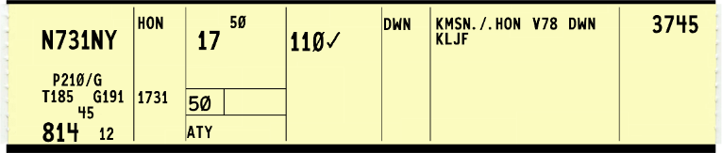
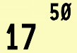
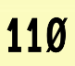
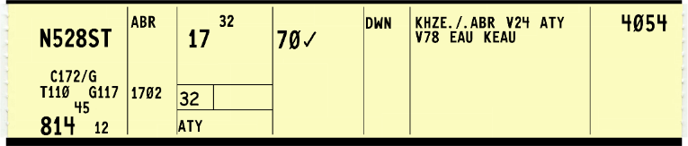
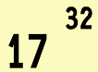
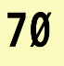
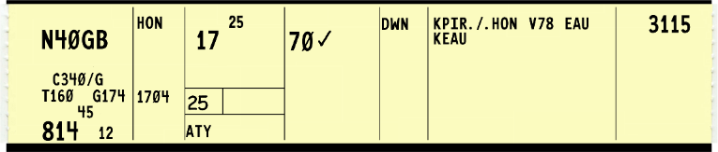
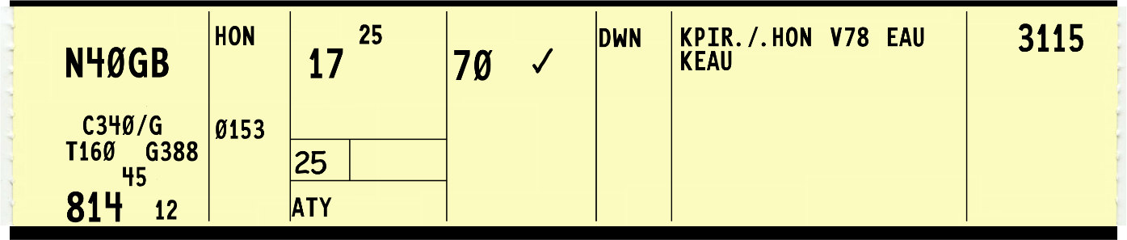
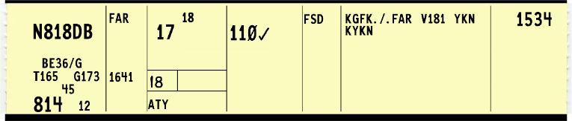
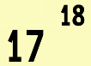

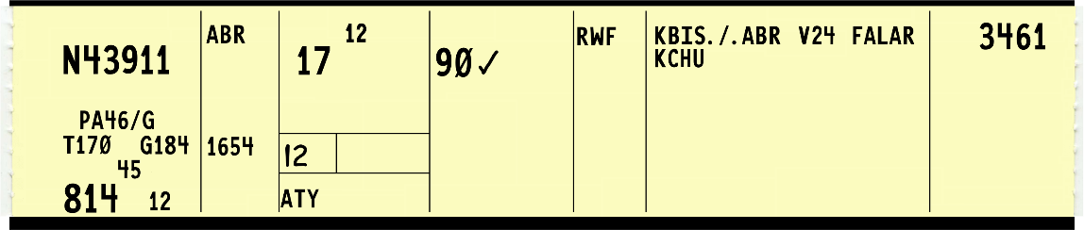
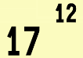

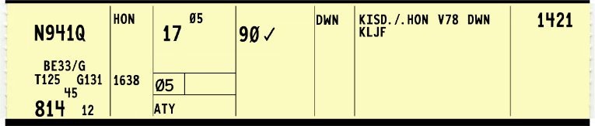
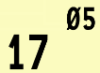

Fix/Time Sequencing Example
Strips have been arranged with earliest time at the bottom
Scan strips and place a red “W” next to the altitude of each aircraft in conflict
ATY

Slide 42
Summary
This lesson covered:
Duty priority
Expeditious compliance
Operational priorities
Requirements for reporting essential information
General control procedures
Procedures for board management

