Slide 2
Minima
Altitude assignment procedures
Phraseology

Slide 3
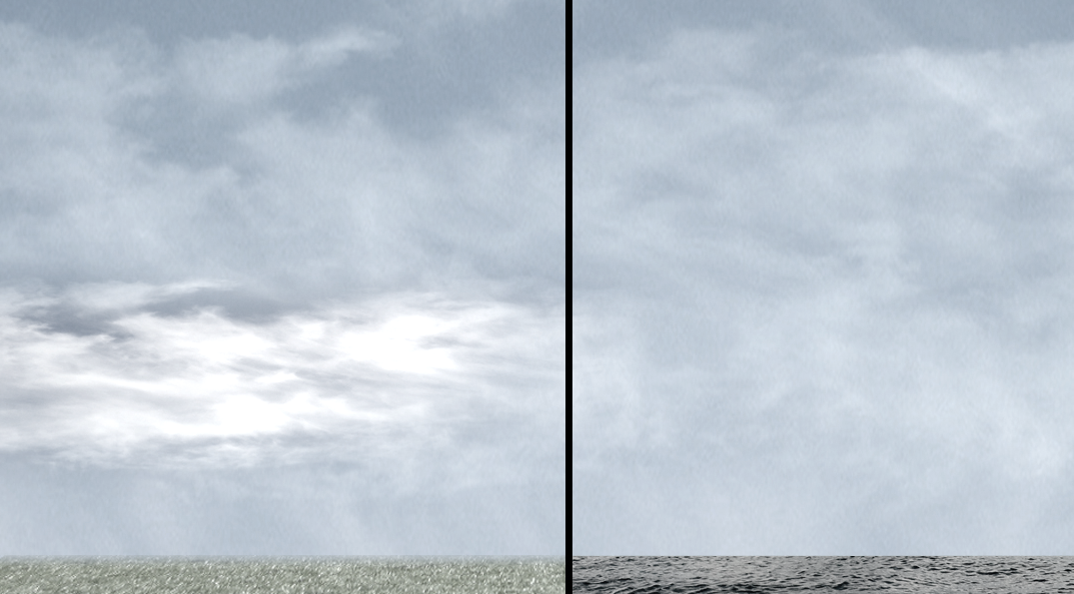



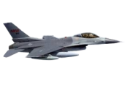

Minima Between Altitudes
5,000’
FL600
2,000’
FL410
4,000’
1,000’ RVSM EQUIPPED AIRCRAFT ONLY
2,000’ FOR NON-RVSM EQUIPPED AIRCRAFT
FL450
FL290
1,000’

Slide 4
Reduced Vertical Separation Minima (RVSM) Airspace
Reduced Vertical Separation Minima (RVSM)
  RVSM is defined as the reduction of vertical space between aircraft from 2,000’ to 1,000’ from FL290 to FL410 inclusive
  Aircraft must meet specific equipment requirements
    Aircraft not meeting the requirements are not authorized entry into RVSM airspace, with a few exceptions

Slide 5
RVSM Exceptions
Department of Defense (DOD) - U.S. military aircraft and all NASA DOD certified aircraft
MEDEVAC aircraft
Foreign State aircraft
Manufacturers development and certification

Slide 6
Non-RVSM Aircraft Above FL290
Apply 2,000’ vertical separation between non-RVSM aircraft and all others
Coordination with affected sectors must be accomplished prior to handoff
  Non-RVSM aircraft at the base or ceiling of your airspace must be coordinated with any affected sectors

Slide 7

Knowledge Check
In which column is minimum vertical separation not being applied?
A
A
B
C
430
420
410
400
390
380
290
280
270
260
250
240
340
330
320
310
300
290

Slide 8
Aircraft Transitioning RVSM Airspace
Non-RVSM aircraft may transition through RVSM airspace to operate above or below it
Notify the supervisor/CIC of transitioning aircraft
Transitioning aircraft require approval before handing off to another sector

Slide 9
Severe Turbulence and Mountain Wave in RVSM Airspace
When severe turbulence, mountain wave, or other weather conditions cause altitude deviations of 200 feet or more, the pilot will advise ATC

Slide 10
RVSM Phraseology
Non-RVSM aircraft
  Use NEGATIVE RVSM in all verbal ground-to-ground communications involving non-RVSM aircraft while cleared to operate within RVSM airspace
  To deny entry to RVSM airspace, state “Unable clearance into RVSM airspace”

Slide 11
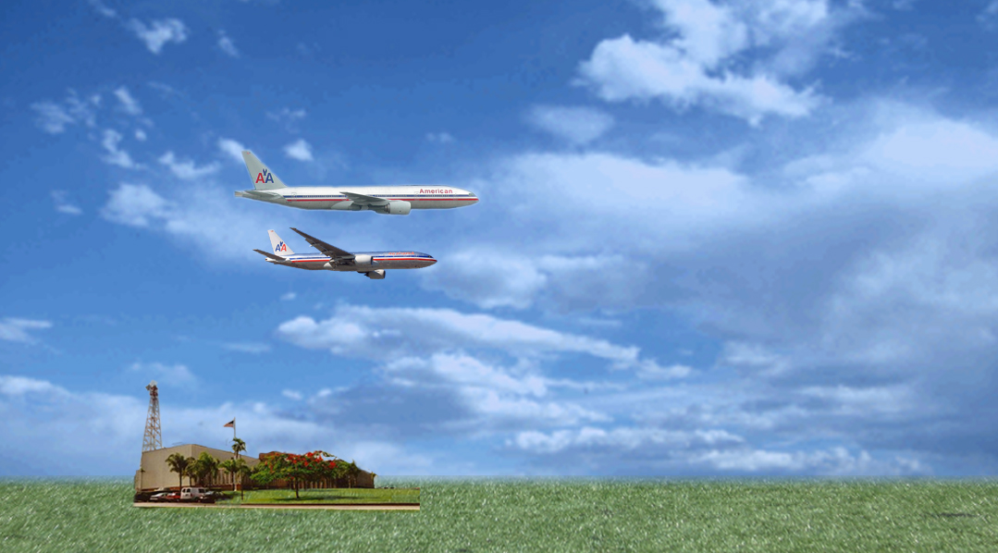
Altitude Assignment
130
“AMERICAN TWENTY-ONE LEAVING ONE ONE THOUSAND FOR FLIGHT LEVEL TWO THREE ZERO.”
120
AAL21
110
100
AAL94
“AMERICAN TWENTY-ONE, ROGER. AMERICAN NINETY-FOUR, CLIMB AND MAINTAIN ONE ONE THOUSAND.”
ARTCC

Slide 12
Exceptions to Altitude Assignment
Assign an altitude to an aircraft only after the aircraft previously at that altitude has reported, or is observed at or passing through another altitude that is separated from the first by the appropriate minima, when:
  Severe turbulence is reported
  Military aircraft are conducting aerial refueling
  The aircraft previously at that altitude has been issued a clearance permitting climb or descent at pilot’s discretion

Slide 13
Knowledge Check
Severe turbulence exists; N30PP requests descent to 7,000’; N32WM requests descent to 9,000’. What is the procedure to clear each aircraft to its requested altitude?
N30PP
BE80/A
T200 G215
02
195 03
OKC
0920
MMB
KOKC OKC V17 MMB KGAG/1035
5153
41
130
09
ZELNU
70
ZME
N32WM
C421/A
T210 G225
02
114 03
OKC
0924
150
MMB
KPWA OKC V17 MMB V507 LBL KHUG/1025
2533
44
09
90
ZELNU
ZME
ANSWER: When N30PP reports leaving 8,000’, N32WM can be assigned 9,000’. Aircraft could also be stepped down in altitude.

Slide 14
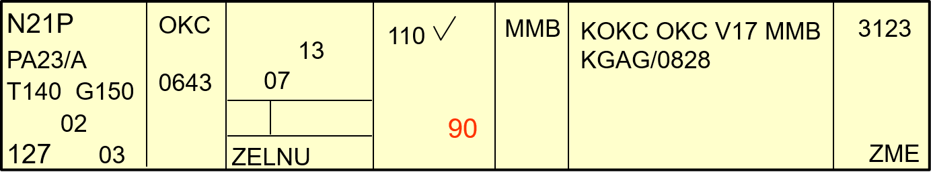
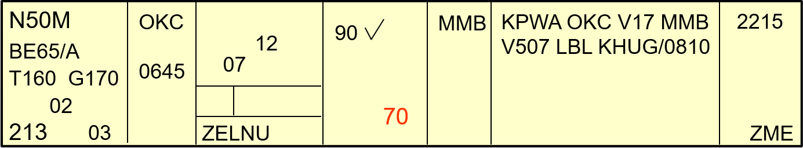
Knowledge Check
What procedure and phraseology would be used to clear N50M and N21P to their requested altitudes?
N21P
PA23/A
T140 G150
02
127 03
OKC
0643
110
MMB
KOKC OKC V17 MMB KGAG/0828
3123
13
07
90
ZELNU
ZME
N50M
BE65/A
T160 G170
02
213 03
OKC
0645
MMB
KPWA OKC V17 MMB V507 LBL KHUG/0810
2215
12
90
07
ANSWER:
“QUEEN AIR FIVE ZERO MIKE, DESCEND AND MAINTAIN SEVEN THOUSAND. REPORT LEAVING NINER THOUSAND.”
When N50M reports leaving niner thousand…
“APACHE TWO ONE PAPA, DESCEND AND MAINTAIN NINER THOUSAND.”
70
ZELNU
ZME

Slide 15
Knowledge Check
What procedure should be applied if N21P requests 13,000’ and N50M requests 11,000’?
N21P
PA23/A
T140 G150
02
127 03
OKC
0643
110
MMB
KOKC OKC V17 MMB KGAG/0828
3123
13
07
130
ZELNU
ZME
N50M
BE65/A
T160 G170
02
213 03
OKC
0645
MMB
KPWA OKC V17 MMB V507 LBL KHGQ/0810
2215
12
90
07
110
ZELNU
ZME
ANSWER: When N21P reports leaving 11,000’, N50M may be assigned 11,000’.

Slide 16
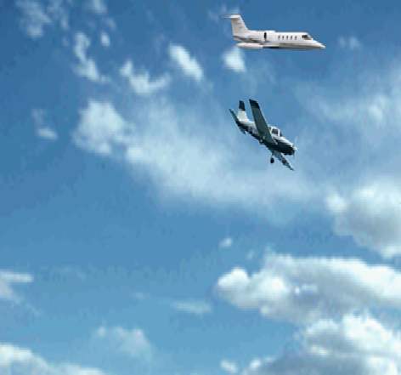
Knowledge Check
Answer the following questions and explain your answer:
Would you descend the Learjet to seven thousand?
LEARJET
80
“PIPER FIVE ZERO LEAVING SEVEN THOUSAND FOR SIX THOUSAND.”
70
ANSWER:
No. The vast difference in aircraft performance characteristics in this situation makes this altitude change dangerous.

Slide 17
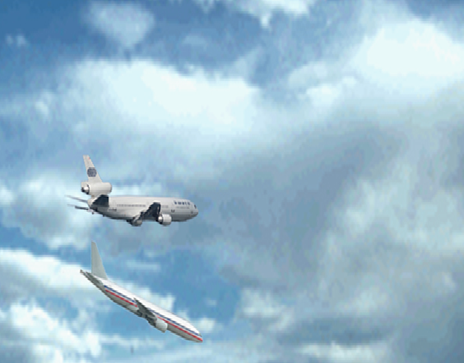
Knowledge Check
Answer the following questions and explain your answer:
Would you descend the MD11 to one zero thousand?
MD11
110
AMERICAN NINETY-FOUR LEAVING ONE ZERO THOUSAND FOR NINER THOUSAND
100
Yes. The aircraft performance characteristics in this situation are compatible..

Slide 18
Crossing Restrictions
Are a pilot’s discretion climb or descent
Pilot may level off at any altitude
Once an altitude is vacated, the pilot may not return to it

Slide 19
Cruise Clearance
Authorizes flight at any altitude from the Minimum IFR Altitude (MIA) up to and including the altitude specified in the clearance
Pilot may level off at any intermediate altitude within the altitude block
Climb and descent within the block is pilot’s discretion
  Cannot return to an altitude that is verbally reported leaving
Cruise clearance is an approval to make an approach at destination airport

Slide 20
Pilot’s Discretion
ATC has offered the pilot the option of starting climb or descent when they wish
  Climb/descent rate determined by pilot
  Aircraft may level off at any intermediate altitude
  May not return to a previously vacated altitude

Slide 21

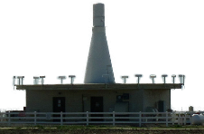
Pilot’s Discretion (Cont’d)
240
220
200
“UNITED TEN CROSS LAKEVIEW V-O-R AT OR ABOVE FL200, DESCEND AND MAINTAIN 6000.”

Slide 22
Pilot’s Discretion (Cont’d)
290
270
250
230
“SOUTHWEST EIGHTY-THREE DESCEND NOW TO FL270, CROSS LAKEVIEW V-O-R AT OR BELOW FL250, MAINTAIN FL180.”

Slide 23
Separation by Pilots
When pilots in direct radio communication with each other during climb and descent concur, you may authorize:
  The lower aircraft, if climbing to maintain vertical separation below the other aircraft
  The upper aircraft, if descending to maintain vertical separation above the other aircraft

Slide 24
Formation Flights in RVSM Airspace
Utilize RVSM separation standards for a formation flight that consists of all RVSM approved aircraft
Utilize non-RVSM separation standards for a formation flight above FL290, which does not consist of all RVSM approved aircraft
Ensure the proper equipment suffixes are entered

Slide 25
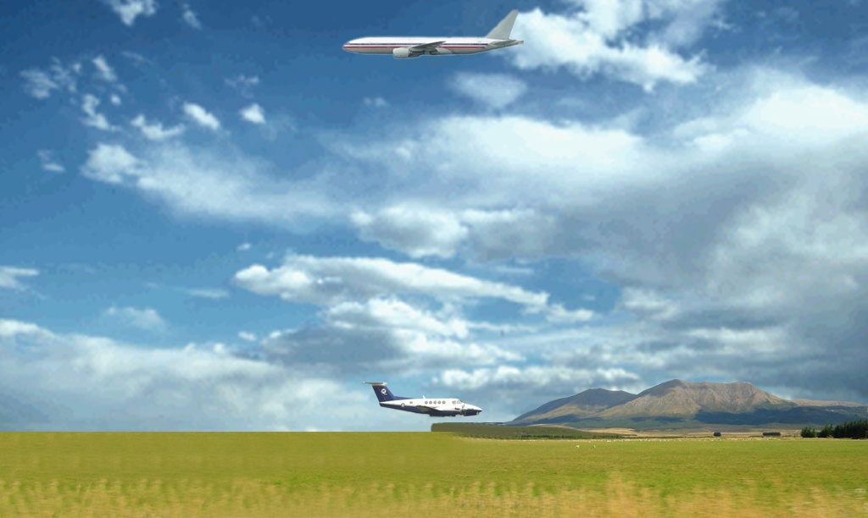
Separation from SUA and ATCAA
1,000 FEET
SUA/ATCAA
10,000’ - FL290
500 FEET

Slide 26
Altitude Reports
Altitude reports
  “SAY ALTITUDE”
  “SAY FLIGHT LEVEL”
  “VERIFY ASSIGNED ALTITUDE”

Slide 27
Altitude Amendments
Use “AMEND ALTITUDE” to:
  Cancel or amend a crossing restriction
  Remove pilot’s discretion from a climb or descent clearance

Slide 28
Practice Exercise 1: Vertical Separation
  Purpose
    Practice applying the appropriate vertical separation minima
  Materials
    Practice exercise 1: Vertical Separation
    Pen or pencil
  Directions
    Using approved strip marking, record the clearance and control information on the flight progress strips

Slide 29
Exercise 1 - Question 1
TIME: 1235 - How would you clear each aircraft to its requested altitude?
N5PX
BE30/G
T310 G300
02
176 01
GRIME
1228
120
OED
KSAC SAC RBL V23 OED KMFR
5136
56
12
140
RBL
N67L
BE20/G
T310 G300
02
213 01
GRIME
1227
OED
KSAC SAC RBL V23 OED KMFR
2607
55
100
12
RBL
120
POSSIBLE SOLUTION: Have N5PX climb and maintain 14,000’ and report leaving 12,000’. After receiving the report leaving 12,000’, have N67L climb and maintain 12,000’.

Slide 30
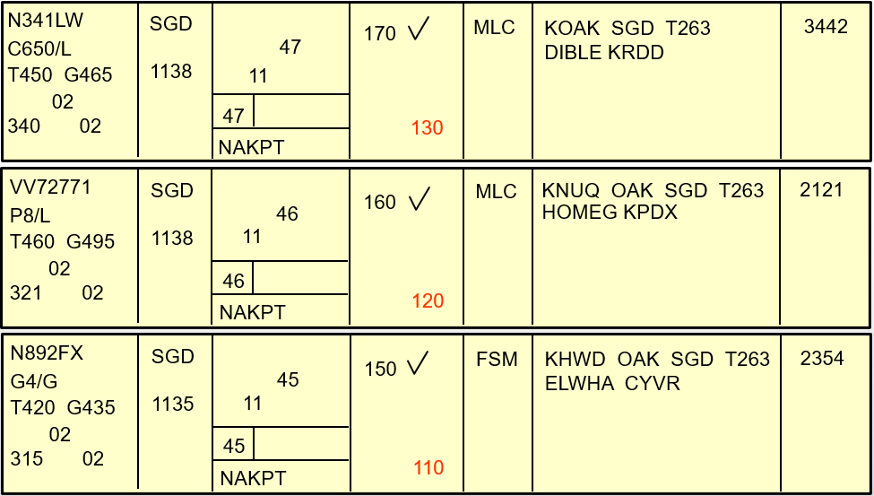
Exercise 1 - Question 2
TIME: 1144 - How would you clear each aircraft to its requested altitude?
N341LW
C650/L
T450 G465
02
340 02
SGD
1138
170
MLC
KOAK SGD T263 DIBLE KRDD
3442
47
11
47
130
NAKPT
VV72771
P8/L
T460 G495
02
321 02
SGD
1138
MLC
KNUQ OAK SGD T263 HOMEG KPDX
2121
46
160
11
46
NAKPT
120
POSSIBLE SOLUTION: Have N892FX descend and maintain 11,000’ and report leaving even altitudes. As you receive the even altitude reports, descend VV72771 to those altitudes and request VV72771 to report leaving odd altitudes. As VV72771 reports leaving odd altitudes, descend N341LW to those altitudes.
N892FX
G4/G
T420 G435
02
315 02
SGD
1135
FSM
KHWD OAK SGD T263 ELWHA CYVR
2354
45
150
11
45
NAKPT
110

Slide 31
Exercise 1 - Question 3
TIME: 0738 - How would you clear each aircraft to its requested altitude?
N674S
C310/A
T170
02
413 01
ENI
50
KSTS STS V494 ENI KUKI/0053
2315
D-A
ZME
50
0731/0732
70
KSTS P0730
N42P
PA23/A
T160
02
425 01
ENI
70
KSTS STS V494 ENI KUKI/0056
1503
D-A
ZME
70
0730/0730
KSTS P0730
90
POSSIBLE SOLUTION: Have N42P climb and maintain 9,000’ and report leaving 7,000’. When N42P reports leaving 7,000’, assign 7,000’ to N674S.

Slide 32
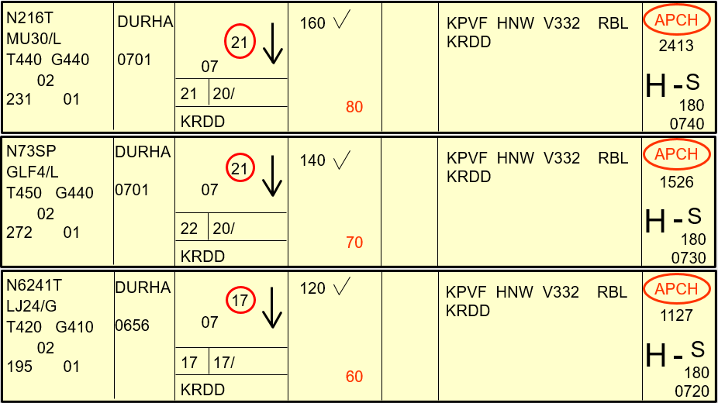
Exercise 1 - Question 4
TIME: 0720 - How would you clear each aircraft to its requested altitude?
N216T
MU30/L
T440 G440
02
231 01
DURHA
0701
160
KPVF HNW V332 RBL
KRDD
APCH
21
2413
07
H
S
180
0740
21
20/
80
KRDD
N73SP
GLF4/L
T450 G440
02
272 01
DURHA
0701
140
KPVF HNW V332 RBL
KRDD
APCH
21
07
1526
H
S
180
0730
22
20/
70
KRDD
N6241T
LJ24/G
T420 G410
02
195 01
POSSIBLE SOLUTION: Have N6241T descend and maintain 6,000’ and report leaving odd altitudes. As you receive those reports, descend N73SP to those altitudes and request N73SP to report leaving even altitudes. As you receive vacating reports from N73SP, assign N216T those altitudes.
DURHA
0656
120
KPVF HNW V332 RBL
KRDD
APCH
17
07
1127
H
S
180
0720
17
17/
60
KRDD

Slide 33
Minima
Altitude assignment procedures
Phraseology

Slide 34

The End

