Slide 1
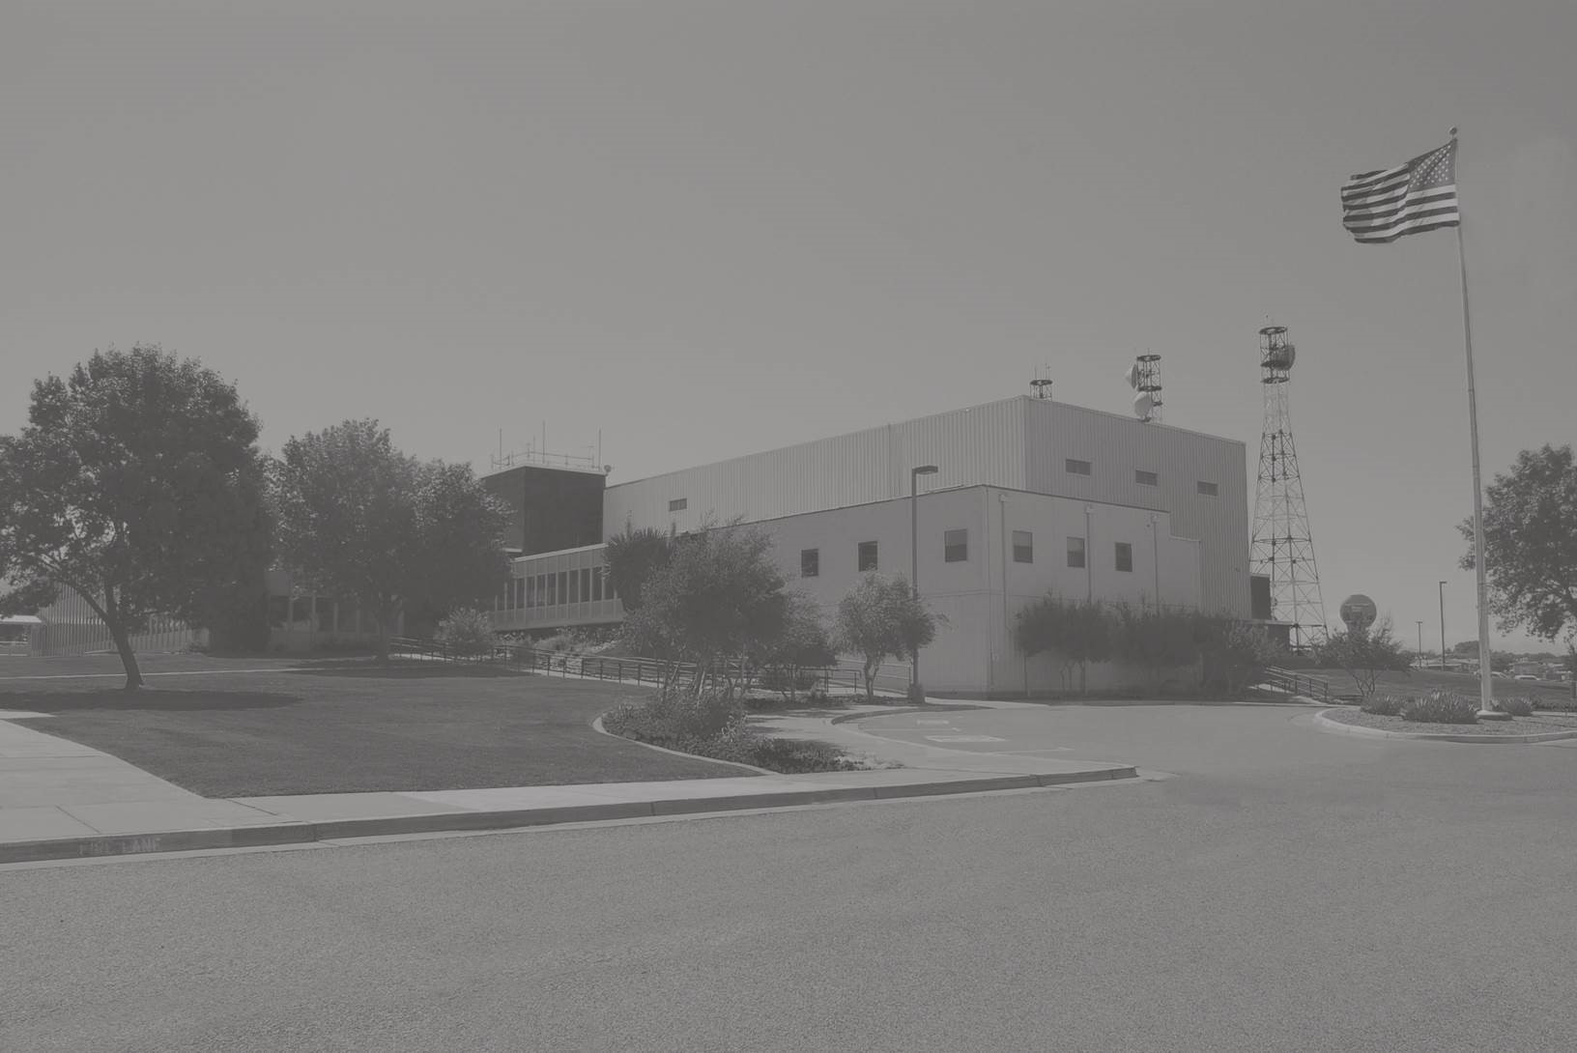

Slide 2
Lesson Objectives
At the end of this lesson, you will be able to identify:
Phraseology for ATC communications
Communications procedures

Slide 3
International Civil Aviation Organization (ICAO) Phonetics
ICAO phonetics are used for the pronunciation of numbers and letters
Clarifies individual letters
Prevents misunderstanding

Slide 4
Serial Numbers
Number | Stated
11,295 | "ONE ONE TWO NINER FIFE"
20,069 | "TWO ZERO ZERO SIX NINER"

Slide 5
Altitudes or Flight Levels
Number | Stated
10,000 | "ONE ZERO THOUSAND“ or, restated for clarity: “TEN THOUSAND”
17,900 | "ONE SEVEN THOUSAND NINER HUNDRED“ or, restated for clarity: “SEVENTEEN THOUSAND NINER HUNDRED”
Flight Level | Stated
180 | "FLIGHT LEVEL ONE EIGHT ZERO"
290 | "FLIGHT LEVEL TWO NINER ZERO"

Slide 6
MDA/DH Altitudes
Number | Stated
1,320 | "MINIMUM DESCENT ALTITUDE, ONE TREE TWO ZERO"
386 | "DECISION HEIGHT, TREE EIGHT SIX"

Slide 7
Time
Time (12 Hour) | Time (24 Hour) | Stated
1:15 a.m. | 0115 | “ZERO ONE ONE FIFE”
1:15 p.m. | 1315 | “ONE TREE ONE FIFE”
Time | Stated
2230 UTC | “TWO TWO TREE ZERO ZULU”
4:30 p.m. | “ONE SIX TREE ZERO LOCAL”
6:30 p.m. | “ONE EIGHT TREE ZERO PACIFIC”
11:02:15 | “ONE ONE ZERO TWO AND ONE QUARTER”
22:03:27 | “TWO TWO ZERO TREE AND ONE HALF”

Slide 8

Knowledge Check
What is the phraseology for stating an altitude?
“NINE THOUSAND FEET”
“NINER THOUSAND”
“NINER THOUSAND FEET”

Slide 9
Practice Exercise 1: ATC Times
Purpose
Review appropriate pronounciation of times in ATC communications
Materials
Practice exercise 1: ATC Times
Pen or pencil
Directions
Convert the 12 hour time into 24 hour time. Write the 24 hour time and the pronunciation in the spaces provided.

Slide 10
Practice Exercise 1
Time
Time
Stated: (ZULU or LOCAL as appropriate)
(24 Hour)
2:30 a.m.
0230
“ZERO TWO TREE ZERO LOCAL”
2058 UTC
2058
“TWO ZERO FIFE EIGHT ZULU”
6:25 a.m.
0625
“ZERO SIX TWO FIFE LOCAL”
11:30 p.m.
2330
“TWO TREE
TREE
ZERO LOCAL”
3:59 UTC
0359
“ZERO TREE FIFE NINER ZULU”
10:11 p.m.
2211
“TWO
TWO
ONE
ONE LOCAL”
7:12 a.m.
0712
“ZERO SEVEN ONE TWO LOCAL”
2136 UTC
2136
“TWO ONE TREE
SIX ZULU”

Slide 11
Field Elevation
Elevation | Stated
17 feet | "FIELD ELEVATION, ONE SEVEN"
817 feet | "FIELD ELEVATION, EIGHT ONE SEVEN"
2,817 feet | "FIELD ELEVATION, TWO EIGHT ONE SEVEN"

Slide 12
Altimeter Setting
Setting | Stated
29.92 | "ALTIMETER, TWO NINER NINER TWO"
30.01 | "ALTIMETER, TREE ZERO ZERO ONE"

Slide 13
Knowledge Check
What is the phraseology for stating an altimeter?
“ALTIMETER TWENTY NINE NINETY TWO”
“ALTIMETER TWO NINER POINT NINER TWO”
“ALTIMETER TWO NINER NINER TWO”

Slide 14
Practice Exercise 2: Numbers Phraseology, Part 1
Purpose
Review pronunciation of numbers in ATC communications
Materials
Practice exercise 2: Numbers Phraseology, Part 1
Pen or pencil
Directions
Write the pronunciation for each group of numbers in the spaces provided

Slide 15
Practice Exercise 2
Number | Pronounced
Altitude, 13,000 feet
Altitude, 19,000 feet
Altimeter, 29.92
UTC Time, 2235
Field Elevation, 166
“ONE TREE THOUSAND”
“FLIGHT LEVEL ONE NINER ZERO”
“ALTIMETER TWO NINER NINER TWO”
“TWO TWO TREE FIFE ZULU”
“FIELD ELEVATION ONE SIX SIX”

Slide 16
Surface Wind
Surface Wind | Stated
03025 | "WIND, ZERO TREE ZERO AT TWO FIFE"
27015G35 | "WIND, TWO SEVEN ZERO AT ONE FIFE GUSTS TREE FIFE"

Slide 17
Heading
Heading
Stated
5 degrees
30 degrees
360 degrees
“Heading zero zero fiFe”
“Heading zero tree zero”
“Heading tree six zero”

Slide 18
Beacon Code
Beacon Code | Stated
1000 | "ONE ZERO ZERO ZERO"
2100 | "TWO ONE ZERO ZERO"
1622 | "ONE SIX TWO TWO"

Slide 19
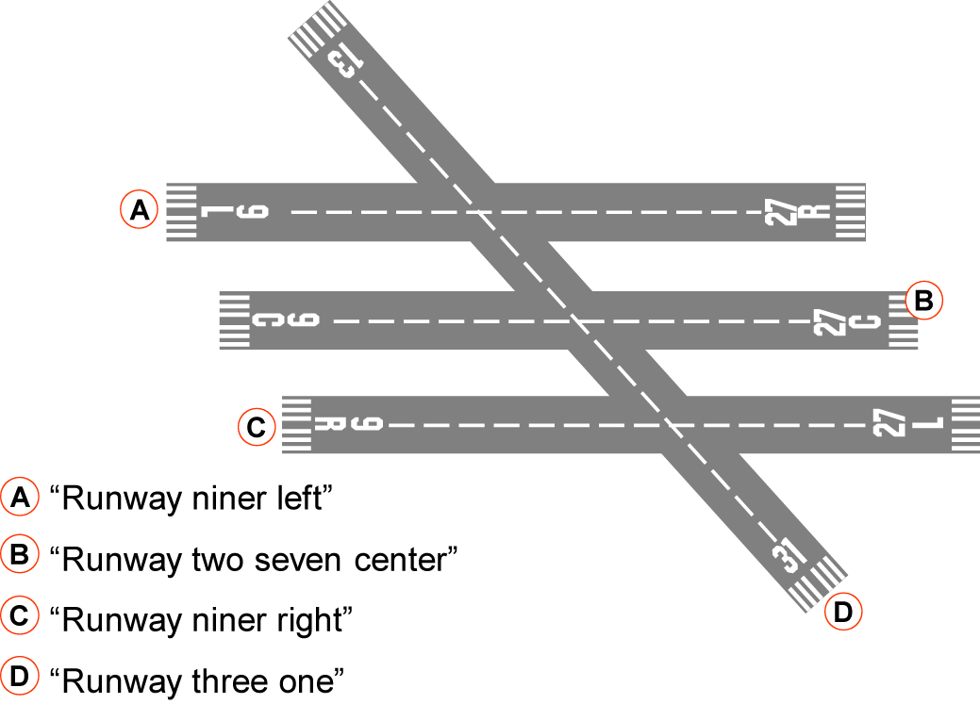
Runways

Slide 20
Frequencies
Frequency
Stated
126.55
369.0
121.5
253.0
135.275
302 kHz
“One two six point fiFe fiFe”
“Tree six niner point zero”
“One two one point fiFe”
“Two FIFE tree point zero”
“One tree fiFe point two seven”
“Tree zero two kiloHertz”

Slide 21
Frequencies (Cont’d)
Channel | Stated
12 | “LOCAL CHANNEL ONE TWO”
103 | “TACAN CHANNEL ONE ZERO TREE”

Slide 22
Speed and Mach Number
Speed | Stated
250 | "TWO FIFE ZERO KNOTS"
190 | "ONE NINER ZERO KNOTS”
Mach | Stated
1.5 | "MACH ONE POINT FIFE"
0.66 | "MACH POINT SIX SIX"
0.7 | "MACH POINT SEVEN"

Slide 23
Miles
Mileage | Stated
30 | "TREE ZERO MILES"
55 | “FIFE FIFE MILES"
108 | "ONE ZERO EIGHT MILES"

Slide 24
Knowledge Check
What is the phraseology for stating the frequency 116.225?
“ONE SIXTEEN POINT TWO TWENTY FIFE”
“ONE ONE SIX POINT TWO TWO FIFE”
“ONE ONE SIX POINT TWO TWO”

Slide 25
Practice Exercise 3: Numbers Phraseology, Part 2
Purpose
Review pronunciation of numbers in ATC communications
Materials
Practice exercise 3: Numbers Phraseology, Part 2
Pen or pencil
Directions
Write the pronunciation for each group of numbers in the spaces provided

Slide 26
Practice Exercise 3
Number
Pronounced
Speed, 250
"TWO FIFE ZERO KNOTS"
Frequency, 126.1
"ONE TWO SIX POINT ONE"
Miles, 30
"TREE ZERO MILES"
Runway, 15
"RUNWAY ONE FIFE"
Heading, 30 (degrees)
"HEADING ZERO TREE ZERO"
Wind, 50 (degrees) 20 (knots)
"WIND ZERO FIFE ZERO AT TWO
ZERO"
Code, 1200
"ONE TWO ZERO ZERO"
Mach, 0.9
"MACH POINT NINER"
Frequency, 123.255
"ONE TWO TREE POINT TWO FIFE"
Runway, 31C
"RUNWAY TREE ONE CENTER"
"WIND TWO ZERO ZERO AT ONE
Wind, 200 (degrees) 10 (knots)
ZERO"

Slide 27
Facility Identification
“Oakland Center”
“Anchorage Radio”
“Boston Tower”
“Tampa Approach”
“CORPUS CHRISTI G-C-A”

Slide 28
Knowledge Check
How does a pilot identify an airport traffic control tower?
State the name of the facility followed by the word “AIRPORT”
State the name of the facility followed by the word “TOWER”
State the word “TOWER” followed by the facility name

Slide 29
Knowledge Check
QUESTION
How is Oakland, California ARTCC identified?
“Oakland Center”
“OAKLAND RADIO”
“OAKLAND APPROACH”

Slide 30
Aircraft Identification - Civil
Civil identification examples
U.S. Aircraft Registry
“November One TREE two SIX”
Aircraft Model
“Skylane One TREE Two SIX”
Aircraft Manufacturer
“cessna one TREE two SIX”

Slide 31
Aircraft Identification - Air Carrier
Group form examples:
AAL52 - “AMERICAN FIFTY-TWO”
DAL100 - “DELTA ONE HUNDRED”
UAL75 - “UNITED SEVENTY-FIFE”
If confusion exists, pronounce digits one at a time for clarity
SWA570 - “SOUTHWEST FIFE SEVEN ZERO”

Slide 32
Aircraft Identification - Air Taxi
Air taxi identification examples:
TN15Q
“TANGO MOONEY ONE FIFE QUEBEC”
TN31H
“TANGO NOVEMBER TREE ONE HOTEL”

Slide 33
Aircraft Identification - Air Ambulance
Air Carrier and Air Taxi examples:
“MEDEVAC” in the flight plan remarks
DAL51 - “MEDEVAC DELTA FIFTY-ONE”
TN612 - “MEDEVAC TANGO NOVEMBER SIX ONE TWO”
General Aviation example:
LN3BH - “MEDEVAC TREE BRAVO HOTEL”

Slide 34
Restate Call Sign for Clarity
Examples
AAL52 - “AMERICAN FIFTY-TWO AMERICAN”
ASA52 - “ALASKA FIFTY-TWO ALASKA”

Slide 35
U.S. Military Prefixes
Prefix | Service | Example
A | Air Force | A35562
C | Coast Guard | C12577
G | Air/Army National Guard | G56472
R | Army | R33617
VM | Marine | VM56734
VV | Navy | VV32756

Slide 36
Special Operations Prefixes
Prefix | Mission/Special Operation | Example
E | Air Evac (Air Evacuation) | E50213
RCH | AMC (Air Mobility Command) | RCH276
S | SAM (Special Air Mission) | S29000
L | Logair (USAF Contract) | L65324
Service prefix | Example: “COAST GUARD RESCUE” | C7233

Slide 37
U.S. Military Tactical and Training
Examples:
PINON63 - “Pinyon six tree”
Skyblt11 - “skybolt one one”
Roper61 - “roper six one”
VVAB10 - “NAVY ALPHA BRAVO ONE ZERO”

Slide 38
Presidential Aircraft Identification
Office | Military | Civil
President | "(Military service) ONE" Examples: "AIR FORCE ONE", "MARINE ONE" | "EXECUTIVE ONE"
President's Family | "EXECUTIVE ONE FOXTROT" | "EXECUTIVE ONE FOXTROT"
Vice President | “(Military service) TWO" Examples: "AIR FORCE TWO", "MARINE TWO" | "EXECUTIVE TWO"
Vice President's Family | "EXECUTIVE TWO FOXTROT" | "EXECUTIVE TWO FOXTROT"

Slide 39
DOT and FAA Flights
Official | Identifier | Call Sign
Secretary of Transportation | DOT-1 | "TRANSPORT ONE"
Deputy Secretary of Transportation | DOT-2 | "TRANSPORT TWO"
Administrator, Federal Aviation Administration | FAA-1 | "SAFEAIR ONE"
Deputy Administrator, Federal Aviation Administration | FAA-2 | "SAFEAIR TWO"

Slide 40
Other Special Flights
Special Flight | Call Sign
Flight Check | "FLIGHT CHECK"
Air Force Aerial Sampling Mission | "SAMP"

Slide 41
Foreign Registry
Civil:
State aircraft type or manufacturers name followed by letters/digits of aircraft registration, or
Letters/digits of aircraft registration or call sign
Air Carrier:
State ICAO 3LD telephony of operating company followed by letters/digits of registration or call sign, or
The flight number in group form
Military:
Name of the country and military service followed by separate digits/letters of registration or call sign

Slide 42
Foreign Registry (Cont’d)
Foreign aircraft registry beginning with a number
Current En Route automation will not process an aircraft identification that begins with a number
Amend an aircraft ID containing six or fewer characters by inserting the letter “Q” as the first character of the aircraft ID
An aircraft ID that contains seven characters is amended by replacing the first character with the letter “Q”
This procedure does not apply to Advanced Technologies and Oceanic Procedures (ATOP)

Slide 43
Knowledge Check
What is the prefix for a domestic general aviation aircraft?
“TANGO”
“KILO”
“NOVEMBER”

Slide 44
Knowledge Check
What is the phraseology for AAL52?
“AMERICAN FIFTY-TWO”
“52 AMERICAN”
“AMERICAN FIFTY”

Slide 45
Knowledge Check
What is the prefix for a civilian airborne ambulance flight?
“LIFEFLIGHT”
“LIFEGUARD”
“MEDEVAC”

Slide 46
Knowledge Check
What are the letter prefixes for the following military services: Air Force, Army, and Navy?
AF, RM, and VM
AF, AR and VV
A, R and VV

Slide 47
Knowledge Check
What is the call sign for the Administrator of the FAA?
“ADMINISTRATOR ONE”
“FAA ONE”
“SAFEAIR ONE”

Slide 48
Words and Phrases
Controllers and pilots need to speak the same language
Use the words or phrases in radio and interphone communications contained in the Pilot/Controller Glossary

Slide 49
Emphasis for Clarity
Emphasize digits, letters or similar sounding words to aid in distinguishing similar sounding call signs
Notify each pilot concerned when in communications with aircraft having similar sounding call signs
Notify the operations supervisor/CIC of any duplicate flight identification numbers or phonetically similar-sounding call signs when the aircraft are operating simultaneously within the same sector

Slide 50
Monitoring Requirements
Monitor interphones and assigned radio frequencies continuously
Maintain adequate volume to hear all calls

Slide 51
Pilot Acknowledgement
Ensure acknowledgement from the pilot for all clearances or instructions issued
If no acknowledgement is received, attempt to re-establish contact

Slide 52
Authorized Interruptions
As necessary, a pilot may be authorized by ATC to interrupt the communications guard
A time limit for the pilot to be off frequency should be issued by the controller
The pilot should inform the controller of the frequency that will be monitored
The controller should instruct the pilot to report back on the sector frequency

Slide 53
Authorized Transmissions
Transmit only those messages:
Necessary for air traffic control
That contribute to air safety

Slide 54
False or Deceptive Communications
Take action to prevent, and report false, deceptive, or phantom controller communications
Correct false information
Broadcast an alert
Collect pertinent information regarding the incident
Notify supervisor/CIC

Slide 55

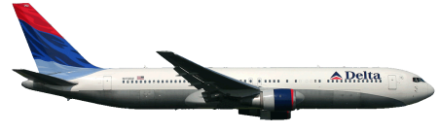
Authorized Relays
“DELTA TREE SIXTY, WILCO.”
“DELTA TREE SIXTY CONTACT YOUR COMPANY FOR A MESSAGE.”

Slide 56
Radio Message Format
“MEMPHIS CENTER, DELTA TWO TWENTY-TWO, LEVEL AT ONE SEVEN THOUSAND.”
“DELTA TWO TWENTY-TWO, MEMPHIS CENTER, THE MEMPHIS ALTIMETER TWO NINER NINER SEVEN.”

Slide 57
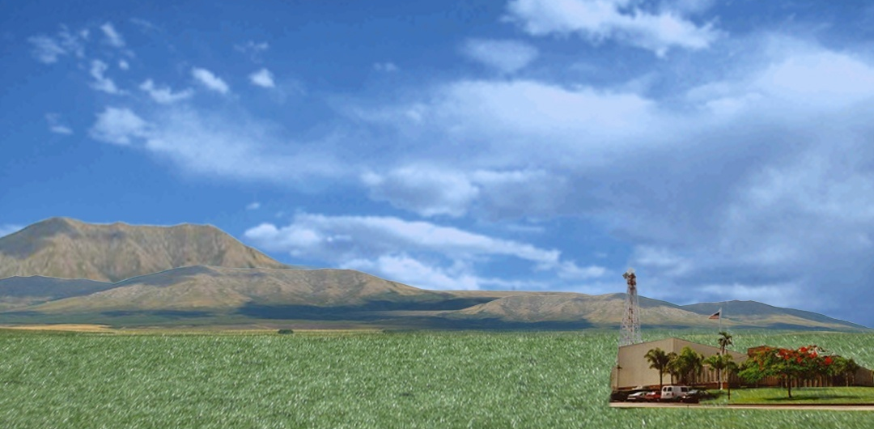



Abbreviated Transmissions
N7823T
N6723T
“NOVEMBER TWO TREE TANGO…”

Slide 58
Knowledge Check
When may a pilot interrupt their communication guard?
When at cruise altitude
When authorized by ATC
Only in two pilot aircraft

Slide 59
Interphone Priorities
First priority
Emergency messages
Second priority
Clearances and control instructions
Third priority
Movement and control messages
Fourth priority
Movement messages on VFR aircraft

Slide 60
Priority Interruption
To interrupt a lower priority message when you have an emergency or control message to transmit, use the words:
EMERGENCY
Example: “BREAK FOR EMERGENCY”
CONTROL
Example: “BREAK FOR CONTROL”

Slide 61
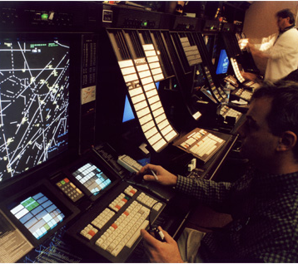
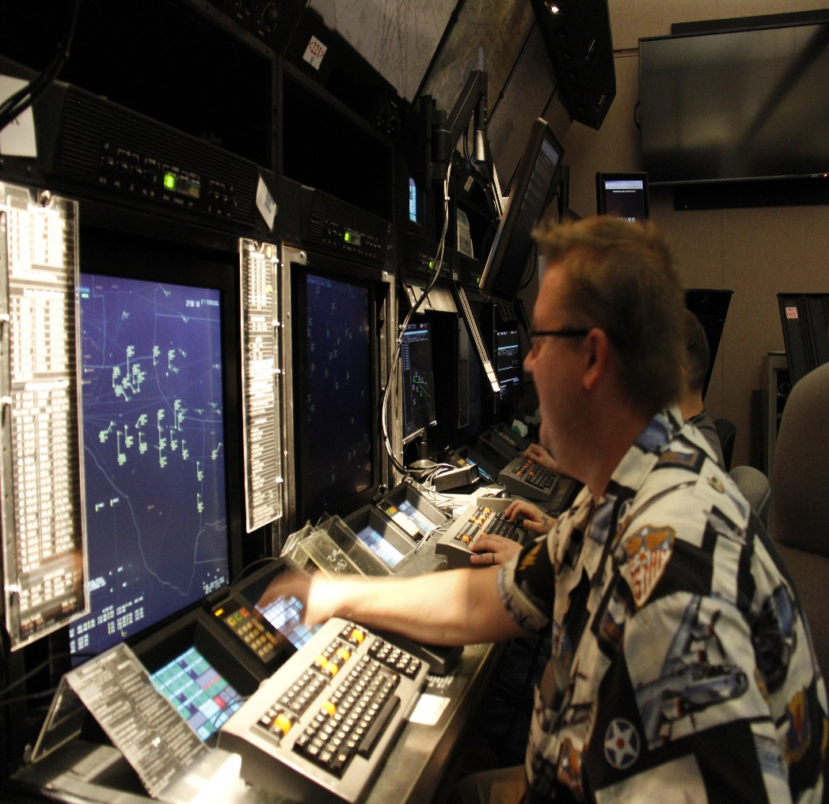
Interphone Message Format
“ONE TWO MILES NORTHWEST OF BARTLESVILLE, CODE TWO TWO SIX ONE AT SEVEN THOUSAND DIRECT FORT SMITH.”
“CODE TWO TWO SIX ONE, POINT OUT APPROVED, G.T.”
“SECTOR FORTY-TWO, GO AHEAD.”
“SECTOR FORTY-TWO, TULSA LOW POINT OUT.”
“F.X.”

Slide 62
Loss of Communications
Loss of communications for more than 5 minutes requires notification to the supervisor/CIC
Note the time of last communication
Inform the Supervisor what steps have been taken to reestablish communications with the aircraft

Slide 63
Knowledge Check
If a pilot does not acknowledge your clearance, and your attempts to reestablish communications are not successful, what action must you take?
Consider that the clearance was not issued
Advise the supervisor/CIC
Relay the clearance through other aircraft

Slide 64
Good Communication Skills
Talk to each other
Relay critical info
Give specific info
Confirm message understood
Careful stripmarking
Speak…
Explicitly! Specifically!
Clearly! Slowly!
Speak up when needed

Slide 65
Barriers to Communication
Use of non-standard phraseology
Using complicated or unfamiliar terms
Lack of attention, interest, or distractions
Differences in perception and viewpoint
Interpersonal barriers

Slide 66
Controller Responsibilities In Communication
Speaking
Listening
Professional attitude
Assertive communication
Appropriate communication for the type of pilot

Slide 67
Practice Exercise 4: Communications Skills
Purpose
Identify and understand common barriers to communication
Materials
Practice exercise 4: Communication Skills
Pen or pencil
Directions
Listen to the audio files and write down the strengths and weaknesses of each controller’s communications

Slide 68

Practice Exercise 4: Communications Skills
This exercise contains seven audio recordings of controller communication
Listen to the situations and write down your impression of each
Situation 1
Situation 2
Situation 3
Situation 4
Situation 5
Situation 6
Situation 7

Slide 69
Practice Exercise 5: Listening for Readback Errors
Purpose
Identify readback errors in ATC communications
Materials
Practice exercise 5: Listening for Readback Errors
Pen or pencil
Directions
Listen to the audio files and write down any readback errors

Slide 70
Practice Exercise 5: Listening For Readback Errors
This exercise contains eight audio recordings of situations in which clearances are issued
Listen for the readback errors and write them down
Clearance 1
Clearance 1 corrected
Clearance 2
Clearance 2 corrected

Slide 71
Practice Exercise 5: Listening For Readback Errors (Cont’d)
This exercise contains eight audio recordings of situations in which clearances are issued
Listen for the readback errors and write them down
Clearance 3
Clearance 3 corrected
Clearance 4
Clearance 4 corrected

Slide 72
Practice Exercise 5: Listening For Readback Errors
This exercise contains eight audio recordings of situations in which clearances are issued
Listen for the readback errors and write them down
Clearance 5
Clearance 5 corrected
Clearance 6
Clearance 6 corrected

Slide 73
Practice Exercise 5: Listening For Readback Errors
This exercise contains eight audio recordings of situations in which clearances are issued
Listen for the readback errors and write them down
Clearance 7
Clearance 7 corrected
Clearance 8
Clearance 8 corrected

Slide 74
Lesson Summary
This lesson covered:
Phraseology for communicating
Communications procedures

Slide 75

The End

