Slide 2
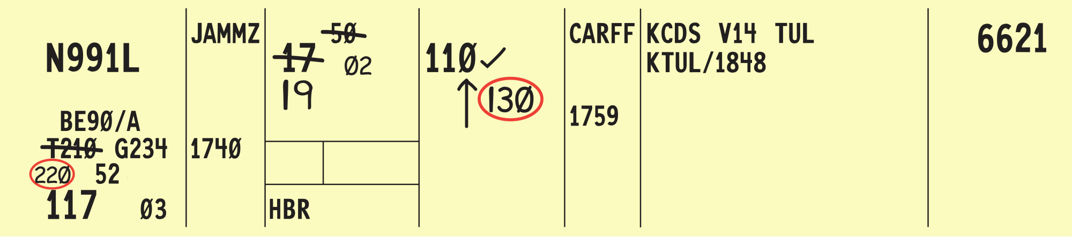
Recording Clearances and Control Information

Slide 3
Flight progress strip notations
Flight strip data entries

Slide 4

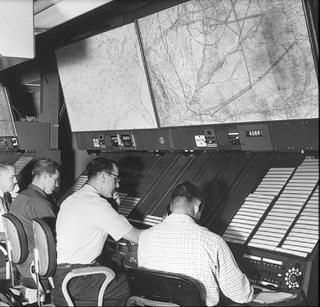
Post Current Data
Clearance information must be current, obsolete data may confuse the current state of the flight
  Maintain required data only
  Remove strips when no longer required for control purposes

Slide 5
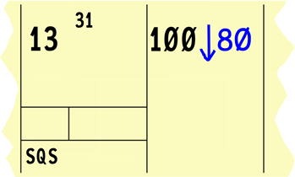
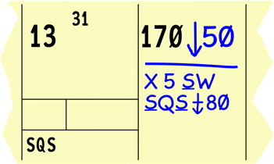
Strip Marking Records Clearances
Strip Marking records data on air traffic and clearances required for control and other air traffic control services
  Proper strip marking is an abbreviated format for recording data
  Clearances should be correctly represented in strip marking

Slide 6
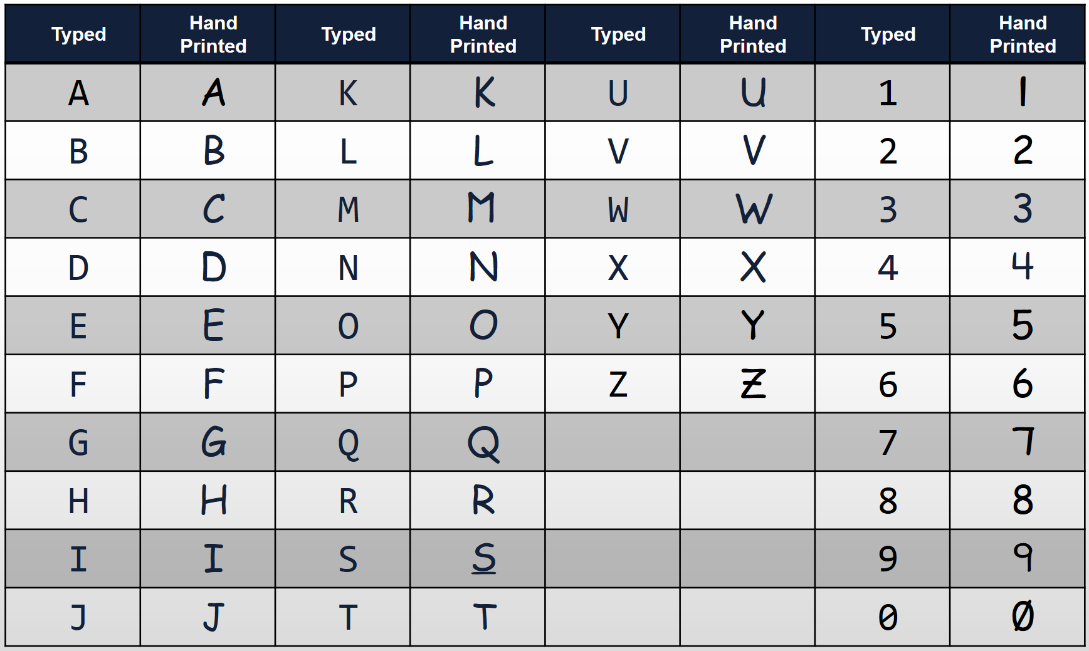
Standard Hand-Printed Characters

Slide 7
Corrections, Amendments and Preplanning
Do not erase or overwrite any item
  Write new altitude information immediately adjacent to old information and within the same block
Use an “X” to delete:
  Climb/descent arrows
  At or above/below symbols
  Cruise symbol
  Unwanted altitude information
Do not draw a line through an altitude until the aircraft reports or is observed (valid Mode C) leaving the altitude

Slide 8
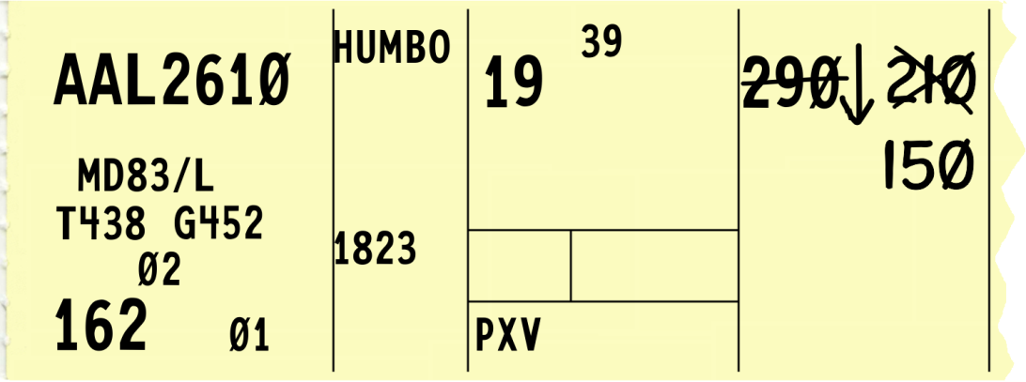
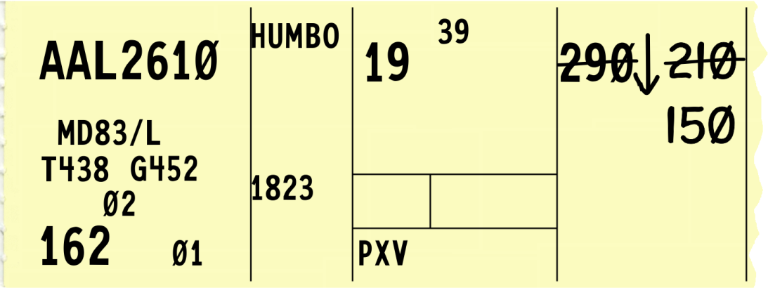
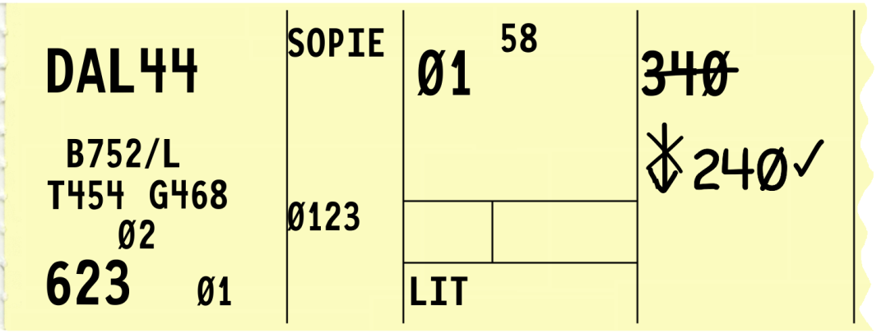
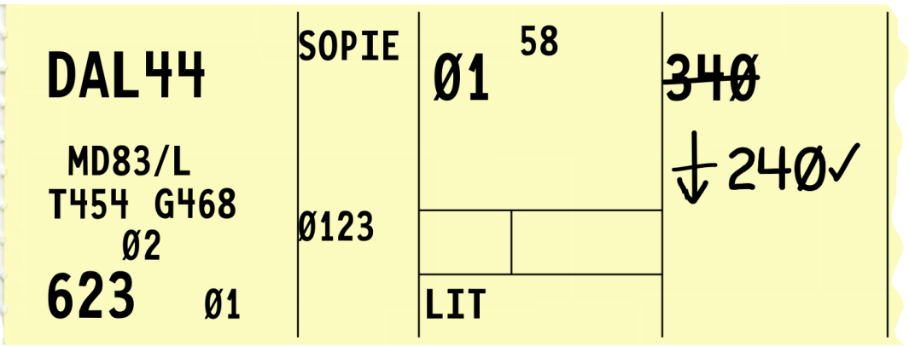
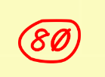

Corrections, Amendments and Preplanning (Cont’d)
Correct
Incorrect

Slide 9
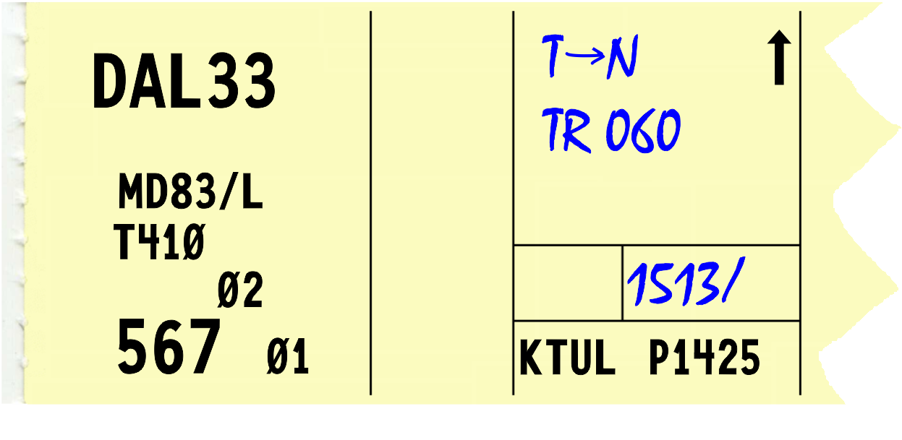
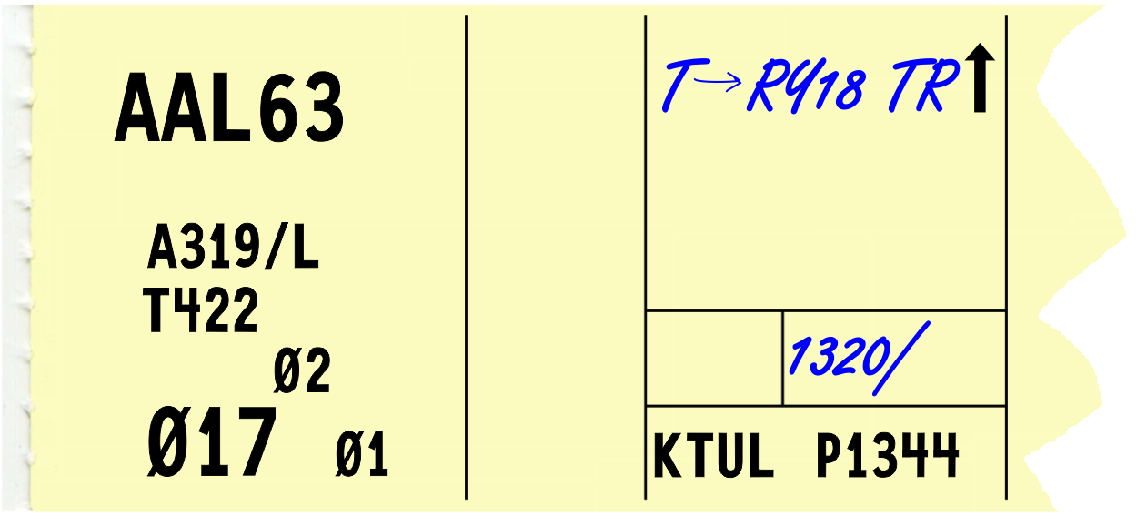
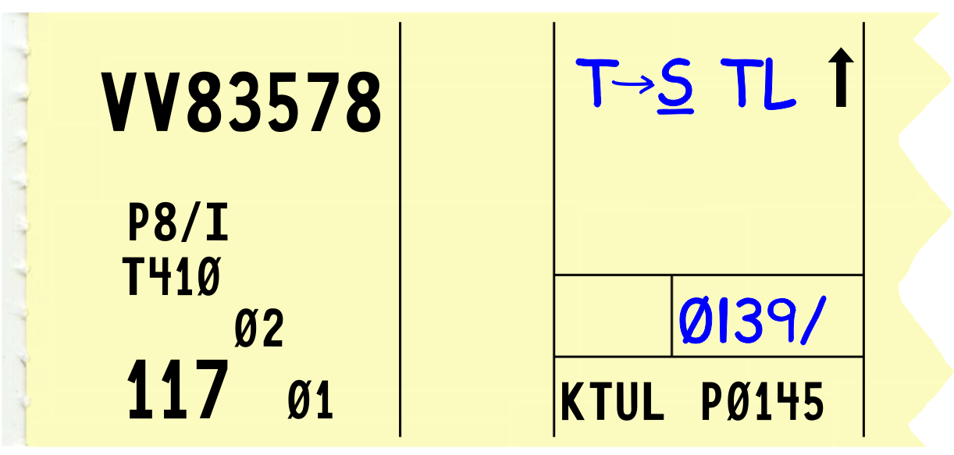
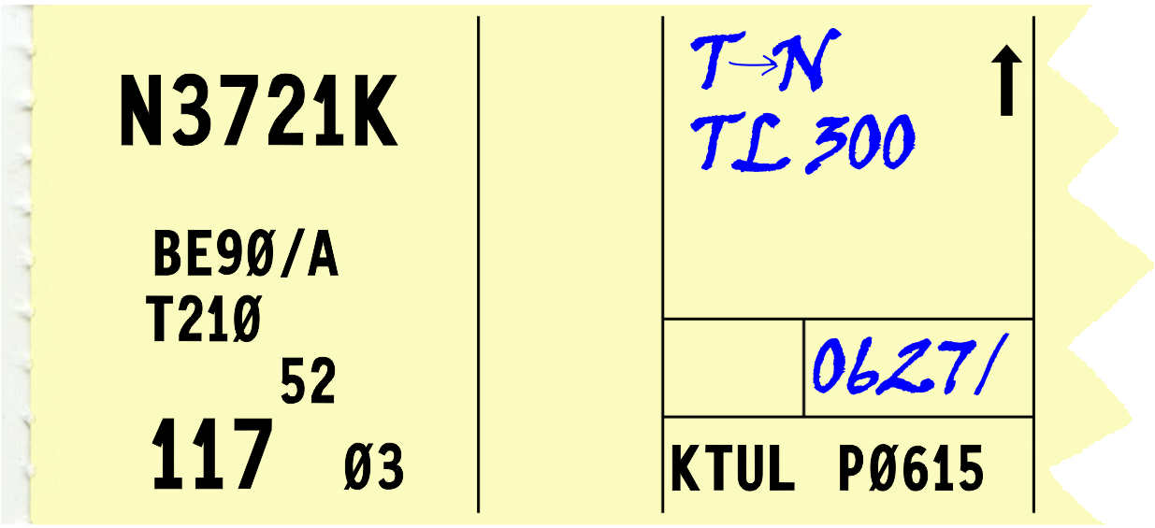
Knowledge Check
Which flight strip has properly printed characters?
C.
A.
B.
D.

Slide 10
Knowledge Check
How is unwanted altitude information indicated in strip marking?
Overwrite the attitude with bold pen
Draw a single horizontal line through the altitude
Place an “X” over the altitude

Slide 11
Knowledge Check
When should flight strips be removed from flight progress boards?
When the pilot checks on frequency
At the end of your shift
When no longer required for control purposes

Slide 12
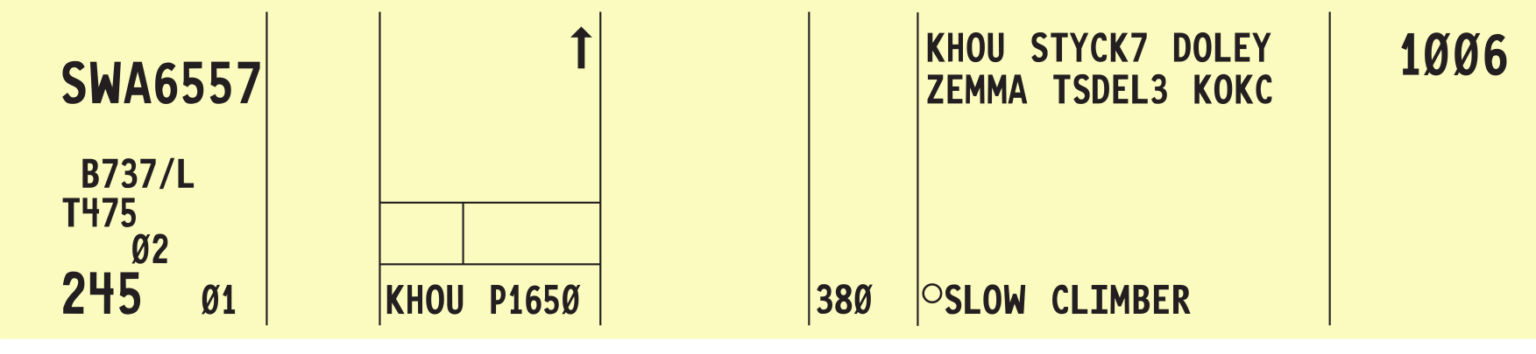
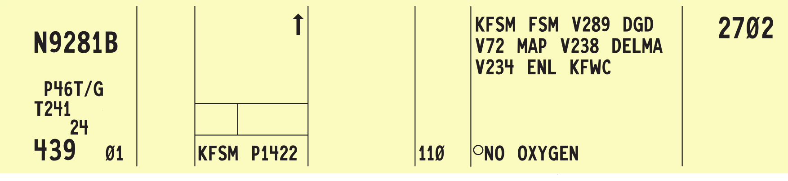
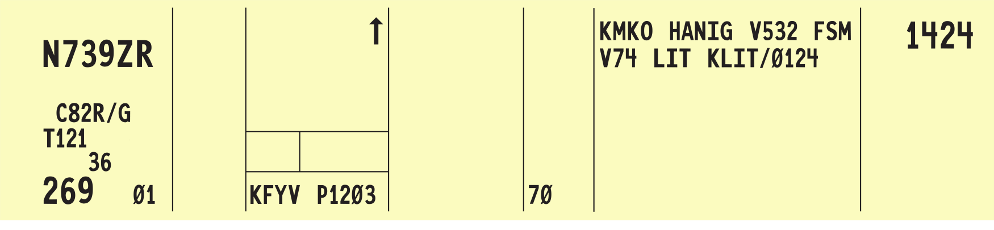
Proposal Strips
16
19
16
19
16
19

Slide 13
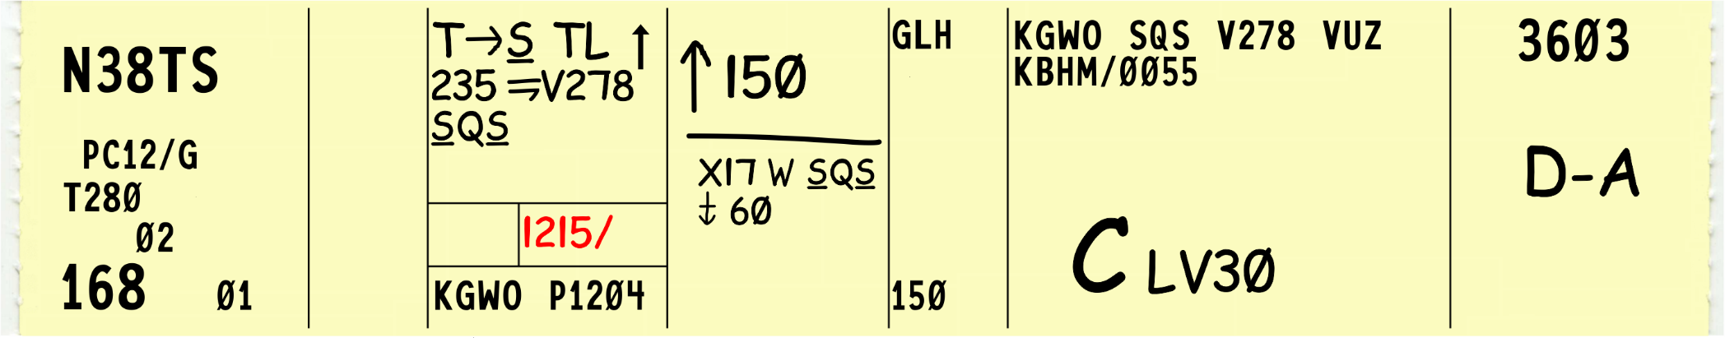
Departure Strips - Data Entries
15
20
28
18
26
29-30
Clearance information for departing aircraft
Departure time (actual or assumed)
Altitude information
Remarks
Miscellaneous control data
29-30. Transfer of control data and coordination indicators

Slide 14
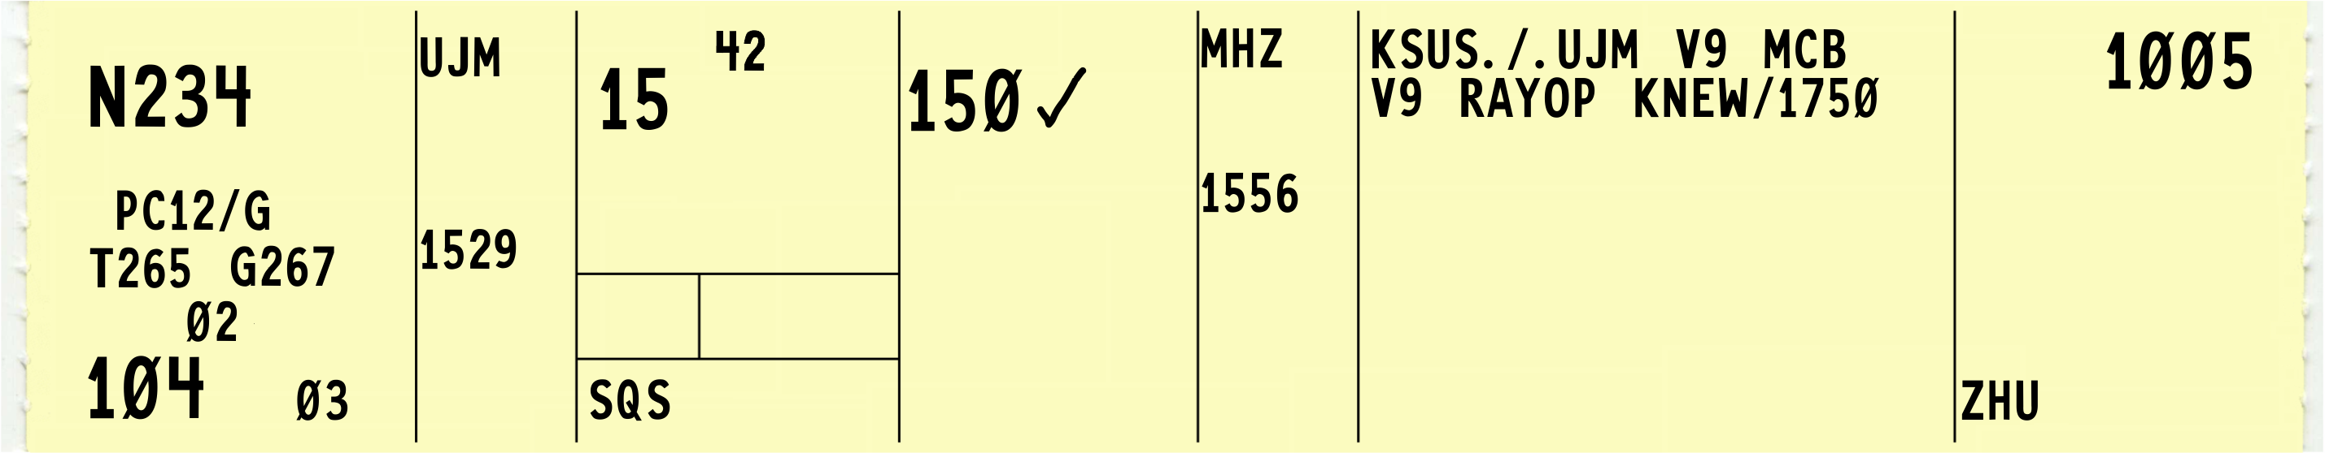
En Route Strips - Data Entries
11
15
20
12
14a
19
20a
11. Previous fix
12. Estimated time over previous fix
14a. Plus time, in minutes, previous fix to the posted fix
15. Center estimated time over posted fix
19. Posted fix
20. Altitude information
20a. TCAS Resolution Advisory (RA) events

Slide 15
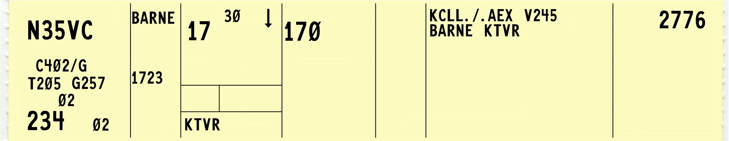
Arrival Strips - Data Entries
16
Arrival arrow

Slide 16
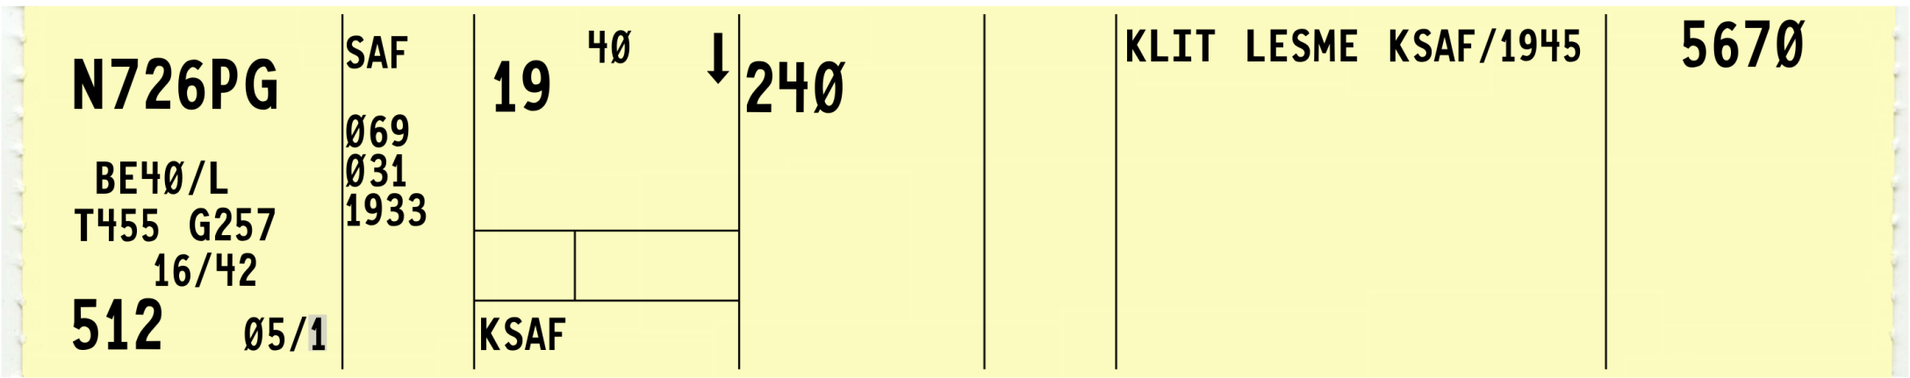
Computer Programmed Blocks
16
8
9
7
10
Sector number
Computer ID (CID)
Estimated ground speed
Sector/Strip Request (SR) originator
Strip number/revision
Arrow; departing “↑”, arriving “↓”

Slide 17
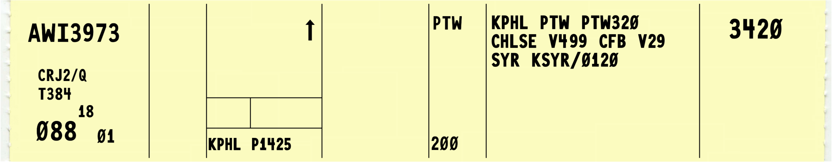
Flight Strip Data Locations
3
21
25
27
4
5
24
29-30
19
26
Aircraft identification
Number, type aircraft/suffix
Filed true airspeed
Fix, proposed time
Next fix
Requested altitude
Point of origin, route of flight
Remarks
Beacon code
29-30. Transfer of control data and ______coordination indicators

Slide 18

Knowledge Check
3
11
15
16
20
27
21
25
4
28
8
12
5
18
6
24
29-30
7
10
14a
19
20a
26
What block contains Filed True Airspeed?
  4
  5
  8

Slide 19
Knowledge Check
3
11
15
16
20
27
21
25
4
28
8
12
5
18
6
24
29-30
7
10
14a
19
20a
26
What block contains Proposed Departure Time?
  15
  18
  19

Slide 20
Knowledge Check
3
11
15
16
20
27
21
25
4
28
8
12
5
18
6
24
29-30
7
10
14a
19
20a
26
Miscellaneous Control Data (e.g., clearance limit, EFC, time cleared for approach) is entered in which block?
  25
  26
  28

Slide 21
Knowledge Check
3
11
15
16
20
21
27
25
4
28
5
8
12
6
18
24
7
26
29-30
10
14a
19
20a
Departure Time (actual or assumed) is entered in which block?
  15
  18
  19

Slide 22
Knowledge Check
3
11
15
16
20
27
21
25
4
28
8
12
5
18
6
24
29-30
7
10
14a
19
20a
26
Altitude Information is entered in which block?
  20
  21
  25

Slide 23
Knowledge Check
3
11
15
16
20
27
21
25
4
28
8
12
5
18
6
24
29-30
7
10
14a
19
20a
26
Departure Instructions are entered in which block?
  15
  25
  28

Slide 24
Knowledge Check
3
11
15
16
20
21
27
25
4
28
8
12
5
18
6
24
29-30
7
10
14a
19
20a
26
Which block contains a Center Estimate over Posted Fix for en route flights?
  11
  15
  21

Slide 25
Knowledge Check
3
11
15
16
20
27
21
25
4
28
8
12
5
18
6
24
29-30
7
10
14a
19
20a
26
RA events are recorded in which block?
  20a
  25
  26

Slide 26
Knowledge Check
3
11
15
16
20
27
21
25
4
28
8
12
5
18
6
24
29-30
7
10
14a
19
20a
26
Which block will contain an arrow to indicate departing/arriving flights?
  15
  16
  20

Slide 27
Knowledge Check
3
11
15
16
20
27
21
25
4
28
8
12
5
18
6
24
29-30
7
10
14a
19
20a
26
Which block contains the Estimated Time over Previous Fix?
  12
  18
  21

Slide 28
Practice Exercise 1: Flight Strip Data Locations
Purpose
  Review computer generated flight strip data locations
Materials
  Practice exercise 1 from Lesson 1 handout
  Pencil or pen
Directions
  Use the flight strip examples provided to answer the questions

Slide 29
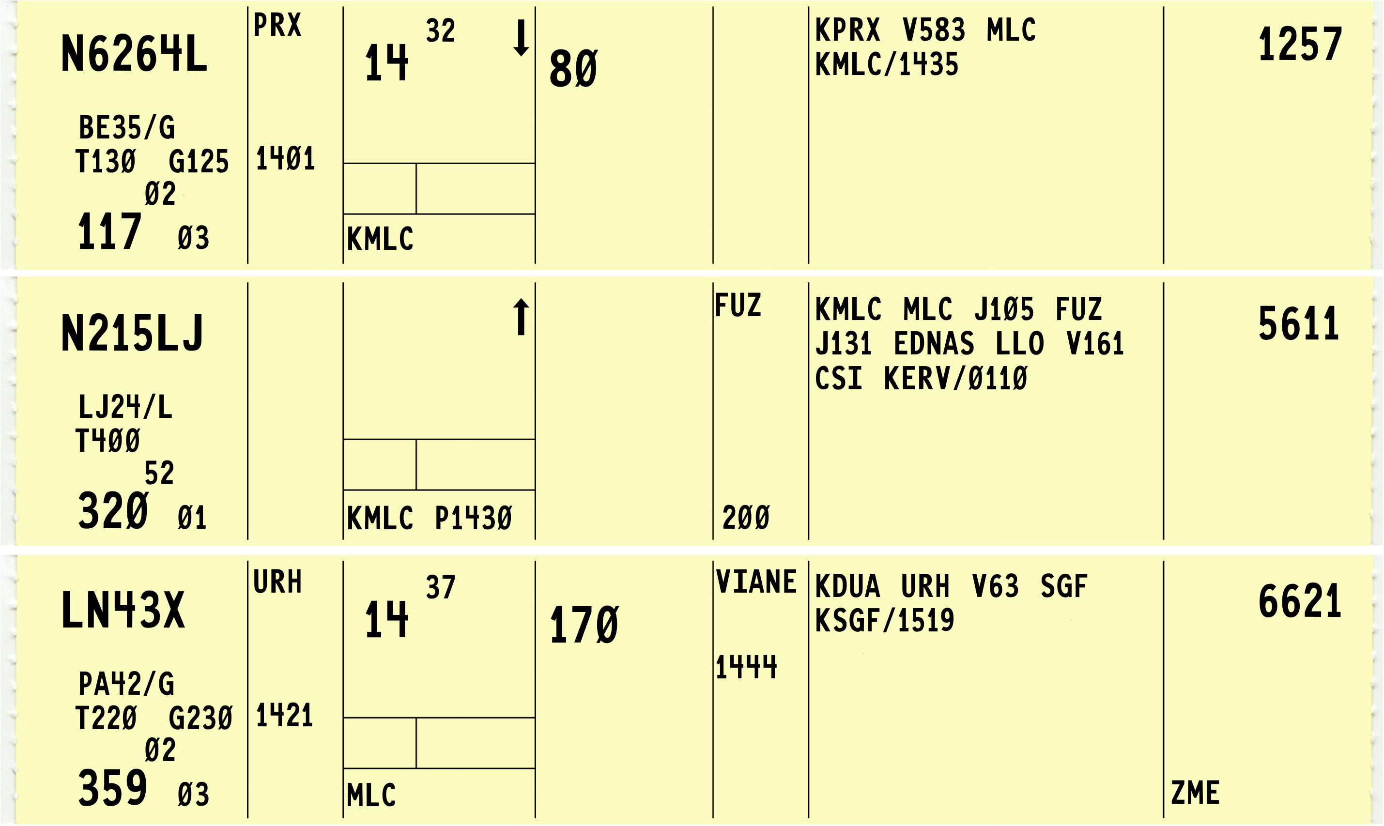
Practice Exercise 1

Slide 30
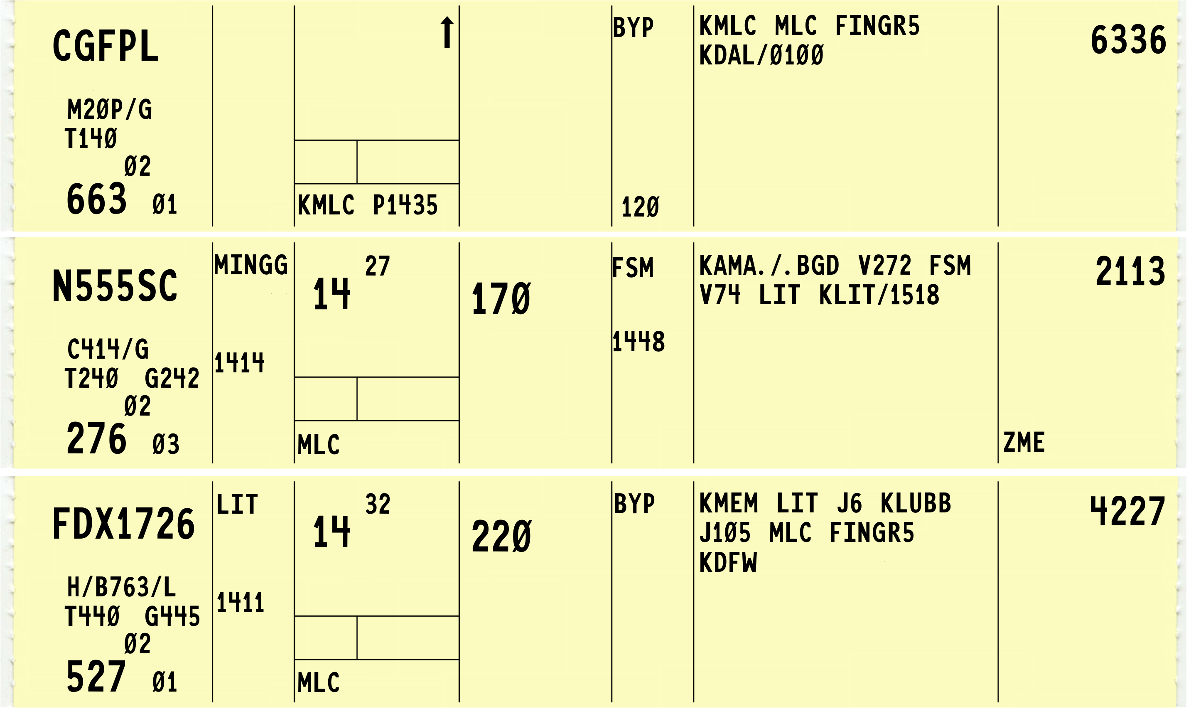
Practice Exercise 1 (Cont’d)

Slide 31
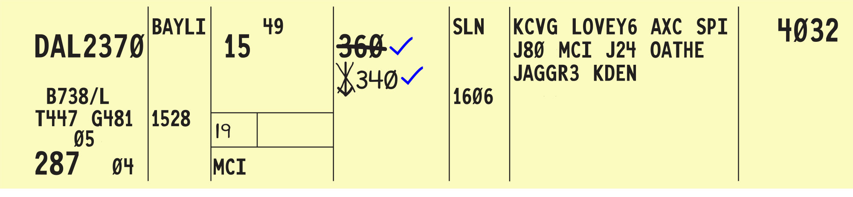
Aircraft Reported at Assigned Altitude

Slide 32
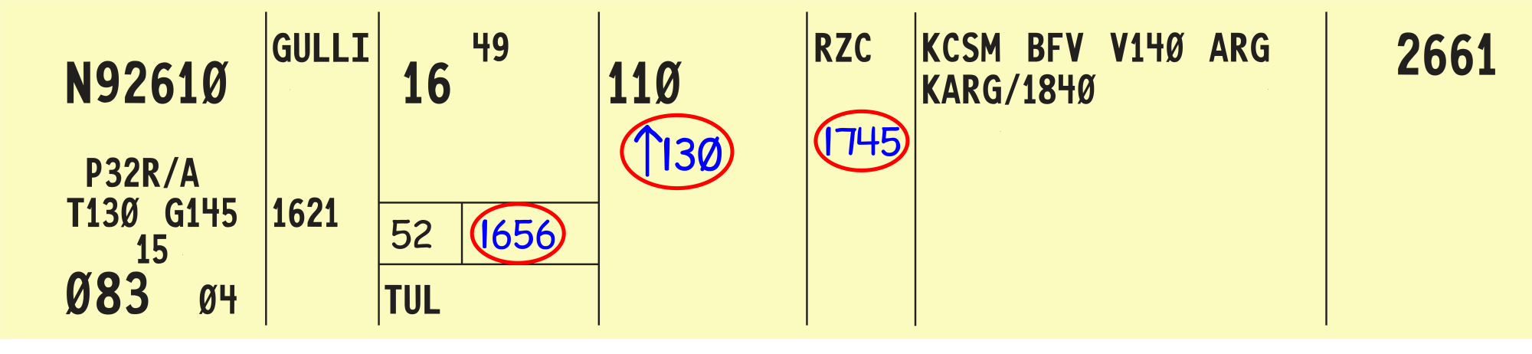
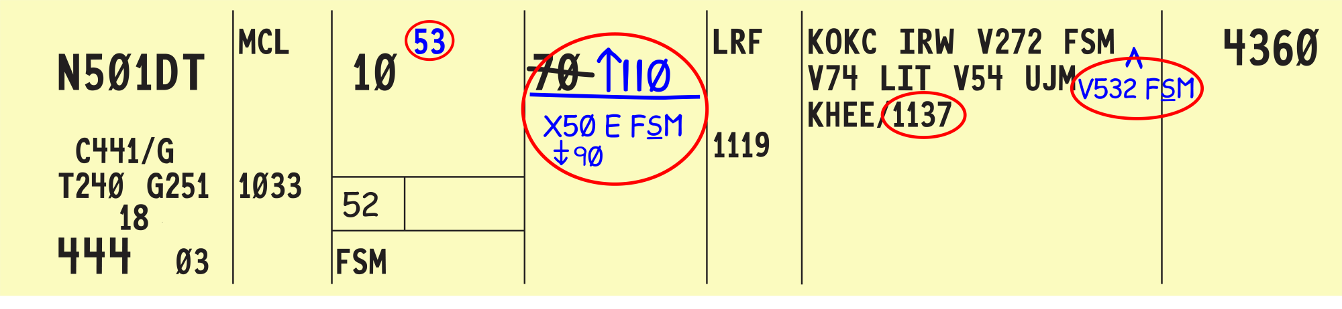
Information Forwarded

Slide 33


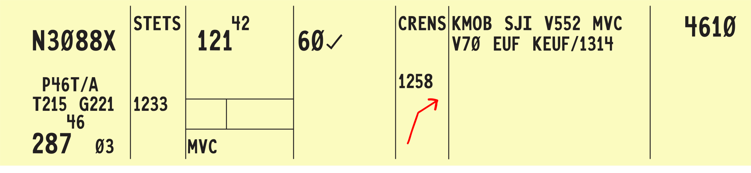
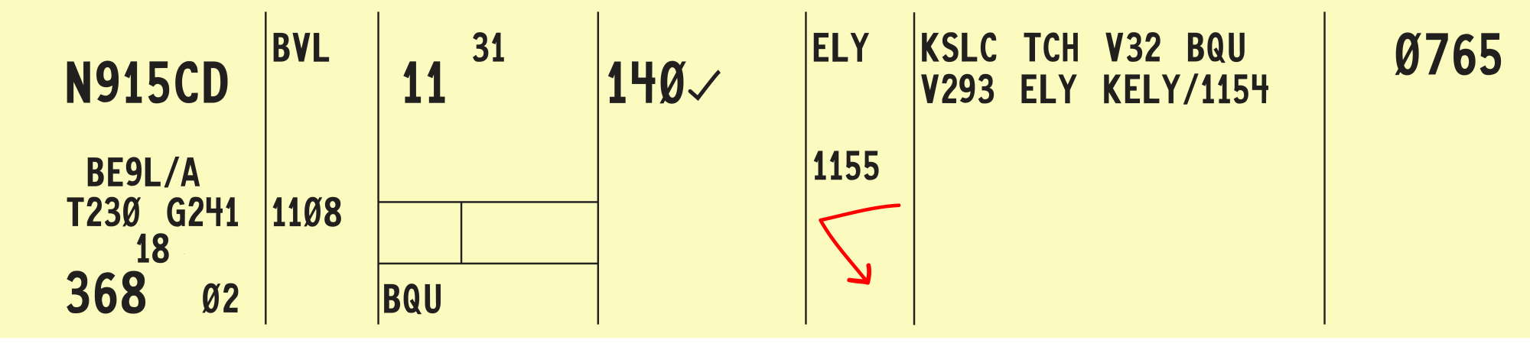
Direction of Flight

Slide 34

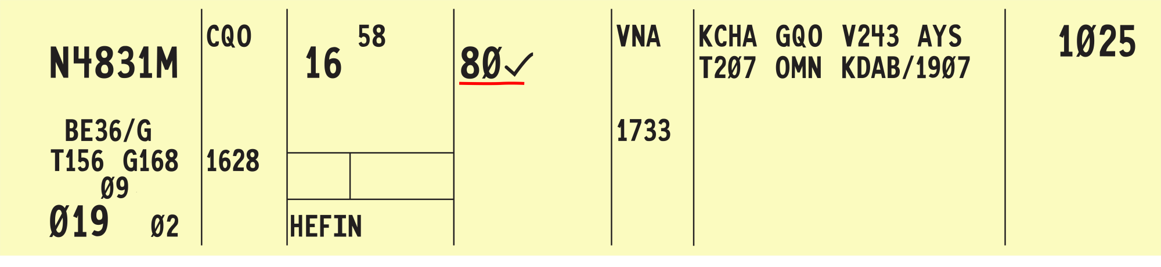
Inappropriate Altitude for Direction of Flight

Slide 35

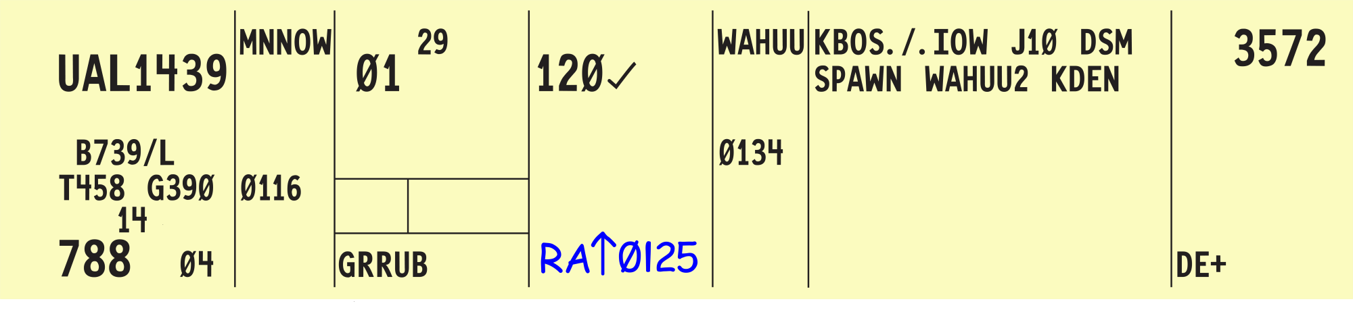
Resolution Advisory

Slide 36

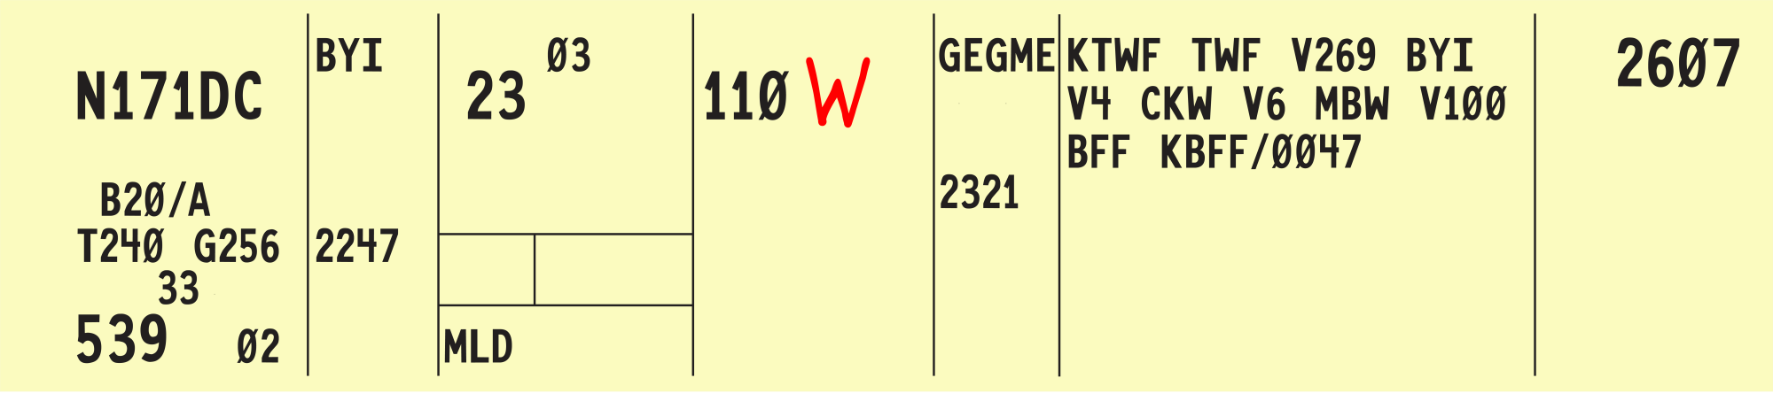
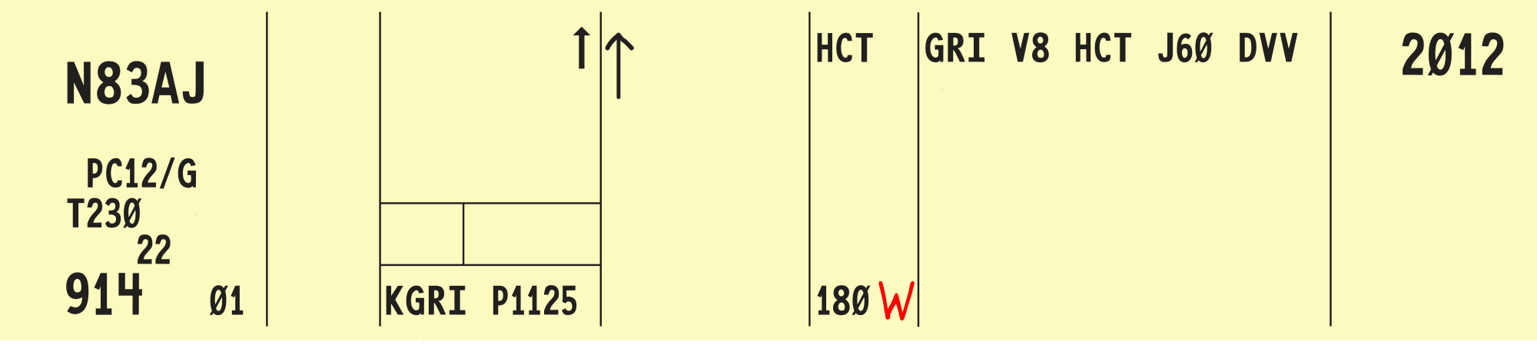
Warning
En Route Strip
Proposal Strip

Slide 37

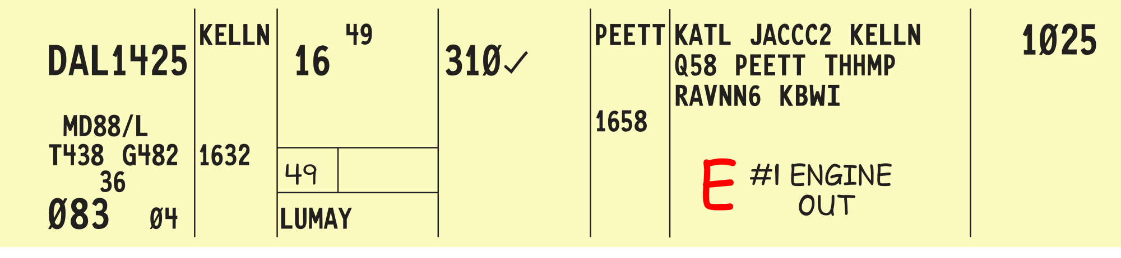
Emergency

Slide 38

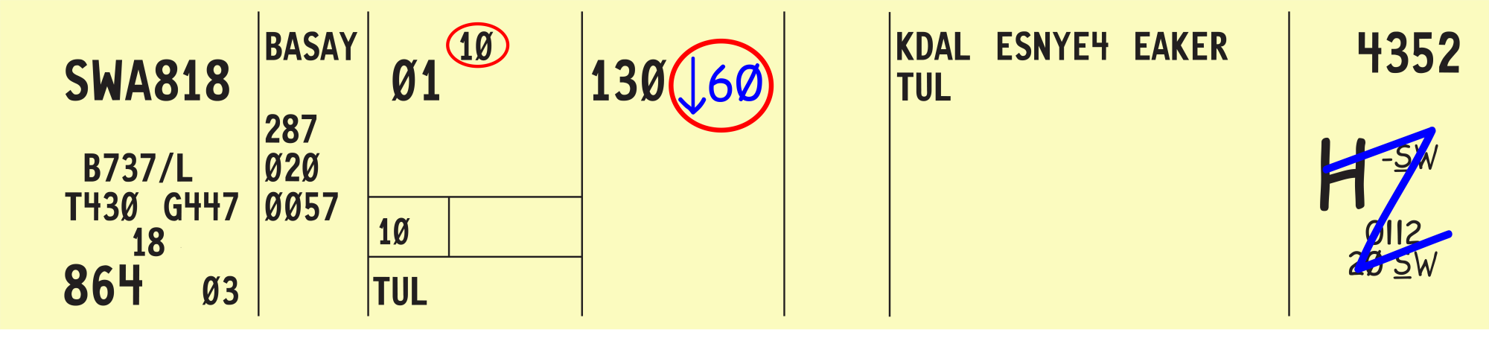

Tower Jurisdiction

Slide 39
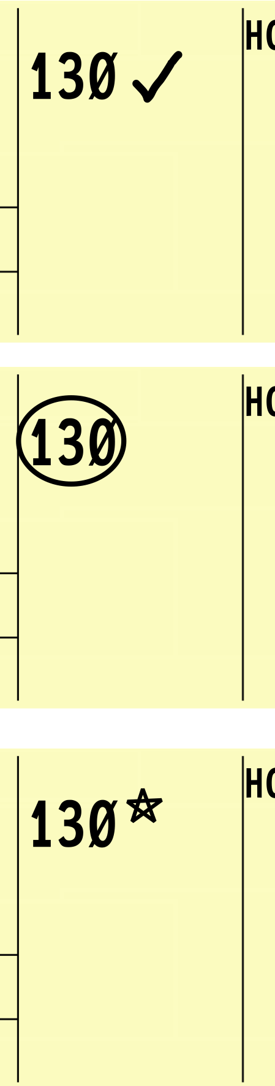
Knowledge Check
Which example indicates a pilot checking in at their assigned altitude?
A.
B.
C.

Slide 40
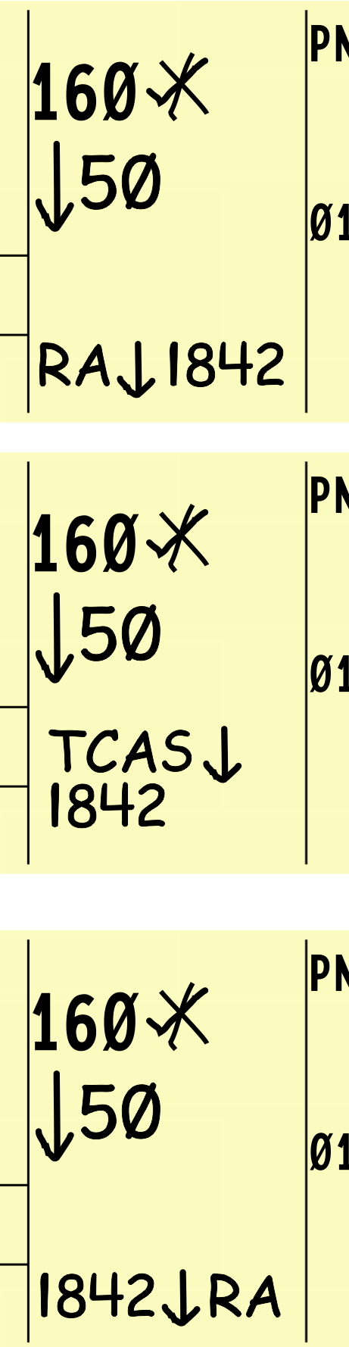
Knowledge Check
How is a TCAS Resolution Advisory recorded?
A.
B.
C.

Slide 41
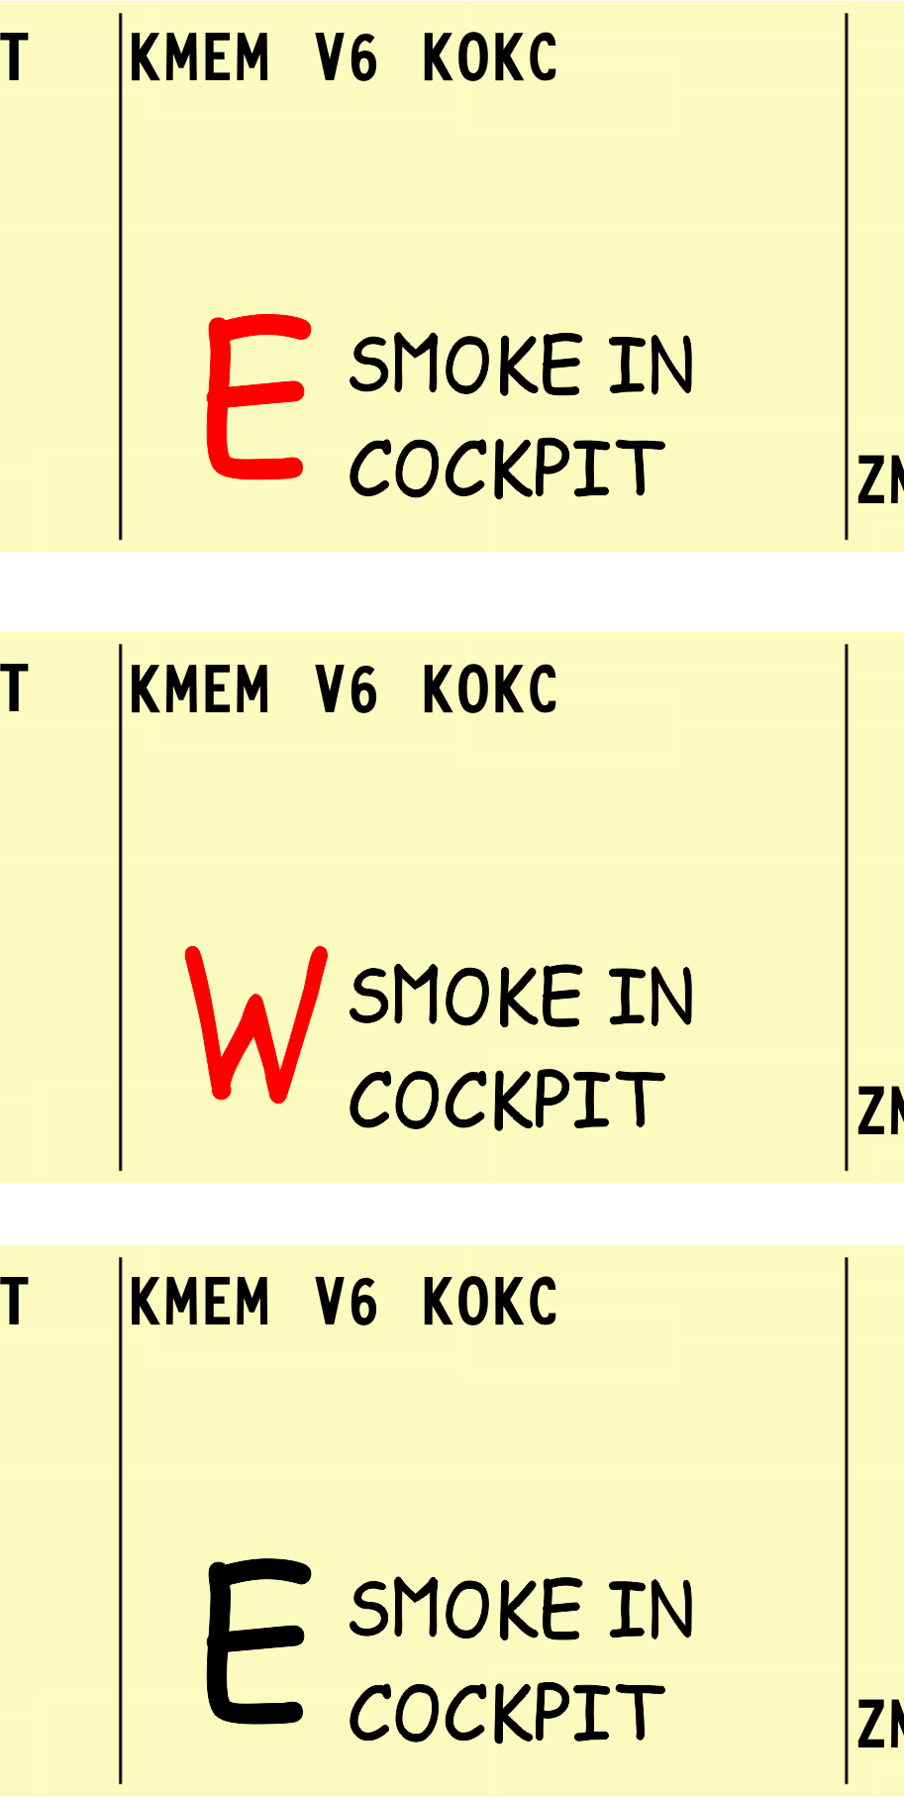
Knowledge Check
What is the strip marking for aircraft emergencies?
A.
B.
C.

Slide 42
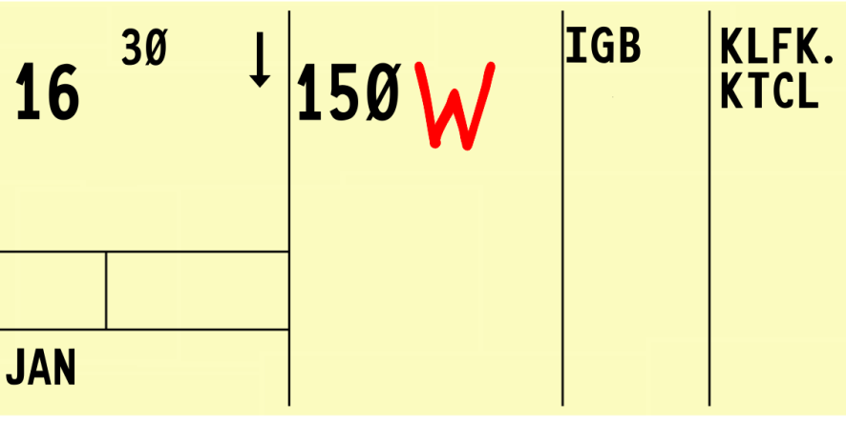
Knowledge Check
What does this strip
marking represent?
  The route of flight is a zig-zag pattern
  A warning is associated with the current altitude
  The route of flight is a general westerly direction

Slide 43
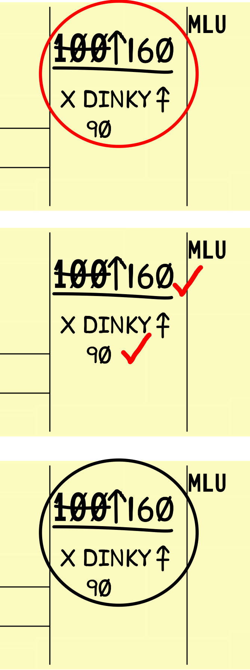
Knowledge Check
Which strip marking indicates altitude and restriction were coordinated?
A.
B.
C.

Slide 44

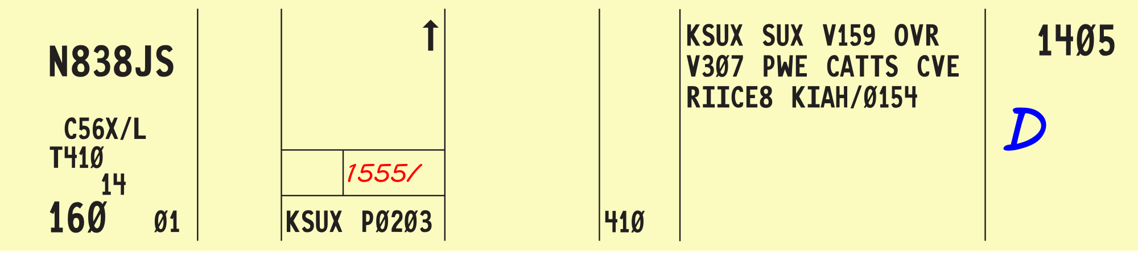
Cleared to Depart From Fix

Slide 45

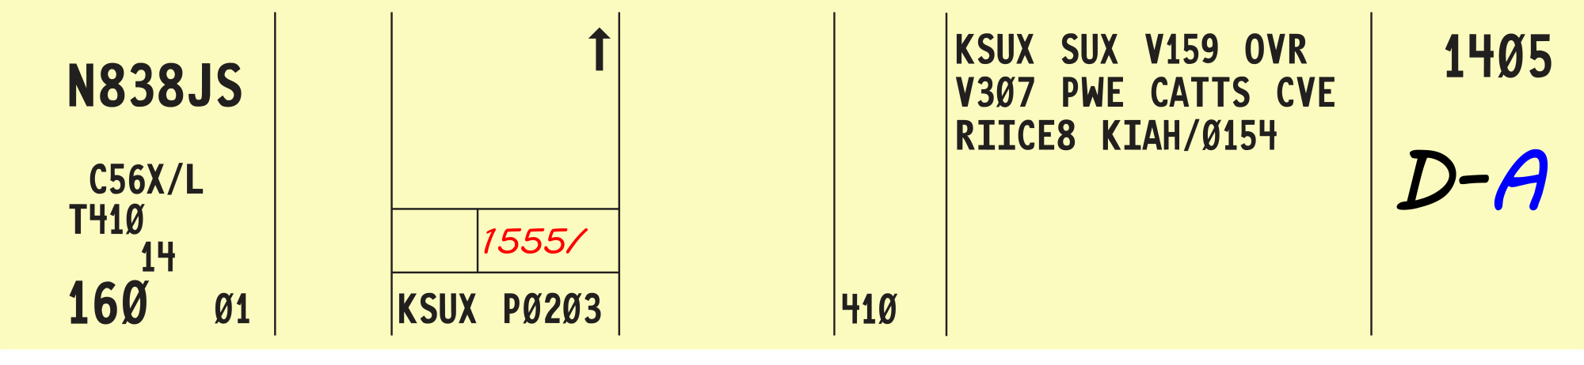
Cleared to Destination Airport

Slide 46

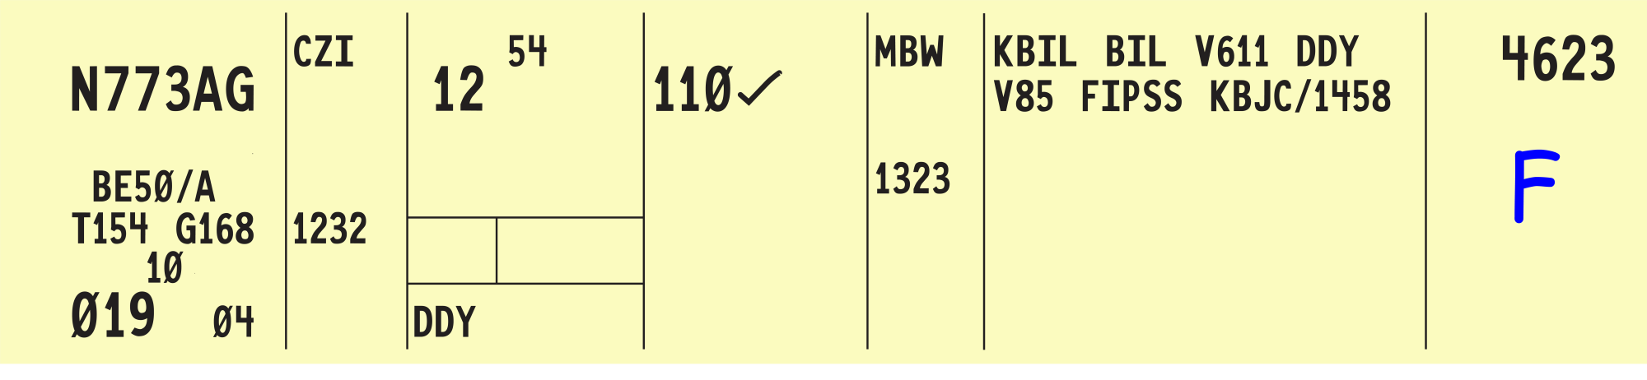
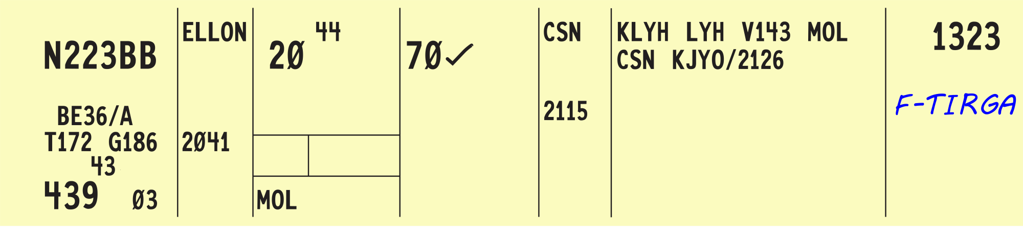
Cleared to Posted Fix or Other Fix
(FIX)

Slide 47


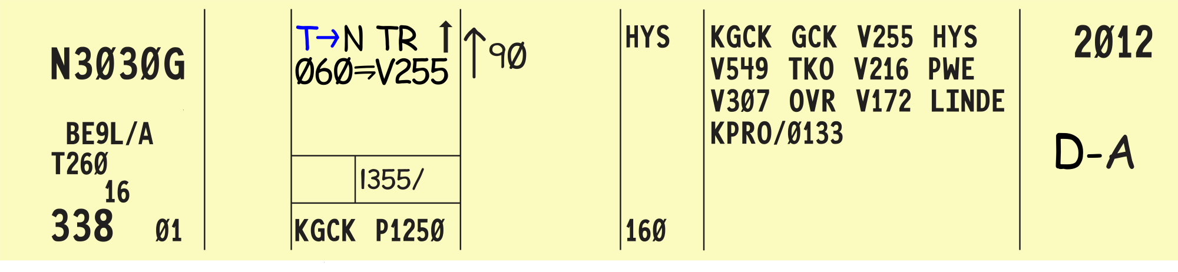
Depart

Slide 48
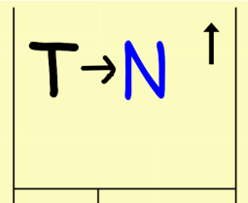
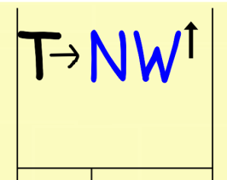
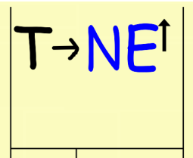

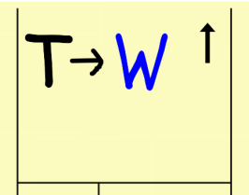

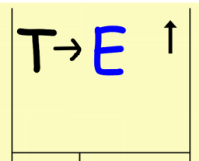



Departure Direction
North
Northwest
Northeast
West
East
AIRPORT
Southwest
Southeast
South

Slide 49









Departure Runway

Slide 50




Turn Left or Turn Right
or

Slide 51


Departure Heading
(Heading)
or

Slide 52


Until

Slide 53



Join or Intercept Airway, Jet Route, Track, or Course

Slide 54




Before and After
“…release one minute after November Two One...”
“…DESCEND TO REACH SIX THOUSAND AT OR BEFORE ONE SIX ONE ONE...”

Slide 55


Hold For Release

Slide 56





Release
“Release CIRRUS TWO GOLF FOXTROT one minute after MALIBU SEVEN PAPA CHARLIE”

Slide 57



Released Your Discretion
NOTE: Indicates assumed departure time as being coordinated with next sector
“Visual separation approved between Twin Cessna Four Five Six and SKYHAWK Two Three four. Twin Cessna Four Five Six released.”

Slide 58


Clearance Void If Not Off By
(Time)

Slide 59


Alternate Instructions
“…climb to and report reaching VFR-On-Top, no tops reports. If not on top at six thousand, maintain six thousand and advise.”

Slide 60


Climb and Maintain (altitude)
Descend and Maintain (altitude)
OR

Slide 61


At

Slide 62

OR
At or Above (altitude)
At or Below (altitude)

Slide 63


Block Altitude Assignment

Slide 64


Climb/Descend at Pilot’s Discretion
“…descend at pilot’s discretion, maintain one sEVEN thousand”

Slide 65

Reported Other Than Assigned Altitude
Alt.
Aircraft was assigned 110 but reported on frequency level at 120

Slide 66


Cross

Slide 67


Cleared to Hold (Instructions Issued)
“…cleared to NORTH PLATTE VOR/DME. Hold southwest ON VICTOR EIGHTY. No delay expected.”

Slide 68


DME Holding and Instructions
“…cleared to BORGER zero niner zero radial two zero mile fix. Hold east on THE zero niner zero radial, one zero mile legS. Expect further clearance one SEVEN ZERO zero.”

Slide 69


Cleared Over the Fix
“…cleared to Amarillo AIRPORT via Victor one fourteen”
or
“…cleared to Amarillo Airport via last routing cleared”

Slide 70

DME ARC of NAVAID
(Miles) (Direction)
“…cleared to JOIN ONE FIVE mile arc Northwest of BOZEMAN VOR/DME...”

Slide 71


Special VFR Operations Authorized

Slide 72


Pilot Canceled IFR

Slide 73



Knowledge Check
How is “depart” recorded in block 15?
A.
B.
C.

Slide 74


Knowledge Check
What does this strip marking represent?
  “CLEARANCE VOID IF NOT OFF BY ZERO TWO FIVE ONE”
  “JOIN VICTOR AIRWAY AFTER ZERO TWO FIVE ONE”
  “VFR AFTER ZERO TWO FIVE ONE”

Slide 75

Knowledge Check
What does this strip marking represent?
  “TAKE OFF NORTH, TURN LEFT”
  “DEPART NORTH, TURN LEFT”
  “DEPART NOW, TURN LEFT”

Slide 76

Knowledge Check
How is “HOLD FOR RELEASE” recorded in block 15?
A.
B.
C.

Slide 77

Knowledge Check
What does this strip marking
represent?
  “DEPART RUNWAY FIVE TILL REACHING ONE FIVE THOUSAND THEN CROSS VICTOR TWENTY-TWO”
  “DEPART RUNWAY FIVE TURN RIGHT HEADING ONE FIVE ZERO UNTIL JOINING VICTOR TWENTY-TWO”
  “DEPART RUNWAY FIVE TO REACH ONE HUNDRED FIFTY FEET BY JOINING VICTOR TWENTY-TWO”

Slide 78



Knowledge Check
Which strip marking indicates the aircraft checked in at an altitude other than its assigned altitude?
A.
B.
C.

Slide 79

Knowledge Check
Which strip marking indicates cleared over fix?
A.
B.
C.

Slide 80

Knowledge Check
What does this strip marking
represent?
  Pilot canceled IFR at 2321
  Pilot reported over the clearance limit at 2321
  Pilot called leaving assigned altitude at 2321

Slide 81

Knowledge Check
How would you record; “CLEARED TO JACKSON TWO FIVE ONE RADIAL TWO ZERO MILE FIX, HOLD SOUTHWEST ON TWO FIVE ONE RADIAL, ONE FIVE MILE LEGS, EXPECT FURTHER CLEARANCE AT ONE ONE TWO ZERO”?
A.
B.
C.

Slide 82

Knowledge Check
How do you record “IF NOT OFF BY 2235, ADVISE (facility) NO LATER THAN 2245 OF INTENTIONS”?
A.
B.
C.

Slide 83


Report Leaving
“…Report leaving six thousand”

Slide 84


Report Reaching
“…Report reaching six thousand”

Slide 85


Report Passing (fix/altitude),
Report Crossing (radial bearing, etc.)
“…report crossing MARION two THREE EIGHT radial, report passing ALING”

Slide 86


Communication Transfer

Slide 87

Restriction Bar

Slide 88

Knowledge Check
What does this strip marking
represent?
  “DESCEND AND MAINTAIN ONE SIX THOUSAND ROUTE LEFT TO FLIGHT LEVEL ONE EIGHT ZERO”
  “DESCEND AND MAINTAIN FLIGHT LEVEL ONE EIGHT ZERO REACH LOWER TO ONE SIX THOUSAND”
  “DESCEND AND MAINTAIN ONE SIX THOUSAND REPORT LEAVING FLIGHT LEVEL ONE EIGHT ZERO”

Slide 89

Knowledge Check
What does this strip marking
represent?
  “RADAR POINTOUT AT JELMI”
  “REPORT PRIOR TO JELMI”
  “REPORT PASSING JELMI”

Slide 90

Knowledge Check
What does this strip marking
represent?
  “CLIMB TO (requested altitude) ONE FIVE MILES EAST OF MONROE ”
  “CONTACT (next facility/sector) ONE FIVE MILES EAST OF MONROE”
  “CLEARED TO HOLD ONE FIVE MILES EAST OF MONROE”

Slide 91


Radar Contact

Slide 92


Radar Service Terminated

Slide 93


Radar Contact Lost

Slide 94


Radar Handoff (Complete)

Slide 95


Radar Vector

Slide 96


Pilot Resumed Own Navigation

Slide 97



Point Out Initiated

Slide 98

Knowledge Check
What does this strip marking represent?
  The aircraft is ready to depart
  The route of flight was revised
  The flight is radar identified

Slide 99

Knowledge Check
How would you indicate “RADAR CONTACT LOST”?
A.
B.
C.

Slide 100

Knowledge Check
What does this strip marking represent?
  Radar vector is coordinated
  Radar service terminated
  Radar handoff is complete

Slide 101


Approach Clearance
“…cleared approach Miami Airport”

Slide 102


Cruise Clearance
“…cleared to Perry Airport, cruise six thousand”

Slide 103

Through Clearance
“…cleared through TEXARkANA Airport TO HELENA AIRPORT VIA…”

Slide 104



Knowledge Check
How do you record “CLEARED VOR APPROACH”?
A.
B.
C.

Slide 105

Knowledge Check
What does this strip marking represent?
  “CLEARED TO TRANSIT (destination) AIRPORT”
  “CLEARED THROUGH TO (destination) AIRPORT”
  “CLEARED TO TRAIN AT (destination) AIRPORT”

Slide 106



Knowledge Check
How do you record “CRUISE FIVE THOUSAND”?
A.
B.
C.

Slide 107
Practice Exercise 2: Strip Marking Symbols
Purpose
  Review strip marking symbols
Materials
  Practice exercise 2 from Lesson 1 handout
  Pencil and/or pen in black and red
Directions
  Write the proper symbol for each clearance item. Use the appropriate color if necessary.

Slide 108



Practice Exercise 2: Strip Marking Symbols (Cont’d)
1.
2.
3.
At or Above
Alternate Instruction
IAFDOF Altitude

Slide 109



Practice Exercise 2: Strip Marking Symbols (Cont’d)
4.
5.
6.
Clearance Void
Depart
Cruise

Slide 110



Practice Exercise 2: Strip Marking Symbols (Cont’d)
7.
8.
9.
Reported at Assigned Altitude
Until
Direction of Flight Indicator

Slide 111


Practice Exercise 2: Strip Marking Symbols (Cont’d)
10.
11.
12.
Communications Transfer
Join/Intercept
At or Below

Slide 112



Practice Exercise 2: Strip Marking Symbols (Cont’d)
13.
14.
15.
Emergency
Restriction Bar
Information Forwarded

Slide 113


Practice Exercise 2: Strip Marking Symbols (Cont’d)
16.
17.
18.
Radar Contact
Reported at Other Than Assigned Altitude
Radar Handoff Completed

Slide 114



Practice Exercise 2: Strip Marking Symbols (Cont’d)
19.
20.
21.
Pilot Canceled Flight Plan
Cross
Radar Service Terminated

Slide 115



Practice Exercise 2: Strip Marking Symbols (Cont’d)
22.
23.
24.
Local SVFR
Radar Vector
Before

Slide 116


Practice Exercise 2: Strip Marking Symbols (Cont’d)
25.
26.
27.
Radar Contact Lost
Point Out Initiated
Pilot Resumed Own Navigation

Slide 117



Practice Exercise 2: Strip Marking Symbols (Cont’d)
28.
29.
30.
Block Altitude Assignment
After
Arc

Slide 118

Practice Exercise 2: Strip Marking Symbols (Cont’d)
31.
Warning

Slide 119
Practice Exercise 3: Recording Clearances and Control Information
Purpose
  Review and practice strip marking on flight strips using proper characters and symbols in the correct locations
Materials
  Practice exercise 3 from Lesson 1 handout
  Appendix: Location Identifiers
  Pencil and/or pen in black and red
Directions
  Record the clearances and control information on the flight progress strips as per the clearance/request read by the instructor

Slide 120


Question 1

Slide 121


Question 2

Slide 122


Question 3

Slide 123

Question 4

Slide 124

Question 5

Slide 125


Question 6

Slide 126


Question 7

Slide 127


Question 8

Slide 128


Question 9

Slide 129


Question 10

Slide 130


Question 11

Slide 131


Question 12

Slide 132


Question 13

Slide 133
Practice Exercise 4: Flight Strip Marking
Purpose
  Review and practice strip marking on flight strips using proper characters and symbols in the correct locations
Materials
  Practice Exercise Handout: Flight Strip Marking
  Appendix: Location Identifiers
  Pencil and/or pen in black and red
Directions
  Record the clearances and control information on the flight progress strips as per the clearance/request read by the instructor

Slide 134


Question 1

Slide 135


Question 2

Slide 136


Question 3

Slide 137


Question 4

Slide 138


Question 5

Slide 139


Question 6

Slide 140


Question 7

Slide 141


Question 8

Slide 142


Question 9

Slide 143


Question 10

Slide 144



Question 11

Slide 145



Question 12

Slide 146


Question 13

Slide 147
Purpose of strip marking
Post current data
Record clearances
Standard characters
Corrections and amendments

Slide 148
Lesson Summary (Cont’d)
Types of flight strips
Flight strip data entries
General information
Clearance abbreviations
Miscellaneous abbreviations
Control information symbols
Approach abbreviations

Slide 149

The End

