Slide 1
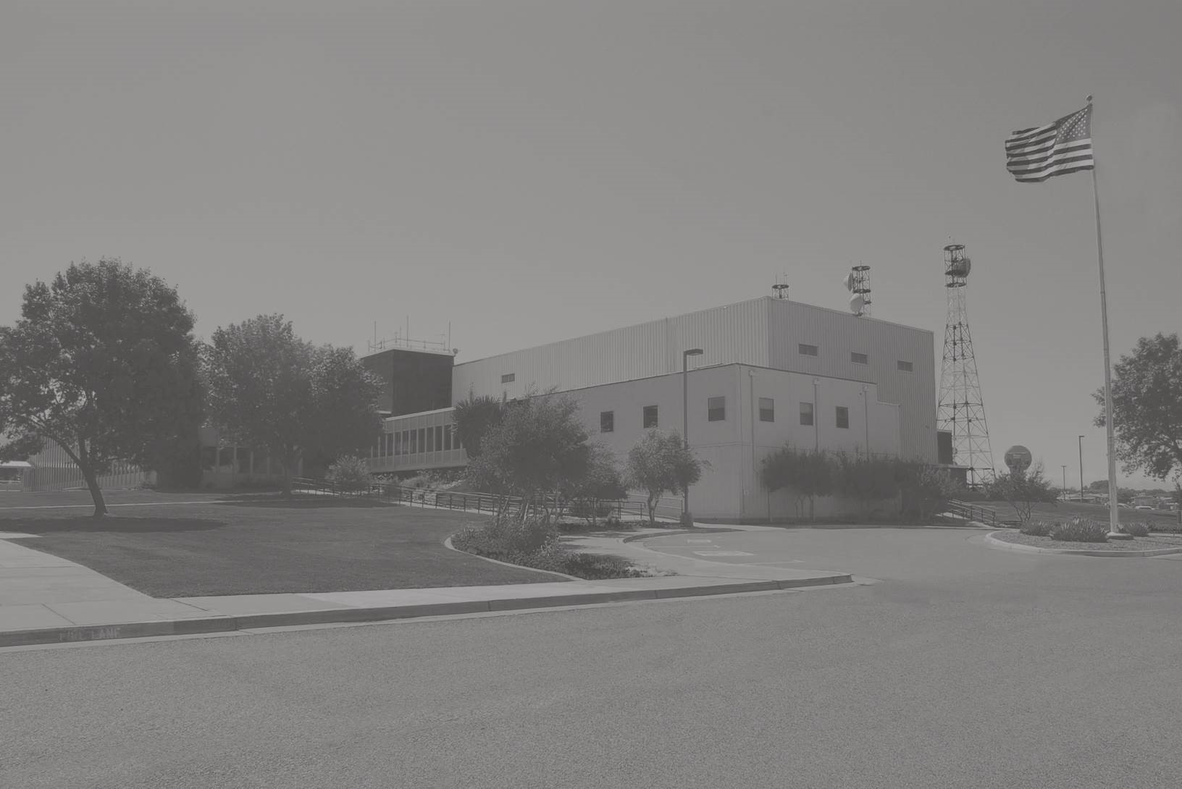
Radar Flight Data Controller Training
Lesson 6: Computer Command
Composition and Entry
Course 55053
Version 2019-12.1

Slide 2
Lesson Objectives
At the end of this lesson you will be able to:
Identify Command Composition
Identify Types of System Responses
Determine Eligibility for Command Entry
Determine Flight Data Command Composition
Determine Information Request Command Composition
Determine Miscellaneous Command Composition

Slide 3

Command Composition Order
All commands must begin with a Command ID:
Two (2) letter designator
Hard-labeled function keys
Field
01
02-AID
03-TYP
06-FIX
Field
Field
Field
Field
05-SPD
SPACE
SPACE
SPACE
SPACE
SPACE
SPACE
SPACE
SPACE
FP
N123
C172/G
115
KALB
Element
Element
Element
/
Element
Element
Element
Hard-Labeled Key
07-TIM
10-RTE
Field
Field
Field
09-RAL
SPACE
SPACE
SPACE
P1455
80
KALB .. GDM . V2 . KBOS
Element
Element
Element
Element
..
Element
.
Element
.
Element

Slide 4
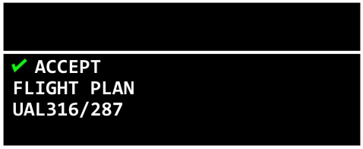
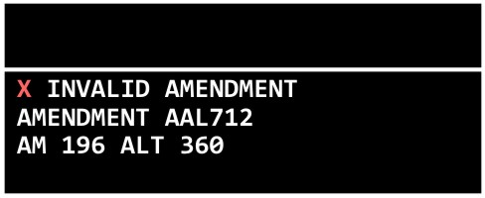
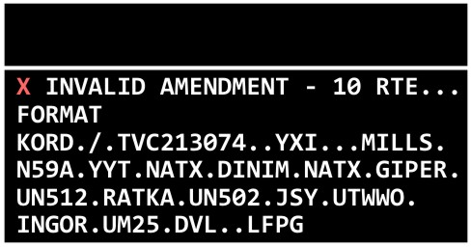
Message Composition Area (MCA) View
MCA Preview and Feedback Areas
Accept
Message
Reject
Message
Expanded
View

Slide 5
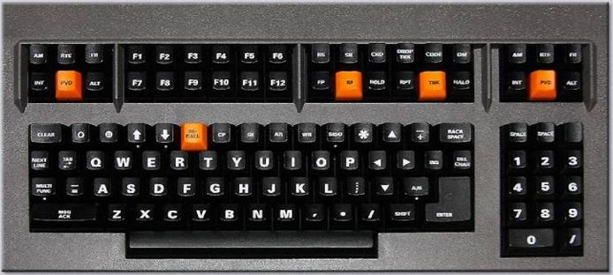
Command Acceptance Checks
Commands entered by the controller are checked for:
Syntax and Format
Source Legality
Semantics

Slide 6
Types of System Responses
After entry, the system will respond:
Accept
Reject
Error

Slide 7
Accept
If input passes all checks, data is displayed on one or more of the following:
MCA Feedback Area
Flight Strip Printer (FSP)
Situation Display

Slide 8
Reject/Error Message Overview
Display in the MCA Feedback Area.
Error checking stops at the first error.
Additional errors may be present.
Command is not retained in the Preview Area.
RECALL will display the command in the Preview Area for correction and resubmission.

Slide 9
Syntax and Format
Command Input Example
FP AAL14238 MD83/L 440 KLEX P0040 320 KL EX..VXV.J43.OTK..KMCO
X REJECT – AAL14238 FLID FORMAT
FLIGHT PLAN
FP AAL14238 MD83/L 440 KLEX P0040 320
KLEX..VXV.J43.OTK..KMCO
Error Message Example
Note: Field 02 (AID) must be 2 to 7 characters

Slide 10
Syntax and Format Checking
AM 204 10 KDFW.ARDIA6.E✱LVR..NNEAL.KIDDZ3
ILLEGAL CHARACTER
AM TIM 152 P1455
INCORRECT SEQUENCE
PARAMETER OUTSIDE RANGE
AM 359 SPD 045
PF N25TK BE55/G 185 KMAF P1005 160 KMAF.BG TOE.BACHR4.KDAL
INVALID TWO-LETTER COMMAND ID

Slide 11
Syntax and Format Errors
GI W30 OD4 NEEDS ASSISTANCE
X REJECT – W30 INCORRECT ROUTING
GEN INFO
GI W30 OD4 NEEDS ASSISTANCE
W30 is an incorrect position
The letter “O” is incorrect, it should be the clear weather symbol
The system stops processing at the first error it encounters in the command

Slide 12
Source Legality Error
CP TMDI 600
X ILLEGAL SOURCE
CP TMDI 600
The source legality check determines if a position is authorized to enter the command. If not, the system generates a source legality error.
ILLEGAL SOURCE error message is displayed in the Feedback Area
Original command is not retained in the Preview Area

Slide 13
Semantic Error
FP AAL142 H/B763/L 440 RBL EXX00 330 KSFO ./.RBL..FMG.J32.MLD..KMSP
X NO AIRSPACE PENETRATION
FLIGHT PLAN AAL142
FP AAL142 H/B763/L 440 RBL EXX00 330 KSFO./.RBL..FMG.J32.MLD..KMSP
Note: Flight does not penetrate sector airspace

Slide 14
Reject/Error Message Examples
BCN CODE USED BY OTHER AC
NOT YOUR CONTROL
DUPLICATE FIELD REFERENCE
MESSAGE TOO LONG – or – SHORT
(FIX NAME) CANNOT MERGE

Slide 15
Invalid Field Reference
AM N8629N RAH 120
X RAH INVALID REFERENCE
AMENDMENT
AM N8629N RAH 120
Note: RAH is an invalid field reference.

Slide 16
Message Too Long
DM AAL25 0102 270 ○SLOW CLIMBER
X MESSAGE TOO LONG
DEPARTURE
DM AAL25 0102 270 ○SLOW CLIMBER
Correct Format: DM FLID (TIM) (ALT)

Slide 17
Controller Responses to Error Messages
Cancel Entire Command
CXX cancels the entire command.
Take No Action
Command will cancel after an adapted number of minutes.
Edit / Correct Command
Recall the command via the RECALL key.
Use text-editing capabilities to correct the command.

Slide 18
Knowledge Check
What will happen if CXX is entered in response to an error?
Change the time entered to Current Time
Cancel the command
Enter .XXX. into Field 10
Notes:
ELO-3

Slide 19
Knowledge Check
A command entry does not have the expected result. You should _______.
re-enter the command
have the Radar Controller coordinate
check the MCA View for ‘Accept’ or ‘Reject’
Notes:
ELO-1

Slide 20
Knowledge Check
When is ILLEGAL SOURCE displayed?
Flight plan starts from a restricted airport
Aircraft call sign is on a watch list
Position is not authorized to enter the command
Notes:
ELO-2

Slide 21
Command Eligibility
Flight Data Commands
Sector Eligibility Requirements
Termination of Eligibility
Information Request Commands
Eligibility not Required

Slide 22
Knowledge Check
A sector is eligible to enter a command affecting the flight plan database if ________.
the flight is IFR
a flight will pass through your facility
your sector will receive a departure strip
Notes:
ELO-2

Slide 23
Flight Data Command Types
Field | Contents
FP | Flight Plan
SP | Stereo Flight Plan
RS | Remove Strip
DM | Departure Message
HM | Hold Message
AM | Amendment Message

Slide 24
Flight Plan - FP
(
)
01-MSG TYP
02-AID
03-TYP
04–BCN
05-SPD
SPACE
SPACE
SPACE
SPACE
FP
NKS701
B737/L
1235
450
(
)
06-FIX
07-TIM
09-RAL
10-RTE
11 – RMK
SPACE
SPACE
SPACE
370
SPACE
SPACE
PBI
P1730
PBI..ACY
⨁ FRC
FP NKS701 B737/L 1235 450 PBI P1730 370 PBI..ACY ⨁ FRC

Slide 25
Stereo Flight Plan - SP
(
)
(
)
01-Msg Typ
02-AID
03–TYP
05-SPD
SPACE
SPACE
SPACE
SP
ROCK1
2/F15/I
dd(d)(d)
(
)
(
)
07-TIM
08-ALT
or
09-RAL
10-RTE
11-RMK
SPACE
SPACE
SPACE
SPACE
⨁ or 𐰗 and text
P1730
BASSI
ddd
SP ROCK1 2/F15/I P1730 BASSI

Slide 26
Remove Strip - RS
01-Msg Typ
02-FLID
SPACE
FLID may be:
AID
CID
BCN
RS
N1234
RS N1234

Slide 27
Remove Strip - RS (cont'd)
Example: Accept4
Y
RS N1234
CONFIRM BY ENTERING Y
REMOVE STRIP N1234/001
√ ACCEPT
REMOVE STRIP
N1234/001

Slide 28
Remove Strip - RS (cont'd)
Example: Reject4
YES
RS N1234
X REJECT - NOT CONFIRMED
REMOVE STRIP
RS 001
CONFIRM BY ENTERING Y
REMOVE STRIP N1234/001

Slide 29
Departure Message - DM
(
)
(
)
01-Msg Typ
02-FLID
07-TIM
08-ALT
SPACE
N700PX
SPACE
2003
SPACE
VFR
DM
DM N700PX 2003 VFR

Slide 30
Hold Message - HM
(
)
01-Msg Typ
02-FLID
21-Hold Data
310-Holding Instructions
S P A C E
S P A C E
S P A C E
HM
354
Position(/EFC)
N/LT/10NM
HM N700PX RDU/1245 N/LT/10NM

Slide 31
Hold Message Syntax
Action | Syntax | Example
Present Position Hold | HM FLID P | HM AAL236 P
Hold at Fix | HM FLID FIX | HM AAL236 RMG
Hold at Fix with EFC | HM FLID FIX/EFC | HM AAL236 RMG/1234
Present Position Hold with EFC and Hold Instructions | HM FLID P/EFC (Direction/Turns/ Leg Lengths) | HM AAL236 P/1234 NW/LT/20NM
Cancel Hold | HM FLID C | HM AAL236 C

Slide 32
Amendment Message - AM
01-Msg Typ
02-FLID
Field Ref
Amendment Data
S P A C E
SPACE
SPACE
AM
112
BCN
3442
AM 112 BCN 3442

Slide 33
Flight Data Field Abbreviations
Field 02 - AID
Field 03 - TYP
Field 04 - BCN
Field 05 - SPD
Field 06 - FIX
Field 07 - TIM
Field 08 - ALT
Field 09 - RAL
Field 10 - RTE
Field 11 - RMK

Slide 34
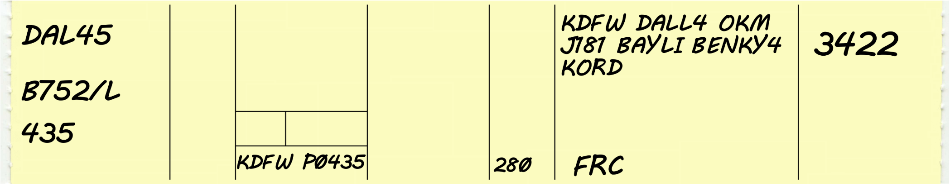
Flight Data Fields
01
Message Type
02
AID
03
TYP
04 BCN
05
SPD
06
FIX
07
TIM
09
RAL
---------------------------------------------------------------------------------⨁FRC
KDFW
KDFW.DALL4.OKM.J181.BAYLI.BENKY4.KORD
280
P0435
435
3422
B752/L
FP DAL45
FP
10 RTE
11 RMK

Slide 35
Field 02 Amendment
01-Msg Typ
02-FLID
Field Ref
Amendment Data
S P A C E
SPACE
SPACE
AM
235
AID
N4TC
AM 235 AID N4TC

Slide 36
Knowledge Check
Which field(s) are optional in a DM Command?
07 (TIM) and 09 (RAL)
08 (ALT)
07 (TIM) and 08 (ALT)
Notes:
ELO-3

Slide 37
Knowledge Check
Which command requires confirmation?
Stereo Flight Plan (SP)
Remove Strips (RS)
Strip Request (SR)
Notes:
ELO-3

Slide 38
Knowledge Check
Which of the following AM commands is correct?
AM N404JP RAL 100
AM N404JP BCN 6624 04
AM N404JP 02 N405JP ALT 100
Notes:
ELO-3

Slide 39
Route Amendment Special Characters
Special Character(s) | Field 10 Placement | Result
↑ | After departure fix | Insert or change a departure point
↓ | Appended to end | New destination
+ + | From the divergent fix until the route converges again or destination | Pending ARTCC adapted preferential route
> < | From the divergent fix until the route converges again or destination | Pending Traffic Flow Management (TFM) protected segment
✱ | Appended to end | Prohibit the system application of adapted routes and new destination
⊕ | Appended to end | Inhibit Equipment Restricted Route (ERR) application and new destination

Slide 40
Route Amendment
Example 14
Current Route:
Amendment:
Result:
KATL.KAJIN2.STNGA..MLU..KDFW
AM AAL22 10 MLU..YUYUN.BEREE1.KDFW
KATL.KAJIN2.STNGA..MLU..YUYUN.BEREE1.KDFW

Slide 41
Route Amendment
Example 24
Current Route:
Amendment:
Result:
KORD.JOT.J35.STL..FSM..BRDJE3.KDFW
AM AAL22 10 JOT.J35.KSTL↓
KORD.JOT.J35.KSTL

Slide 42
Time Element Suffix
Example 4
Current Route:
Amendment:
Result:
KCEF..VIPER/D1+00..SYR087075..LASER/D0+15..KCEF
AM AAL22 10 VIPER/D1+00..SYR087075..LASER..KCEF/1800
KCEF..VIPER/D1+00..SYR087075..LASER..KCEF/1800

Slide 43
Amend Departure Fix - Active
Example 4
Current Route:
Amendment:
Result:
KBED..REVSS..BAF..MOBBS..SAGES.V489.COATE..KMMU
AM AAL22 10 KBOS↑
KBOS..REVSS..BAF..MOBBS..SAGES.V489.COATE..KMMU

Slide 44
Amend Departure Fix - Proposal
Example 4
Current Route:
Amendment:
Result:
KLUK..JBNCH..GIJ.V526.DEERE..KPWK
AM AAL22 06 KHAO 10 KHAO↑
KHAO..JBNCH..GIJ.V526.DEERE..KPWK

Slide 45
Suppressing ADR / AAR / ADAR (Adapted Departure Route / Adapted Arrival Route / Adapted Departure Arrival Route)
Current Route:
Amendment:
Result:
KHOU.STYCK6.DOLEY..FUZ..SPS..HALEN..+HALEN.BOSSS2+.KDEN/0130
AM AAL22 10 KDEN✱/0130
KHOU.STYCK6.DOLEY..FUZ..SPS..HALEN..KDEN✱/0130

Slide 46
Active Flight Plan - Amend Merged Route Data
Current Route:
Amendment:
Result:
KTLH..SZW..DAWWN..BEORN.HOBTT2.KATL
AM AAL22 06 BEORN 10 BEORN.GNDLF2.KATL
KTLH./.BEORN.GNDLF2.KATL

Slide 47
06, 07, 10 Route Amendment
Current Route:
Amendment:
Result:
KSFO./.FMG.J32.CZI..ABR..RWF..KMSP
AM AAL22 06 BAM040023 07 E2345 10 BAM040023..FAR.GEP6.KMSP
KSFO./.BAM040023..FAR.GEP6.KMSP

Slide 48
Knowledge Check
KCHS.V437.SAV..KELER..SSI.V3.OMN..KDAB
Given the route above, an amendment that will change the route from over SAV via V37 SSI direct OMN is _______.
AM N45TD 10 SAV.V37.SSI.OMN
AM N45TD 10 SAV.V37.SSI..OMN
AM N45TD 10 SAV..V37..SSI.OMN
Notes:
ELO-3

Slide 49
Knowledge Check
KGNV..OCF.V157.LAL..SRQ..KVNC
Given the route above, an amendment that will change the route from over OCF via V581 DADES V7 KLAL landing KLAL is _______.
AM AAL12 10 OCF.V581.DADES.V7.KLAL↓
AM AAL12 10 OCF.V581.DADES.V7.LAL..KVNC↓
AM AAL12 10 OCF.V581.DADES.V7..KLAL↓
Notes:
ELO-3

Slide 50
Route Amendment – “By The Numbers”
Current Route:
Input:
Route Readout:
KMIA./.ORL.J53.CRG..CAE..RDU..CAE..KPOB
Field 10 Correction:
5..8
AM N1234
Result:
1-KMIA.2-/.3-ORL.4-J53.5-CRG..6-CAE..7-RDU..8-CAE..9-KPOB
KMIA./.ORL.J53.CRG..CAE..KPOB

Slide 51
Field 10 Amendment
Examples 4
1-KISM.2-/.3-GUANO.4-V267.5-CRG.6-V51.7-AMG..8-DBN/D1+30..9-KFTY
KABC.V1.DEF..CDE.V3.LMN..KABC
Data Entry | Results | New Field 10 Data
3..7
Removes elements 4 thru 6
KISM./.GUANO..AMG..DBN/D1+30..KFTY
8
Deletes delay after DBN
KISM./.GUANO.V267.CRG.V51.AMG..DBN..KFTY
8/D0+30
Changes delay after DBN from 1+30 to 0+30
KISM./.GUANO.V267.CRG.V51.AMG..DBN/D0+30..KFTY
5.V37.SAV..8
Changes route between CRG and DBN
KISM..ORL..GUANO.V267.CRG.V37.SAV..DBN..KFTY*/1530

Slide 52
Practice Exercise 1:
Route Amendment Correction
To be completed in this classroom
Your instructor will provide direction.

Slide 53
Exercise: Route Amendment Correction
1-KISM..2-ORL..3-GUANO.4-V267.5-CRG.6-V51.7-AMG..8-DBN..9-KFTY
Data Entry | Results | New Field 10 Data
KABC.V1.DEF..CDE.V3.LMN..KABC
2..5
Deletes elements 3 and 4
KISM..ORL..CRG.V51.AMG.. DBN..KFTY
3..9
Deletes elements 4 thru 8
KISM..ORL..GUANO..KFTY
5.V51.AMG..9
Changes route between CRG and KFTY
KISM..ORL..GUANO.V267.CRG.V51.AMG..KFTY
5..AYS..7
Changes element 6
KISM..ORL..GUANO.V267.CRG..AYS..AMG..DBN..KFTY
5/D1+00
Adds delay to element 5
KISM..ORL..GUANO.V267.CRG/D1+00.V51.AMG..DBN..KFTY

Slide 54
Exercise: Route Amendment Correction
1-KISM..2-ORL..3-GUANO.4-V267.5-CRG.6-V51.7-AMG..8-DBN..9-KFTY
Data Entry | Results | New Field 10 Data
KABC.V1.DEF..CDE.V3.LMN..KABC
9/1430
Adds ETA to KFTY
KISM..ORL..GUANO.V267.CRG.V51.AMG..DBN..KFTY/1430
KMLB↑
Revises departure point
KMLB..ORL..GUANO.V267.CRG.V51.AMG..DBN..KFTY
8..KPDK↓
Revises destination
KISM..ORL..GUANO.V267.CRG.V51.AMG..DBN..KPDK
9*/1530
Inhibits AAR, revises ETA
KISM..ORL..GUANO.V267.CRG.V51.AMG..DBN..KFTY*/1530

Slide 55
Practice Exercise 2:
Route Amendment Correction
To be completed in this classroom
Your instructor will provide direction.

Slide 56
Field 11 Amendment
01-Msg Typ
02-FLID
Field Ref
Amendment Data
S P A C E
SPACE
SPACE
AM
235
RMK
○TCAS EQUIPPED
AM 235 RMK ○TCAS EQUIPPED

Slide 57
Information Request Commands
Field | Contents
AR or QD | Altimeter Request
WR | Weather Request
SR | Strip Request
FR | Flight Plan Readout

Slide 58
Altimeter Request - AR
Additional
(
)
(
)
01
LOCID
LOCID
LOCID
SPACE
SPACE
SPACE
…
AR
SDF
aaa
aaa
AR SDF CRW HTS JKL

Slide 59
Altimeter Request - QD
Additional
(
)
(
)
01
LOCID
LOCID
LOCID
SPACE
SPACE
SPACE
…
QD
PDX
aaa
aaa
QD PDX HIO UAO SLE CVO EUG

Slide 60
Weather Request - WR
Additional
(
)
(
)
01
LOCID
LOCID
LOCID
SPACE
SPACE
SPACE
WR
BOS
aaa
aaa
WR BOS

Slide 61
Knowledge Check
What is the command to print the weather at the following airports: CNM ELP FST?
WR CNM ELP FST P
WR CNM ELP FST D
WR CNM ELP FST
Notes:
ELO-5

Slide 62
Strip Request - SR
01
02-FLID
13 - LOCID
16 - Output Routing
SPACE
SPACE
SPACE
SR
178
BNA
BNAT
SR 178 BNA BNAT

Slide 63
Strip Request - SR (cont’d)
01
02-FLID
551 - Scope
16 - Output Routing
SPACE
SPACE
SPACE
SR
178
/T
38
SR 178 /T 38

Slide 64
Strip Request - SR
Examples 4
All strips for requesting sector
SR 234 /A 36
All strips for another local sector
SR AAL1292 /A04 38
Most relevant strip
SR AAL1292 /T 01

Slide 65
Flight Plan Readout - FR
(
)
(
)
01
02-FLID
ICAO Flight Data
Out. Rte.
SPACE
SPACE
SPACE
FR
UAL72
C
P
FR UAL72 C P
Note: Field 16 can only be the letter P (Printer)
Note: Field 42 can be a C,F,I,1,2 or A. Each returns a slightly different version of the ICAO data.

Slide 66
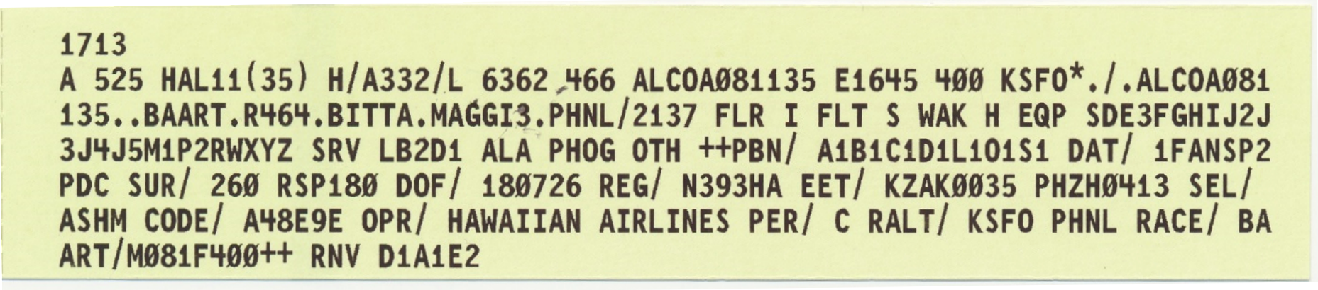
ICAO Flight Plan Readout (Printer)
FR HAL11 P
Start of ICAO FP

Slide 67
ICAO Flight Plan Readout (Response Area)
FR HAL11 I
Start of ICAO FP
A 525 HAL11 FLR I FLT S HAK H EQP SDESFGHIJ2J3J4JSH1PZRHXYZ SRV LB2D1 ALA PHOG 0TH ++PBN/ A1B1C1D1L1O1S1 DAT/ 1FANSP2PDC SUR/ 260=RSP180 DOF/ 180726 REG/ N393HA EET/ KZAK0035 PHZH0413 SEL/ ASHM CODE/ A48E9E OPR/ HAWAIIAN AIRLINES PER/ C RALT/ KSFO PHNL RACE/ BAART /M081F400++ RNV D1A1EFR HAL11 I

Slide 68
Knowledge Check
Select the correct command to readout ICAO information.
FR I DAL55
FR ICAO AAL20
FR UAL35 I
Notes:
ELO-4

Slide 69
Knowledge Check
Which is the correct command to print a Domestic Flight Plan?
FR 3501 D
FR 3507 P
FR 3509 P

Slide 70
Miscellaneous Commands
Field | Contents
GI | General Information Command
RF | Request Flight Plan Transfer
WX | Weather Input
AS | Altimeter Setting Input

Slide 71
General Information - GI
Up to 47 additional
(
)
01
Output Routing
Out. Rte.
General Info
SPACE
SPACE
SPACE
GI
03
…
31
𐰗SECTOR 12 CLOSED
GI 03 31 ○SECTOR 12 CLOSED

Slide 72
General Information Syntax
Field 01 | Field 16 | Field 11 | Result
GI | aaaT | ○Free Text | Sent to named tower, e.g., ORDT
GI | aaaA | ○Free Text | Sent to named approach control arrival position
GI | C | ○Free Text | Sent to all active sector FSPs and AT Specialist Workstations in the center.
GI | aaaO | ○Free Text | Sent to named approach control overflight position
GI | aaaD | ○Free Text | Sent to named approach control departure position
GI | dd (dd) | ○Free Text | Sent to sector number (up to 48 sectors/positions)

Slide 73
Request Flight Plan Transfer - RF
01
02-FLID
Facility
SPACE
SPACE
RF
322
PCT
RF 322 PCT
Note: The RF command is used to transfer flight data to a neighboring facility (ARTS/STARS, CAATS, ATOP, etc.)

Slide 74
Weather Input - WX
01
LOCID
Time
Weather Data
SPACE
SPACE
SPACE
WX
PKB
1155
𐰗17007KT 10SM CLR 17/03 A3002
WX PKB 1155 ○17007KT 10SM CLR 17/03 A3002

Slide 75
Altimeter Setting Input - AS
Additional
(
)
01
Time
LOCID
Altim.
LOCID
Altim.
SPACE
SPACE
SPACE
SPACE
SPACE
AS
1155
PKB
992
aaa
ddd
AS 1155 PKB 992

Slide 76
Knowledge Check
Which is not a characteristic of a GI command?
May begin with clear or overcast weather symbol
Sends plain language command to specified address
May be sent to up as many as 48 destinations
Notes:
ELO-3

Slide 77
Knowledge Check
What is the purpose of an RF command?
Transfers flight data to a neighbor facility
Specify a Radio Frequency for a sector
Force a flight plan to another facility’s situation display or view
Prevent an Unsuccessful Transmission Message (UTM) to a facility
Notes:
ELO-3

Slide 78
Knowledge Check
What is the purpose of a WX command?
Requests weather observation data for an adapted station
Enters weather observation data for an adapted reporting station
Requests weather observation data for a non-adapted reporting station
Enters weather observation data for a non-adapted reporting station
Notes:
ELO-3

Slide 79
Knowledge Check
Which of the following is a correct AS command format?
AS PSB 998 1215
AS 998 PSB 1215
AS 1215 998 PSB
AS 1215 PSB 998
Notes:
ELO-3

Slide 80
Practice Exercise 3
Completed in the Test and Training Lab (TTL)
Exercise to practice the steps for:
Command Composition and Entry
You may use notes and references to complete the exercise
Your instructor will provide direction

Slide 81
Practice Exercise 4
Completed in the Test and Training Lab (TTL)
Exercise to practice the steps for:
Entering Miscellaneous and Information Request Commands
You may use notes and references to complete the exercise
Your instructor will provide direction

Slide 82
Lesson Summary
This lesson covered:
Command Composition
Types of System Responses
Eligibility for Command Entry
Flight Data Command Composition
Information Request Command Composition
Miscellaneous Command Composition

Slide 83

THE END

