Slide 1
radar flight data Controller Training
Lesson 5: Computer Field Format
Course - 55053
Version 2019-12.1

Slide 2
Does Everything Look Right to You?
A
Bird
in the
the Hand
Paris
in the
the Spring
Once
in a
a Lifetime

Slide 3
Objectives
At the completion of this lesson, you will be able to:
Identify computer command structure
Determine the appropriate command field entries

Slide 4
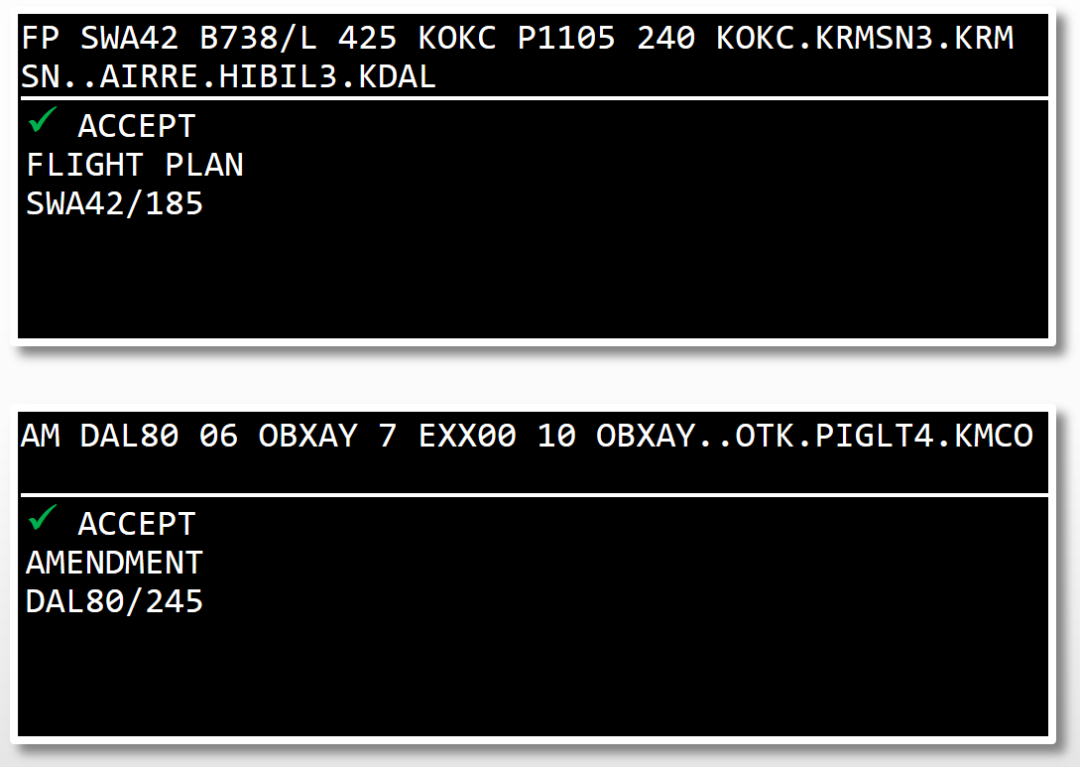
Computer Commands
Format
Fields
Elements
Characters
Aircraft ID Syntax
La(a)(a)(a)(a)(a)

Slide 5

Input Command Breakdown
Field
Field
Element
Element
Element
Element
Characters
Characters
Characters
Characters
Characters
Characters
Characters

Slide 6
Fields, Characters and Elements
Field 02
Field 03
Field 05
Elements
UAL866 450
H/ /L
B789
Characters
Space
Space

Slide 7
Knowledge Check
For most commands, if the input fields are not in the required order, the command will fail.
True
False

Slide 8
Knowledge Check
Elements are ________.
smaller units of information within a field
the sole item in a command
separated by a space

Slide 9
Knowledge Check
A field is separated from another field by a ________.
equal sign
period
space

Slide 10
Command Fields
Field 01
Message Type
Fields 02 - 11
Three letter abbreviations
Field Number | Field Abbreviation | Field Content
02 | AID | Aircraft ID
03 | TYP | Type
04 | BCN | Beacon
05 | SPD | Speed
06 | FIX | Fix
07 | TIM | Time
08 | ALT | Altitude
09 | RAL | Requested Altitude
10 | RTE | Route
11 | RMK | Remarks
AM AAL12 05 450
AM AAL12 SPD 450

Slide 11
Knowledge Check
All commands begin with a ________.
field abbreviation
command ID
space character

Slide 12

Field 01 Message Type
Element | Format | Example
Command ID | LL | FP
 | Hard-Labeled Function Keys
Format Characters | Definition
L | Letter
d | Number
a | Alphanumeric
( ) | Optional

Slide 13
Field 02 (AID) - Flight Identification (FLID)
Element | Format | Examples
Aircraft ID | La(a)(a)(a)(a)(a) Ld | AF1 SWA1237 VV3C45 N1
Computer Identification (CID) | ddd daa | 128 12A
Beacon Code | dddd | 2014
Slant Character /
Departure Point (Optional) | aa(a)(a)(a)(/)(a)(a)(a)(a)(a) | AAL112/KSLC A458/4600N/12845W

Slide 14
Field 03 (TYP) Aircraft Data
 | Element | Format | Examples
Element A | Number of Aircraft | (d) or (d)(d) | 3/F15 or 12/T38
 | Special/Heavy Aircraft Indicator | (L) (d)(L) | H/B747 2H/C17
Element B | Slant Character /
Element C | Type of Aircraft | La(a)(a) | B2 M20T
Element D | Slant Character /
Element E | Aircraft Equipment Suffix | (L) | C172/X

Slide 15
Knowledge Check
Within Field 03, will the system accept ten heavy aircraft (e.g., 10H/C17/L)?
Yes
No

Slide 16
Knowledge Check
The Special Aircraft Indicator (SAI) is found in Field 02.
True
False

Slide 17
Knowledge Check
Select the correct format for a flight of two F15s with aircraft equipment suffix P.
2-F15/P
2F15/P
2/F15/P

Slide 18
Field 04 (BCN) Beacon Code
Element | Format | Example
Beacon Code | (dddd) | 1426

Slide 19
Knowledge Check
Which of the following contain all valid Field 02 flight IDs?
3XGVR, 3214, AF1, AAL3214
VVAC321, N24TF, 689, 3218
VVAC321, 3214, CGWRD, 14A
AAL23114, VM2485, SWA3214

Slide 20
Field 05 (SPD) Speed
Element | Format | Examples
True Airspeed | (d)(d)dd | 95 095 440
Mach Speed | Lddd | M083
Classified Speed | SC | SC

Slide 21
Field 06 (FIX) Coordination Fix
Element | Format | Examples
Fix Name | aa(a)(a)(a) | SERVE KSLC
Fix-Radial-Distance | aa(a)(a)(a)dddddd | TINGS310013
Lat/Long | aaaa(a)(a)/aaaa(a)(a) | 3500N/14000W 3405/11824

Slide 22
Field 07 (TIM) Coordination Time
 | Element | Format | Examples
Element A | Type of Time | L | E = Estimated P = Proposed Departure D = Actual Departure
Element B | Time | dddd XXdd | 1500 XX20

Slide 23
Knowledge Check
Choose the valid Field 06 format.
GINGR093089
IWR18025
3625N/09875W

Slide 24
Knowledge Check
Choose the proper Field 07 format for an airborne flight.
P1548
E1628
D2262

Slide 25
Knowledge Check
What is a key format limitation for Field 04?
Must be entered in hours + minutes.
Has a maximum value of 3700.
Only numbers 0-7 can be used.

Slide 26
Knowledge Check
What is the proper Field 05 format for MACH .82?
M82
M082
0.82

Slide 27
Knowledge Check
Which field is the coordination fix?
03
05
06

Slide 28
Knowledge Check
How is a point indicated in Field 06 for a location that is NOT stored in the computer?
Screen X/Y coordinates
Full spelling of town name
Latitude/longitude coordinates or fix-radial-distance

Slide 29
Field 08 (ALT) Assigned Altitude
Element | Format | Example
Altitude in Hundreds of Feet | (d)dd | 70
VFR-on-Top | OTP | OTP
VFR-on-Top with Altitude | OTP/(d)dd | OTP/85
Block Altitudes | (d)ddB(d)dd | 190B220
Aircraft Above Specified Altitude | ABV/(d)dd | ABV/600
Assigned Altitude with Different Altitude After Fix | (d)dd/FIX/(d)dd | 140/DSM/160
VFR | VFR | VFR
VFR with Altitude | VFR/(d)dd | VFR/095

Slide 30
Field 09 (RAL) Requested Altitude
Element | Format | Example
Altitude in Hundreds of Feet | (d)dd | 80
VFR-on-Top | OTP | OTP
VFR-on-Top with Altitude | OTP/(d)dd | OTP/65
Block Altitudes | (d)ddB(d)dd | 100B120
Aircraft Above Specified Altitude | ABV/(d)dd | ABV/600
VFR | VFR | VFR
VFR with Altitude | VFR/(d)dd | VFR/095

Slide 31
Knowledge Check
What is a correct altitude format for VFR-On-Top at 8,500’?
OTP/85
VFR/85
VOT/085

Slide 32
Knowledge Check
Any entry made into Field 08 is also valid for Field 09.
True
False

Slide 33
Knowledge Check
How is an assigned altitude of FL290 through FL350 entered in Field 08?
350B290
290+350
290B350

Slide 34
Knowledge Check
You are entering the altitude into an active flight plan. In which field is this altitude entered?
Field 05
Field 08
Field 09

Slide 35
Field 10 (RTE) Route
Element | Format | Examples
Fix Name | aa(a)(a)(a) | TUL DANCI KU51E
Fix-Radial-Distance | aa(a)(a)(a)dddddd | AMG180015
Lat/Long | dddd(L)/(d)dddd(L) | 3500S/10200E

Slide 36
Field 10 (RTE) Route (cont’d)
Element | Format | Examples
Airway | aa(a)(a)(a)(a)(a)(a) | V16 Q154 |  | J73 T304
Coded Route | aa(a)(a)(a)(a)(a)(a) | IR20 IR143 |  | VR66 AR101
SID/STAR | aa(a)(a)(a)d | BUJ6 VOLLS3 |  | ELVIS1
Element Delimiters | Description |  | Example
. | Separates Unlike Elements |  | GRB.J38
.. | Separates Like Elements |  | GRB..EAU

Slide 37
Field 10 (RTE) Route (cont’d)
Element | Meaning
/ | Tailoring/Truncation Indicator
XXX or ??? | Incomplete Route Indicator
> < | Protected Segment Indicator Electronic Readout
) ( | Protected Segment Indicator Flight Strip
✱ | Asterisk or Splat
⨁ | Overcast Symbol

Slide 38
Field 10 (RTE) Route (cont’d)
Element | Meaning
VFR DVFR | Visual Flight Rules Defense Visual Flight Rules
+ | Plus Sign

Slide 39
Field 10 (RTE) Route (cont’d)
Element | Format | Examples
Stereo Tag | La(a)(a)(a)(a)(a)(a) | AD2 FOX7
Slant Character /
Delay Data | /D(d)d+dd | /D10+30
Estimated Time En Route (ETE) | /dddd | /0130
Estimated Time of Arrival (ETA) | /dddd | /1445

Slide 40
Field 11 (RMK) Remarks and/or ICAO Special Handling (STS)
Element | Format | Example
Interfacility Remarks | 𐰗(Text) | 𐰗FRC
Intrafacility Remarks | ⨁(Text) | ⨁REQ FL210
ICAO Special Handling | ⦶(Text) | ⦶HAZMAT

Slide 41
Knowledge Check
Which of the following remarks, in its entirety, will NOT be transmitted to another center?
○ REQ HIGHER ALT AFTER BNA
⨁ REQ FL210 AFTER VHP ○ ONE VOR INOP
⨁ REQ HIGHER ALT AFTER GRR

Slide 42
Knowledge Check
Format the following route of flight for Field 10:
KSEA V23 V182 ONP T274 CRAAF CVO070040 DSD KBDN
KSEA.V23..V182.ONP.T274.CRAAF..CVO070040.. DSD..KBDN

Slide 43
Knowledge Check
What is the significance of the “✱” in Field 10?
Warns of route merge problems
Indicates additional information in Remarks
Suppresses ADR, AAR or ADAR

Slide 44
Knowledge Check
What is the significance of the “/” character in Field 10 when it appears as the second element?
Expired route is omitted
Estimated Time En Route follows
The route contains a SID

Slide 45
Knowledge Check
When “./.” appears immediately before the destination fix, what does it denote?
ETA was omitted at departure
The flight will delay to the destination
A portion of the route is suppressed on Flight Strips

Slide 46
Knowledge Check
Which of these fix elements can be filed in Field 10?
VFR Reporting points, Victor airways, Q Routes
Adapted fixes, Fix-radial-distance points, Lat./Long. Coordinates
Jet Routes, Obstructions, Cities

Slide 47
Knowledge Check
What is the correct order if both the ○ and ⊕ are used in the same command?
○ precedes ⨁
⨁ precedes ○
○ + precedes ⨁

Slide 48
Practice Exercise 1: Computer Field Format
To be completed in this classroom
Your instructor will provide direction

Slide 49
Practice Exercise 2: Command ID
Completed in the Test and Training Lab (TTL)
You may use notes and references to complete the exercise
Your instructor will provide direction

Slide 50
Lesson Summary
Fields
Elements
Characters

