Slide 1
Radar Flight Data Controller Training
Lesson 4: Computer Operational Equipment
Course - 55053
Version 2019-12.1

Slide 2
Lesson Objectives
At the end of this lesson, you will be able to identify select functions of the:
A Position equipment
RA Position equipment
R Position equipment

Slide 3
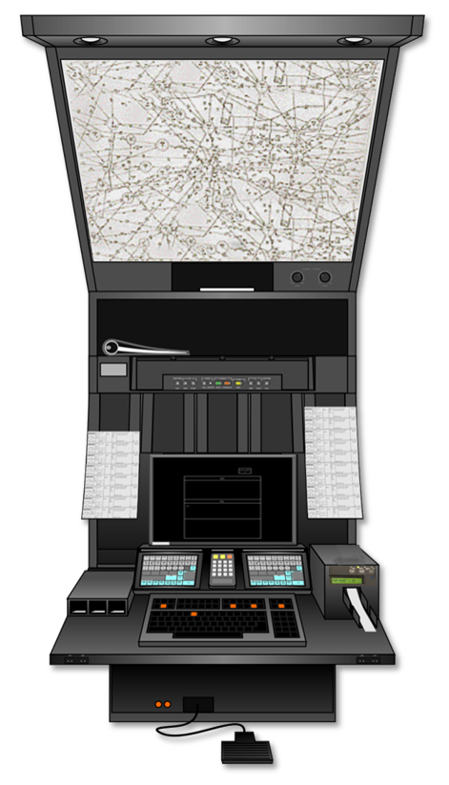
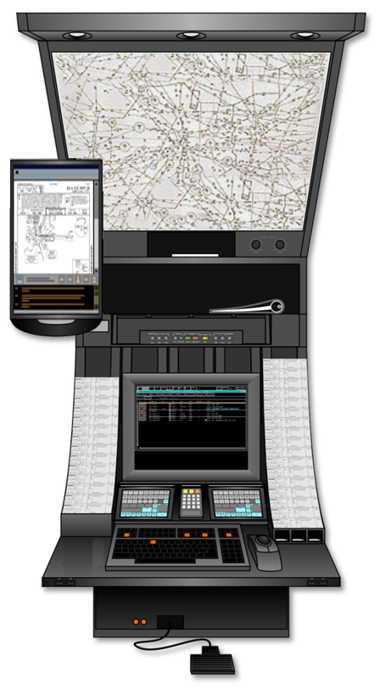
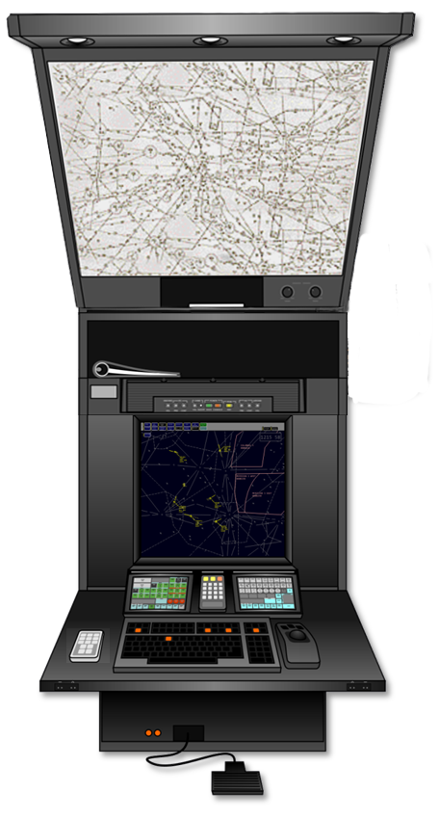
Control Position Consoles
A Position RA Position R Position

Slide 4
A Position Console
Flight Strip Lighting
Binder Storage
Backlit Chart Holder
Map/Strip
Lighting Controls
Loudspeaker Panel
Assembly (LPA)
Additional Storage
Monitor
Voice Switching and
Control System (VSCS)
Flight Strip Bays
Flight Strip Printer
Used Strip Receptacle
Keyboard
Headset Jacks
Foot Switch

Slide 5
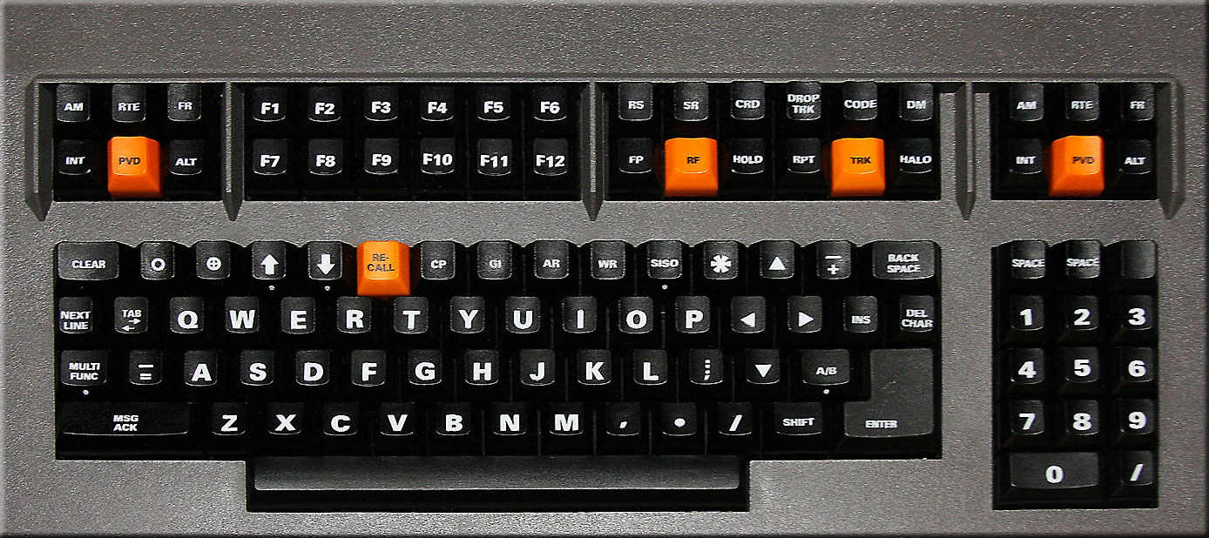
Keyboard
• Alphabetic, Special Character Keys, and Numeric
Keypad
• Hard-Labeled Function Keys
• Category Keys
Text-Editing Keys
Immediate Action Hard-Labeled Function Keys

Slide 6
Keys and Keypad
Special Character Keys
Alphabetic Keys
Numeric Keys

Slide 7
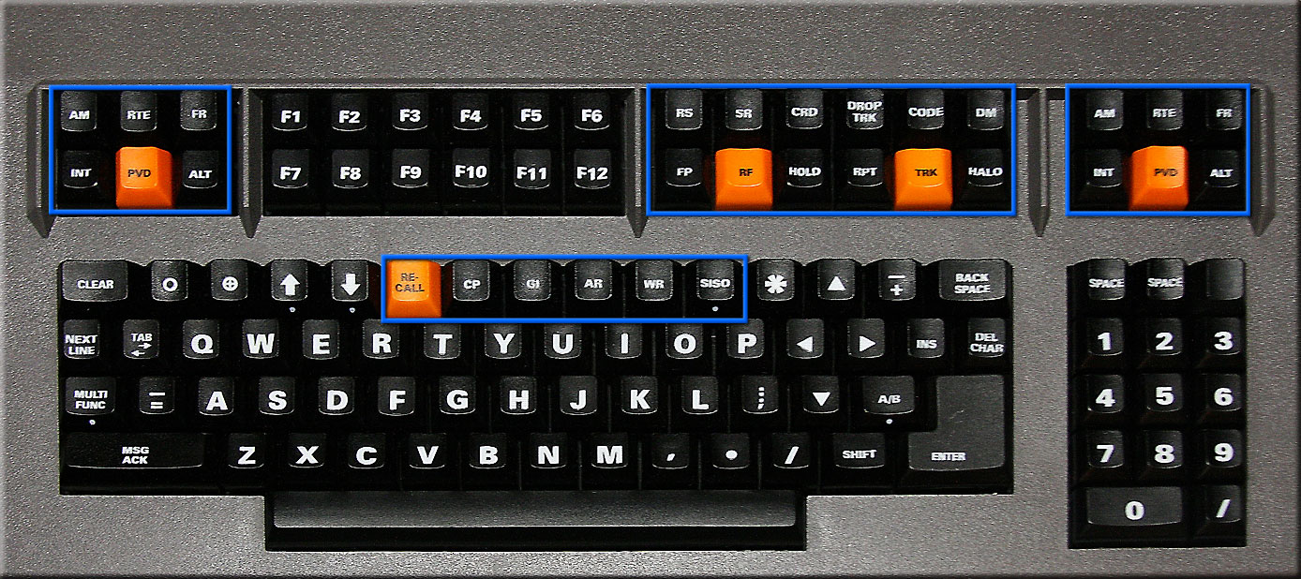
Hard-Labeled Function Keys

Slide 8
Category Keys

Slide 9
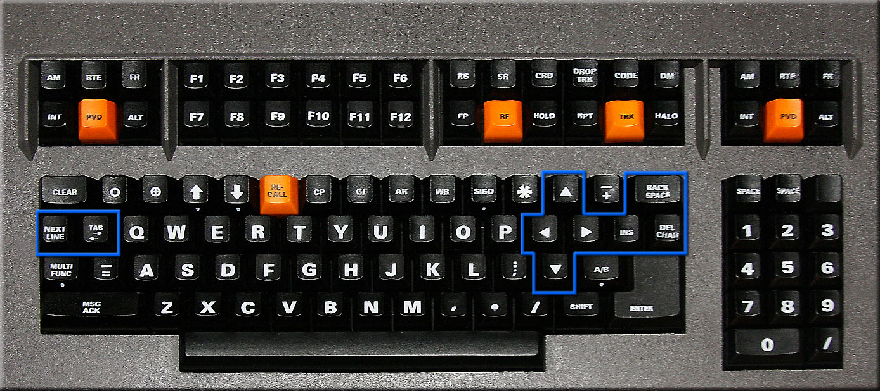
Text Editing Keys

Slide 10
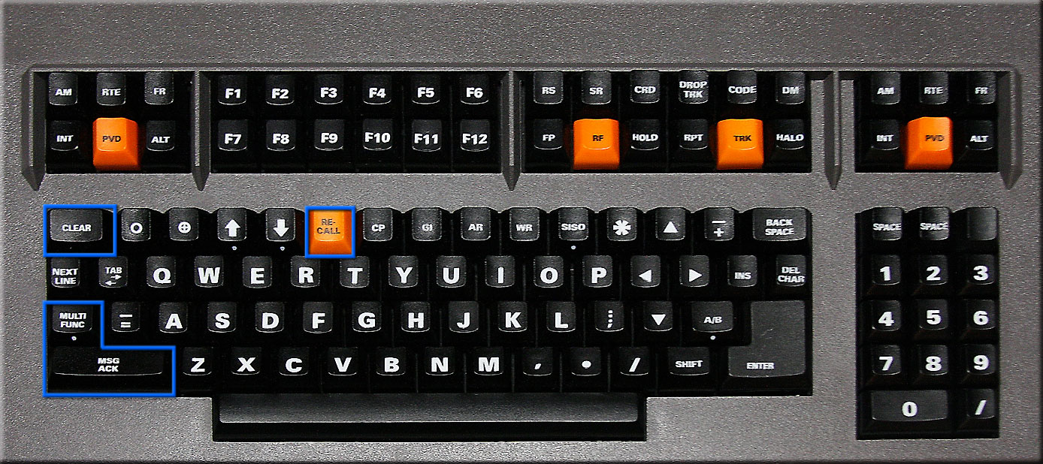
Immediate Action Hard-Labeled Function Keys

Slide 11

Knowledge Check
Which key would you press to view a previously entered command?
  MULTI FUNC
  NEXT LINE
  RECALL

Slide 12
Knowledge Check
Which key removes all information from the Preview Area and Feedback Area?
  BACKSPACE Key
  CLEAR Key
  RECALL Key

Slide 13
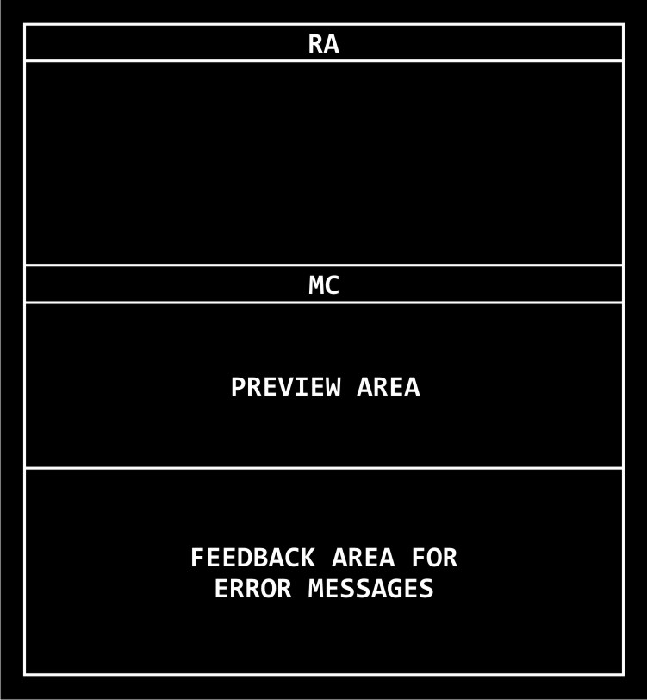
A Position View: A-CRD
Response
Area Header
Response Area
Message Composition Area Header
Message Composition Area

Slide 14
Knowledge Check
From top to bottom, the areas of the A-CRD are:
  Response Area, Preview Area, Feedback Area
  Preview Area, Response Area, Feedback Area
  Preview Area, Feedback Area, Response Area

Slide 15
Knowledge Check
The result of an accepted command would appear in which area of the A-CRD?
  Response Area
  Preview Area
  Feedback Area

Slide 16


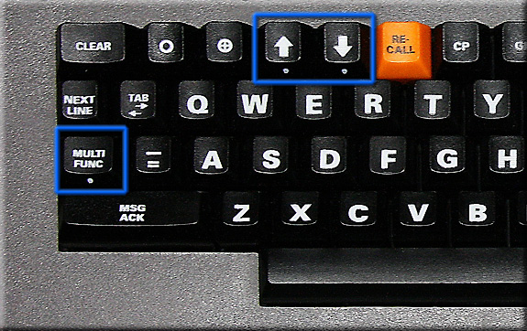
A Position View
Time View
Alarm Volume View

Slide 17
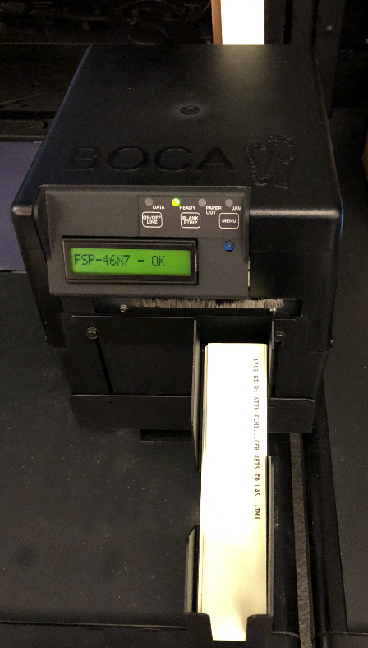
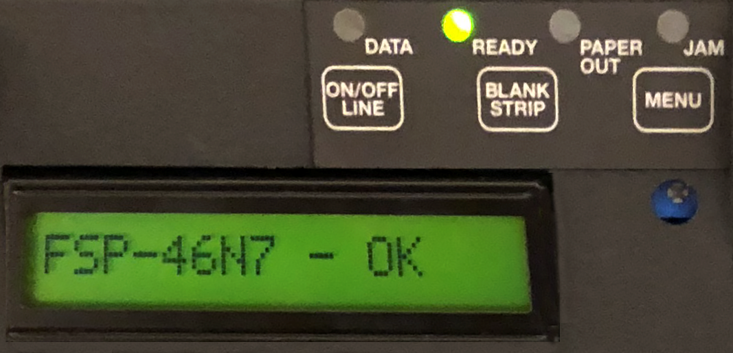
Flight Strip Printer (FSP)
Controls and Indicators

Slide 18
Practice Exercise 1:
Loading Flight Strip Printer
You will complete this exercise in the lab at the conclusion of this lecture.

Slide 19
RA Position Console
Flight Strip Lighting
Binder Storage
Backlit Chart Holder
Map/Strip
Lighting Controls
En Route Information
Display System (ERIDS)
Tracker Panel or
Additional Storage
RA Display Monitor
Voice Switching and
Control System (VSCS)
Flight Strip Bays
Keyboard
Used Strip Receptacle
Trackball
Headset Jacks
Footswitch

Slide 20
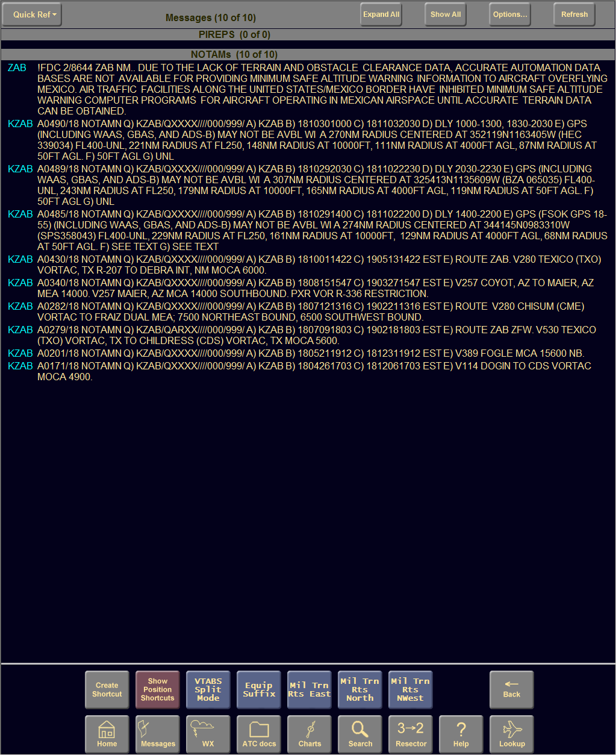
En Route Information Display System (ERIDS)

Slide 21
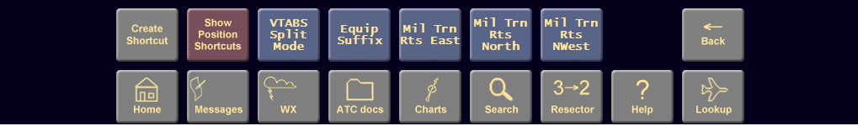

ERIDS Home Page Buttons
Home – This will return the display directly to the home page.
Messages – NOTAMS, GI messages, SIGMETS, AIRMETS will be displayed on a Message screen.
WX – PIREPS and weather messages are entered on this page.

Slide 22
ERIDS Home Page Buttons (cont’d)
ATC docs – Allows you to browse all national and local documents stored in ERIDS, such as the 7110.65, letters of agreement etc.
Charts – Sectional charts, overhead controller charts, En route charts are all accessible from this button.

Slide 23
ERIDS Home Page Buttons (cont’d)
Search – Allows you to search documents, facility identifiers, NAVAIDS, aircraft types.
Resector – This changes the sector that the ERIDS is assigned to, allowing messages to be sent to the correct sector. The correct sector shortcuts will also be displayed when this is set.

Slide 24
ERIDS Home Page Buttons (cont’d)
Help – This provides the user with help in using ERIDS.
Lookup – Allows fast lookup of NAVAIDS and airport information.

Slide 25
ERIDS Home Page Buttons (cont’d)
Back – Will take you back one page, from anywhere in ERIDS.
Create Shortcut – Allows you to make a site shortcut, or a position specific shortcut.
Shortcuts – Site or position shortcuts

Slide 26
Knowledge Check
Which button is used to find the JO 7110.65 and other FAA orders?
  ATC docs
  Orders
  WX

Slide 27
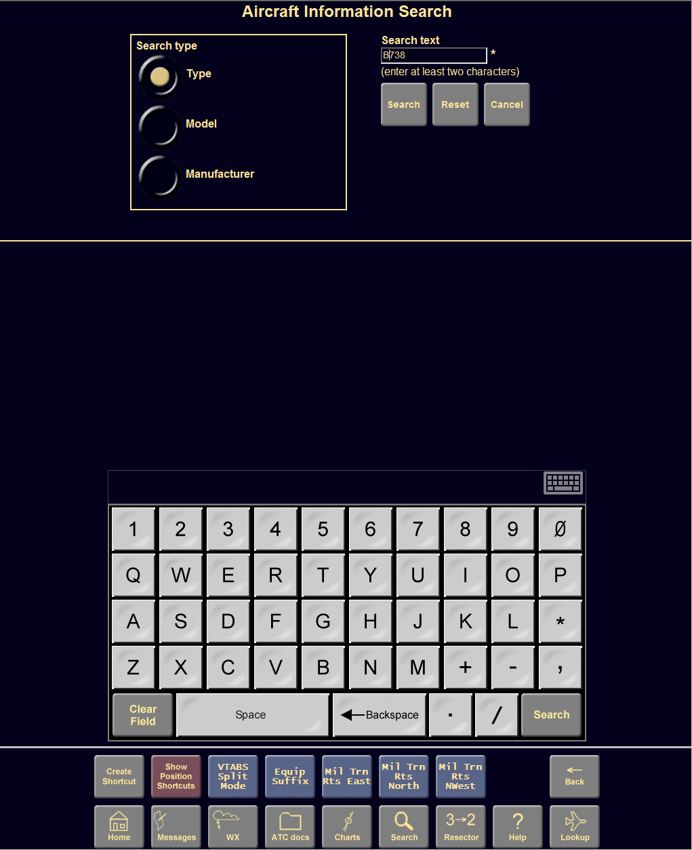
ERIDS Keyboards
Several variations
  Automatically displayed
  May be maximized or minimized

Slide 28
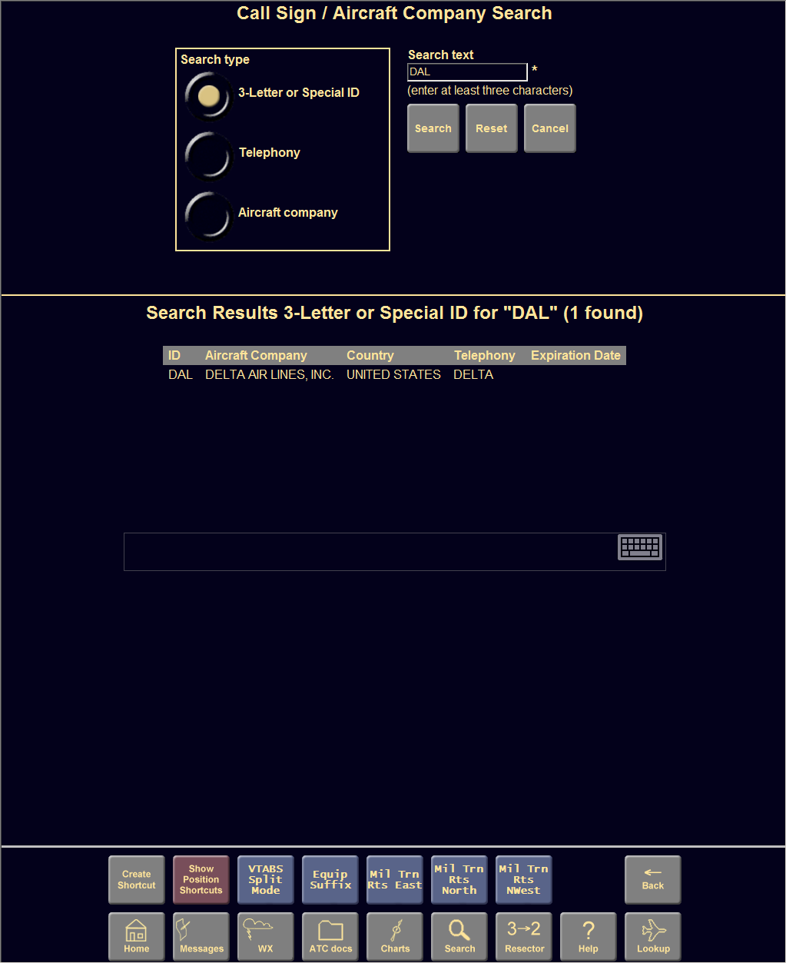
ERIDS Keyboards
(Cont’d)
Minimized by touching the keyboard icon on the screen
Moved by dragging the icon with your finger

Slide 29
Knowledge Check
What do you touch to minimize or maximize the ERIDS keyboard?
  The minimize key
  The keyboard icon
  The keyboard can’t be changed

Slide 30
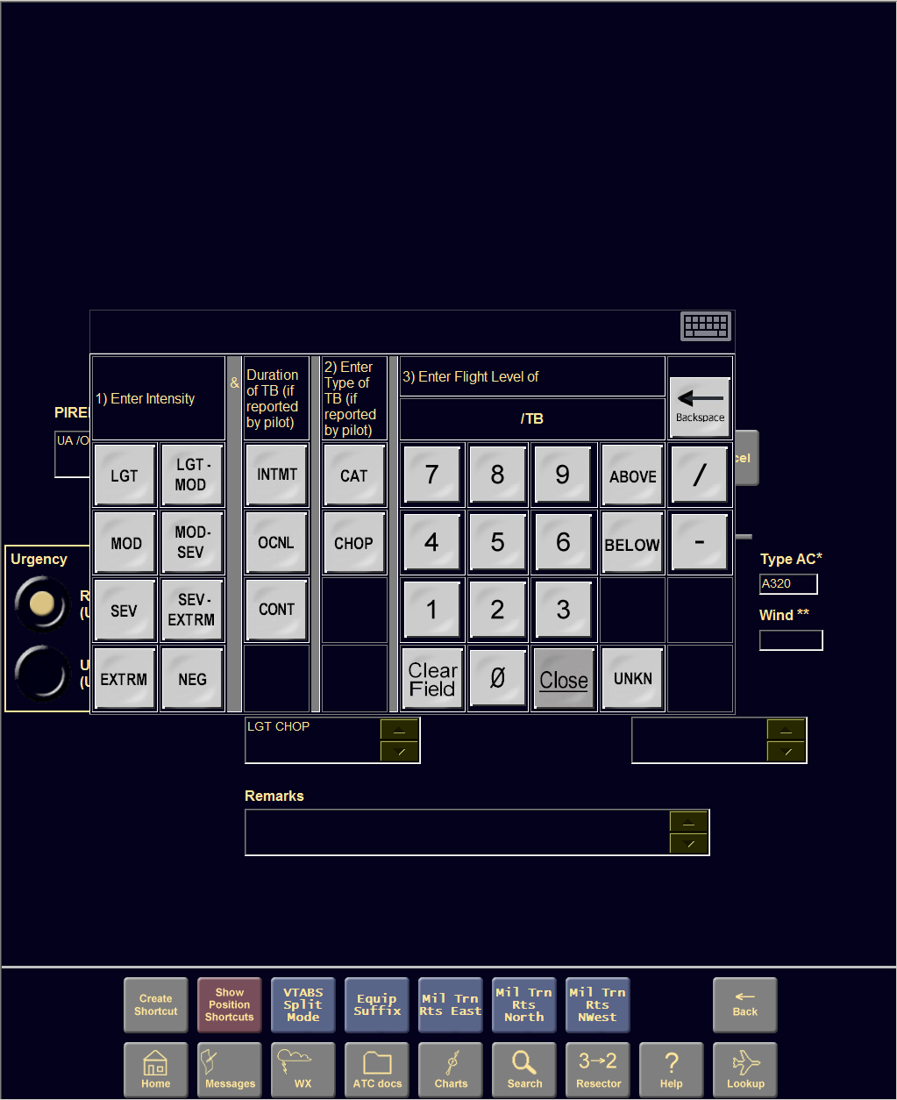
ERIDS PIREP Keyboard
Specialized to enter PIREPS and weather information

Slide 31
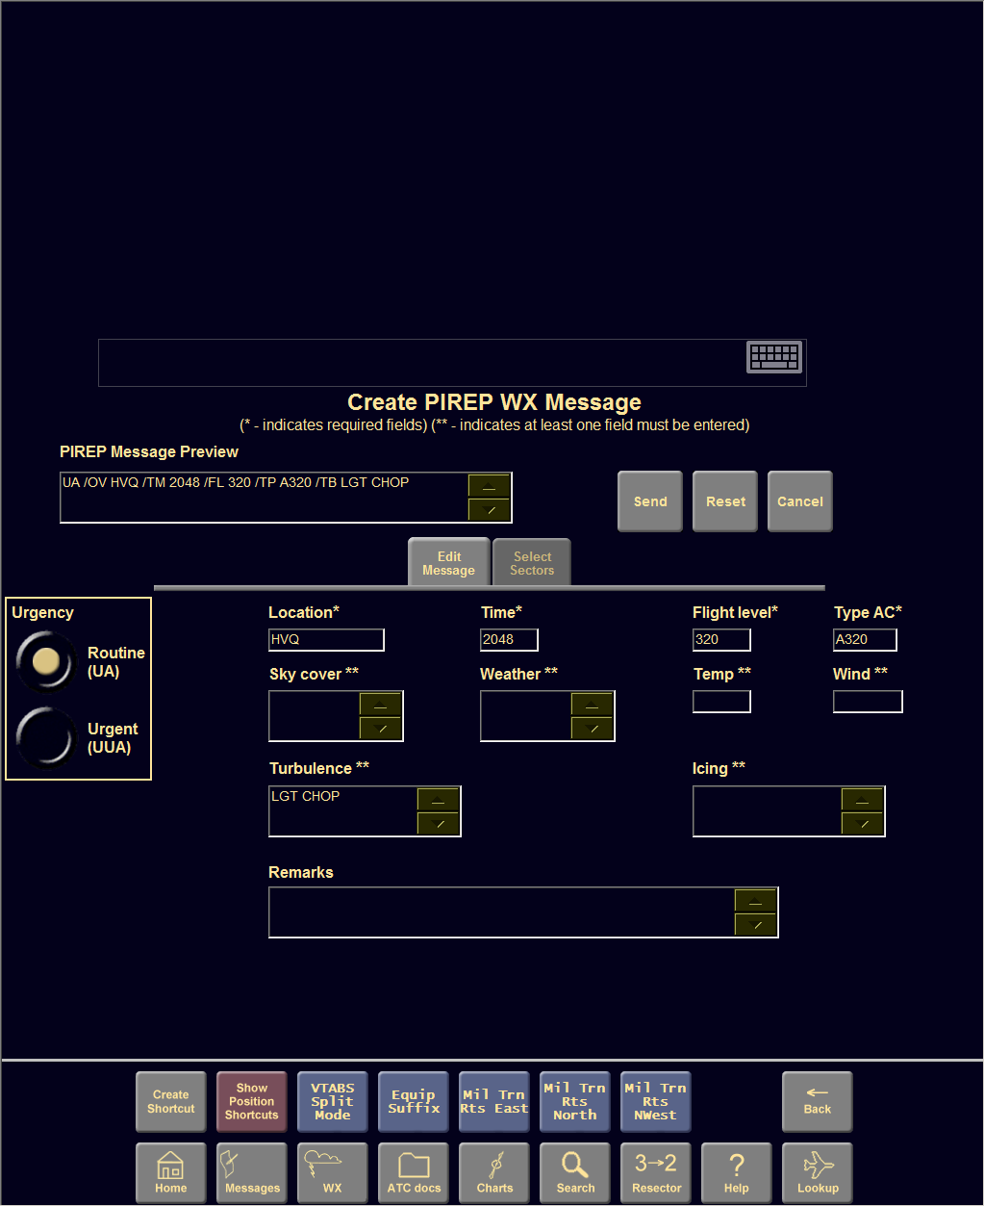

Creating a PIREP
Required Field
  Urgency
  Location
  Time
  Flight level
  Type aircraft

Slide 32
Creating a PIREP (Cont’d)
Optional Fields
  Sky cover
  Weather
  Temperature
  Wind
  Turbulence
  Icing
  Remarks

Slide 33
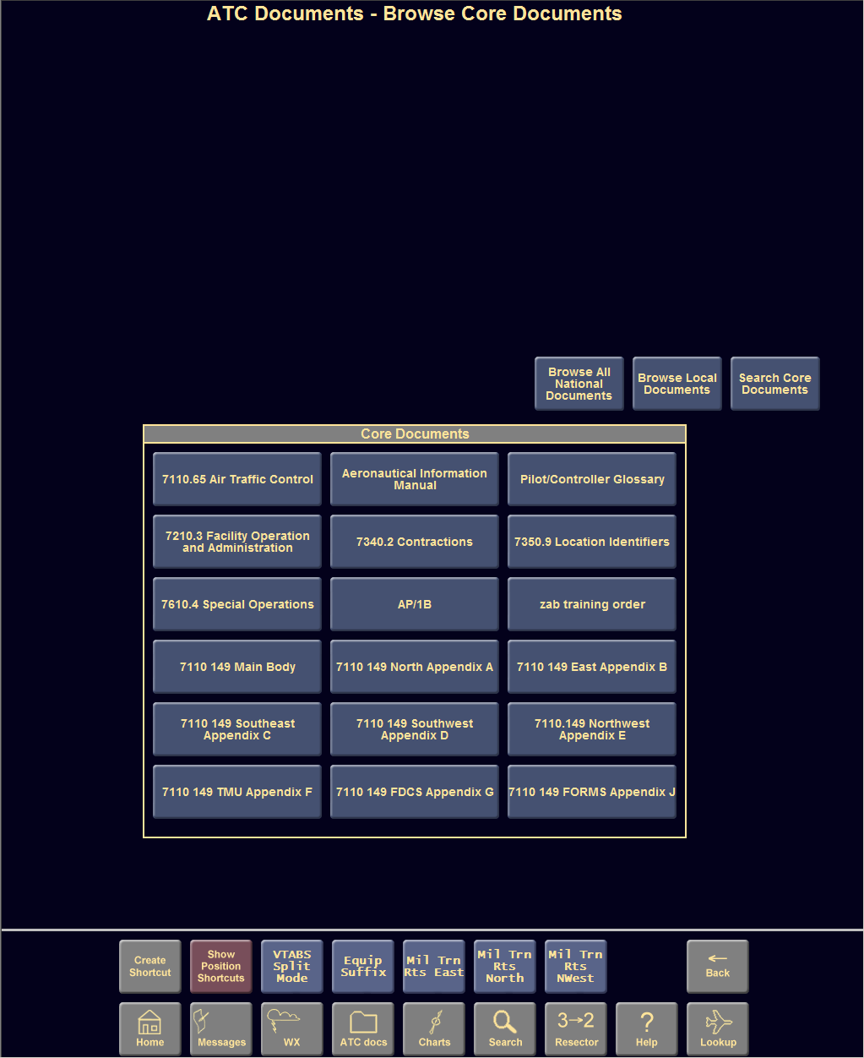
ATC Docs
Allows you to:
Browse All National Documents
Browse Local Documents
Search Core Documents

Slide 34
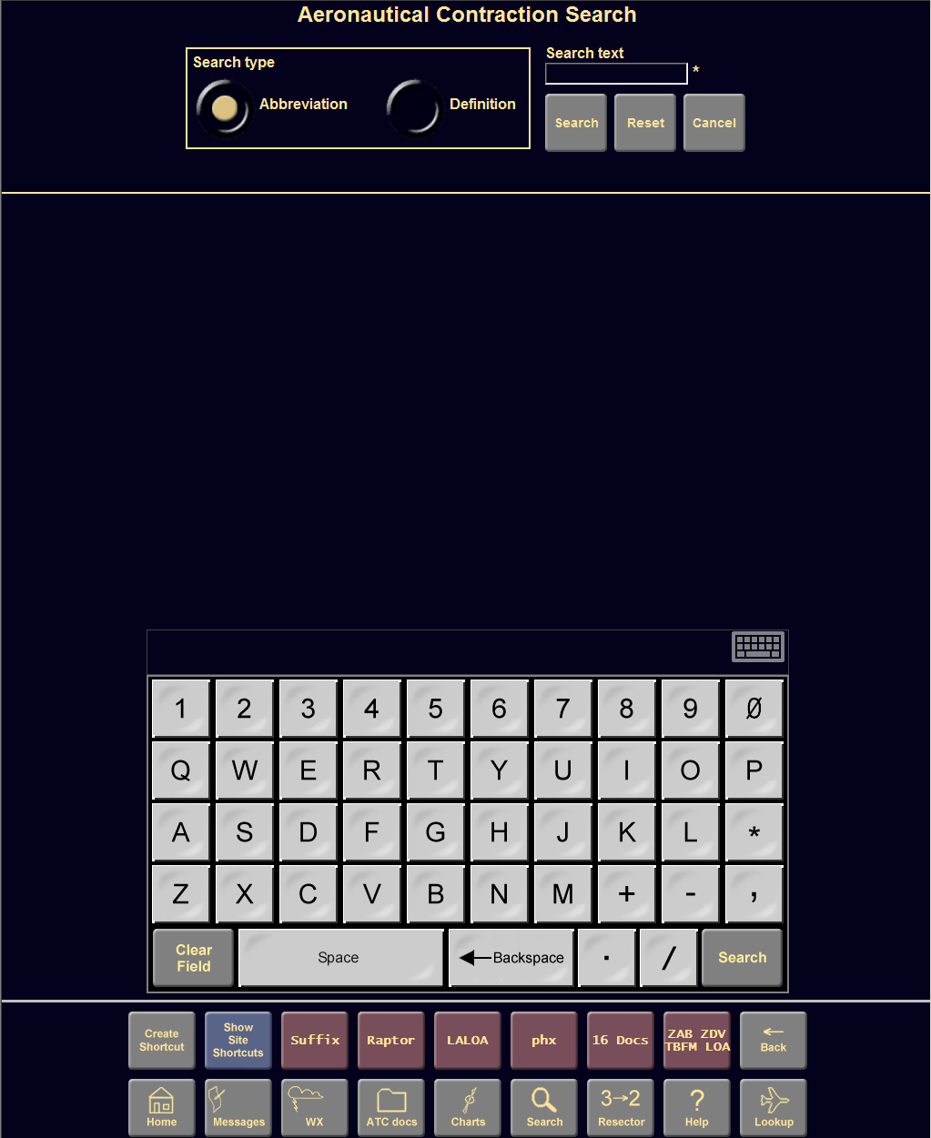
Search
Allows you to search:
FAA and aeronautical contractions
Aircraft information
Call signs/Company aircraft
Allows you to search:
  FAA and aeronautical contractions
  Aircraft information
  Call signs/Company aircraft

Slide 35
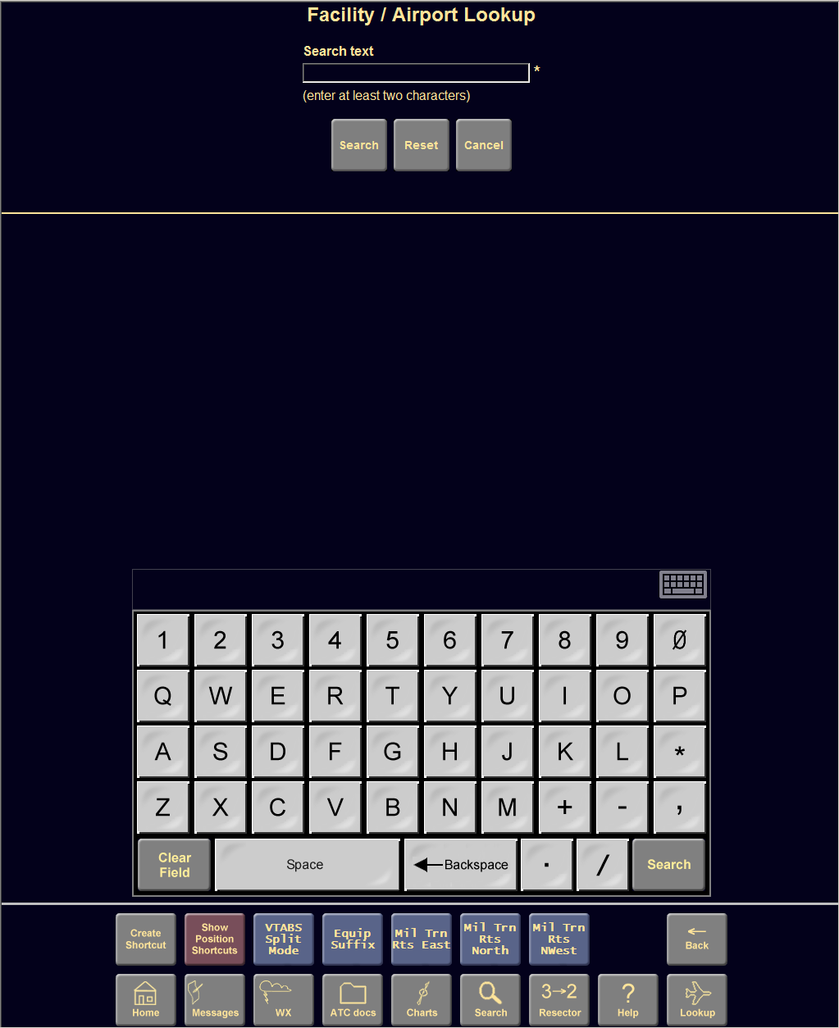
Lookup
NAVAIDS and fixes
Airports
  Approaches
  SIDs
  STARs
  Runways
  Airport Facility Directory
  NOTAMS

Slide 36
Practice Exercise 2:
ERIDS Checklist
You will complete this exercise in the lab at the conclusion of this lecture.

Slide 37
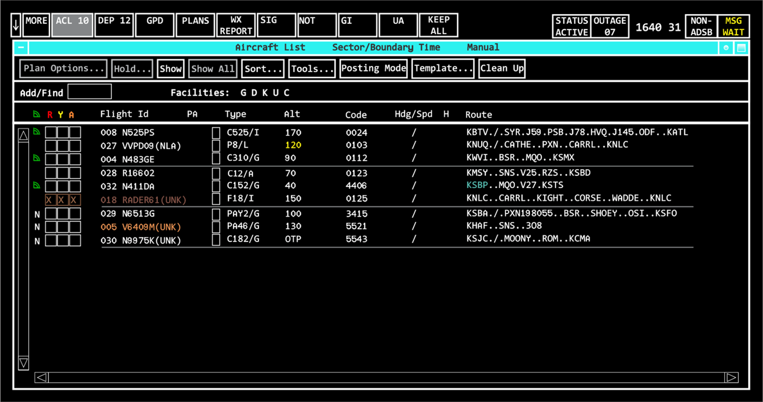
RA Display
09

Slide 38
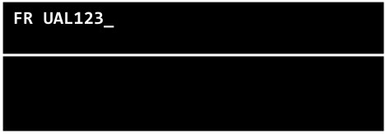
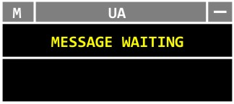
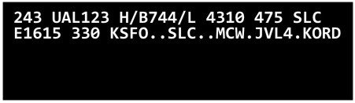
RA Display (Cont’d)
Update Area
Message Composition Area
Response Area

Slide 39
RA Display (Cont’d)
MCA
Preview Area
  Compose commands
Feedback Area
  System response to commands
Example of accepted message
FP SWA42 B738/L 425 KOKC P1105 240 KOKC.KRMSN3.KRM SN..AIRRE.HIBIL3.KDAL
Preview Area
✓ ACCEPT
FLIGHT PLAN
SWA42
Feedback Area
Example of rejected message
FP SWA42 B738/L 425 KOKC P1185 240 KOKC.KRMSN3.KRM SN..AIRRE.HIBIL3.KDAL
X TIM P1185 FORMAT
FLIGHT PLAN
FP SWA42 B738/L 425 KOKC P1185 240 KOKC.KRMSN3.KRMSN..AIRRE.HIBIL3.KDAL

Slide 40
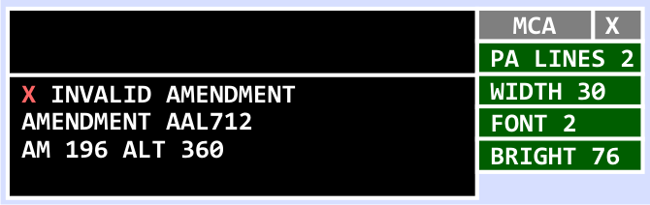
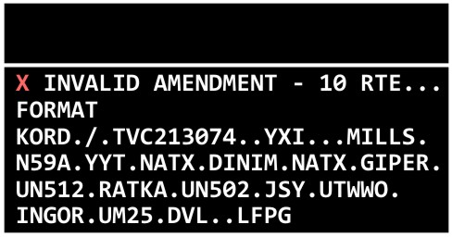
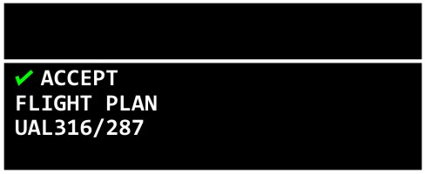
RA Display (Cont’d)
MCA Preview and Feedback Areas
MCA View
Menu
Reject
Message
Example
Accept
Message
Example
Expanded
View

Slide 41

RA Trackball
Trackball Pick (TBP)
Left-Click
Trackball Enter (TBE)
Middle-Click
Trackball Home (TBH)
Right-Click

Slide 42
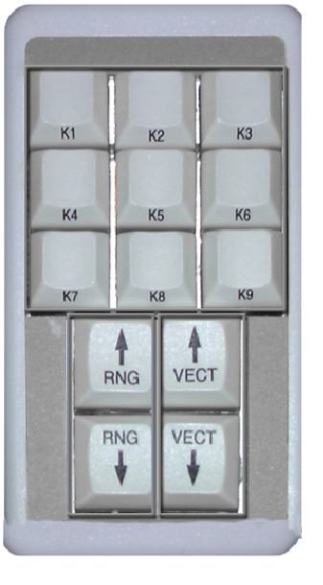
R Position Console
KSD
Map/Strip
Lighting Controls
Backlit Chart Holder
Binder Storage
Tracker Panel or
Additional Storage
Voice Switching and
Control System (VSCS)
Situation Display (SD)
Keyboard
Trackball
Keypad Selection
Device (KSD)
Headset Jacks
Foot Switch

Slide 43
Knowledge Check
Which position has a Situation Display?
  A Position
  R Position
  RA Position

Slide 44
Lesson Summary
Control Position Consoles
  A Position
    Keyboard
    A-CRD
    Time and Alarm view
    Flight Strip Printer
  RA Position
    Display
    MCA Preview and Feedback Areas
    Trackball
    ERIDS
  R Position
    R-position console
    KSD

Slide 45

THE END

