Slide 1
Radar Flight Data
Controller Training
Lesson 3: Flight Progress Strip Distribution
Course - 55053
Version 2019-12.1

Slide 2
Lesson Objectives
At the end of this lesson, you will be able to:
List the steps for delivering strips
Identify data contained on flight strips
List the steps for preparing flight strips

Slide 3
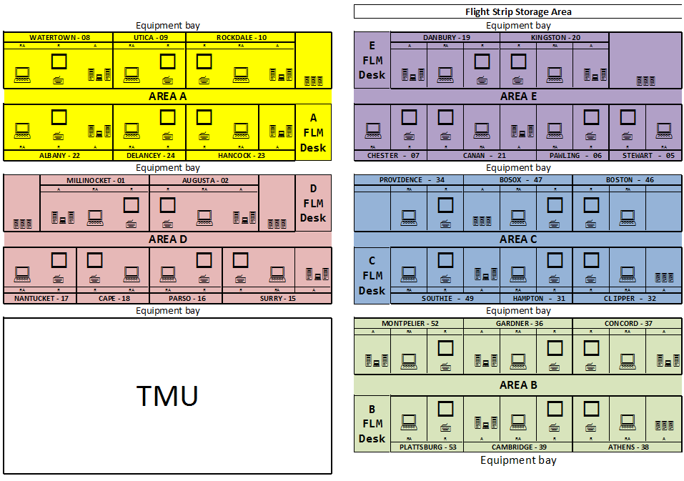
Sample Control Room Layout

Slide 4
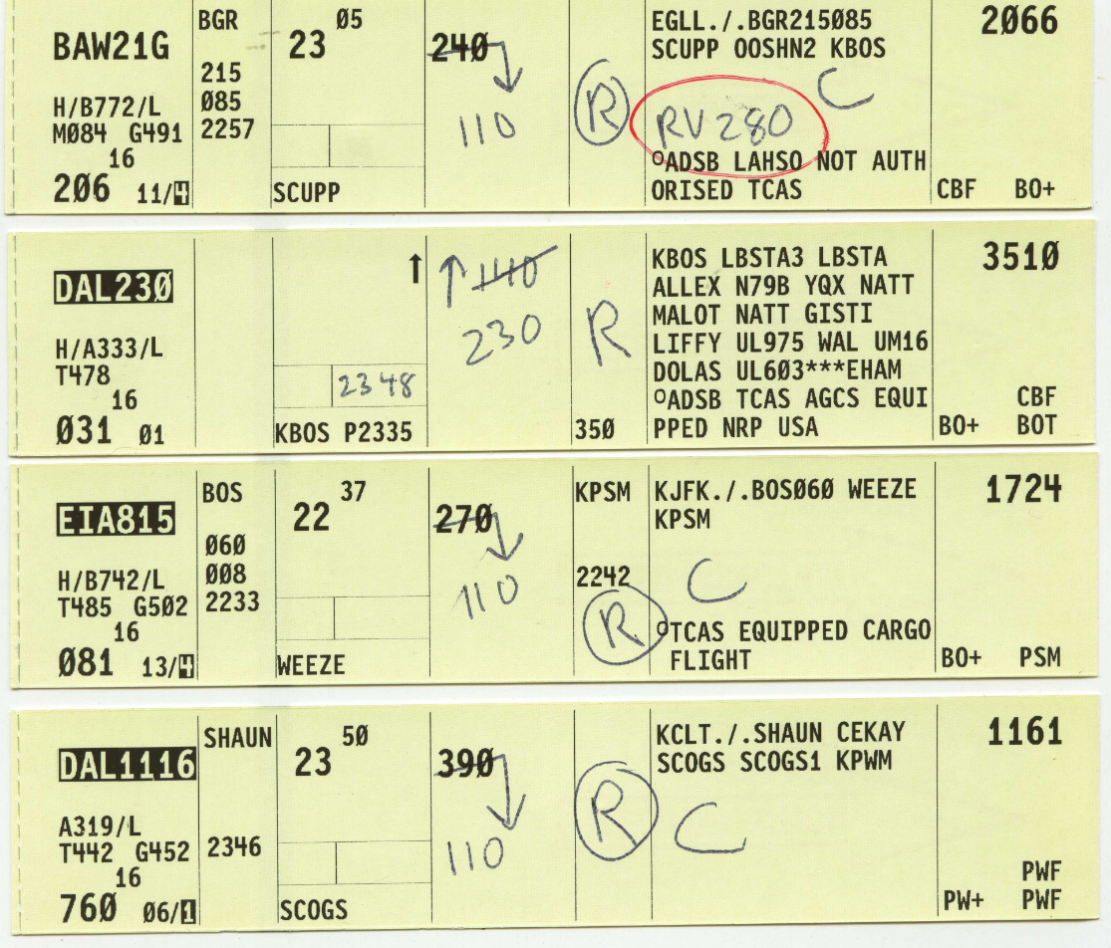
Strip Delivery
Hand-Carried
Placement by Fix Posting
  Proximity to route of flight
    Active bay
    Inactive bay
    Proposal bay

Slide 5

Knowledge Check
What is the first step in delivering strips?
  Turn the printer off
  Remove the printed strips from the printer
  Sort the strips alphabetically

Slide 6
Knowledge Check
When delivering strips, how should they be sorted?
  Alphabetically
  By Beacon Code
  By Fix Posting

Slide 7
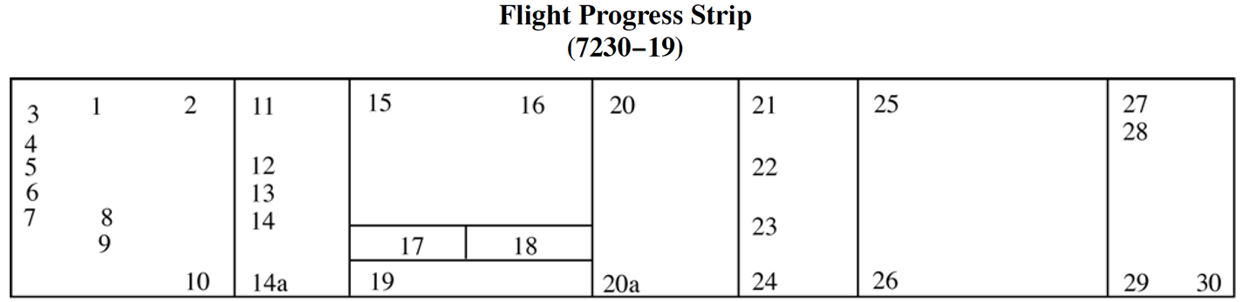

En Route Data Entries
Manually Prepared Strips are prepared when the computer is shut down for maintenance or other reasons.
When an outage occurs, information is routed to a paired printer.
JO 7110.65

Slide 8

Flight Strip Data Locations
3
4
5
Aircraft identification
Type of aircraft/suffix
True airspeed

Slide 9

Flight Strip Data Locations
11
15
12
19
Aircraft identification
Type of aircraft/suffix
True airspeed
Previous Fix
Est. time over Previous Fix
Est. time over Fix
Fix, departing proposed time

Slide 10

Flight Strip Data Locations
20
24
Aircraft identification
Type of aircraft/suffix
True airspeed
Previous Fix
Est. time over Previous Fix
Est. time over Fix
Fix, departing proposed time
Altitude information
Requested altitude

Slide 11
Flight Strip Data Locations
21
22
Aircraft identification
Type of aircraft/suffix
True airspeed
Previous Fix
Est. time over Previous Fix
Est. time over Fix
Fix, departing proposed time
Altitude information
Next Fix
Est. time over Next Fix
Requested altitude

Slide 12
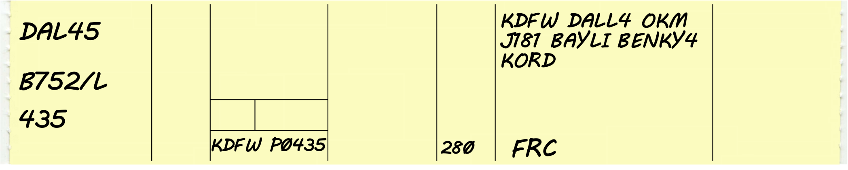
Flight Strip Data Locations
25
26
Aircraft identification
Type of aircraft/suffix
True airspeed
Previous Fix
Est. time over Previous Fix
Est. time over Fix
Fix, departing proposed time
Altitude information
Next Fix
Est. time over Next Fix
Requested altitude
Route of flight
Remarks

Slide 13
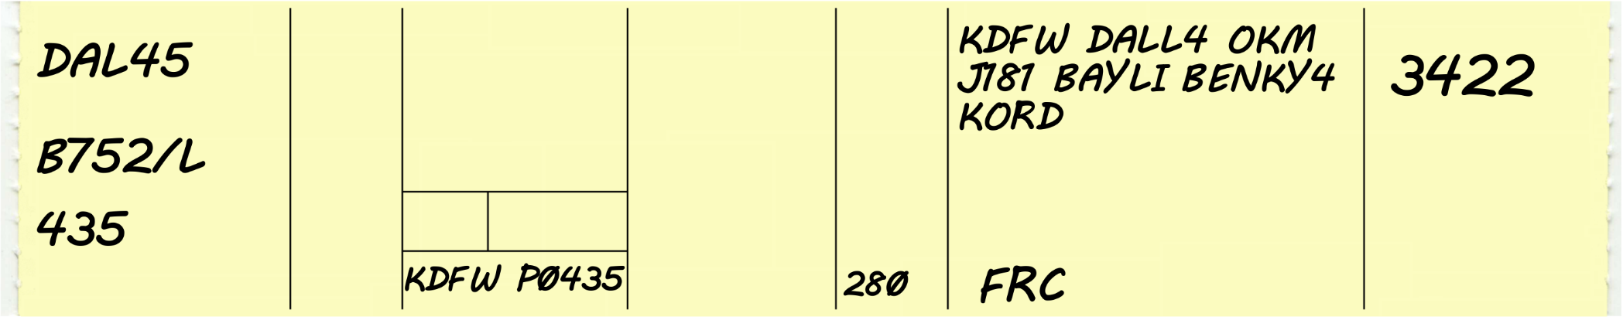
Flight Strip Data Locations
27
Aircraft identification
Type of aircraft/suffix
True airspeed
Previous Fix
Est. time over Previous Fix
Est. time over Fix
Fix, departing proposed time
Altitude information
Next Fix
Est. time over Next Fix
Requested altitude
Route of flight
Remarks
Mode 3/A beacon code

Slide 14
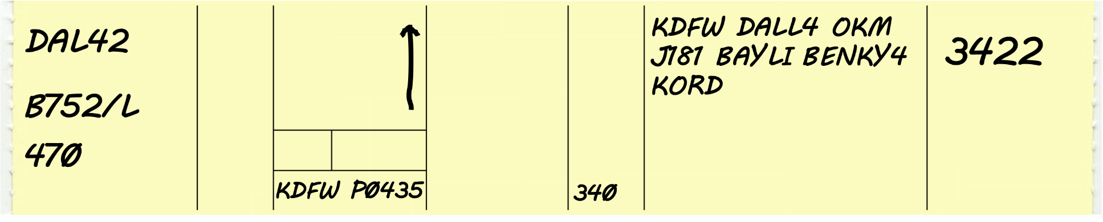
Knowledge Check
3
11
20
25
27
12
4
5
19
24
Proposal Delta Forty-two,
Proposal Delta Forty-two, Boeing seven-fifty-seven two hundred slant-Lima, true airspeed four-seven-zero knots, proposed departure Dallas/Fort Worth zero-four-three-five, requesting flight level three-four-zero, route KDFW DALL4 OKM J181 BAYLI BENKY4 KORD, code three-four-two-two.
Proposal Delta Forty-two, Boeing seven-fifty-seven two hundred slant-Lima, true airspeed four-seven-zero knots, proposed departure Dallas/Fort Worth zero-four-three-five, requesting flight level three-four-zero, route KDFW DALL4 OKM J181 BAYLI BENKY4 KORD, code three-four-two-two.
Proposal Delta Forty-two, Boeing seven-fifty-seven two hundred slant-Lima, true airspeed four-seven-zero knots, proposed departure Dallas/Fort Worth zero-four-three-five, requesting flight level three-four-zero, route KDFW DALL4 OKM J181 BAYLI BENKY4 KORD, code three-four-two-two.
Proposal Delta Forty-two, Boeing seven-fifty-seven two hundred slant-Lima, true airspeed four-seven-zero knots, proposed departure Dallas/Fort Worth zero-four-three-five, requesting flight level three-four-zero, route KDFW DALL4 OKM J181 BAYLI BENKY4 KORD, code three-four-two-two.
Proposal Delta Forty-two, Boeing seven-fifty-seven two hundred slant-Lima, true airspeed four-seven-zero knots, proposed departure Dallas/Fort Worth zero-four-three-five, requesting flight level three-four-zero, route KDFW DALL4 OKM J181 BAYLI BENKY4 KORD, code three-four-two-two.
Proposal Delta Forty-two, Boeing seven-fifty-seven two hundred slant-Lima, true airspeed four-seven-zero knots, proposed departure Dallas/Fort Worth zero-four-three-five, requesting flight level three-four-zero, route KDFW DALL4 OKM J181 BAYLI BENKY4 KORD, code three-four-two-two
Proposal Delta Forty-two, Boeing seven-fifty-seven two hundred slant-Lima, true airspeed four-seven-zero knots, proposed departure Dallas/Fort Worth zero-four-three-five, requesting flight level three-four-zero, route KDFW DALL4 OKM J181 BAYLI BENKY4 KORD, code three-four-two-two

Slide 15
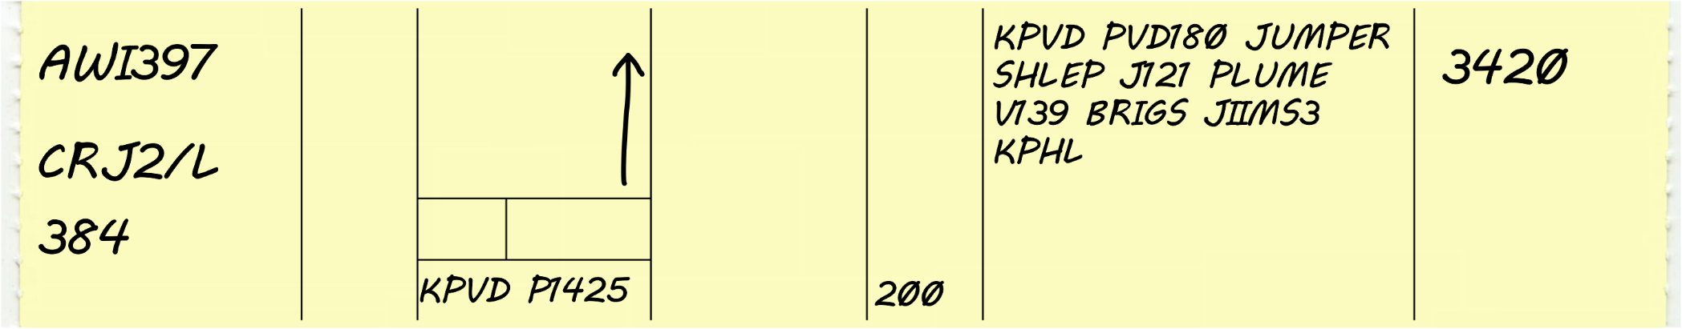

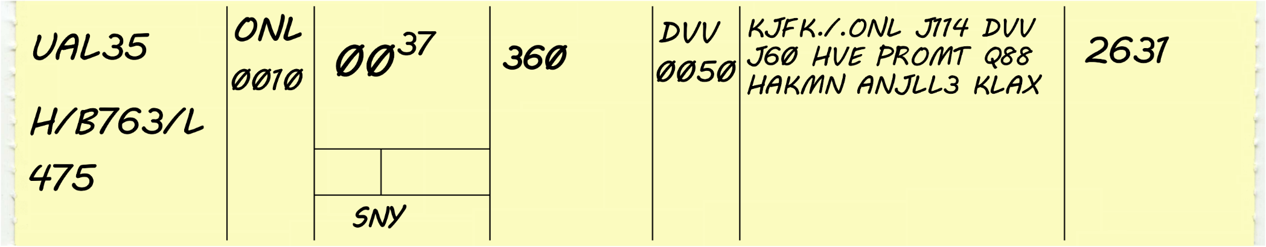
Manually Prepared Strips
Proposed Flight
Airborne Flight
25
3
27
4
5
19
24
11
21
25
3
15
20
27
12
22
4
5
Tailoring Symbol
19

Slide 16
Manually Prepared Strips
Check for completeness.
Prepare strips needed plus a strip for the next sector
Compute fix/times

Slide 17



Speed Comparison
7 Miles/Min.
420 Knots
Distance flown is a function of speed
  Higher speed aircraft cover a greater distance each minute
3 Miles/Min.
180 Knots
2 Miles/Min.
120 Knots

Slide 18
Time / Miles per Minute Table
Speed | Miles/Min.
60 | 1
120 | 2
180 | 3
240 | 4
300 | 5
360 | 6
420 | 7
480 | 8
540 | 9
600 | 10
This table shows how many miles per minute an aircraft will fly at a given speed.

Slide 19



Miles Per Minute Calculation
Time from one point to another can be calculated by the following formula:
Convert knots to miles per minute, divide the speed by 60.
420 knots = 7 miles per minute

Slide 20

Quick Estimate from 1/10 Hour
6 minutes is 1/10 of 60 minutes
Therefore, 1/10 of the speed is how far the aircraft will fly in 6 minutes
Example, 420 knots = 420 miles in 60 min.
  Remove the last digit of both Distance and Time.
Therefore, this aircraft will fly 42 miles in 6 minutes

Slide 21
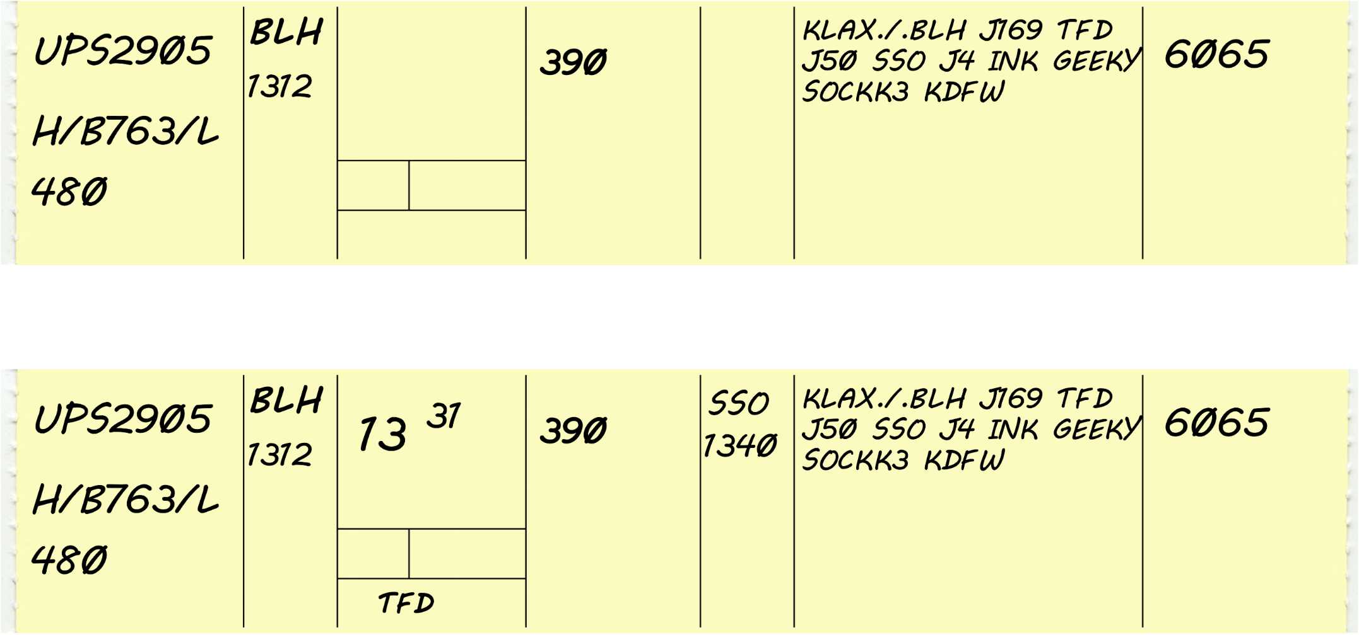
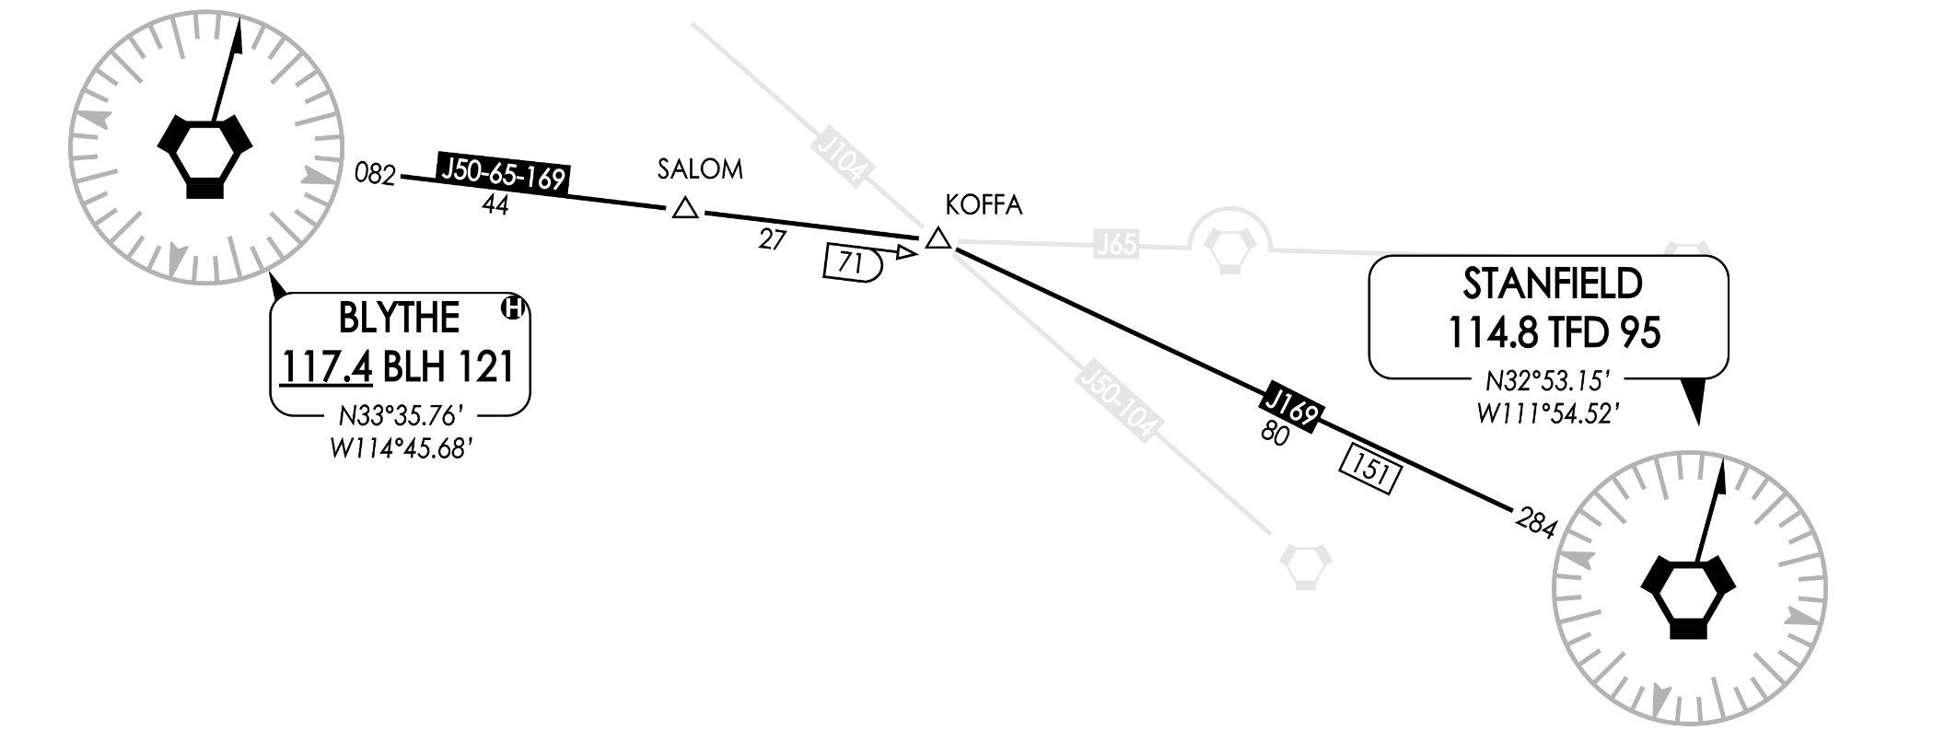
Time Calculation
Use the table to determine miles-per-minute
Calculate the time from BLH to TFD
  152 miles from BLH to TFD
  152 miles ➗ 8 miles/min. = 19 minutes
Speed | Miles/Min.
420 | 7
480 | 8
540 | 9

Slide 22
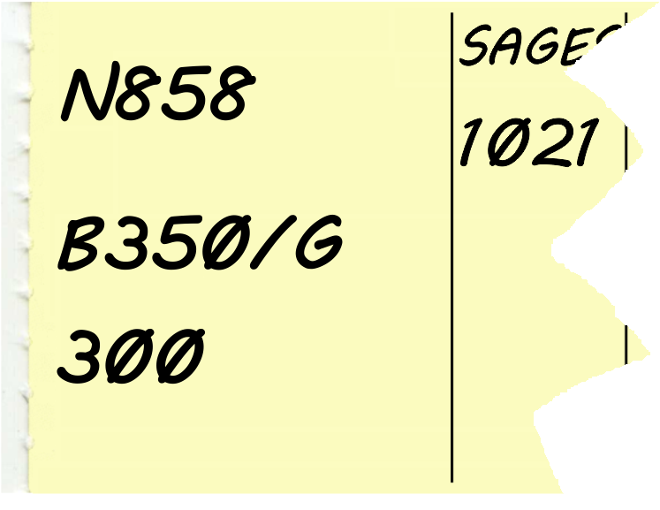
Knowledge Check
How many miles per minute is N858 traveling?
3
4
5

Slide 23
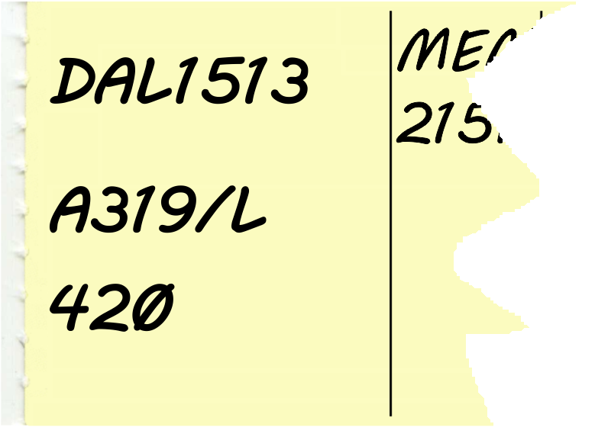
Knowledge Check
How many miles per minute is DAL1513 traveling?
6
7
8

Slide 24
Knowledge Check
An aircraft flying at 382 knots will take approximately how many minutes to travel 76 miles?
  10
  12
  18

Slide 25
Knowledge Check
An aircraft flying at 160 knots will take approximately how many minutes to travel 96 miles?
  16
  24
  36

Slide 26
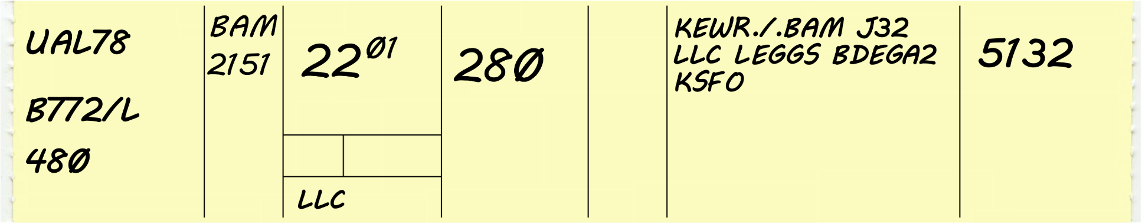
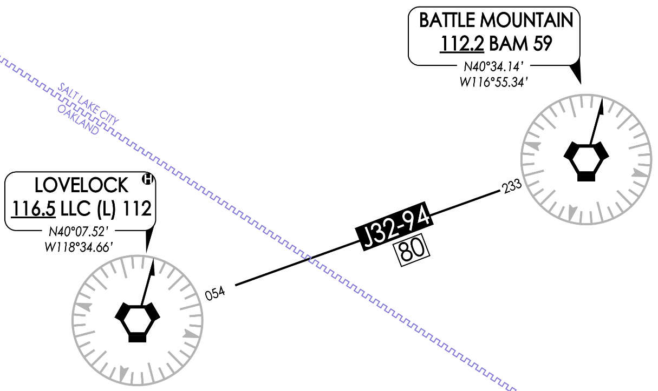
Knowledge Check
Compute LLC time.
2159
2201
2239

Slide 27
Practice Exercise #1
Use Flight Strip Worksheet to record flight plans read by the instructor
Focus on legible hand written characters and completeness of information
Use chart slides, when revealed, to calculate requested fix/times

Slide 28
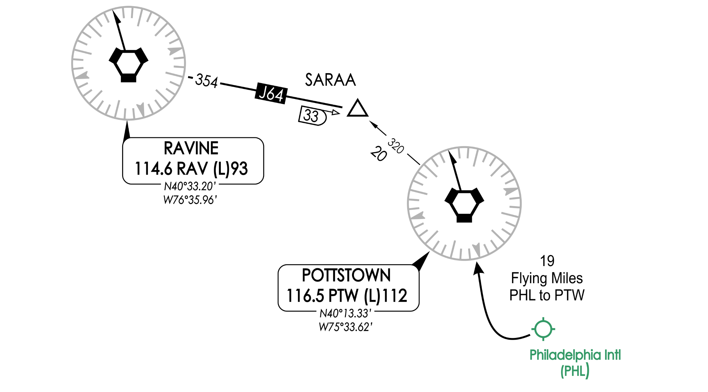
N310ZM Calculate RAV fix time

Slide 29
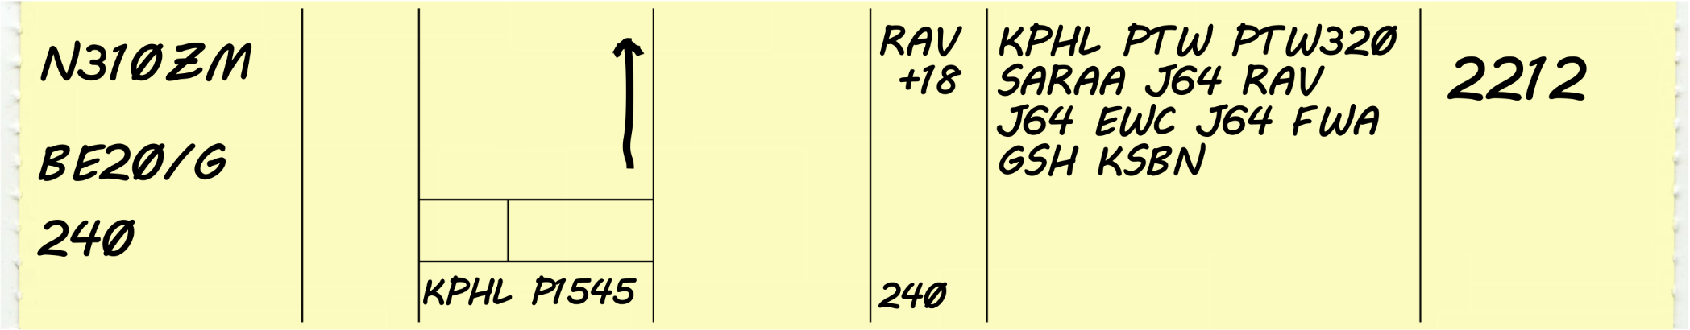
Ex. #1 Correct Flight Strips
KPHL to RAV 72 miles
Speed is 240 knots
240 knots = 4 miles/min.
72 miles ➗ 4 miles/min. = 18 min.
  -OR-
24 miles in 6 min. 24 x 3 = 72, 6 x 3 =18 min.

Slide 30
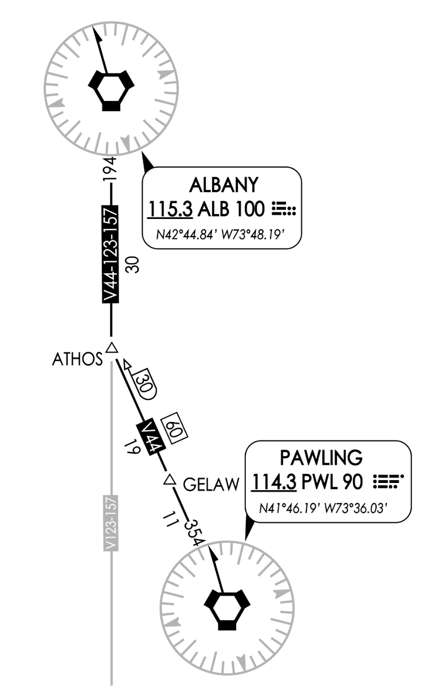
N80HK
Calculate PWL fix time

Slide 31
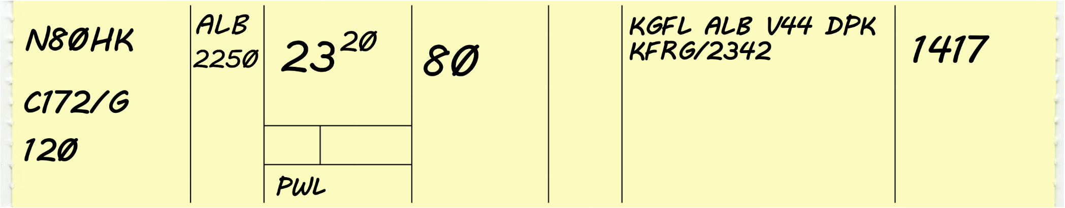
Ex. #1 Correct Flight Strips
ALB to PWL 60 miles
Speed is 120 knots
120 knots = 2 miles/min.
60 miles ➗ 2 miles/min. = 30 min.
  -OR-
12 miles in 6 min. 12 x 5 = 60, 6 x 5 = 30 min.

Slide 32
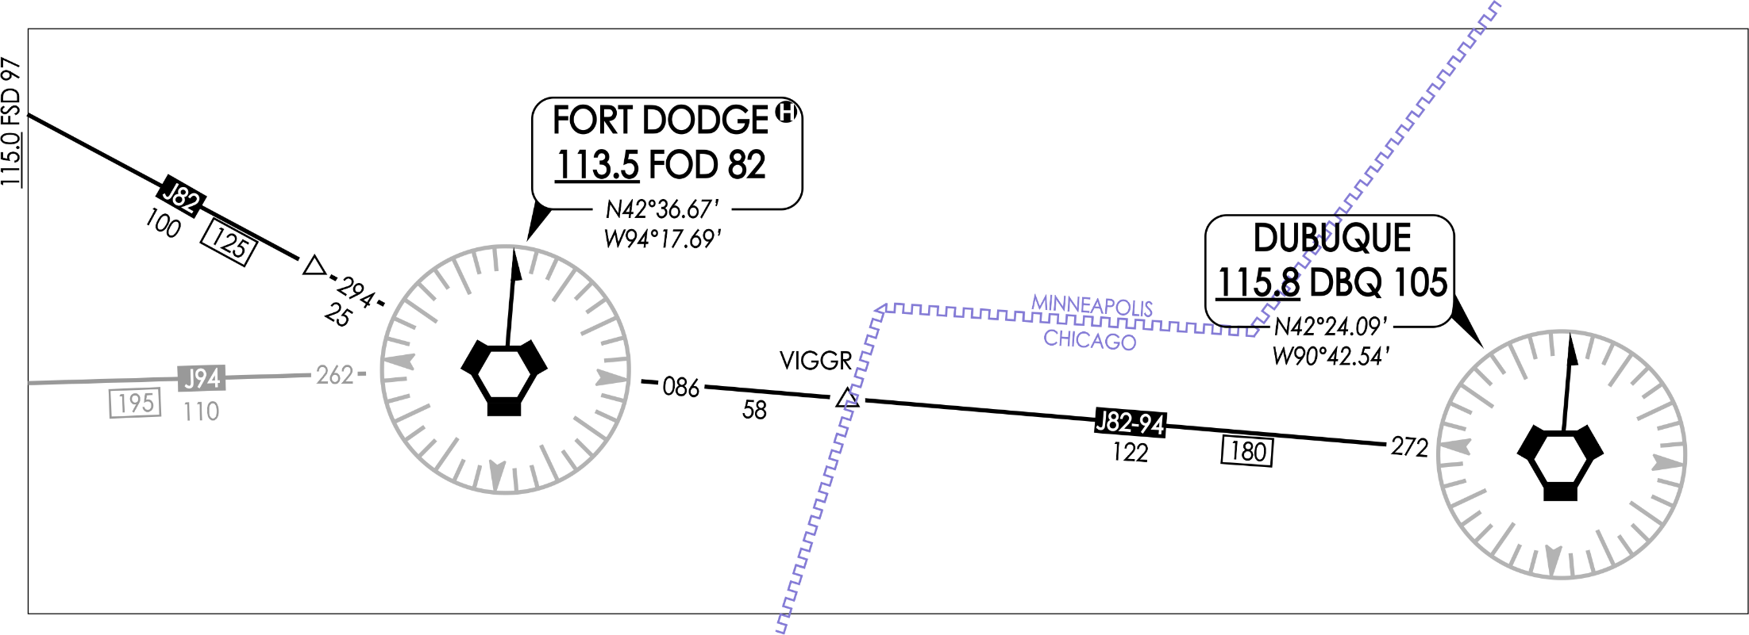
DAL1167 Calculate FOD fix time

Slide 33
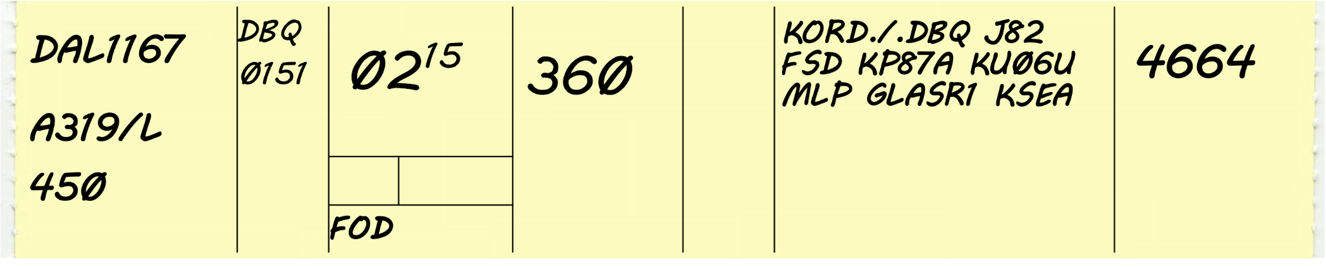
Ex. #1 Correct Flight Strips
DBQ to FOD 180 miles
Speed is 450 knots
450 knots = 7.5 miles/min.
180 miles ➗ 7.5 miles/min. = 24 min.
  -OR-
45 miles in 6 min. 45 x 4 = 180, 6 x 4 =24 min.

Slide 34
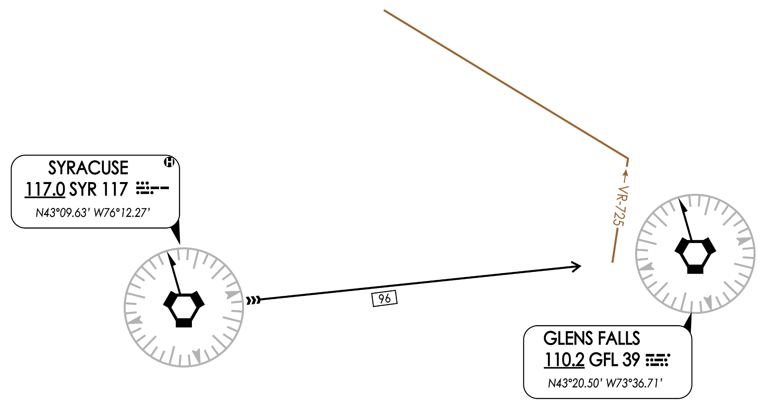
JAWS21 Calculate
GFL278014 fix time

Slide 35
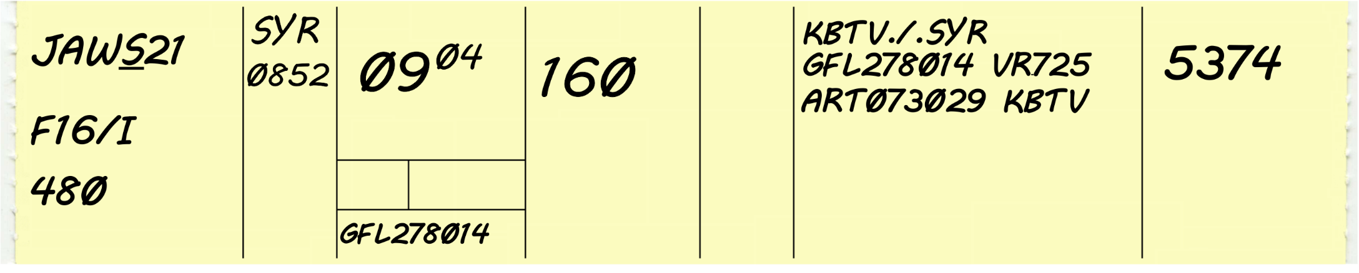
Ex. #1 Correct Flight Strips
SYR to GFL278014 96 miles
Speed is 480 knots
480 knots = 8 miles/min.
96 miles ➗ 8 miles/min. = 12 min.
  -OR-
48 miles in 6 min. 48 x 2 = 96, 6 x 2 =12 min.

Slide 36
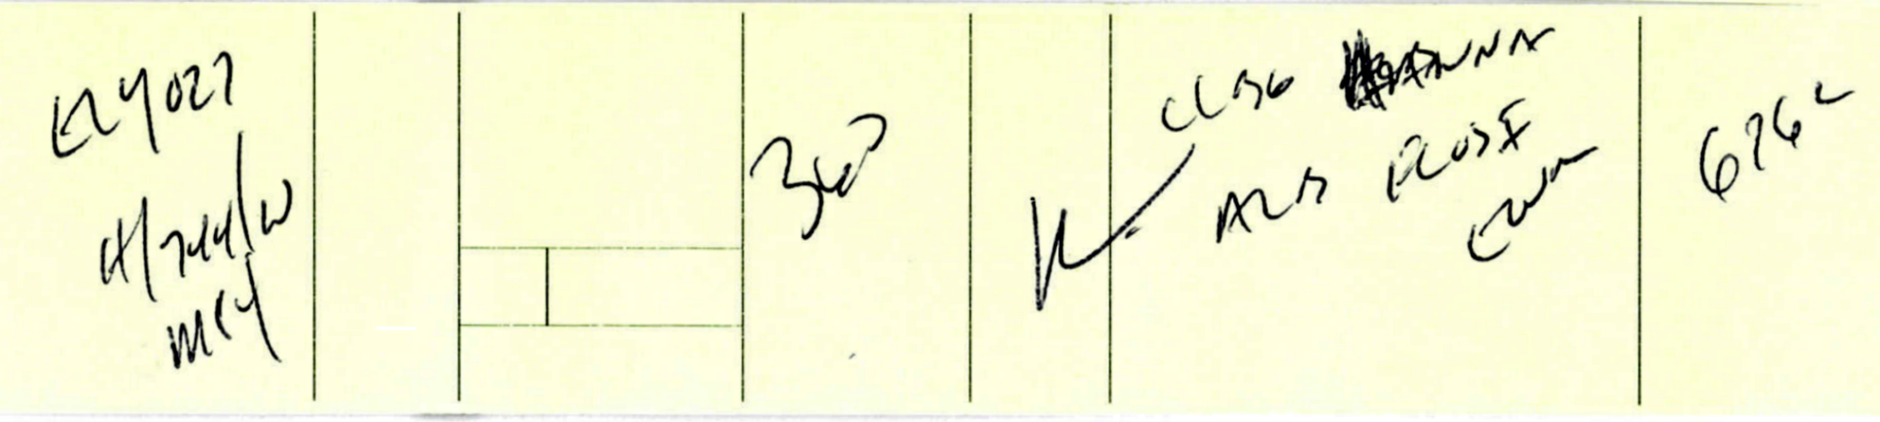
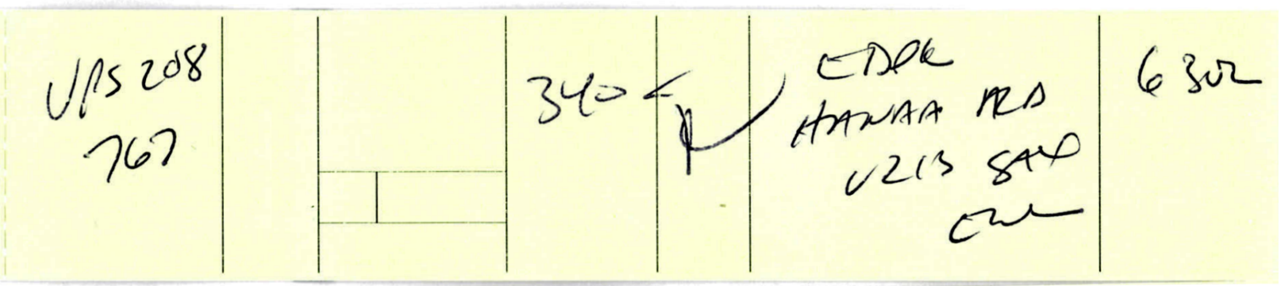
Poor Examples

Slide 37
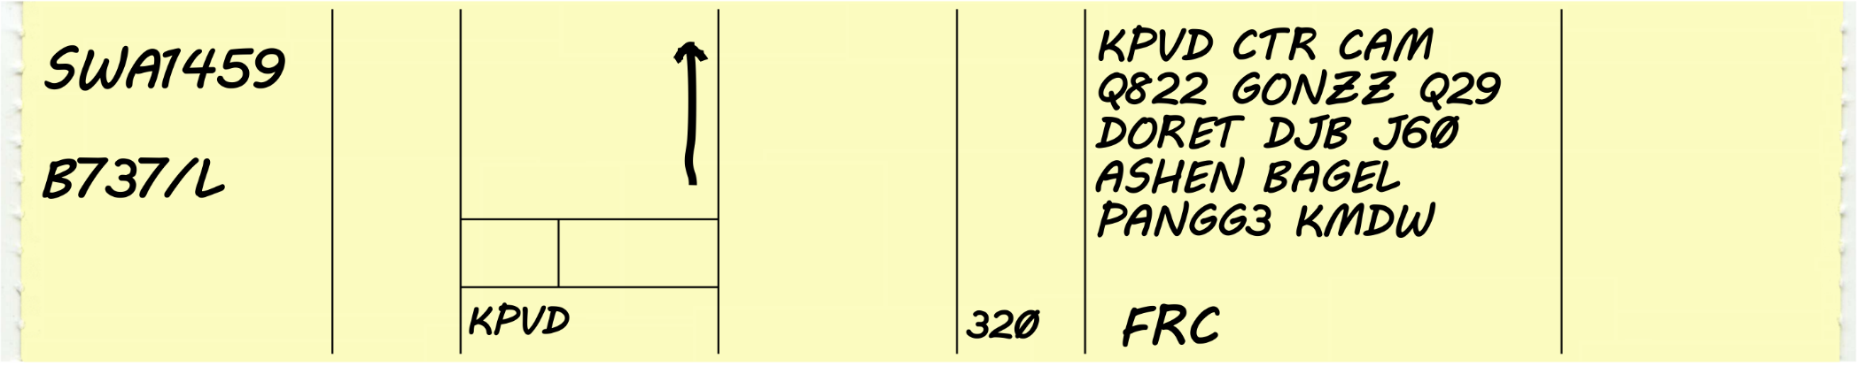
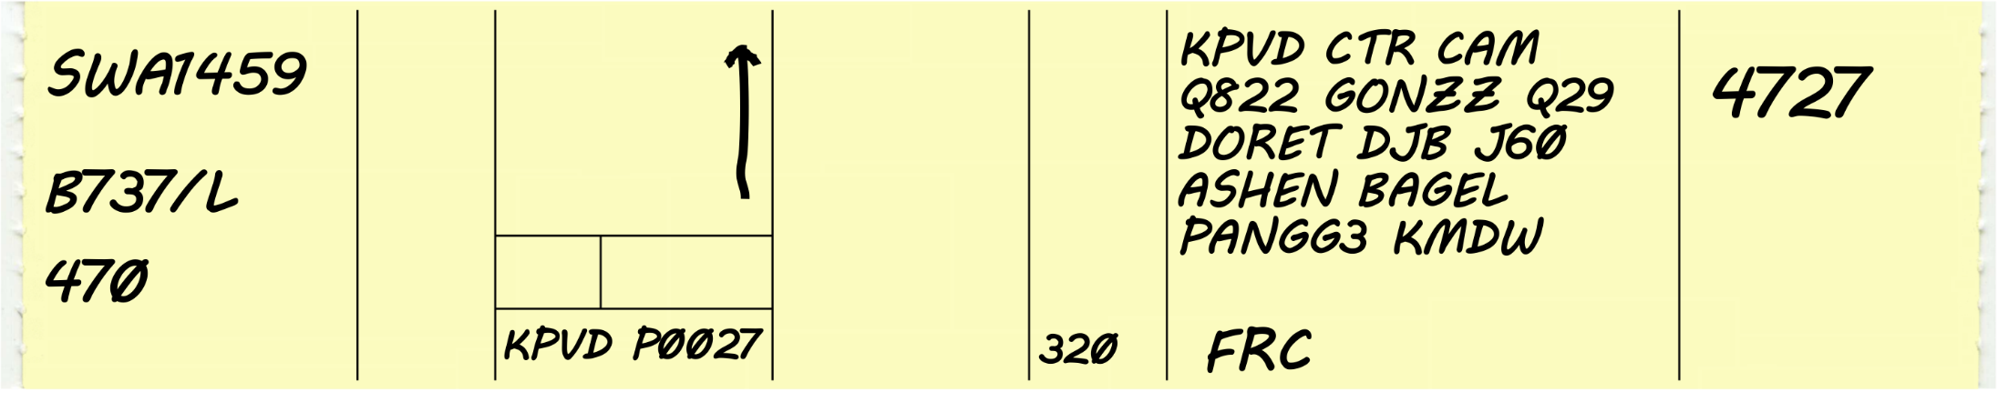
Knowledge Check
27
5
19
What data was omitted on this manually prepared strip?
5 - True Airspeed
19 - Proposed Time
27 - Beacon Code

Slide 38
Knowledge Check
How are strips prepared when automation systems are not available?
  Strips are prepared by the Traffic Management Coordinator and distributed as necessary.
  Strips are prepared by Tech-Ops at the high-speed printer.
  Strips are prepared manually by the Assistant Controller or other controllers.

Slide 39
Sectors
Name
  All sectors are named and/or numbered based on facility policy.
Location
Bays
  Inactive
  Suspense
  Active
Printer assignments

Slide 40
Knowledge Check
The Flight Strip Printer at you sector was offline while you installed a new box of paper. What will happen to the strips that attempted to print while it was offline?
  Strips will print at a specific location in your facility.
  Strips will reprint at this sector once you place the printer online.
  Strips are lost and must be requested from the computer.

Slide 41
Lesson Summary
List the steps for delivering strips
  Control room layout
  Strip delivery
Identify data contained on flight strips
  Flight Strip data locations
List the steps for preparing flight strips
  Manually prepared strips

Slide 42


