Slide 1
Radar Flight Data
Controller Training
Lesson 2: Voice Switching and Control System (VSCS) Equipment
Course - 55053
Version 2019-12.1

Slide 2
Lesson Objectives
By the end of this lesson, you will be able to identify the components and functions of the:
Voice Switching and Control System (VSCS) Display Module (VDM)
Push-to-Talk (PTT)
Air-to-Ground (A/G) Screen
VSCS Indirect Access Keypad (VIK)
Ground-to-Ground (G/G) Screens
Utility Screen

Slide 3

VSCS
VSCS is a computer controlled switching system that provides air traffic controllers with all voice circuits (air to ground and ground to ground) necessary for air traffic control.

Slide 4
Components of the VSCS system
VSCS Display Module (VDM) – The VDM is the touch module that displays and controls the six screens available for communications.
Dual Jack Module (DJM) – The set of jacks where the headset or handset is plugged into the console.
Footswitch – The pedal on the ground that can be used to activate the Push-to-Talk (PTT).
Loudspeakers – The speakers where received A/G and G/G communications may be directed.

Slide 5
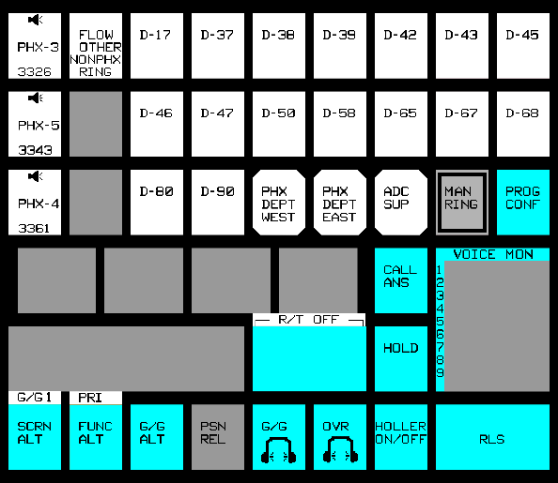
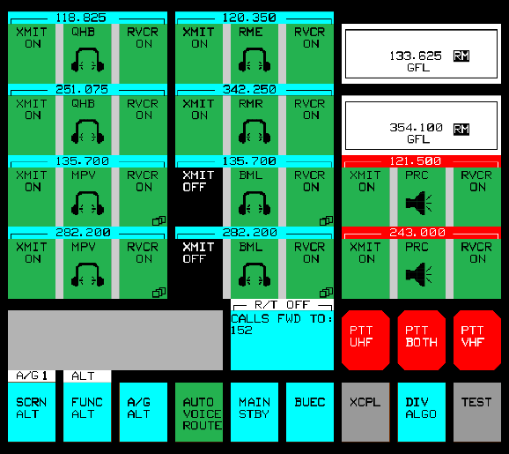
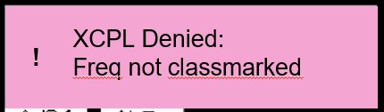
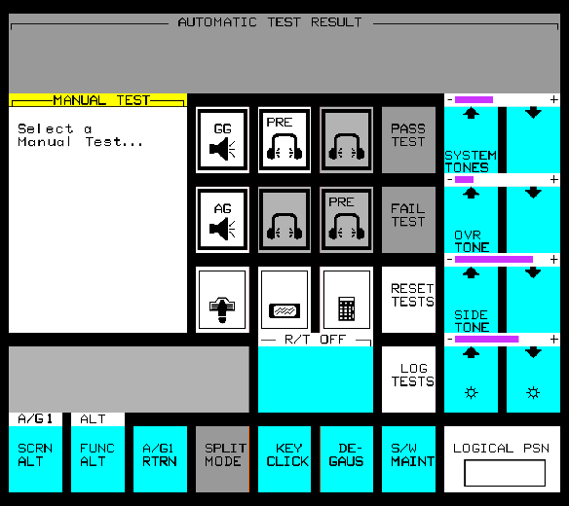

VDM Functions
XCPL Denied:
Freq not classmarked
!

Slide 6
Knowledge Check
Which button allows switching between any of the six different displays?
  UTIL
  SCRN ALT
  R/T OFF

Slide 7

Push-To-Talk (PTT)
PTT is performed on a(n):
Headset/Handset (HS) PTT switch
PTT footswitch
Emergency PTT button
Non-latching Direct Access (DA) button

Slide 8

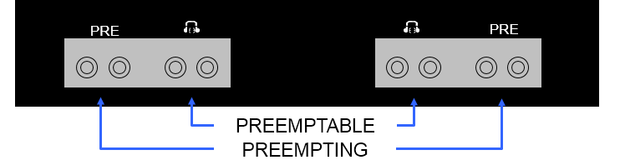
HS Jacks – PTT Priority
LOUDSPEAKER ASSEMBLY
Notes:
Push-to-Talk (PTT) activates outgoing A/G or G/G communication once a transmitter is enabled or an active G/G call is established.
PTT is performance on a(n)
◉ HS PTT switch
◉ PTT footswitch
◉ Emergency PTT button
◉ Nonlatching Direct Access (DA) button
When multiple HSs are plugged in, other operators at the position are affected by the local PTT priority rules for HS PTT switches and PTT footswitches.
The following HS jacks have equal priority when paired:
◉ Preemptable and preemptable
◉ Preempting and preempting
When preempting and preemtable HS jacks are paired, the preempting jack has priority.

Slide 9
Knowledge Check
Which jack has priority for Push-To-Talk (PTT)?
  Preemptable
  Preemptable and Preempting are equal
  Preempting

Slide 10
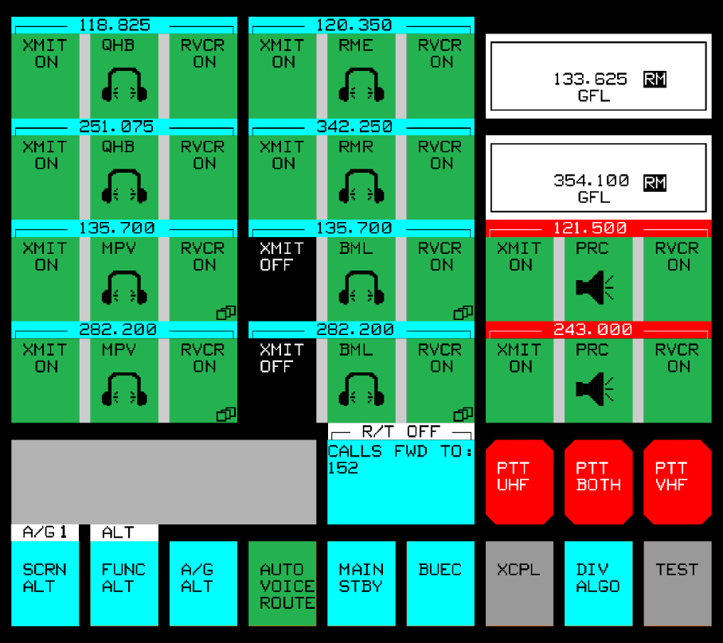
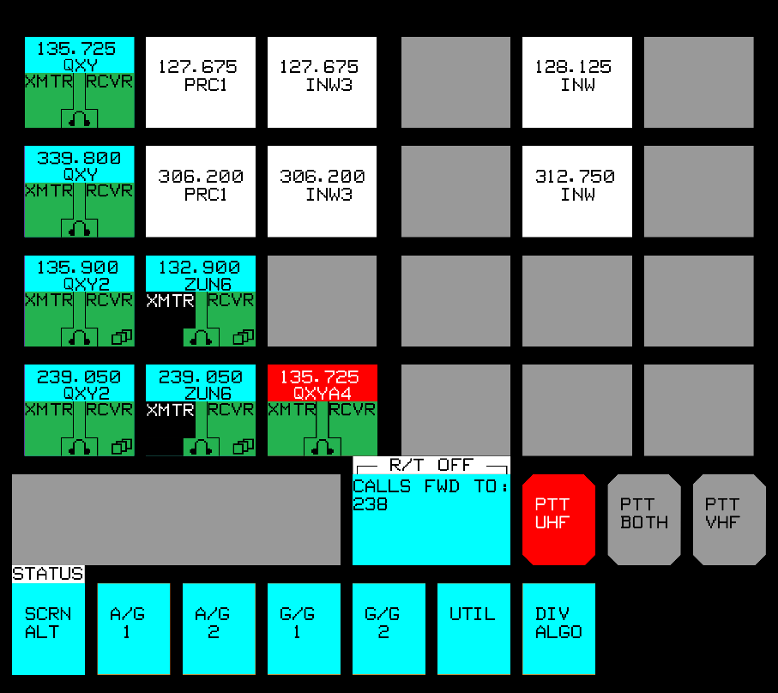
Air-to-Ground (A/G) Screens
A/G 1
A/G Status

Slide 11
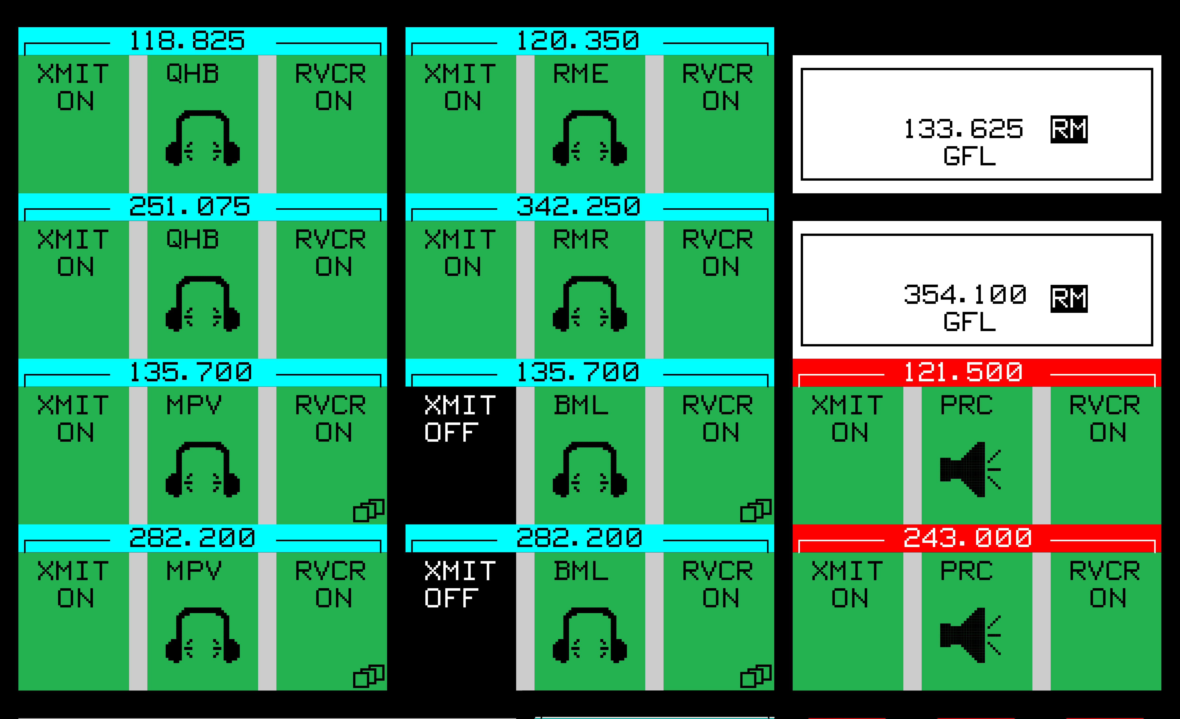
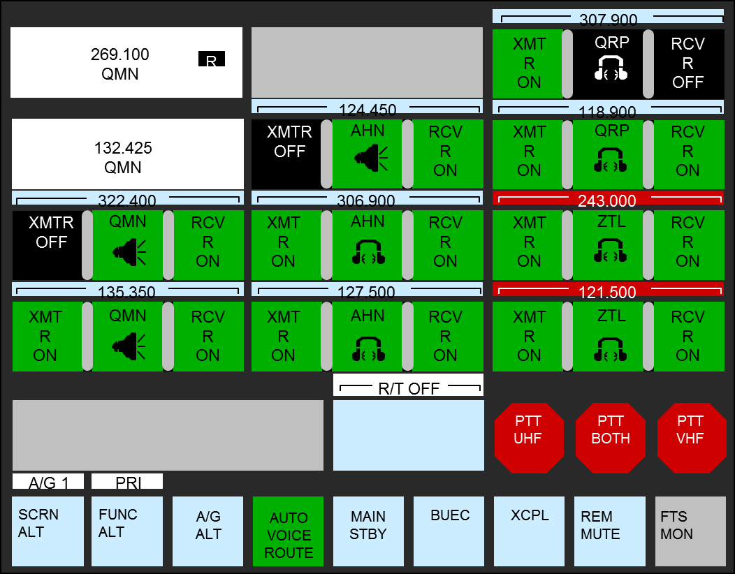
A/G Frequency Buttons

Slide 12
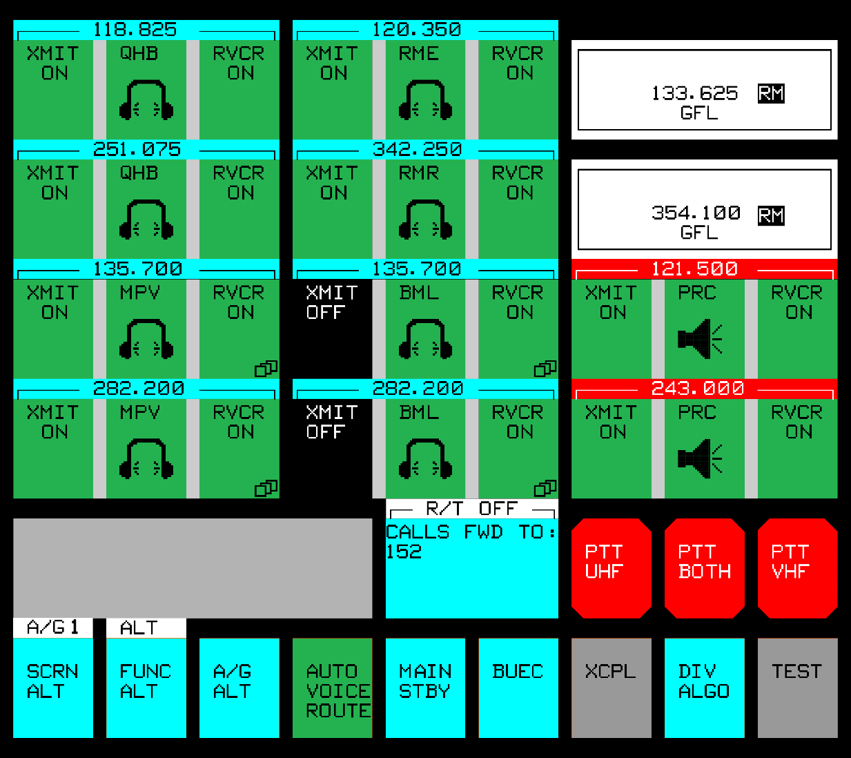

Diversity Algorithm (DIV ALGO)
Diversity Algorithm Indicator (DIV ALGO)

Slide 13
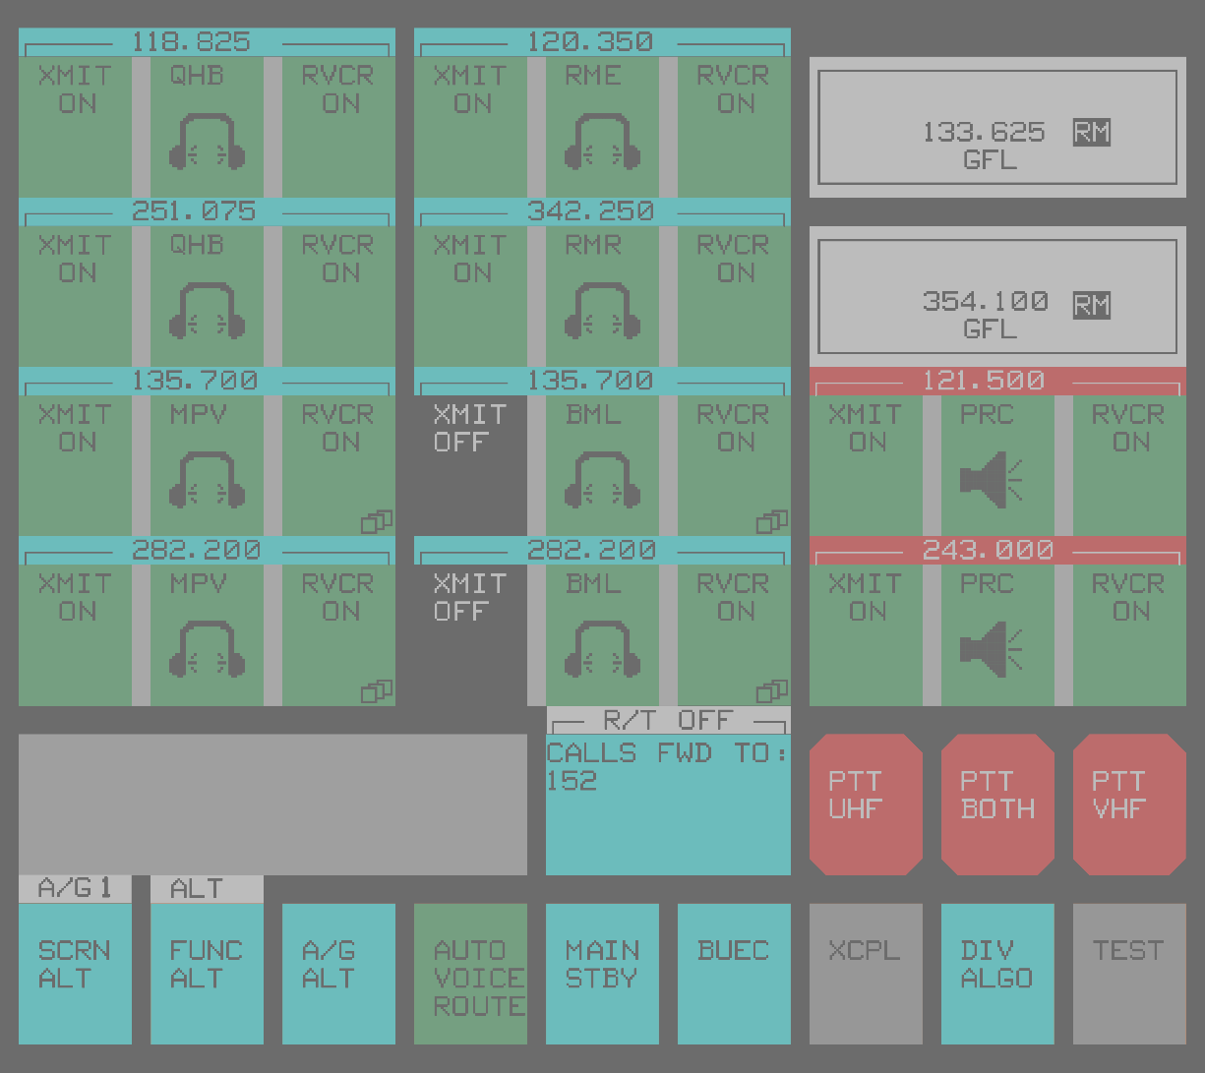
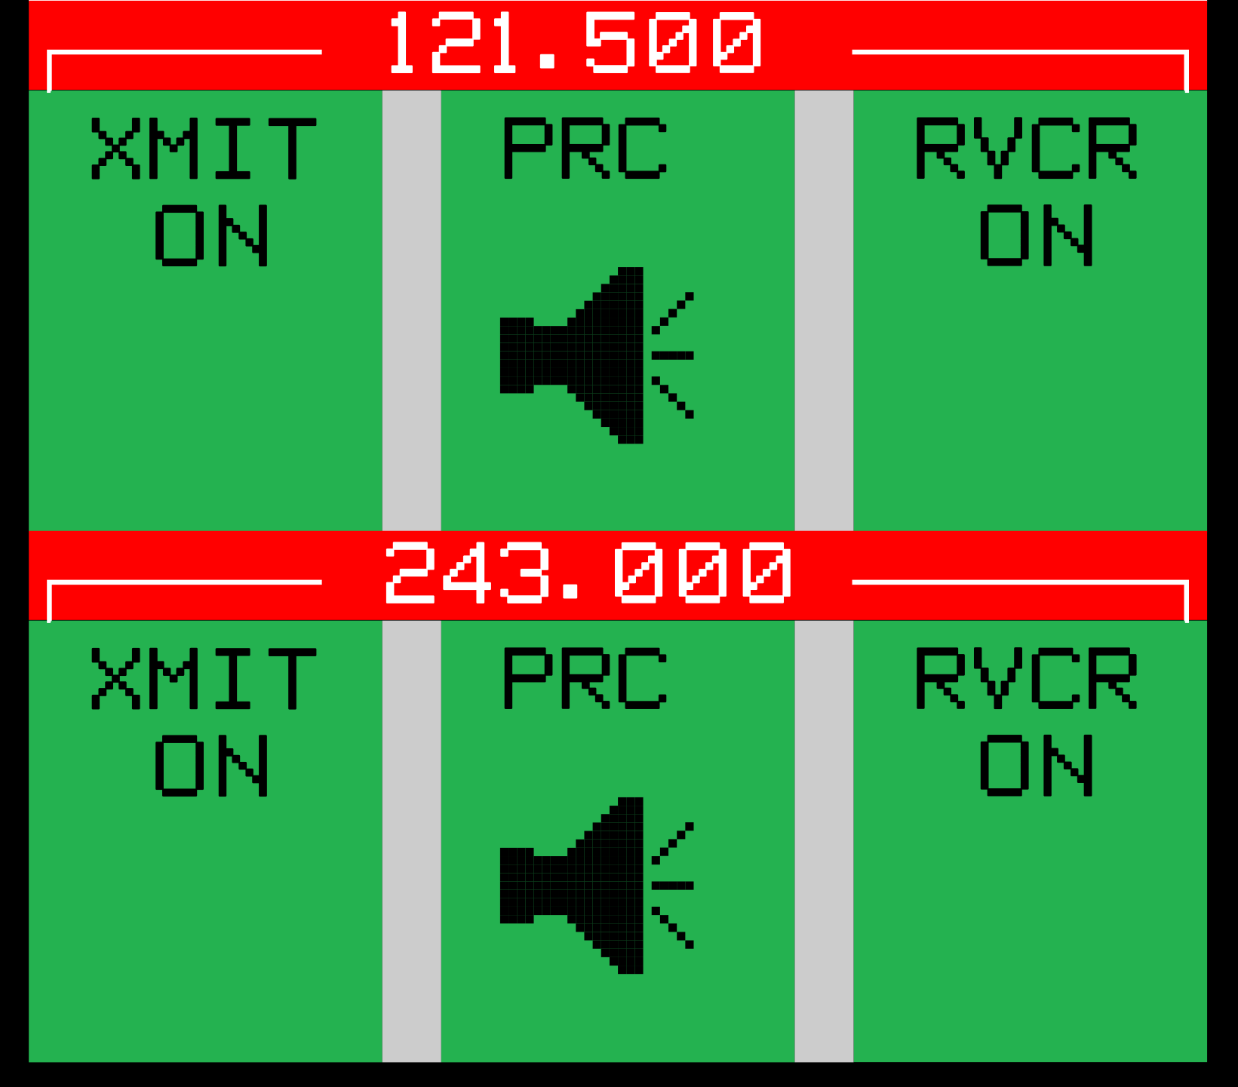
A/G Emergency Frequency Buttons

Slide 14

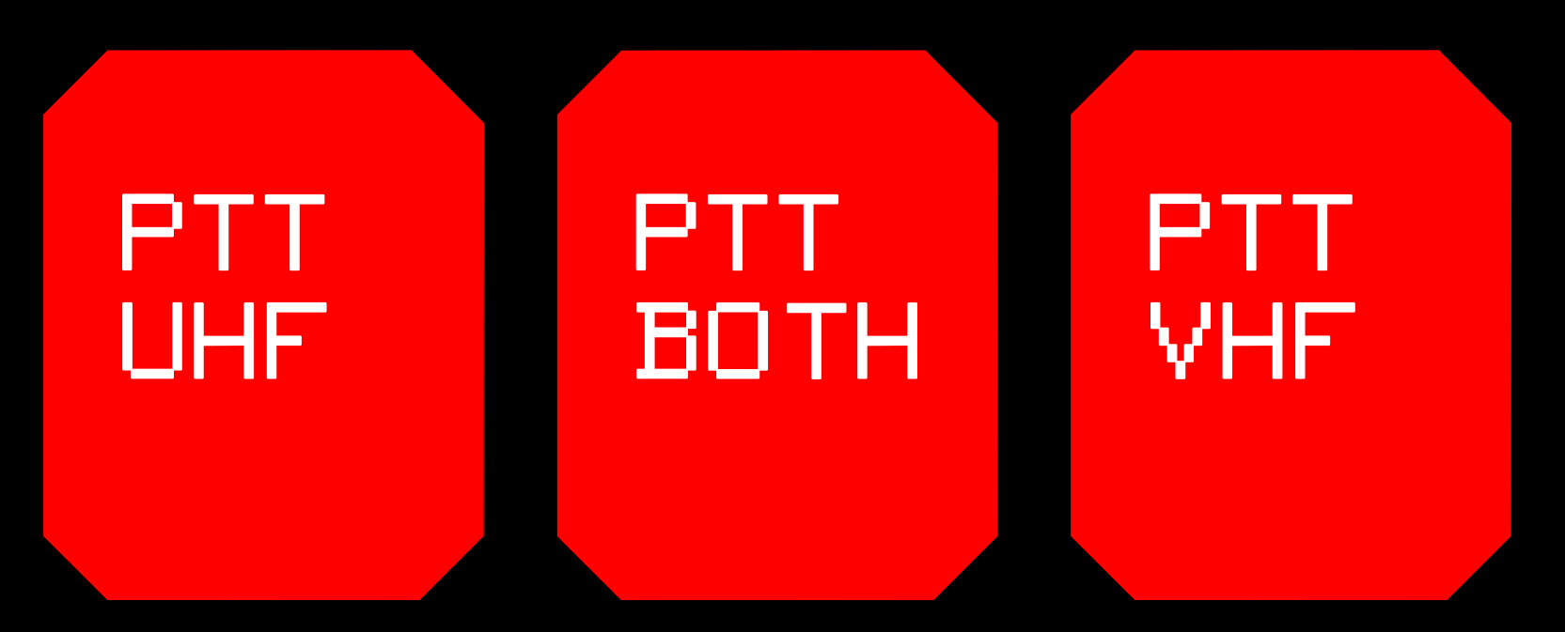
A/G Emergency PTT: Non-latching
Notes:
Emergency Push-to-Talk (PTT) Nonlatching Buttons
A Nonlatching button will perform a function only while touched. When released, the function changes back to the previous state.
The A/G PTT
For nonemergency frequency communications:
Activates outgoing A/G communications once a transmitter is enabled.
Is performed with an HS PTT switch or footswitch.
For emergency frequency communications:
Activates outgoing A/G emergency frequency communications.
Performed with the Emergency PTT (nonlatching) buttons on the:
A/G 1 screen
A/G 2 screen
A/G Status screen

Slide 15

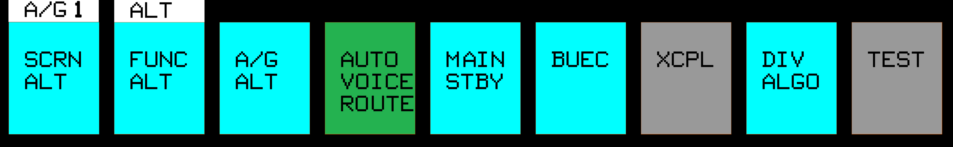
Select A/G Function Buttons
Notes:
A/G Function Buttons
Control A/G communications resources and screen selection
SEE TOT for missing information

Slide 16
Knowledge Check
When emergency frequencies are assigned, the Emergency PTT buttons activate Push-to-Talk for all non-emergency frequencies and emergency frequencies.
  True
  False

Slide 17
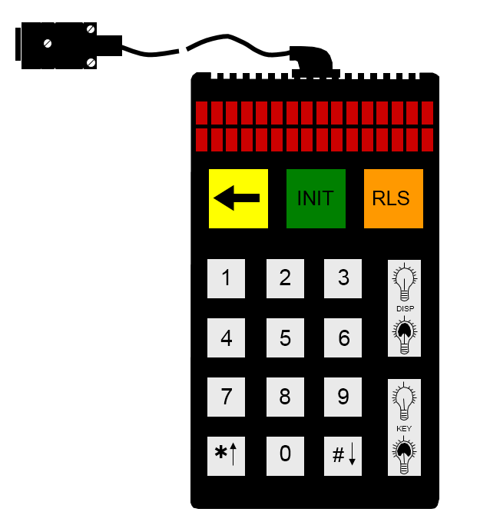
VSCS Indirect Access Keypad (VIK)
Initializing the keypad (INIT Key)
Entering numbers and symbols
Deleting numbers and symbols
Releasing G/G active calls
Adjusting VIK display or keypad brightness

Slide 18
VIK Special functions
FUNCTION | KEY COMBINATION
Exchange displays | INIT, *, 3
Speed Dial | INIT, *, 5, dd
Call forward enable | INIT, *, 1, ddd
Call forward disable | INIT, #, 1
Voice monitoring enable | INIT, *, 2, ddd
Voice monitoring disable | INIT, #, 2, n
Split mode enable | INIT, *, 7
Split mode disable | INIT, #, 7
Key click enable | INIT, *, 4
Key click disable | INIT, #, 4

Slide 19
Knowledge Check
Split Mode can be enabled from the VIK.
  True
  False

Slide 20


Ground-to-Ground (G/G) Screen
Direct Access (DA) Buttons
Common Answer Queue (CA)
Voice Monitor Progressive Conference Index
Ground-to-Ground (G/G) Function Buttons

Slide 21

Direct Access (DA) and Common Answer (CA) Queue Buttons
Incoming calls are directed to a position’s DA button (if available) or its CA queue button.

Slide 22
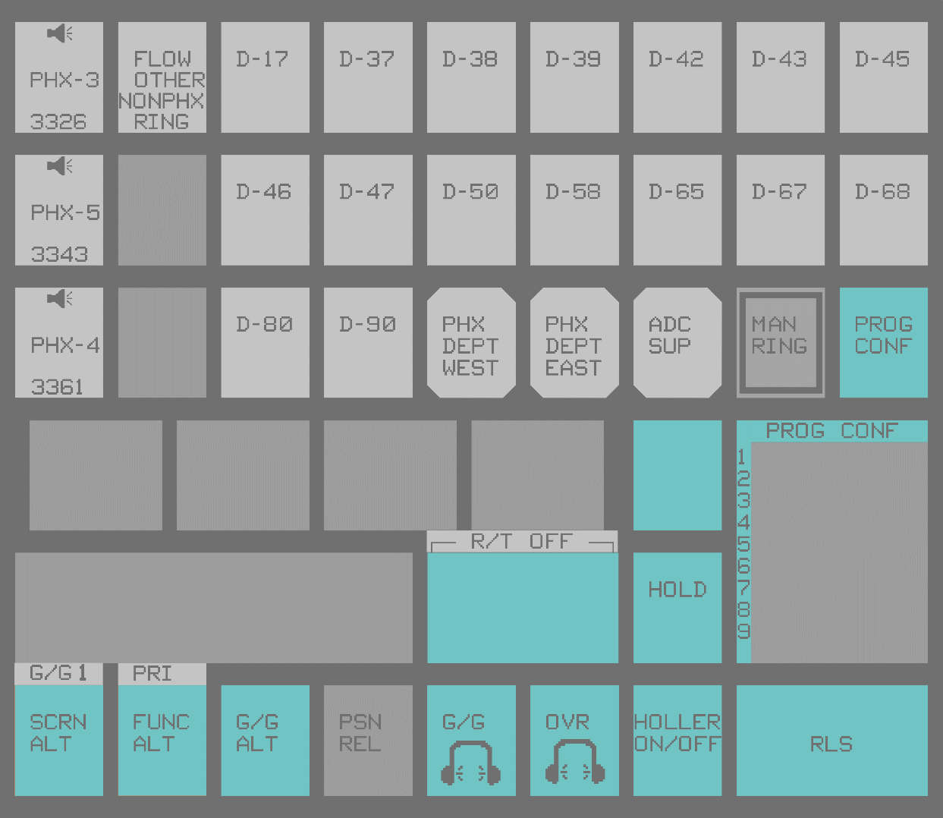
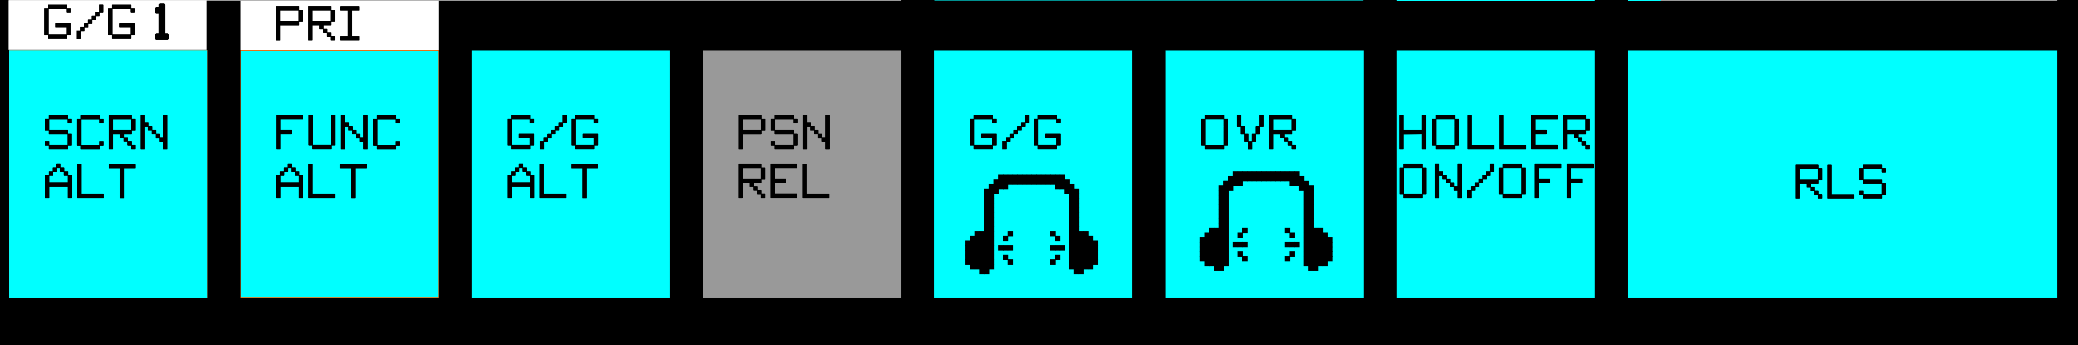
G/G Function Buttons

Slide 23
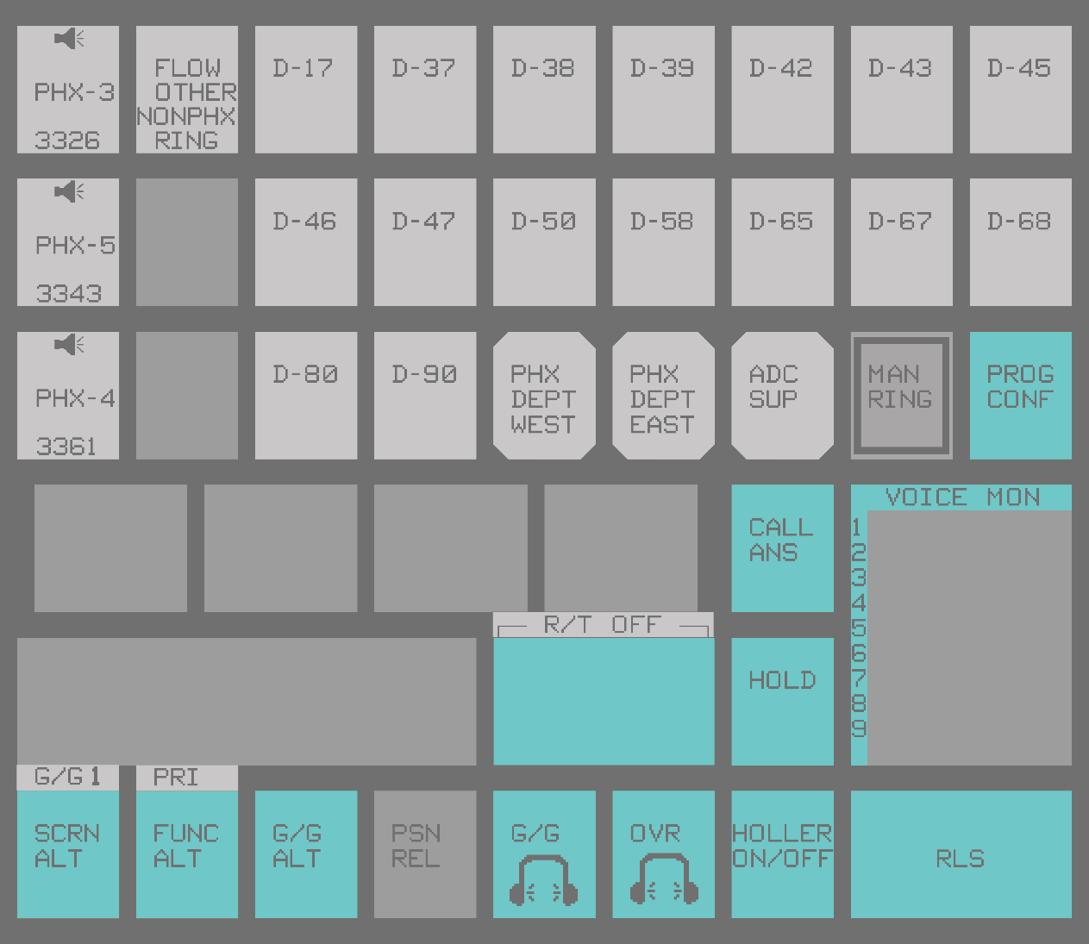
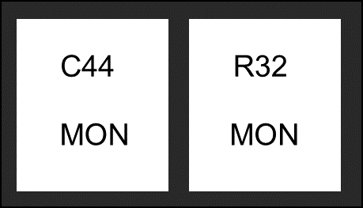
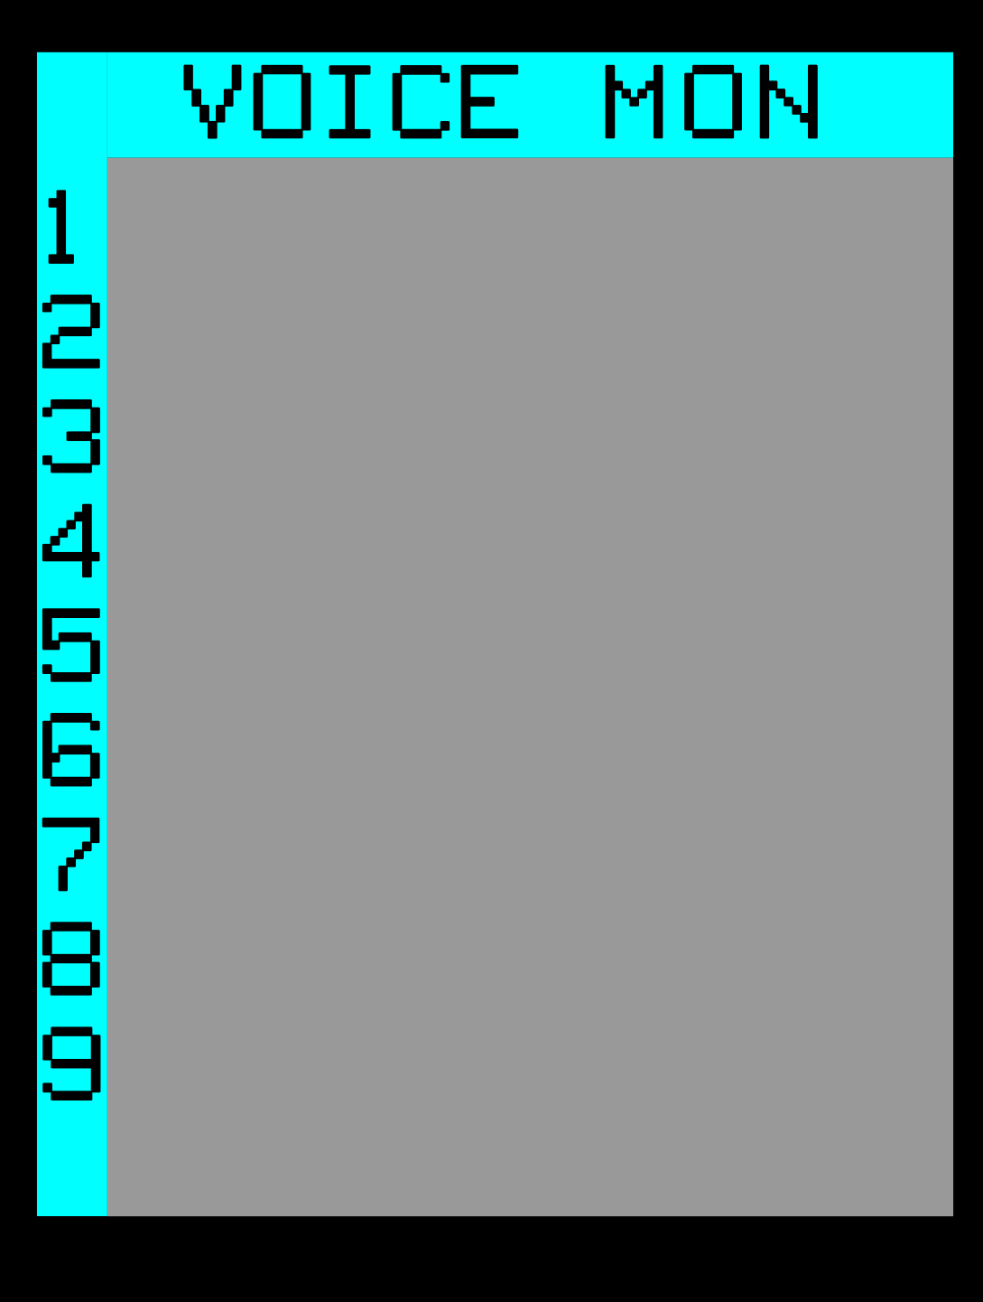
Voice Monitor

Slide 24

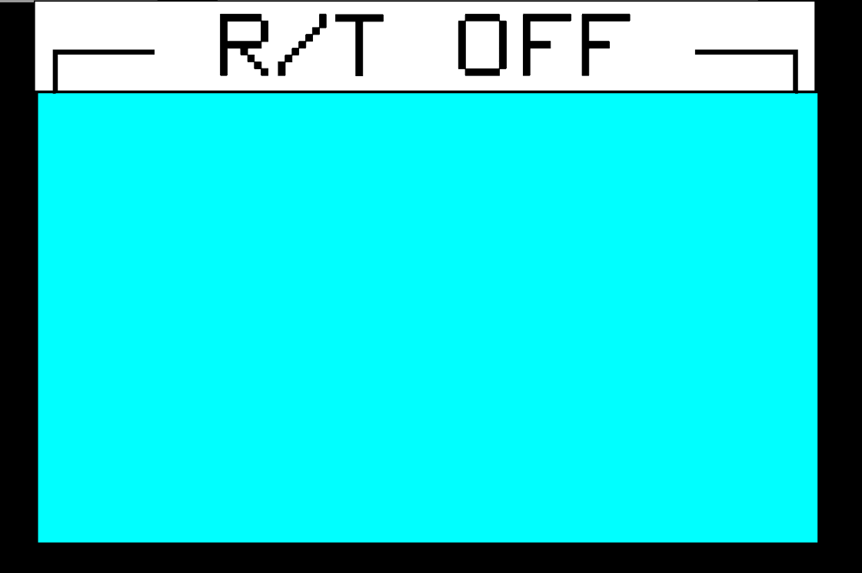
Radio Transfer (R/T) Switch

Slide 25

Override Call
Listens to outgoing and incoming (to HS) communications at another position and communicates with that position

Slide 26
Knowledge Check
When receiving an incoming Override call, your microphone automatically goes active.
  True
  False

Slide 27
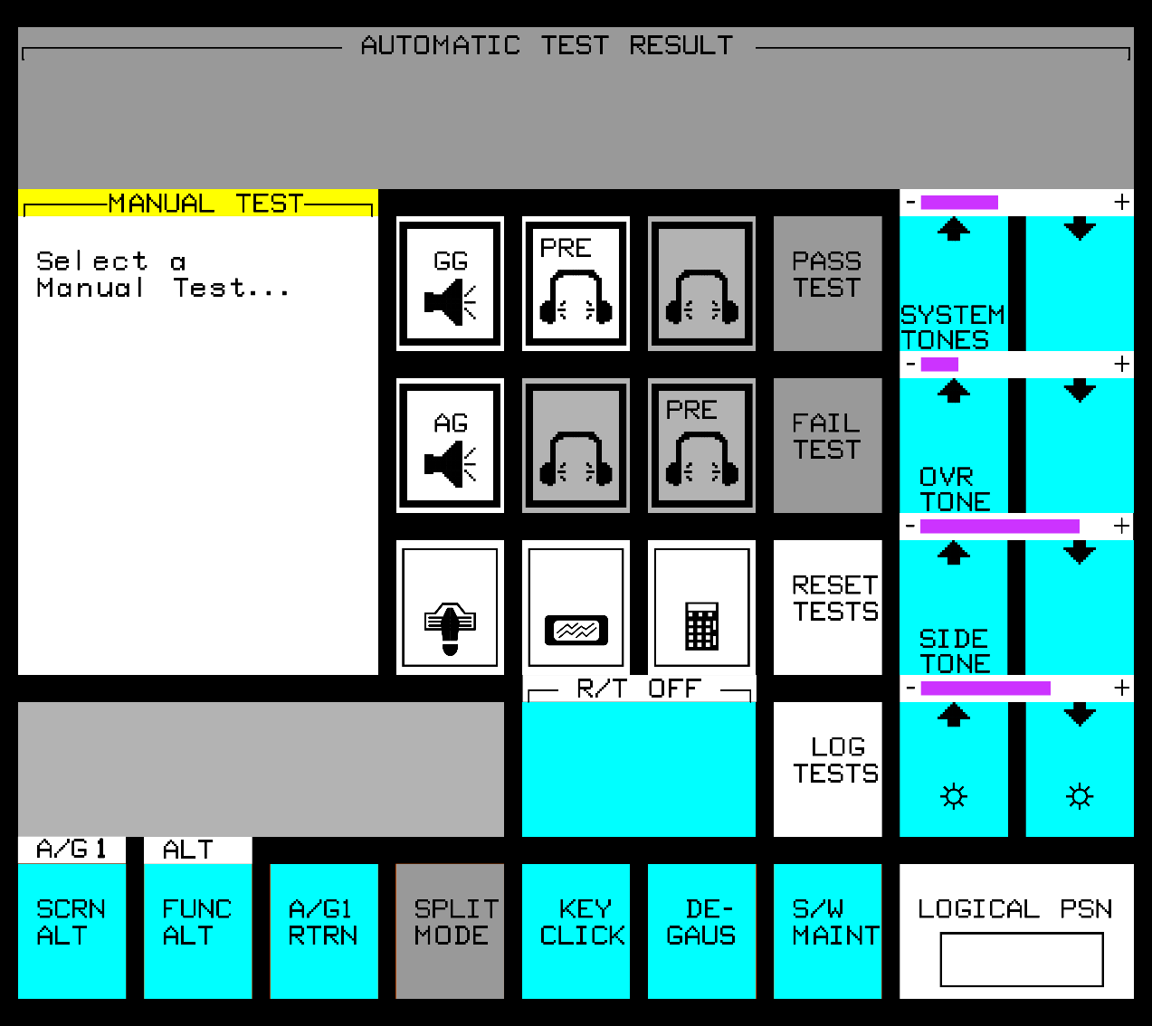
Utility (UTIL) Screen

Slide 28
Knowledge Check
To activate Split Mode, both headsets must be plugged into the same Dual Jack Module (DJM).
  True
  False

Slide 29
Lesson Summary
VSCS VDM
  SCRN ALT Button
  Message Acknowledgment
  FUNC ALT Button
PTT/PTT Priority
A/G Screens
  Frequency Buttons
  Emergency Frequency Buttons
  A/G Emergency PTT –
  Non-latching
  Function Buttons
VSCS VIK
  Functions
  INIT Key
  Number Keys
  Backspace (<-) Key
  RLS Key
  DISP and KEY Brightness Buttons
  Special Functions
G/G Screens
  DA and CA Queue Buttons
  Function Buttons
  Voice Monitor
  R/T Switch
  Override Call
Utility Screen

Slide 30

THE END

