Slide 1

Radar Flight Data Controller Training
Lesson 1: Air Traffic Service Routes and Airspace
Course - 55053
Version 2019-12.1

Slide 2
Introduction
Purpose of Radar Flight Data Controller (A-Side) Training
To prepare the developmental and Certified Professional Controller In Training (CPC-IT) to perform independently (under general supervision) all duties of the Radar Flight Data position on all sectors within an area of specialization as well as to attain certification on those positions.

Slide 3
Course 55053 Lessons
Radar Flight Data Controller Training
Lesson 1: Air Traffic Service Routes and Airspace
Lesson 2: Voice Switching and Control System Equipment
Lesson 3: Flight Progress Strip Distribution
Lesson 4: Computer Operational Equipment
Lesson 5: Computer Field Format
Lesson 6: Computer Command Composition and Entry

Slide 4
OJT and Certification
OJT
After successful completion of instructor-led training, OJT must be conducted in the operational environment in accordance with chapter 6 of FAA Order 3120.4.
Certification
Successful completion of OJT results in certification.

Slide 5
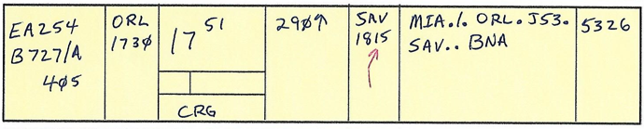
Background: A-Side 1965–1972
Flight Plans (FPs) were passed manually and duties included:
Receiving FPs via landline or teletype
Writing each FP on a strip
Drawing a direction arrow on each strip
Calculating and recording Fix Estimates on each strip
Producing strips as required for downstream sectors
“Running” the strip(s) to the appropriate areas and/or positions

Slide 6

Background: A-Side 1973–2004
FPs automatically distributed through Computer Update Equipment and duties included:
Removing Flight Progress Strips from printer
Placing strips in holders
Drawing a direction arrow on each strip
Placing each needed strip above/beside appropriate bay
During periods of equipment failure reverting to pre 1973 duties

Slide 7

Background: A-Side 2005–Present
Today, the En Route Automation System:
Displays flight plans electronically on EDST
Distributes flight plans automatically
Usually only prints strips for nonradar segments of flight
*Note: The Radar Flight Data position contains all the equipment necessary to pass flight plans and amendments manually and via automation.

Slide 8
Primary Responsibilities
Radar Flight Data Position
Operate Interphone.
Assist Radar Associate Position in managing flight progress strips.
Receive/process and distribute flight progress strips.
Ensure flight data processing equipment is operational, except for EDST capabilities.
Request/receive and disseminate weather, NOTAMs, NAS status, traffic management, and Special Use Airspace status messages.
Manually prepare flight progress strips when automation systems are not available.
Enter flight data into computer.
Assist facility/sector in meeting situation objectives.

Slide 9
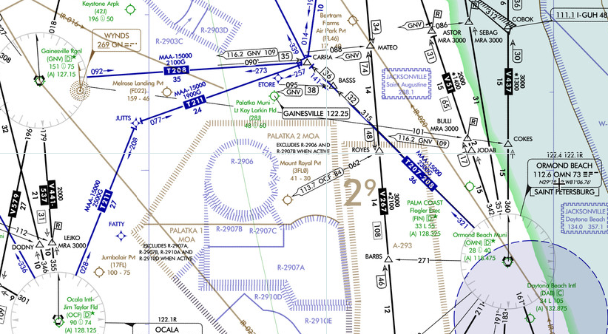
Air Traffic Service Routes and Airspace

Slide 10
Lesson Objectives
At the end of this lesson you will be able to identify characteristics of:
Federal Airways and Jet Routes
Area Navigation (RNAV) Routes
Standard Terminal Arrivals (STARs) and Standard Instrument Departures (SIDs)
Special Use Airspace (SUA) and Special Activity Airspace (SAA)
At the end of this lesson, given a center area chart, label the chart in accordance with FAA JO 3120.4, Appendix D. and local directives.

Slide 11
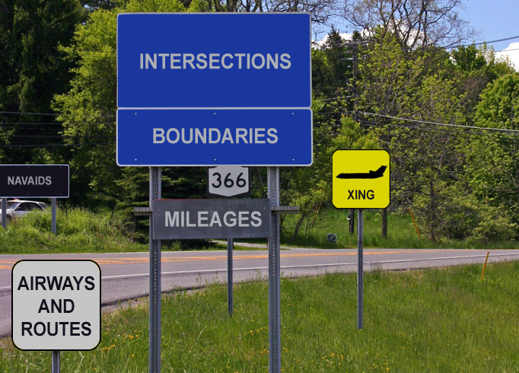

Air Traffic Service (ATS) Routes
WAYPOINTS
STARs
AND
SIDs

Slide 12
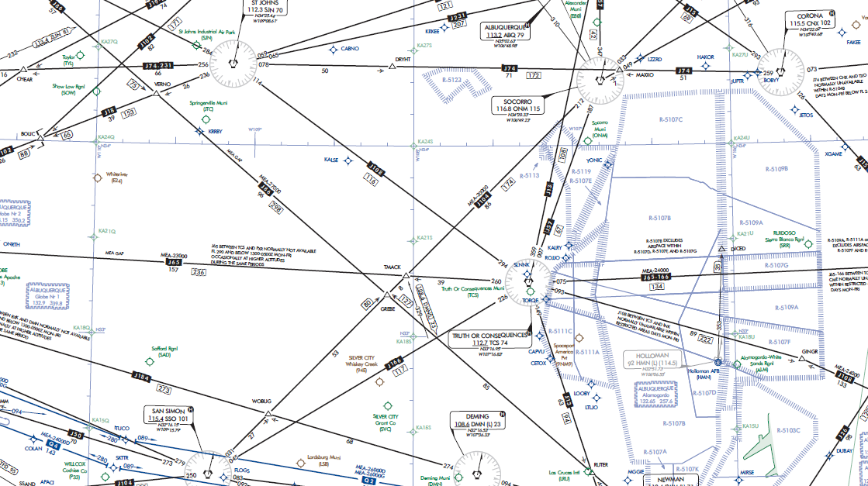
High Altitude Chart

Slide 13
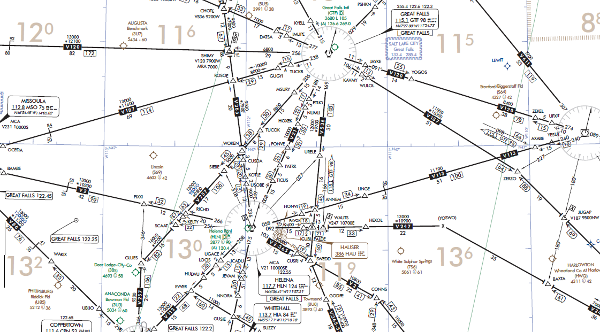
Low Altitude Chart

Slide 14
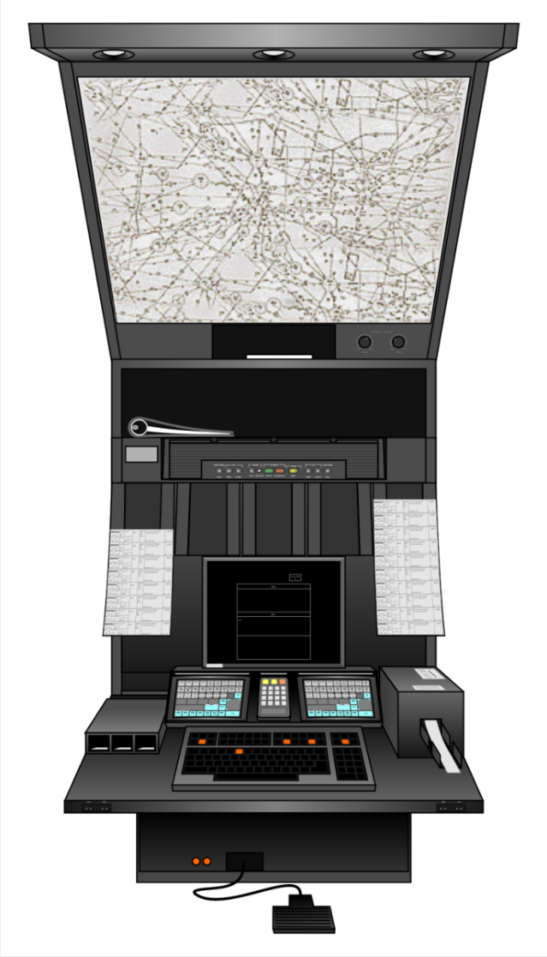
Facility Controller Charts
Backlit chart holders are used to display local controller charts

Slide 15
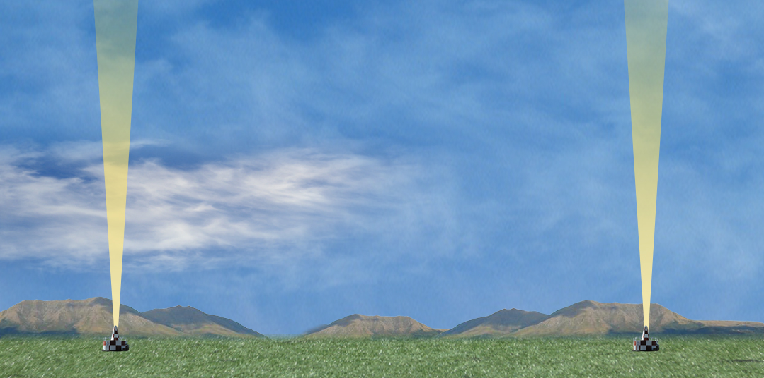
Federal Airways and Jet Routes Altitude Limits
FL450
Jet Routes
FL180
Federal Airways
1,200 feet AGL

Slide 16
Knowledge Check
What is the maximum altitude of a jet route?
A. FL450
B. Up to but not including FL450
C. FL600

Slide 17
Knowledge Check
What is the base altitude of a federal airway?
A. 1,200 feet AGL
B. 10,000 feet AGL
C. 18,000 feet MSL

Slide 18
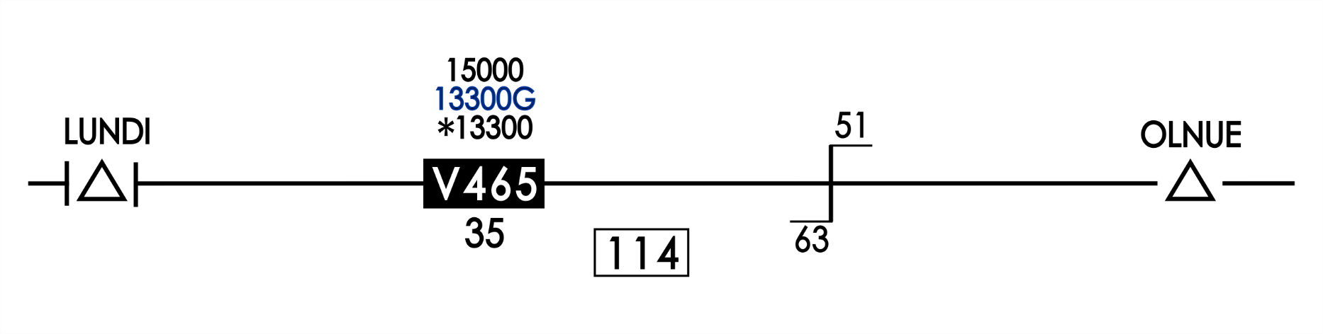
Minimum Altitudes
Minimum En Route IFR Altitude (MEA)
Global Navigation Satellite System Minimum En Route IFR Altitude (GNSS MEA)
Minimum Obstruction Clearance Altitude (MOCA)
15000 - MEA
13300G - GNSS MEA
*13300 - MOCA

Slide 19
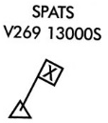
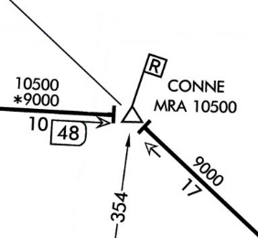
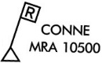
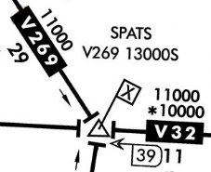
Minimum Altitudes Cont’d
Minimum Crossing Altitude (MCA)
Minimum Reception Altitude (MRA)

Slide 20
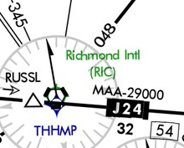
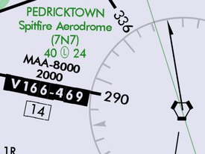
Maximum Authorized Altitude (MAA)
Maximum Authorized Altitude (MAA)
MAAs are shown on IFR High Altitude Charts when MAA is other than 45,000’.
MAAs are depicted on En Route Low Altitude Charts when MAA is below17,500’.

Slide 21
Knowledge Check
What is the MEA between LUNDI and OLNUE?
A. 1,200’
B. 13,300’
C. 15,000’

Slide 22
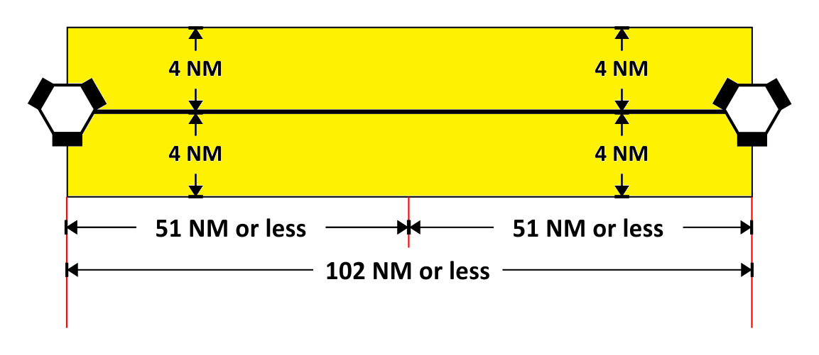
Federal Airway and Jet Route Width

Slide 23


Federal Airway and Jet Route Width Cont’d
260NM
130NM
51NM
4NM
4.5°
10NM
4NM
4NM
4NM
4.5°
10NM
NAVAID
NAVAID

Slide 24
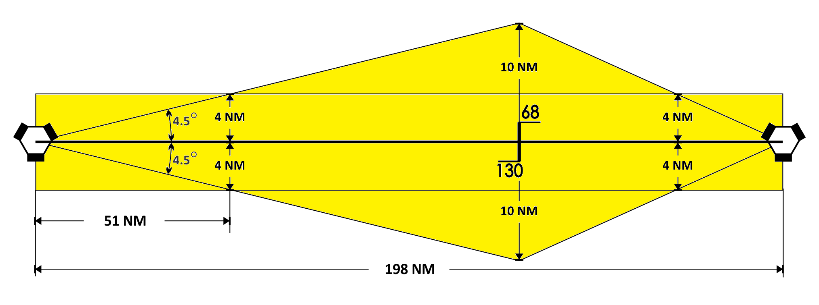
Offset Changeover Point

Slide 25
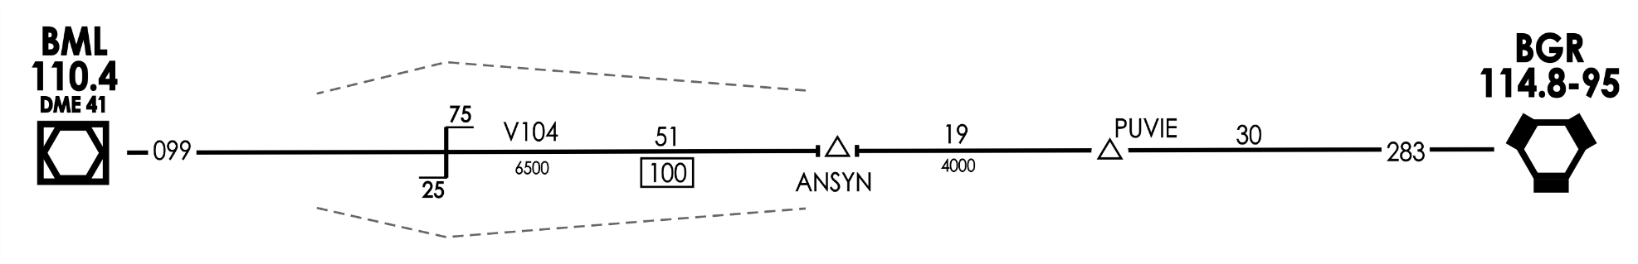
Offset Changeover Point Cont’d
Controller Charts

Slide 26
Knowledge Check
At 51NM, the normal protected airspace width of a jet route is ________NM.
A. 4
B. 6
C. 8

Slide 27
Knowledge Check
At 130NM, the normal protected airspace width of a jet route is ________NM.
A. 8
B. 10
C. 20

Slide 28
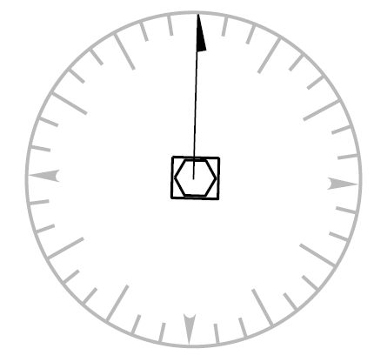
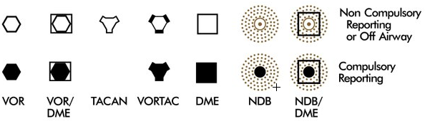
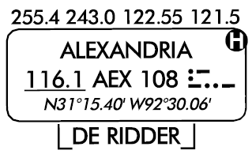
Radials
Specific radials from NAVAIDs identify federal airways and jet routes.
Compass Rose around a NAVAID:
Orientated to Magnetic North of the NAVAID

Slide 29
NAVAID Classes
VOR, VORTAC, and TACAN aids are classed according to their operational use.
The three classes of NAVAIDs are:
T− Terminal
L− Low altitude
H− High altitude

Slide 30
VOR/VORTAC/TACAN NAVAIDs
Normal Usable Altitudes and Radius Distances
CLASS ALTITUDE (FEET) DISTANCE (NM)
T 1,000 to 12,000 AGL 25 L 1,000 to 18,000 AGL 40 H 1,000 to 14,500 AGL 40 H 14,500 to 17,999 AGL 100 H 18,000 to 45,000 AGL 130 H Above 45,000 AGL 100
L/MF RADIO BEACON
Usable Radius Distances for All Altitudes
CLASS POWER (WATTS) DISTANCE (NM)
Compass Locator Under 25 15 MH Under 50 25 H 50-1,999 50 HH 2,000 or more 75

Slide 31
NAVAID Use and Symbols
NAVAIDs:
Define AIRWAYs
Define Jet Routes
Provide point-to-point guidance information or position information
NAVAID Symbols on En Route Charts

Slide 32
NAVAID Symbols Cont’d
Non Compulsory Reporting
Compulsory Reporting
Note: VHF/UHF is depicted in Black. L/MF is depicted in Brown.

Slide 33
Federal Airway and Jet Route Identification
VOR federal airways - are based on VOR or VORTAC NAVAIDs and are identified by a "V" (Victor) followed by the route number (e.g., “Victor Twelve”, charted as "V12").
LF/MF airways – are based on LF/MF NAVAIDs - are sometimes called "colored airways" because they are identified by color name and number (e.g., "Amber One", charted as "A1").
Jet routes - are most often based on VOR or VORTAC NAVAIDs, and are identified by a "J" (Jay) followed by the route number (e.g., “Jay Twelve”, charted as "J12").

Slide 34
Knowledge Check
What prefix is used to identify jet routes?
A. Route
B. VOR
C. J

Slide 35
Knowledge Check
Which of these are not components of Jet Routes?
A. VORs
B. VORTACs
LF/MF Nondirectional Beacons
DMEs

Slide 36

Intersection
Intersection is a point defined by any combination of courses, radials, or bearings of two or more navigational aids.
FLYBY
J13
J8

Slide 37


Mileage Depiction
High and Low Altitude En Route Charts
Distance Measuring Equipment (DME) Fix
VHF/UHF LF/MF RNAV
N/A
N/A
Chart Example:
5
10
First segment 5NM; second segment 10NM; total mileage provided in encircled DME arrow.

Slide 38
Mileage Depiction Cont’d
High and Low Altitude En Route Charts
Total Mileage between Compulsory Reporting Points or NAVAIDs:
VHF/UHF L/MF RNAV
Mileage between other fixes, NAVAIDs and/or mileage breakdown:
VHF/UHF L/MF RNAV
229
149
N/A
229
125
131

Slide 39
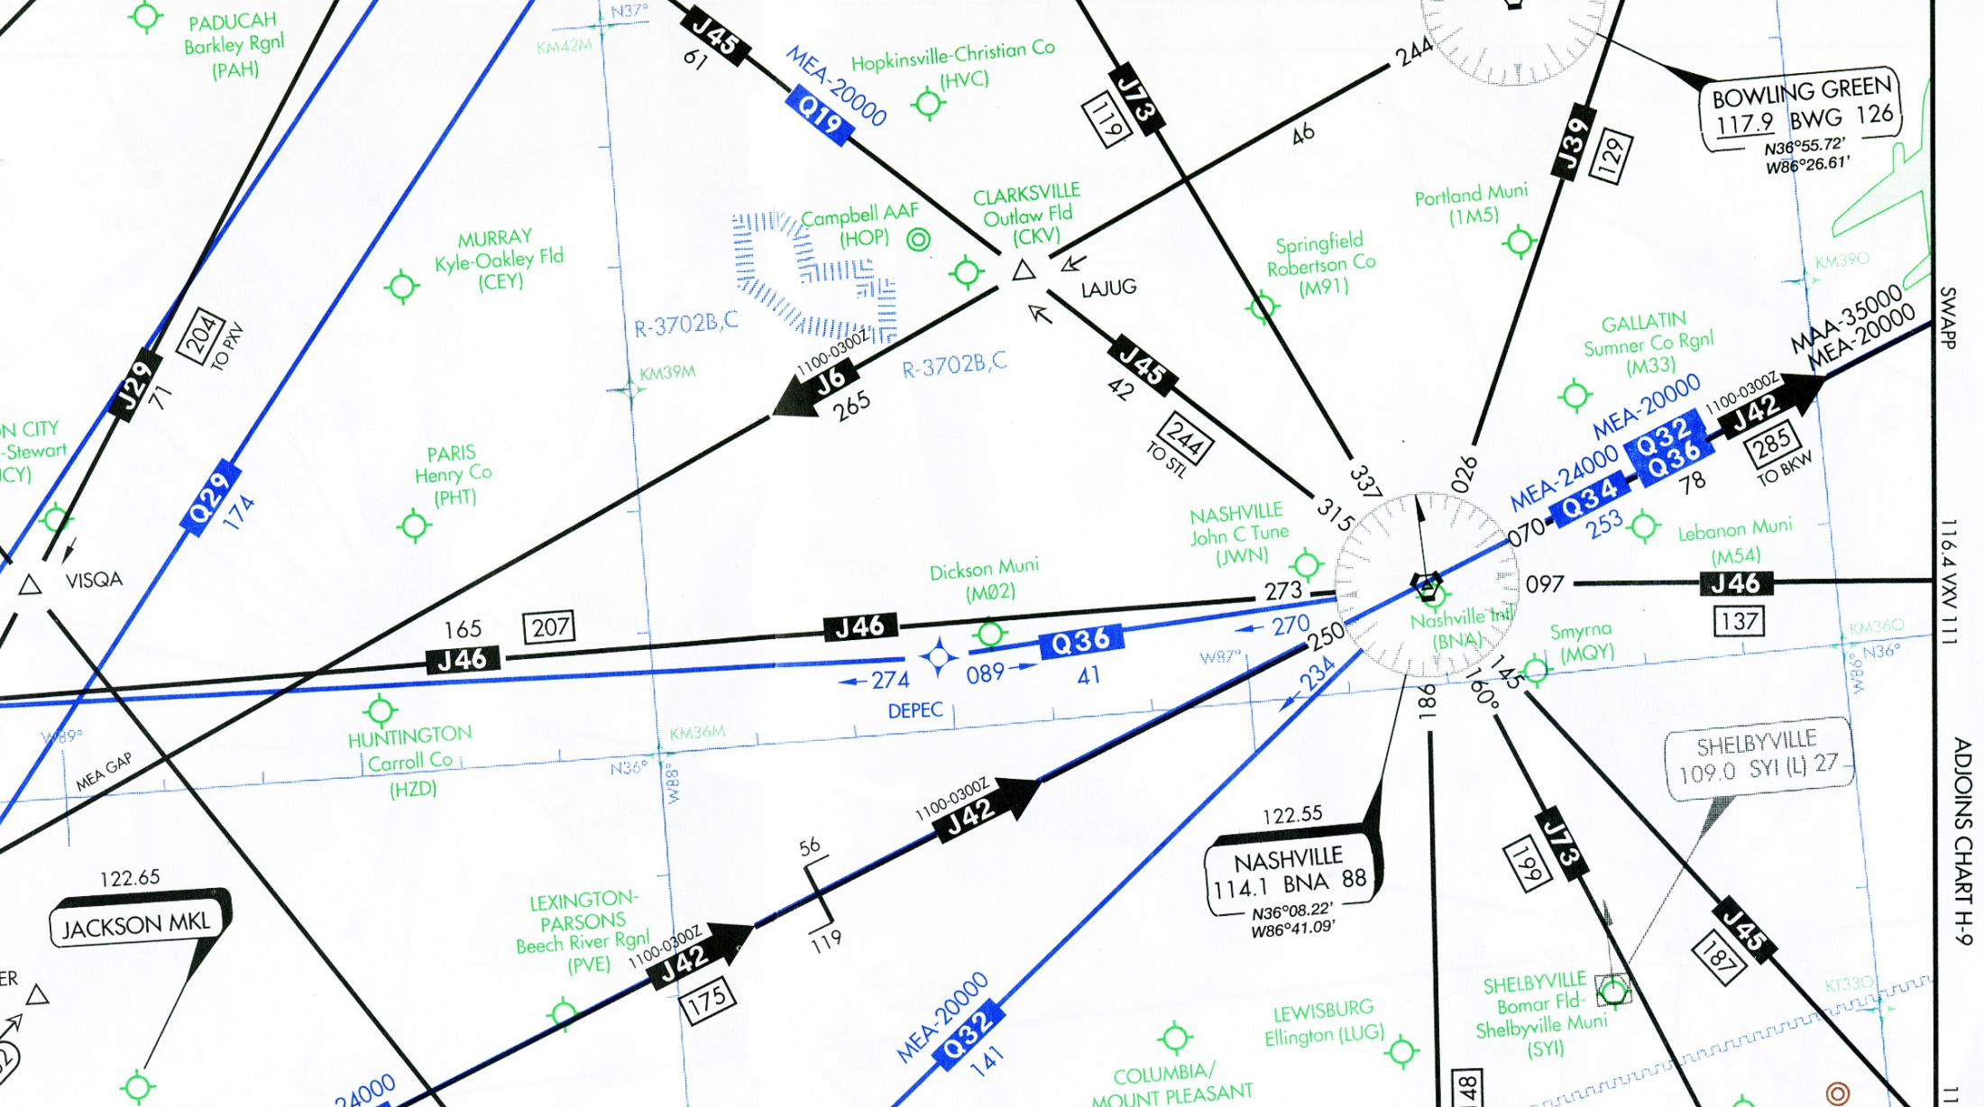



RNAV Routes and Waypoints
NRS waypoint
Q route waypoint
Q route

Slide 40
Q Routes and T Routes Altitude Limits
FL450
Q Routes
FL180
T Routes
1,200 feet AGL

Slide 41
Knowledge Check
What is the minimum altitude of a T route?
A. 700 feet MSL
B. 1,200 feet AGL
C. 1,200 feet MSL

Slide 42
Knowledge Check
An Intersection may be best defined as which of the following?
A. A point defined where two federal airways, two jet routes, or two Q routes cross.
B. A point defined by any combination of courses, radials, or bearings of two or more navigational aids.
C. A point where two jet routes cross.

Slide 43
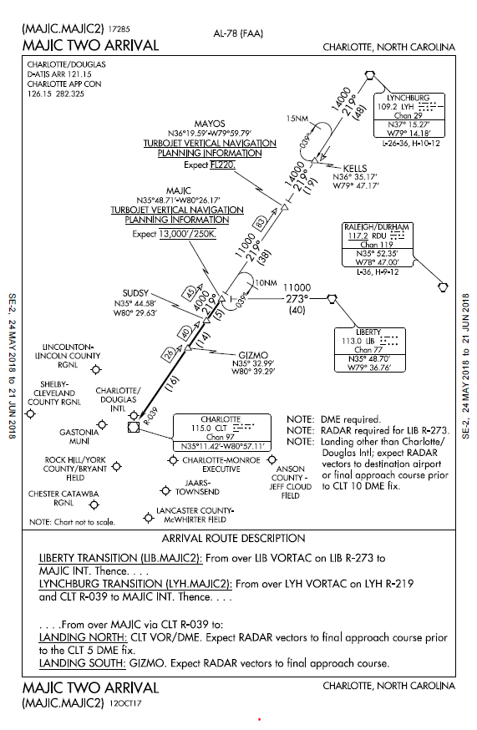
Standard Terminal Arrival (STAR)
A STAR is an ATC coded IFR arrival route, which:
Simplifies clearance delivery procedures
Facilitates transition between en route and instrument approach procedures
Depicts preplanned IFR ATC arrival procedures in graphic and textual form
Is presented as a separate chart
May serve a single or more than one airport

Slide 44
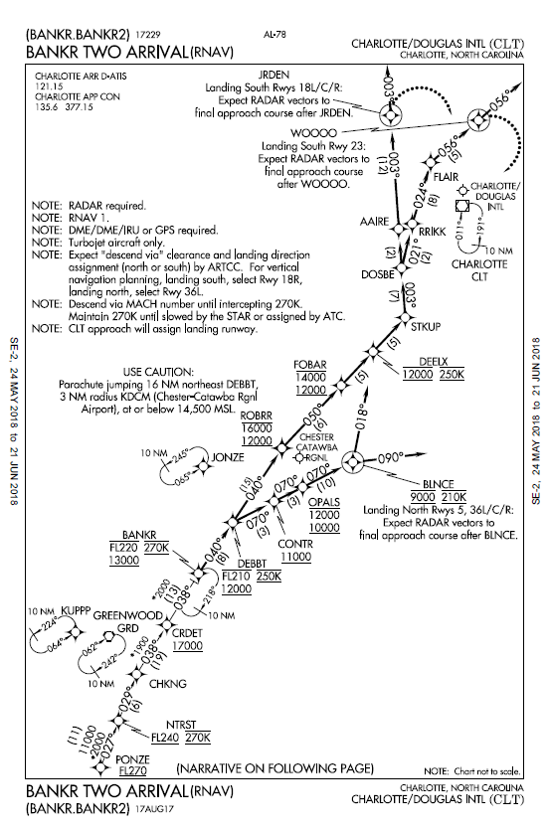

STAR Cont’d
RNAV STAR
Requires system performance currently met by GPS or DME/DME/IRU RNAV systems that satisfy specific criteria.
All public RNAV STARs are RNAV1.
Note: If a flight plan does not contain the required ICAO equipment and RNAV value, ATC automation equipment will neither assign nor accept computer entry of an RNAV STAR.
Notes:
*Note: An RNAV STAR must satisfy the criteria discussed in AC 90−100A, U.S.
10/12/17 AIM
Arrival Procedures 5−4−3
Terminal and En Route Area Navigation (RNAV)
Operations*. RNAV1 procedures must maintain a total
system error of not more than 1 NM for 95% of the
total flight time.
*Note: If a flight plan does not contain the required equipment and RNAV value, ATC automation equipment will not assign or accept an RNAV STAR.

Slide 45
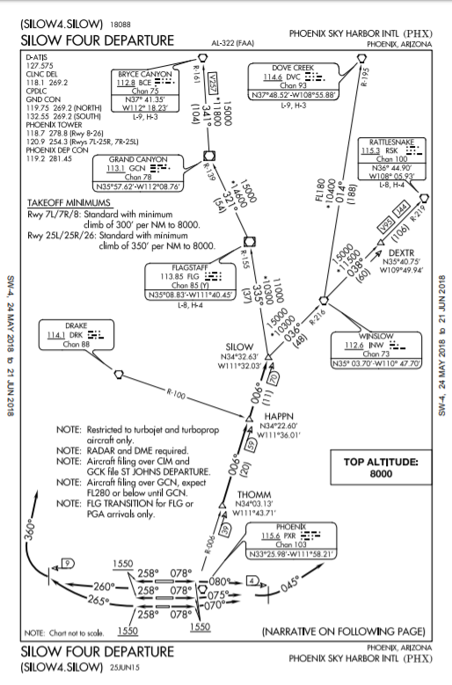
Standard Instrument Departure (SID)
Standard Instrument Departures are air traffic control (ATC) procedures:
Printed for pilot controller use in graphic form
Provide obstruction clearance
Provide a transition from the terminal area to the En Route structure
Reduce pilot/controller workload
ATC clearance is required

Slide 46
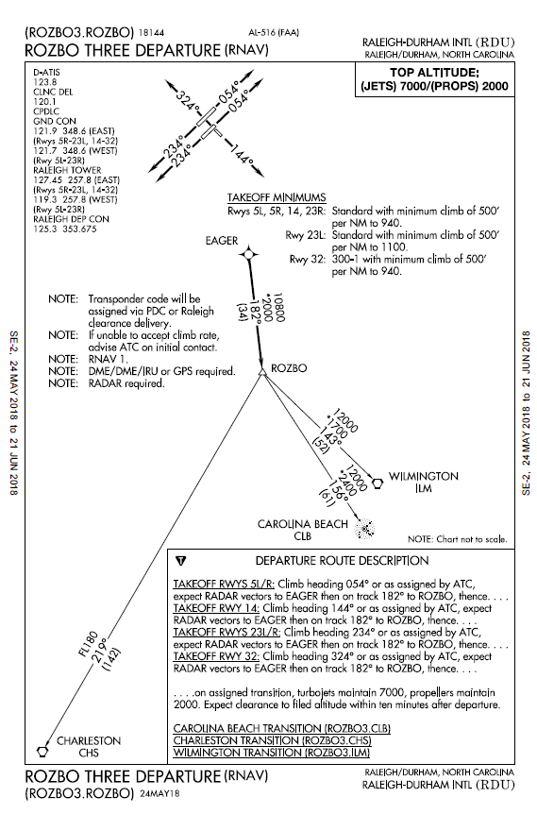
SID Cont’d
RNAV SID:
Requires system performance currently met by GPS or DME/DME/IRU RNAV systems that satisfy specific criteria.
All public RNAV SIDs are RNAV1.
Note: If a flight plan does not contain the required ICAO equipment and RNAV value, ATC automation equipment will neither assign nor accept computer entry of an RNAV SID.

Slide 47
Knowledge Check
An RNAV STAR may be assigned regardless of equipage contained in the flight plan?
A. Yes
B. No

Slide 48
Special Use Airspace (SUA)
Airspace of defined dimensions identified by an area on the surface of the earth
Activities must be confined because of their nature –and/or–
Wherein limitations may be imposed upon aircraft operations that are not a part of those activities
Types of SUA
Regulatory
Prohibited Area
Restricted Area
Non-Regulatory
Warning Area
MOA
Alert Area
Controlled Firing Area (CFA)
National Security Area (NSA)

Slide 49
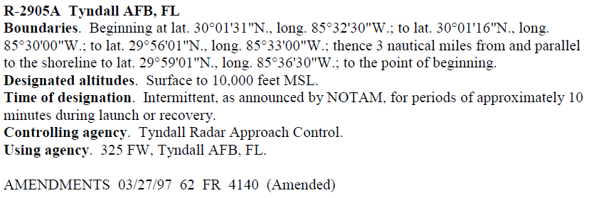
SUA Cont’d
SUA airspace is defined in JO 7400.10
Example JO 7400.10 entry:

Slide 50
Special Activity Airspace (SAA)
Airspace defined within the NAS which limits aircraft operations.
Characteristics
Dimensions are programmed into En Route Decision Support Tool (EDST).
Airspace can be designated as either active, inactive, or pending by EDST screen entry.
Aircraft trajectories are tested against the dimensions and alerts are issued when violations are predicted.
Airspace may be:
– Restricted Areas | – ATC-Assigned Airspace
– Prohibited Areas | – Other designated airspace areas
– Military Operations Areas
Notes:
SPECIAL ACTIVITY AIRSPACE (SAA)− Any airspace with defined dimensions within the National Airspace System wherein limitations may be imposed upon aircraft operations. This airspace may be restricted areas, prohibited areas, military operations areas, ATC assigned airspace, and any other designated airspace areas. The dimensions of this airspace are programmed into EDST and can be designated as either active or inactive by screen entry. Aircraft trajectories are constantly tested against the dimensions of active areas and alerts issued to the applicable sectors when violations are predicted.

Slide 51
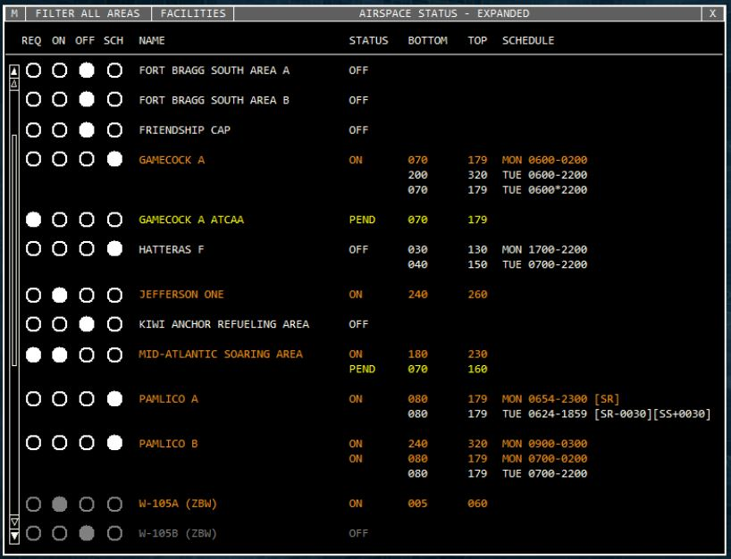
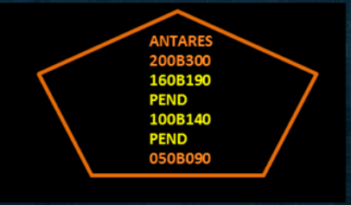
SAA Cont’d
Individual SAA Status is entered in EDST and may be displayed at facility adapted R and all RA positions.

Slide 52
Knowledge Check
Which SUAs are depicted on aeronautical charts?
Restricted Areas
Temporary Military Operations Areas (MOAs)
Controlled Firing Areas (CFAs)
Temporary Restricted Areas

Slide 53
Knowledge Check
An aircraft alert will be generated when an aircraft trajectory violates the active SUA?
A. Yes
B. No

Slide 54
Lesson Summary
Federal airways and jet routes
Area Navigation (RNAV) Routes
Standard Terminal Arrivals (STARs) and Standard Instrument Departures (SIDs)
Special Use Airspace (SUA) and Special Activity Airspace (SAA)

Slide 55

THE END

